Slide 1
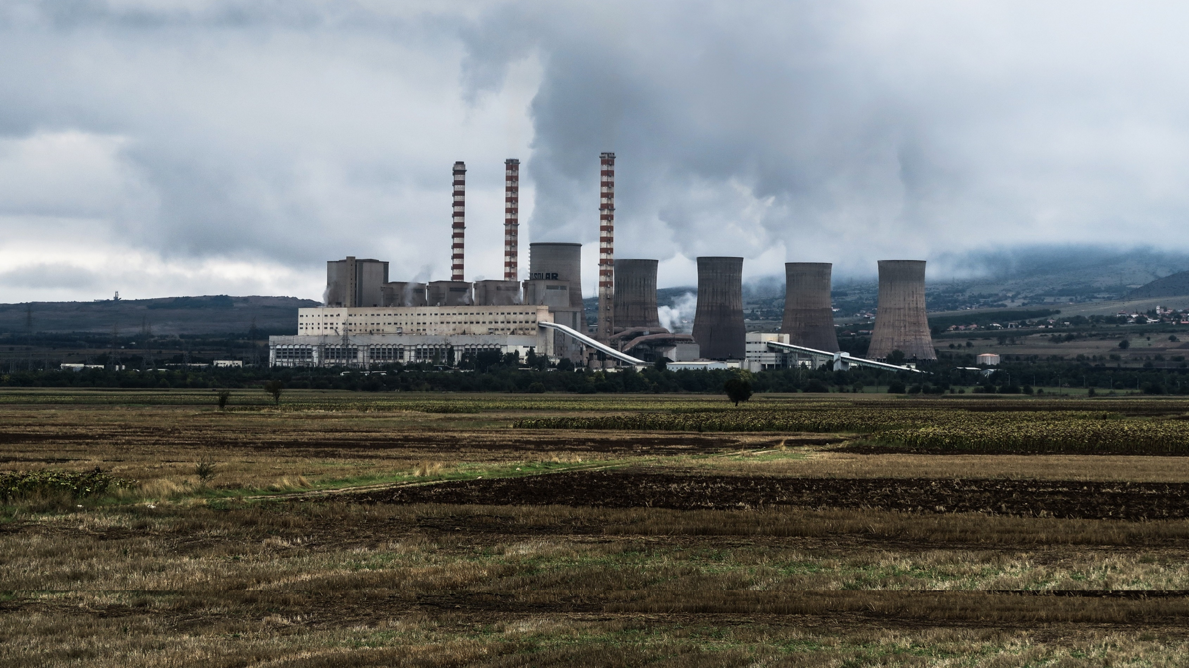
LIVE
18:47
BREAKING
NEWS
A VERY HIGH AIR POLLUTION WARNINGS ACROSS EUROPE
£56 PER CAN OF FRESH AIR – IS IT OUR FUTURE? SHARE YOUR THOUGHTS ON SOCIAL MEDIA

Slide 2

