Slide 1

The EUCAST new definitions of the S, I and R categories and the use of ATU.
November 27, 2020
NordicAST online seminar

Slide 2
Agenda
Short presentation of the ”EUCAST New I”
Short presentation of the Area of Technical Uncertainty
Reports from nordic countries (in the order of slide submissions)
Denmark
Suomi/Finland
Norway
Sweden
Iceland

Slide 3
In 2019 EUCAST changed the definitions of S, I and R.
The essence of the change was to emphasise that
phenotypic susceptibility testing is quantitative.
all breakpoints are exposure dependant.

Slide 4
EUCAST agreed there was a need for revising definitions
I – Susceptible, increased exposure A microorganism is categorised as Susceptible, Increased exposure when there is a high likelihood of therapeutic success because exposure to the agent is increased by adjusting the dosing regimen or by its concentration at the site of infection.
The old definition: I - Intermediate A microorganism is defined as intermediate by a level of antimicrobial agent activity associated with uncertain therapeutic effect. It implies that an infection due to the isolate may be appropriately treated in body sites where the drugs are physiologically concentrated or when a high dosage of drug can be used; it also indicates a buffer zone that should prevent small, uncontrolled, technical factors from causing major discrepancies in interpretations.

Slide 5
Dose and exposure
Dose is the amount of drug given to the patient
Dose can be increased by any of the following means
Increase of the individual dose (from 1 g x 2 to 2 g x 2)
Shortening of the interval between doses (from 1 g x 2 to 1 g x 3 or 4 or 6)
Exposure is the amount of drug which the infecting organism is subjected to at the site of infection.
Exposure can be increased by any of the following means
Increase of the dose over time
Change of the mode of administration (from oral to IV, from IV injection to IV infusion)
Taking advantage of the pharmacokinetics of the agent (concentration in specific body fluids or tissues).

Slide 6
The I category is used to signal low inherent sensitivity of some species to an agent and to compensate for low-level resistance mechanisms which can still be overcome by appropriate EXPOSURE.
S
I

Slide 7
Phenotypic AST is quantitative (MIC, Inhibition zone)…… and all breakpoints are dose/exposure dependent.
all breakpoints are dose/exposure dependant
no agent: no effect
relevant amount of agent: effect
too much agent: effect and toxicity.
the new definitions describe two levels of sensitive and one level of resistance
susceptible breakpoints (S and I) are related to levels of dosing/exposure to overcome degrees of sensitivity (intrinsic or acquired).
resistant breakpoint (R) is related to the predicted failure of the agent irrespective of dosing/exposure. The reduced susceptibility can be intrinsic or acquired.
all countries were addressed in preparation for the change in definitions
All countries were asked to validate the EUCAST dosing levels.

Slide 8
Following 6 consultations 2015 – 2019,
the new definitions were introduced 2019.

Slide 9
EUCAST decided
To keep S, I and R
To emphasize the relationship between the breakpoints for categorisation (S, I and R) AND the concentration of the antimicrobial agent at the site of the infection (exposure).
To review all and revise relevant breakpoints to ascertain that breakpoints correspond to the new definitions.
To remove the ”uncertain effect” (EMA, EUCAST and company) and the ”uncontrolled errors” (laboratory).
To task clinical laboratories with the responsibility for uncontrolled errors, irrespective of origin, and for EUCAST to help identify and form strategies for difficult areas (introduction of ATU).
Why?
Because a poll among colleagues, NACs, ESCMID, EMA, ECDC etc showed that >80% were in favor of not changing the ”I”.
And when asked, companies responsible for LIS and semi-automoatic AST devices claimed to have problems introducing and synchronising a change within a reasonable time.
Notes:
Det beslut som fattats är ....

Slide 10
EUCAST decided
To keep S, I and R
To emphasize the relationship between the breakpoints for categorisation (S, I and R) AND the concentration of the antimicrobial agent at the site of the infection (exposure).
To revise breakpoints so that breakpoints correspond to the new definitions.
To remove”uncertain effect” (responsibility of EMA, EUCAST and company) and the ”uncontrolled errors” (laboratory) from the definitions.
To task clinical laboratories with the responsibility for uncontrolled errors, irrespective of origin, and for EUCAST to help identify and form strategies for difficult areas (introduction of ATU).
Notes:
Det beslut som fattats är ....

Slide 11
The drivers of exposure: DOSE and MODE of ADMINISTRATION
The EUCAST dosing tab lists the drivers of exposure: dose and modes of administration which were used when breakpoints were determined.
It is not a therapy guideline.

Slide 12
Dosages |  | EUCAST Clinical Breakpoint Tables v. 10.0, valid from 2020-01-01
EUCAST breakpoints are based on the following dosages (see section 8 in Rationale Documents). Alternative dosing regimens which result in equivalent exposure are acceptable. The table should not be considered an exhaustive guidance for dosing in clinical practice, and does not replace specific local, national, or regional dosing guidelines. However, if national practices significantly differ from those listed below, EUCAST breakpoints may not be valid. Situations where less antibiotic is given as standard or high dose should be discussed locally or regionally.
Uncomplicated UTI: acute, sporadic or recurrent lower urinary tract infections (uncomplicated cystitis) in patients with no known relevant anatomical or functional abnormalities within the urinary tract or comorbidities.
Penicillins | Standard dose | High dose | Uncomplicated UTI | Special situations | Special situations
Benzylpenicillin | 0.6 g (1 MU) x 4 iv | 1.2 g (2 MU) x 4-6 iv |  | Meningitis caused by S. pneumoniae: For a dose of 2.4 g (4 MU) x 6 iv, isolates with MIC≤0.06 mg/L are susceptible. Pneumonia caused by S. pneumoniae: breakpoints are related to dosage: For a dose of 1.2 g (2 MU) x 4 iv, isolates with MIC ≤0.5 mg/L are susceptible. For a dose of 2.4 (4 MU) g x 4 iv or 1.2 g (2 MU) x 6 iv, isolates with MIC ≤1 mg/L are susceptible. For a dose of 2.4 g (4 MU) x 6 iv, isolates with MIC ≤2 mg/L are susceptible. | Meningitis caused by S. pneumoniae: For a dose of 2.4 g (4 MU) x 6 iv, isolates with MIC≤0.06 mg/L are susceptible. Pneumonia caused by S. pneumoniae: breakpoints are related to dosage: For a dose of 1.2 g (2 MU) x 4 iv, isolates with MIC ≤0.5 mg/L are susceptible. For a dose of 2.4 (4 MU) g x 4 iv or 1.2 g (2 MU) x 6 iv, isolates with MIC ≤1 mg/L are susceptible. For a dose of 2.4 g (4 MU) x 6 iv, isolates with MIC ≤2 mg/L are susceptible.
Ampicillin | 2 g x 3 iv | 2 g x 4 iv |  | Meningitis: 2 g x 6 iv | Meningitis: 2 g x 6 iv
Ampicillin-sulbactam | (2 g ampicillin + 1 g sulbactam) x 3 iv | (2 g ampicillin + 1 g sulbactam) x 4 iv
Amoxicillin iv | 1 g x 3-4 iv | 2 g x 6 iv |  | Meningitis: 2 g x 6 iv | Meningitis: 2 g x 6 iv
Amoxicillin oral | 0.5 g x 3 oral | 0.75-1 g x 3 oral | 0.5 g x 3 oral | H. influenzae: High dose only | H. influenzae: High dose only
Amoxicillin-clavulanic acid iv | (1 g amoxicillin + 0.2 g clavulanic acid) x 3-4 iv | (2 g amoxicillin + 0.2 g clavulanic acid) x 3 iv
Amoxicillin-clavulanic acid oral | (0.5 g amoxicillin + 0.125 g clavulanic acid) x 3 oral | (0.875 g amoxicillin + 0.125 g clavulanic acid) x 3 oral | (0.5 g amoxicillin + 0.125 g clavulanic acid) x 3 oral | Amoxicillin-clavulanic acid has separate breakpoints for systemic infections and uncomplicated UTI. When amoxicillin-clavulanic acid is reported for uncomplicated UTI, the report must make clear that the susceptibility category is only valid for uncomplicated UTI. H. influenzae: High dose only | Amoxicillin-clavulanic acid has separate breakpoints for systemic infections and uncomplicated UTI. When amoxicillin-clavulanic acid is reported for uncomplicated UTI, the report must make clear that the susceptibility category is only valid for uncomplicated UTI. H. influenzae: High dose only
Piperacillin | 4 g x 3 iv | 4 g x 4 iv |  | Pseudomonas spp.: High dose only | Pseudomonas spp.: High dose only
Piperacillin-tazobactam | (4 g piperacillin + 0.5 g tazobactam) x 3 iv | (4 g piperacillin + 0.5 g tazobactam) x 4 iv |  | Pseudomonas spp.: High dose only | Pseudomonas spp.: High dose only
Ticarcillin | 3 g x 4 iv | 3 g x 6 iv |  | Pseudomonas spp.: High dose only | Pseudomonas spp.: High dose only
Ticarcillin-clavulanic acid | (3 g ticarcillin + 0.1-0.2 g clavulanic acid) x 4 iv | (3 g ticarcillin + 0.1 g clavulanic acid) x 6 iv |  | Pseudomonas spp.: High dose only | Pseudomonas spp.: High dose only
Phenoxymethylpenicillin | 0.5-2 g x 3-4 oral depending on species and/or infection type | None
Oxacillin | 1 g x 4 iv | 1 g x 6 iv
Cloxacillin | 0.5 g x 4 oral or 1 g x 4 iv | 1 g x 4 oral or 2 g x 6 iv
Dicloxacillin | 0.5-1 g x 4 oral or 1 g x 4 iv | 2 g x 4 oral or 2 g x 6 iv
Flucloxacillin | 1 g x 3 oral or 2 g x 4 iv (or 1 g x 6 iv) | 1 g x 4 oral or 2 g x 6 iv
Mecillinam oral | None | None | 0.2-0.4 g x 3 oral

Slide 13
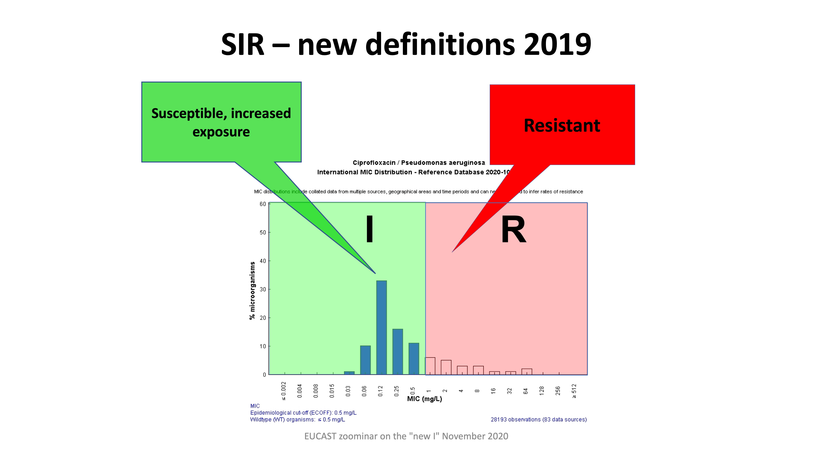
The ”arbitrary S-breakpoint” is to ensure that you obtain an ”I” rather than an ”S” when testing.
S≤0.001 mg/L
S≥50 mm

Slide 14
Agents where wild type* Pseudomonas are reported
I or R (Table 2020**).
*Wild type – organisms without phenotypcially detectable resistance mechanisms **No change planned for 2021.

Slide 15
Agents where wild type* Pseudomonas can be reported S, I or R in Table 2020**
*Wild type – organisms without phenotypcially detectable resistance mechanisms **No change planned for 2021.

Slide 16
Introducing the ”the new I” Examples: Pseudomonas aeruginosa and Acinetobacter vs. several agents, S. aureus vs ciprofloxacin, H.influenzae vs. amoxicillin+/-clavulanic acid, etc .
Follow the EUCAST recommendation – introduce the EUCAST breakpoints and take steps to explain to clinical colleagues locally and nationally.
Report ”Susceptible, increased exposure (I)”, and add a comment to explain.
The ”Stewardship model” - introduce the EUCAST breakpoints, perform testing, categorize according to the EUCAST recommendations…..but maybe you need not always report
For serious infections – always report and add comment as suggested above.
For less serious infections (Pseudomonas, H. influenzae) report ”R”, but not ”S” and ”I” – and add a comment: ”If antibiotics are considered necessary - contact the microbiologist for susceptibility advice”.

Slide 17
Refrain from introducing ”local or national breakpoints”
The ”old I” lacked meaning and respect among colleagues. The system where only S and R meant anything was blunt. The ”new I” is logical and will gain respect if we take pains to explain and push it and unite behind it.
EMA and ECDC trust that European countries act uniformly.
If one decides not to follow EUCAST on the Pseudomonas issue, the system will break in other places and national (or local) updating of the AST system will become difficult.
Semiautomated devices will not honor local or national recommendations, you will have to recalibrate zone diameter breakpoints to correspond etc. Some colleagues will insist on following the European standard and eventually you will have several systems in your country. The NAC was created to look after national aspects of the EUCAST system and to influence EUCAST - trust the NAC and follow their advice. Make sure you respond to EUCAST consultations!
Stewardship issues:
Will the ”new I” push colleagues towards using meropenem, meropenem-vaborbactam, ceftazidime-avibactam, ceftolozane-tazobactam? All of these are ”hospital drugs” and it will be possible to educate hospital based colleagues. Other colleagues will not use IV agents.
Antibiotics should be avoided in banale infections with Ps. aeruginosa, H. influenzae, and many others. The lack of ”an oral S for ciprofloxacin” should if anything help towards that.
Specialists (ID, CM, Stewardship) will frequently be asked by colleagues ”What to do?”. This is good stewardship.

Slide 18
ATU An alert in the laboratory - take action or ignore!

Slide 19
MIC/zone correlates are mostly excellent…and unproblematic

Slide 21
ATU

Slide 22
ATU

Slide 23
Area of Technical Uncertainty (ATU)
ATU is NOT a susceptibility category – it is to alert laboratory staff of a predictable difficulty/uncertainty with test or interpretation.
The ATU is NOT to compensate for poor methodological skills – on the contrary, AST today require more skills than before.
The ATU does NOT interfere with S, I and R interpretation and it is certainly not a fourth susceptibility category.
The ATU is NOT a wide range of results – it is defined by a single MIC-value and/or a short range of zone diameter values.
How the ATU is dealt with depends on the situation (the sample and type of infection, the agent, the infecting organism).

Slide 24
The ATU corresponds to the ”grey zone” in…
….many other tests performed in the laboratory.
You need to develop a strategy for uncertain results!

Slide 25
Results in ATU – alternative actions!
Repeat the test – only if there was an obvious and identifiable reason for the failure (basically the test was never performed – wrong disk, wrong plate, outdated trays etc).
Confirm using an alternative test (MIC, PCR, PBP-agglutination…) – always repeat the original test, you will learn something.
Report the result with comment – “unreliable test result”.
Leave blank with a comment – “unreliable test result”.
Discuss and explain – phone clinical colleague.
Report the problem to the breakpoint committee – it may well be a breakpoint problem.

Slide 26
Try to solve the problem IF..…
easy to solve.
requested to do so
only few alternative antibiotics for therapy.
in serious infections (a positive blood culture).
frequently recurring problem.

Slide 27
Denmark

Slide 28
The “new I” process in Denmark
Spring 2019: Discussions in Danish NAC -> need to involve Stewardship people to secure the most optimal implementation of “new I”
Autumn 2019: First meeting – general acceptance of “new I” but need to consult with local representatives from the five Regions in Denmark
Follow-up meeting: Two Regions will implement the “new I”, two will continue to report drug/bug combinations, where WT is susceptible, increased exposure as S with dosing comment, and one is split in half
This is the current situation in Denmark following several “follow-up meetings”
Main concerns from the Stewardship point of view are overuse of meropenem for P. aeruginosa and ciprofloxacin for H. influenzae.

Slide 29
Suomi / Finland

Slide 30

Issues and plans on the new I -Finland
NordicAST online seminar
27th November, 2020
Kaisu Rantakokko-Jalava

Slide 31
Great plans from late 2019… changed
FiRe planned campaigns for the implementation of the new I
MISTÄ TIETÄÄ ETTÄ ANTIBIOOTTI TEHOAA?
-HOW DO YOU KNOW THAT THE ANTIBIOTIC WORKS
Sessions accepted in three events
Itä-Suomen lääketiedetapahtuma/Eastern Finland in September 2020…became virtual ”Etä-Suomen..”
Turun lääketiedepäivät/Turku in November 2020…session cut out when the event was transformed virtual
Lääkäripäivät 2021, Helsinki (national) in 2020…session cut out when the event was transformed virtual

Slide 32
Finnish NAC?
FiRe (Finnish Study Group for Antimicrobial Resistance) has worked since 1992, but it is an unofficial network of Finnish clinical microbiology laboratories
In the beginning of 2020, THL (Finnish Insitute for Health and Welfare) nominated a new national expert group for AST (HeKA), which was supposed to work on implementation of the new I
Because of COVID-19, HeKA has not had its first meeting as yet…

Slide 33
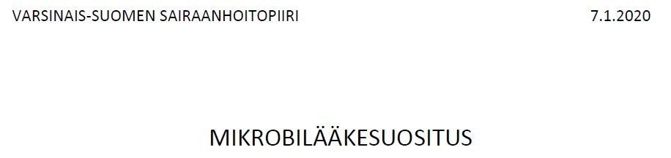


Finnish vs EUCAST dosing?

Slide 34
Finnish vs EUCAST dosing?
Each hospital has its own guide for antimicrobial treatment, including dosing.
Recommendations for common mild infections are given in Current Care Guidelines by the Finnish Medical Society Duodecim

Slide 35

A very Finnish problem
Intravenous cefuroxime is the first line antimicrobial for most community-acquired febrile infections
EUCAST standard dose 750 mg x 3 i.v, high dose 1,5 g x 3 i.v
In Finland, 1.5 g x 3 i.v is standard dose. High dose would be 1,5 g x 4 i.v.
Should wild-type E. coli etc. be interpreted S or I?

Slide 36
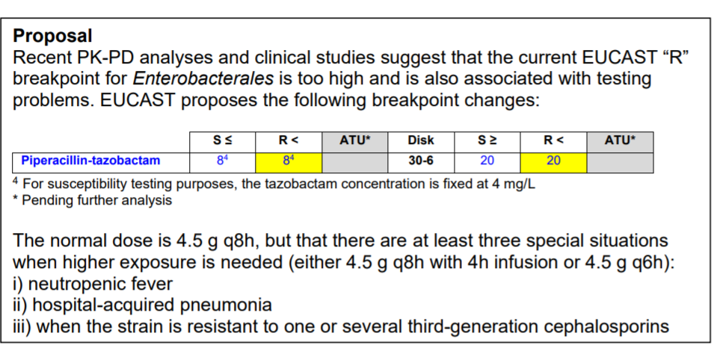
Pip-tazo EUCAST general consultation
ATU removed, only S/R.
”S” of an ESBL strain could still be edited to ”I” (except for ceftoloza/tazo, cefta/avi.) See above iii)

Slide 37
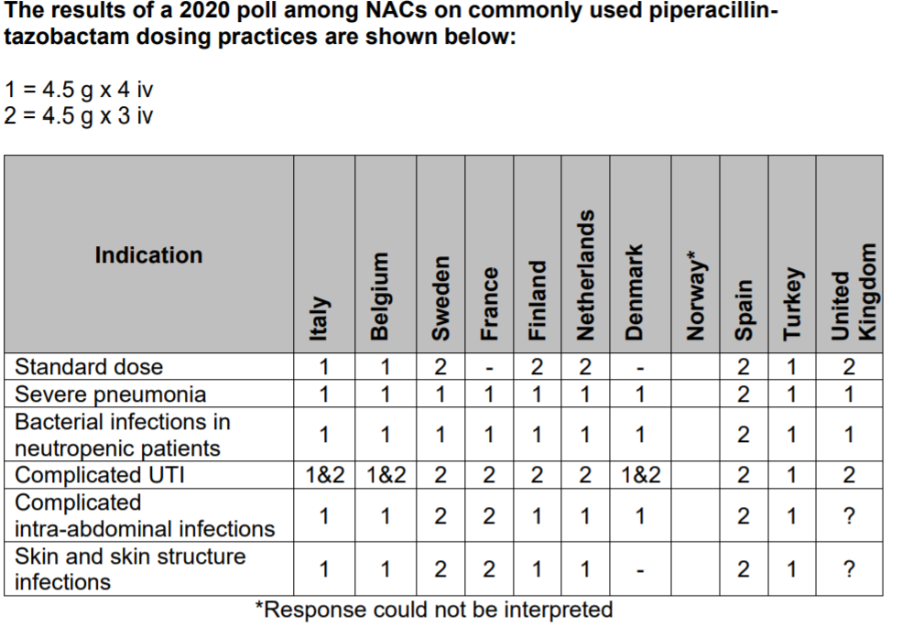
HUS mikrobilääkehoidon
opas:
Neutropeninen kuume:
piptazoa ei mainittu,
keftriax 2g, tobra.jne
Sairaalakeuhkokuume:
kefurox 1.5g x4
piptazo 4g x4
Immuunipuutteisen
empyeema: piptazo 4gx3!
Vatsan alueen infektio
ylä-gi (sappiperäinen)
septinen shokki: piptazo
4g x4
koolonperforaatio ja
septinen shokki: mero 1gx3
Vaikea iho- ja pehmytk.inf
piptazo 4g x4
Pyelonefriitti (sairalaper.)
Piptazo 4g x3.

Slide 38
Notes on dosing Finland vs. EUCAST (mostly Tyks-based)
i.v. –dosing for penicillins: usually cover well both S and I
Peroral dosing of penicillins: often only twice a day, while EUCAST dosing is x 3
Hemophilus requires a high dose x 3
Pseudomonas: dosing tends to be lower than the EUCAST high dose
Use of two effective drugs is recommended
Aminoglykoside: dosing is lower than that in EUCAST table
Used only in combination therapy

Slide 39
”New I” and P. aeruginosa
Wild-type P. aeruginosa now
Wild-type P. aeruginosa after implementation of the new I
Keftatsidiimi | S
Keftolotsaani-tatsobaktaami | S
Meropeneemi | S
Piperasilliini-tatsobaktaami | S
Siprofloksasiini | S
Tobramysiini | S
Keftatsidiimi | I
Keftolotsaani-tatsobaktaami | S
Meropeneemi | S
Piperasilliini-tatsobaktaami | I
Siprofloksasiini | I
Tobramysiini | (S)

Slide 40
”New I” and P. aeruginosa
Wild-type P. aeruginosa EUCAST v. 10
Keftatsidiimi | I
Keftolotsaani-tatsobaktaami | S
Meropeneemi | S
Piperasilliini-tatsobaktaami | I
Siprofloksasiini | I
Tobramysiini | (S)
Herkkä annoksella 2 g x 3 iv
Herkkä annoksella (1+0,5) g g x 3 iv
Herkkä annoksella 1 g x 3 iv
Herkkä annoksella 4 g x 4 iv
Herkkä annoksella 750 mg x 2 po tai 400 mg x 3 iv
Herkkä annoksella 6-7 mg/kg x 1 iv, mutta vain yhdistettynä toiseen tehoavaan lääkkeeseen

Slide 41
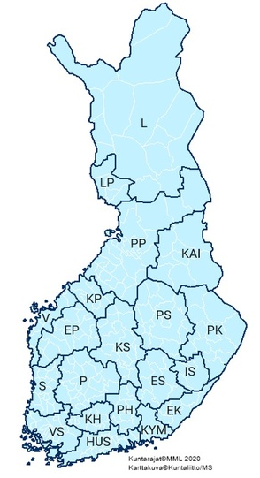
Plans on implementation of the ”new I”
HUSLAB and Tyks will implement the new I when taking up the new LIS My+
Possibility to code automated comments according to interpretation, e.g.
”Ceftatzidime I means susceptible with dose 2gx3 i.v”
(Also possibility for automated internal notes in a certain two-ended area, not just with values above/below a certain point =ATU)
Schedule
South Carelia (EK) 2/2021
Rest of HUSLAB (KYM, HUS) 3/2021
Tyks (VS) spring 2021

Slide 42
PLAN/HUSLAB
FEB 2021 SOUTH CARELIA , MARCH 2021 REST OF HUS
TEAMS-INFOS TO DOCTORS: JAN SOUTH CARELIA, FEB HKI, HUS
HUSLAB WEBPAGE: LINKS TO DOSING, NORDICast FINNISH AND SWEDISH? Or an own reduced table.
LÄÄKÄRILEHTI (Finnish Medical Journal) JAN-FEB
MIKROBILÄÄKEHOIDON OPPAAT (Guides to use of antimicrobials); HUS, HKI January
Lab reports to include a phone number for further information?

Slide 43
Norway

Slide 44


Implementation of «I» and «ATU» in Norway Excerpts from a national survey and experiences from a single lab
Karianne Wiger Gammelsrud
Christoffer Lindemann
NordicAST online seminar #2 2020
www.unn.no/afa

Slide 45
National survey November 2020
Thus far answers from 14 of 20 laboratories
Quest-back regarding experiences and implementation of:
The new I-catagory
ATU
RAST
Selective AST-reporting

Slide 46
Have your implemented the new I- category in your lab?
How do you report the new I- category to the clinician?
With a standard With an individually Other* comment «tailored» comment
Yes No Partially
* Standard comment which is used sporadically (e.g. P. aeruginosa)
At Oslo University Hospital: All AST-reports include a standard comment with the definition of S-I-R. In addition, a specfic I-comment when at least one antibiotic is an I (wording some-what different for «wild-type I»).

Slide 47
Have you had a dialogue with the clinicians before implementing the new I-category? (More than one answer possible)
Some comments:
The clinicians are some-what confused about the new meaning of «I»
Still many misunderstandings around the meanig of «I»
Many questions the first year, fewer comments from the clinicians now
Very problematic. Clinicians are still hesitant of using antibiotics categorized as «I» - even after many presentations/teaching/information
The implementation has gone smoothly
Yes, Yes, Yes, written No Other* meetings teaching information

Slide 48
Have you implementet ATU?
Does your LIS-system have the possability to warn an ATU?
Yes No Partially
Yes No

Slide 49
Which strategy have you chosen to handle ATUs in your lab? (More than one answer possible)
Some general comments:
LIS not optimal for handling the ATU
Lack of techincal support
Often individual considerations regarding how to handle ATU which in turn may lead to different approaches by different people within the lab
Lack of a good alternative test (BMD)
ATU handeled according to clinical information, sample type and bacterial finding
Retesting/alternative test delays the final AST-report to the clinician
More effort when important samples from severely ill patients (eg MIC-testing, PCR-methods)
Alternative Report as Report as Other* test uncertain resistant
* Choose not to give out the antibiotic (e.g. many «S»-antibiotics to choose from or if the antibiotic is not clinically relevant/important)

Slide 50

ATU implementation: Experiences from a Norwegian lab
Department of Microbiology
Haukeland University Hospital
Bergen, Norway.

Slide 51
Haukeland University Hospital
LIS: Unilab 700 from AlphaSoft
All results documented directly in the LIS
Zone-mm / MIC recorded
Categorisation to S/I/R automatically in the LIS
Implementation of ATU had to be done in the LIS
Software changes finalized February 2019

Slide 52
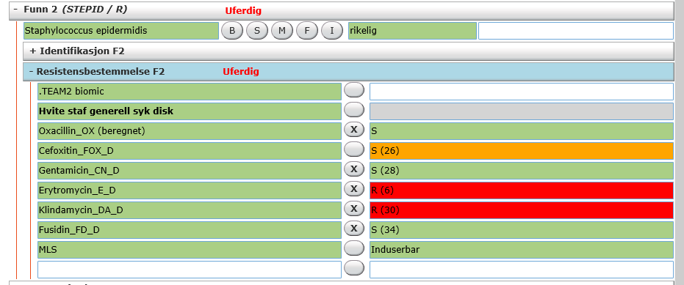
Cefoxitin zone-mm within ATU – marked with an orange colour.

Slide 53
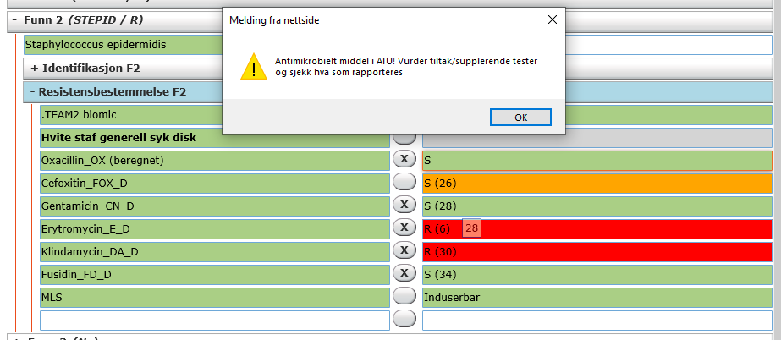
Final report is not possible due to unresolved ATU!
«Antimicrobial agent within ATU! Consider measures/supplemental tests and check what is reported»

Slide 54
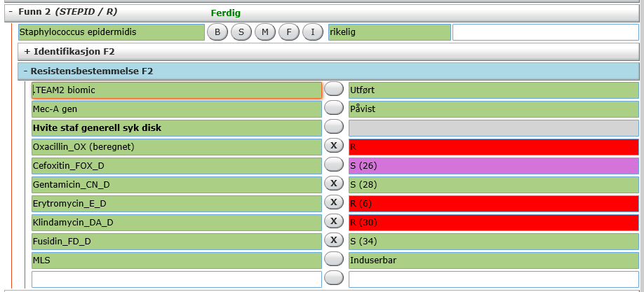
Cefoxitin ATU is resolved with mecA-PCR. Consequently, oxacillin is reported R
ATU is marked as resolved, and changes colour to purple.

Slide 55
How to pass information on AST to clinicians?
Challenge to LIS
More and more sophisticated information, old tools
Different breakpoints for different foci
E.g. amox-clavulanate:
intravenous/peroral,
uncomplicated UTI/other infections
(low-potency/high potency disk)
How to pass essential information in easily understandable words?

Slide 56
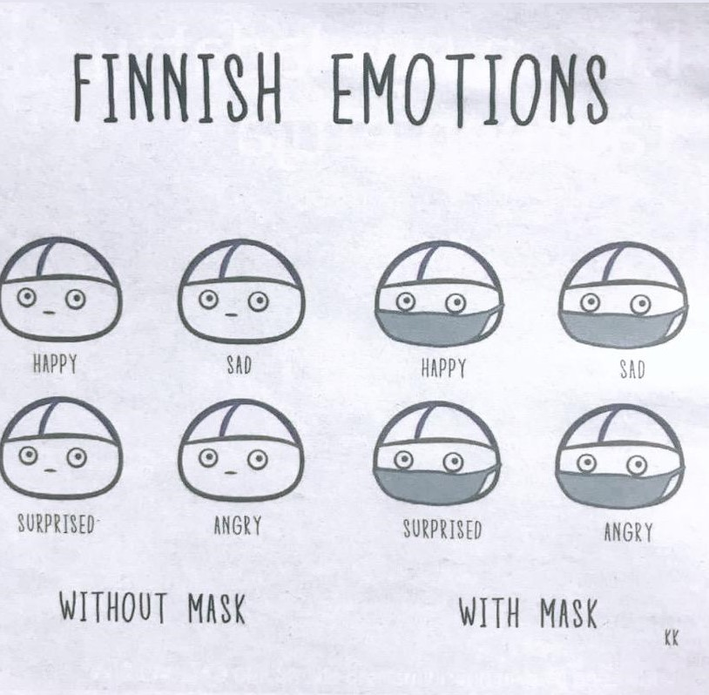
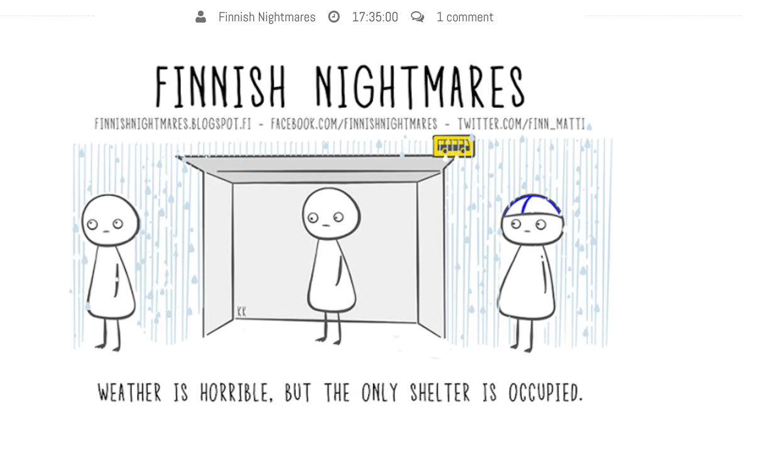
Thank you and Anu Pätäri-Sampo & Nathalie Friberg, HUSLAB

Slide 57
Sweden

Slide 58
Implementation of the new I definition in Sweden
Anna-Karin Smekal
Specialist Physician in Infectious Diseases and Clinical Microbiology
Karolinska University Hospital
Stockholm

Slide 59
Planned national activities 2020
NordicAST WS Gothenburg May 2020 for the laboratories
Spring-meeting 2020 for microbiology laboratories and ID: joint symposium by Gunnar, Christian and me ” The new I and ATU”
RAF/SRGA (NAC): published a Swedish adaptation of the ”Dosage sheet” in the NordicAST breakpoint table for laboratories and clinicians in March 2020. Link from NordicAST.org/brytpunktstabeller

Slide 60
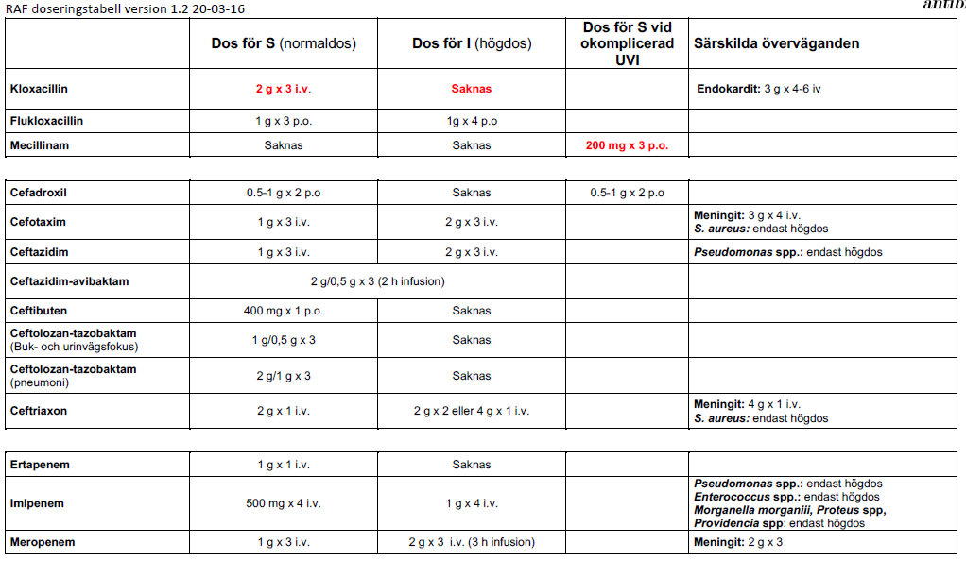
https://www.sls.se/globalassets/raf/resistensbestamning/raf-doseringstabell-normal-hog-dos.pdf

Slide 61
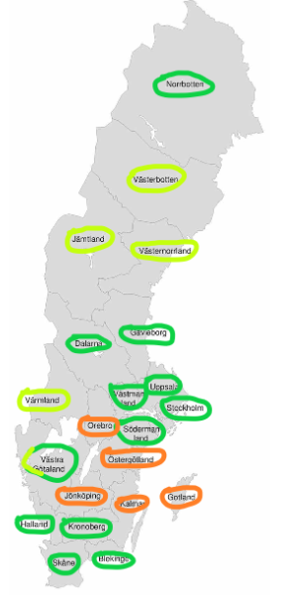
Implementation in Sweden -The new I definition
In total 25 labs in 21 regions
12/21 of the regions have implemented the new I according to the NordicAST Bp table v 10.0 (2020)
4/21 of the regions have implemented almost everything and report they will have everything in place by end of 2020
5/21 of the regions are delayed because of problems with LIS/new LIS on the way and/or because of the covid-19 pandemic

Slide 62
P. aeruginosa – the worst problem from an antibiotic stewardship point of view?
WT P. aeruginosa 2020
Ceftazidime I
Meropenem S
Ciprofloxacin I
Imipenem I
Piperacillin-tazobactam I

Slide 63
Example: WT P. aeruginosa report from Karolinska University Laboratory
Pseudomonas aeruginosa Klassificering I innebär att isolatet är behandlingsbart med högdos av aktuellt antibiotika.
Piperacillin-tazobaktam I Ceftazidim I Ciprofloxacin I
Allmänt meddelande från laboratoriet: EUCAST definition av SIR-systemet för resistensbestämning av bakterier: S= Känslig för normal dosering; I= Känslig vid ökad exponering (högdos); R= Resistent. Mer info: se NordicASTs brytpunktstabell, www.nordicast.org, avsnitt dosering.
If WT: no reporting of carbapenems.
2 comments in the report of what I means
Purpose of this starting strategy: to get more phone calls and contact with the clinicians in order to be able to explain and educate about the new I definition and to avoid overuse of meropenem
Implementation with help from the ID consultants.
Plan: to always release the carbapenems to special wards like the ICUs after more education and information

