Slide 1
Technical and legal interoperability beyond EU
Secretary General of OTIF François Davenne
Brussels, 27 April 2016

Slide 2
COTIF – developing uniform law
Founded in 1893 in Bern
Applies to international traffic by rail
Is international law
Member States can make declarations not to apply selected parts of COTIF
Freight / Passenger Contracts
Legal interoperability
Dangerous Goods Regulation
Technical Regulation
Safe exchange of vehicles
Exchange of dangerous goods wagons
Technical interoperability
Notes:
Hosting the meetings of the supervisory authority with all the immunity necessary for the implementation of the protocol

Slide 3
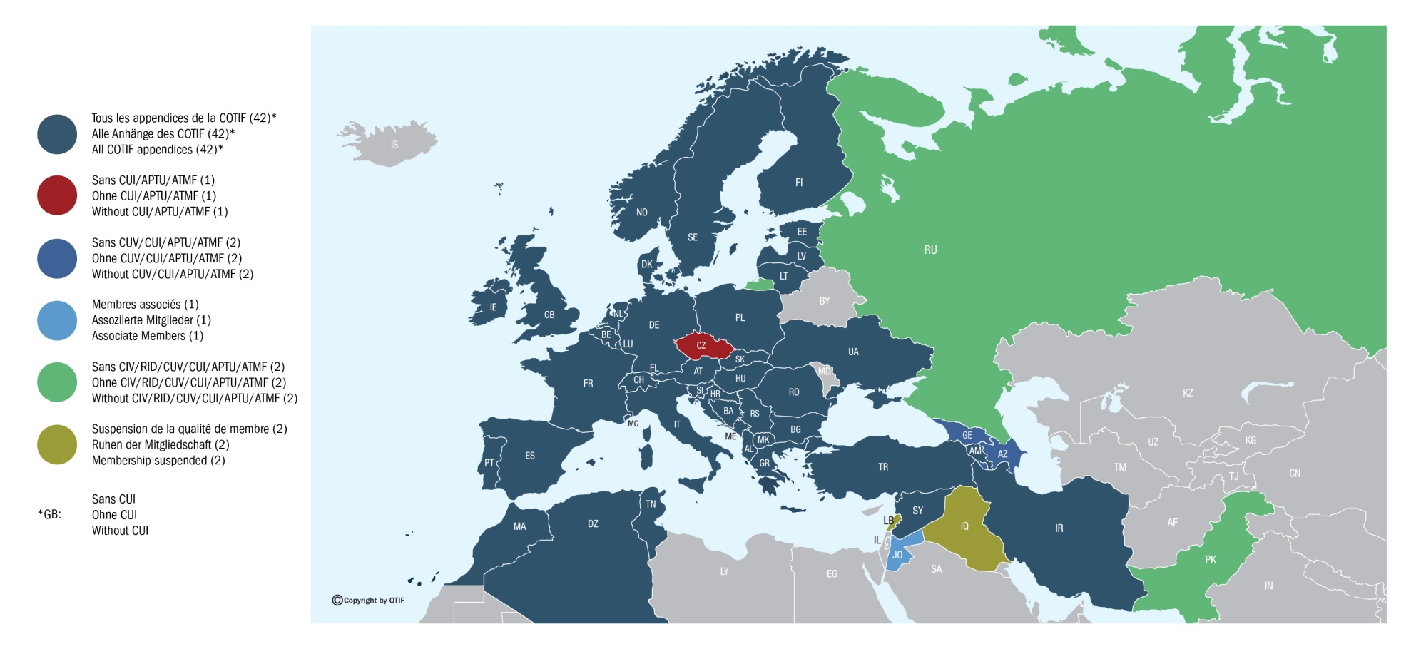
Champ d’application géographique de la COTIF et ses appendices
Geografischer Anwendungsbereich des COTIF und dessen Anhänge
Geographical scope of COTIF and its appendices
État au 14 avril 2016
Stand 14. April 2016
Situation on 14th April 2016

Slide 4
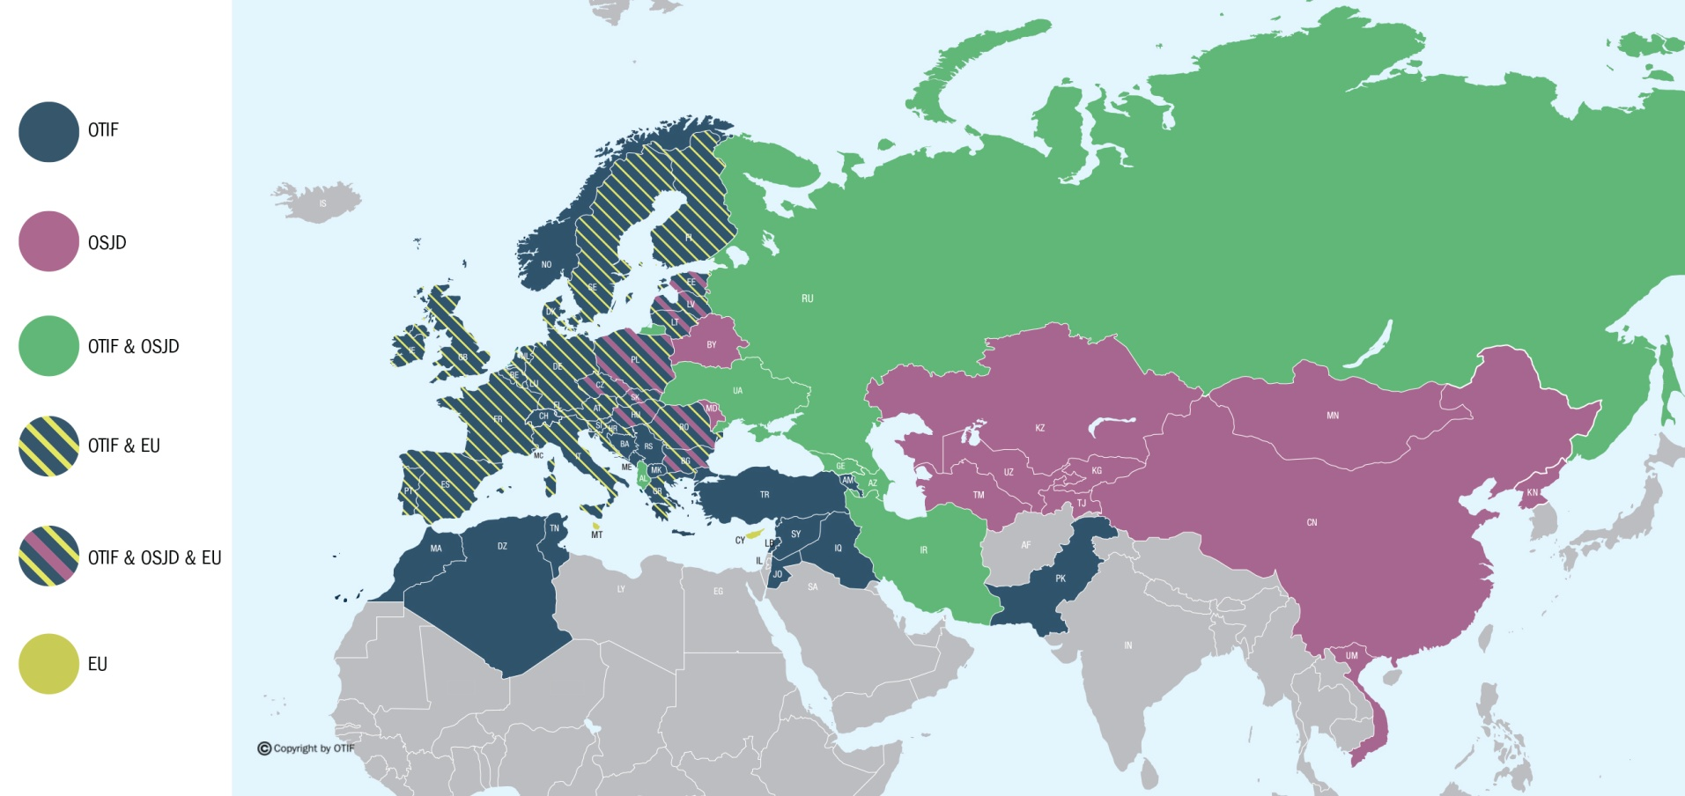
État au 15 janvier 2016
Stand 15. Januar 2016
Situation on 15th January 2016
OTIF – OSJD – EU Member States

Slide 5


Comparing EU and OTIF regulations
EU
OTIF
Improve efficiency and market share of rail
Promote, improve and facilitate international traffic
Objectives
Domestic and international traffic in EU
International traffic between OTIF Member States
Scope of regulation
EU Member States are required to open their rail markets to competition
OTIF does not have requirements imposing a particular market model
Market model
Interoperability and safety
Organisation of railways
Competition regulation
Passengers’ rights
Dangerous goods regulation
Approval and use of vehicles
Uniform contract law:
passengers/freight
use of vehicles
use of infrastructure
Dangerous goods regulation
Scope of application

Slide 6


Seven Appendices of COTIF
Relation to EU and UN rules
Appendix А
CIV
Uniform Rules
concerning
the Contract
of
International
Carriage
Of
Passengers
by Rail
Appendix B
CIM
Uniform Rules
concerning
the Contract
of International
Carriage
of Goods
by Rail
Appendix C
RID
Regulation
concerning
the
International
Carriage
of Dangerous
Goods
By Rail
Appendix D
CUV
Uniform Rules
concerning
Contracts of
Use
of Vehicles
in International
Rail Traffic
Appendix E
CUI
Uniform Rules
concerning
the Contracts
of Use of
Infrastructure
in International
Rail Traffic
Appendix F
APTU
Uniform Rules
concerning
the Validation
of Technical
Standards and
Adoption of
Uniform
Technical
Prescriptions
applicable to
Railway
Material
Appendix G
ATMF
Uniform Rules
concerning
the Technical
Admission of
Railway
Material
used
in International
Traffic

Slide 7
Unified railway law to connect Europe, Asia and Africa:
Railways as international networks
Developing an international interoperability model
Modal shift towards significant Eurasian freight transport by rail
Reducing GHG emissions and foster human development
Connected
Purely national networks belong to the past
A regional approach is vital
Uniform
Common technical and contract law
Common high level rules
Interoperable
Common technical rules
Common interfaces definition
Partnership based approach with other organisations

Slide 8
OTIF partnerships
MEMBER STATES
EU
Member States and/or member cooperation organisations of OTIF
OSJD, UNECE, ERA, GCC, ESCAP
First Level:
international state organisations
CER/UIC/CIT RailnetEurope
UNIFE
UIP
Dangerous goods
industry
Second Level: Professional and user associations in the rail sector
WCO
ITJ
FIATA
Third Level: Professional and state organisations
OTIF

Slide 9

12th General assembly : The The legal appendixes
COTIF- Convention concerning international carriage by rail + Appendices
Appendix А
Appendix B
Appendix D
Appendix E
CIV
CIM
CUV
CUI
Uniform Rules
concerning
the Contract
of International
Carriage
of Passengers
by Rail
Uniform Rules
concerning
the Contract
of International
Carriage
of Goods
by Rail
Uniform Rules
concerning
Contracts of Use
of Vehicles
in International
Rail Traffic
Uniform Rules
concerning
the Contracts
of Use
of Infrastructure
in International
Rail Traffic

Slide 10
Legal interoperability : Legal pyramid
Legal requirements covered by COTIF: mandatory
Standards contracts defined by sector Organisation (CIT, GCU bureau, …)
Company contracts
/
Specific developments
(e-booking, etc..)
OTIF legal
appendixes :
uniform rules
for Contracts
Agreement between States makes it mandatory to comply with uniforms rules
Increasing level of detail
Publicly available standard contracts : voluntary
Multilateral agreement between railways undertakings defining General Terms and Conditions to comply with OTIF uniform rules.
Not public
Intellectual property of a company. Compliance with GTC and COTIF.

Slide 11
Unifiying transport contracts for freight
How International law covers Euro-Asiatic trafic
CIM
SMGS
CIM / SMGS
common consignment note
Combination of existing consignment notes
CIM contract
SMGS contract
The unified railway law (EURL) developed under the aegis of UNECE provides an interface law between CIM and SMGS
Single contract would improve Euro-Asian rail traffic dramatically

Slide 12
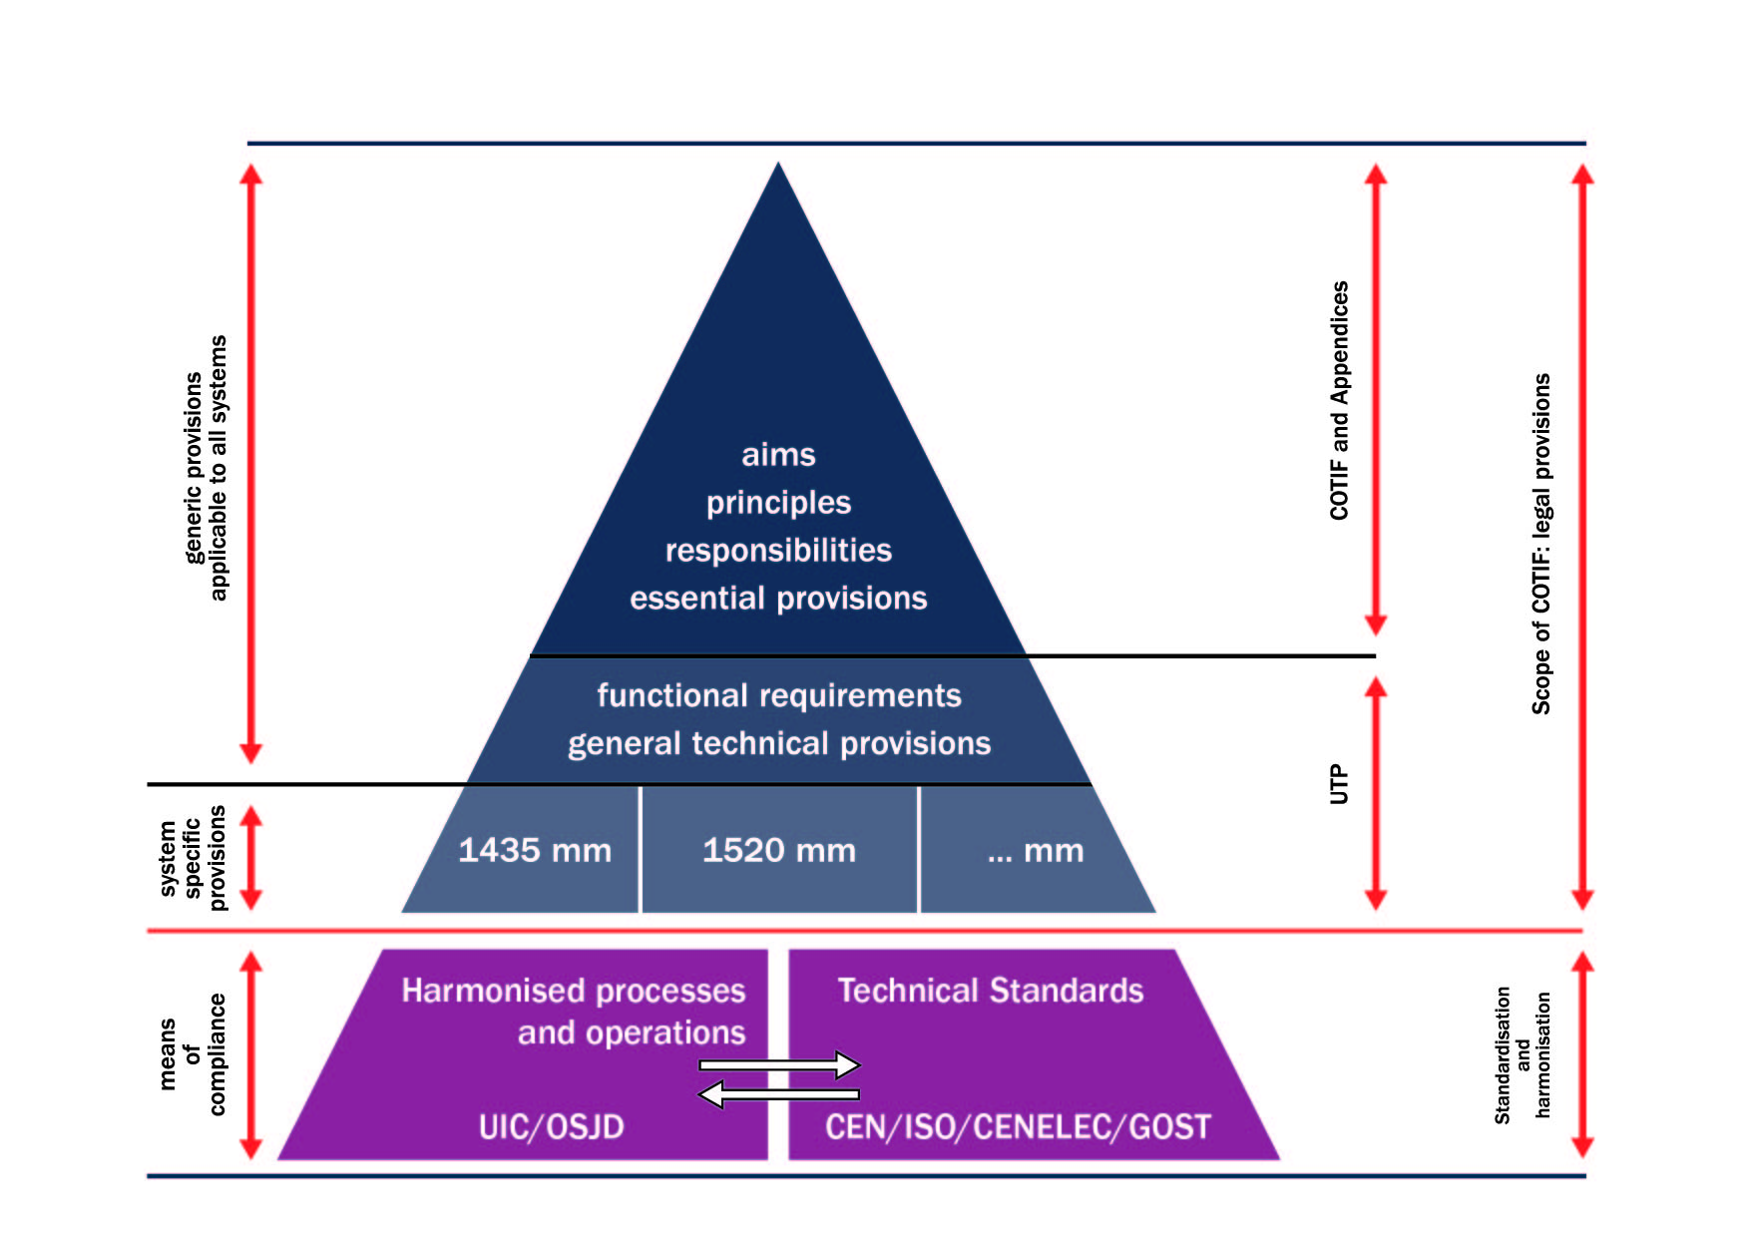
Technical interoperability: a general framework

Slide 13
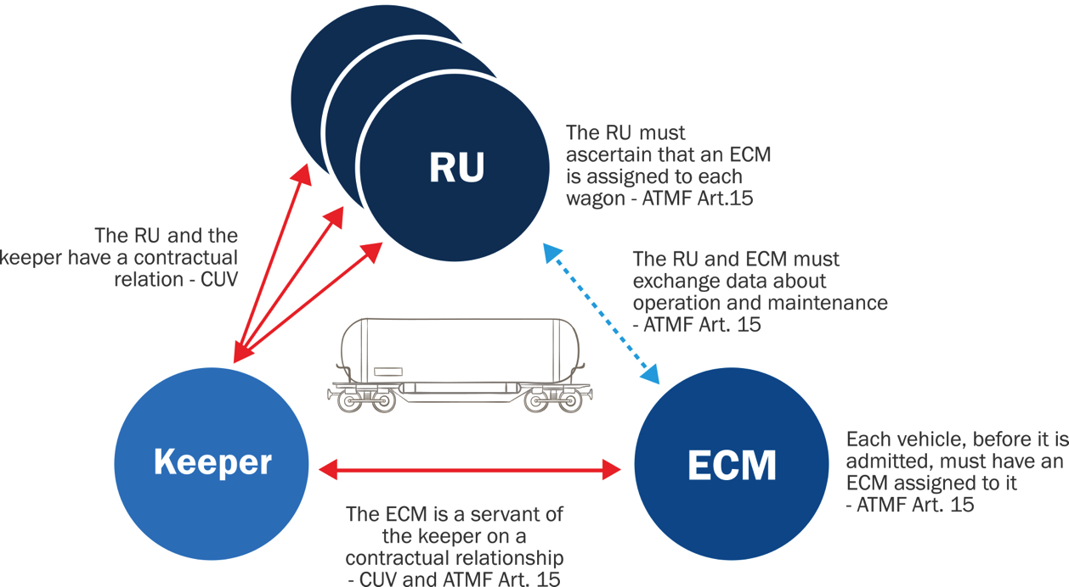
A zoom on private keeper contractual framework

Slide 14
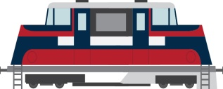
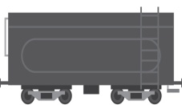
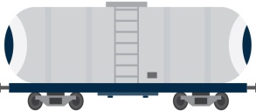

Operational concepts for international rail traffic
Reconfiguring and preparation of train at border crossing station; other locomotive, other driver, other operational rules.
Exchange of vehicles
Interoperability
Uninterrupted train movement across border, without changing train configuration or driver
Train preparation at point of departure

Slide 15
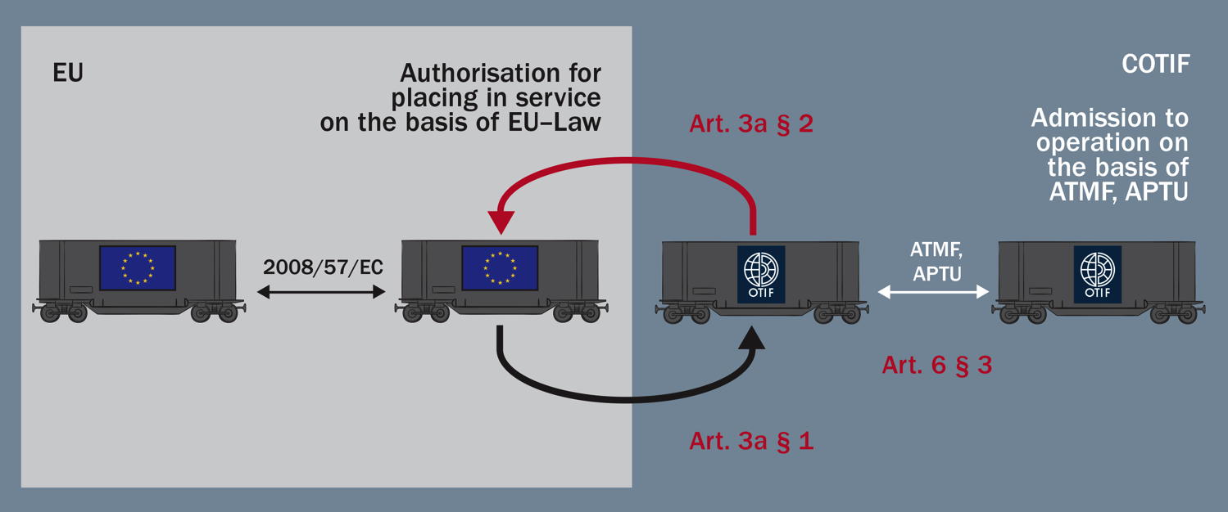
Equivalence with EU law

Slide 16
Setting up interoperability: last General Assembly and further steps
Market access
Competition regulation
(not in scope of COTIF)
Level 4
Unified railway Market
Level 3
Interoperability of trains in a network of different systems
Accident investigation /Safety supervision.
Train driver licensing/Operational rules
Definition of separate tasks IM and RU
Safety responsibilities for all actors.
CCS compatibility/Telematics applications
Interface train/infrastructure
Level 2
International exchange of railway vehicles
ATMF, APTU
Train composition requirements.
Accessible national vehicle registers
Vehicle requirements in UTP.
Maintenance: ECM
COTIF today
Level 1
International transport of goods and passengers
CUV, RID
Contract of carriage CIM, CIV.
Standard contracts.
Notes:
Pre-departure checks.
Vehicle coupling interfaces.

Slide 17
Regulations for the Transport of Dangerous Goods
UN Recommendations
on the Transport of
Dangerous Goods
(Model Regulations)
ICAO
Technical
Instructions
(aviation)
IMDG
Code
(maritime)
Regulations for
the (European)
Land Modes
RID
(rail)
ADR
(road)
ADN
(inland waterways)

Slide 18
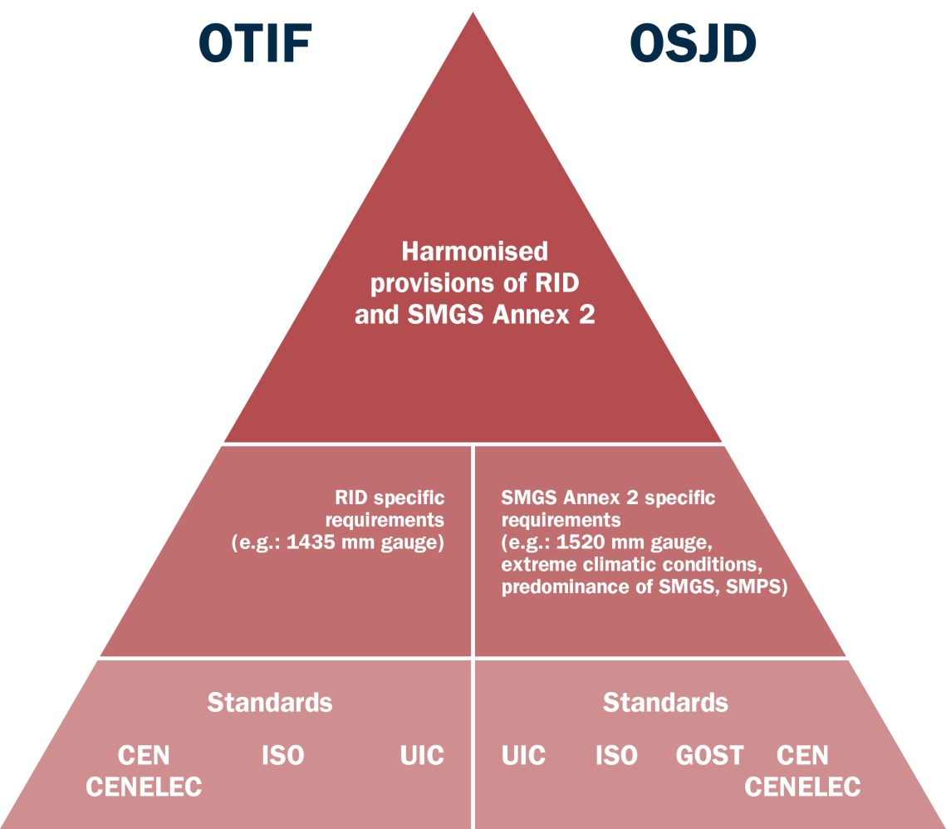
Transport of dangerous goods : an harmonized regime

Slide 19
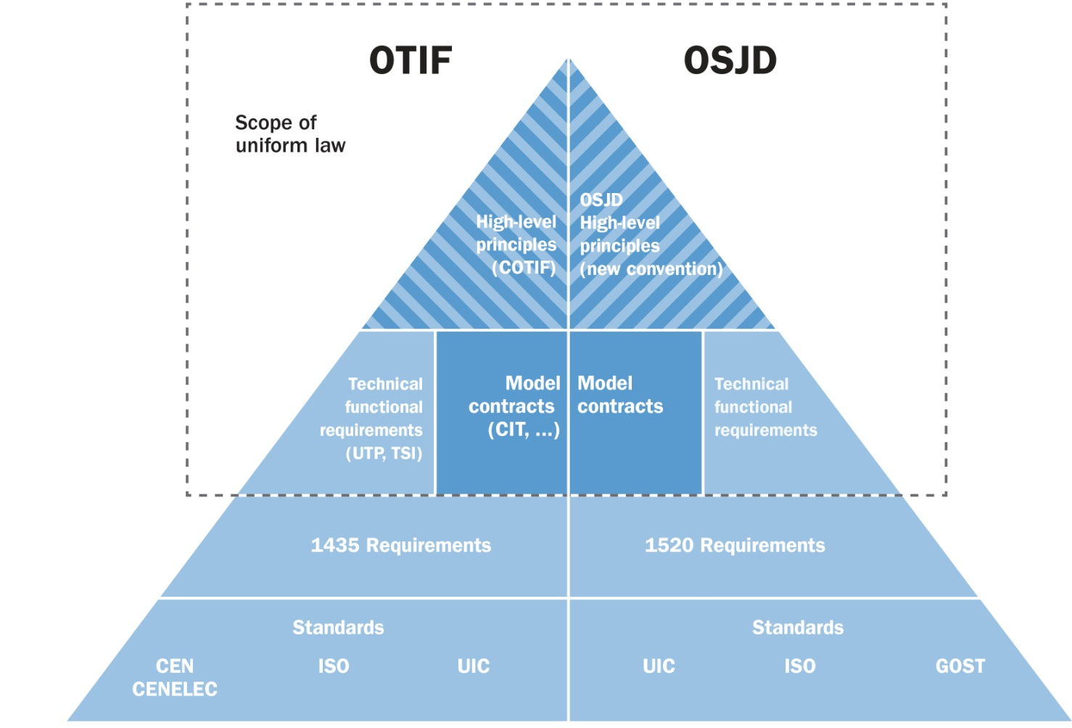
COTIF – A forum for developing uniform law

Slide 20
COTIF – developping uniform law for interoperable networks
International binding law
A bridging concept
An approach based on partnership
Railways as networks: connected, uniform and interoperable
Freight / Passenger Contracts
Legal interoperability
Dangerous Goods Regulation
Technical Regulation
Towards full interoperability
Exchange of dangerous goods wagons
Technical interoperability

Slide 21
Thank You for your attention

Slide 22
Gryphenhübeliweg 30
CH - 3006 Berne
+ 41 (0)31 359 10 10
media@otif.org
www.otif.org

