Slide 1
European Railway Technology – Quo Vadis?
European Rail Summit
Brussels, 28 April 2016
Josef DOPPELBAUER, Executive Director

Slide 2
Rail is in Competion with Other Transport Modes …
 | Rail Pax | Rail Freight | Automotive | Aviation | Maritime
Traffic pattern | mostly national | international significant |  | international | international
National regulations | yes (move to European) | yes (move to European) | minor restrictions | international | international
National products* | yes | yes | no** | no | no
National operating rules | yes | yes | no | no | no
Global supply chain | partly | partly | yes | yes | yes
Cost and Quality of products are a function of
Volume and Global Supply Base
* Vehicles/Rolling Stock and Controls Systems
** except for Road Pricing
Notes:
Rail is in competition with other transport modes – and rail has economic disadvantages

Slide 3
Example Aviation
Aviation
Boeing 737 family 4 000 units
Airbus 320 family 3 000 units
Hi-Speed Trains
TGV (seven types) 550 units
Shinkansen family approx. 600 units
Notes:
For example …

Slide 4
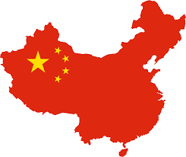

A Comparison within the Rail Sector ...
Country | Length of High-Speed* Network (km) | # of High-Speed Trains
China (2016) | 19 000 | 4 000
China (plan 2020) | 30 000 | 7 500 (estimated)
France | 2 000 | 400
Germany | 1 300 | 250
Spain | 3 100 | 150
Italy | 1 350 | 100
* High-Speed > 200 km/h

Slide 5
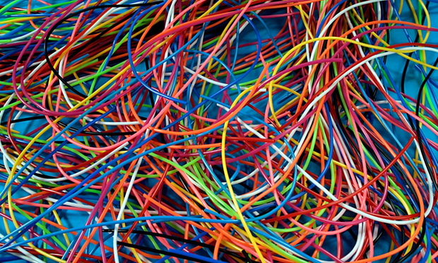
Digital Railways in Europe
Some European railway undertakings are investing heavily in digitalization
Many customer-focused developments are underway
The focus is on company use and not on a wider strategic agenda

Slide 6
A Way Out for European Rail?
Customer Driven
Single European
Railway Area
Innovation
& digital technologies
EU-wide regulation & processes
Attractive for
Customers
Less
Fragmentation
Technical harmonisation, in particular ERTMS
Cooperation & competitive operation
Cost down -
Quality up
Interoperability
Market Orientation
Global Reference
Notes:
What can we do to solve the real problems of the system?
It is a COLLECTIVE problem – we need to foster cooperation & competitive operation
The whole story is about creating an open shared system (which enables competition) – cooperation is endorsed through standardization (e.g. ERTMS System Authority, Stakeholders Platform)

Slide 7
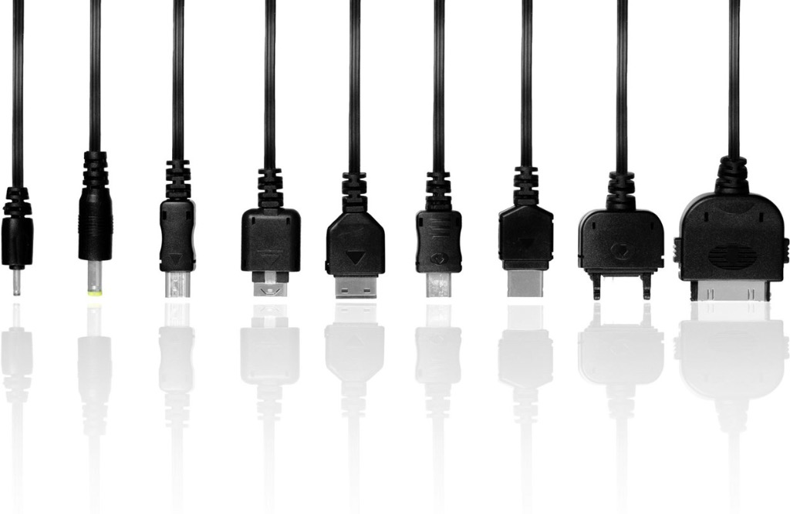
Benefits of a Harmonized Approach
Interoperability without borders
Innovation without re-inventing the wheel

Slide 8

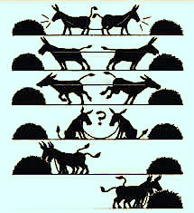
The Vision
From
Development
3 years
>100 MEUR cost
Delivery 5 years
1 bEUR revenue
Fragmented national markets
Project specific design
New train development project
New train development project
To
Standardisation and Coordinated Innovation
Enhanced train development project
Enhanced train development project
Lower costs, better quality for customers, better margins for suppliers

Slide 9
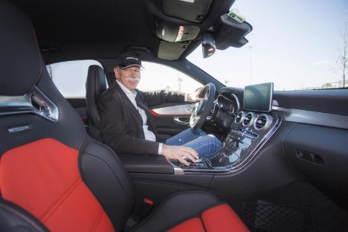
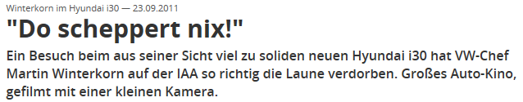
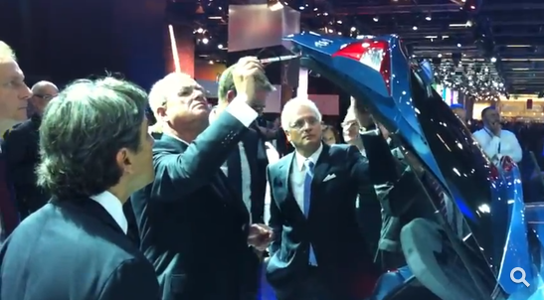
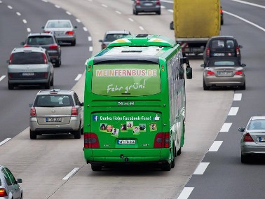
Key to Success: Know Your Products
(and those of your competitors …)
Die Welt: „You still enjoy driving yourself?“
Dieter Zetsche: „... Whenever time allows, or at test drives, I do
not miss any opportunity and I drive myself….last weekend, it was
a GLC. But I also test cars from competitors I am interested in.
I examine them carefully, more intensively than it‘s possible on fairs. This is the most beautiful part of my job.“ Die Welt, 11 March 2015
„DB CEO Rüdiger Grube takes competition by buses seriously. He tested the Hamburg-Berlin connection and complains about a serious delay. He was just impressed by the price.“
Die Welt, 03 December 2014
Handelsblatt

Slide 10
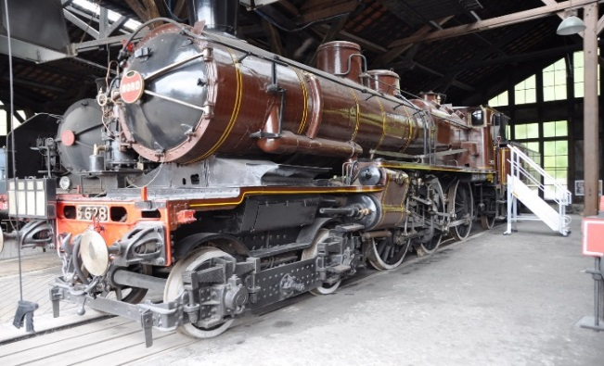
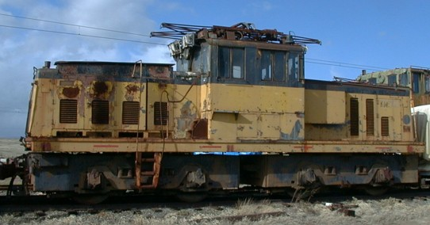
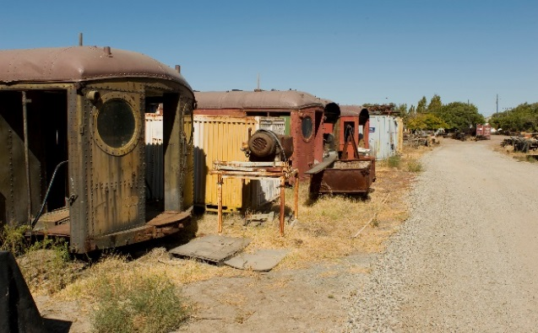
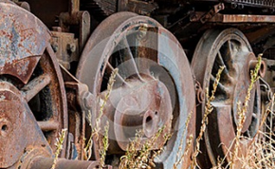

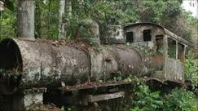
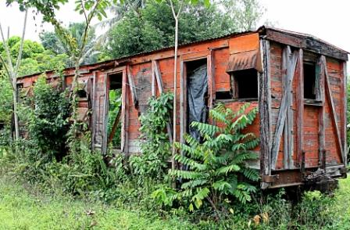
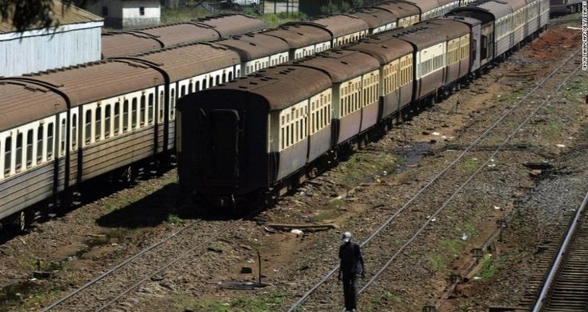
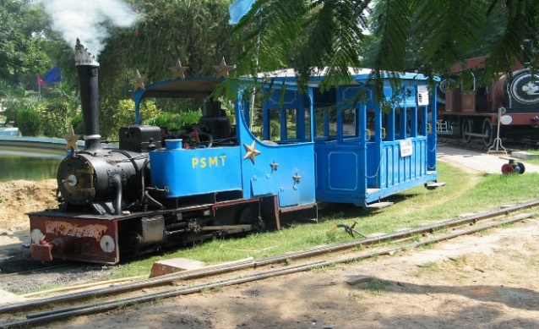
Don’t End Up in the Railway Museum

Slide 11

A Sustainable Europe Through Rail
Less cost
More quality
More capacity
More passengers
More goods
More Green
We do not cheat

