Slide 1

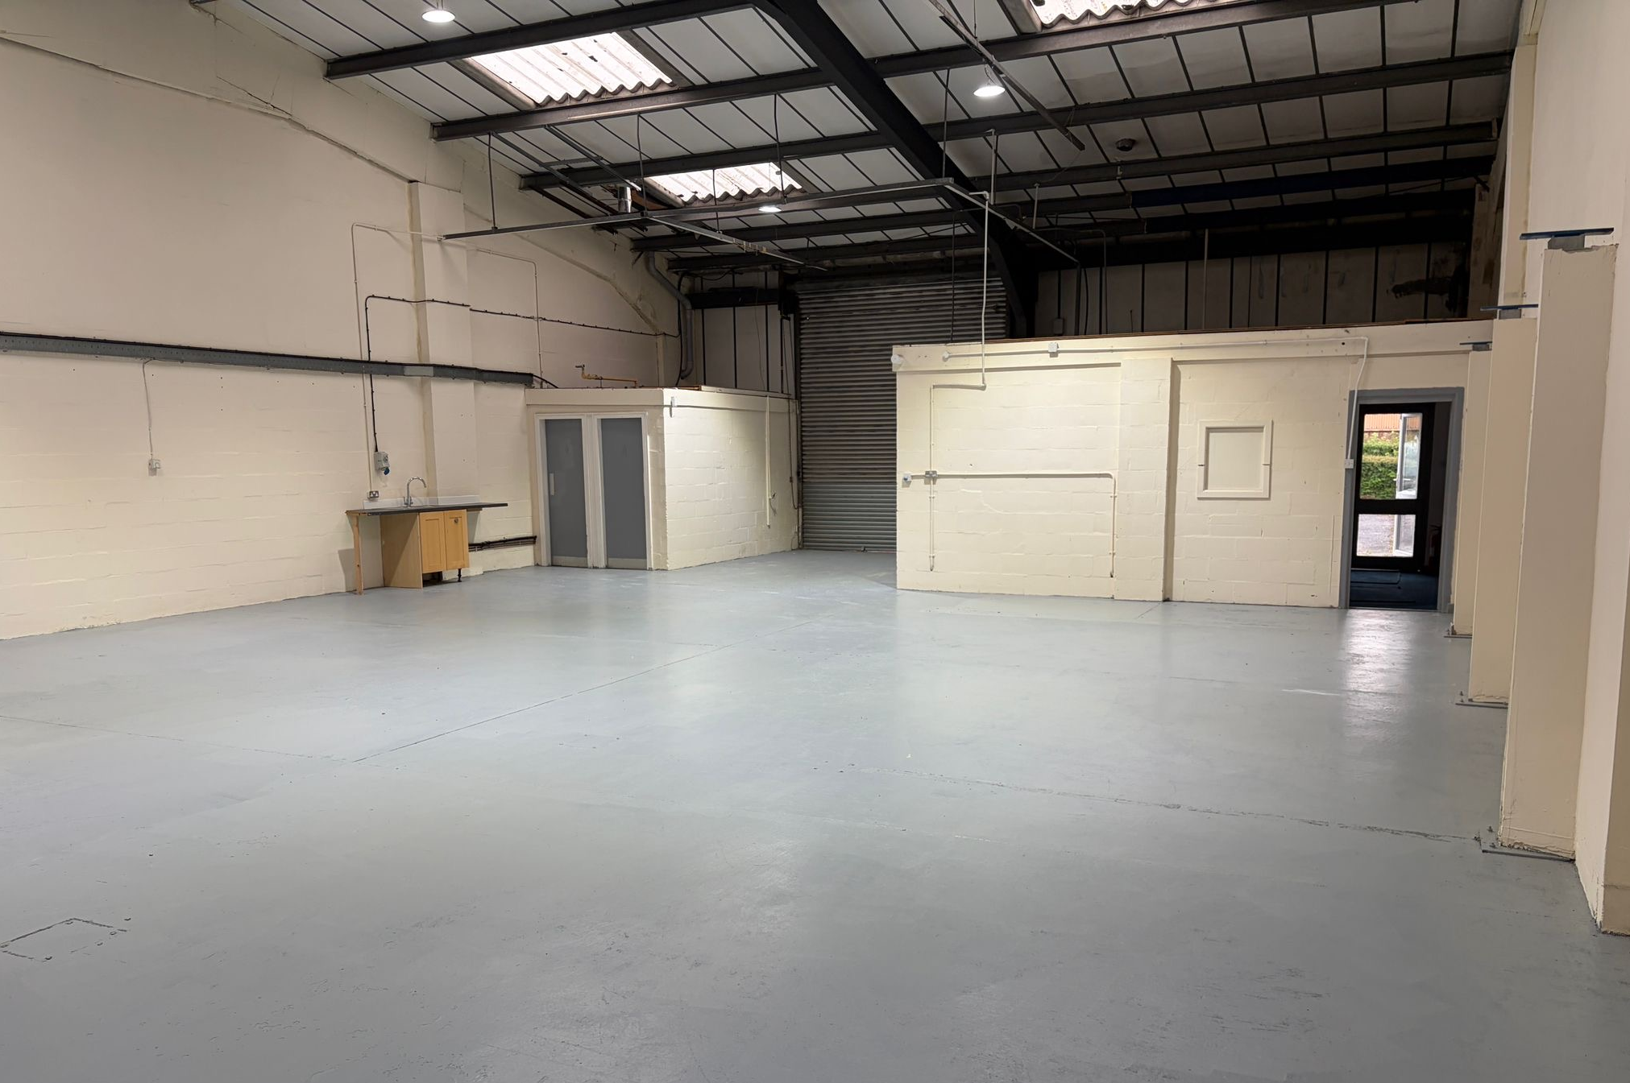
UNIT
28
Tatton Court, The Grange, Warrington, WA1 4RR
TO LET/FOR SALE
2,414 SQ FT (224.27 SQ M) MID TERRACE INDUSTRIAL/WAREHOUSE UNIT

Slide 2
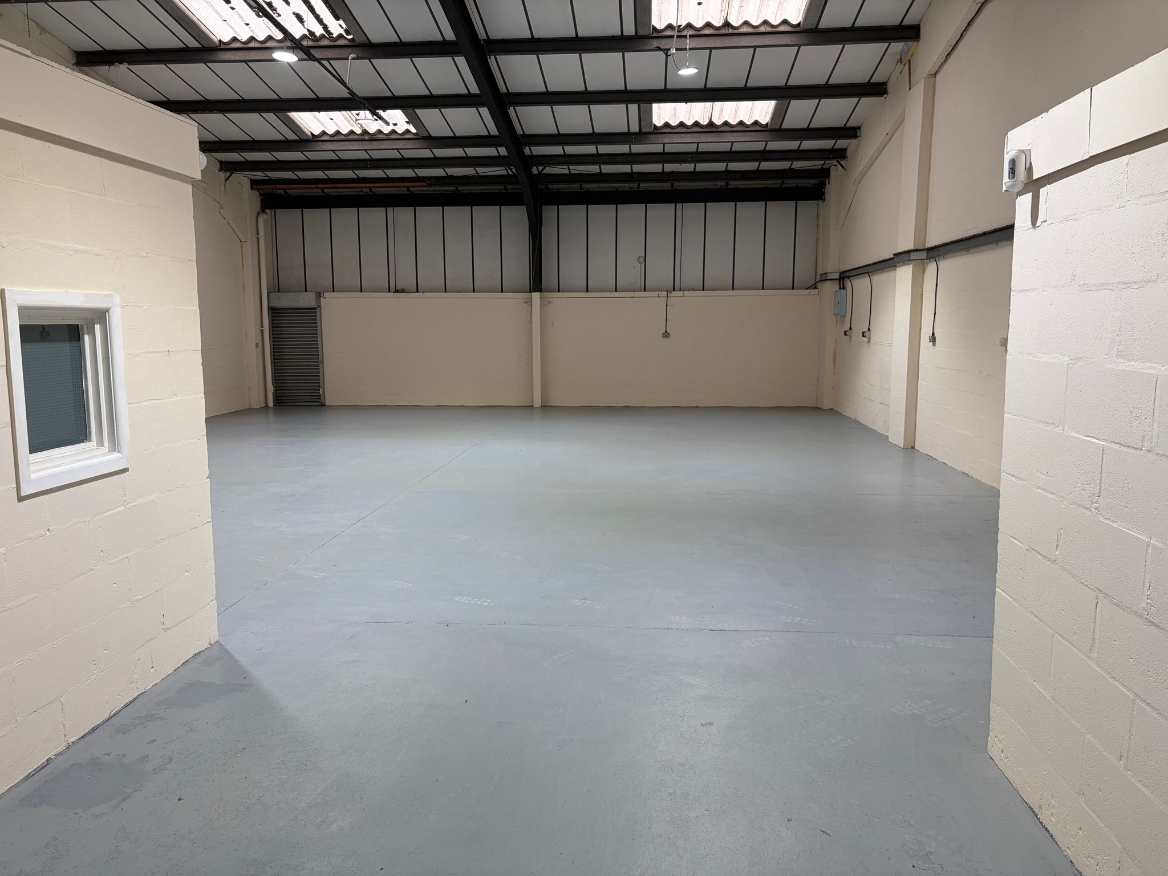
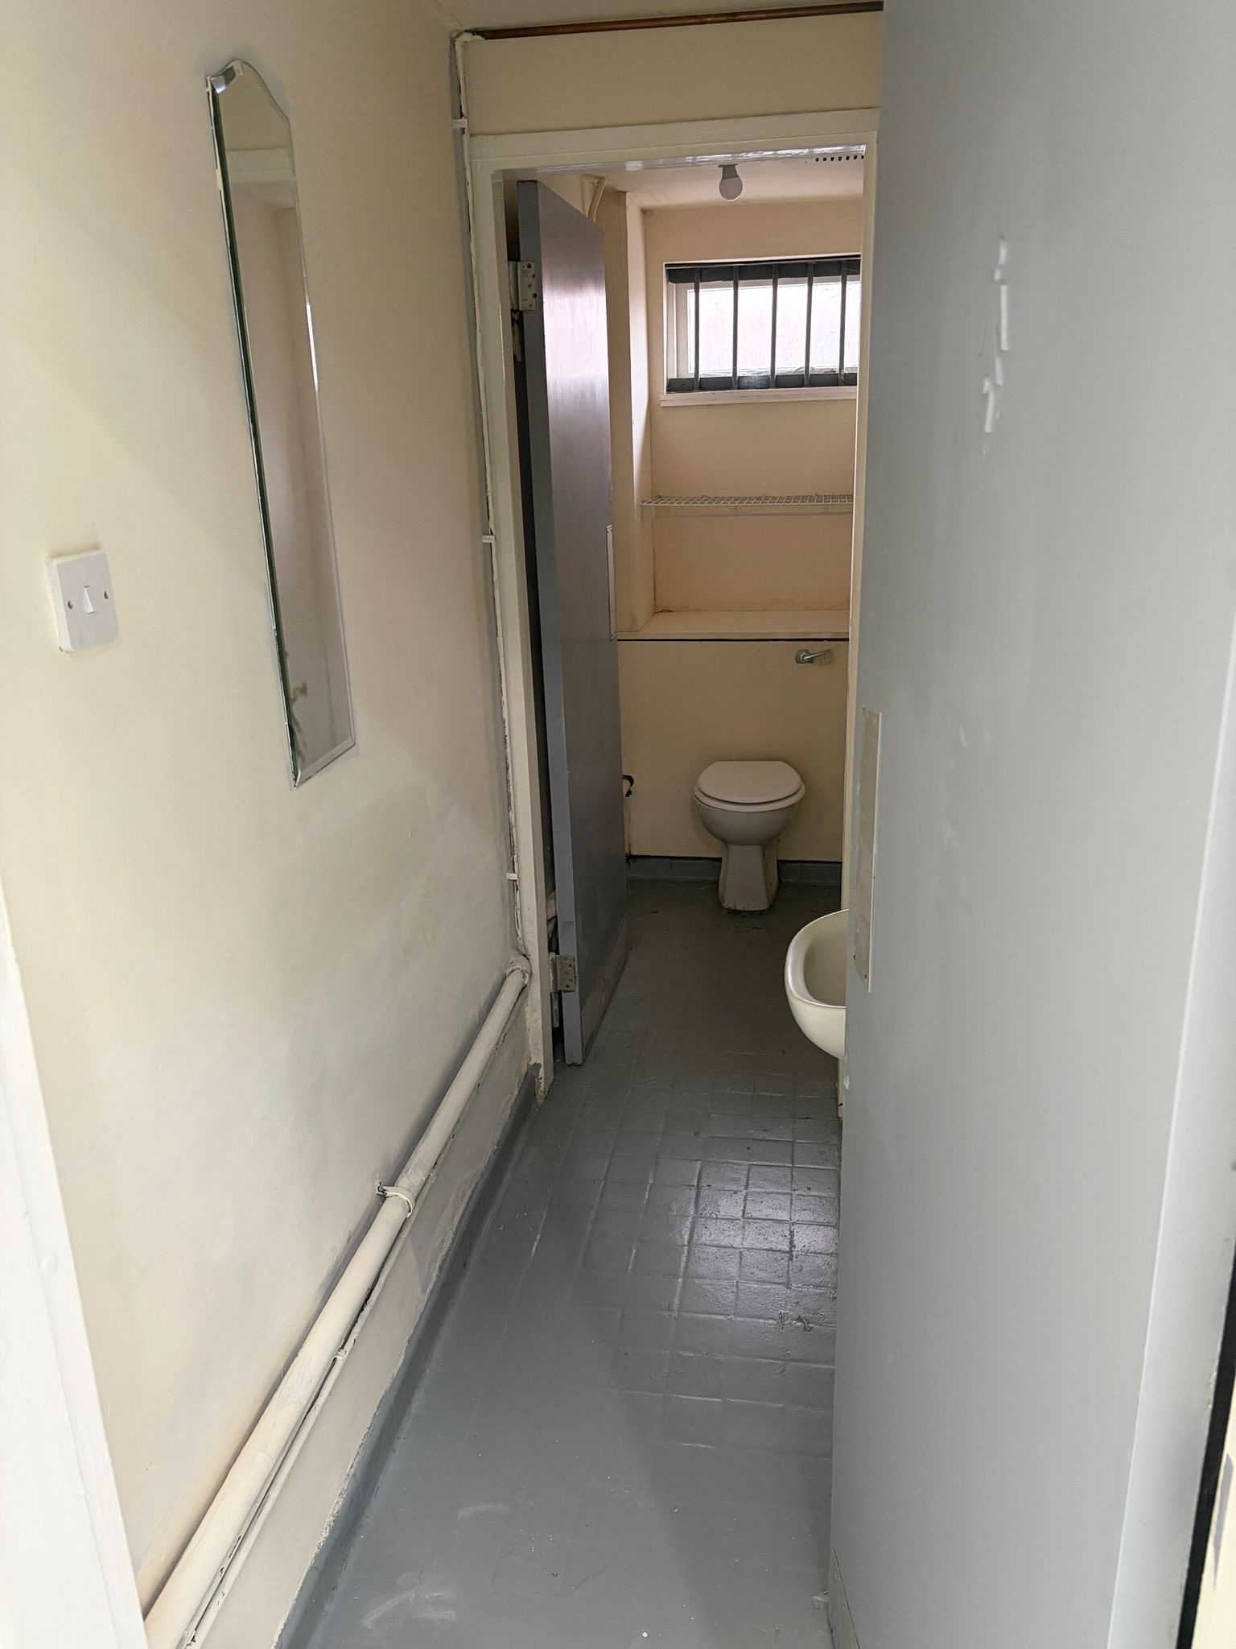
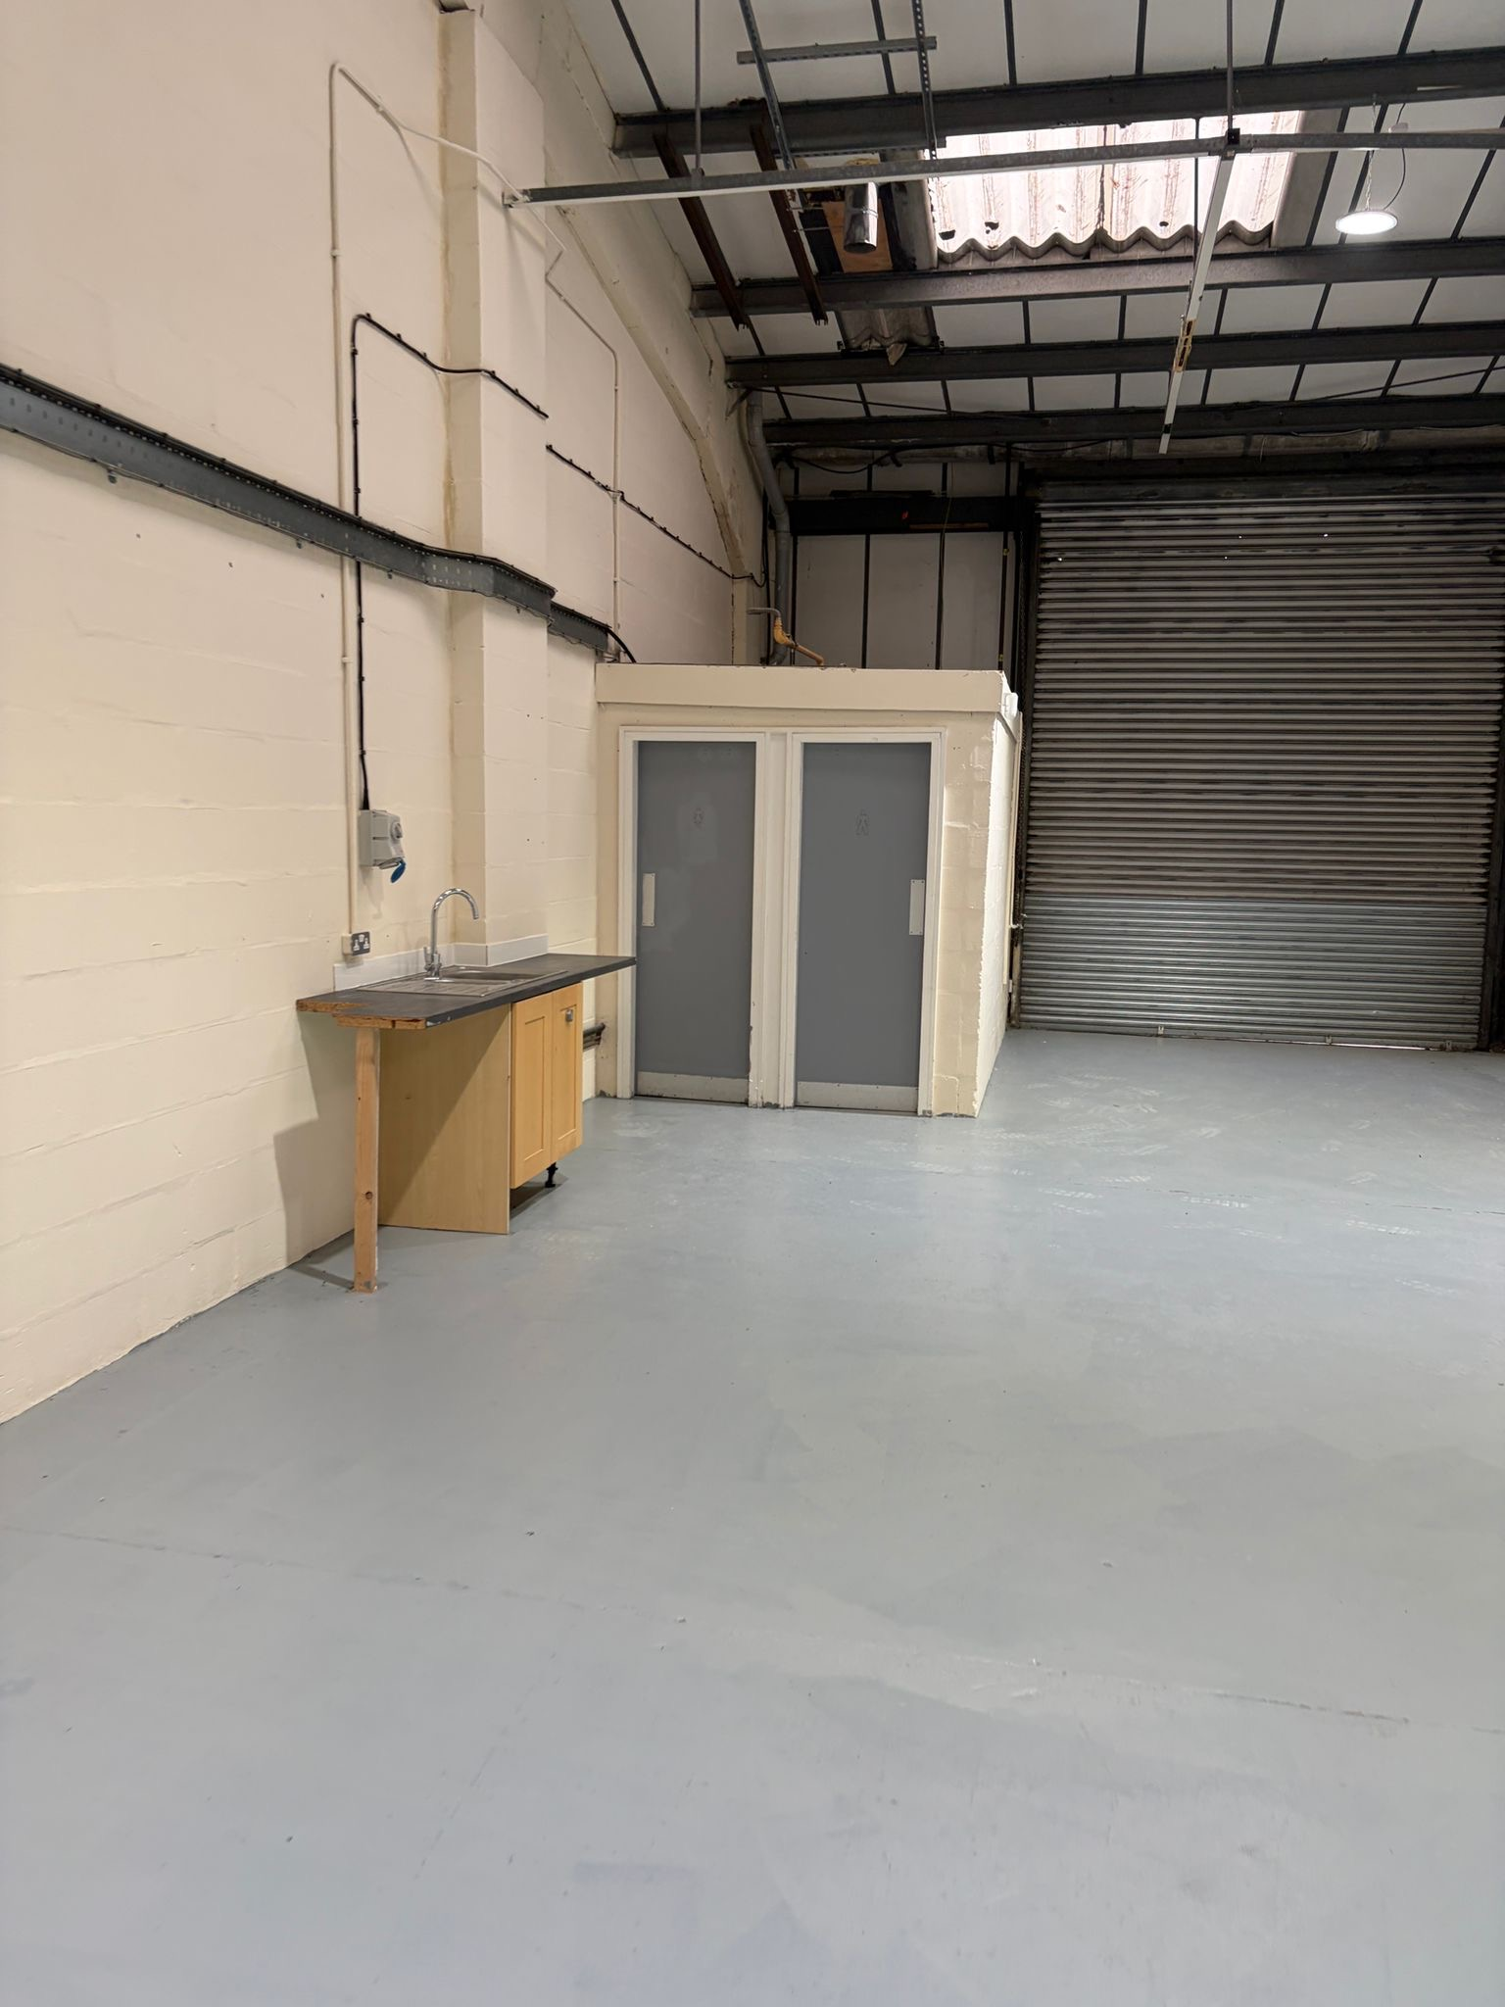
LOCATION
Tatton Court is situated to the East of Warrington, in the well-known and significant Grange Industrial Area, which covers some 200 acres. Junction 21 of the M6 is located approximately 1.5 miles to the south and provides easy access to both the South and North of England. The M6/M62 and M6/M56 interchanges lie one Junction either side of Junction 21 of the M56.
DESCRIPTION
End terrace modern unit benefitting from the following specification:-
Level access loading provisions
W/C
Steel portal frame construction
Small integral office
Shared yard and parking
ESTATE CHARGE
There is a small estate charge payable to cover services, facilities and general estate maintenance. Further information can be provided upon request.

Slide 3
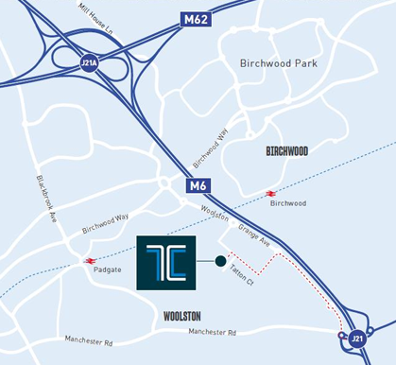


PRICE
Available upon request
TENURE
Available on a Leasehold or Freehold basis
LEGAL COSTS
Each party is to be responsible for their own costs incurred in this transaction.
ANTI MONEY LAUNDERING
Under Anti-Money Laundering Regulations, we are obliged to verify the identity of a proposed tenant/purchaser once a letting or sale has been agreed, prior to the instruction of solicitors.
This is to help combat fraud and money laundering, and the requirements are contained in statute.
CONTACT
For further information please contact:-
Anthony Mellor
anthony@b8re.com
Tel: 01925 320520
Sam Paddon
sam@b8re.com
Tel: 07376 591823
John Barton
john@bcrealestate.co.uk
Tel: 0161 636 920
WA1 4RR
MISREPRESENTATION ACT: B8RE for themselves and for the vendors or lessors of this property whose agents they are, give notice that (i) these particulars are produced in good faith, are set out as a general guide only and do not constitute any part of an offer or contract. They are believed to be correct but any intending purchasers or tenants should not rely on them as statements or representations of fact but must satisfy themselves as to the correctness of each of them. (ii) no person in the employment of CBRE or B8RE has any authority to make or give any representation or warranty in relation to this property. March 2025

