Slide 1
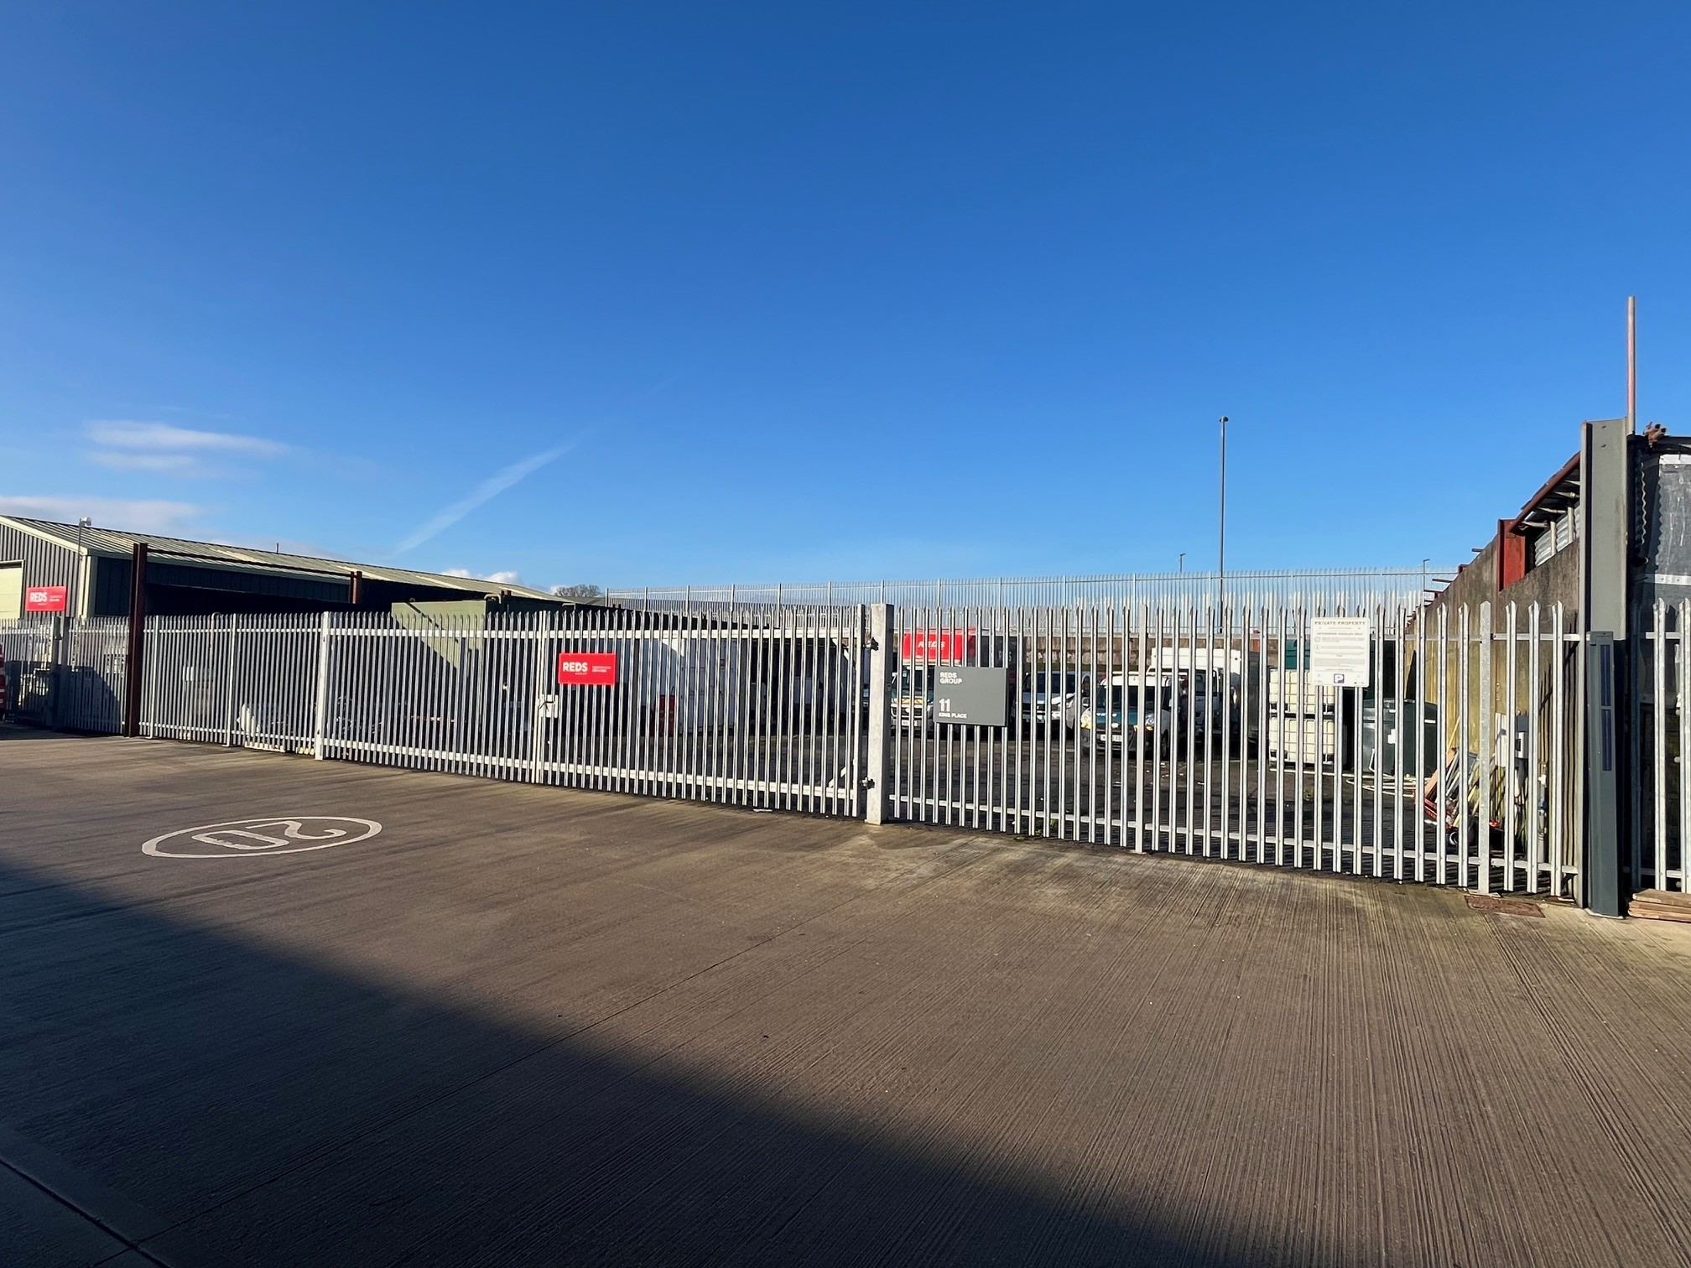

UNIT 11 KING PLACE
TO LET
Hitchcocks Business Park, Uffculme, Cullompton EX15 3FH
Open Storage Yard
611.5 sq m (6,582 sq ft)

Slide 2
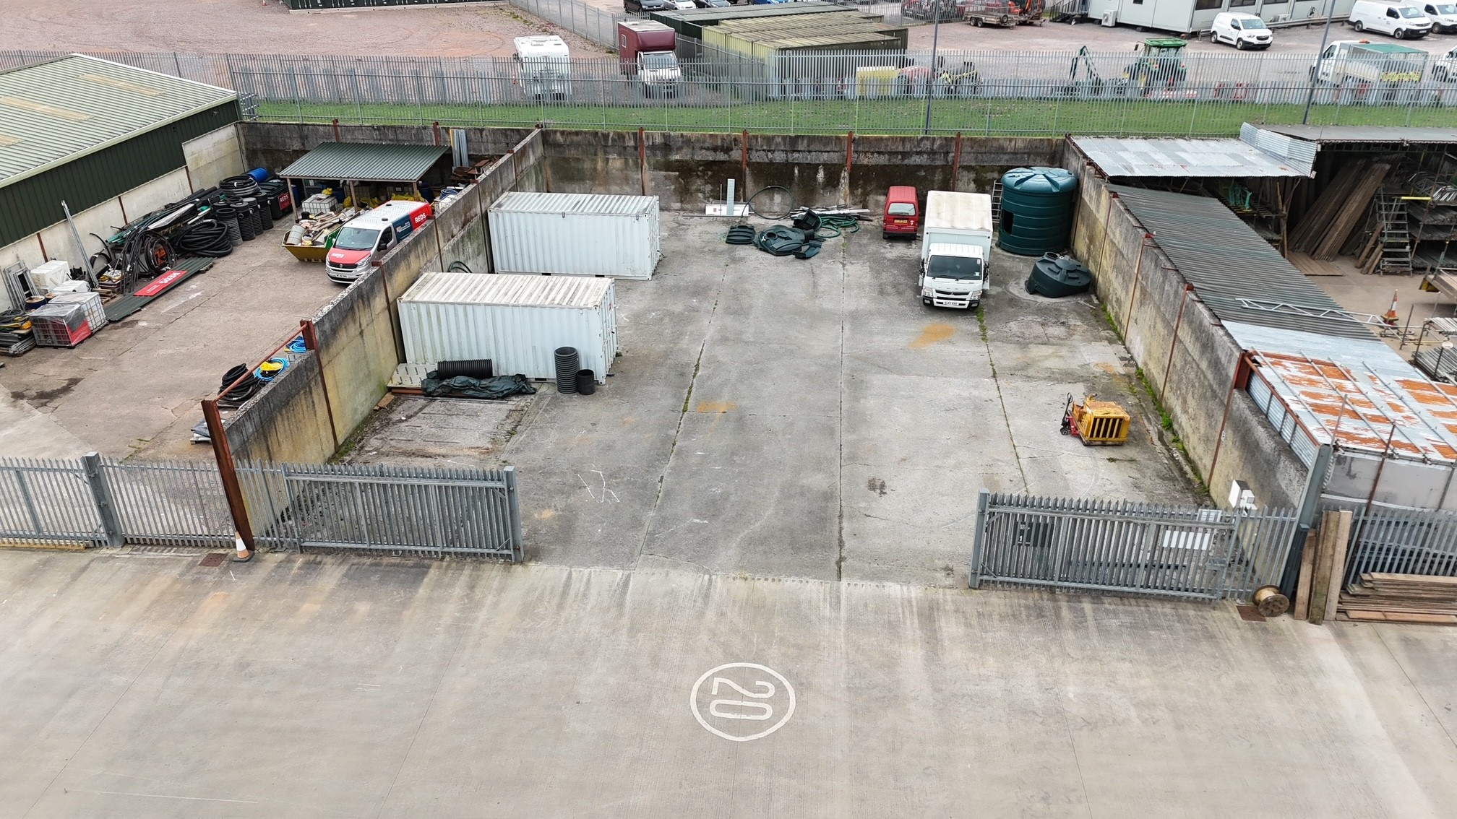
TERMS
The property is available by way of a new full repairing and insuring lease for a term of years to be agreed
RENT
£16,455 per annum exclusive of all other outgoings (£2.50 per sq ft)
SERVICE CHARGE
A service charge based on 5% of the annual rent will be payable to cover repairs, maintenance and sit security for the common parts of the business park
LEGAL COSTS
Each party to bear their own legal costs associated with the letting
VAT
VAT will be payable on the rent and service charge
DESCRIPTION
A mid-terrace open storage yard comprising the following:
Concrete surface
Steel palisade fencing
Double gates opening at 10m wide
8 allocated parking spaces
611.5 sq m (6,582 sq ft) gross internal area

Slide 3
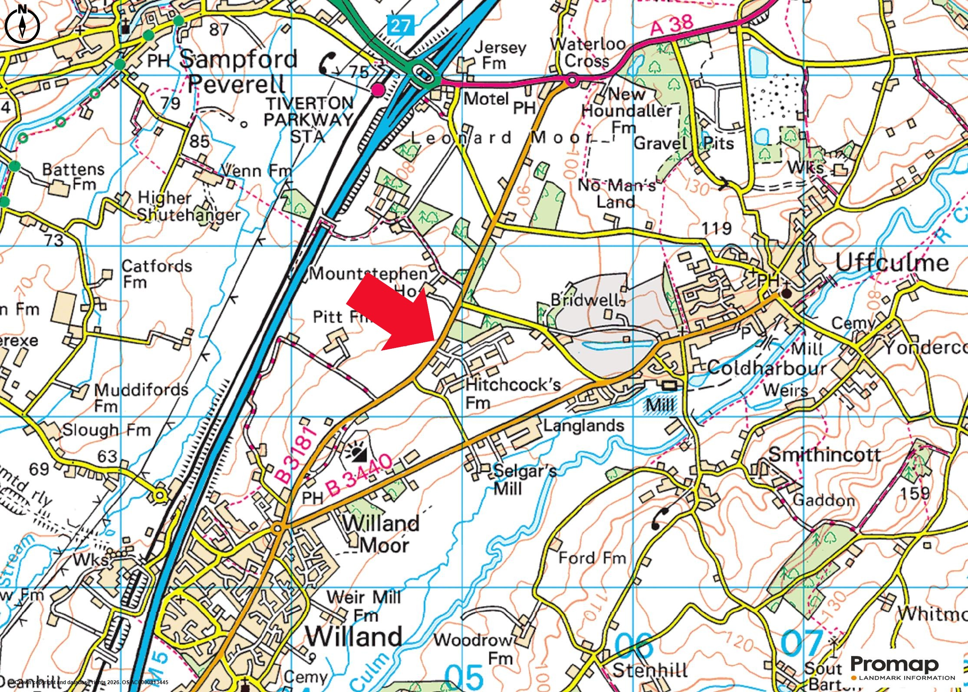
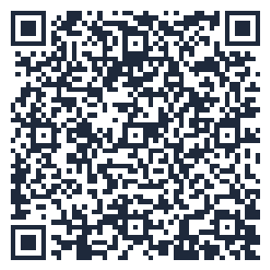
LOCATION
Hitchcocks Business Park is located 1.5 miles from Junction 27 of the M5. A thriving community and nearby rail and air links make it an ideal base for your business
As a family-owned business we are always on site and work continuously to ensure Hitchcocks Business Park is a great place to work
Unit location via what3words.com ///chief.dummy.blunt
SECURITY
On-site security is provided at night as well as CCTV to common parts of the business park
SERVICES
Mains 3 phase electricity, water, private drainage & telecoms are available
EPC
Not applicable
RATEABLE VALUE
The HMRC website lists the Rateable Value as £18,000
PLANNING
The property has the benefit of planning consent for E1(g), B2 & B8 use
ANTI-MONEY LAUNDERING
Interested parties will be required to provide relevant information
Take a virtual tour by scanning the code below:
Insert image

Slide 4
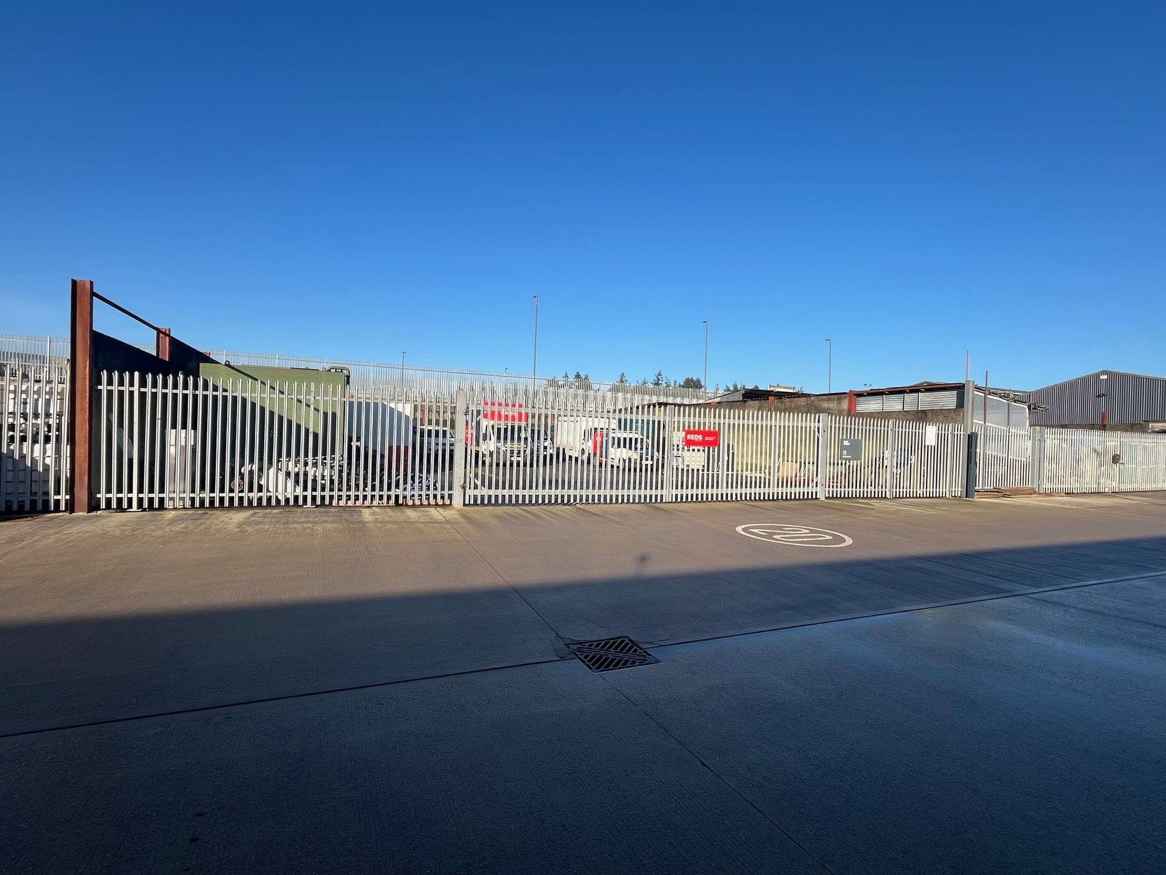
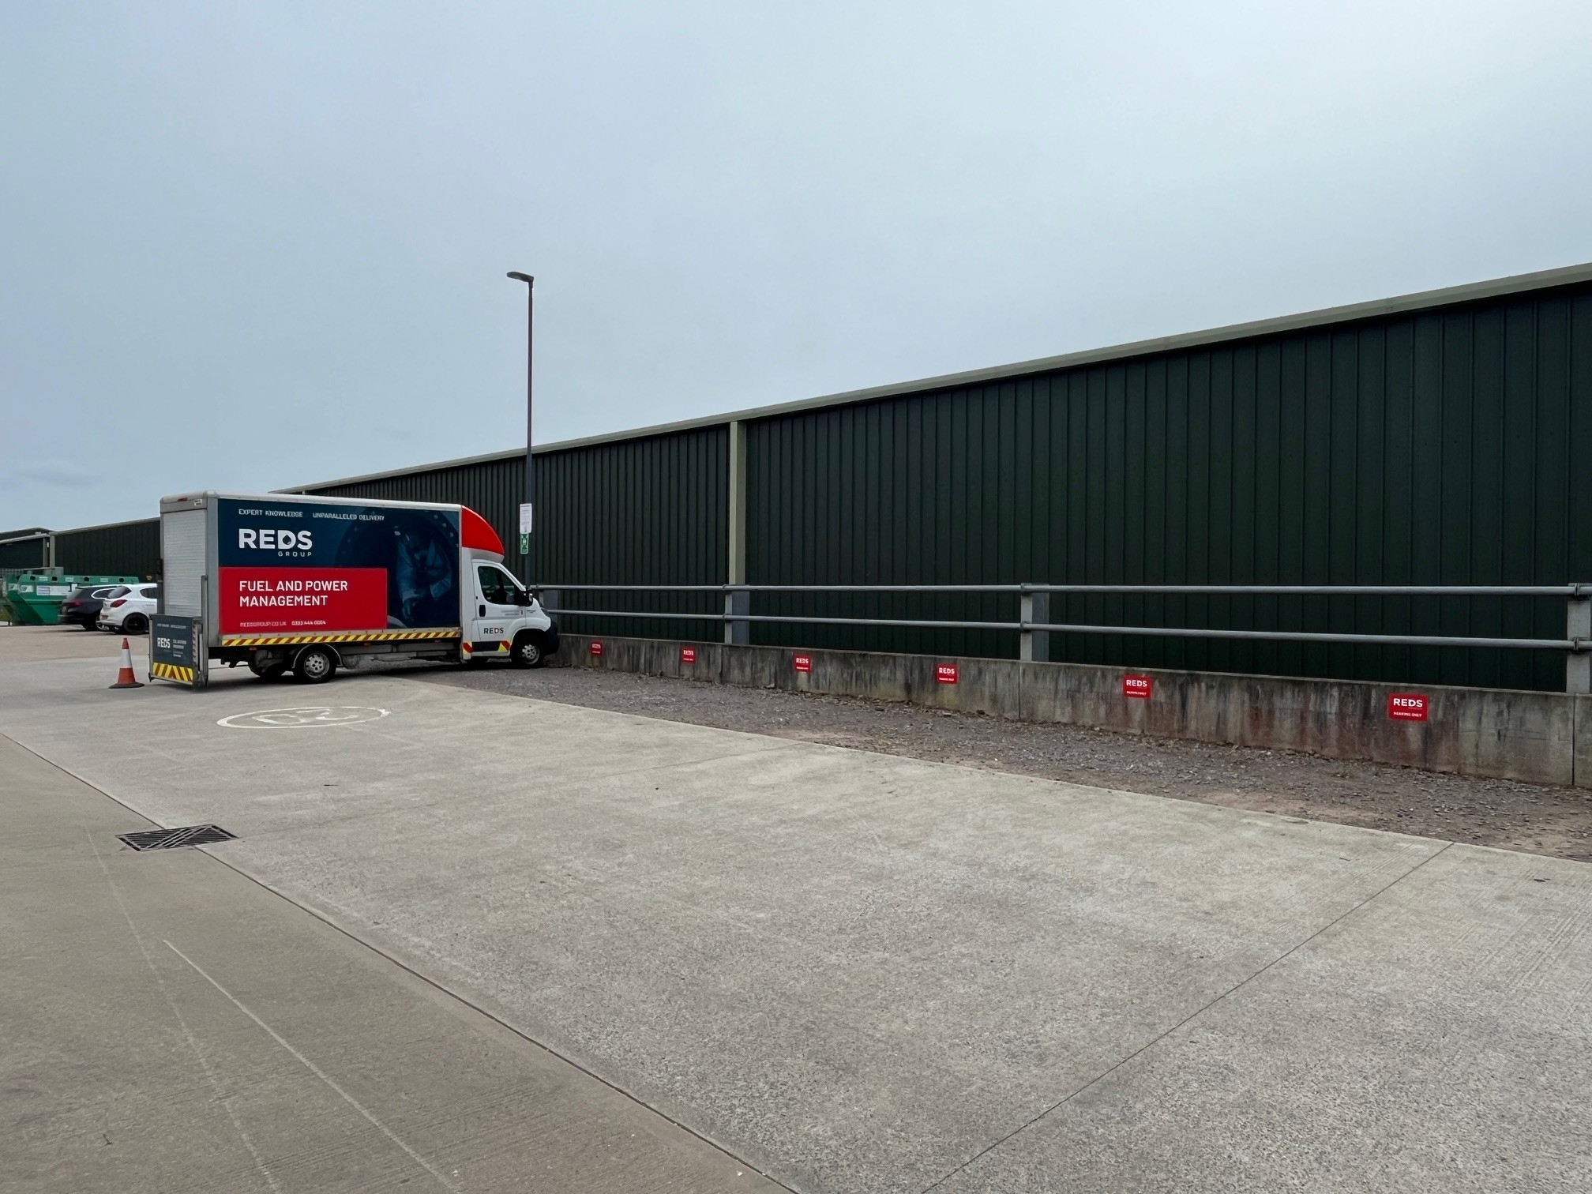
Insert image
For further information or to arrange a viewing contact us:
Tel: 01884 840136 or 07719 325133 Email: tim@hitchcocksbusinesspark.co.uk
These particulars do not constitute any offer or contract and although they are believed to be correct, their accuracy cannot be guaranteed and they are expressly excluded from any contract. They may be subject to change without notice. Interested parties should satisfy themselves as to the accuracy of all information by inspection, professional advice and/or other appropriate means

