Slide 1
2ND FLOOR
149-151 COMMERCIAL ROAD
WHITECHAPEL
LONDON
E1 1PX
EDUCATIONAL USE PREMISES IN THE HEART OF WHITECHAPEL
1,767 SQFT

Slide 2
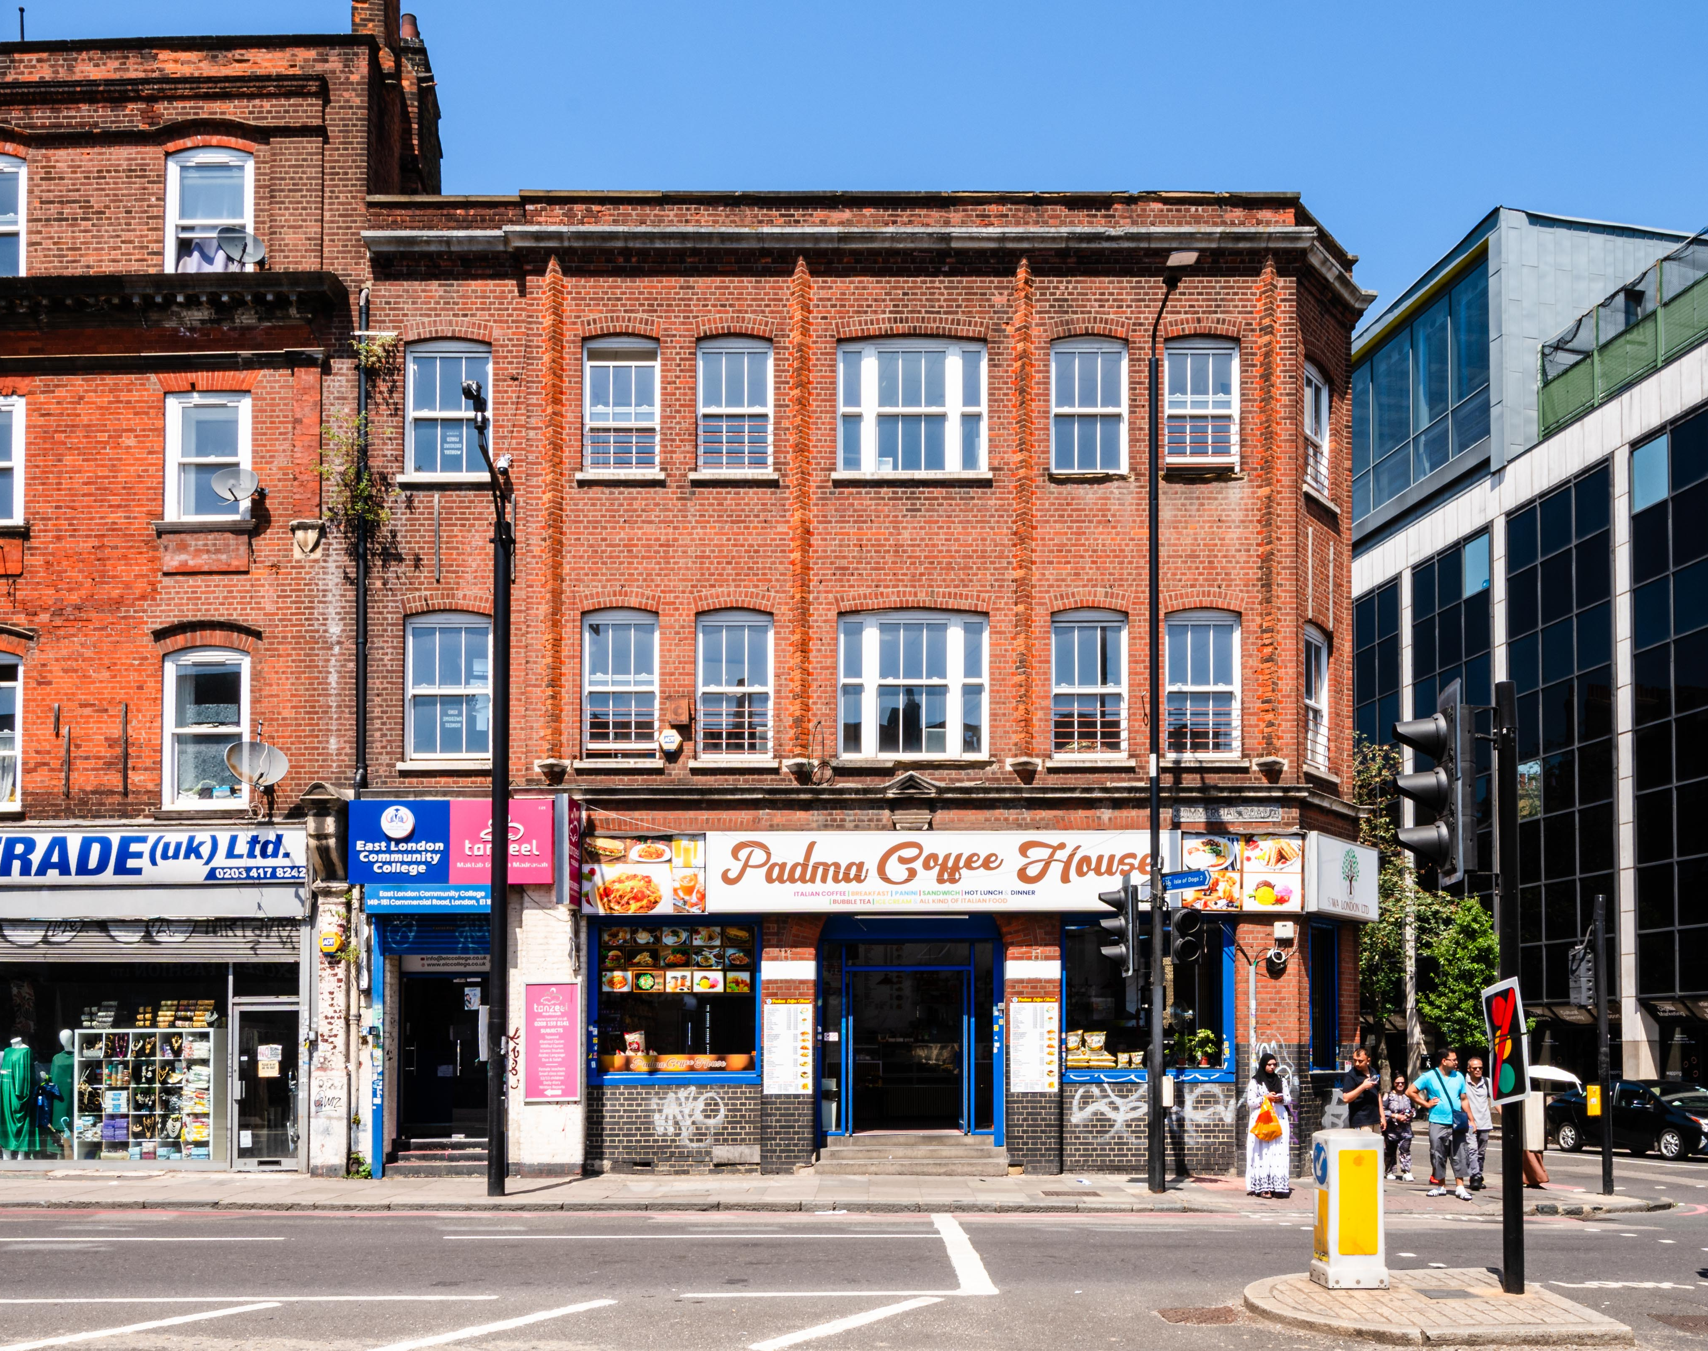
DESCRIPTION
149-151 COMMERCIAL ROAD,
  London, E1 1PX
The available office/F1 space is located on the 2nd floor and is offered on a self-contained basis. The premises benefits from self-contained access from Commercial Road, good natural light throughout, good ceiling height, and would suit a variety of businesses looking for an office or an educational use (Class F1).
Summary
F1 Use Class
Self Contained
WC Facilities
Kitchen Facility
Class Room
Good Natural Light

Slide 3
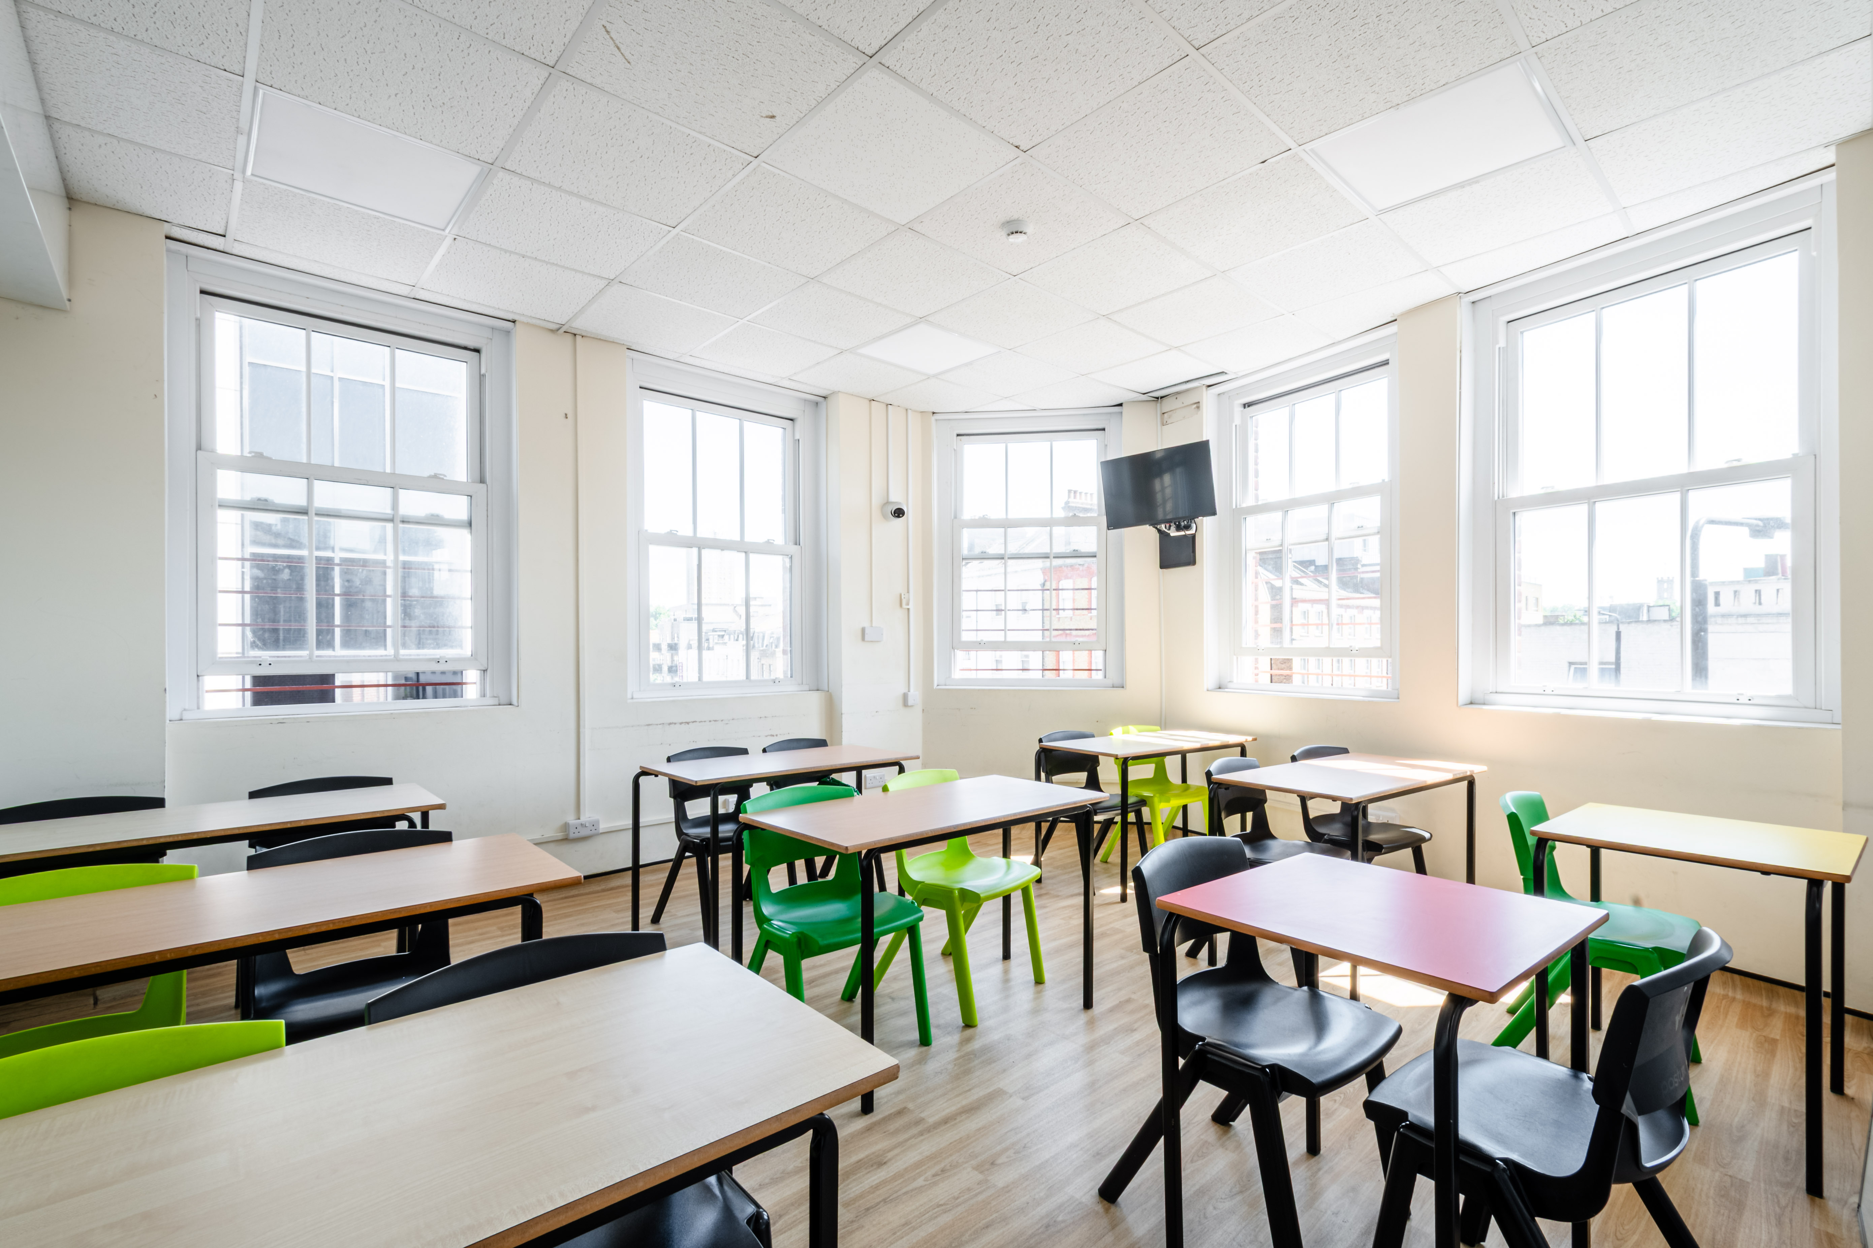
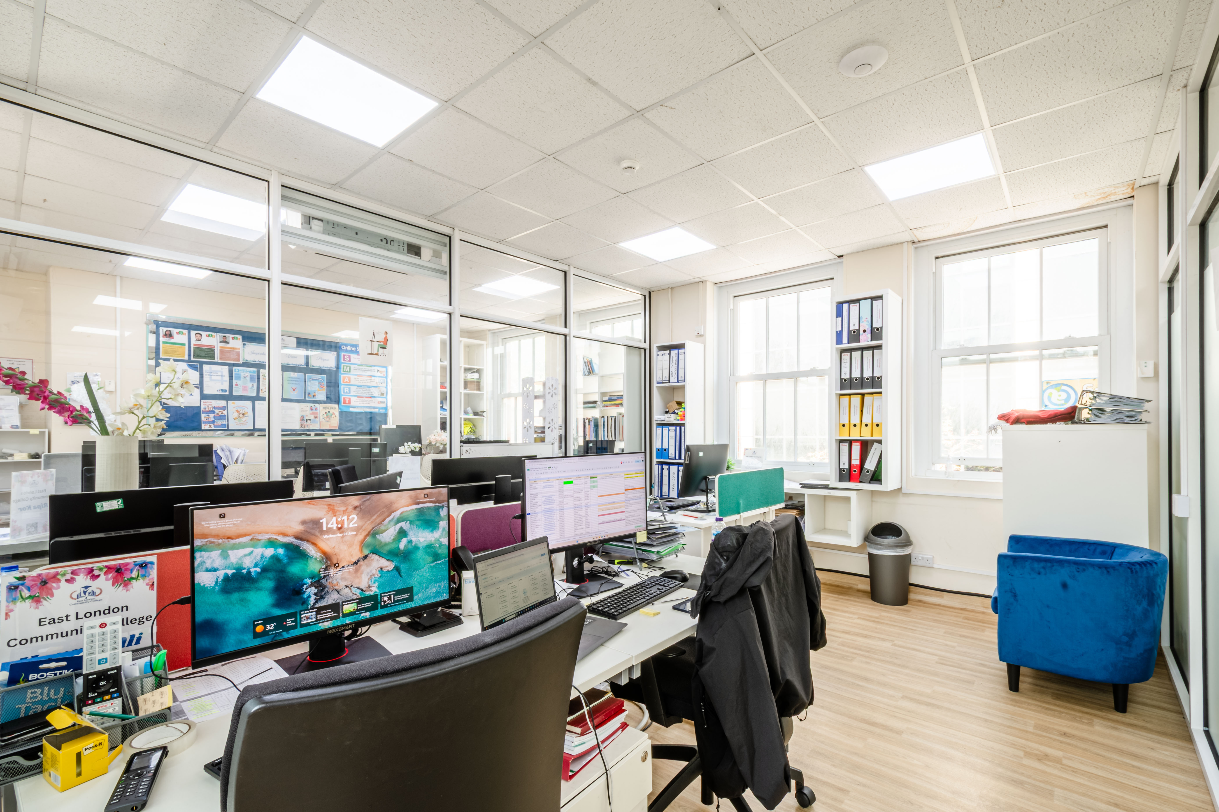
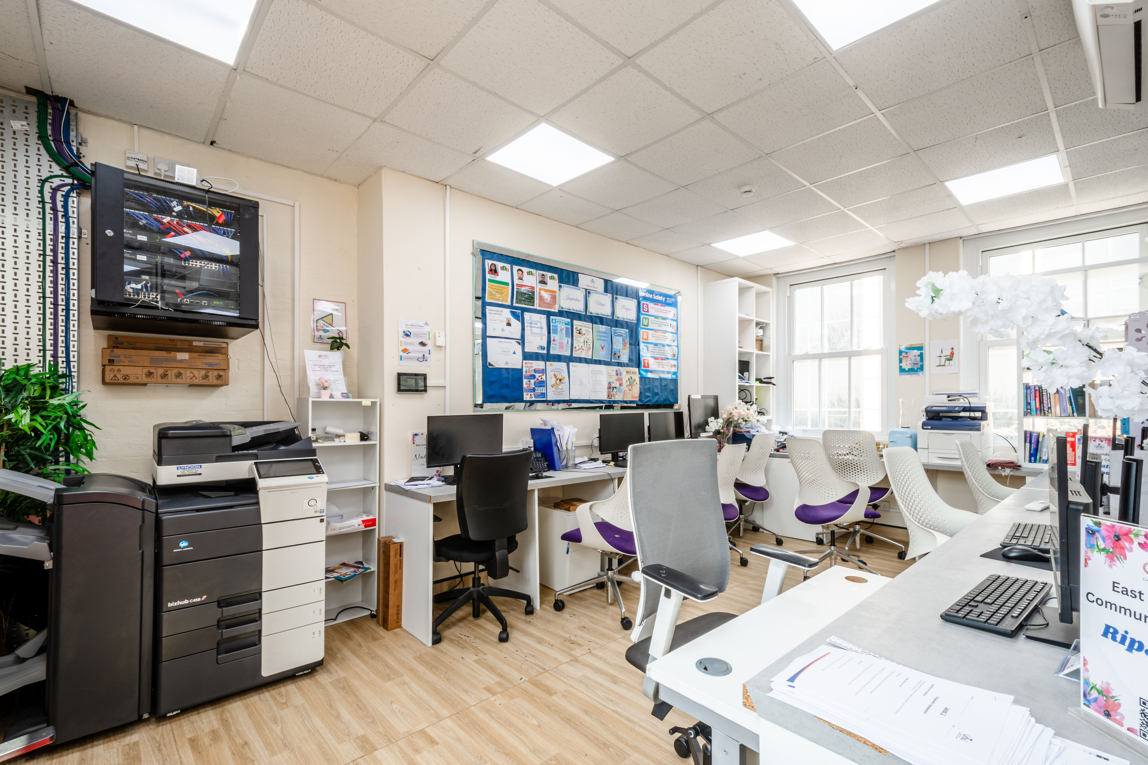
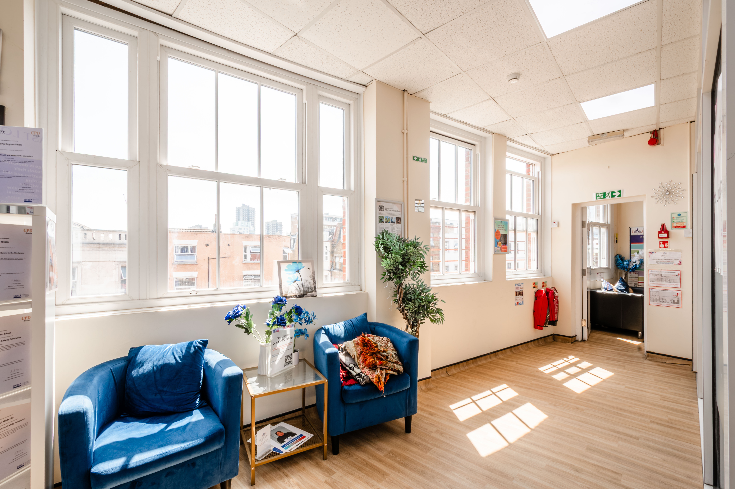

Slide 4
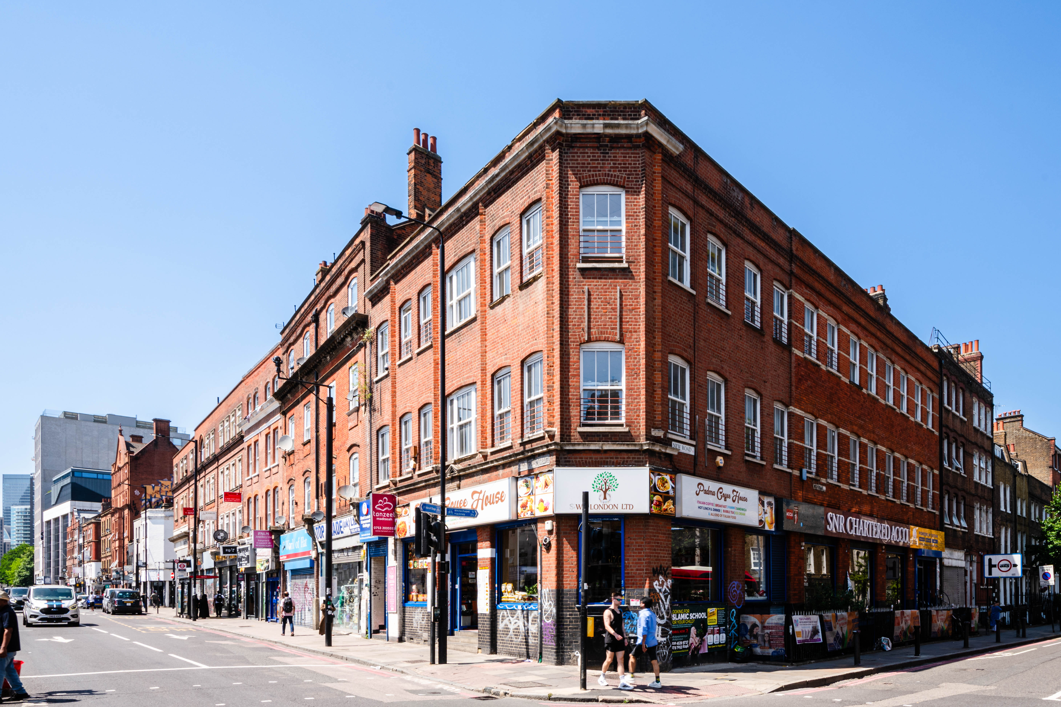
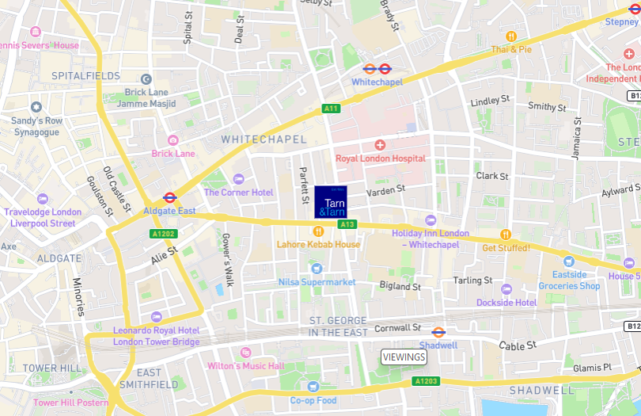
LOCATION
149-151 COMMERCIAL ROAD,
  London, E1 1PX
The area
The property is located on the north side of Commercial Road on its junction with New Road. Commercial Road is an important artery which connects the City of London with both Canary Wharf and Greater London. The area is also extremely well served by public transport, with Aldgate East and Whitechapel Underground Stations only a short walk away as well as many local bus routes.
Transport
Aldgate East (7-minute walk) – Hammersmith & City & District Line
Whitechapel (11-minute walk) – Overground Line, Hammersmith
& City, District Line, Elizabeth Line
Shadwell (11-minute walk) – Overground Line & DLR Line

Slide 5


149-151 COMMERCIAL ROAD,
  London, E1 1PX
ACCOMMODATION
FLOOR | SQ FT | RENT (£ PSF) | SERVICE CHARGE | BUSINESS RATES | TOTAL YEAR
2ND FLOOR | 1,767
TOTAL | 1,767 | £32 PSF | TBC | £15,437.09 | £71,981.05
BUSINESS RATES
ANTI - MONEY LAUNDERING
The rates given are a guide and interested parties should make their own enquiries with the local authority.
In accordance with the Money Laundering, Terrorist Financing and Transfer of Funds (Information on the Payer) Regulations 2017 the Tenant will be required to comply with our Anti Money Laundering policy.
Further details on request.
Terms
A new FRI Lease to be contracted Outside the Security and Provisions of the Landlord and Tenant Act of 1954
LOCAL AUTHORITY
London Borough of Tower Hamlets
Building insurance
VAT
Approx. £1,500 per annum
N/A

Slide 6
VIEWINGS
TARN & TARN
53 COMMERCIAL STREET LONDON E1 6BD
T 020 7377 8989
E INFO@TARN-TARN.CO.UK
TEAM
ARTHUR NOWICKI
T 07792 711461
E ARTHUR@TARN-TARN.CO.UK
Luke Marioni
T 077346 01111
E luke@TARN-TARN.CO.UK
GASPER KOSCIK
T 07554 640000
e GASPER@TARN-TARN.CO.UK
OlIVER French
T 07852 527981
E Oliver@tarn-tarn.co.uk
THE CITY FRINGE PROPERTY AGENCY PROVIDING EXPERT ADVICE SINCE 1955.

