Slide 1

30-31
COWCROSS STREET
FARRINGDON EC1
2,376 SQ FT (220 SQ M)
FURNISHED OFFICES IN PRIME FARRINGDON LOCATION
AVAILABLE TO LET

Slide 2
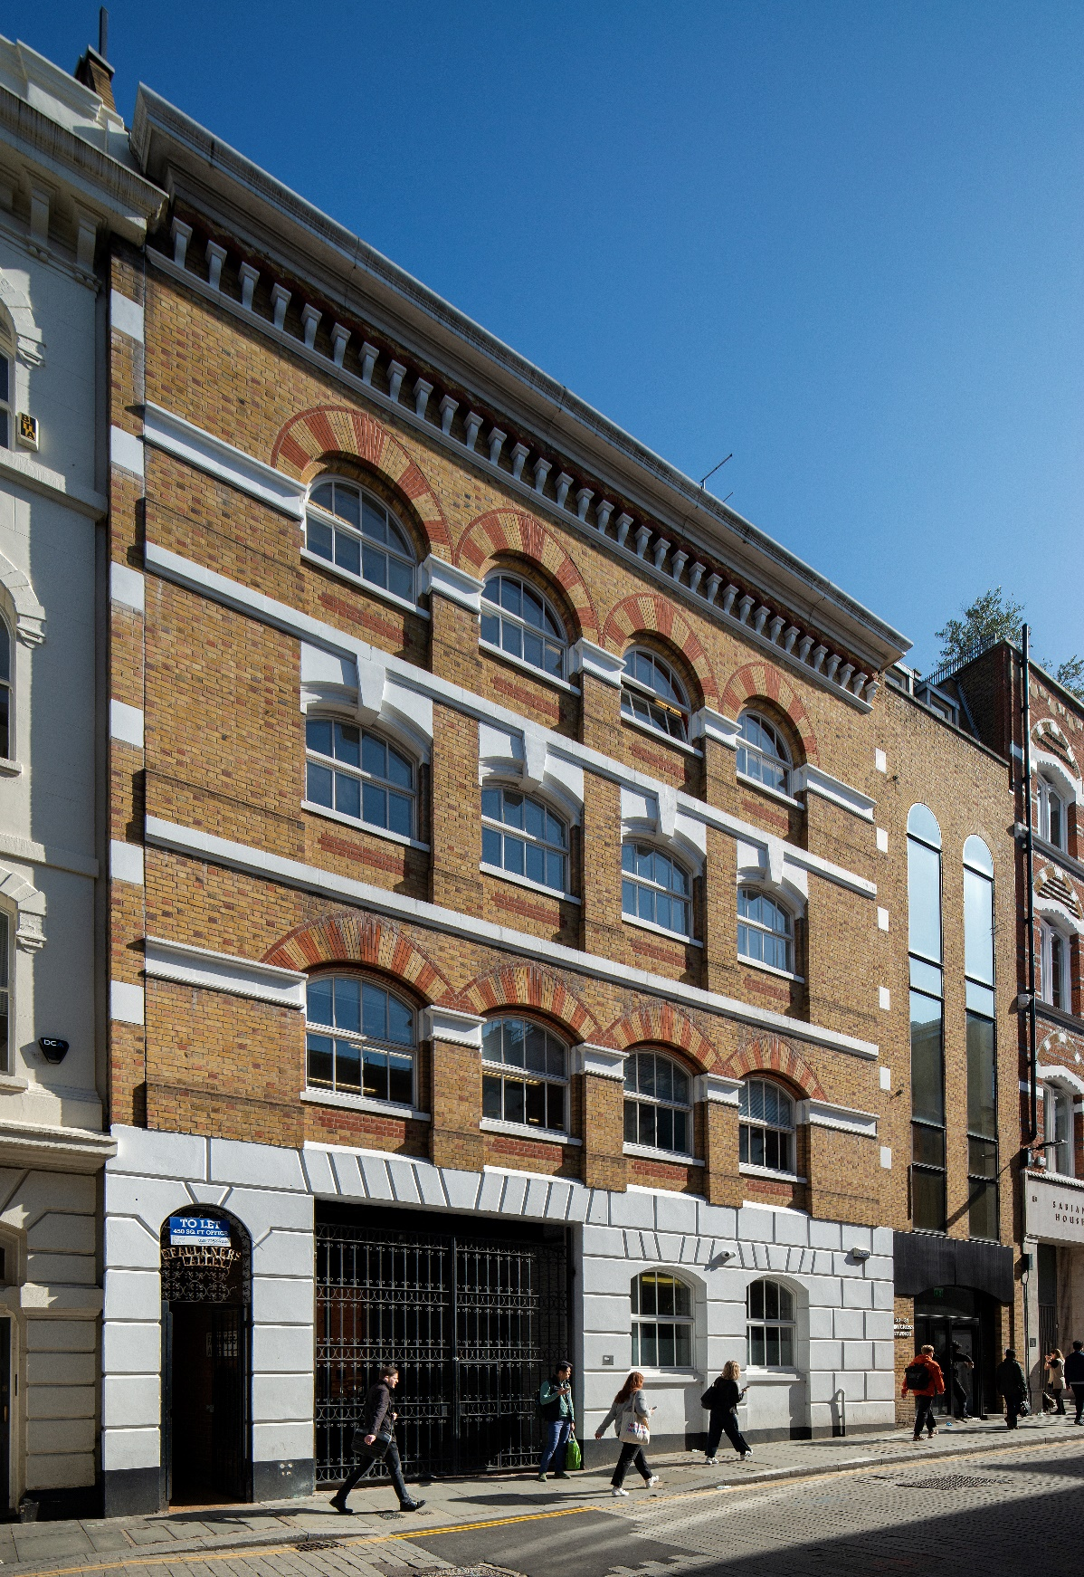
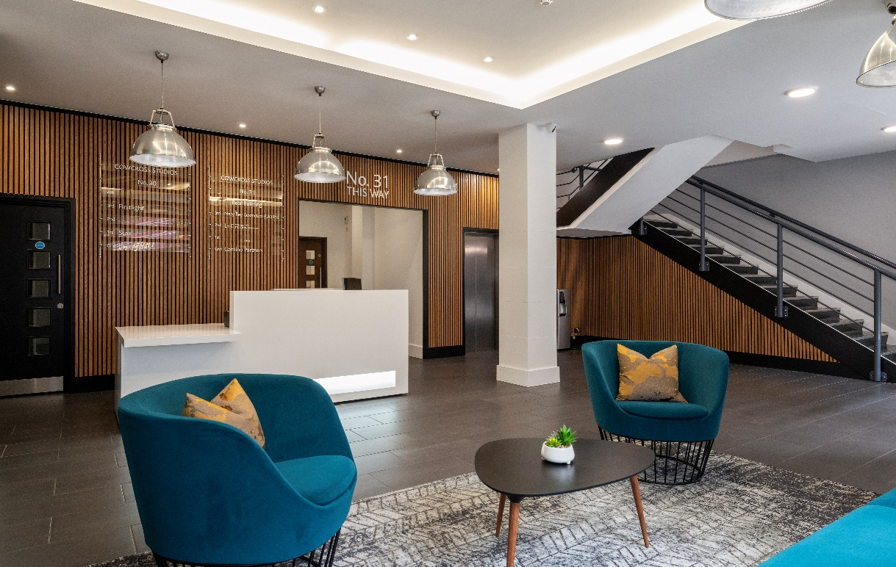
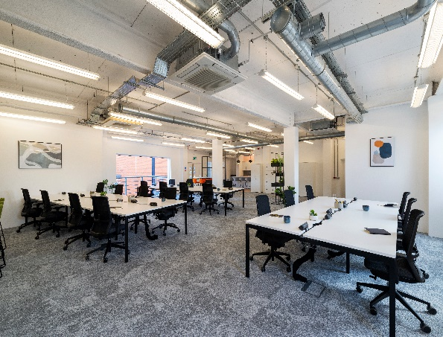
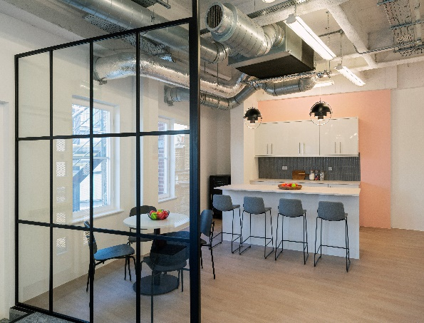
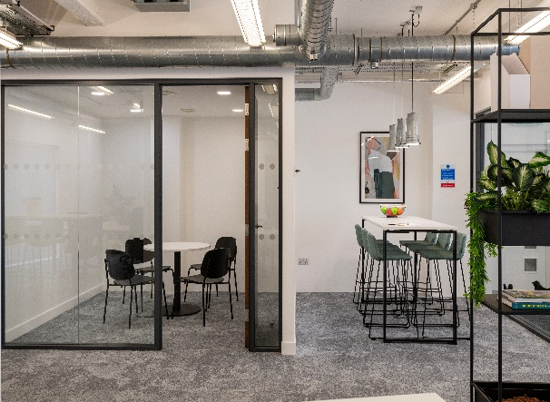


Slide 3
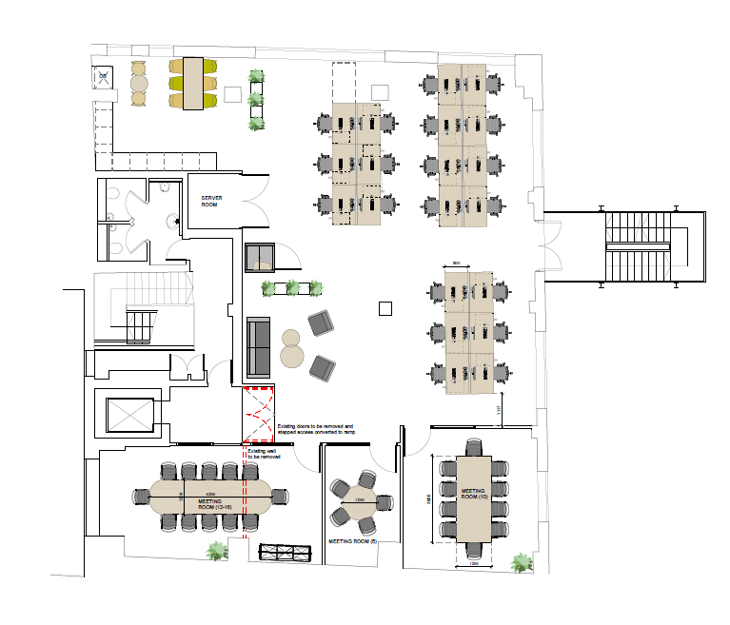
30-31 COWCROSS STREET, LONDON, EC1M 6DQ
Cowcross Street offers good quality, open plan office accommodation set in a gated courtyard campus. Located less than 100m from Farringdon Station, which benefits from the Elizabeth Line and Thameslink.
Farringdon offers unrivalled local amenities with numerous award-winning restaurants, trendy bars and retailers, and is home to some of London’s most recognized gourmet food markets. The excellent mixture of amenity and commercial offerings has led to Farringdon becoming one of the most sought-after sub-markets in which to live, work and socialize.
FLOOR PLAN – 3rd (Rear)
SCHEDULE OF AREAS
Floor | Area sq ft | Area sq m | Status
Third (Rear) | 2,376 | 220 | Furnished
SPECIFICATION
Rent - £65 per sq ft pax
Service Charge - £11.29 per sq ft
Rates - £21.19 per sq ft
A new lease is available from the landlord for a term by arrangement.
Fully Furnished & Fitted
20 x 1200mm desks
12 person Board room
10 person Meeting room
5 person Meeting room
Informal meeting / breakout area
Refurbished Building Reception
Refurbished WC’s
Cycle Storage
Shower & Locker Facilities

Slide 4
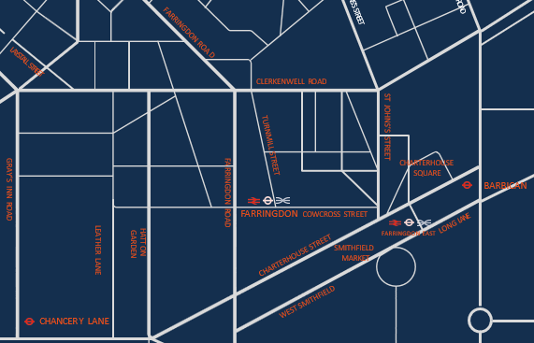

FOR MORE INFORMATION
STRICTLY THROUGH THE LETTING AGENT:
JAMES PROCTOR
j.proctor@kinneygreen.com
+44 (0)7779 789 957
CHARLES FOGG
c.fogg@kinneygreen.com
+44 (0)7841 782 124
Misrepresentation Act: 1. Kinney Green LLP on its own behalf and on behalf of the vendor/lessor of this property whose agent Kinney Green LLP is, gives notice that: (a) these particulars do not constitute in whole or in part an offer or contract for sale or lease; (b) none of the statements contained in these particulars as to the property are to be relied on as statements or representations of fact; and (c) the vendor/lessor does not make or give, and neither Kinney Green LLP nor any of its members or any person in its employment has any authority to make or give, any representation or warranty whatsoever in relation to the property. The only representations, warranties, undertakings and contractual obligations to be given or undertaken by the vendor/lessor are those contained and expressly referred to in the written contract for sale or agreement for lease between the vendor/lessor and a purchaser or tenant. 2. Prospective purchasers or tenants are strongly advised to: (a) satisfy themselves as to the correctness of each statement contained in these particulars; (b) inspect the property and the neighbouring area; (c) ensure that any items expressed to be included are available and in working order; (d) arrange a full structural (and where appropriate environmental) survey of the property; and (e) carry out all necessary searches and enquiries. April 2026.

