Slide 1

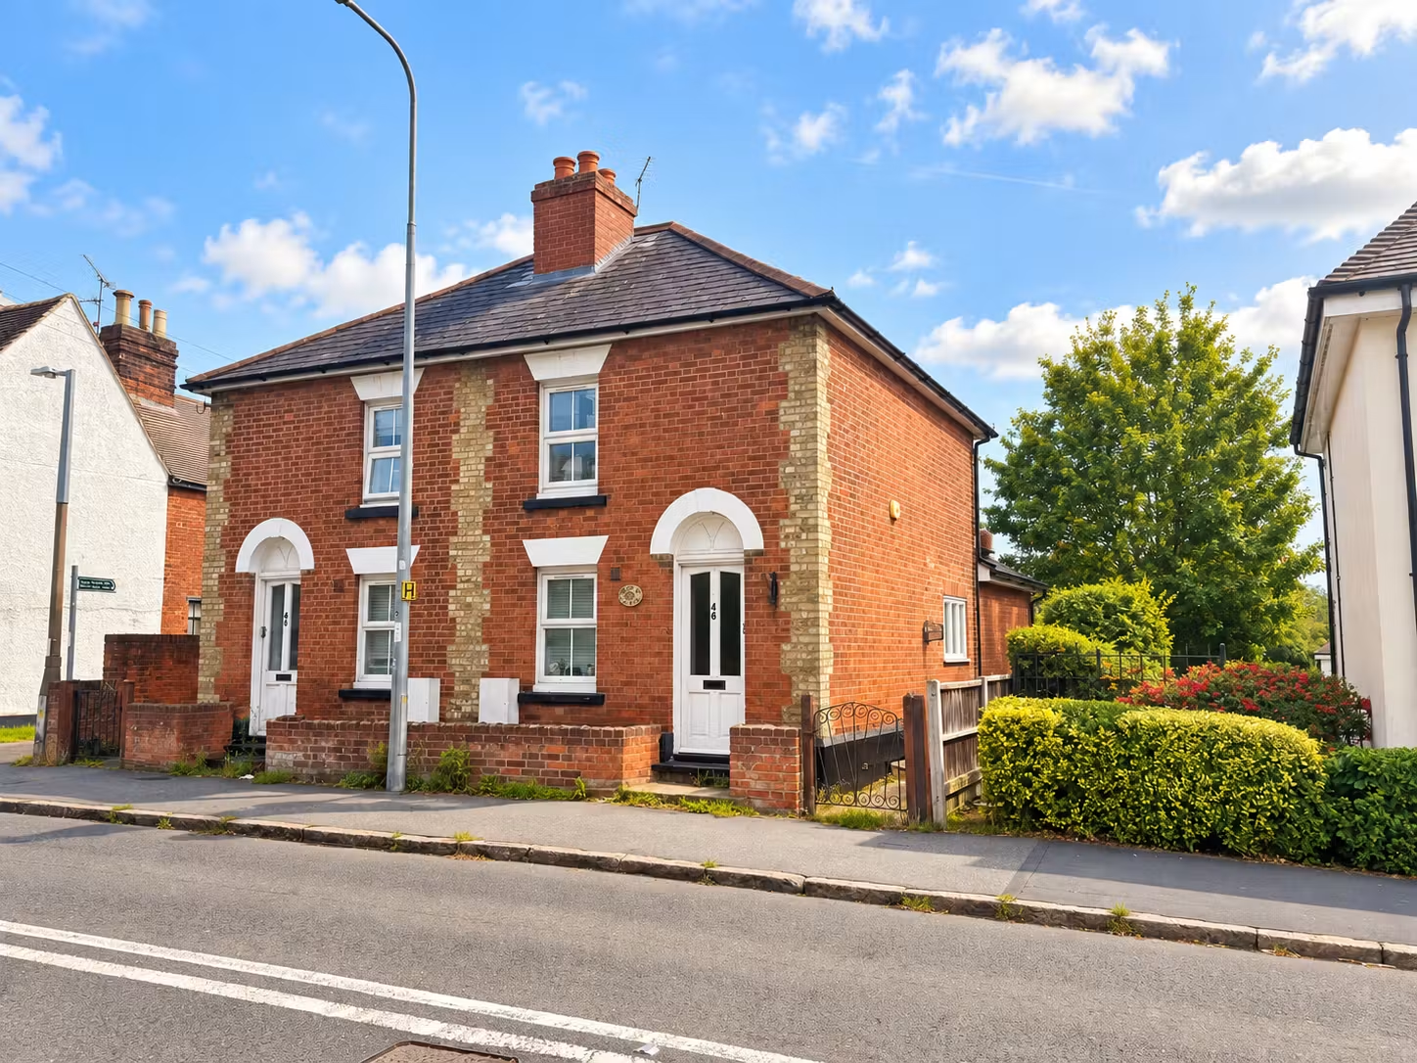
For Sale
46 & 48 Hockley Road, Rayleigh, SS6 8EB
A pair of two-bedroom houses which are currently let out producing a total of £31,200 per annum
Pair of Two-Bedroom House
Spacious living rooms
Fitted kitchens with integrated appliances
Ground floor bathrooms
Ensuites
Double glazing and central heating
Producing £31,200 per annum
Offers in Excess of £600,000
01702 343060 www.ayerscruiks.co.uk

Slide 2
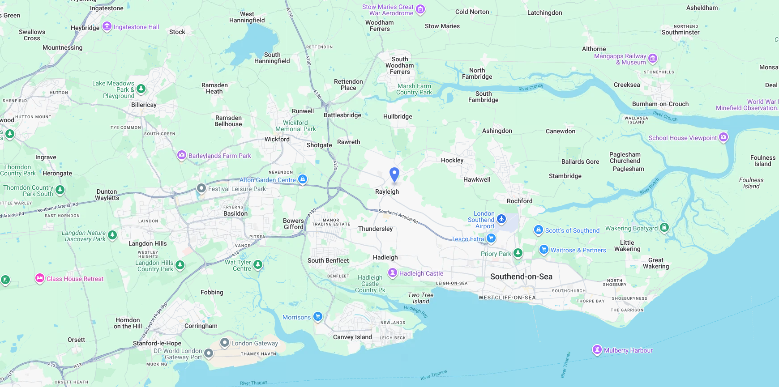
Description
46 Hockley Road, Rayleigh, SS6 8EB
A well-presented two-bedroom property offering well-proportioned accommodation over two floors. The ground floor comprises a lounge, spacious kitchen/diner with French doors opening onto the rear garden, and a family bathroom with separate shower. The first floor provides two bedrooms, with Bedroom One benefiting from an additional WC.
The property is currently let at £1,200 pcm (£14,400 per annum), making it an attractive opportunity for buy-to-let investors.
There is also off-street parking available with the property to the rear.
Summary
Price: Freehold offers in Excess of £600,000
VAT: To be confirmed
EPC: C
Legal fees: Each party to bear their own costs.
Rental Income: The two properties are producing a total of £31,200 per annum
Accommodation – 46 Hockley Road
Ground floor:
Hallway (1m x 2.2m) - Wooden Front Door, Carpeted
Bathroom (2.6m x 2.2m) - Equipped with a WC, wash hand basin, bath, shower cubicle and UPVC double-glazed window
Lounge (3.7m x 3.7m) - UPVC double glazed window, carpeted, smooth plastered ceiling, radiators, storage cupboard
Kitchen/Diner (3.7m x 3.7m) - Wood-effect flooring, equipped with oven, gas hob, stainless steel sink, integrated dishwasher, Velux window and UPVC French glazed doors to the garden
First Floor
Landing, carpeted
Bedroom 1 (2.7 x 3.7m) - Carpeted, smooth plastered ceiling, UPVC double-glazed window to front aspect, 1x radiator, door to W.C with Vinyl flooring equipped with WC, wash hand basin,
Bedroom 2 (3.7m x 2.2m) - Carpeted, smooth plastered ceiling, UPVC double-glazed window to rear aspect, 1x radiator, loft hatch
Contact & Viewings
Cameron Cruiks
01702 608045
cameron@ayerscruiks.co.uk
Bradley Hair
01702 608057
Bradley@ayerscruiks.co.uk
Holly Garrad
01702 608044
holly@ayerscruiks.co.uk
Darrell Clarke
01702 608039
darrell@ayerscruiks.co.uk
Neil Burroughs
01702 608035
neil@ayerscruiks.co.uk
86-88 Baxter Avenue
Southend-on-Sea,
Essex,
SS2 6HZ
Burgundy Court,
64/66 Springfield Road,
Chelmsford,
Essex
CM2 6JY
01702 343060 www.ayerscruiks.co.uk
Misrepresentation Act 1967 These particulars do not constitute, any part of an offer or a contract. All statements contained within these particulars as to this property are made without responsibility on the part of Highlands Properties Ltd. T/A Ayers & Cruiks, of the vendors or lessors. None of the statements contained within these particulars are to be relied upon as statements or representations of fact. Intending purchasers or lessees must satisfy themselves by inspection otherwise, as to the correctness of each of the statements contained in these particulars. The vendors or lessors do not make or give Highlands Properties T/A Ayers & Cruiks nor any person in their employment, any authority to make any representations, whatever in relation to this property. All prices, premiums or rents stated are deemed to be exclusive of VAT, unless stated otherwise Jan 2026.

Slide 3
First Floor Landing – 0.94m x 0.99m
Providing access to both first-floor bedrooms.
Bedroom One – 3.75m x 2.19m
Double-glazed UPVC window overlooking the rear garden, carpeted flooring and wall-mounted radiator.
Bedroom Two – 3.75m narrowing to 2.68m x 2.77m narrowing to 1.77m
Double-glazed UPVC window to the front, carpeted flooring and wall-mounted double radiator. Further benefiting from an en-suite WC.
En-Suite WC – 1.01m x 1.22m
Fitted with a low-level WC and vanity wash basin with mixer tap.
Outside
The property benefits from a large rear garden, providing generous external space.
46 Hockley Road, Rayleigh, SS6 8EB
Summary
Price: Freehold offers in Excess of £600,000
VAT: To be confirmed
EPC: C
Legal fees: Each party to bear their own costs.
Rental Income: The two properties are producing a total of £31,200 per annum
Accommodation – 48 Hockley Road
Entrance Hallway – 1.71m x 2.24m
A bright entrance hallway with laminate flooring, wall-mounted radiator and carpeted staircase leading to the first floor.
Ground Floor Bathroom/Shower Room – 1.90m x 2.24m
Double-glazed UPVC window to the front. Fitted with a panelled bath, separate shower cubicle with overhead shower, low-level WC and pedestal wash basin with mixer tap. Laminate flooring and wall-mounted radiator.
Living Room – 3.75m x 3.75m
Double-glazed UPVC window to the side, laminate flooring and wall-mounted radiator. Further benefiting from useful understairs storage.
Kitchen – 3.67m x 3.76m
Fitted with a range of base and wall-mounted units incorporating a four-ring gas hob, fitted electric oven and overhead extractor. Integrated appliances include an undercounter fridge/freezer and dishwasher. Double-glazed UPVC window overlooking the rear garden and wall-mounted double radiator.
Contact & Viewings
Cameron Cruiks
01702 608045
cameron@ayerscruiks.co.uk
Bradley Hair
01702 608057
Bradley@ayerscruiks.co.uk
Holly Garrad
01702 608044
holly@ayerscruiks.co.uk
Darrell Clarke
01702 608039
darrell@ayerscruiks.co.uk
Neil Burroughs
01702 608035
neil@ayerscruiks.co.uk
Description
A well-presented two-bedroom property, currently let and producing £1,400 pcm (£16,800 per annum). The accommodation comprises a living room, fitted kitchen, ground-floor bathroom with separate shower, and two first-floor bedrooms, one benefiting from an en-suite WC.
Externally, the property benefits from a generous rear garden as well as off street parking.
46 Hockley Road is also available for sale, both properties can be purchased together and are guided at £600,000.
86-88 Baxter Avenue
Southend-on-Sea,
Essex,
SS2 6HZ
Burgundy Court,
64/66 Springfield Road,
Chelmsford,
Essex
CM2 6JY
01702 343060 www.ayerscruiks.co.uk
Misrepresentation Act 1967 These particulars do not constitute, any part of an offer or a contract. All statements contained within these particulars as to this property are made without responsibility on the part of Highlands Properties Ltd. T/A Ayers & Cruiks, of the vendors or lessors. None of the statements contained within these particulars are to be relied upon as statements or representations of fact. Intending purchasers or lessees must satisfy themselves by inspection otherwise, as to the correctness of each of the statements contained in these particulars. The vendors or lessors do not make or give Highlands Properties T/A Ayers & Cruiks nor any person in their employment, any authority to make any representations, whatever in relation to this property. All prices, premiums or rents stated are deemed to be exclusive of VAT, unless stated otherwise Jan 2026.

