Slide 1


50
BROWNLOW HOUSE
51
HIGH HOLBORN
LONDON WC1
1,434 – 1,815 SQ FT – 23 to 27 DESK FITTED SUITE IN PRIME HOLBORN

Slide 2
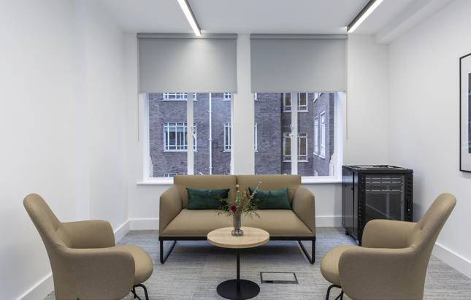
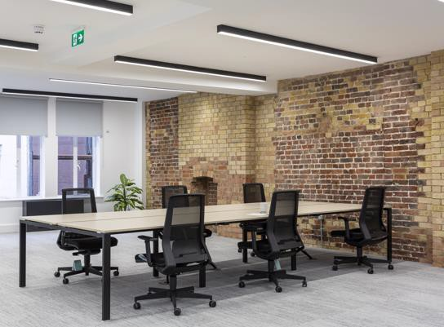
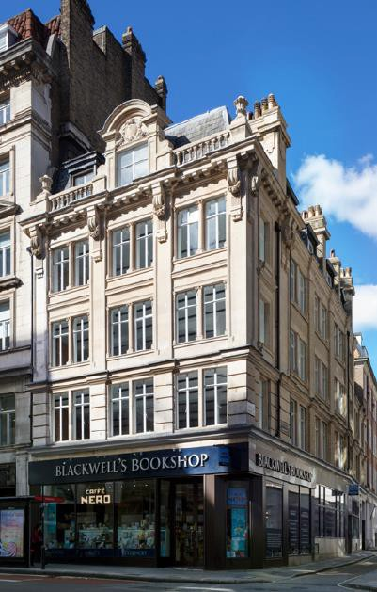
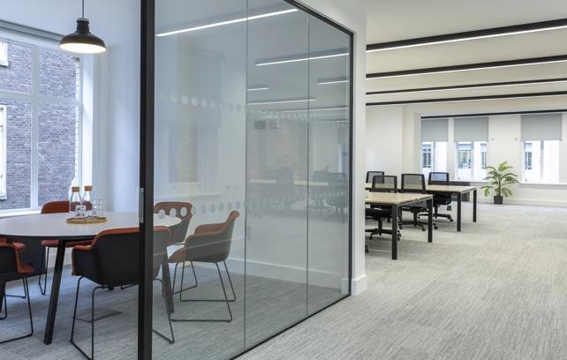
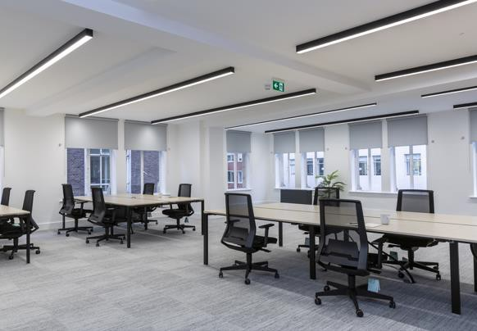
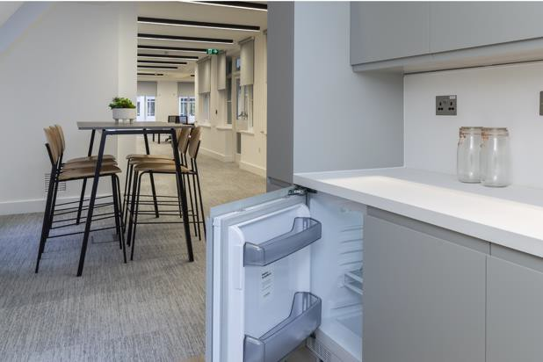

Slide 3




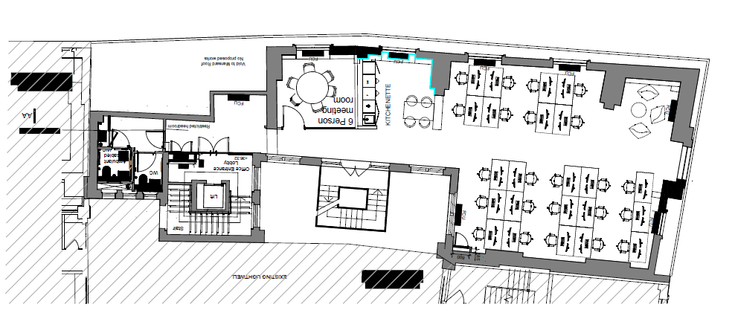
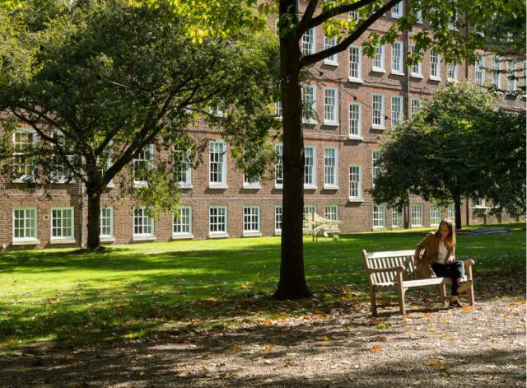
BROWNLOW HOUSE, 50-51 HIGH HOLBORN, LONDON, WC1V 6ER
The building is positioned in a prominent corner position overlooking the junction of High Holborn and Brownlow Street.
The building has undergone a comprehensive refurbishment. Designed by architects, Buckley Gray Yeoman, it offers stylish, high-quality, contemporary office space.
The immediate area has benefitted from a notable increase in the number of hotels, restaurants, bars and cafes. There are excellent transport links close by with Holborn (Central and Piccadilly lines), Chancery Lane (Central line) and Farringdon (Crossrail) being within a few minutes distance.
Schedule of Areas
Floor | Area sq ft | Area sq m | Desks
Fourth | 1,434 | 133 | 23
Third | 1,755 | 163 | TBD
First | 1,815 | 168 | 27
Floor Plan – Fourth Floor
Specification
⁄ Comprehensively refurbished
⁄ Fully-furnished & fitted
⁄ 1400mm desks
⁄ New WC’s
⁄ New air-conditioning
⁄ Remodelled entrance
⁄ Excellent natural light
⁄ Cycle storage facilities
⁄ Shower facilities
⁄ Exposed brick
⁄ Strip LED lighting
P L A N NOT TO SCAL E , F O R INDICATIVE P U R P O S E S
ONLY.

Slide 4
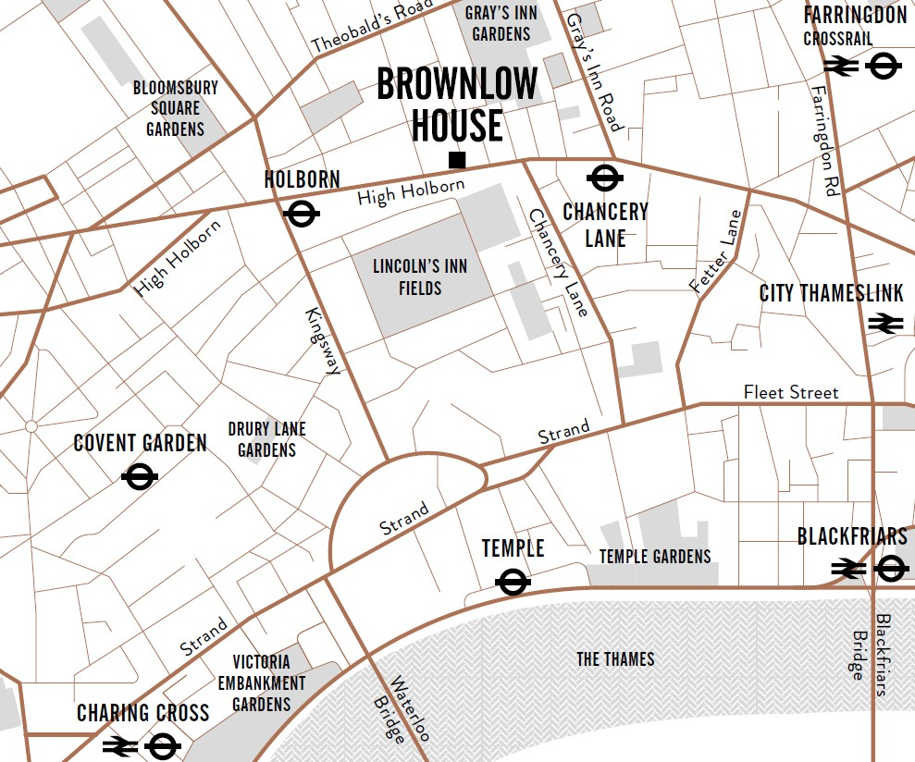

Outgoings:
Rent - £59.50 per sq ft pax
Rates - £24.46 per sq ft
Service Charge - £16.29 per sq ft
EPC – B-44
New flexible lease available from Landlord.
BROWNLOW HOUSE
50
51
HIGH HOLBORN
LONDON WC1
FOR MORE INFORMATION
STRICTLY THROUGH THE LETTING AGENTS:
FAREBROTHER
CHARLES FOGG | JAMES PROCTOR | JULIAN HIND | HARVEY WIDDOWSON
 |  | +44 (0)7976 839 011 | +44 (0)7732 649 308
+44 (0)7841 782 124 | +44 (0) 7779 789 957 | +44 (0)20 7855 3558 | +44 (0)20 7855 3507
c.fogg@kinneygreen.com | j.proctor@kinneygreen.com | jhind@farebrother.com | jainsworth@farebrother.com
Misrepresentation Act: 1. Kinney Green LLPon its own behalf and on behalf of the vendor/lessor of this property whose agent Kinney Green LLP is, gives notice that: (a) these particulars do not constitute in whole or in part an offer or contract for sale or lease; (b) none of the statements contained in these particulars as to the property are to be relied on as statements or representations of fact; and (c) the vendor/lessor does not make or give, and neither Kinney Green LLP nor any of its members or any person in its employment has any authority to make or give, any representation or warranty whatsoever in relation to the property. The only representations, warranties, undertakings and contractual obligations to be given or undertaken by the vendor/lessor are those contained and expressly referred to in the written contract for sale or agreement for lease between the vendor/lessor and a purchaser or tenant. 2. Prospective purchasers or tenants are strongly advised to: (a) satisfy themselves as to the correctness of each statement contained in these particulars; (b) inspect the property and the neighbouring area; (c) ensure that any items expressed to be included are available and in working order; (d) arrange a full structural (and where appropriate environmental) survey of the property; and (e) carry out all necessary searches and enquiries. April 2026.

