Slide 1

BizSpace Basingstoke
Belvedere House

Slide 2

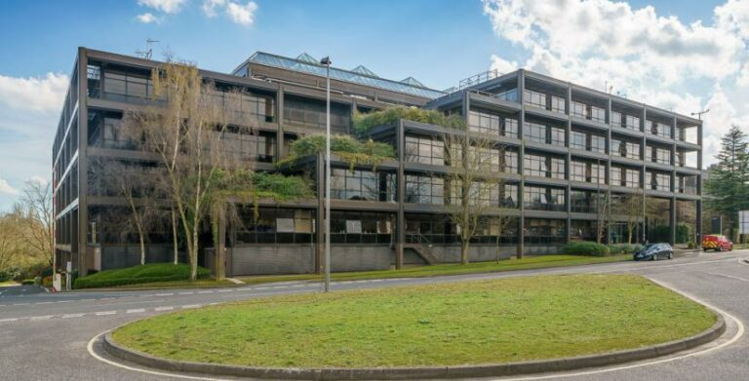
Belvedere House
Bizspace Basingstoke

Slide 3

Included in the price
Free onsite parking
Fully decorated and carpeted offices
Air conditioned
Reception
Onsite Café
Onsite shower
Superfast Internet ethernet cabling to each office with the choice to run your own VoIP system
Wi-Fi
Attractive and comfortable furnished atrium
24 hours / 365-day access
Access by security building passes
Secure CCTV for peace of mind
Fully equipped kitchens,
Toilets on every floor.
Building Insurance & Registered Business Address

Slide 4

Not included in the price
Business rates
Customers are responsible for paying their own business rates, but many are eligible to claim Small Business Rates Relief*
Furnishings
All offices are provided as blank canvases for customers to make their personal mark on**
Electricity
Each office is wired to a smart meter and our recent refurbishment included LED energy saving lights fitted in all new offices
* More about business rates eligibility and Small Business Rates Relief here
** BizSpace works with a number of third-party suppliers who can provide furnishings and services directly to customers at an additional cost

Slide 5
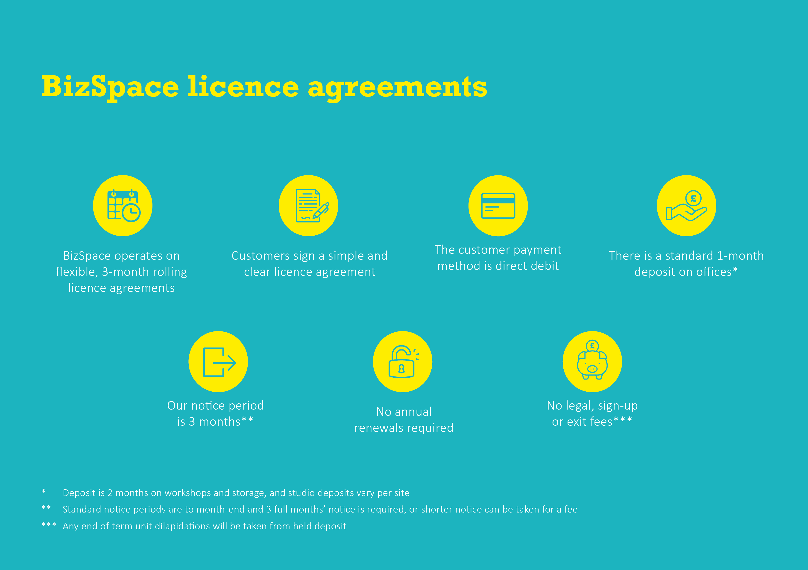

Slide 6
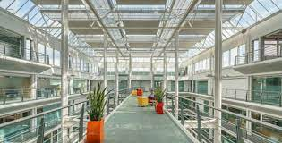
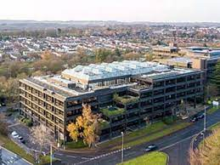
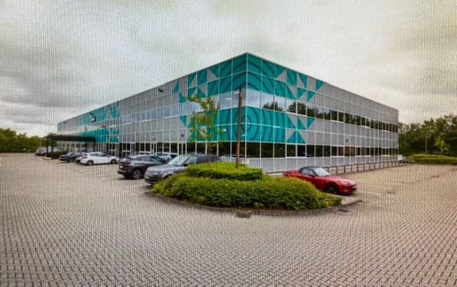
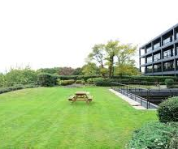

AVAILABILITY
Suite 2.6 4,652.sq.ft 2nd Floor
Suite G6 5,134 sq.ft 2nd Floor Available now
Suite 3.1 3,850.sq.ft 3rd Floor Available 1st March 2024

Slide 7

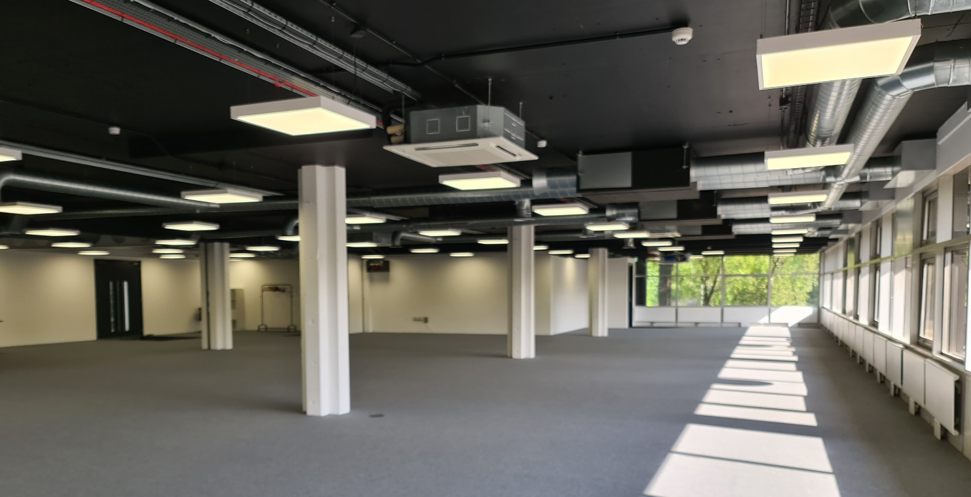
Suite G6
5134.sq.ft located on the Ground floor
Natural light
Disable Access
Wi-Fi internet available throughout the office
Carpeted throughout.
Fully air conditioned
Free Allocated 10 Parking Spaces
Available for 12 Months Contract or long (up to 5 years) Lease

Slide 8
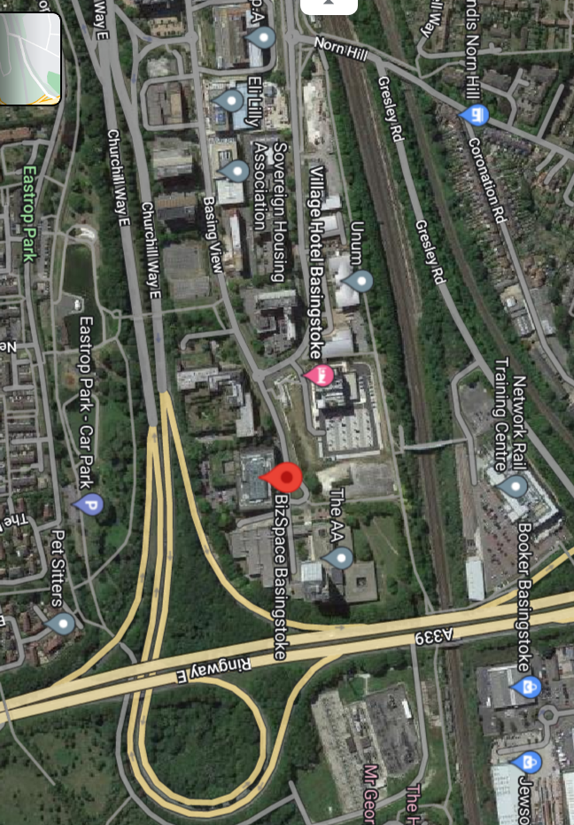
Local information
• Our Centre is situated within an established office campus location with great accessibility by road (M3 J6, only 5 minutes by car) and public transport with Basingstoke train station being 10 minutes walk
• Trains to Basingstoke from London are frequent, the fastest taking just over 40 minutes. Direct trains from Southampton are every hour, taking just over half an hour).
• Village Hotel only across the road
• Within 1 mile of Linford Forum there are a variety of amenities including Co-Operative, local shops, BP, a Novotel Hotel, and the wider Centre: MK is one of the UK's top shopping destinations based in the heart of Milton Keynes.
* More about business rates eligibility and Small Business Rates Relief here
** BizSpace works with a number of third-party suppliers who can provide furnishings and services directly to customers at an additional cost

Slide 9
Business Centre Manager
Melissa Mullen
Telephone
07917764483
01256 856935
Email
Melissa.mullen@bizspace.co.uk
Website
https://www.bizspace.co.uk/spaces/basingstoke
Address
Belvedere House, Basing View, Basingstoke, Hampshire, RG21 4HG

