Slide 1
100
HATTON GARDEN
EC1
AVAILABLE TO LET

Slide 2
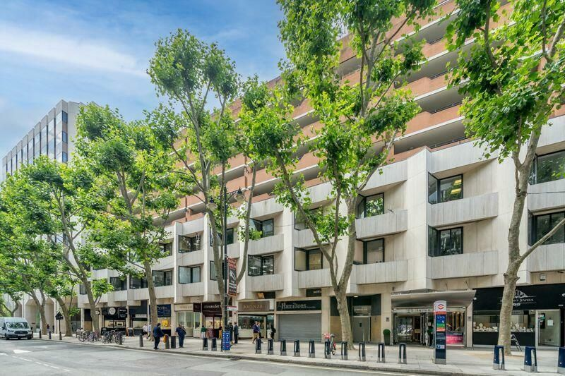

Slide 3
100 HATTON GARDEN EC1N 8NX
100 Hatton Garden is London’s principal jewelry and diamond trade quarter. Tenants include The London Diamond Bourse which is the central institution for diamond trade.
100 Hatton Garden offers excellent transport access, just minutes from Farringdon and Chancery Lane stations, with Elizabeth, Central, Circle and Thameslink services, plus numerous buses and nearby parking options.
Unit | Size sq. ft | Rent | Service Charge | Rates payable | Total per sq ft | Total per annum | Total per month | Availability
Suite 112 | 569 | £52.50 | £13.90 | £25.75 | £92.15 | £52,433 | £4,370 | January
Suite 115/116 | 1,182 | £52.50 | £13.90 | £23.74 | £90.14 | £106,546 | £8,879 | January
Suite 117 | 574 | £52.50 | £13.90 | £25.51 | £91.91 | £52,757 | £4,397 | January
Specification
Amenities
Lease Terms
Commissionaire
Lifts
24-hour extensive security guards
Multi point card reader security
Onsite Property Managers
Secure Parking
Onsite Diamond Bourse
End of Trip Facilities
New leases available directly from the Landlord
All leases are offered on a 3 year term with a rolling 6 months notice break clause

Slide 4
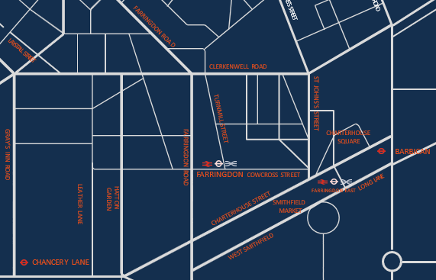

FOR MORE INFORMATION
STRICTLY THROUGH THE LETTING AGENT:
JAMES PROCTOR
j.proctor@kinneygreen.com
+44 (0)7779 789 957
CHARLES FOGG
c.fogg@kinneygreen.com
+44 (0)7841 782 124
Misrepresentation Act: 1. Kinney Green LLP on its own behalf and on behalf of the vendor/lessor of this property whose agent Kinney Green LLP is, gives notice that: (a) these particulars do not constitute in whole or in part an offer or contract for sale or lease; (b) none of the statements contained in these particulars as to the property are to be relied on as statements or representations of fact; and (c) the vendor/lessor does not make or give, and neither Kinney Green LLP nor any of its members or any person in its employment has any authority to make or give, any representation or warranty whatsoever in relation to the property. The only representations, warranties, undertakings and contractual obligations to be given or undertaken by the vendor/lessor are those contained and expressly referred to in the written contract for sale or agreement for lease between the vendor/lessor and a purchaser or tenant. 2. Prospective purchasers or tenants are strongly advised to: (a) satisfy themselves as to the correctness of each statement contained in these particulars; (b) inspect the property and the neighbouring area; (c) ensure that any items expressed to be included are available and in working order; (d) arrange a full structural (and where appropriate environmental) survey of the property; and (e) carry out all necessary searches and enquiries. April 2026.

