Slide 1

KINGSGATE HOUSE
115 HIGH HOLBORN
LONDON WC1
10/14 DESK PRIVATE OFFICES
IN PRIME HOLBORN LOCATION
AVAILABLE TO LET

Slide 2
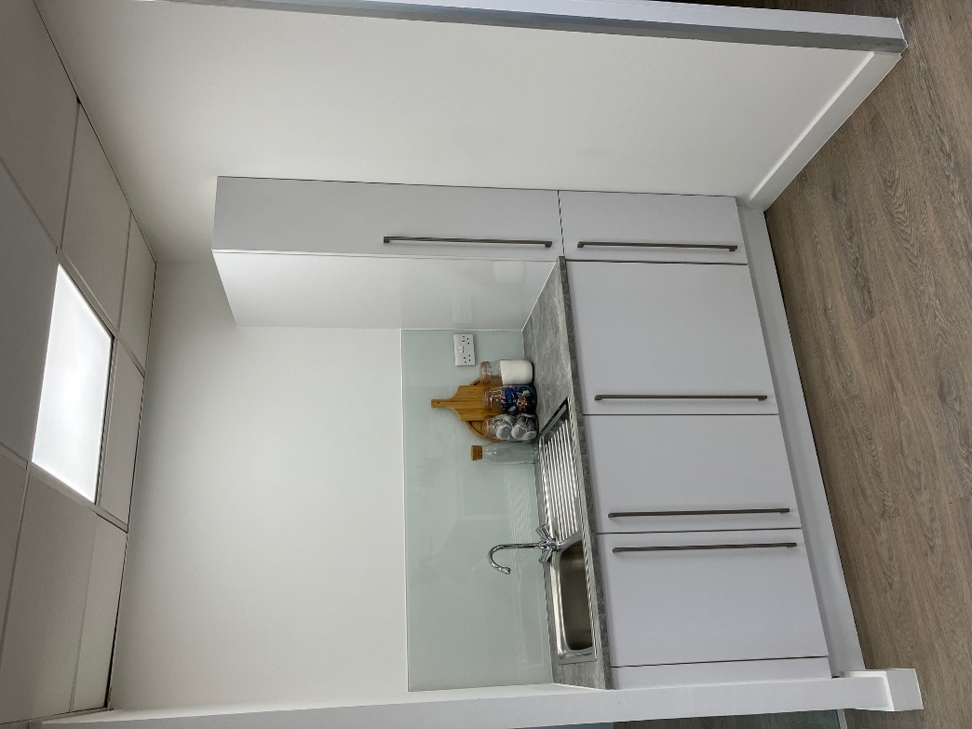
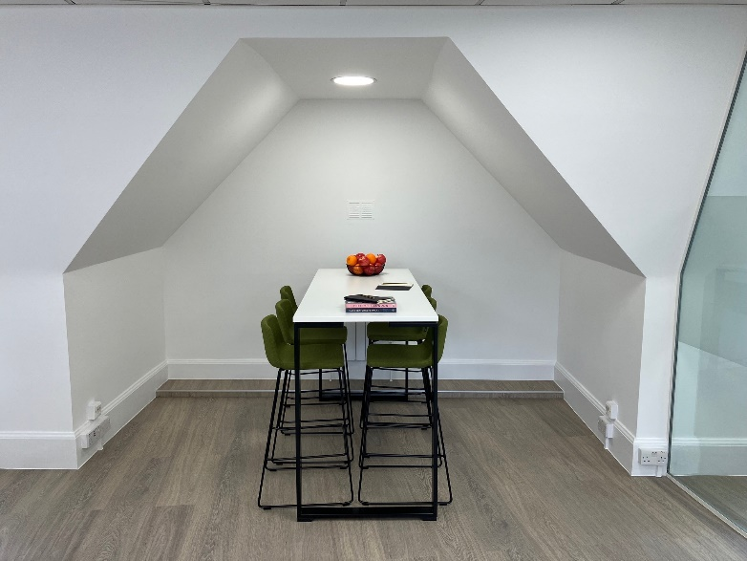
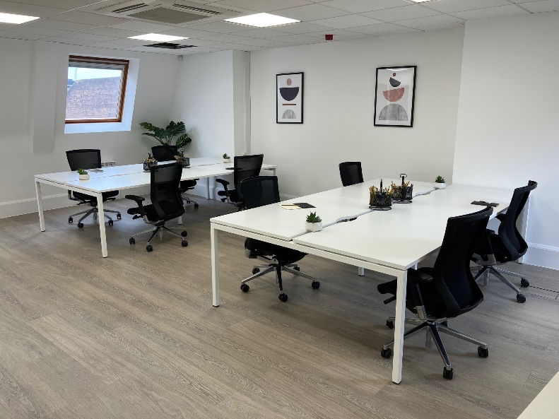
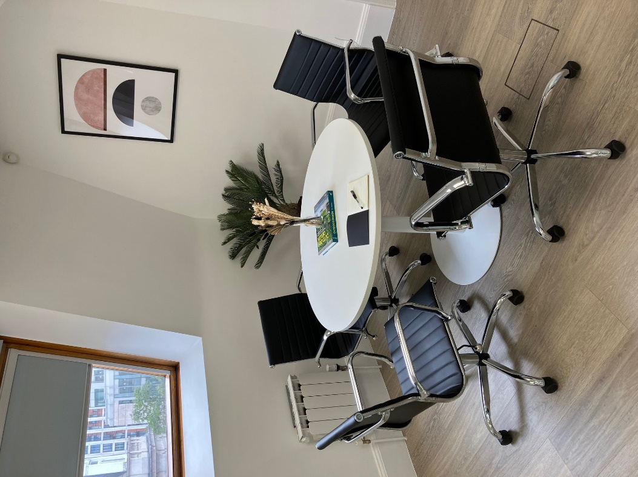

Slide 3
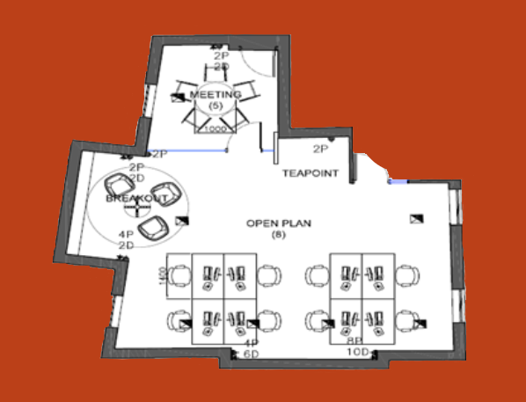
KINGSGATE HOUSE, 115 HIGH HOLBORN,WC1V 6JJ
Kingsgate House offers economic, open plan office accommodation on its own floor opposite Holborn Underground Station.
Holborn offers unrivalled local amenities with numerous restaurants and retailers within a short walk on High Holborn and Kingsway.
FLOOR PLAN – SIXTH FLOOR
SCHEDULE OF AREAS
Floor | Area sq ft | Area sq m | Desks
Sixth Fifth First | 601 904 904 | 56 84 84 | 10 14 14
MANAGED SOLUTION
SPECIFICATION
What is included:
All inclusive price – 6th - £5,250 pcm + VAT
- 1st & 5th - £8,000 pcm + VAT
Internet of 100 Mbps capable of upgrade to 500 Mbps
Cleaning 5 hour per week
Dilapidations / Reinstatement
2 data ports per desk
Handsets on desks
All utilities & local taxes
Fully Furnished & Fitted
Max of 10 desks
6 person Agile Work Stations
1 x 4 Person Meeting Room
Kitchenette

Slide 4
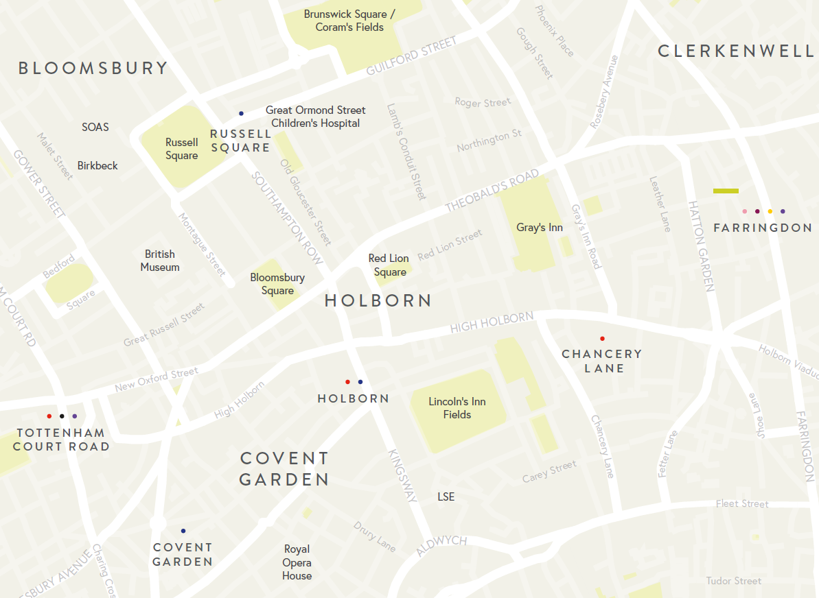


FOR MORE INFORMATION
STRICTLY THROUGH THE LETTING AGENT:
CHARLES FOGG
c.fogg@kinneygreen.com
+44 (0)7841 782 124
JAMES PROCTOR
j.proctor@kinneygreen.com
+44 (0)7779 789 957
Misrepresentation Act: 1. Kinney Green LLP on its own behalf and on behalf of the vendor/lessor of this property whose agent Kinney Green LLP is, gives notice that: (a) these particulars do not constitute in whole or in part an offer or contract for sale or lease; (b) none of the statements contained in these particulars as to the property are to be relied on as statements or representations of fact; and (c) the vendor/lessor does not make or give, and neither Kinney Green LLP nor any of its members or any person in its employment has any authority to make or give, any representation or warranty whatsoever in relation to the property. The only representations, warranties, undertakings and contractual obligations to be given or undertaken by the vendor/lessor are those contained and expressly referred to in the written contract for sale or agreement for lease between the vendor/lessor and a purchaser or tenant. 2. Prospective purchasers or tenants are strongly advised to: (a) satisfy themselves as to the correctness of each statement contained in these particulars; (b) inspect the property and the neighbouring area; (c) ensure that any items expressed to be included are available and in working order; (d) arrange a full structural (and where appropriate environmental) survey of the property; and (e) carry out all necessary searches and enquiries. April 2026.

