Slide 1

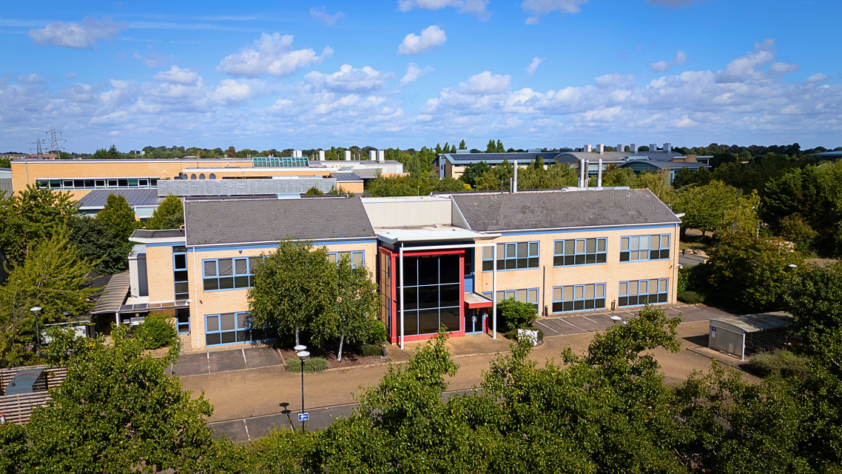
315
CAMBRIDG SCIENCE PARK
CB4 0GQ
Unit 315 is a two storey laboratory building providing fully-fitted lab and open-plan office space, to be taken in its entirety.
The property will suit a range of R&D occupiers looking for a lab-enabled building at superior value.
15,305 sq ft of
lab & open PLAN
office space
www.cambridgesciencepark.co.uk

Slide 2
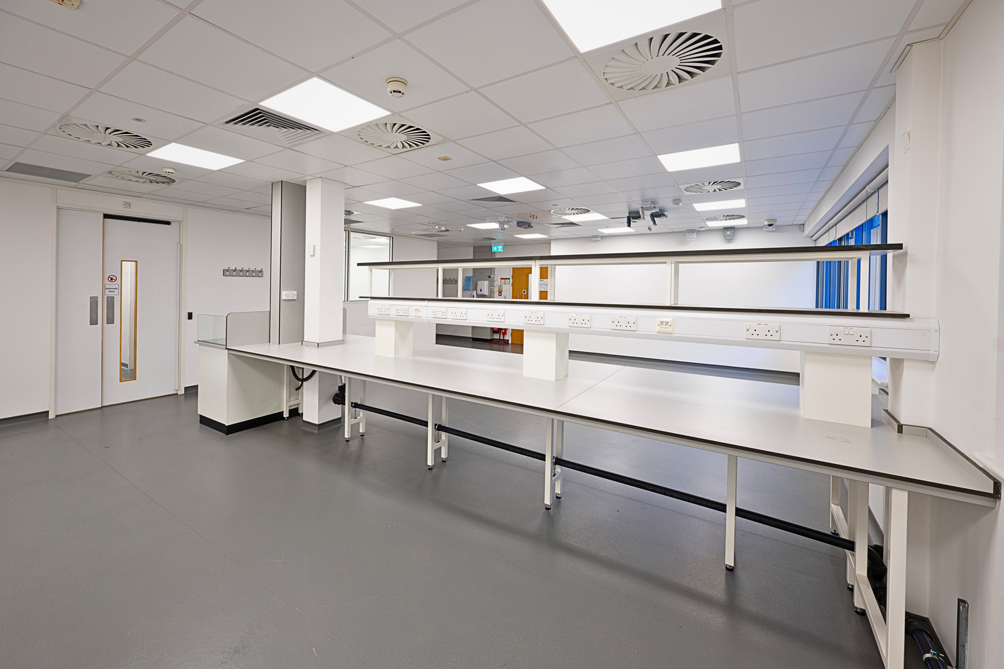
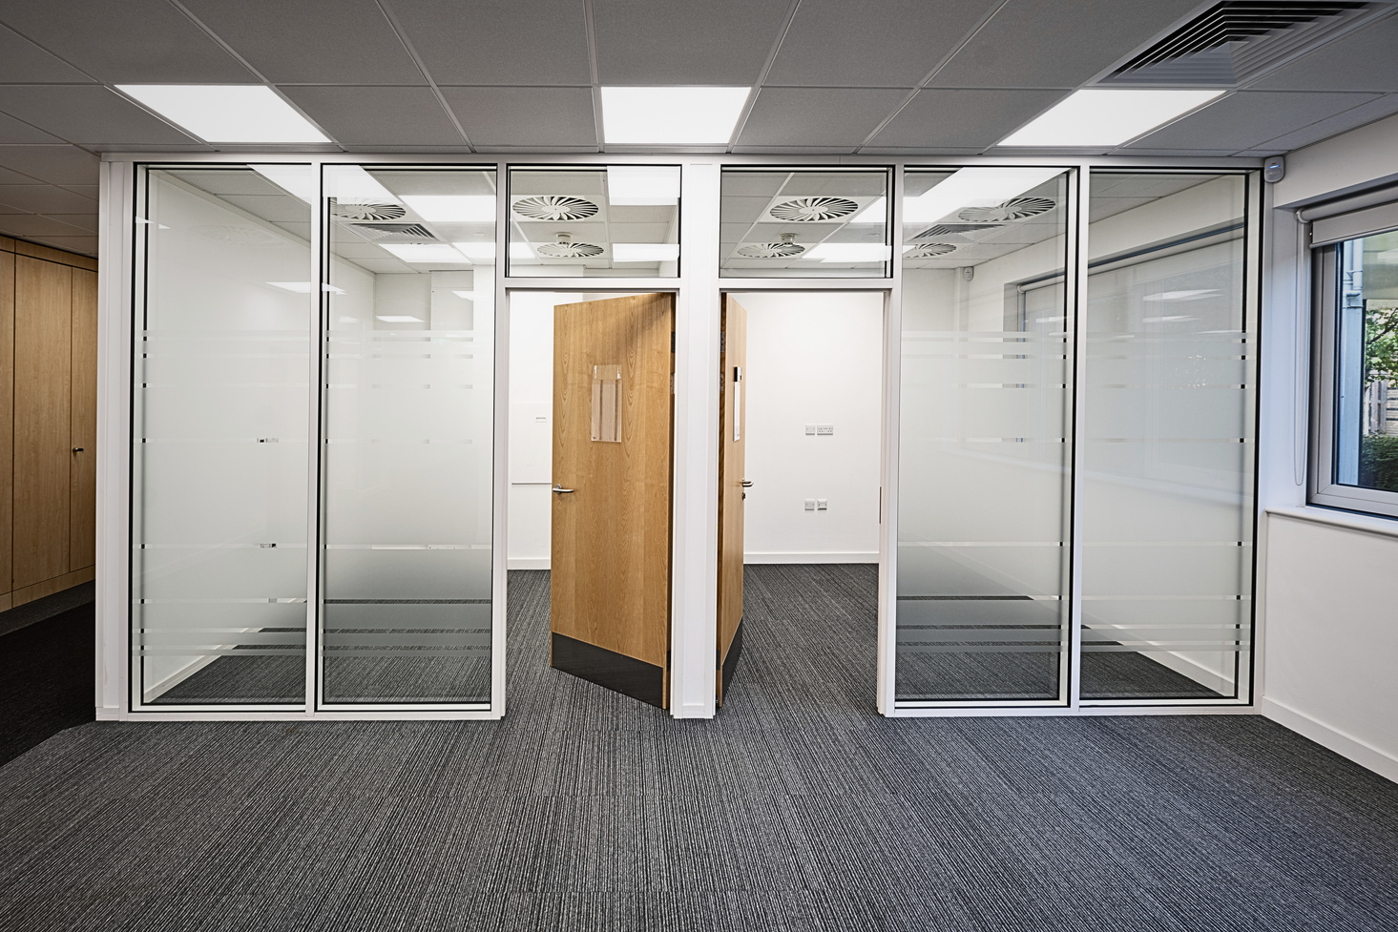
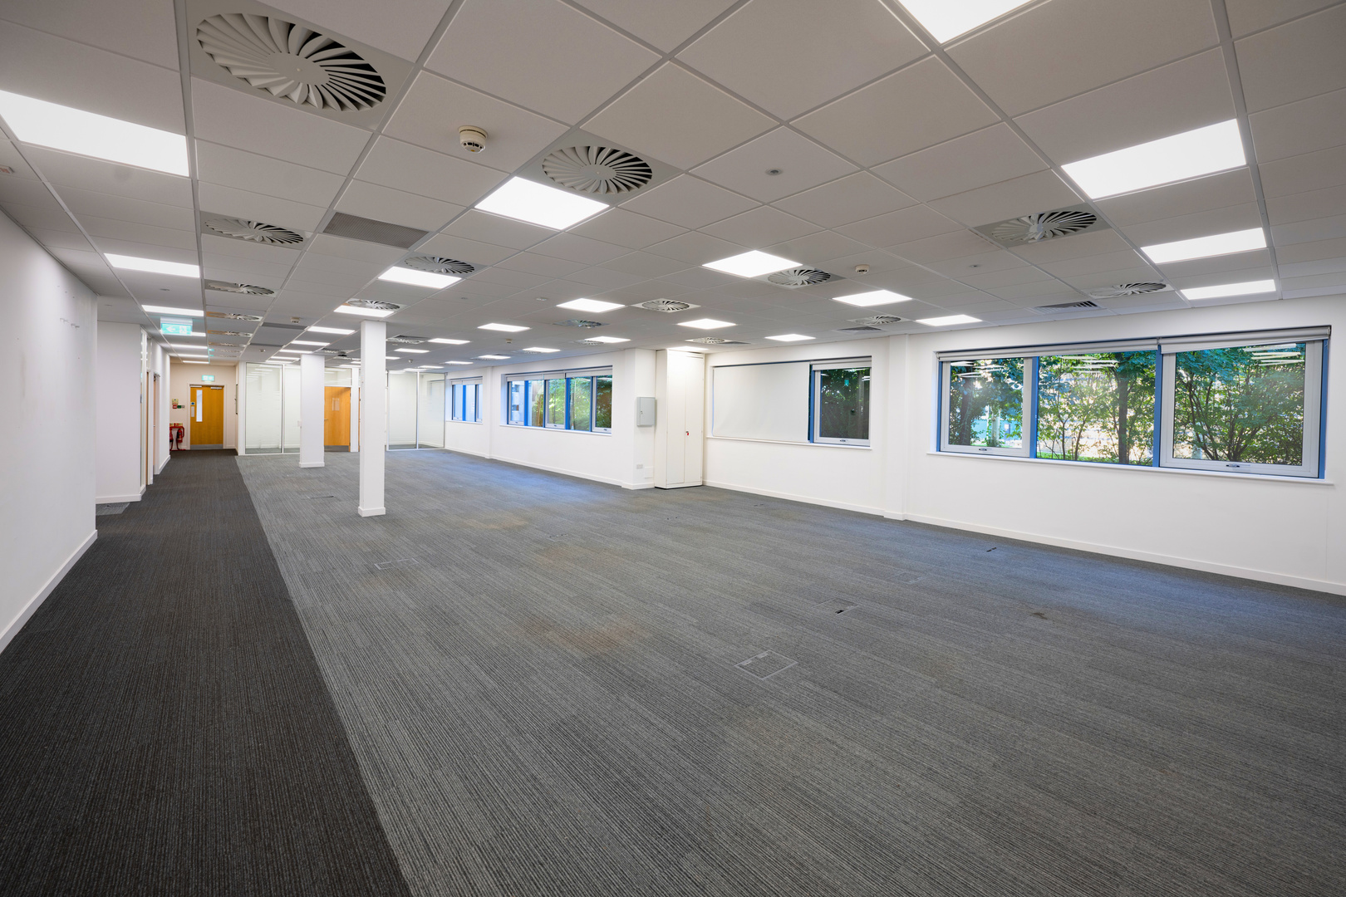

TECHNICAL SPECIFICATION
Open plan laboratory suites
Suspended ceilings
Air heating and cooling
Lift access
Partitioned offices, meeting rooms and boardroom
Kitchen on each floor
Staff room on ground floor
Cycle racks
Reception / Entrance area on each floor
Demised male, female and disabled WC facilities
Outdoor communal space
21 onsite parking spaces
Access to Park amenities including nursery, gym and cafes
available as is or refurbished
Refurbishment would include:
Replacement ceilings
Flooring and lab benching
M&E works
De-gasification of the building
All lighting to be upgraded to LED fittings
Upgraded WCs

Slide 3
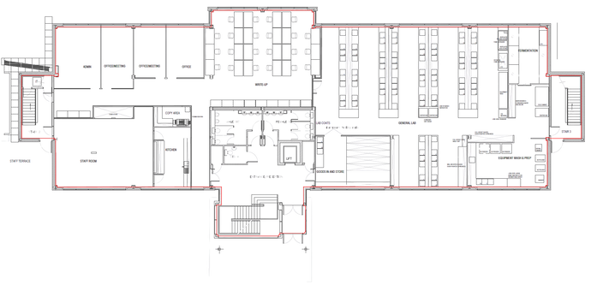
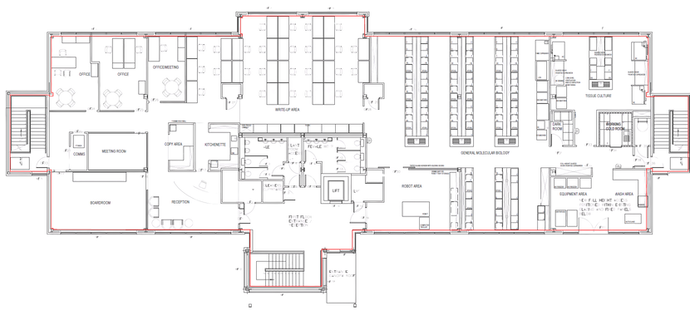
FLOOR PLANS - CURRENT LAYOUT
GROUND floor - 7,706 sq ft*
Current layout**
FIRST floor - 7,599 sq ft*
Current layout**
*Approximate sizes
**Furniture shows an indicative layout and is not included

Slide 4
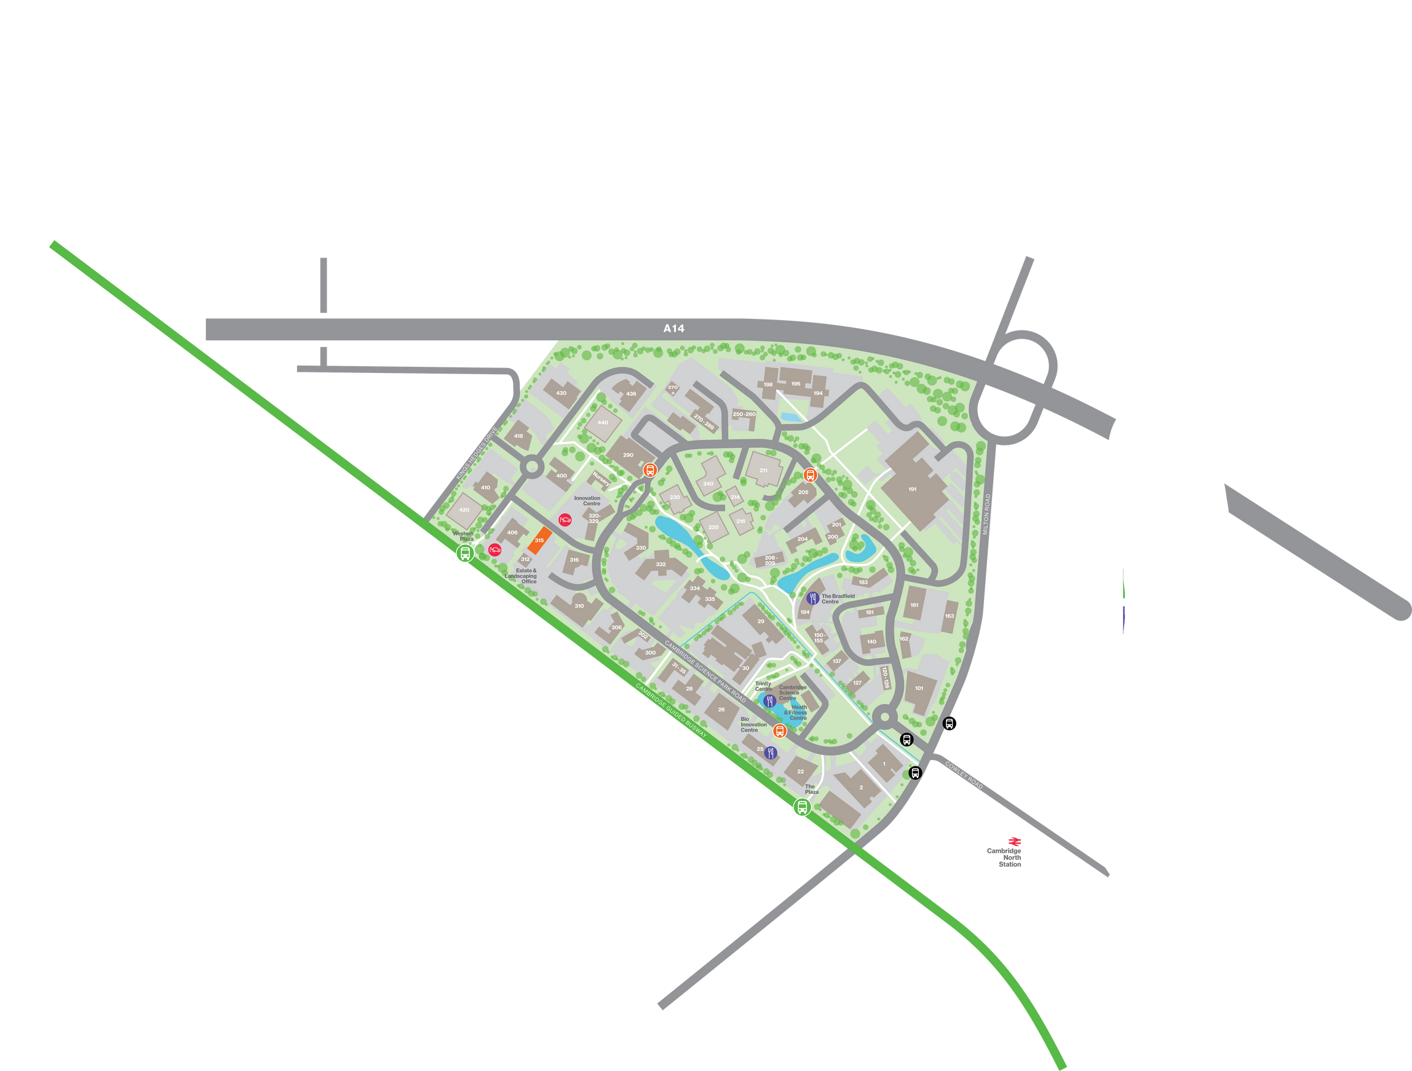
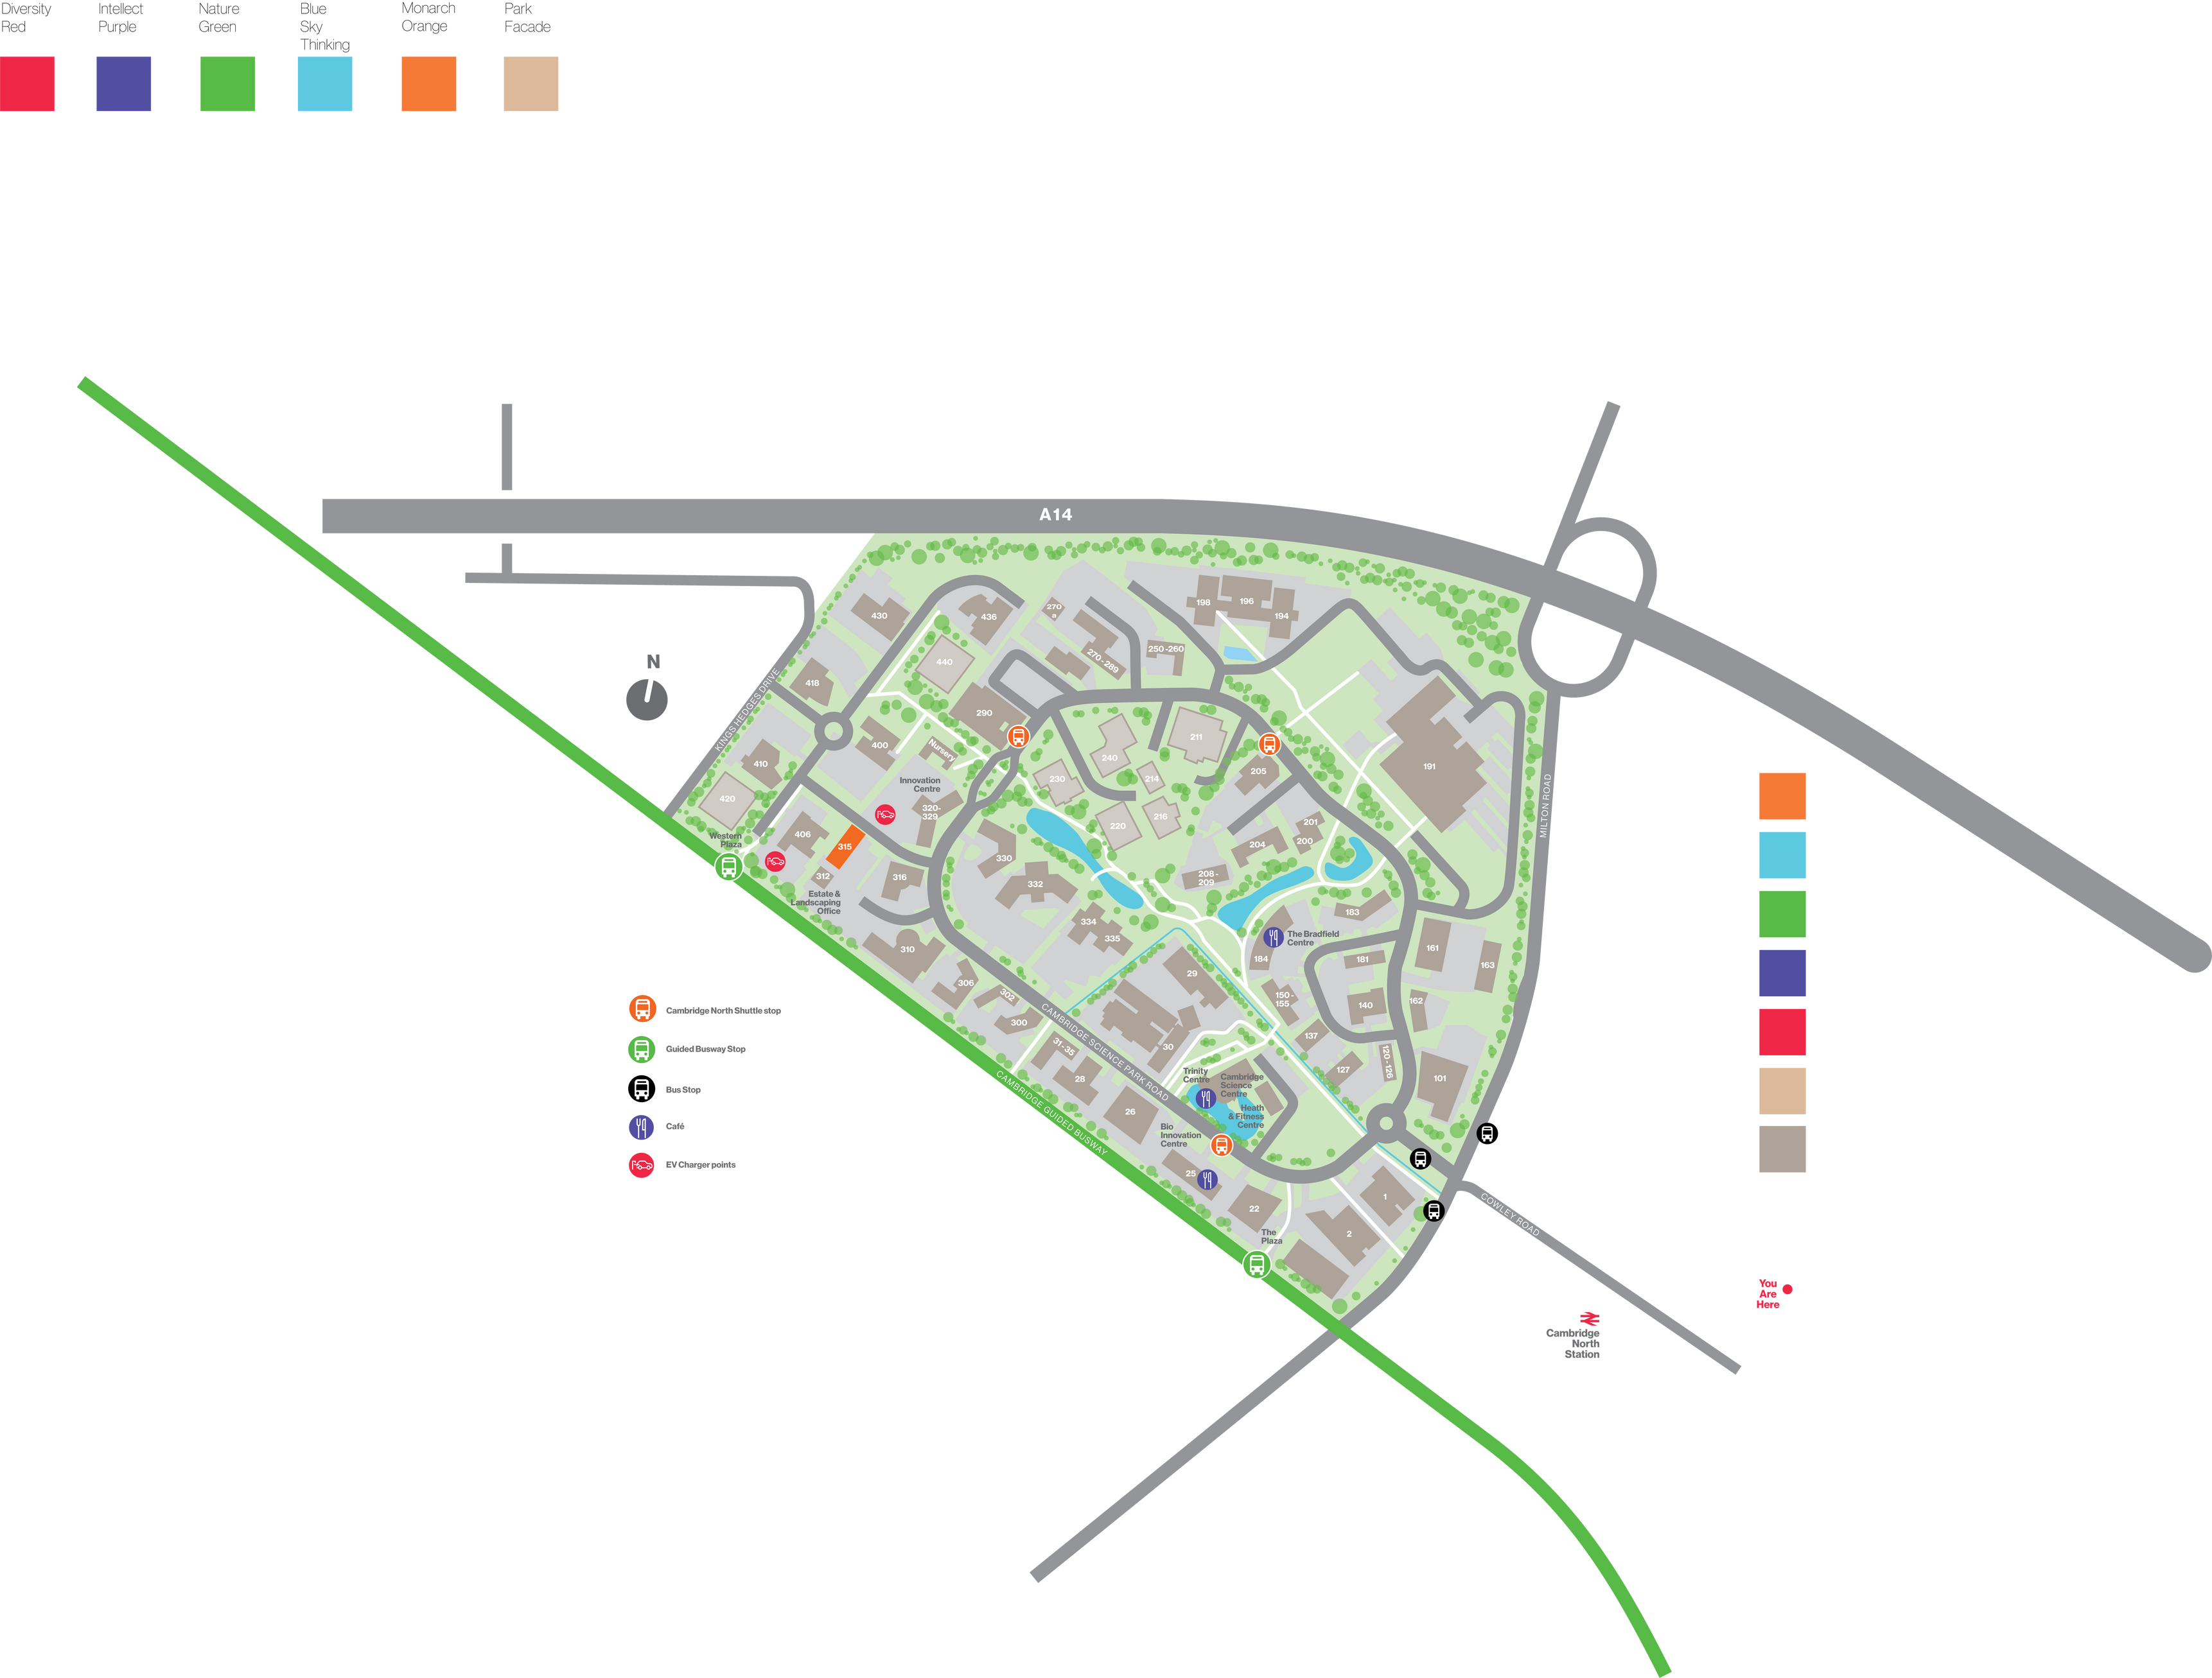
LOCATION &
ACCESSIBILITY
Cambridge Science Park is a dynamic community of talented entrepreneurs at the cutting edge of many scientific disciplines, including big and small, established and start-up organisations.
Unit 315
The Cambridge Science Park is highly accessible with a variety of transport options available on the doorstep to suit all commuting preferences.
Directly accessed from the A14 by road (Junction 28), which also facilitates quick connections to both the M11 and A1, the Cambridgeshire Guided Busway and Cambridge North Railway Station are also within easy cycling and walking distance from the Park.
Cambridge North Shuttle
Guided Busway stop
Bus stop
Cafe
EV charging points
ROAD
CYCLE
RAIL
From Cambridge Science Park:
Central Cambridge: 3 miles
Cambridge International Airport: 4 miles
Stansted International Airport: 34 miles
From Cambridge Science Park:
Cambridge North Station: 6 mins
Cambridge International Airport: 20 mins
Cambridge Station: 21 mins
From Cambridge North:
Cambridge: 4 mins
London King’s Cross: 54 mins
London Liverpool Street: 1hr 17 mins

Slide 5
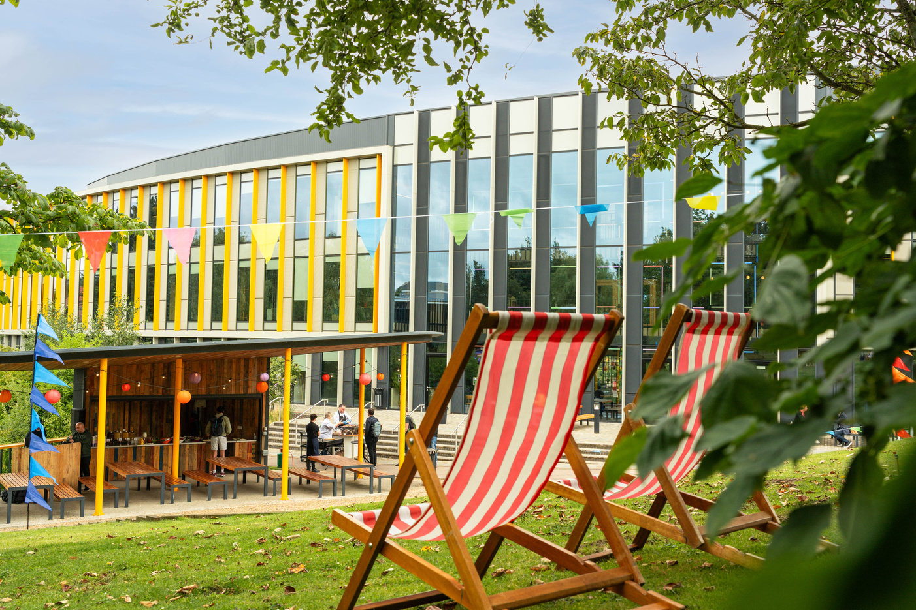

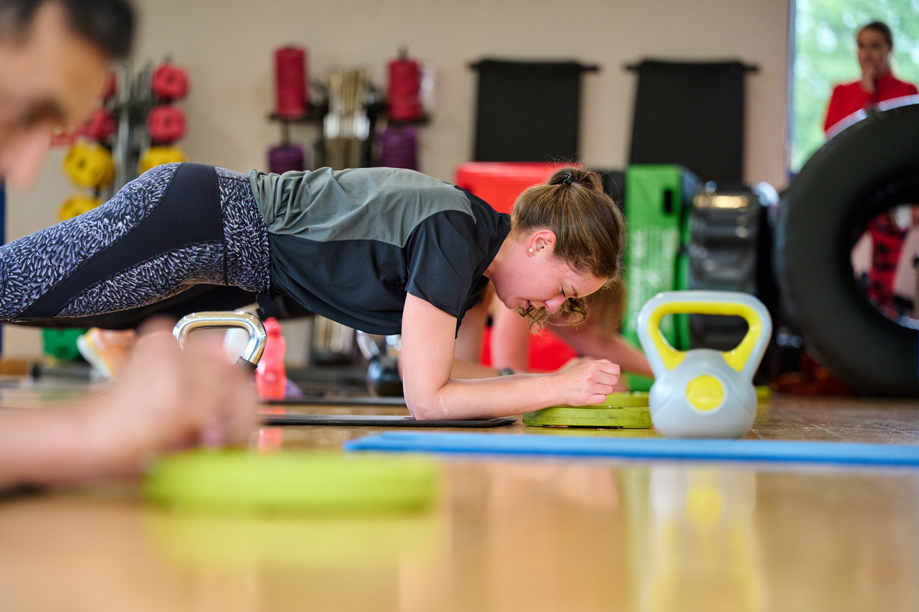
VIBRANT PARK LIFESTYLE
The Cambridge Science Park offers a wide range of amenities for all Park occupiers to enjoy, including access to health and fitness facilities, café spaces and networking and meeting spaces.
PARK AMENITIES
The Lakeside Cafe
The Bradfield Centre
The Trinity Centre
foodPark
Cambridge Science Centre
Revolution Health & Fitness
Park Barbers
Spritely Osteopaths
Bright Horizons Nursery
PhysioBAB
EV Charging points
Enterprise Rent-a-Car
Voi e-scooters
Mobility & Cycle Hub
EVENTS
A fantastic events programme encourages Park occupiers to get together.
Events include wellbeing activities, networking events, wildlife walks, yoga and the extremely popular summer party, movie nights and the Christmas market.

Slide 6


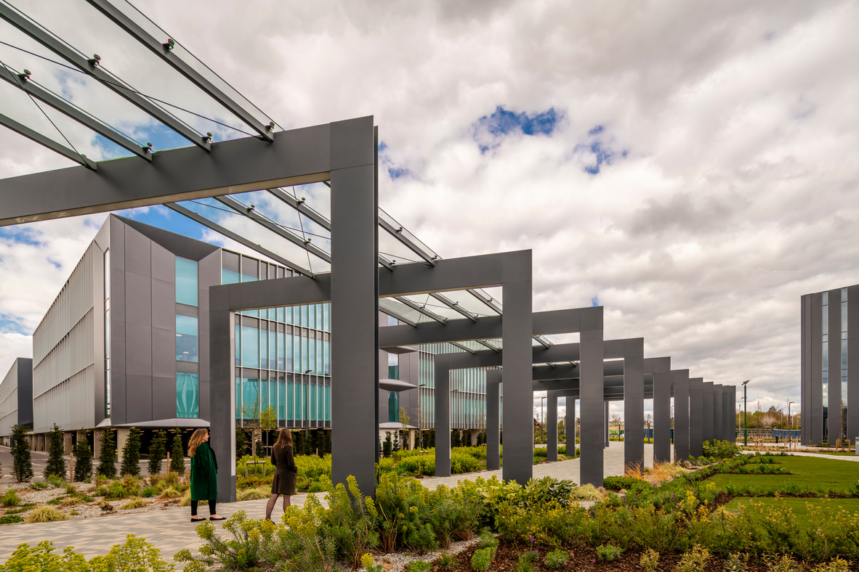


GET IN TOUCH
GEORGE CRAIG
TAMARAH
KEIR
+44 (0)7779 770 902
george.craig@bidwells.co.uk
+44 (0)7442 668 105
tamarah.keir@bidwells.co.uk
Bidwells LLP act for themselves and for the vendors/landlords of this property, whose agents they are, give notice that:
Nothing contained in these particulars or their contents or actions, both verbally or in writing, by Bidwells LLP form any offer or contract, liability or implied obligation to any applicants, viewing parties or prospective purchasers of the property to the fullest extent permitted by law and should not be relied upon as statements or representative of fact. No person in the employment of Bidwells LLP or any joint agents has authority to make or give any representation or warranty whatever in relation to this property. Any areas of measurements or distances are approximate. The text, photographs and plans are for guidance only, may not be to scale and are not necessarily comprehensive. No assumptions should be made that the property has all necessary planning, building regulation or other consents. Bidwells LLP has not carried out a survey, nor tested the services, appliances or facilities. Purchasers must satisfy themselves by inspection or otherwise. All rentals and prices are quoted exclusive of VAT unless otherwise stated. Prospective purchasers and tenants will be asked to produce identification of the intended purchaser/tenant and other documentation in order to support any conditional offers submitted to the vendors. Bidwells LLP accepts no liability of any type arising from your delay or other lack of co-operation. We may hold your name on our database unless you instruct us otherwise.
OS licence no. ES 100017734. © Copyright Bidwells LLP 2017. Bidwells LLP is a limited liability partnership registered in England and Wales (registered number OC 344553).
Registered office is Bidwell House, Trumpington Road, Cambridge CB2 9LD where a list of members is available for inspection. Your statutory rights are not affected by this notice

