Slide 1

HIGH HOLBORN
HOUSE
LONDON
WC1
1,498 – 14,447 SQ FT(139-1,342) SQ M)
OFFICES IN PRIME MIDTOWN LOCATION
AVAILABLE TO LET

Slide 2
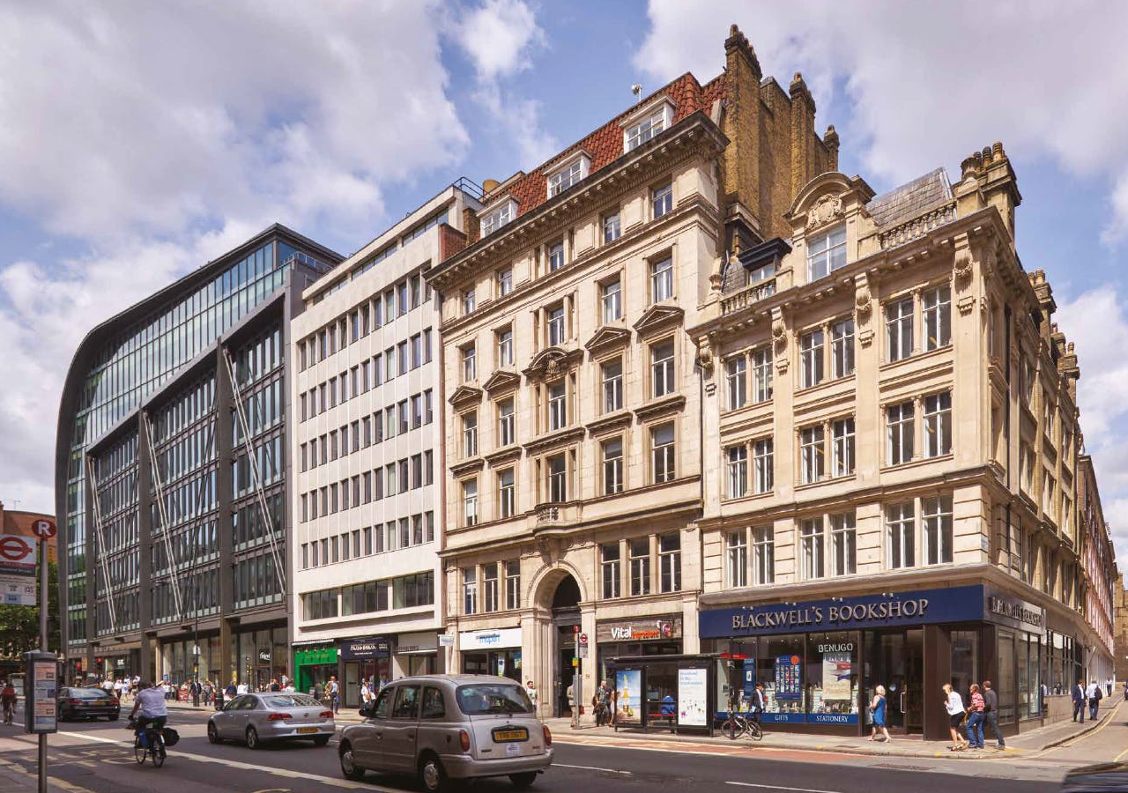

Slide 3
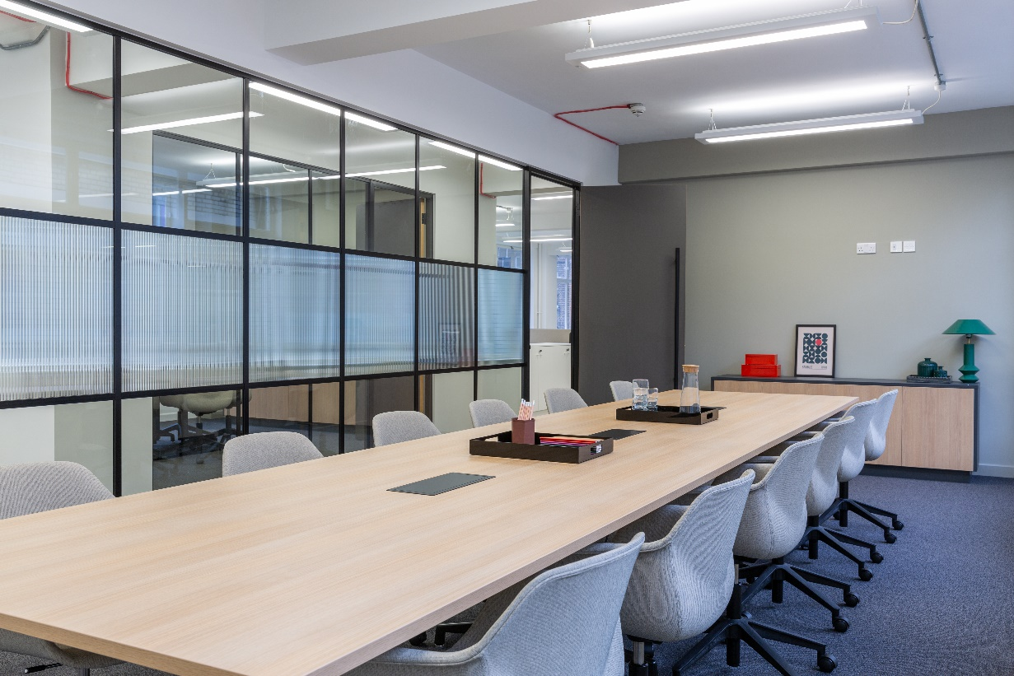
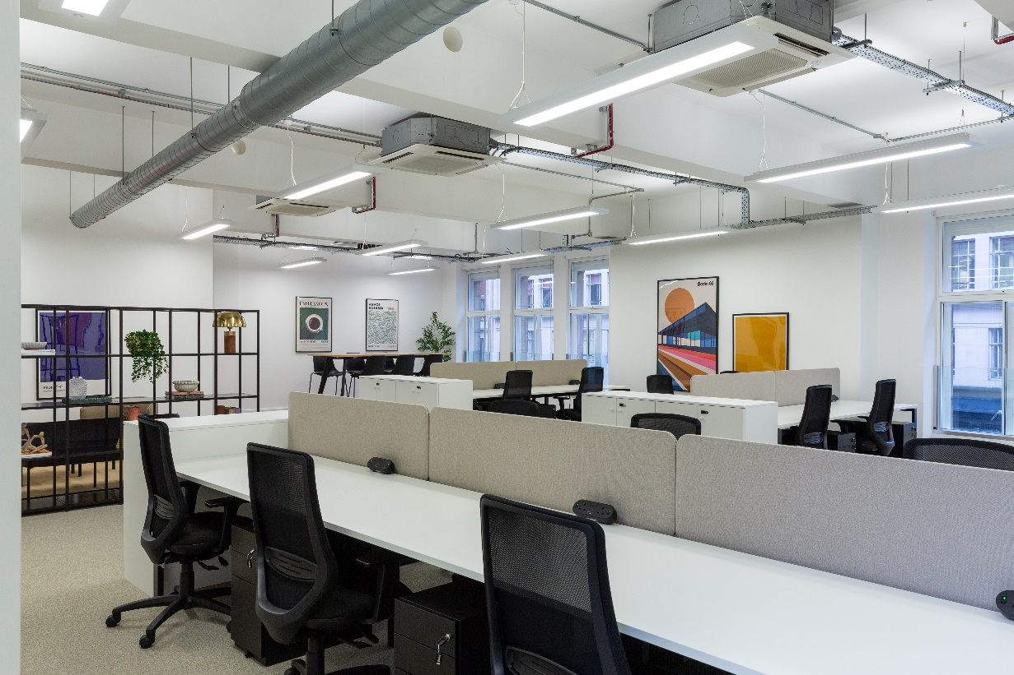
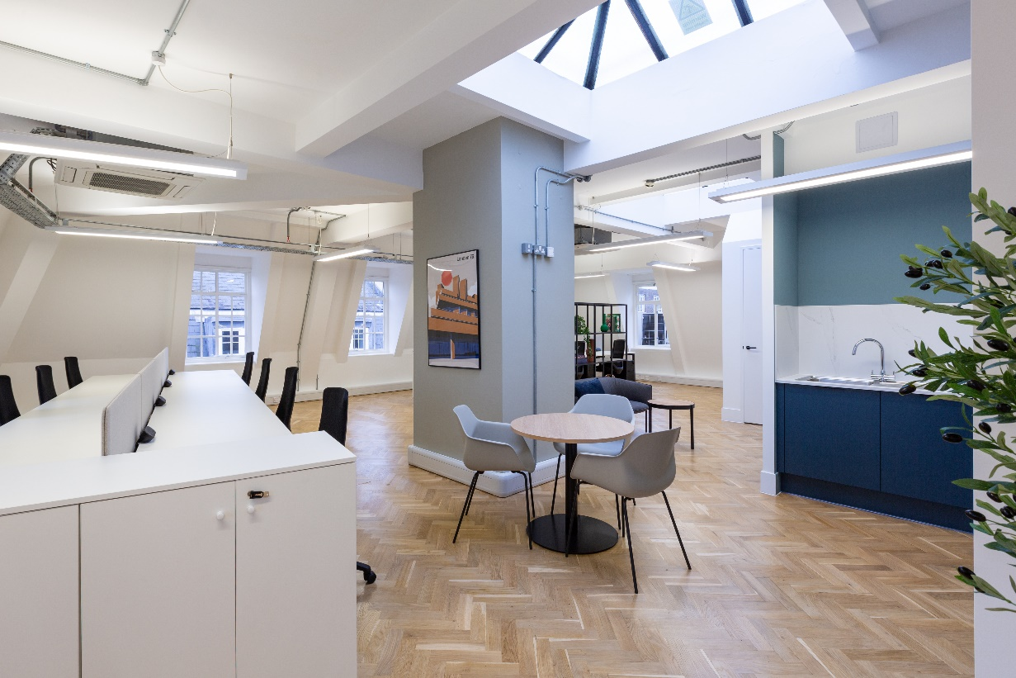
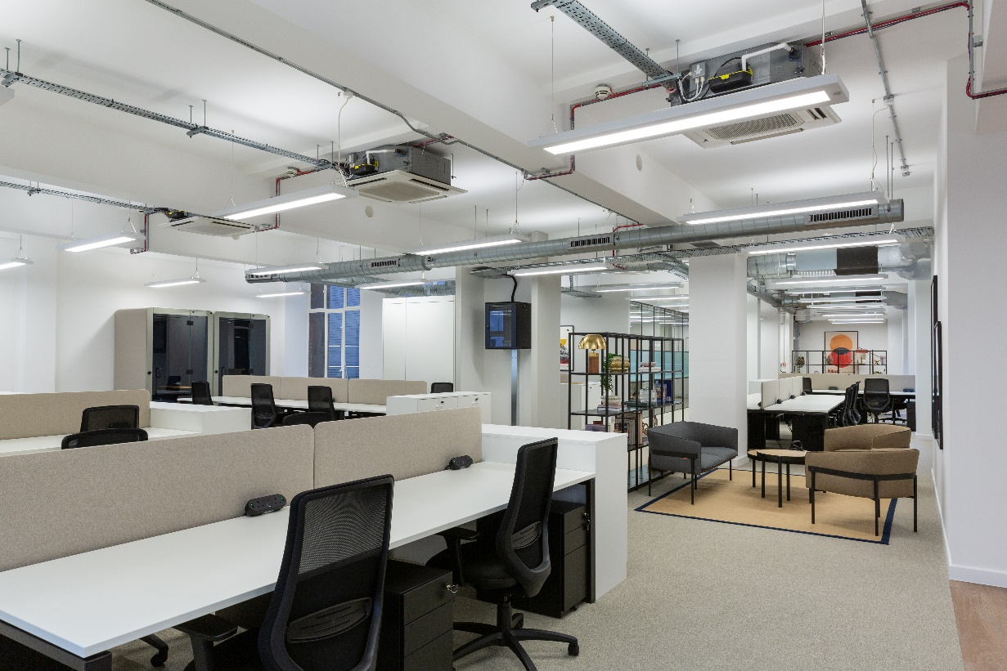

Slide 4
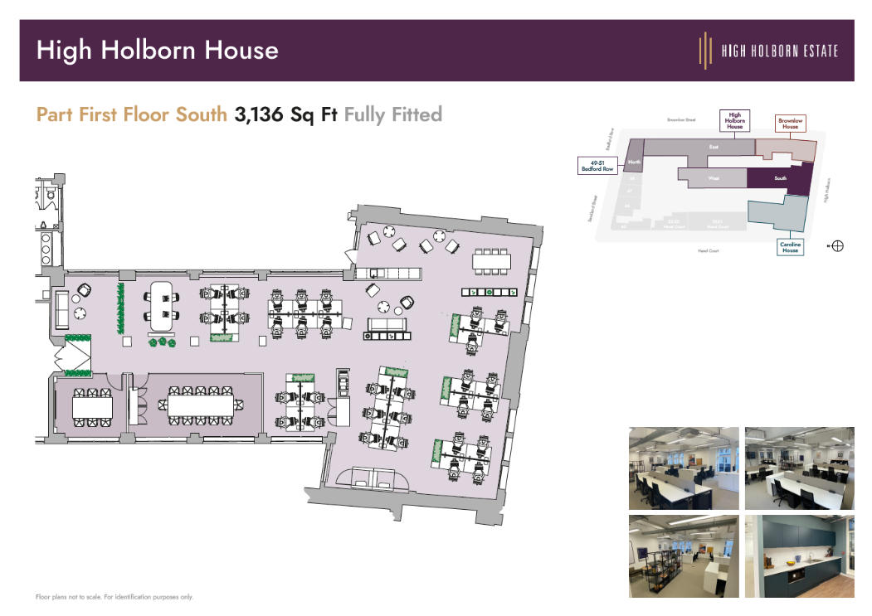
HIGH HOLBORN HOUSE, 52-54 HIGH HOLBORN, LONDON, WC1V 6RB
Retaining many original features, High Holborn House offers generously proportioned floors providing a bright, inspiring work environment. The building has two impressive receptions and benefits from a communal roof terrace.
The building is located on the north side of High Holborn, close to the junction with Chancery Lane. Chancery Lane Underground Station (Central Line) is within a short walking distance, as is Farringdon Station (Mainline, Hammersmith & City, Metropolitan and Circle lines).
FLOOR PLAN – 1st
SCHEDULE OF AREAS
Floor | Area sq ft | Area sq m | Status
Fifth (N) | 1,498 | 139 | Available
Fourth (N) | 1,647 | 153 | Available
First (S) First (N) First (E) First (W) Total | 3,136 1,679 3,929 2,558 14,447 | 291 156 365 237 1,342 | Available Available Available Available
SPECIFICATION
Fitted suites available
Air cooling
Raised floors
3 x passenger lifts
Commissionaire
Communal roof terrace
Cycle storage
Shower facilities
Rent – £69.50 per sq ft pax
Rates - £24.60 per sq ft
Service Charge - £13.29 per sq ft

Slide 5
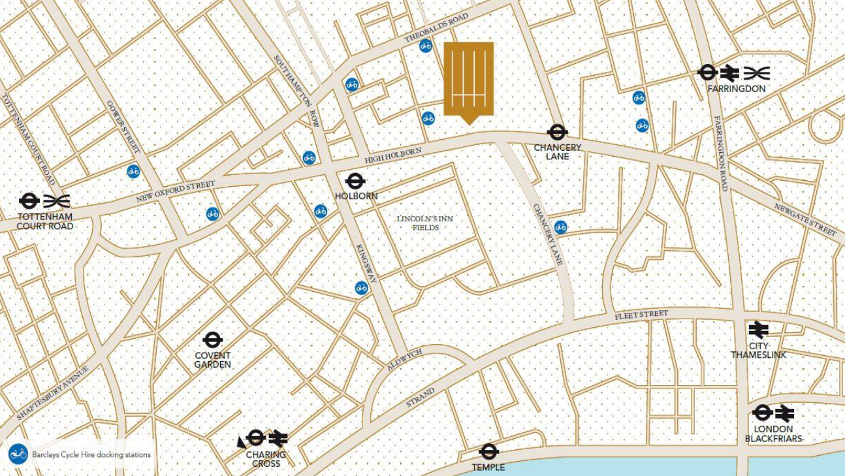

FOR MORE INFORMATION
STRICTLY THROUGH THE LETTING AGENT:
JAMES PROCTOR
+44 (0)7779 789 957
j.proctor@kinneygreen.com
CHARLES FOGG
+44 (0)7841 821 124
c.fogg@kinneygreen.com
Misrepresentation Act: 1. Kinney Green LLP on its own behalf and on behalf of the vendor/lessor of this property whose agent Kinney Green LLP is, gives notice that: (a) these particulars do not constitute in whole or in part an offer or contract for sale or lease; (b) none of the statements contained in these particulars as to the property are to be relied on as statements or representations of fact; and (c) the vendor/lessor does not make or give, and neither Kinney Green LLP nor any of its members or any person in its employment has any authority to make or give, any representation or warranty whatsoever in relation to the property. The only representations, warranties, undertakings and contractual obligations to be given or undertaken by the vendor/lessor are those contained and expressly referred to in the written contract for sale or agreement for lease between the vendor/lessor and a purchaser or tenant. 2. Prospective purchasers or tenants are strongly advised to: (a) satisfy themselves as to the correctness of each statement contained in these particulars; (b) inspect the property and the neighbouring area; (c) ensure that any items expressed to be included are available and in working order; (d) arrange a full structural (and where appropriate environmental) survey of the property; and (e) carry out all necessary searches and enquiries. April 2026.

