Slide 1
To Let
Indicative image of warehouse and racking
Unit 2, Moore Park Way
Haydock, St Helens, WA11 9RX
Up to 5,000 pallet spaces on a R, H & D basis
Main Offices (2 storey) - Up to 27,466 sq ft (2,552 sq m)
Hub Office (2 storey) - Up to 4,954 sq ft (460 sq m)
Available To Let on a Flexible Sub-let Basis
at Haydock525

Slide 2

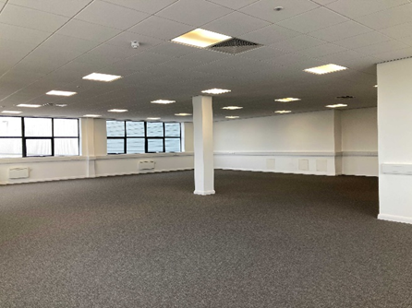
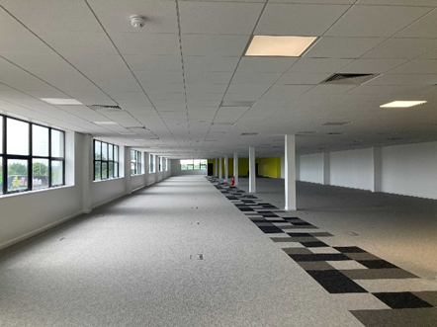
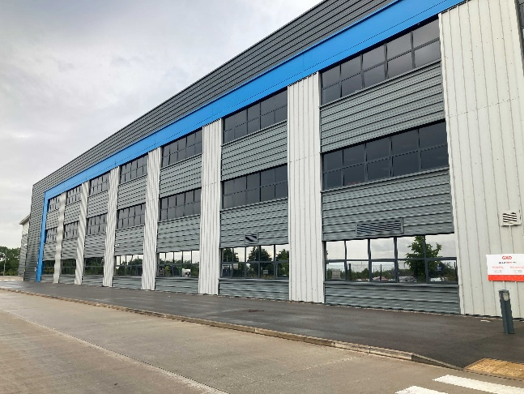
Location
The property is located adjacent to Haydock Industrial Estate, with immediate access to the A580 (East Lancs Road).
Hub Office
The western 2 storey hub offices measuring 4,954 sq ft (460 sq m) are available by way of a sub-lease on terms to be agreed.
Each floor measures 2,477 sq ft (230 sq m) and the offices benefit from suspended ceilings, LED lighting, perimeter trunking and electric panel heaters.
Accommodation
The Grade A distribution warehouse facility was built in 2019 and has the following surplus accommodation available on a sub-let basis:-
Up to 5,000 Pallet Spaces
Available on a short-term R,H&D basis.
Due to food products being stored in the warehouse any other products stored will need to be compatible and approved. For example, the products will need to be suitable for ambient storage with low odour. Any glass or brittle plastics will need to be fully contained.
Grade A space
Up to 5,000 pallet spaces on a Receipt, Handling and Despatch (R,H&D)
Main Offices (2 storey) - Up to 27,466 sq ft (2,552 sq m)
Hub Office (2 storey) - Up to 4,954 sq ft (460 sq m)
Up to 250 car parking spaces & 8 Electric Vehicle (EV) charging spaces
Available as a whole or separately
Car Parking
There are approximately 250 car parking spaces and 8 EV charging spaces available by way of a sub-lease on terms to be agreed.
VAT
VAT will be charged where applicable.
Legal Costs
Each party is to be responsible for their own legal costs incurred in any transaction
Main Office
The 1st and 2nd floor main ancillary offices measuring 27,466 sq ft (2,552 sq m) are available by way of a sub-lease on terms to be agreed.
Each floor measures 13,733 sq ft (1,276 sq m) and the offices benefit from suspended ceilings, LED lighting, raised access floors and a combined heating and cooling system.
Viewing & Further Information strictly by appointment only, please contact: | Viewing & Further Information – strictly by appointment only, please contact:
Warehouse/Pallet Spaces | Office Accommodation
Richard Johnson JLL Mobile: 07980 837328 Email: richard.Johnson@jll.com | Richard Wharton JLL Mobile: 07970 938698 Email: richard.Wharton@jll.com

Slide 3

