Slide 1

21 Godliman Street
St Paul’s, London EC4
639 sq. ft in Prime St Paul’s Location with Roof Terrace

Slide 2
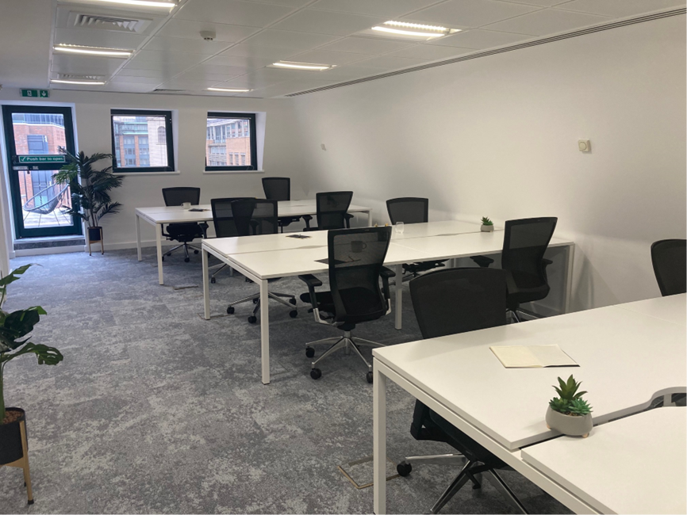

Slide 3

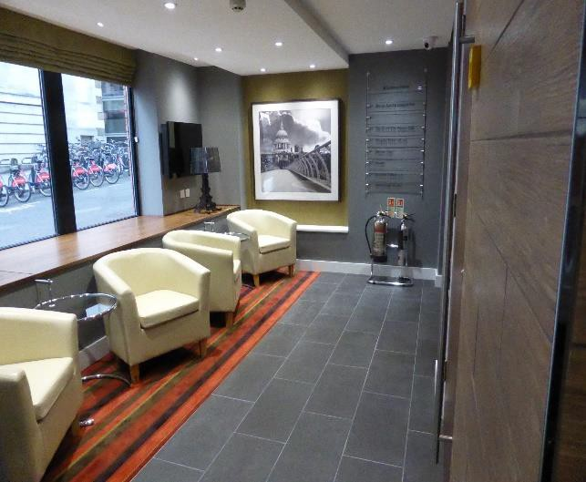
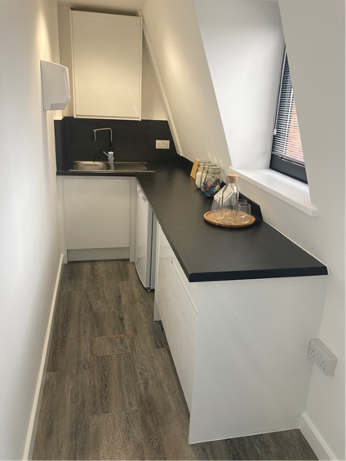
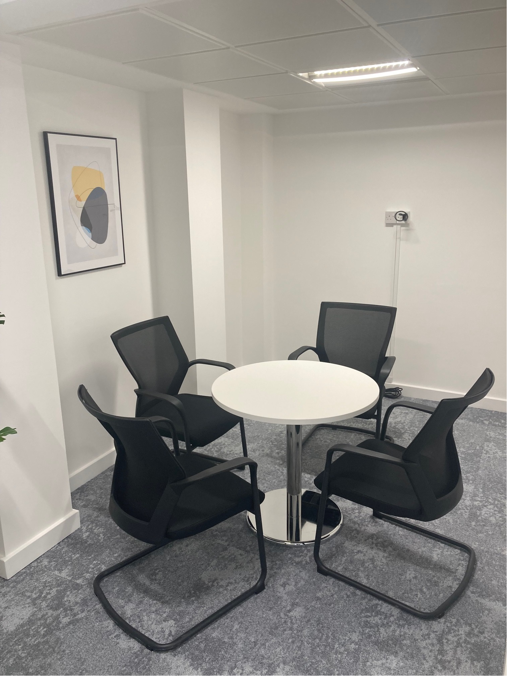
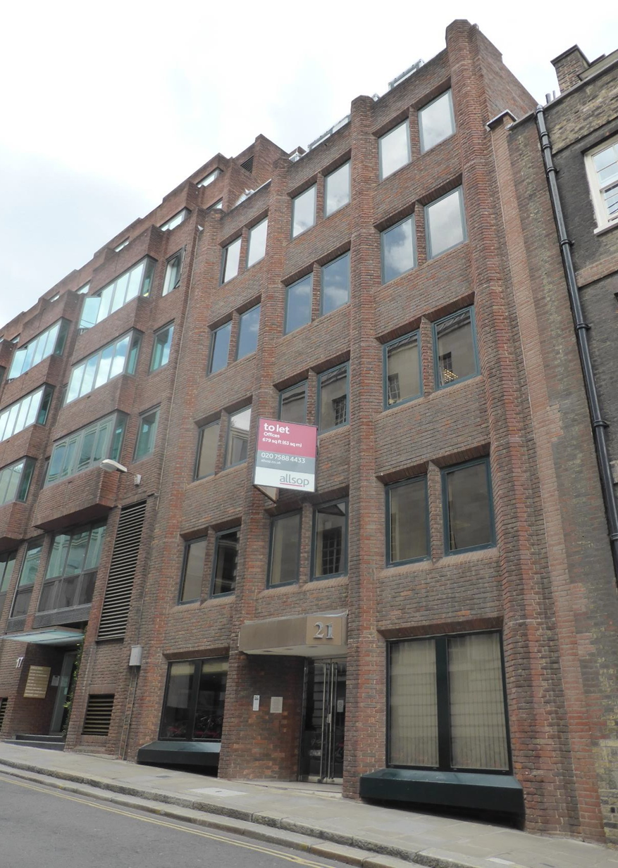
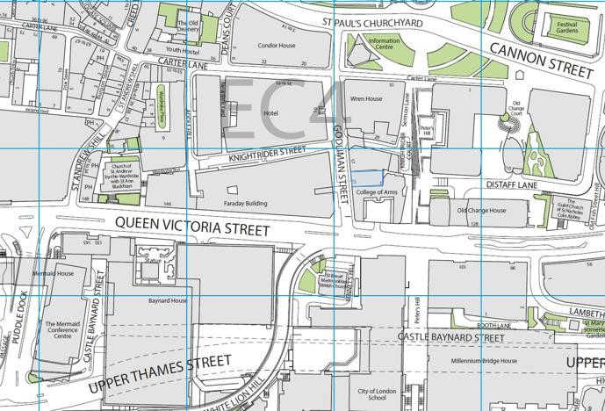
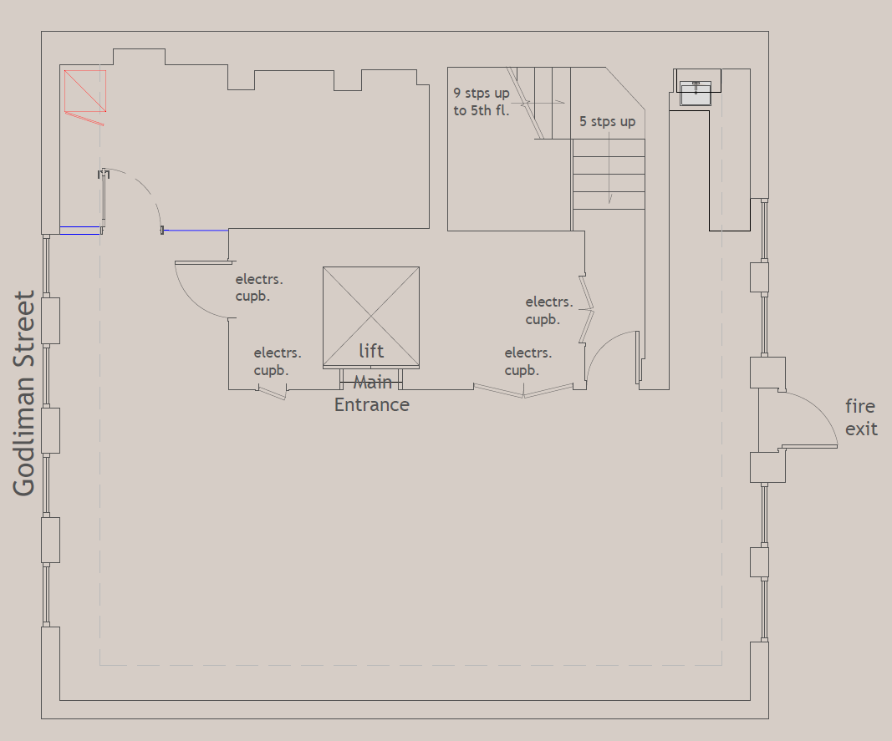
21 Godliman Street, St Paul’s London EC4
The Property offers good quality, open plan office accommodation with good transport links close by and is situated on the eastern side of Godliman Street, which runs between St Paul’s Churchyard and Queen Victoria Street.
Local amenities are excellent as are communications with St Paul’s (Central Line), Mansion House (Circle and District Lines) and Blackfriars Mainline and Underground (Circle and District Lines) stations all within easy walking distance from the property.
Schedule of Areas
Floor | Area sq ft | Area sq m | Desks
Fifth | 634 | 59 | 12
Lower Ground | 925 | 86 | TBD
Specification
Costs
Fully Furnished & Fitted
12 x 1200mm desks
1 x 4 person meeting room
Kitchenette
Cycle Storage
Shower & Locker Facilities to be installed
What is included:
Rent: £52.50 psf
Service Charge: £24.12 psf
Business Rates: £17.60 psf
Floor Plan

Slide 4

Contact Us
James Proctor
j.proctor@kinneygreen.com
+44 (0)7779 789 957
Charles Fogg
c.fogg@kinneygreen.com
+44 (0)7841 782 124
Misrepresentation Act: 1. Kinney Green LLP on its own behalf and on behalf of the vendor/lessor of this property whose agent Kinney Green LLP is, gives notice that: (a) these particulars do not constitute in whole or in part an offer or contract for sale or lease; (b) none of the statements contained in these particulars as to the property are to be relied on as statements or representations of fact; and (c) the vendor/lessor does not make or give, and neither Kinney Green LLP nor any of its members or any person in its employment has any authority to make or give, any representation or warranty whatsoever in relation to the property. The only representations, warranties, undertakings and contractual obligations to be given or undertaken by the vendor/lessor are those contained and expressly referred to in the written contract for sale or agreement for lease between the vendor/lessor and a purchaser or tenant. 2. Prospective purchasers or tenants are strongly advised to: (a) satisfy themselves as to the correctness of each statement contained in these particulars; (b) inspect the property and the neighbouring area; (c) ensure that any items expressed to be included are available and in working order; (d) arrange a full structural (and where appropriate environmental) survey of the property; and (e) carry out all necessary searches and enquiries. April 2026.

