Slide 1

19
BEDFORD ROW
LONDON WC1
1,109 SQ FT(103 SQ M)
REFURBISHED OFFICE FLOOR IN TRADITIONAL TOWN HOUSE
AVAILABLE TO LET

Slide 2
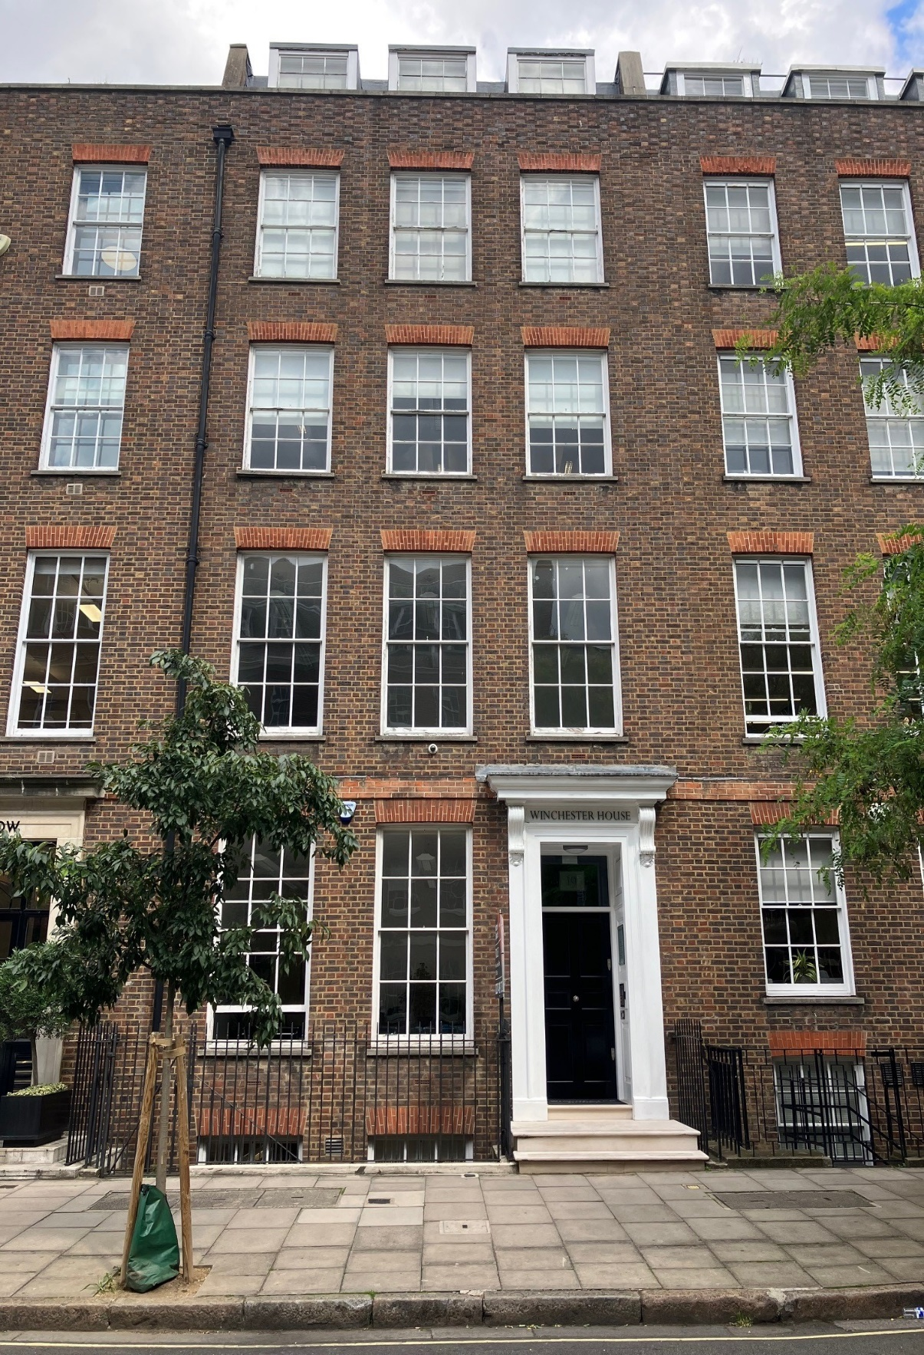
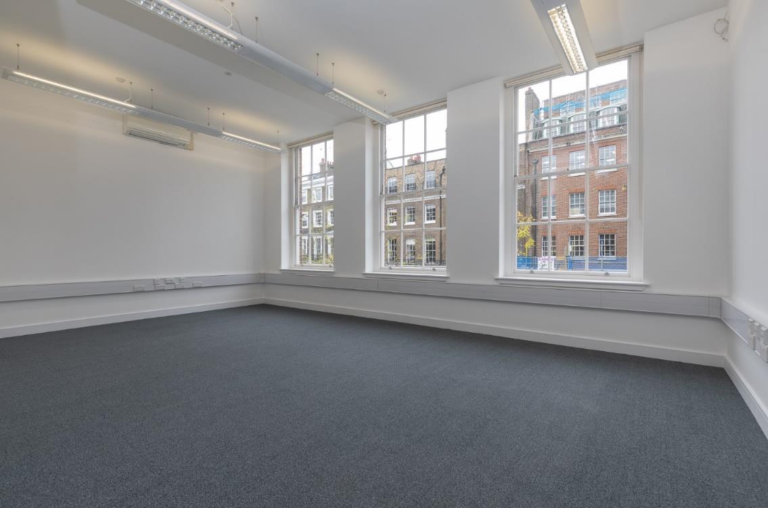
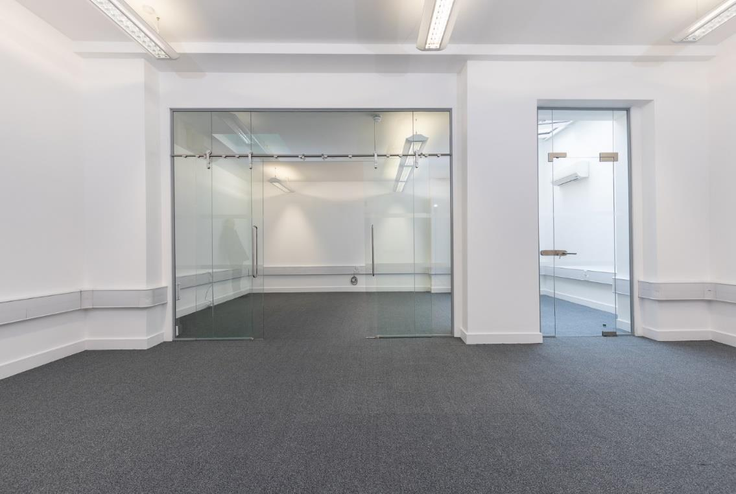

Slide 3
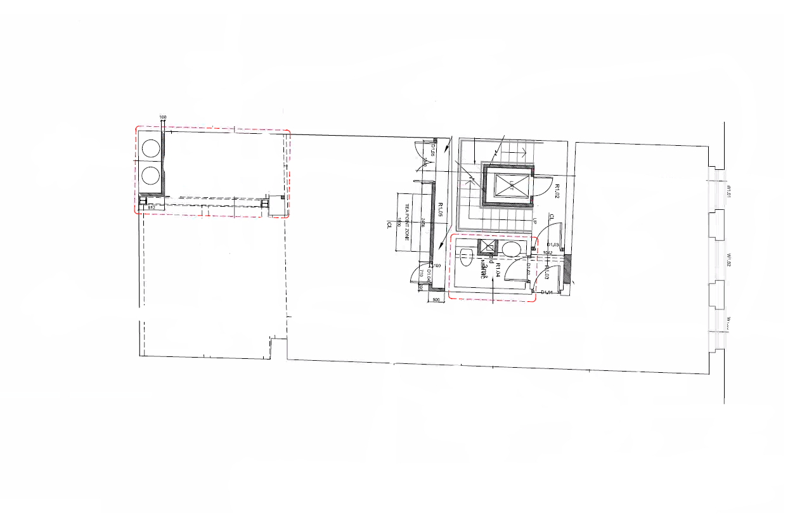
19 BEDFORD ROW, LONDON, WC1R 4EB
19 Bedford Row has been refurbished, now providing a series of small office suites. The property is situated at the northern end of Bedford Row.
The local area benefits from first class local amenities with an abundance of food & beverage outlets, also being a short walk from the increasingly popular Lamb’s Conduit Street. Essential retail is served by High Holborn and Covent Garden is a short walk away.
FLOOR PLAN
SCHEDULE OF AREAS
Floor | Area (sq ft) | Area (sq m) | Availability
First | 1,109 | 103.0 | Available
SPECIFICATION
Refurbished
Fitted meeting room
Passenger lift
Air cooling
Perimeter Trunking
LG7 lighting
Rent – £35.00 per sq ft pax
Rates - £25.86 per sq ft est
Service Charge - £10.00 per sq ft
A new lease is available from the landlord for a term by arrangement.

Slide 4
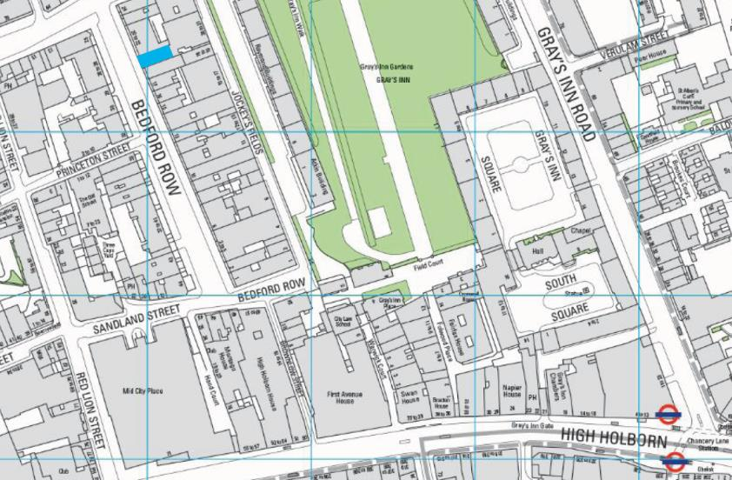

FOR MORE INFORMATION
STRICTLY THROUGH THE LETTING AGENT:
JAMES PROCTOR
+44 (0)7779 789 957
j.proctor@kinneygreen.com
CHARLES FOGG
+44 (0)7841 782 124
c.fogg@kinneygreen.com
Misrepresentation Act: 1. Kinney Green LLP on its own behalf and on behalf of the vendor/lessor of this property whose agent Kinney Green LLP is, gives notice that: (a) these particulars do not constitute in whole or in part an offer or contract for sale or lease; (b) none of the statements contained in these particulars as to the property are to be relied on as statements or representations of fact; and (c) the vendor/lessor does not make or give, and neither Kinney Green LLP nor any of its members or any person in its employment has any authority to make or give, any representation or warranty whatsoever in relation to the property. The only representations, warranties, undertakings and contractual obligations to be given or undertaken by the vendor/lessor are those contained and expressly referred to in the written contract for sale or agreement for lease between the vendor/lessor and a purchaser or tenant. 2. Prospective purchasers or tenants are strongly advised to: (a) satisfy themselves as to the correctness of each statement contained in these particulars; (b) inspect the property and the neighbouring area; (c) ensure that any items expressed to be included are available and in working order; (d) arrange a full structural (and where appropriate environmental) survey of the property; and (e) carry out all necessary searches and enquiries. Images shown are for illustrative purposes and taken from a similar floor in the building. April 2026..

