Slide 1
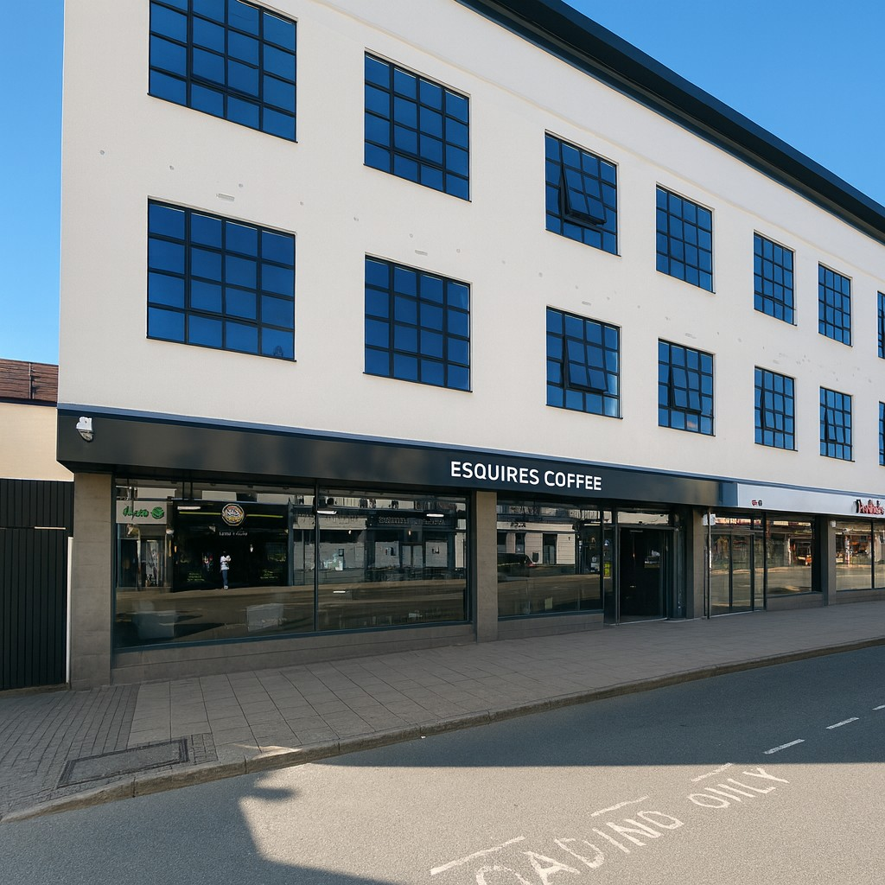


To Let
52 Warwick Street
Leamington Spa | CV32 5JS
Prime Warwick Street Location in Leamington Spa town centre, approximately 145 ft from the Parade, the town’s prime retail area.
Ground floor self-contained unit, with flexible open-plan layout.
Surrounded by major brands including Boots, Caffe Nero, Oliver Bonas, and directly opposite Tavistock Street leading to Tesco Metro
Benefits from existing Class E consent (restaurant/café), offering opportunity for retail, hospitality, or service-based uses.
Former Esquires Coffee, retaining café infrastructure and ready for leisure or hospitality operators.
2,195 sq ft (203.92 sq m) GIA
Rent £45,000 pax
01926 430700 | www.wareingandcompany.co.uk

Slide 2

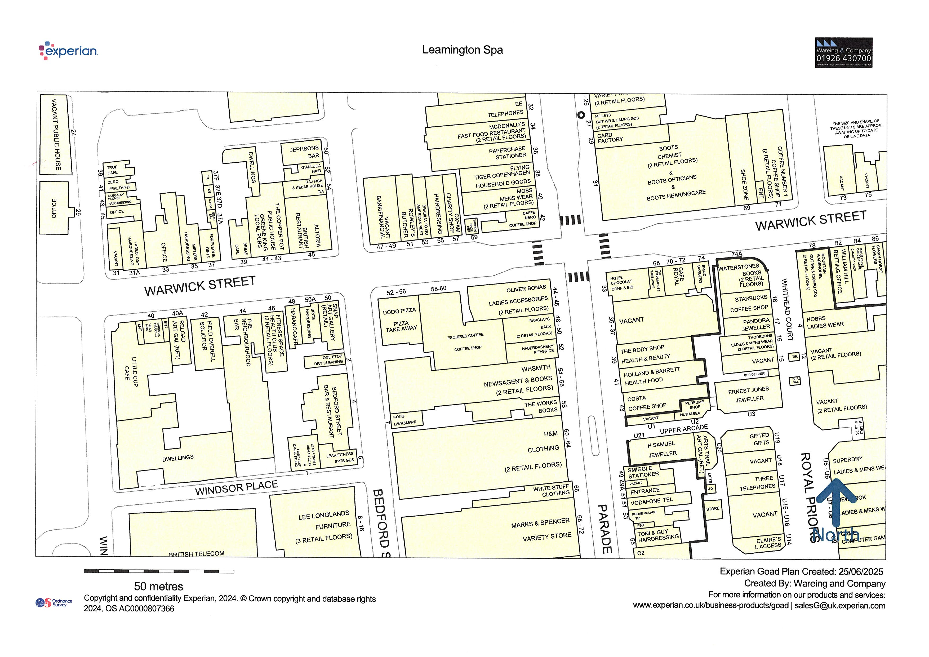



Location
The property occupies a highly prominent position on the south side of Warwick Street, just 145 ft (45m) from The Parade, Leamington Spa’s prime retail thoroughfare. It boasts an impressive frontage to Warwick Street with a return on Bedford Street, maximising visibility to passing footfall and traffic.
This stretch of Warwick Street is home to a strong mix of national brands and independent operators, with nearby occupiers including Boots, Caffe Nero, Oliver Bonas, Barclays, and the rear entrance of Tesco Metro via Tavistock Street. The areas blend of retail, café, and service uses ensures consistent daytime trade.
Warwick Street is also recognised as one of Leamington Spa’s key nightlife destinations, hosting popular bars and venues such as The Copperpot, Jephsons Bar, Altoria, The Neighbourhood, and Clink. This vibrant evening economy provides additional footfall and makes the location especially attractive for Class E leisure operators seeking both daytime and evening custom.
Royal Leamington Spa is an affluent Warwickshire town with a diverse catchment of residents, students, professionals, and tourists. Known for its high-quality independents alongside established high street bands, the ton benefits from strong AB demographics, a thriving food and drink scene, and excellent transport connections to Birmingham, Coventry, and London, all of which underpin demand for high-quality retail and leisure space.
Coventry
Birmingham
London
20 mins
50 mins
2.5 hours
11 mins
30 mins
1hr 40 mins
Guide Price: £430,000

Slide 3
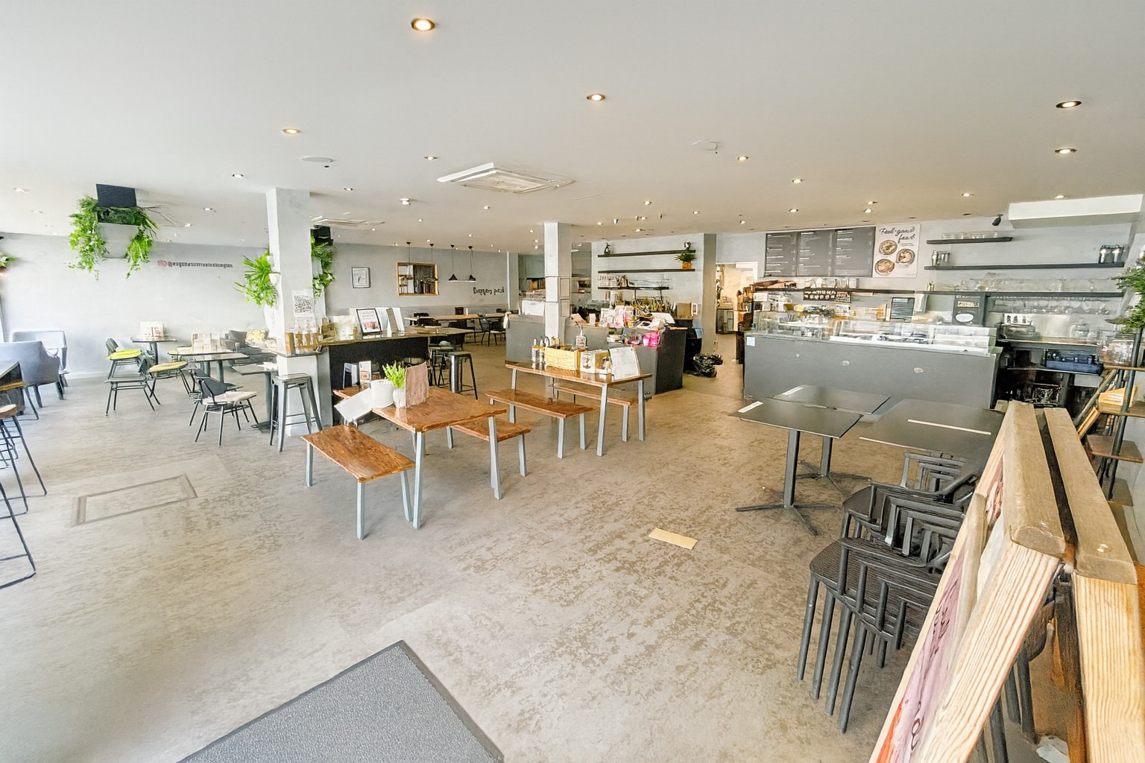
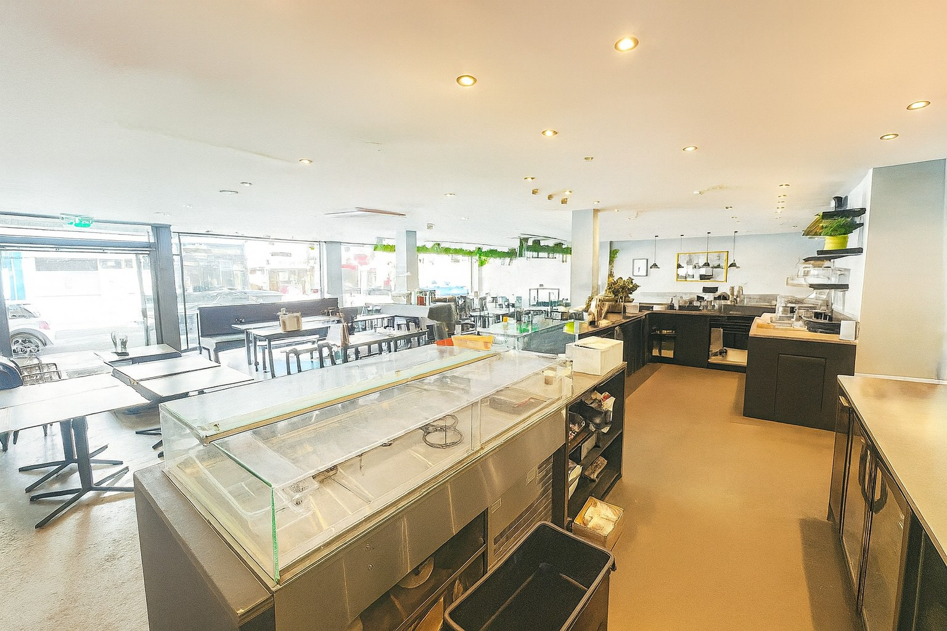
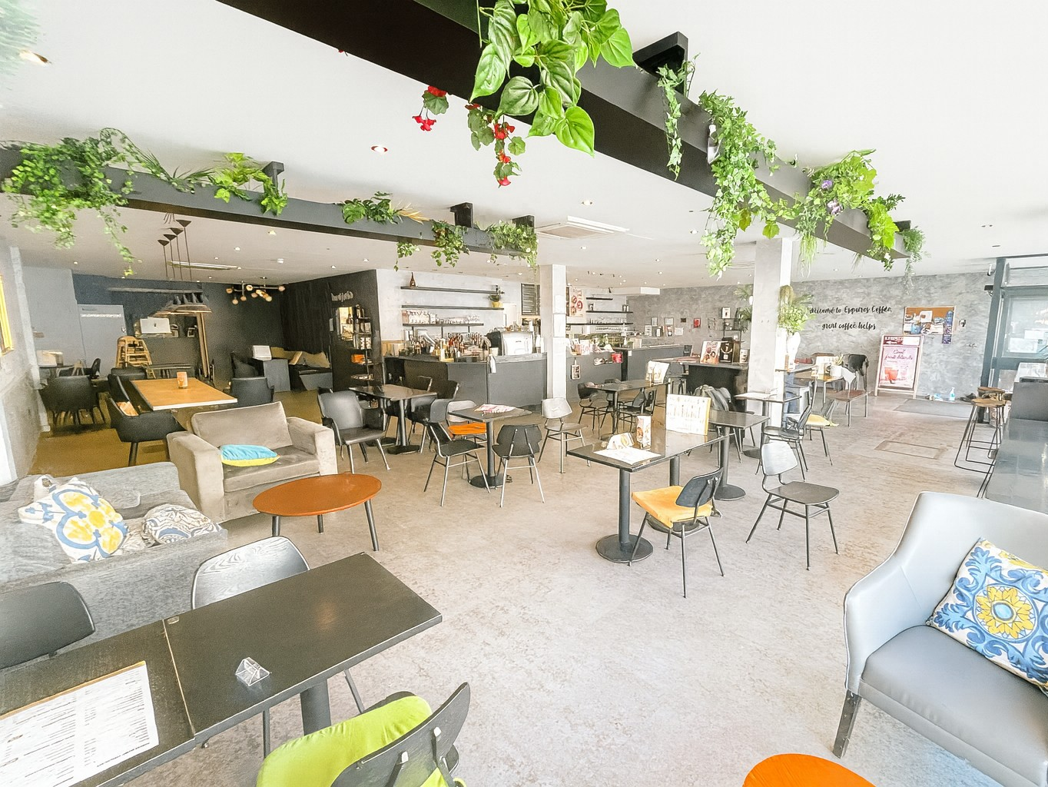
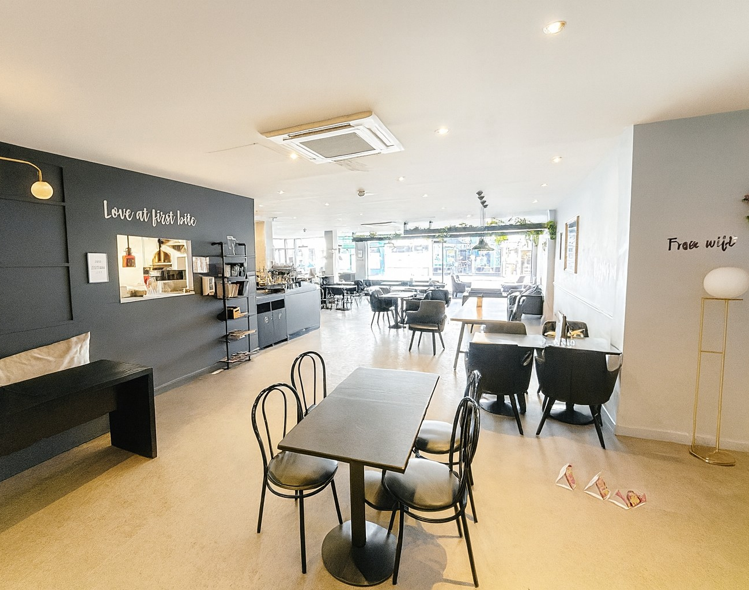
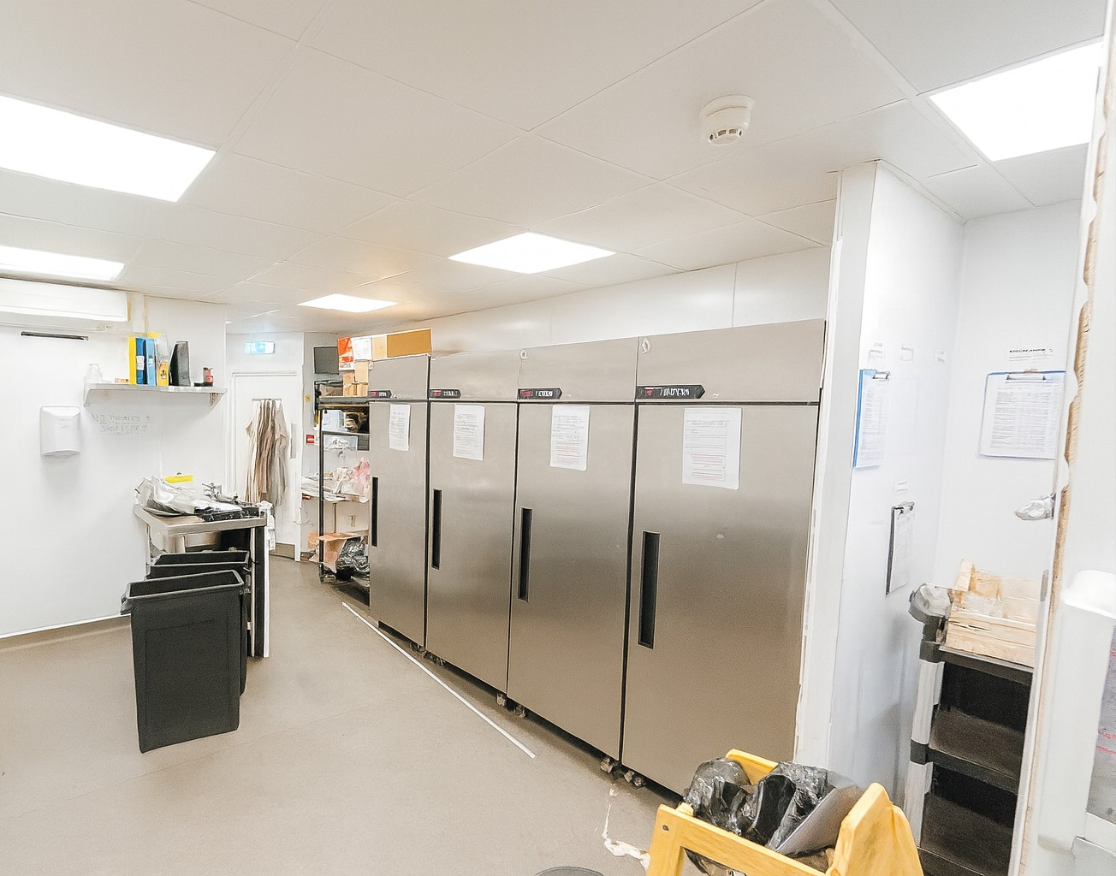

Slide 4
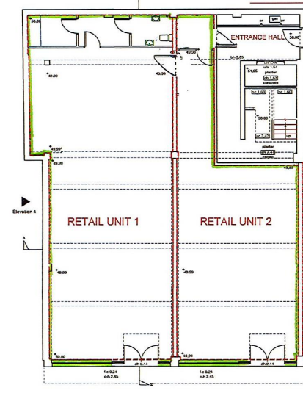
Description
The property comprises a prominent ground floor, self-contained commercial unit, occupying a highly visible position on Warwick Street in the heart of Royal Leamington Spa’s retail and leisure district.
Access is via a dedicated entrance fronting Warwick Street, with the unit benefitting from an extensive frontage, maximising brand exposure to steady pedestrian and vehicular traffic.
The accommodation extends to approximately 2,195 sq ft (203.92 sq m) GIA and is predominantly open-plan, offering a versatile trading area suitable for a variety of retail and leisure uses, including restaurants, cafés.
Most recently occupied by Esquires Coffee, the premises remain existing café infrastructure, including WC facilities and rear servicing, allowing incoming operators to benefit from reduced fit-out time and cost.
The unit forms part of the former Co-operative department store building, whose upper floors have been converted to residential accommodation with separate access to the rear.
This is a rare opportunity to secure a well-located, highly adaptable unit in one of Leamington Spa’s busiest commercial locations, surrounded by strong national and independent operators.
Guide Price: £430,000

Slide 5



Legal Costs
Each Party will meet their own legal and professional costs.
Anti Money Laundering
The Money Laundering Regulations require us to conduct checks upon all Purchasers including Tenants. Prospective Purchasers will need to provide proof of identity and residence. For a company any person owning more than 25% must provide the same.
Services
We understand that all mains services are connected or are available for connection however, interested parties are advised to satisfy themselves that this is the case and that they are in good working order. The agents have not tested any apparatus on site and therefore, cannot verify the conditions.
Planning
We understand that the property benefits from planning consent for uses falling within Class E of the Use Classes Order, including restaurant and café uses. Interested parties are advised to make their own enquiries of Warwick District Council Planning Department on 01926 456760.
EPC
A-24 – A copy can be made available upon request.
Business Rates
Rateable Value: £65,500
Rates Payable: £33,405
Service Charge
The ingoing tenant will pay a contribution towards the general upkeep and maintenance of the external and communal areas of the property. This proportion will be worked on a pro-rata basis.
Lease Term / Rent
The premises are available by wany of a new effective full repairing and insuring lease for a term to be negotiated at a quoting rental of £45,000 per annum (exclusive).
We are advised VAT will be applicable.
Viewing Arrangements:
Strictly by prior arrangement with the sole agents:
Bill Wareing FRICS
T 01926 430700 • M 07715 001018 E bill.wareing@wareingandcompany.co.uk
Jonathan M Blood MRICS
T 01926 430700 • M 07736 809963 E Jonathan.blood@wareingandcompany.co.uk
Wareing & Company
38 Hamilton Terrace, Holly Walk, Leamington Spa Warwickshire CV32 4LY
www.wareingandcompany.co.uk
Guide Price: £430,000
Wareing & Company for themselves and for the seller/lessor of this property who they are agents, give notice that 1. These particulars do not constitute any part of an offer or a contract. 2. All statements contained in these particulars are made without responsibility on the part of the agent(s) or the seller/lessor. 3. None of the statements contained in these particulars are to be relied upon as a statement or representation of fact. 4. Any intending buyer or tenant must satisfy themselves by inspection or otherwise as to the correctness of each of the statements contained in these particulars. 5. Wareing & Company does not make or give nor any person in their employment has any authority to make or give any representation or warranty whatsoever in relation to this property.

