Slide 1
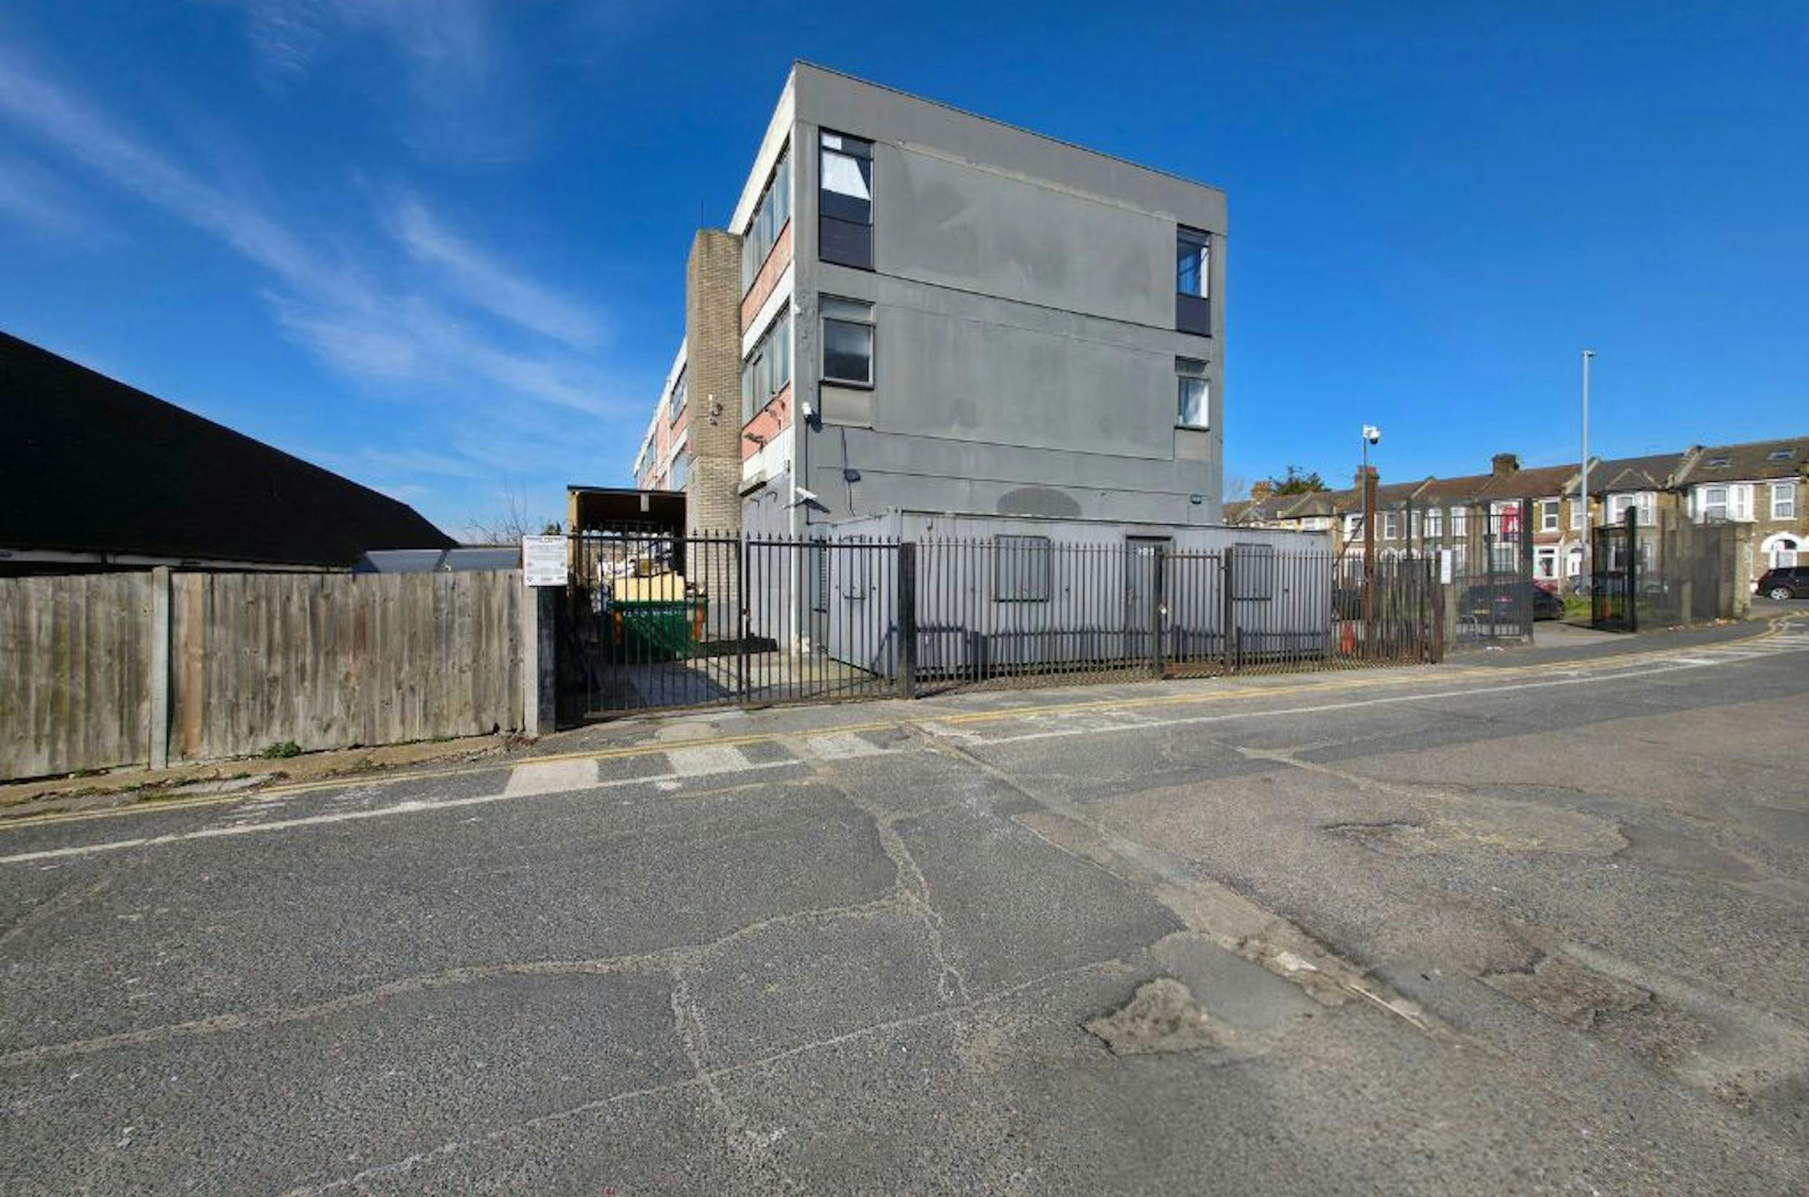



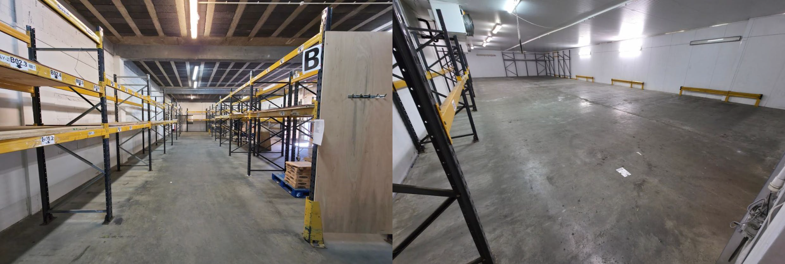
TO LET
Ground Floor Gateway Business Centre, Church Road Leyton, E10 7JQ
5,642 Sq ft
Industrial / Warehouse
strettons.co.uk

Slide 2
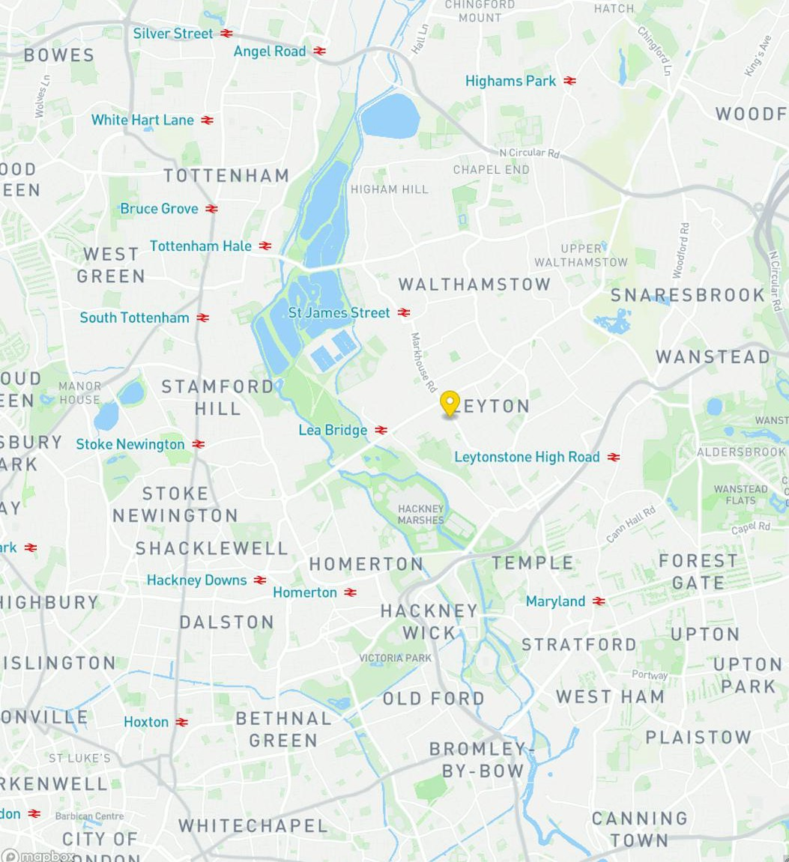

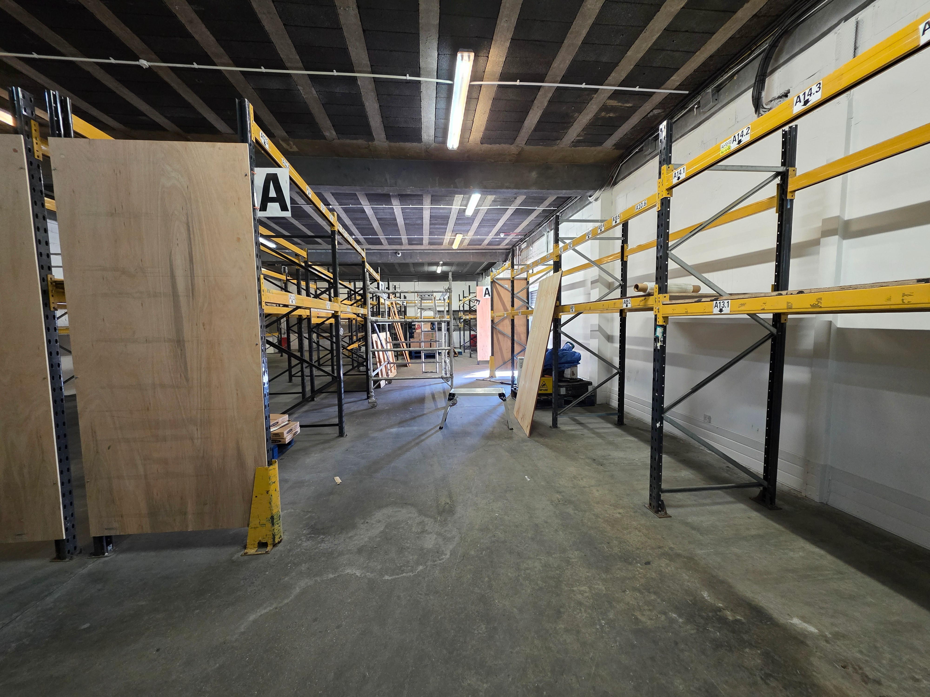

Church Road, Leyton, E10 7JQ
Description
A highly functional ground-floor industrial/warehouse unit, prev iously used for the storage and distribution of refrigerated and f rozen food products. The unit benefits from existing chiller and f reezer compartments, making it ideal for food-related bus inesses, but can also be adapted for a variety of industrial or s torage uses. It features excellent loading facilities, parking, and a secure, self-contained yard.
Location
The property is strategically positioned on Church Road (A1006), within close proximity to Lea Bridge Road and Markhouse Road. It provides excellent transport links, with the A12 offering direct routes to Essex and the City of London.
South London is also easily accessible via the Blackwall Tunnel (A102). Public transport links are strong, with Leyton Midland Road Overground Station a five-minute drive or a 15-minute walk away. Lea Bridge Railway Station (Greater Anglia) is a 10- minute drive or a 20-minute walk from the site
RENT
TERM
EPC
VAT
RATES
£69,500 per annum exclsuive
To Let
To be confirmed
To be confirmed
To be confirmed
Contacts
Chris Wade
020 8509 4476 | 07816 505 718
chris.wade@strettons.co.uk
Harry Robins
0208 509 4426 | 07866 075 899
harry.robins@strettons.co.uk
Strettons and their clients give notice that: 1. They are not authorised to make or give any representations or warranties in relation to the property either here or elsewhere, either on their own behalf or on behalf of their client or otherwise. They assume no responsibility for any statement that may be made in these particulars. These particulars do not form part of any offer or contract and must not be relied upon as statements or, representations of fact. 2. Any areas, measurements or distances are approximate. The text, photographs and plans are for guidance only and are not necessarily comprehensive. It should not be assumed that the property has all necessary planning, building regulation or other consents and the Agents have not tested any services, equipment or facilities. Purchasers must satisfy themselves by inspection or otherwise.
strettons.co.uk

