Slide 1

CAROLINE HOUSE
55-57 HIGH HOLBORN
LONDON WC1
32 DESK MANAGED LEASE
FURNISHED OFFICES IN PRIME HOLBORN LOCATION
AVAILABLE TO LET

Slide 2
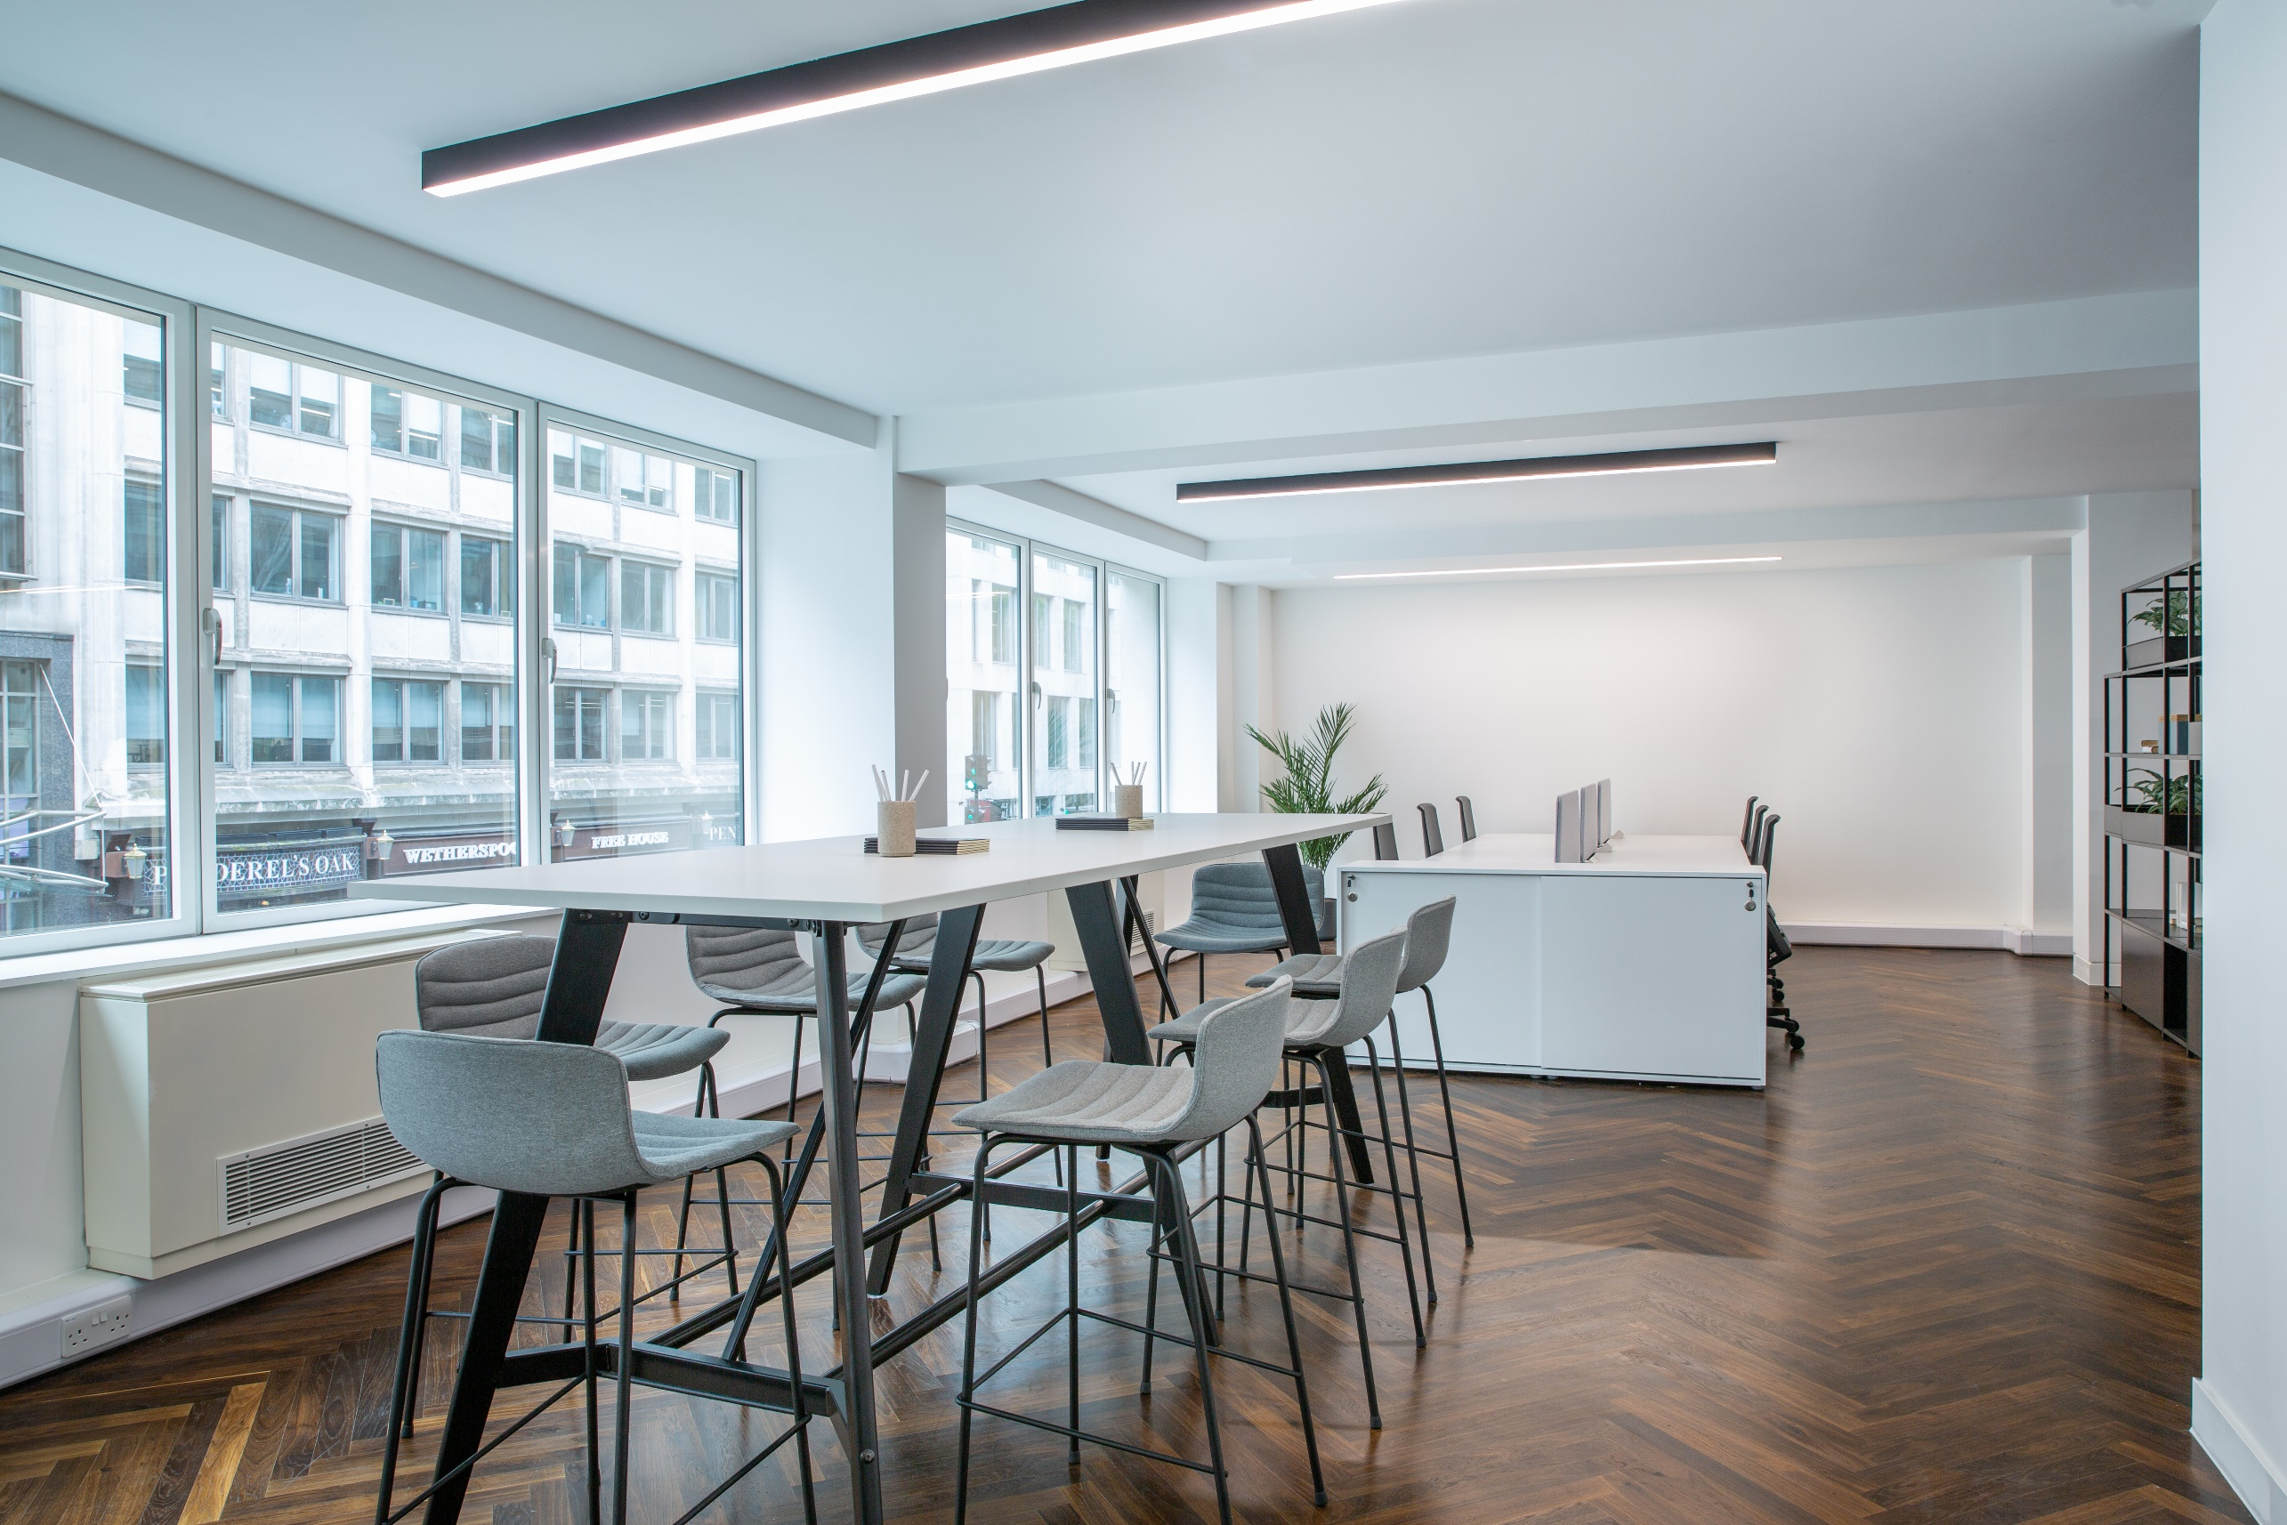

Slide 3
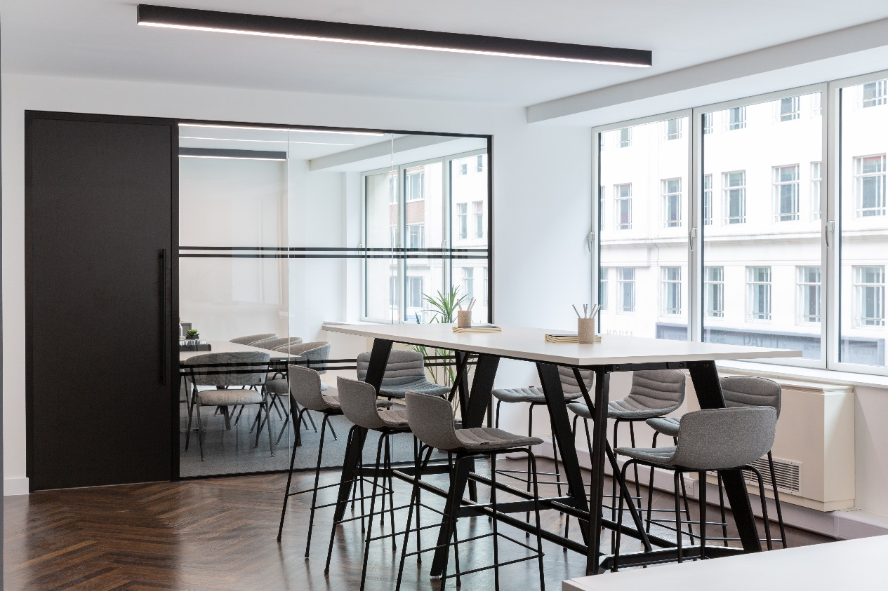
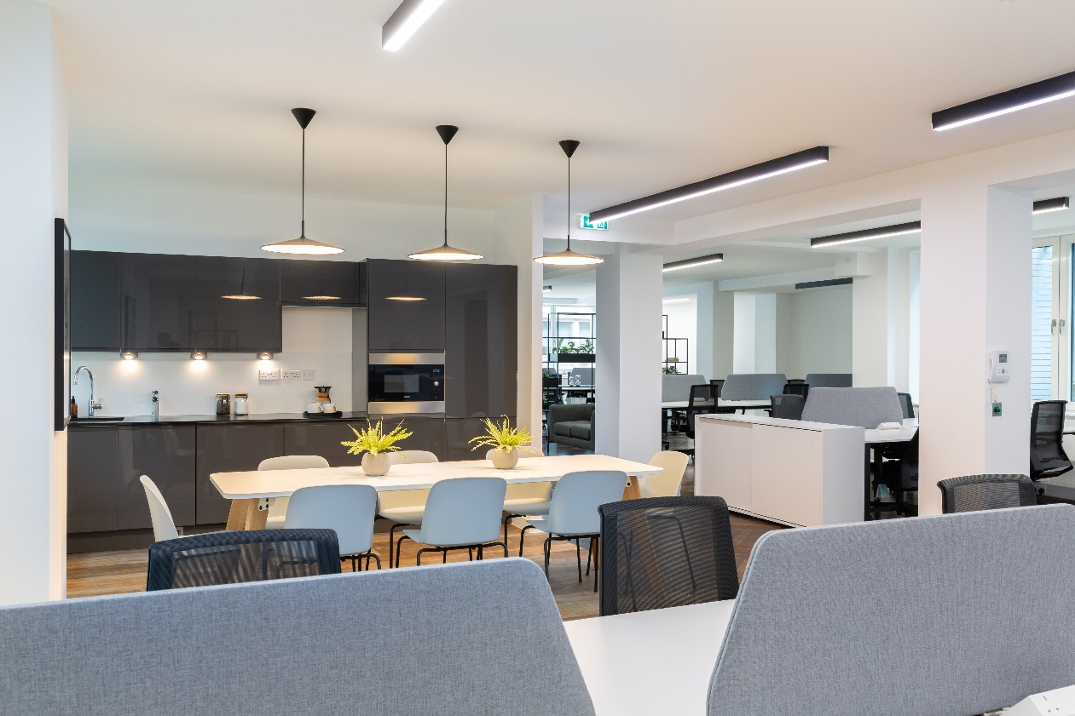

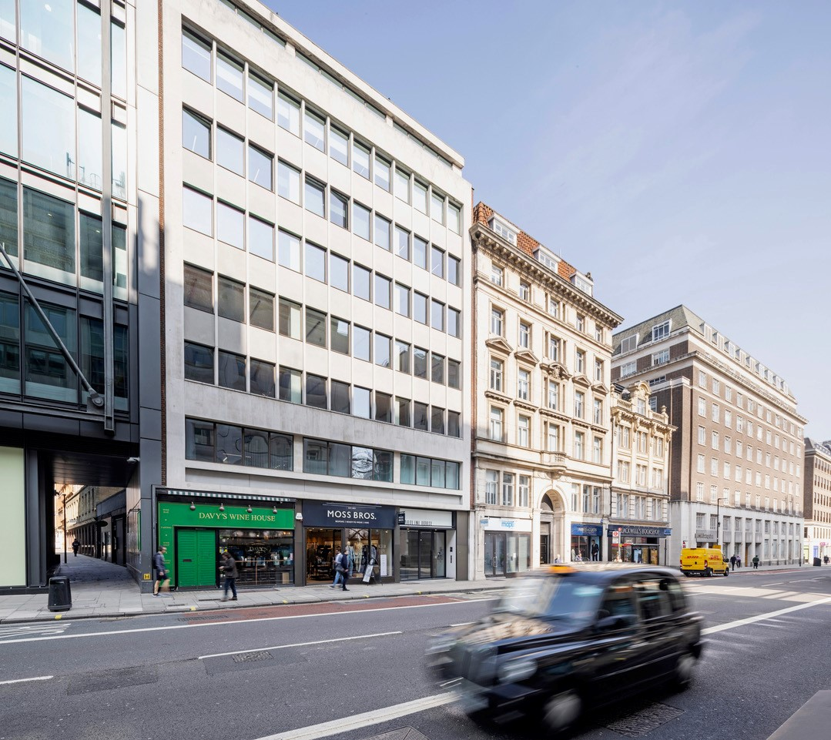

Slide 4
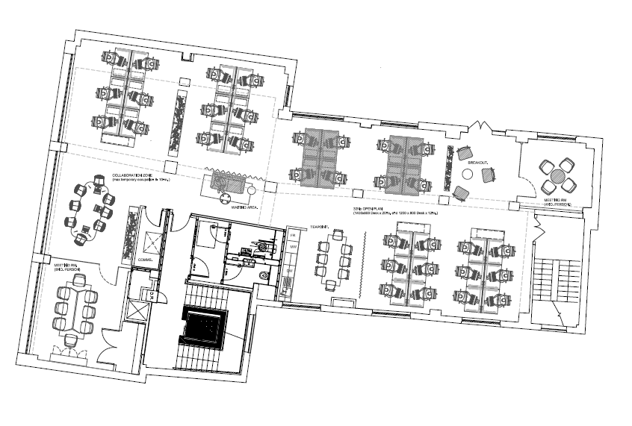
CAROLINE HOUSE, 55-57 HIGH HOLBORN, LONDON, WC1V 6DT
Caroline House offers high quality, open plan office accommodation situated half way between Chancery Lane (Central line) and Holborn (Central & Piccadilly lines) Underground Station. The office has recently been comprehensively refurbished and completed with new furniture.
The local area benefits from first class local amenities with an abundance of food and beverage outlets, essential retailers and is a short walk to Covent Garden.
FLOOR PLAN
SCHEDULE OF AREAS
Floor | Area (sq ft) | Area (sq m) | Desks
Fifth | 1,701 | 158 | TBC
Second | 2,618 | 243 | TBC
First | 2,579 | 240 | 32
SPECIFICATION
What is included:
All inclusive price of
5th floor: £21,500 per calendar month
2nd floor: £33,000 per calendar month
1st floor: £33,000 per calendar month
Internet of 100 Mbps capable of upgrade to 500 Mbps
Cleaning 5 hour per week
Dilapidations / Reinstatement
2 data ports per desk
Handsets on desks
All utilities & local taxes.
Fully furnished & fitted
32 Fixed Desks plus 8 agile work-stations
2 Meeting rooms
Informal meeting / breakout areas
Commissionaire
Air conditioning
LED lighting
Roof terrace
Cycle storage
Shower & locker facilities

Slide 5

FOR MORE INFORMATION
STRICTLY THROUGH THE LETTING AGENT:
JAMES PROCTOR
j.proctor@kinneygreen.com
+44 (0)7779 789 957
CHARLES FOGG
c.fogg@kinneygreen.com
+44 (0)7841 782 124
Misrepresentation Act: 1. Kinney Green LLP on its own behalf and on behalf of the vendor/lessor of this property whose agent Kinney Green LLP is, gives notice that: (a) these particulars do not constitute in whole or in part an offer or contract for sale or lease; (b) none of the statements contained in these particulars as to the property are to be relied on as statements or representations of fact; and (c) the vendor/lessor does not make or give, and neither Kinney Green LLP nor any of its members or any person in its employment has any authority to make or give, any representation or warranty whatsoever in relation to the property. The only representations, warranties, undertakings and contractual obligations to be given or undertaken by the vendor/lessor are those contained and expressly referred to in the written contract for sale or agreement for lease between the vendor/lessor and a purchaser or tenant. 2. Prospective purchasers or tenants are strongly advised to: (a) satisfy themselves as to the correctness of each statement contained in these particulars; (b) inspect the property and the neighbouring area; (c) ensure that any items expressed to be included are available and in working order; (d) arrange a full structural (and where appropriate environmental) survey of the property; and (e) carry out all necessary searches and enquiries. Images shown are for illustrative purposes and taken from a similar floor in the building. April 2026.

