Slide 1
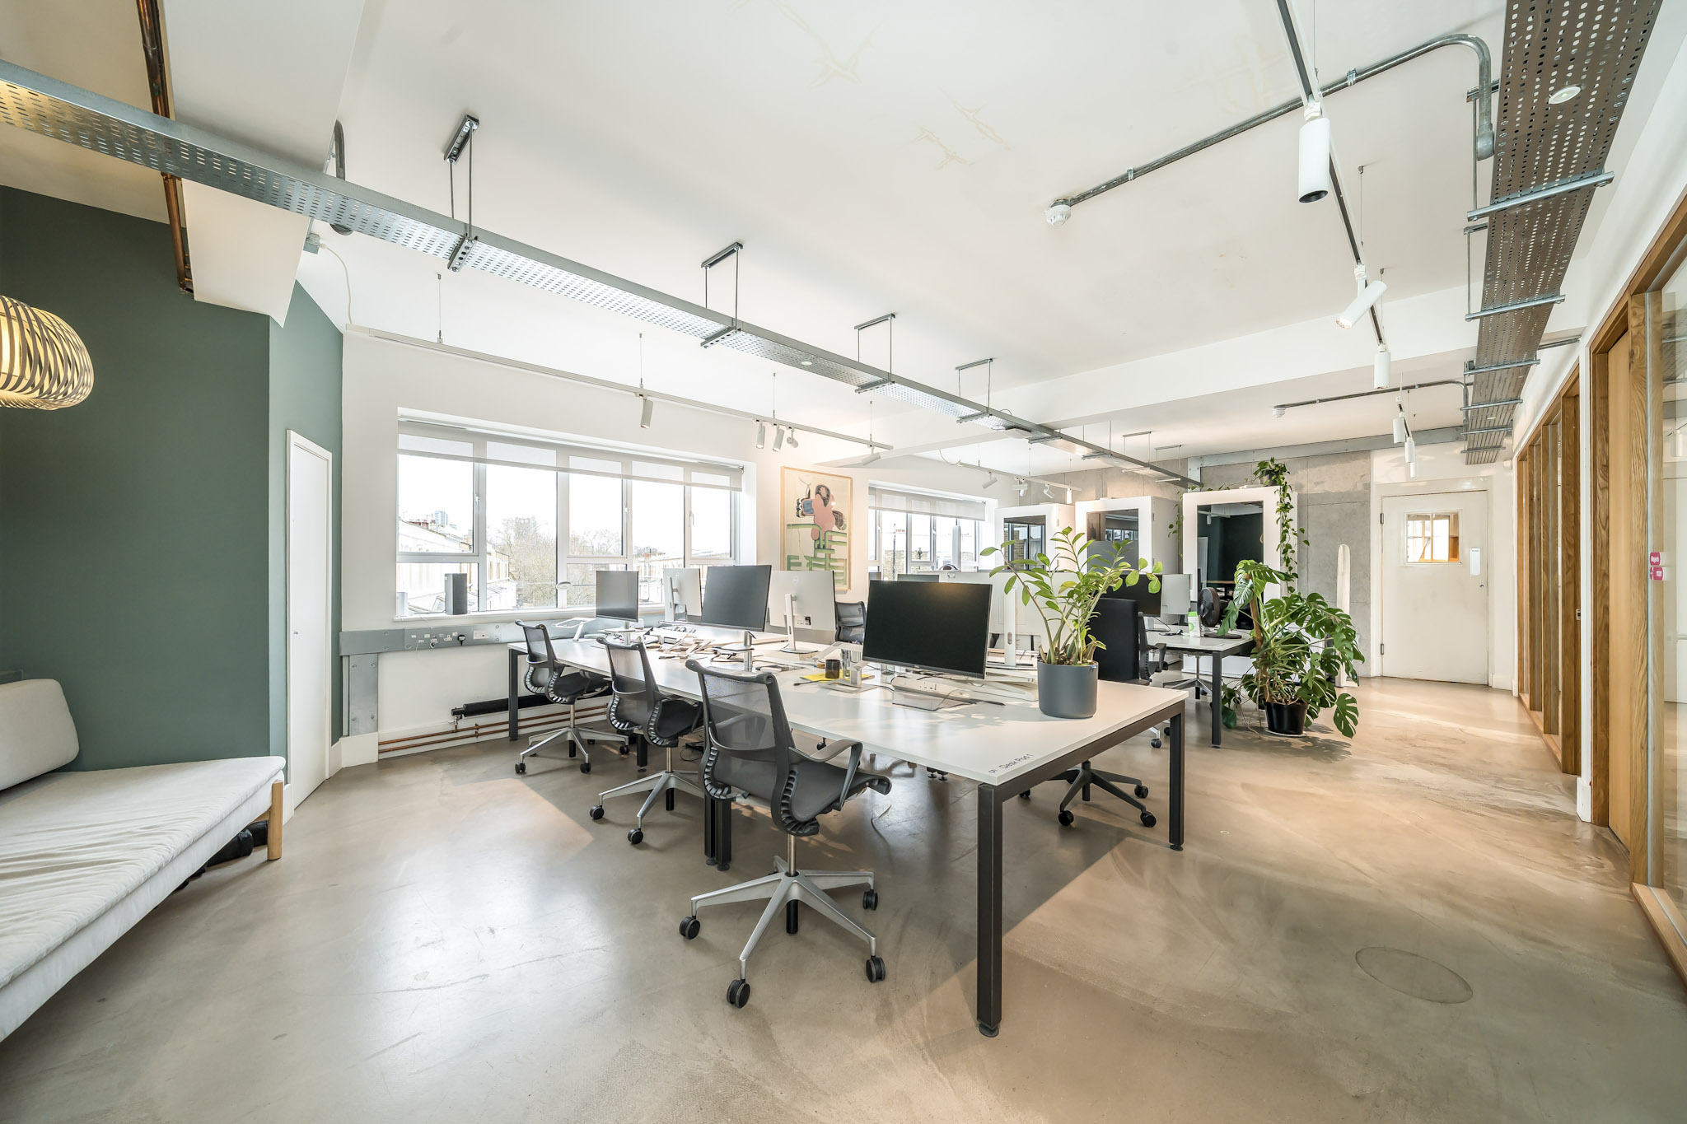


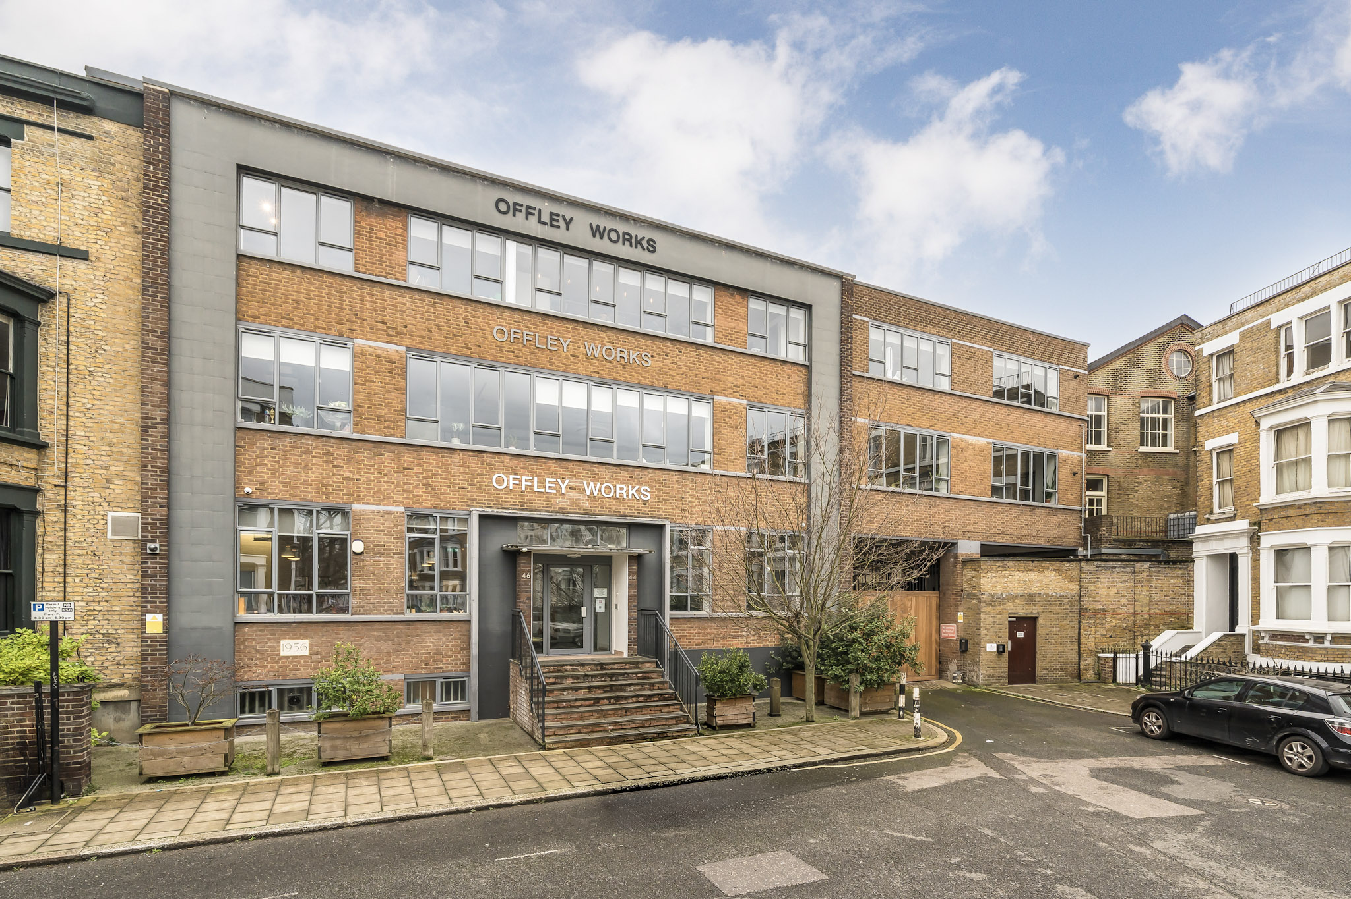

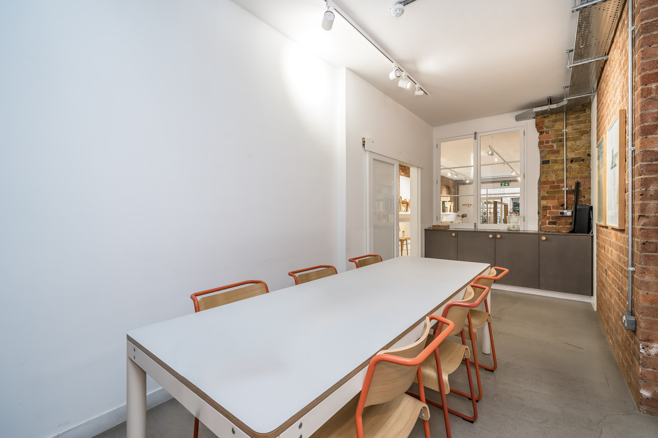

A2 Offley Works
Second Floor Office
Unit A2 Second Floor
Offley Works
Pickle Mews
Oval, London, SW9 0FJ
2,368 sq ft | 245 sq m
Second floor office to let in creative development

Slide 2

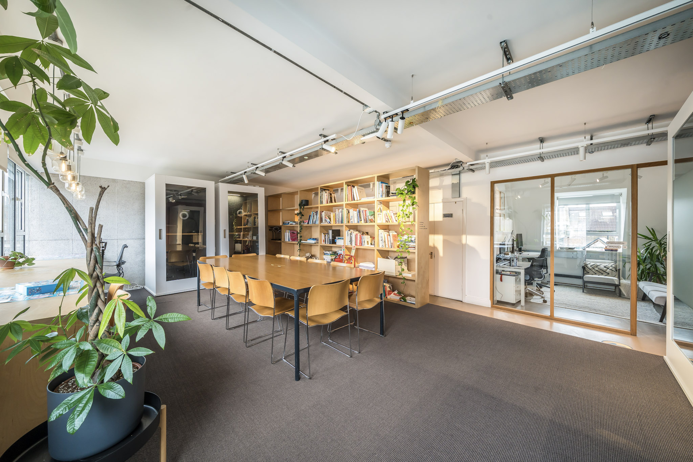
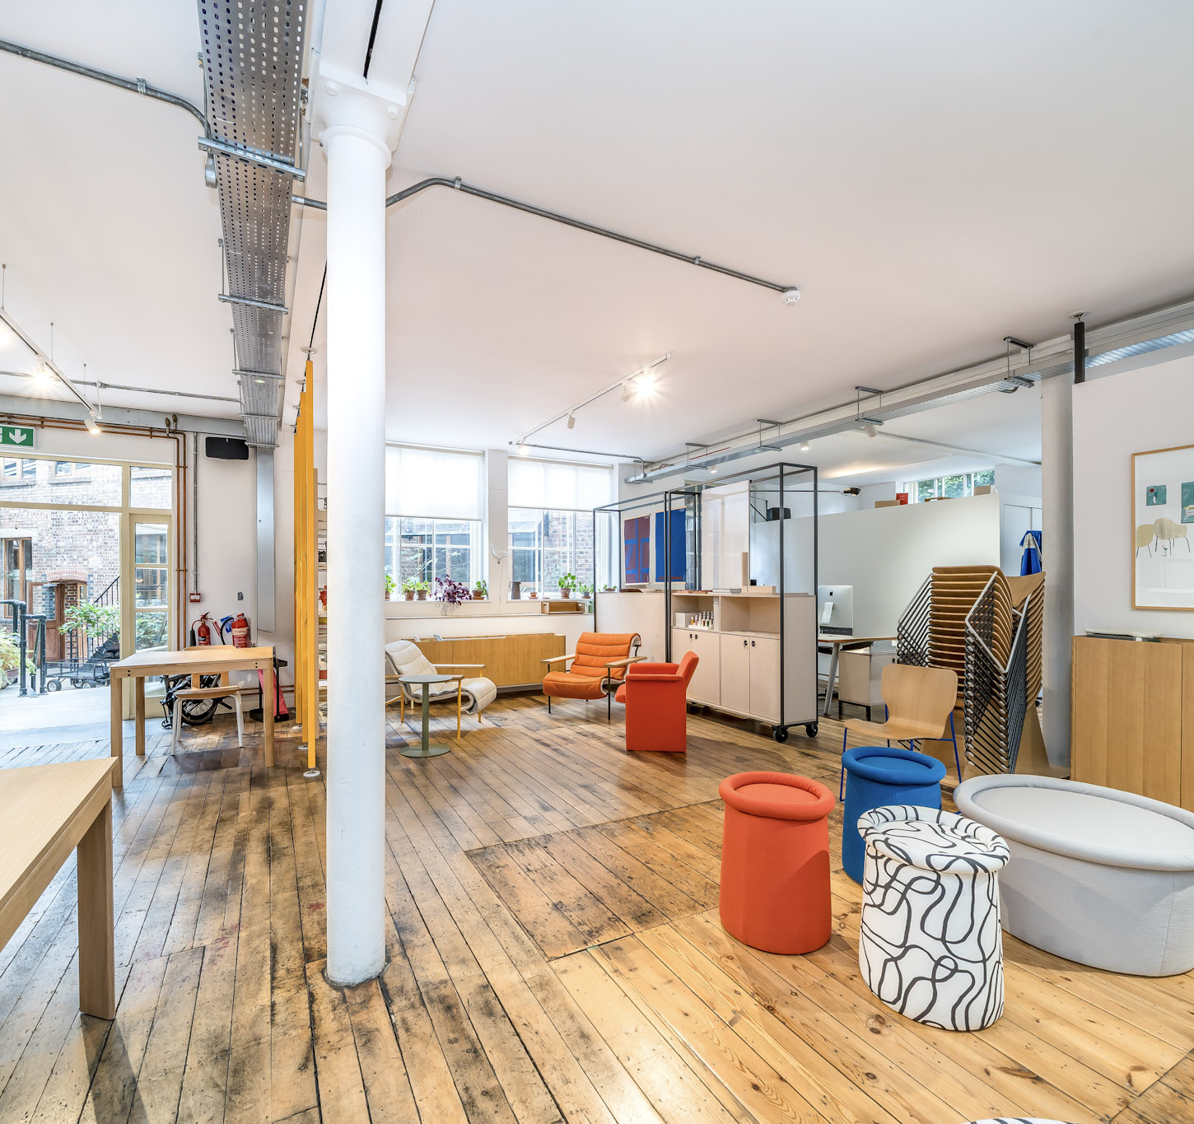
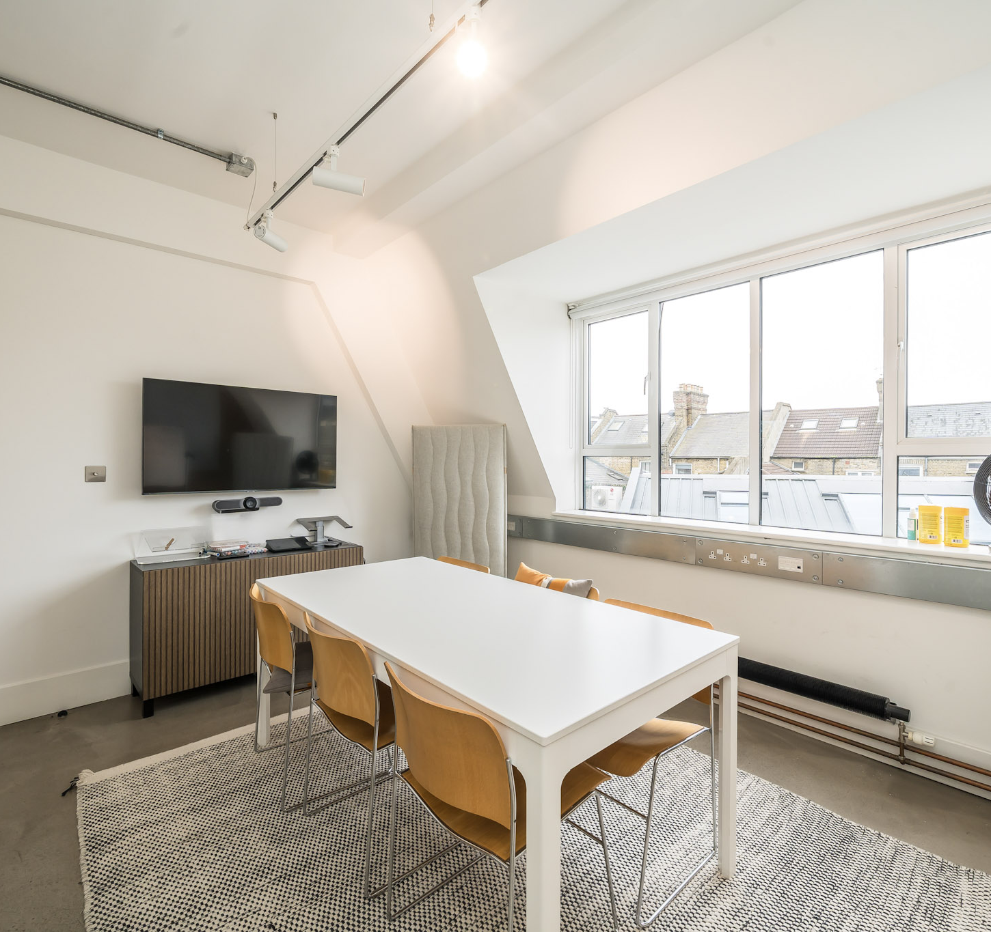

A2 Offley Works
Office In Creative Development
Location
Offley Works is located between Clapham Road and Brixton Road, close to the main crossroads junction at Kennington Park and within a very short walk of Oval Underground station (Northern line). Block C is on the eastern side of the site with access direct from Offley Road and from the Clapham Road entrance to Pickle Mews.
The development comprises a mixed commercial and residential regeneration of this former pickling factory complex, with a central communal courtyard and restaurant/café.
Description
Block A second floor comprises a fully refurbished contemporary office and the available accommodation comprises approximately 2,368 sq ft (245 sqm), arranged as two main open plan area and three meeting rooms plus kitchen. Excellent natural light, with windows along two sides, overlooking the central courtyard.
The courtyard café provides a central focal point for tenants within the development to promote flexible working and co-operation between occupiers and also has free Wi-Fi access together with a variety of food and drink offerings.
Ample on site cycle storage plus workshop. A number of additional amenities are available on a pay to use basis including; storage units/cages, cinema/presentation room, fitness studio and on site catering for meetings or events.

Slide 3
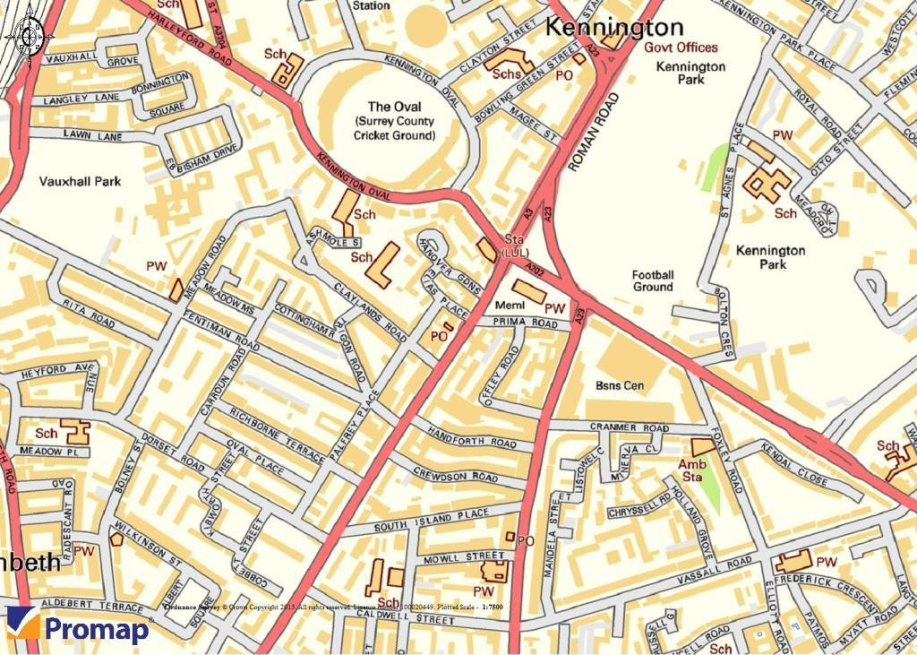
A2 Offley Works
Office In Creative Development
Amenities
Gas central heating
Surface power & data
Track mounted spot lighting
Polished concrete flooring throughout
High speed fibre available
On site security
Excellent natural light
Own kitchen
W.C.s and showers in the communal areas
Tenure
New direct lease on flexible terms.
Rent
£85,248 per annum, exclusive. VAT applicable.
Business rates
Rates payable for the year 2026/27 are approximately £10,733 (Ratable value £36,250).
Service charge
Currently approx. £8.50 per sq ft per annum.
Energy performance
EPC Asset Rating = Band B.
For further details, please contact:
Ben Locke or Nigel Gouldsmith
Tel: 020 7234 9639
E-mail: com@fieldandsons.co.uk
Disclaimer - Field & Sons for themselves and for their clients of this property whose agents they are give notice that: 1) These particulars are set out as a general outline only for the guidance of intending purchasers/tenants and do not constitute part of any offer or contract. 2) All descriptions, dimensions, references to conditions and necessary permissions for use and occupation and other details are given without responsibility and any intending purchaser or tenant should not rely on them as statements or representations of fact but must satisfy themselves by inspection or otherwise as to the correctness of each of them. 3) No person in the employment of Field & Sons has any authority to make or give any representation or warranty whatsoever in relation to this property.
www.fieldandsons.biz

