Slide 1
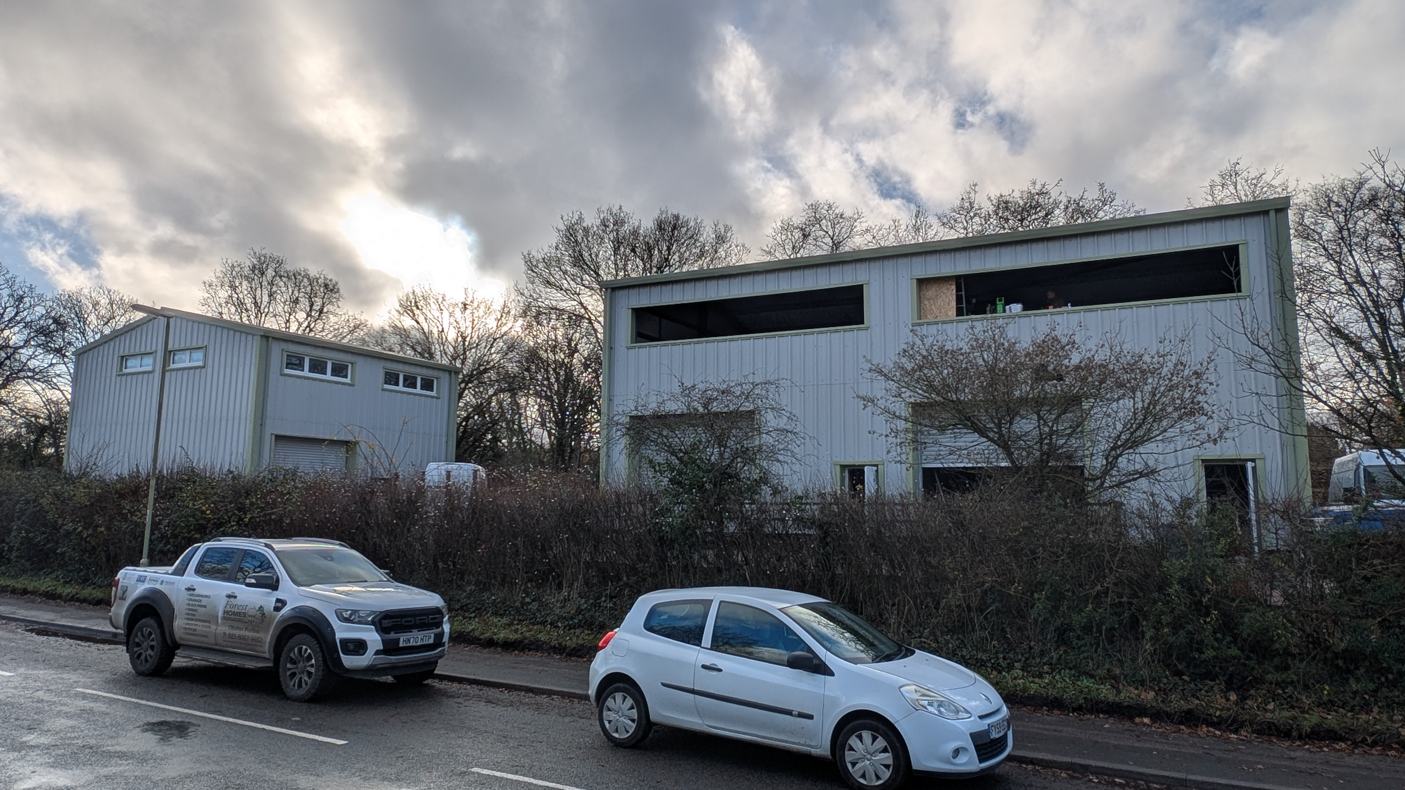

Units 1, 2 & 3 Anchor Point Business Park
Shore Road, Hythe, Southampton
SO45 6GJ
TO LET
www.hlp.co.uk
132.98 sq m (1,430 sq ft) Up To 442.20 sq m (4,756 sq ft
02382 022111
southampton@hlp.co.uk

Slide 2
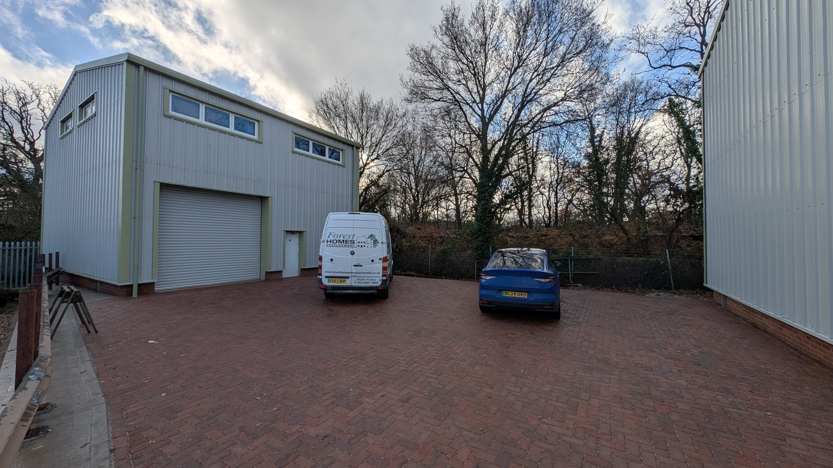
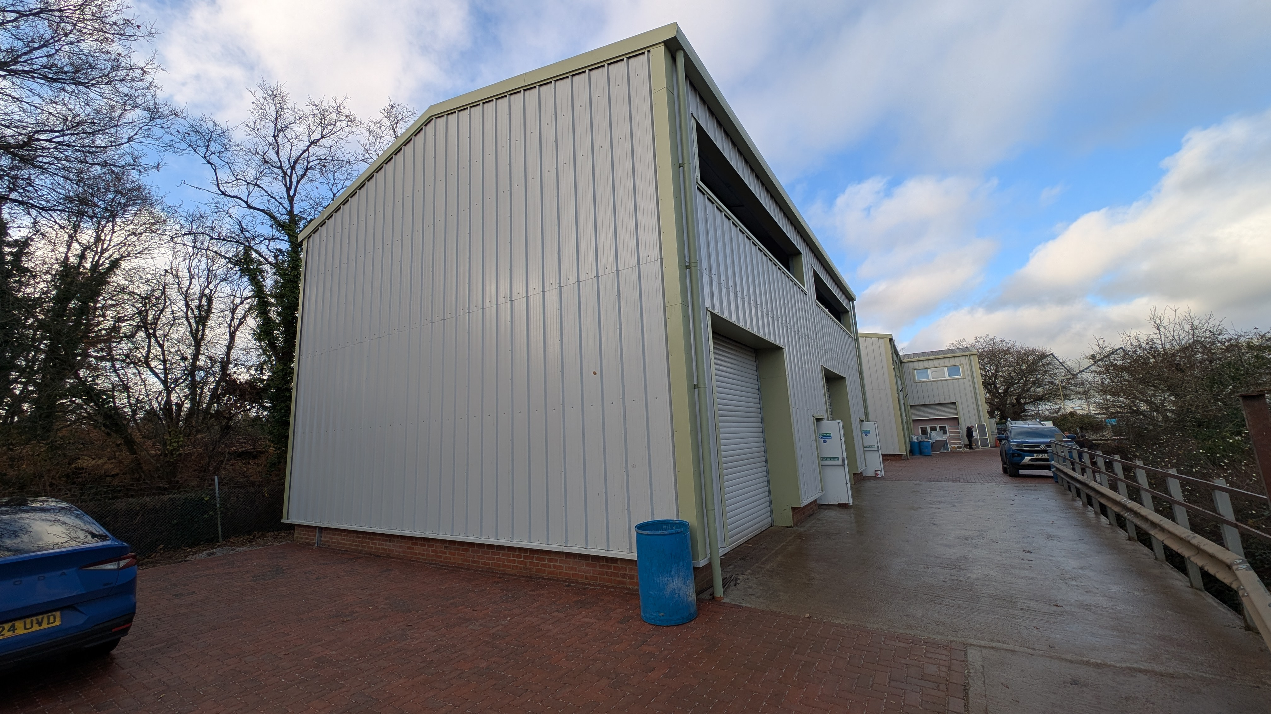
3 New Build Industrial/ Warehouse Units
Description
Anchor Point Business Park comprises a scheme of 6 small business units.. Unit 1, 2 & 3 comprise two semi detached units (2&3) and a single detached unit (1). These units are all built to the same specification on a steel portal frame with insulated profile metal sheet elevations and roof.
Access to the units is via roller shutter door or single personal entrance. Internally each unit has a mezzanine floor with 100% coverage with wooden staircase to each floor.
The first floors will benefit from double glazed ribbon windows with views over Southampton Water. Each unit has 3 phase electric and mains water and drainage. Externally the car parking and access road have been block paved.
Specification
Warehouse
Underside of mezzanine 4.16 m
Unit 1 electric roller shutter door 3.61m wide by 3.46 m high
Units 2 & 3 electric roller shutter door 3.50m wide by 3.46 m high
Insulated profile metal sheet roof & elevations
Concrete floor
Mains water and drainage
3 phase electric supply
Single WC
1st floor mezzanine
Chip board floor on metal frame
Double glazed windows
Wooden staircase
External area
Block paviour car parking

Slide 3
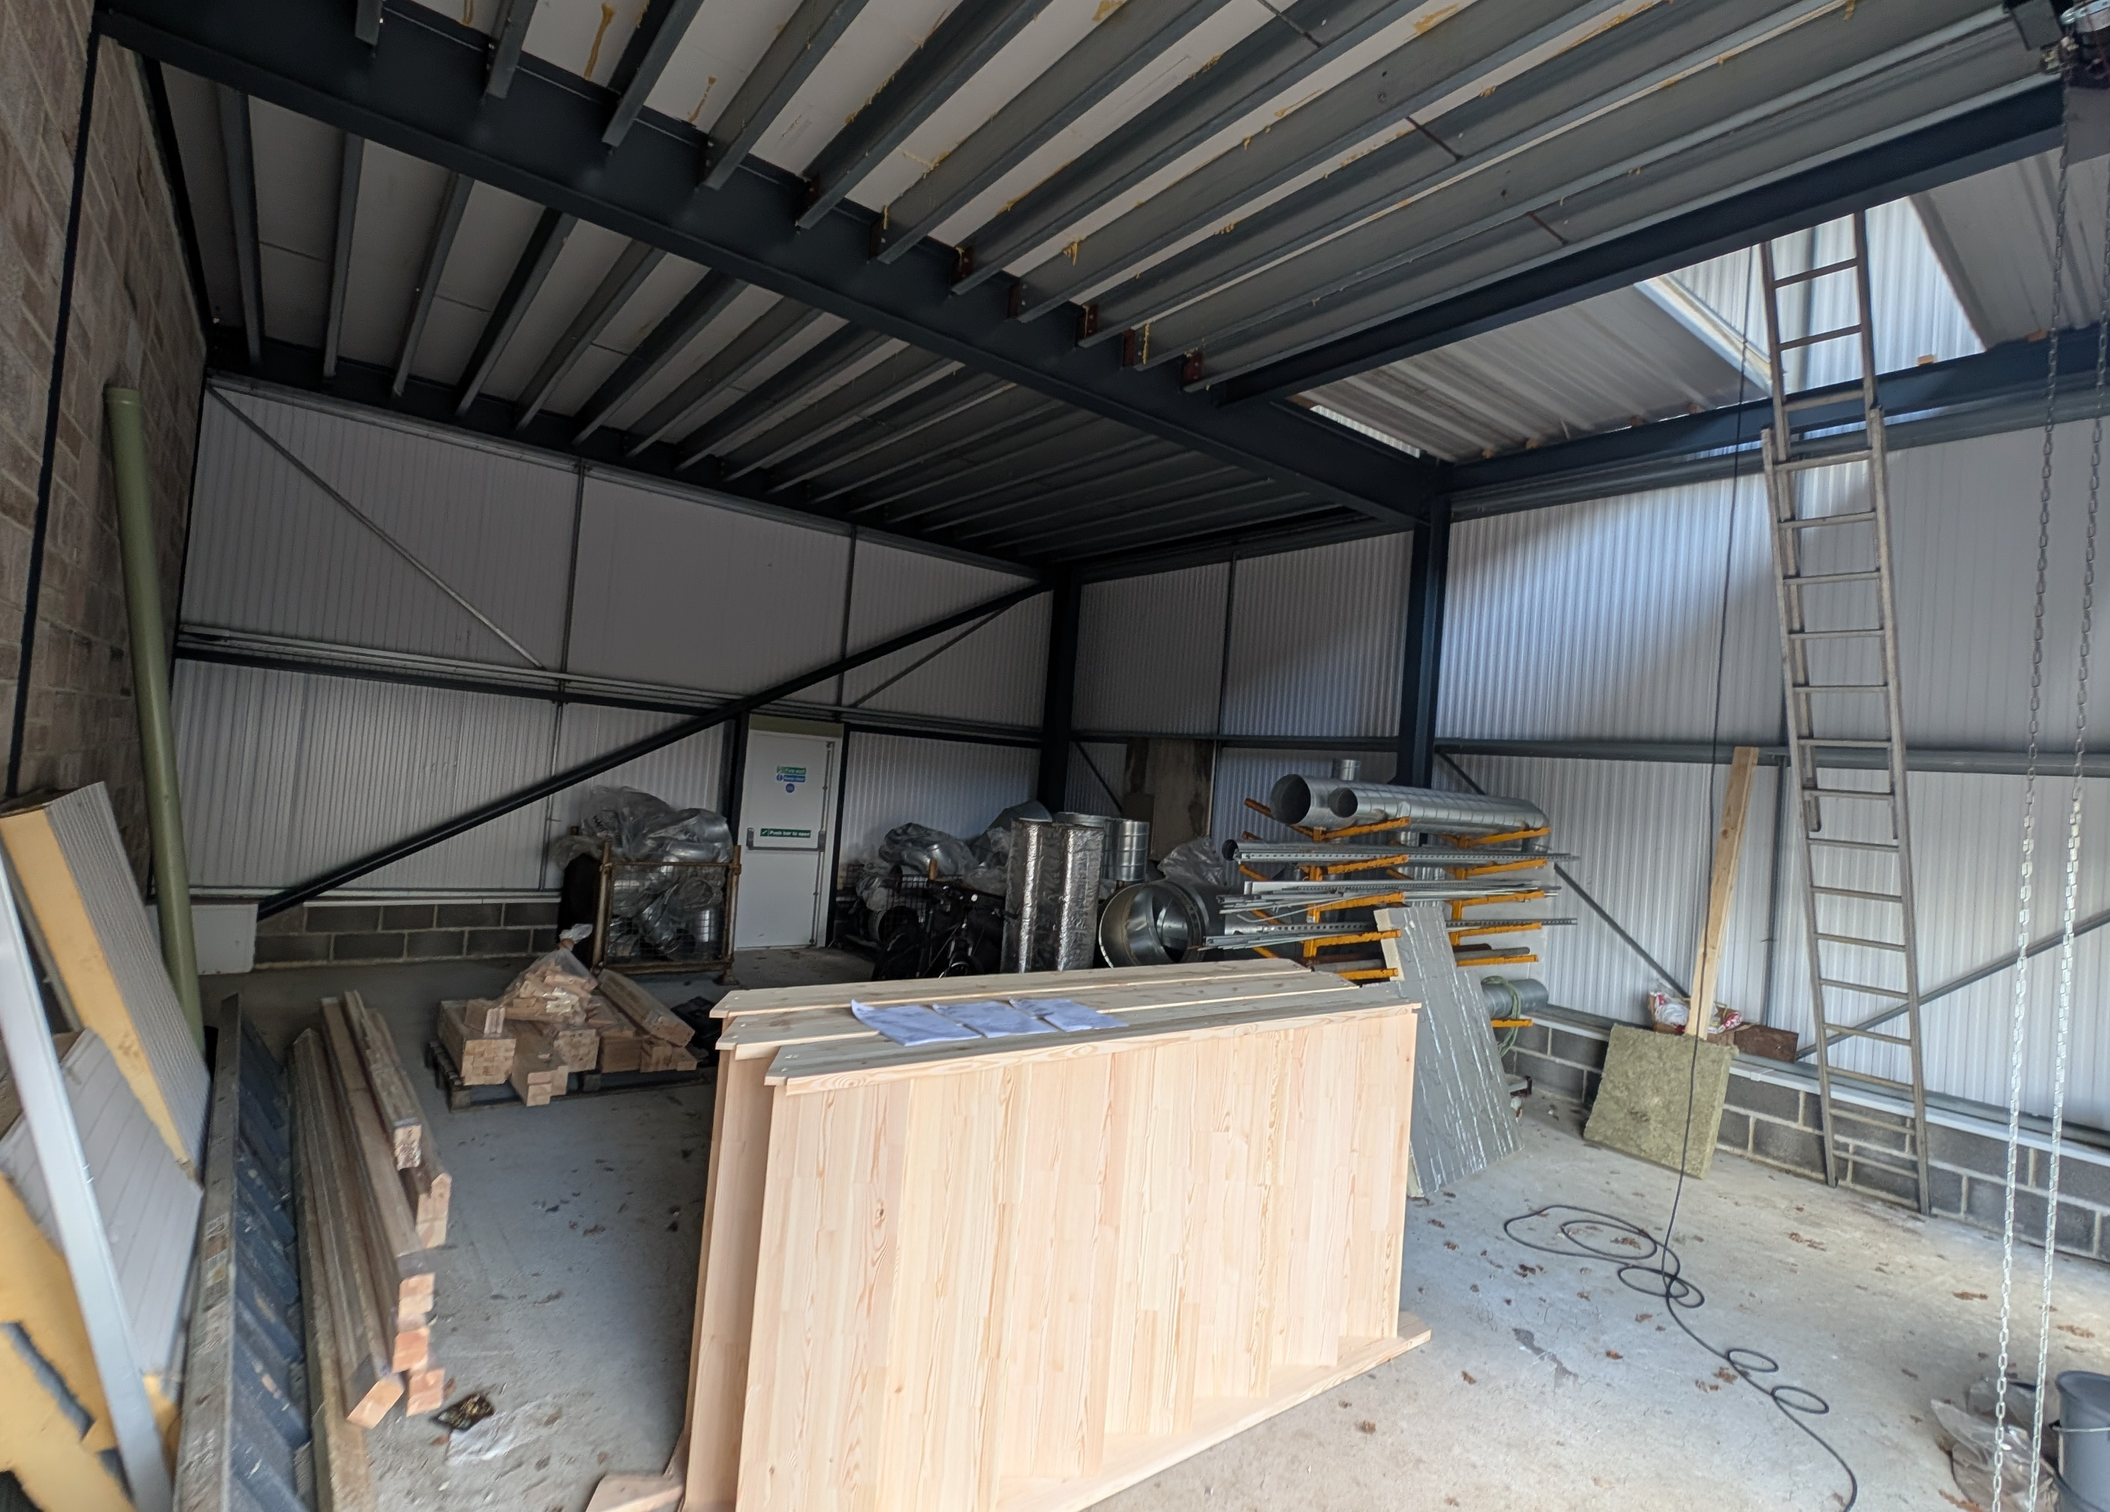
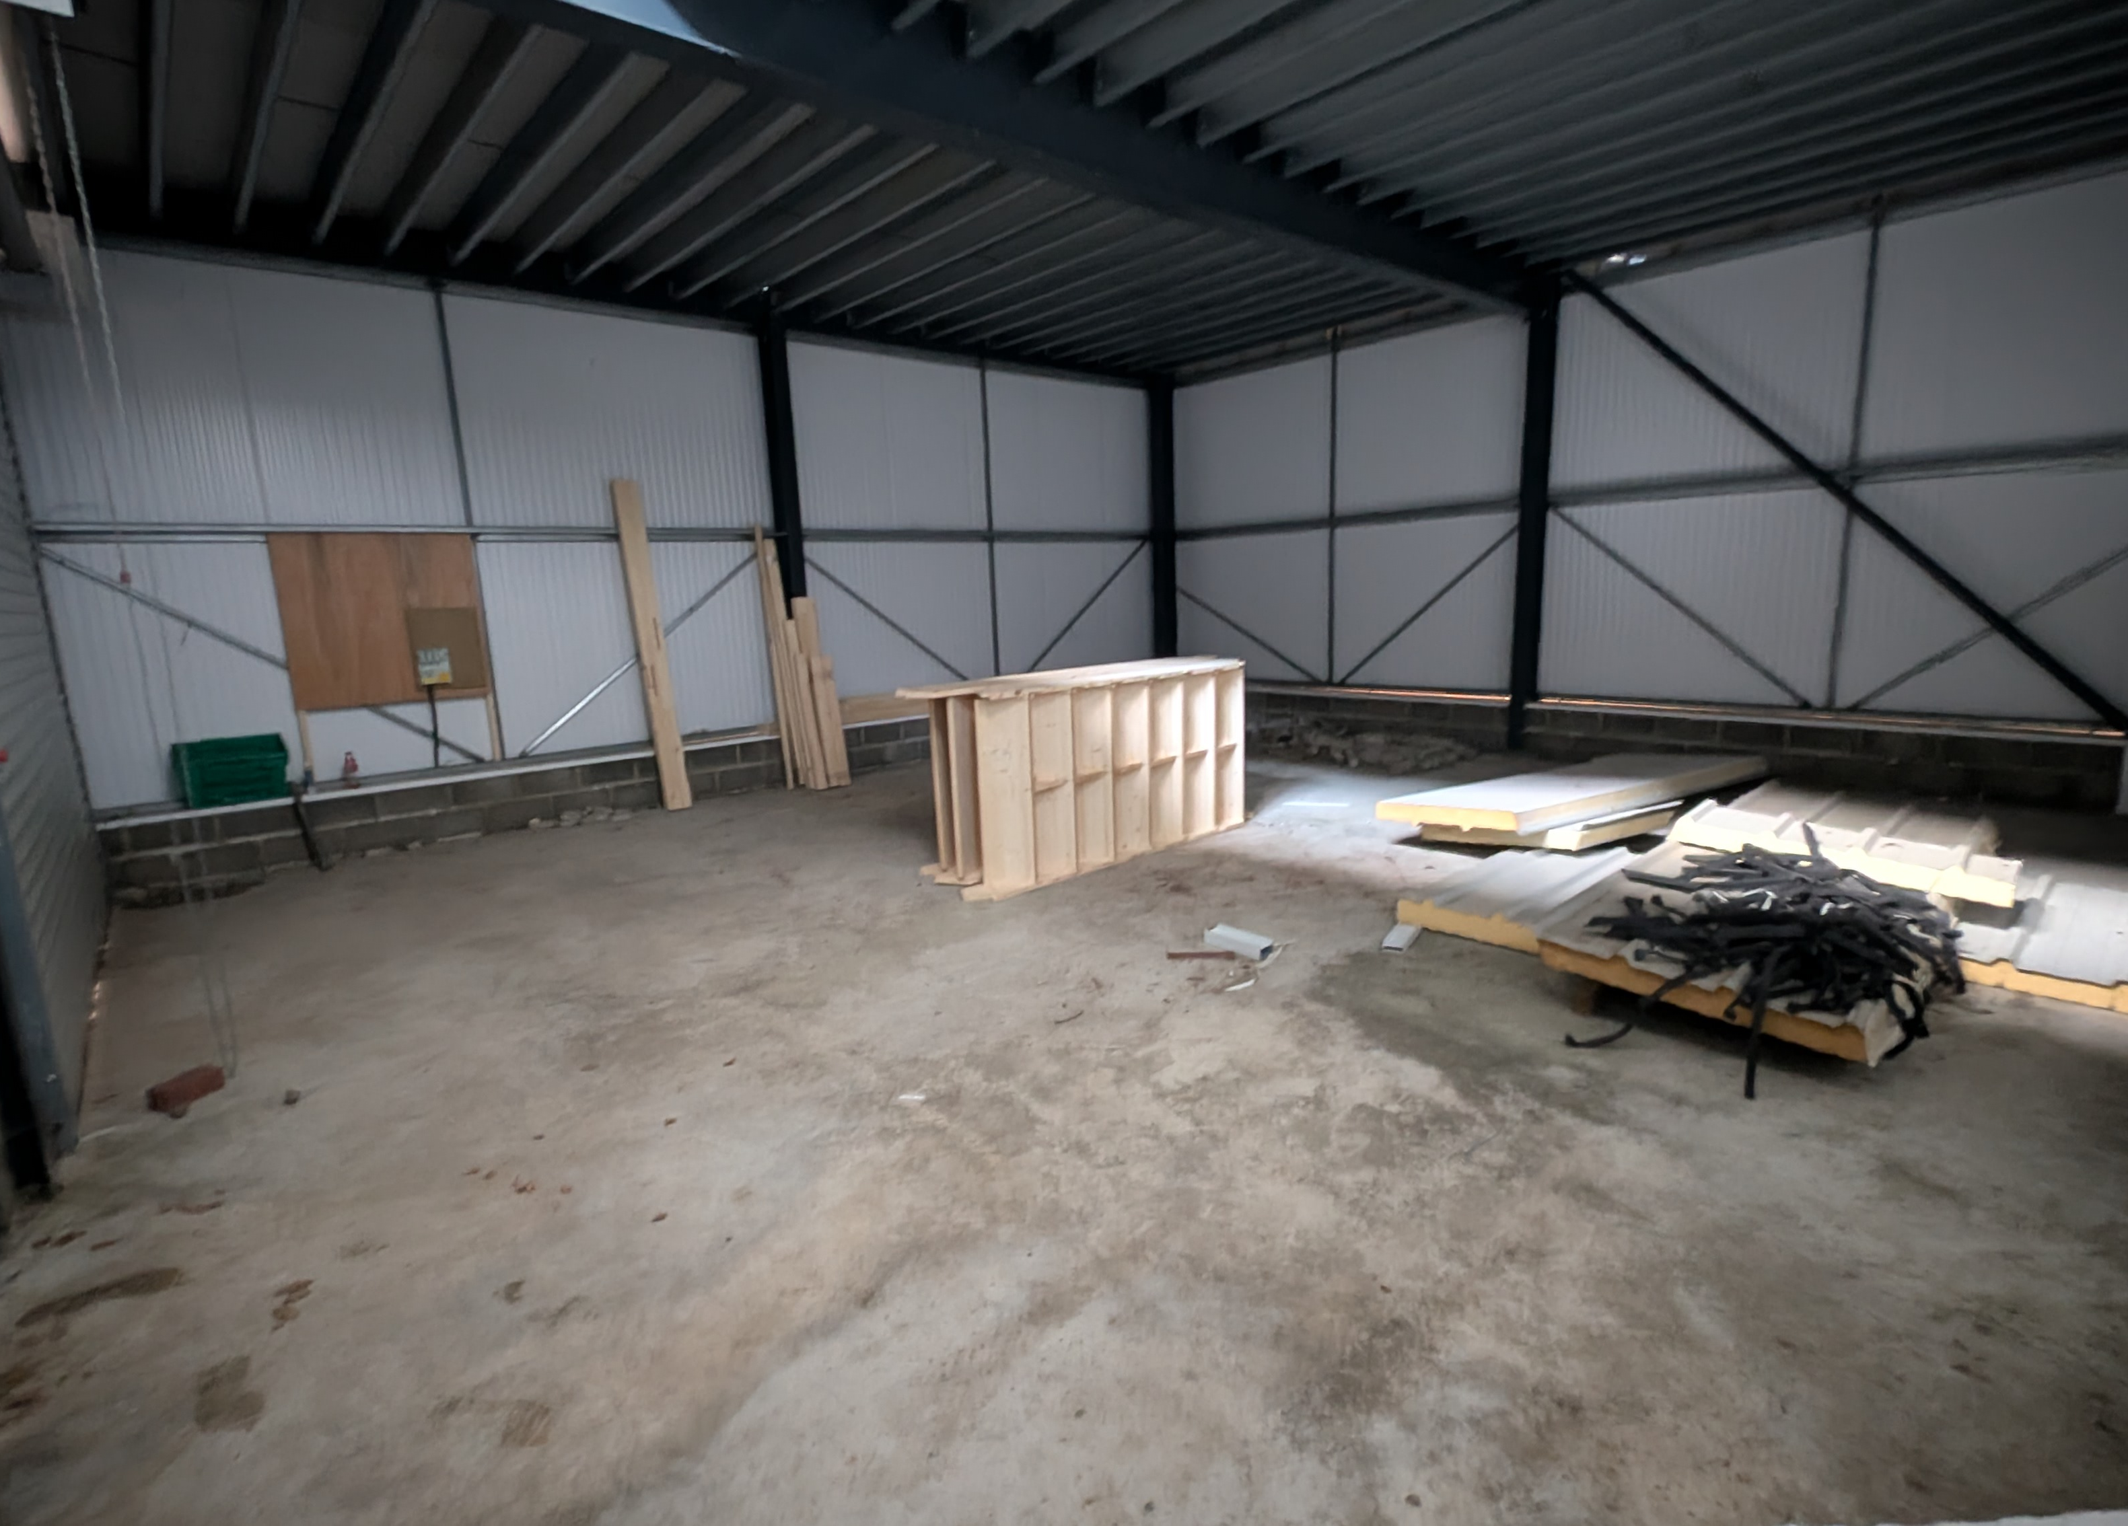
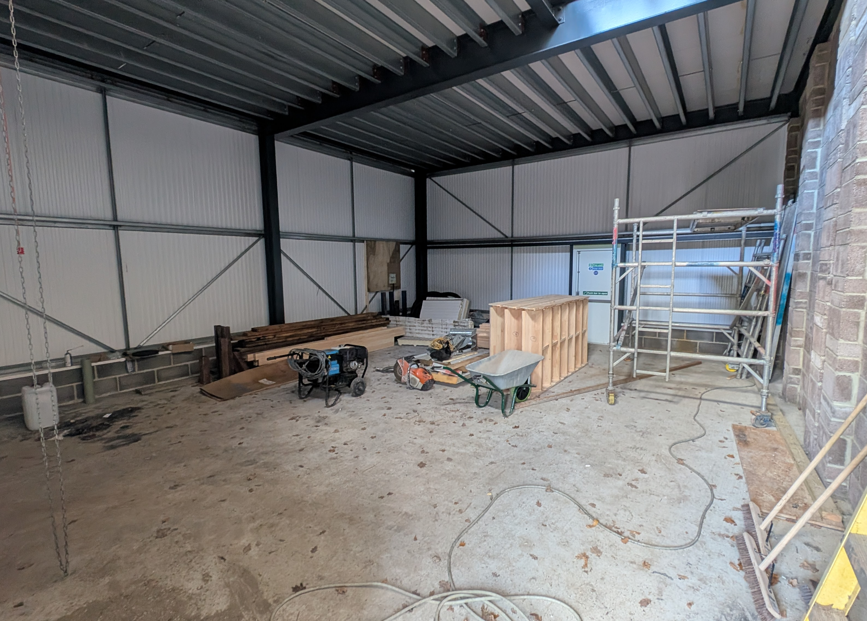
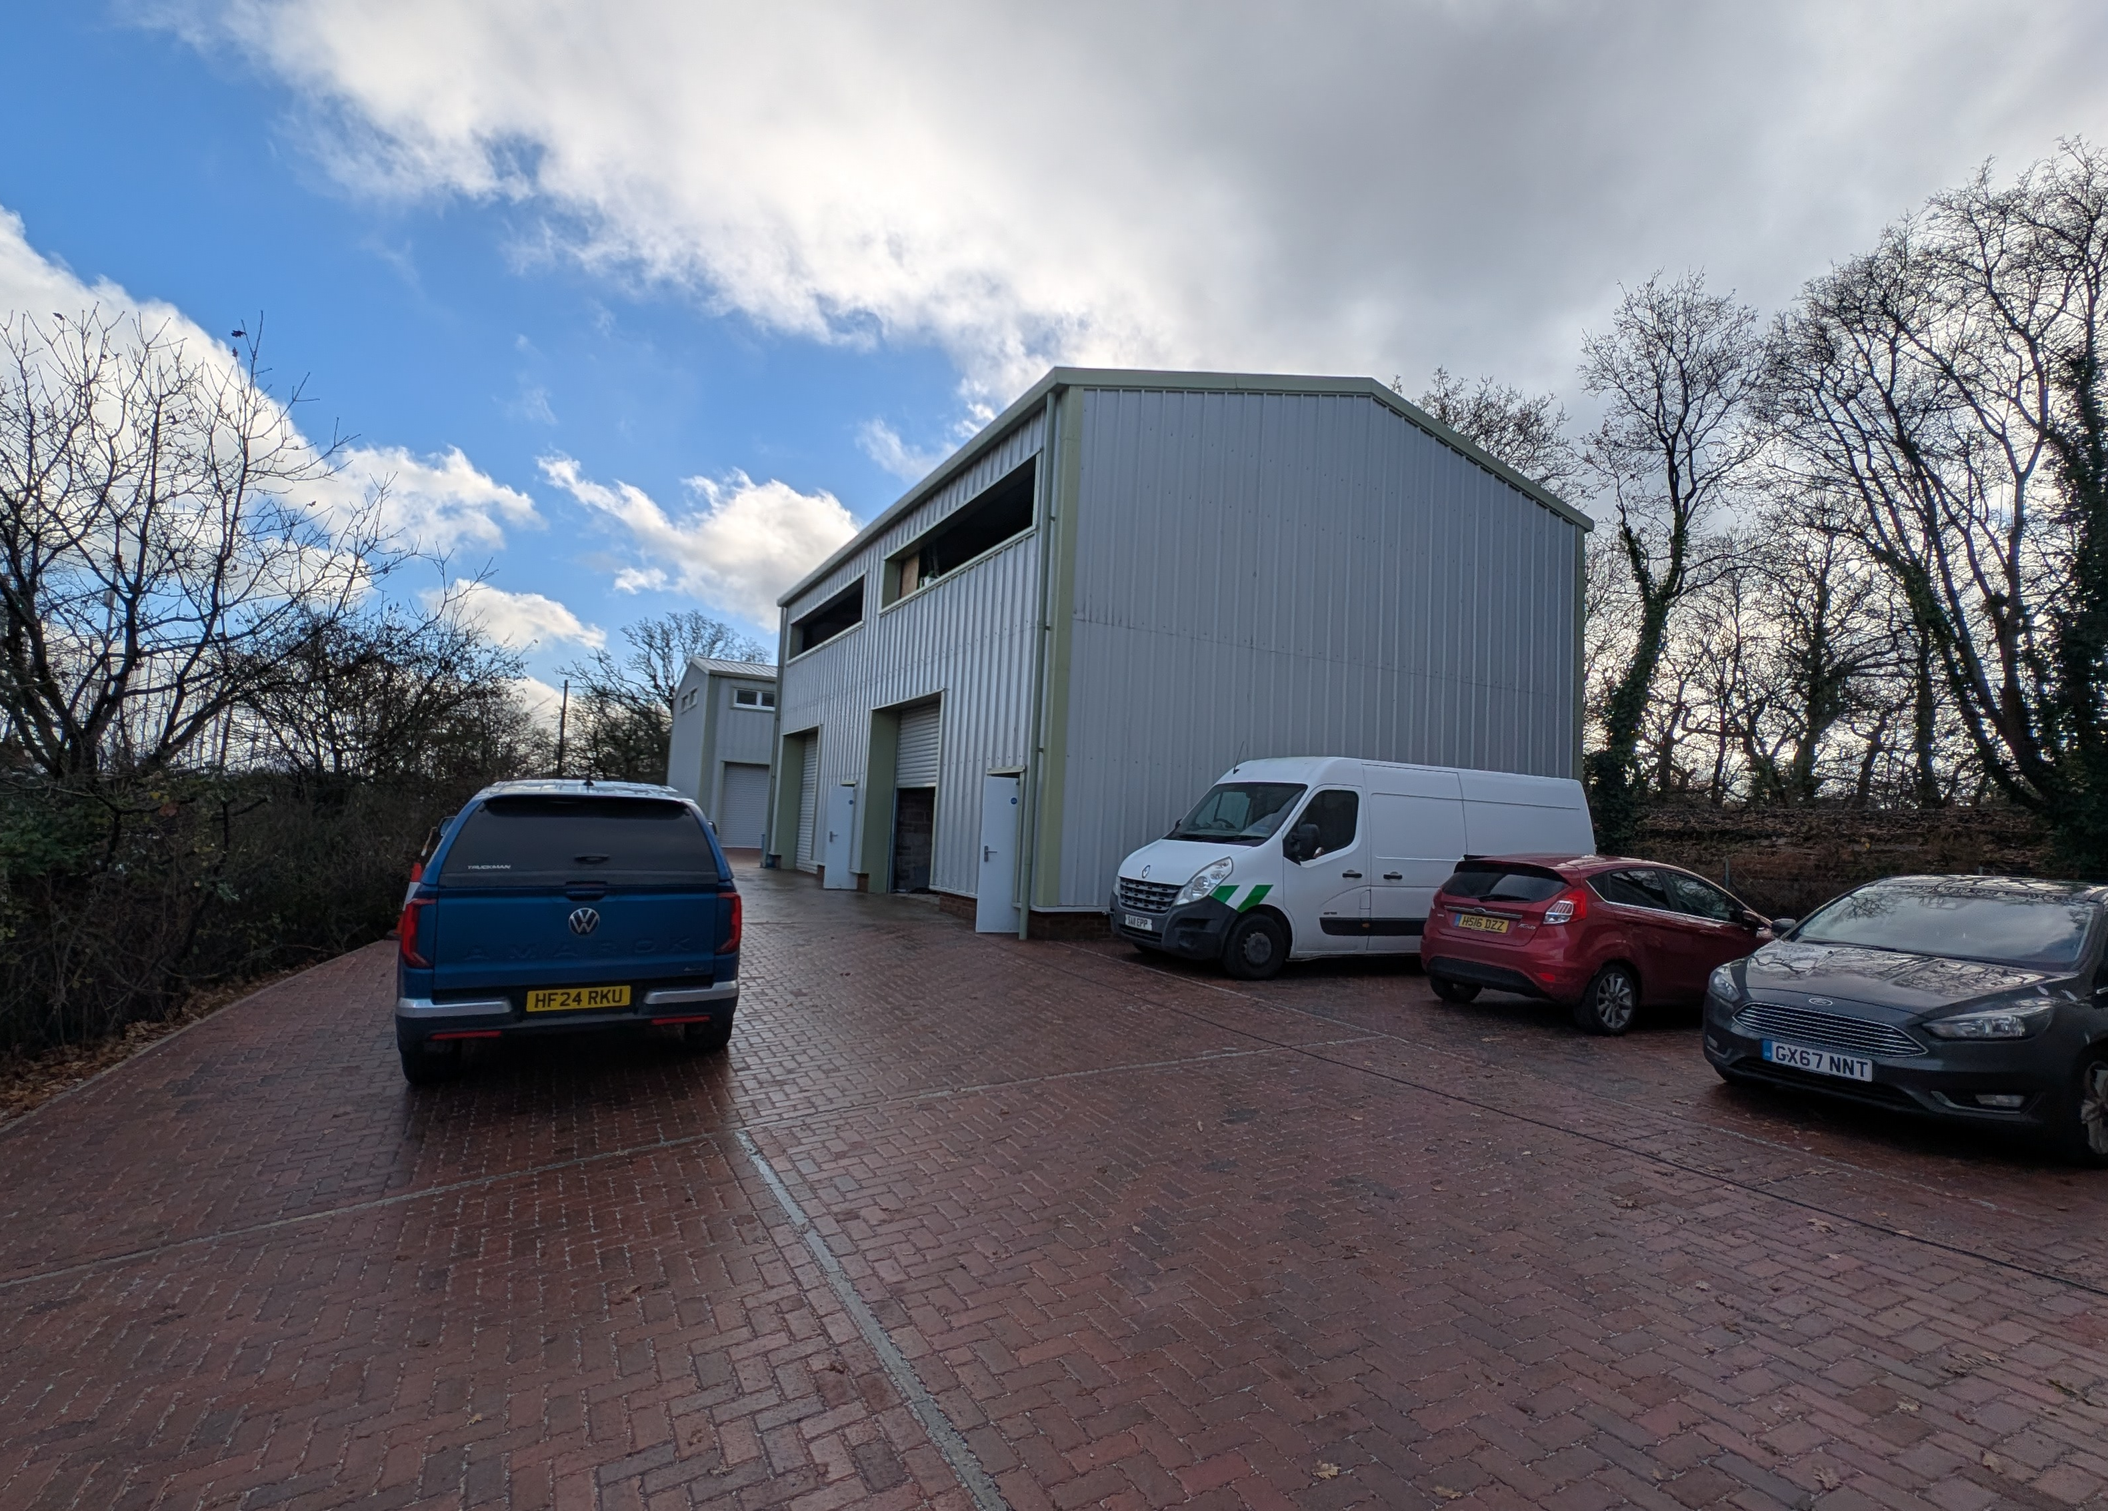

Slide 4
3 New Build Industrial/ Warehouse Units
Accommodation
The accommodation has been measured in accordance with the RICS Code of Measuring practice (6th Edition) to GIA as follows:
Business Rates
The premises are currently under construction and have not yet been assess for the purposes of Business Rates
Estate Charge
We understand there is currently no estate service charge however the lease allows provision for one in the future if so required.
EPC
TBC
Terms
The premises are available by way of a new Full Repairing and Insuring lease on terms to be agreed.
Rent
Unit 1 - £29,750 per annum
Unit 2 - £19,750 per annum
Unit 3 - £19,750 per annum
VAT
Unless otherwise stated terms are strictly exclusive of Value Added Tax and interested parties must satisfy themselves.
Unit 1 | Sq m | Sq ft
Warehouse and ancillary areas | 87.76 | 944
First floor mezzanine | 87.76 | 944
Total | 175.52 | 1,888
Unit 2 | Sq m | Sq ft
Warehouse and ancillary areas | 66.85 | 719
First floor mezzanine | 66.85 | 719
Total | 133.70 | 1,438
Unit 3 | Sq m | Sq ft
Warehouse and ancillary areas | 66.49 | 715
First floor mezzanine | 66.49 | 715
Total | 132.98 | 1,430

Slide 5
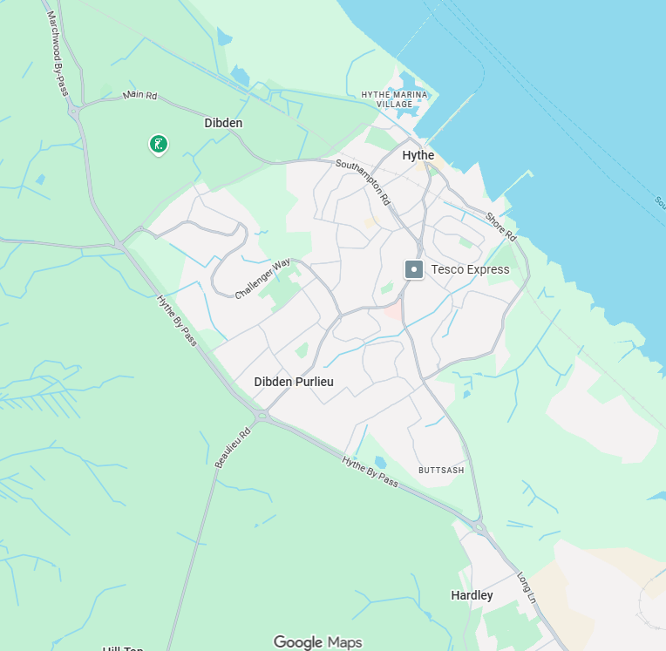
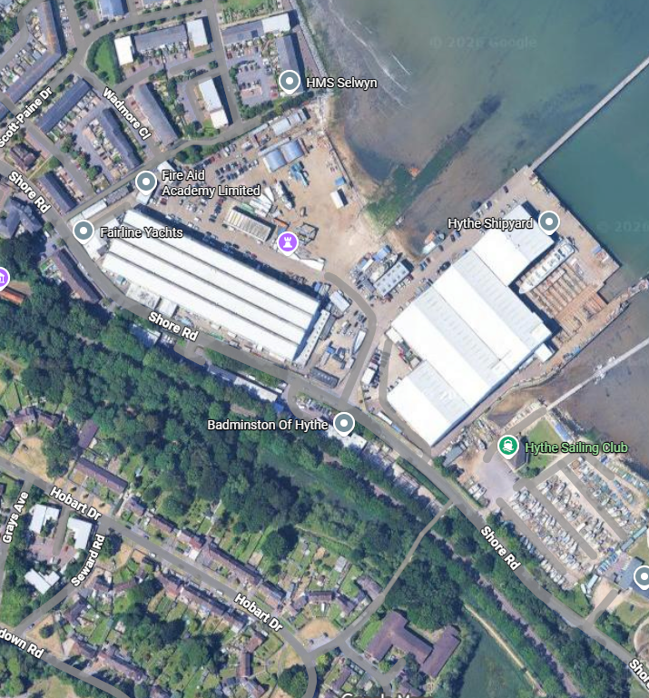



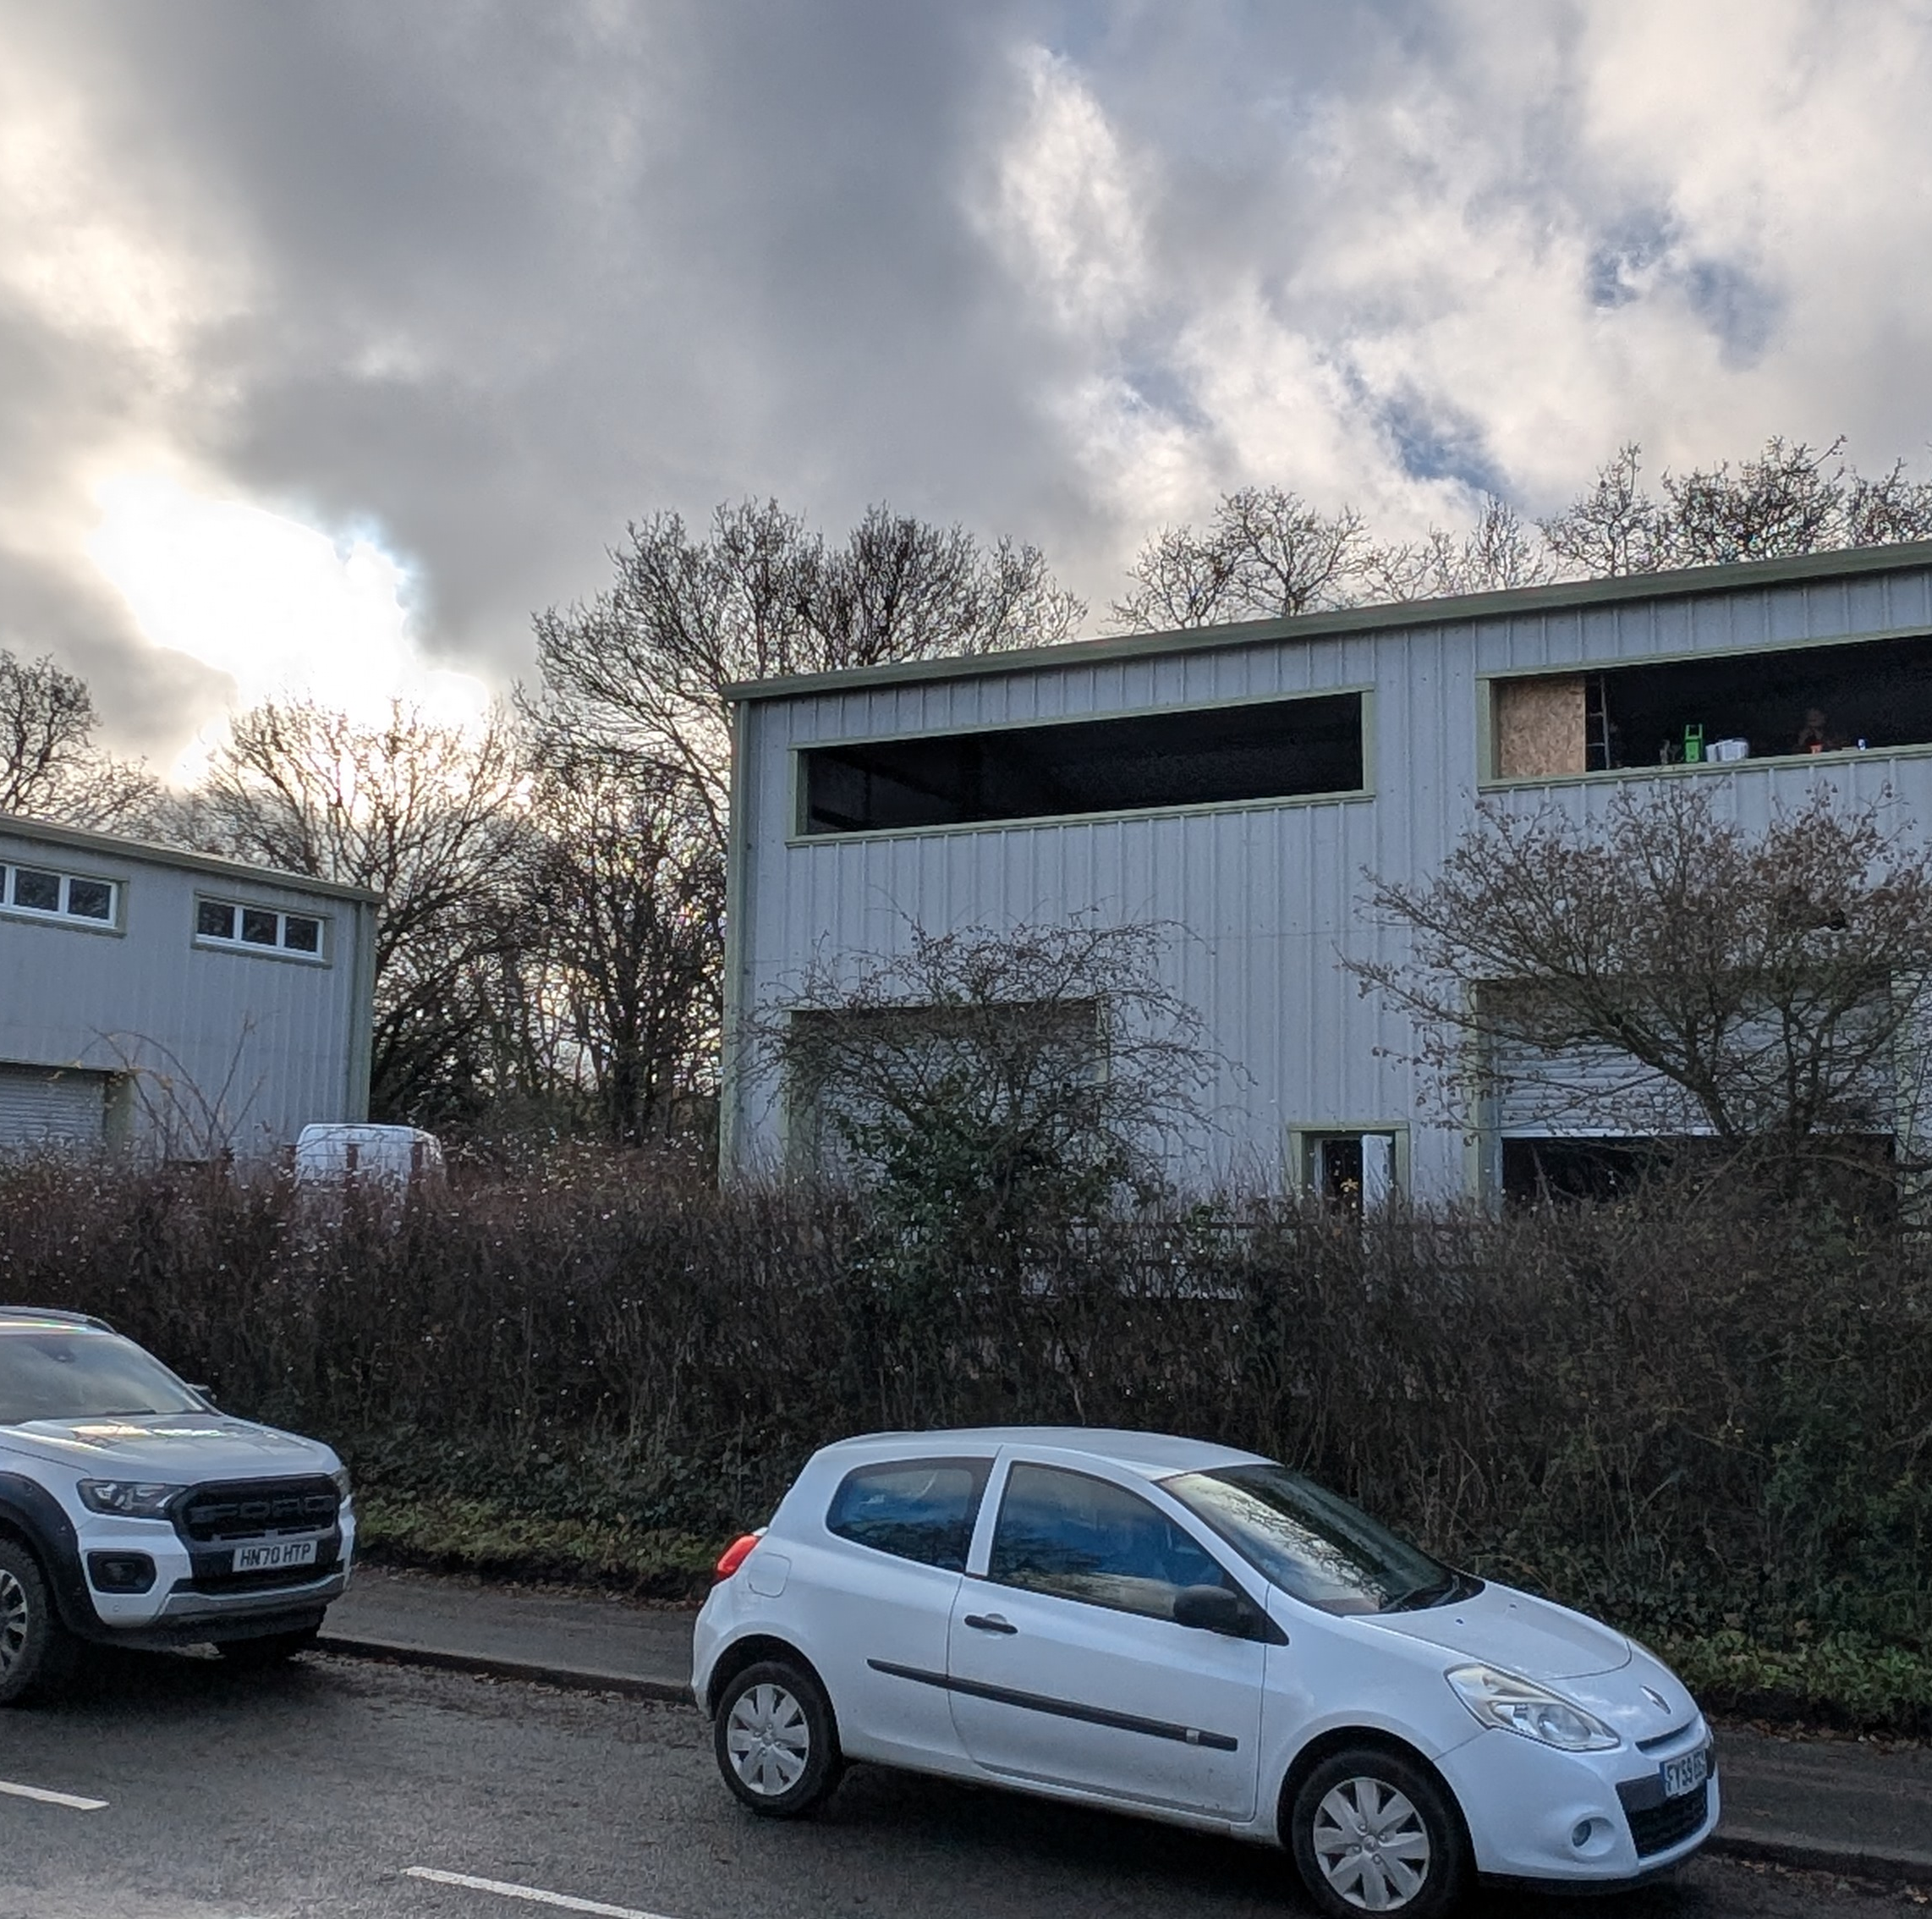



Location
The units are located on Shore Road, Hythe opposite Hythe Marine Park overlooking Southampton Water.
AML
In order to comply with Anti-Money Laundering Regulations 2017 (as amended) and the Proceeds of Crime Act 2002, Hellier Langston are required to identify all prospective purchasers and tenants.
Code for Leasing Business Premises
In England and Wales, the Code for Leasing Business Premises, 1st edition, strongly recommends that any party entering into a business tenancy or lease agreement takes professional advice from a surveyor or solicitor. A copy of the Code (1st edition, February 2020) can be found on the RICS website.
Strictly by appointment with sole agents Hellier Langston

