Slide 1


TO LET
Units 6 & 7 Cape Road
Warwick • CV34 5DS
Storage/Warehouse facility.
Good rental value of £5psf.
Available Immediately on new lease.
Great Location, Close to A46 Bypass, Leamington Spa & Warwick Town Centre’s.
On site Parking.
Accommodation Available:
Total: 12,894 Sq. Ft (1,197.88 Sq. M)
Rent: £64,470 P.A.X
01926 430700 • www.wareingandcompany.co.uk

Slide 2
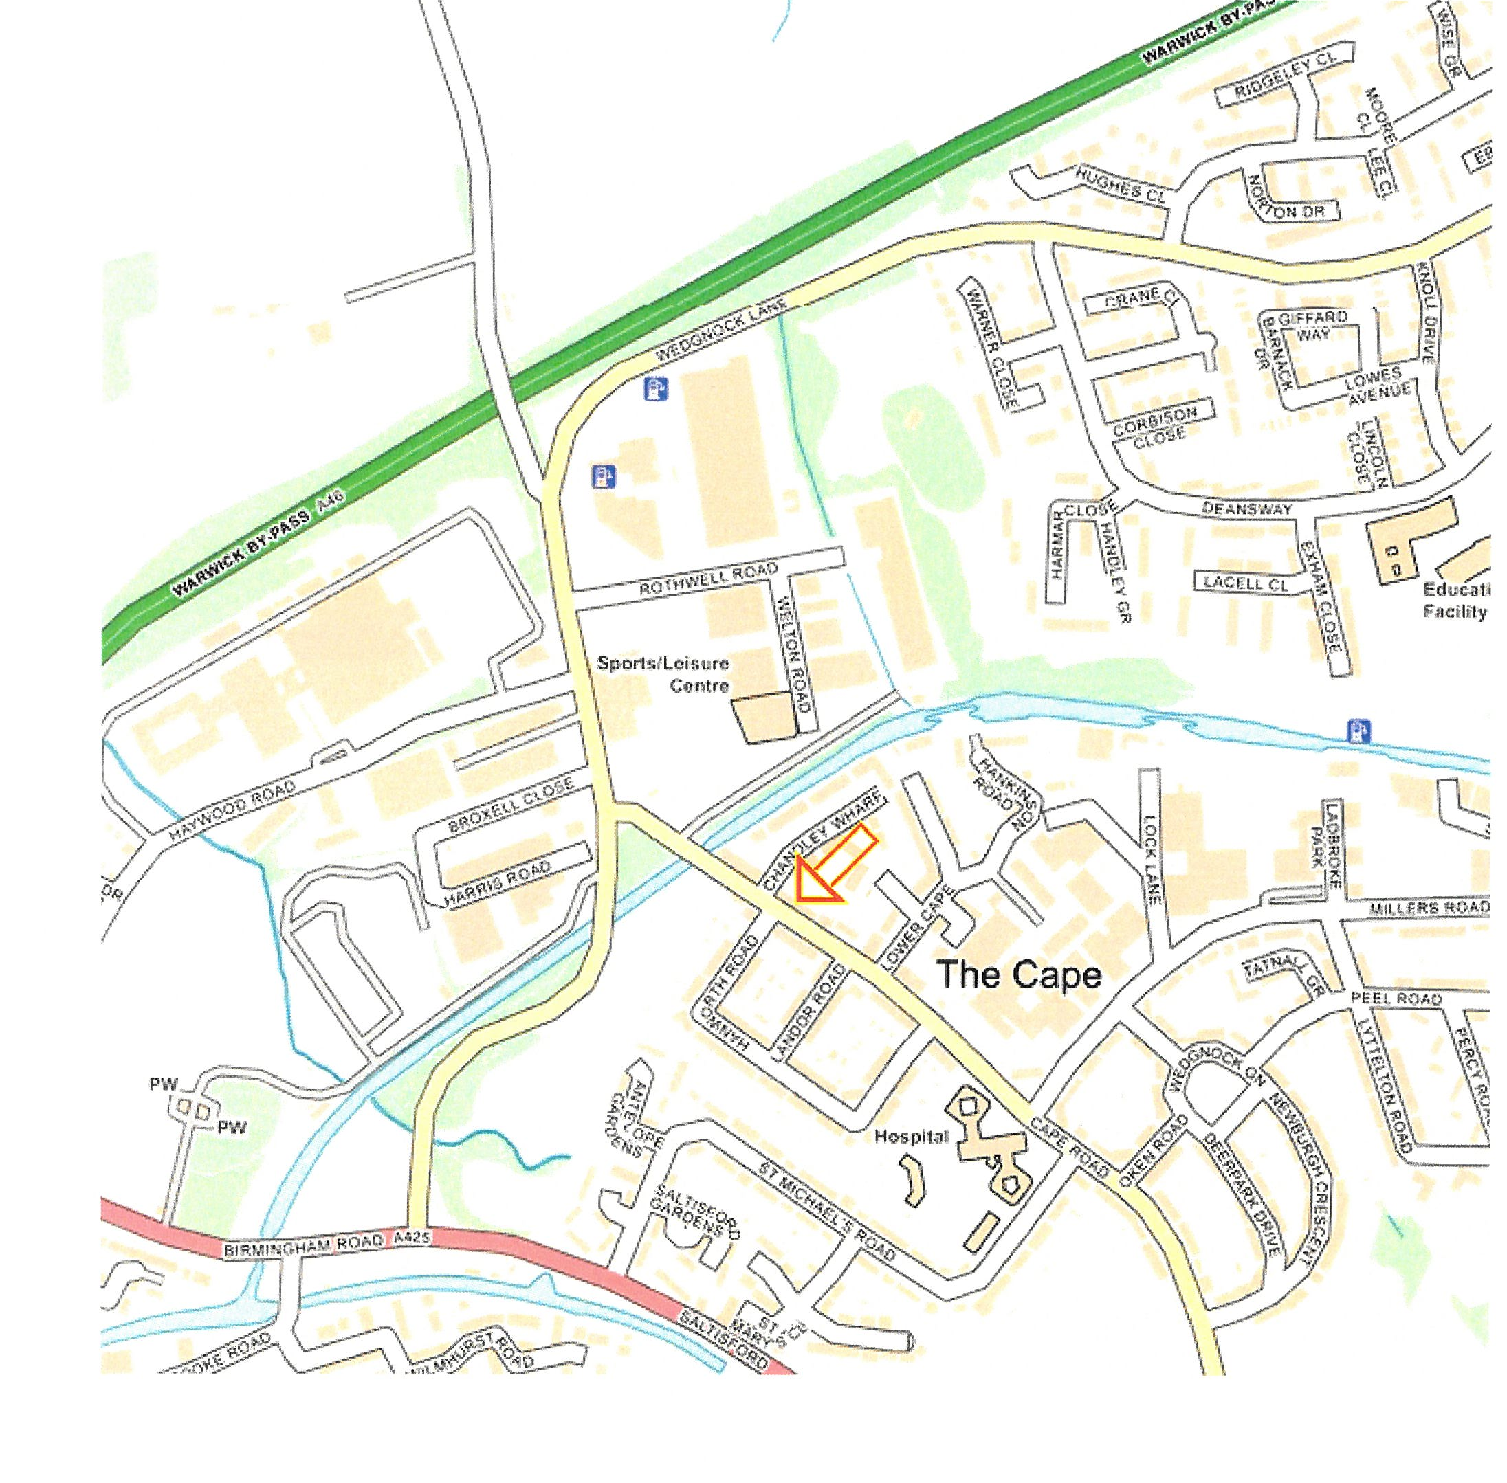

Location
The subject property is situated off Cape Road and is accessed via a shared service road.
The Estate is located within An approx. 5 minute drive of the A46 Bypass which in turn provides excellent access to the wider Midland motorway network.
The property is 1.6 miles from Warwick Parkway Train Station and Warwick Town Centre is approximately 1.4 miles Southeast. Furthermore, Warwick Hospital is only 1.2 Miles West of the site.
Notable local occupiers include Volvo Group, Maxi Haulage, Royal Mail, Avonvale Vets but to name a few.
As for amenities, the property is situated close to the Co-Operative on the corner of Cape Road and Millers Road, M&S Food/BP at Guys Cliffe is a short drive away and the Cape of Good Hope Public House is approx. 10 Minutes Walk.
Guide Price: £430,000

Slide 3
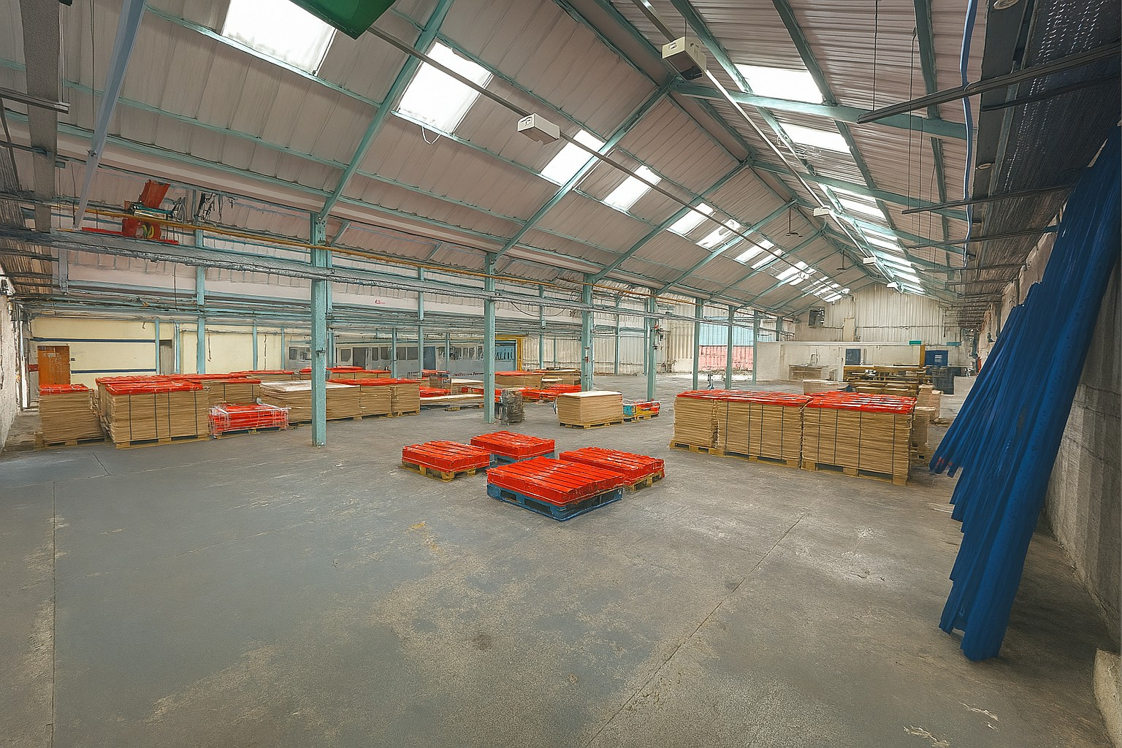
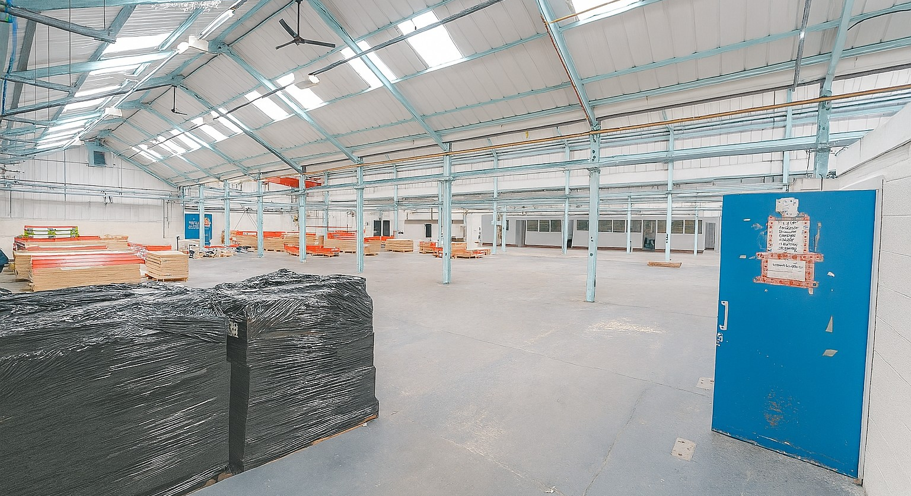
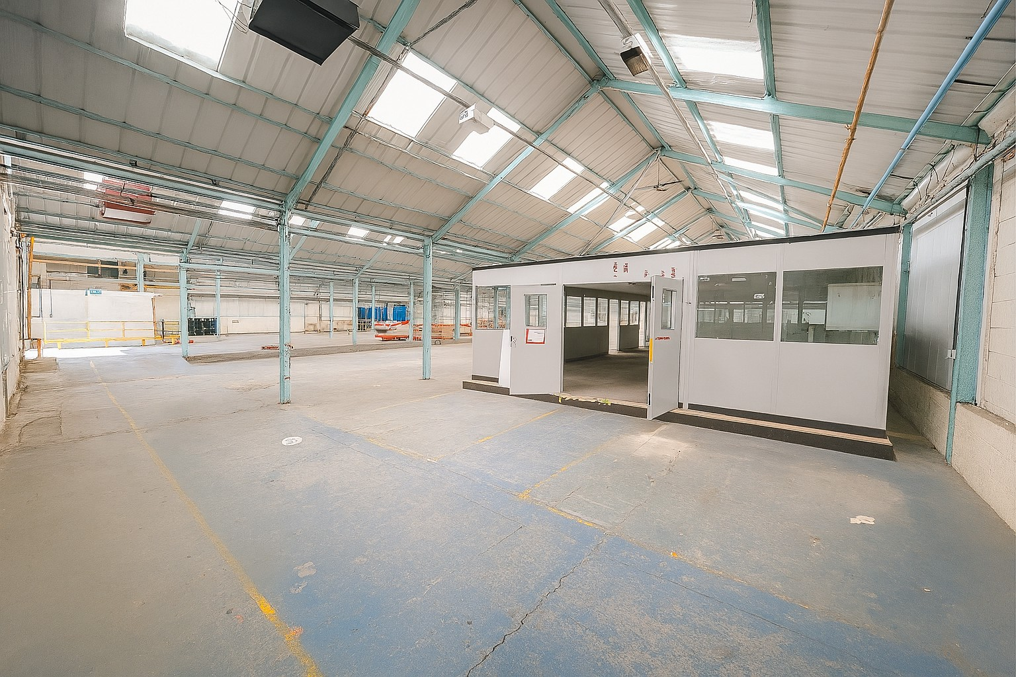
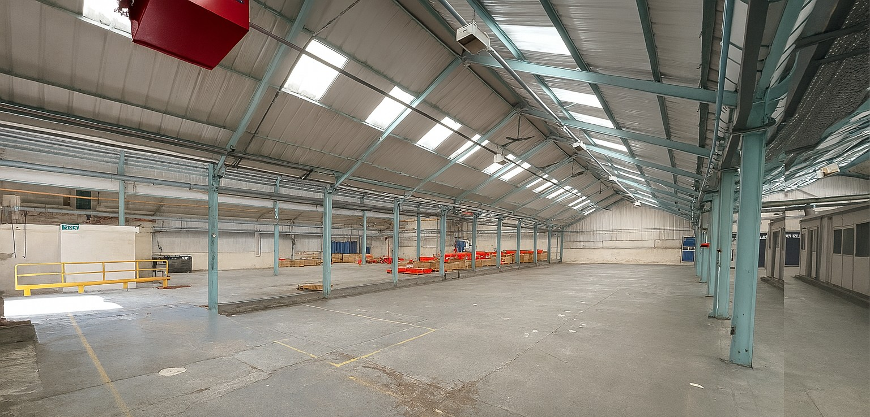

Slide 4
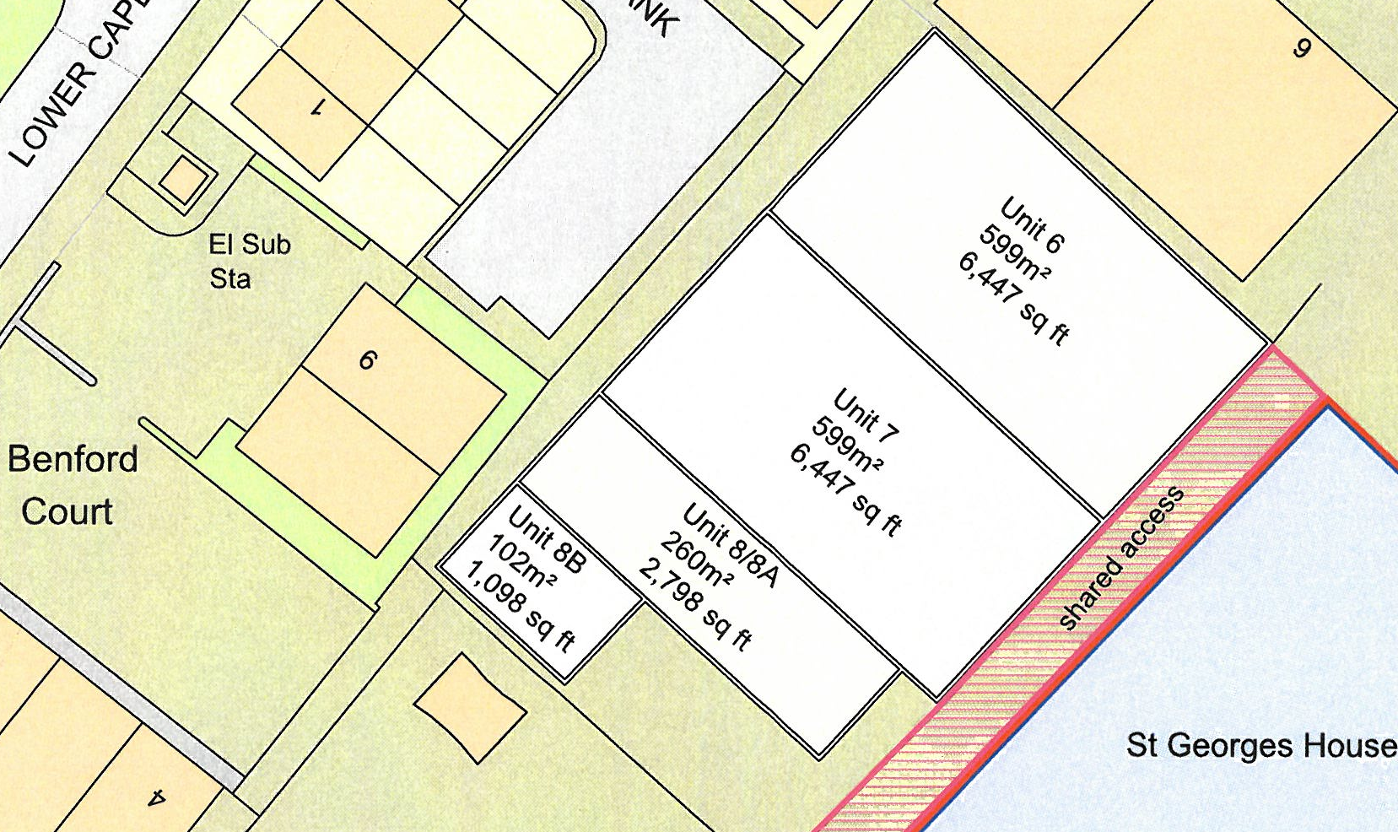
Description
The property comprises:
A detached warehouse arranged over 4 bays.
Depth TBC x Width TBC.
Steel Portal Frame constructed to an eaves height ranging from TBC
Solid Concrete Floor.
Internal masonry walls with surmounted profile cladding system.
Suspended lighting.
Profile cladding roof incorp roof lights which was installed 2 years ago.
Electric Roller Shutter Door.
WC & Tea point facilities.
On site Parking.
Three Phase Electric Supply.
Guide Price: £430,000

Slide 5


Services
We understand that mains electricity, water and drainage are connected to the site however, interested parties are advised to satisfy themselves that this is the case and that they are in good working order. The agents have not tested any apparatus on site and therefore, cannot verify the conditions.
Planning
We understand that the property will have the benefit of planning permission for User Class E purposes. Interested parties are advised to make their own enquiries of Warwick District Council Planning Department on 01926 456760.
EPC
TBC.
Business Rates
Estimated Rateable Value: £68,750
Estimated Rates Payable: £37,537.50 per annum
Anti Money Laundering
The Money Laundering Regulations require us to conduct checks upon all Purchasers including Tenants. Prospective Purchasers will need to provide proof of identity and residence. For a company any person owning more than 25% must provide the same.
Tenure
The property is available to let by way of a new full Repairing and Insuring lease for a term to be agreed at a rent of £64,470 Per Annum Excl. VAT.
Legal Costs
Each Party will meet their own legal and professional costs.
Viewing Arrangements:
Strictly by prior arrangement with the sole agent:
Jonathan Blood MRICS
T 01926 430700 • M 07736 809963
E Jonathan.blood@wareingandcompany.co.uk
Wareing & Company
38 Hamilton Terrace, Holly Walk,
Leamington Spa Warwickshire CV32 4LY
www.wareingandcompany.co.uk
Guide Price: £430,000
Wareing & Company for themselves and for the seller/lessor of this property who they are agents, give notice that 1. These particulars do not constitute any part of an offer or a contract. 2. All statements contained in these particulars are made without responsibility on the part of the agent(s) or the seller/lessor. 3. None of the statements contained in these particulars are to be relied upon as a statement or representation of fact. 4. Any intending buyer or tenant must satisfy themselves by inspection or otherwise as to the correctness of each of the statements contained in these particulars. 5. Wareing & Company does not make or give nor any person in their employment has any authority to make or give any representation or warranty whatsoever in relation to this property.

