Slide 1
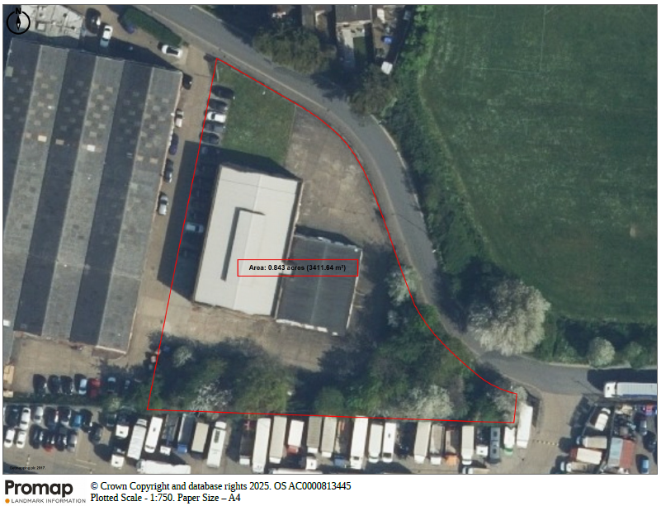

FOR SALE – FREEHOLD INDUSTRIAL / WAREHOUSE / OPEN STORAGE
RARE F REEHOLD UNIT / SIT E – 0.84 acres
New Ford Business Centre, New Ford Road, Waltham Cross, EN8 7PG
Key Highlights
Total Site Area of 0.84 acres (0.34 hectares). Title no. HD276311.
Excellent Transport Connectivity, with proximity to A121 and the M25 (J25)
8,740 sq ft warehouse/ office facilities
Fenced and secure yard area, 360 circulation.
Waltham Cross over ground station within walking distance
Available with full vacant possession.
33 Margaret Street
London W1G 0JD
+44 (0)20 7499 8644
savills.co.uk

Slide 2
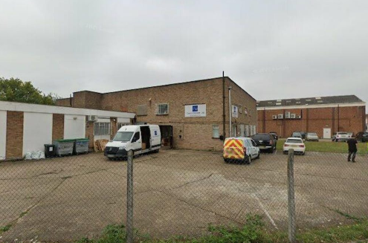
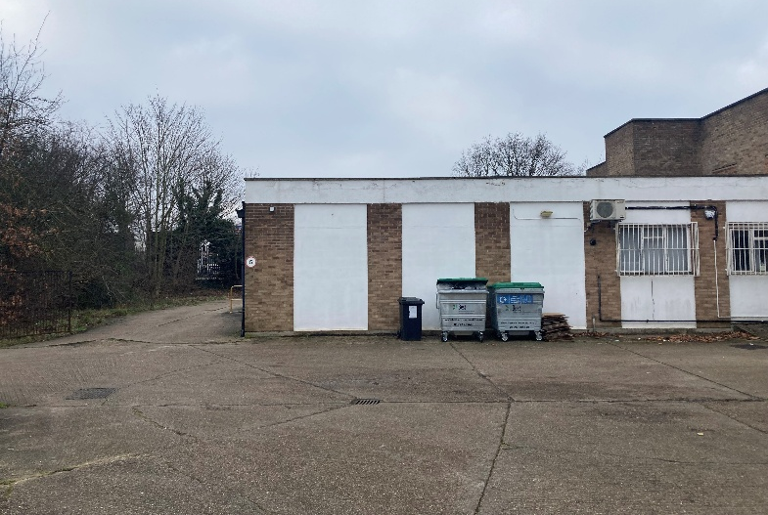
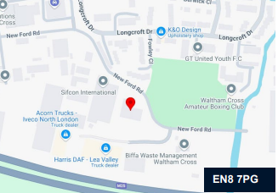
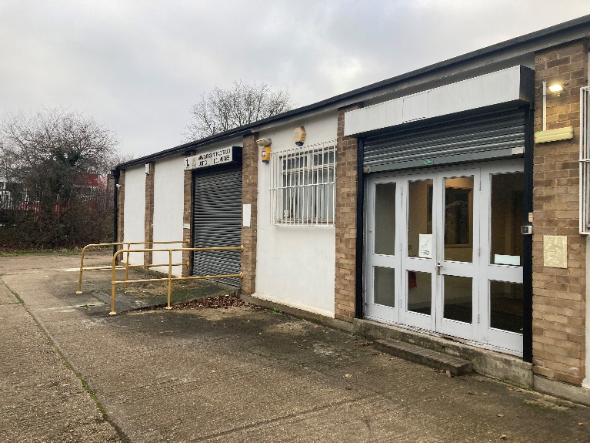
EN8 7PG
Location
The subject site is situated on New Ford Road in Waltham Cross, approximately 12.7 miles (20.4 km) to the North of Central London.
The site benefits from good transport connectivity. It fronts New Ford Road, with J25 of the M25 (2 miles) in close proximity which provides access to central London and beyond.
The site can also be well accessed by rail, with Waltham Cross overground station in walking distance (1.1 miles). This provides regular services service to London Liverpool Street (25-30 mins), Hertford (35 mins) and Cambridge (55 mins).
Travel Distances
LOCATION | MILES
Waltham Cross Station | 1.1 miles
(J25) M25 | 2.0 miles
(J26) M25 | 3.1 miles
(J23)- A1 M25 | 10.8 miles
Central London | 12.7 miles
Description
The site comprises 0.84 acres with a well maintained 8,740 sq. ft warehouse / office facility. Available with vacant possession, this property will be of interest to investors and owner-occupiers.
Warehouse/ office
Total built floor area (GEA) | 8,740 sq ft
33 Margaret Street
London W1G 0JD
+44 (0)20 7499 8644
savills.co.uk

Slide 3
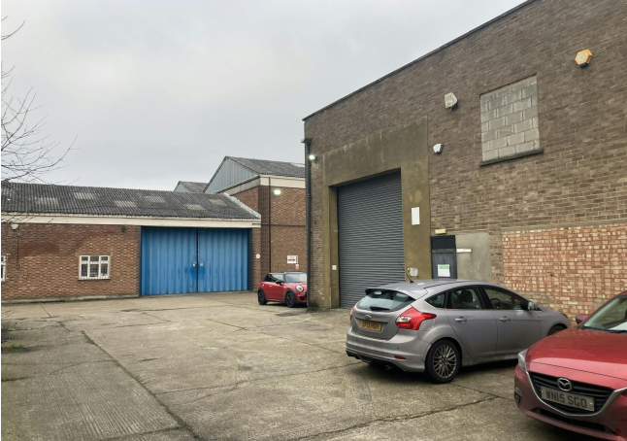
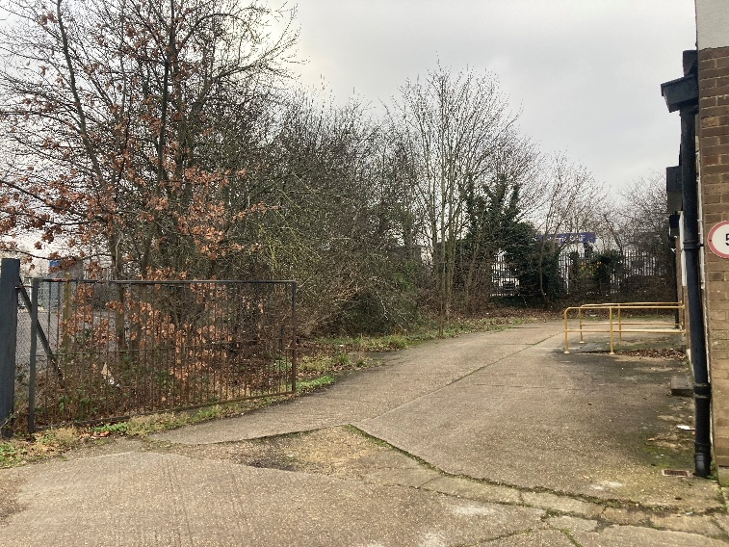
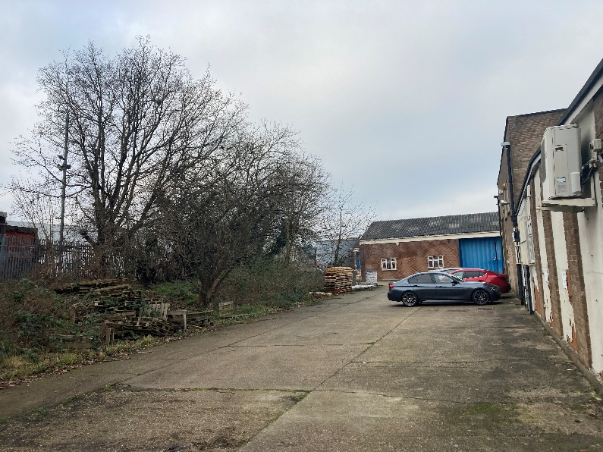
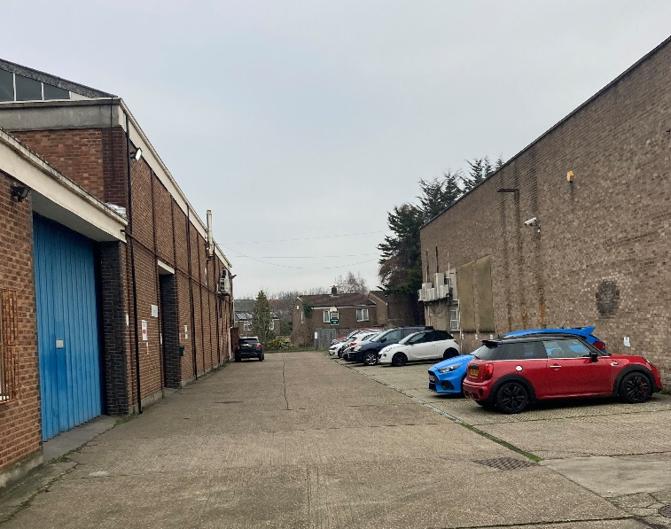
Tenure
The property is available on a freehold basis, subject to contract. Terms and further information are available upon request.
EPC
The small ancillary office has an EPC D(80) with rating
valid until 24th April 2035.
Offers
Unconditional offers for the freehold interest are to be submitted by informal tender by a date to be confirmed.
VAT
Please note that the site is VAT elected
Viewings
Viewings can be arranged via sole agents Savills.
Harry Stoneham
+44 (0) 7870 999 263
harry.stoneham@savills.com
Tom Marshall
+44 (0) 7812 426270
Tom.a.marshall@savills.com
Alice Rowley
+44 (0) 7779 402 808
Alice.rowley@savills.com
IMPORTANT NOTICE
Savills, their clients and any joint agents give notice that: 1. They are not authorised to make or give any representations or warranties in relation to the property either here or elsewhere, either on their own behalf or on behalf of their client or otherwise. They assume no responsibility for any statement that may be made in these particulars. These particulars do not form part of any offer or contract and must not be relied upon as statements or representations of fact. 2. Any areas, measurements or distances are approximate. The text, photographs and plans are for guidance only and are not necessarily comprehensive. It should not be assumed that the property has all necessary planning, building regulation or other consents and Savills have not tested any services, equipment or facilities. Purchasers must satisfy themselves by inspection or otherwise. Generated by AgentsInsight / Generated on 05/05/2025

