Slide 1


90
Chancery Lane
MIDTOWN
LONDON WC2
966 – 24,167 SQ FT – 12 or 40 DESK FITTED SUITE IN PRIME MIDTOWN

Slide 2
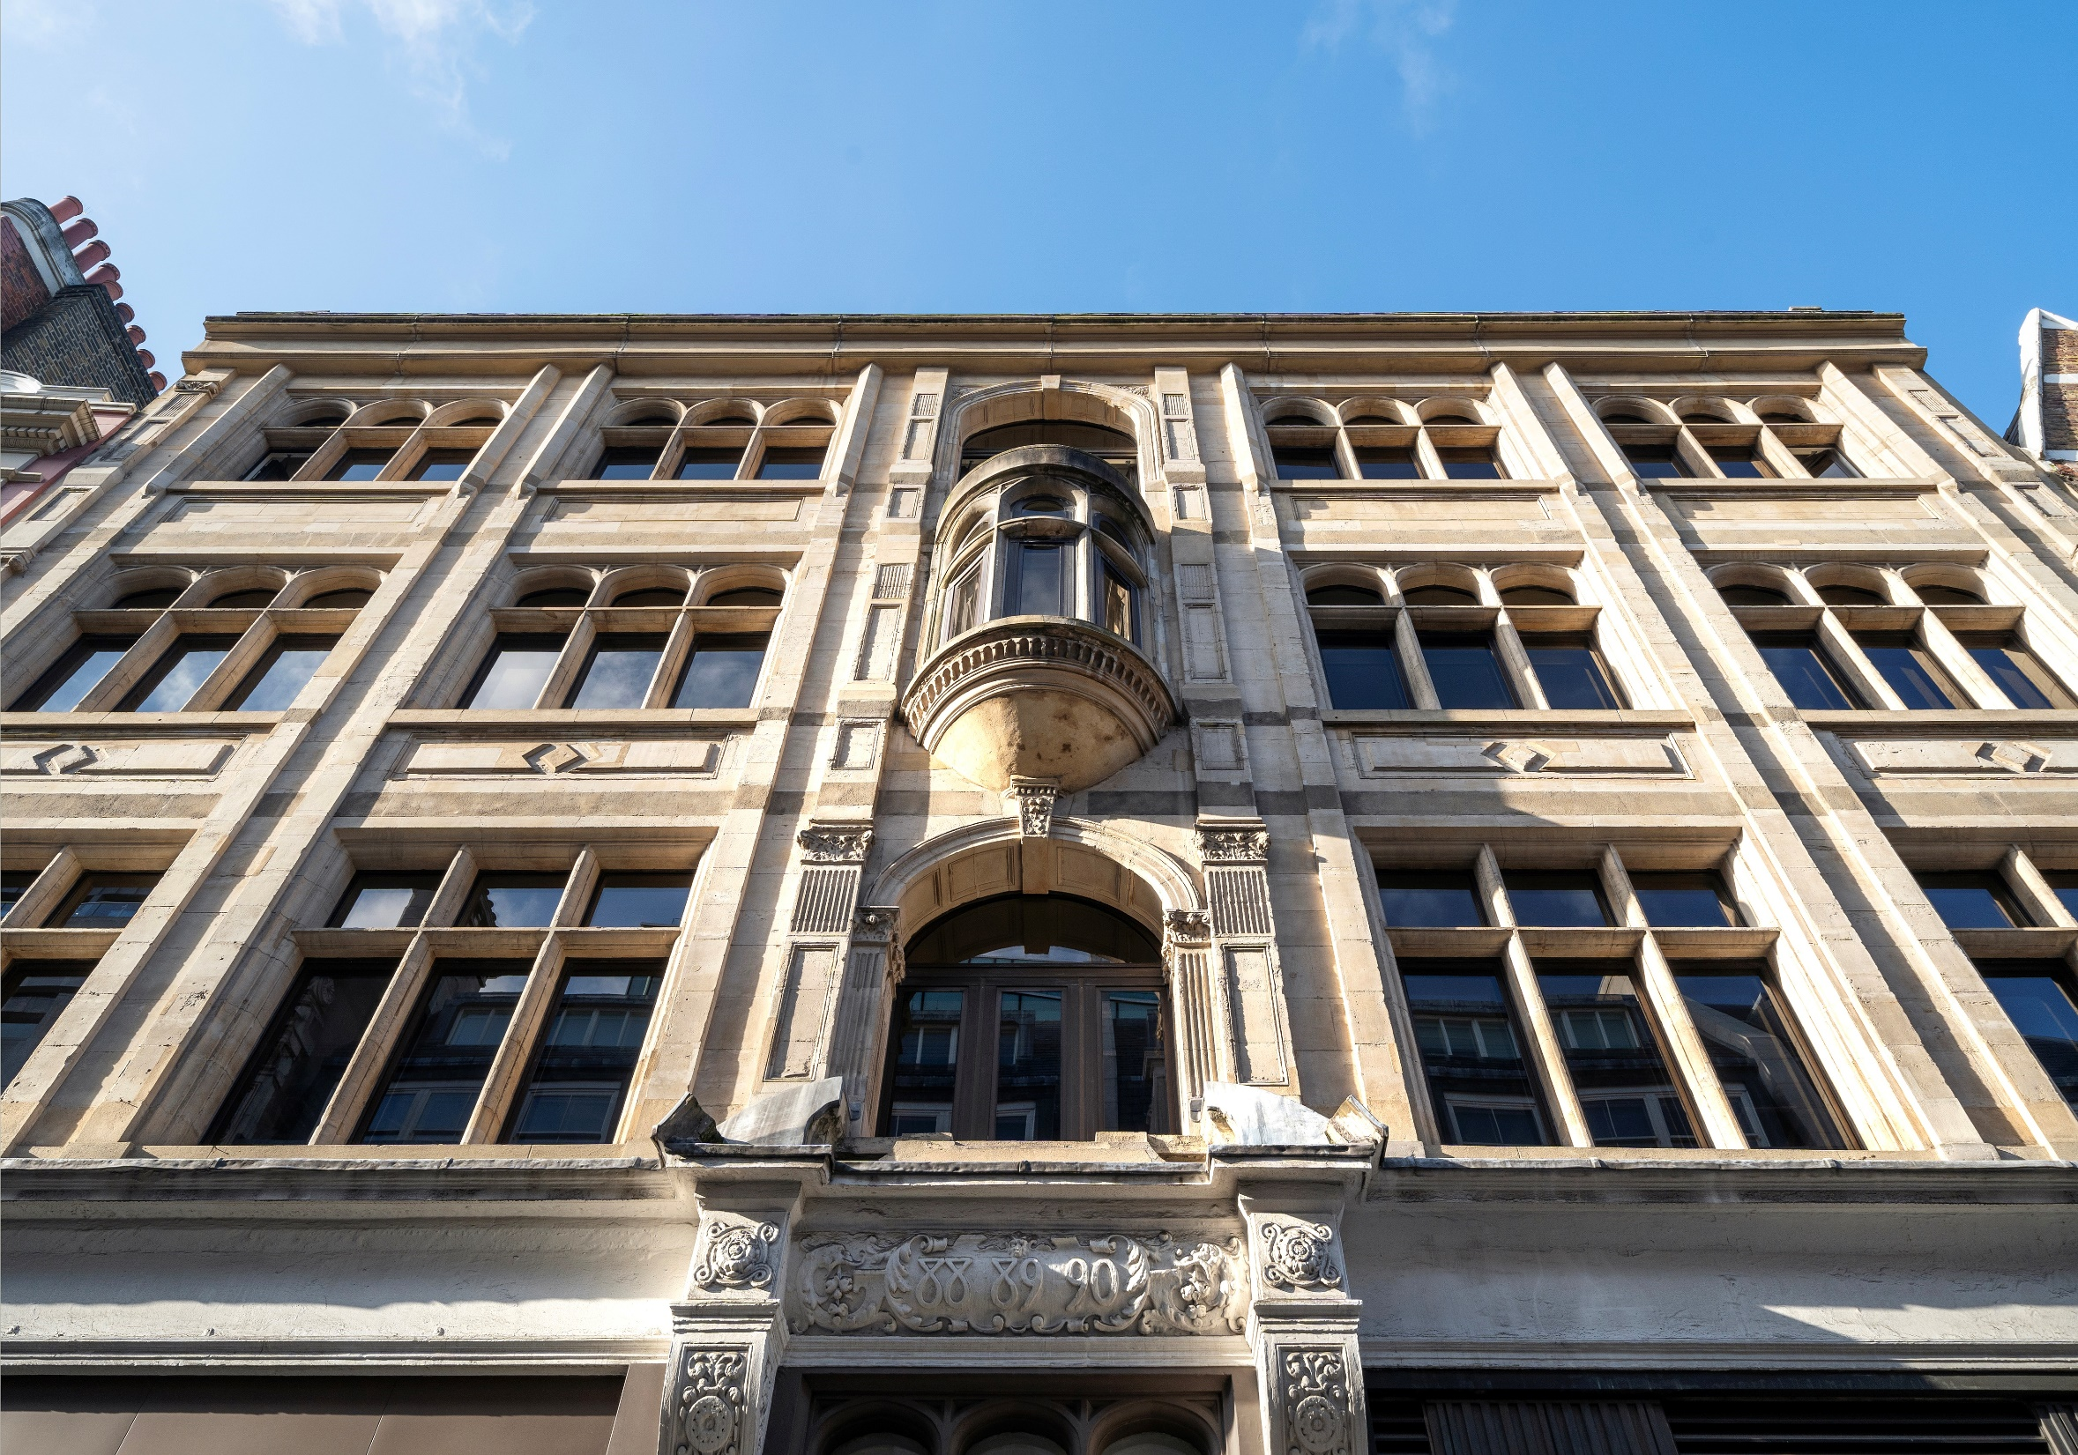

Slide 3
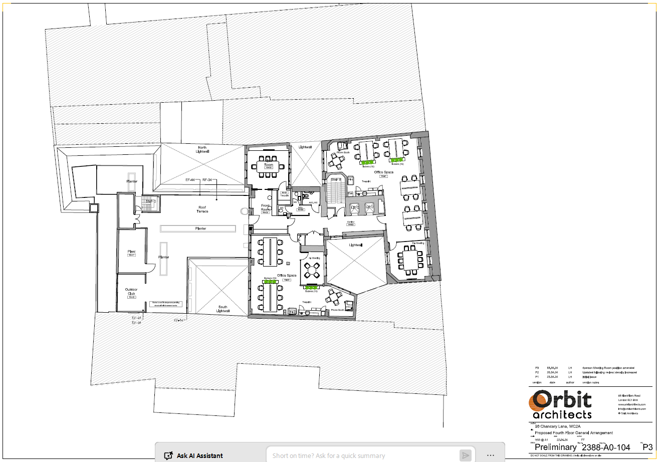
90 CHANCERY LANE, MIDTOWN, LONDON, WC1V 6ER
The building is positioned in a prominent position on Chancery Lane
The building has undergone a comprehensive refurbishment. Designed by architects, Buckley Gray Yeoman, it offers stylish, high-quality, contemporary office space.
The immediate area has benefitted from a notable increase in the number of hotels, restaurants, bars and cafes. There are excellent transport links close by with Holborn (Central and Piccadilly lines), Chancery Lane (Central line) and Farringdon (Crossrail) being within a few minutes distance.
Schedule of Areas
Floor | Area sq. ft | Desks | Availability
4th rear | 966 | 12 | Available
4th front | 1,313 | 16 | Available
G & LG Duplex | 4,273 | 40 | Available
Specification
Comprehensively refurbished
Communal Roof Terrace
Communal Club Room
Manned Reception
1400mm desks
New WC’s
New air-conditioning
Remodeled entrance
Excellent natural light
Cycle storage facilities
Shower facilities
Exposed brick
Strip LED lighting
What is included:
All inclusive price:
4th rear: £12,250 per month + VAT
4th front: £16,750 per month + VAT
G & LG Duplex: £43,000 per month + VAT
Internet of 100 Mbps capable of upgrade to
500 Mbps
Cleaning 5 hour per week
Dilapidations / Reinstatement
2 data ports per desk
Handsets on desks
All utilities & local taxes
P L A N NOT TO SCAL E , F O R INDICATIVE P U R P O S E S
ONLY.

Slide 4
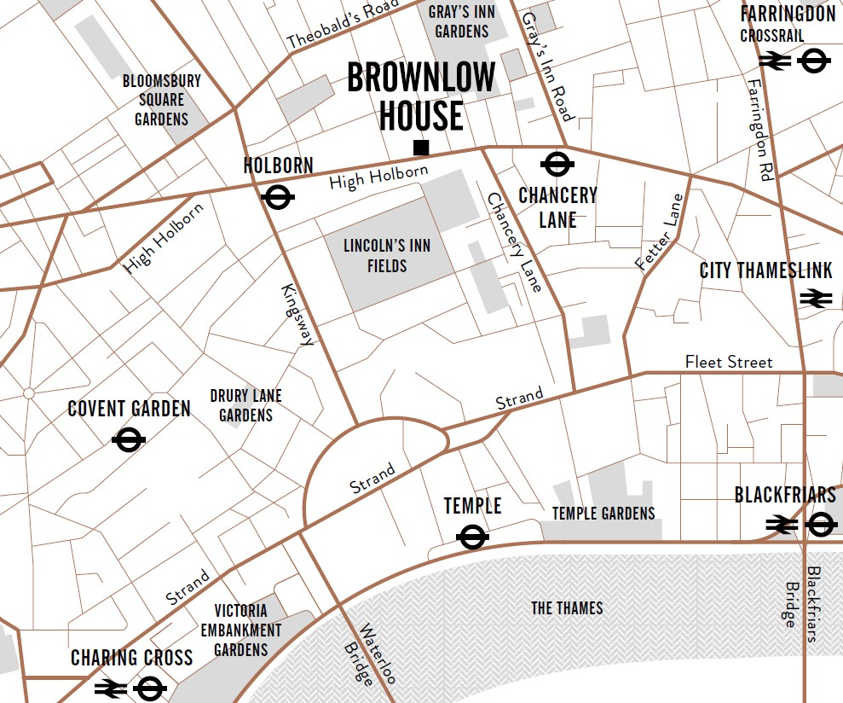

EPC – B-44
New flexible lease available from Landlord.
FOR MORE INFORMATION
STRICTLY THROUGH THE LETTING AGENTS:
James Proctor
07779 789 956
j.proctor@kinneygreen.com
Charles Fogg
07841 782 124
c.fogg@kinneygreen.com
Misrepresentation Act: 1. Kinney Green LLP on its own behalf and on behalf of the vendor/lessor of this property whose agent Kinney Green LLP is, gives notice that: (a) these particulars do not constitute in whole or in part an offer or contract for sale or lease; (b) none of the statements contained in these particulars as to the property are to be relied on as statements or representations of fact; and (c) the vendor/lessor does not make or give, and neither Kinney Green LLP nor any of its members or any person in its employment has any authority to make or give, any representation or warranty whatsoever in relation to the property. The only representations, warranties, undertakings and contractual obligations to be given or undertaken by the vendor/lessor are those contained and expressly referred to in the written contract for sale or agreement for lease between the vendor/lessor and a purchaser or tenant. 2. Prospective purchasers or tenants are strongly advised to: (a) satisfy themselves as to the correctness of each statement contained in these particulars; (b) inspect the property and the neighbouring area; (c) ensure that any items expressed to be included are available and in working order; (d) arrange a full structural (and where appropriate environmental) survey of the property; and (e) carry out all necessary searches and enquiries. April 2026.

