Slide 1
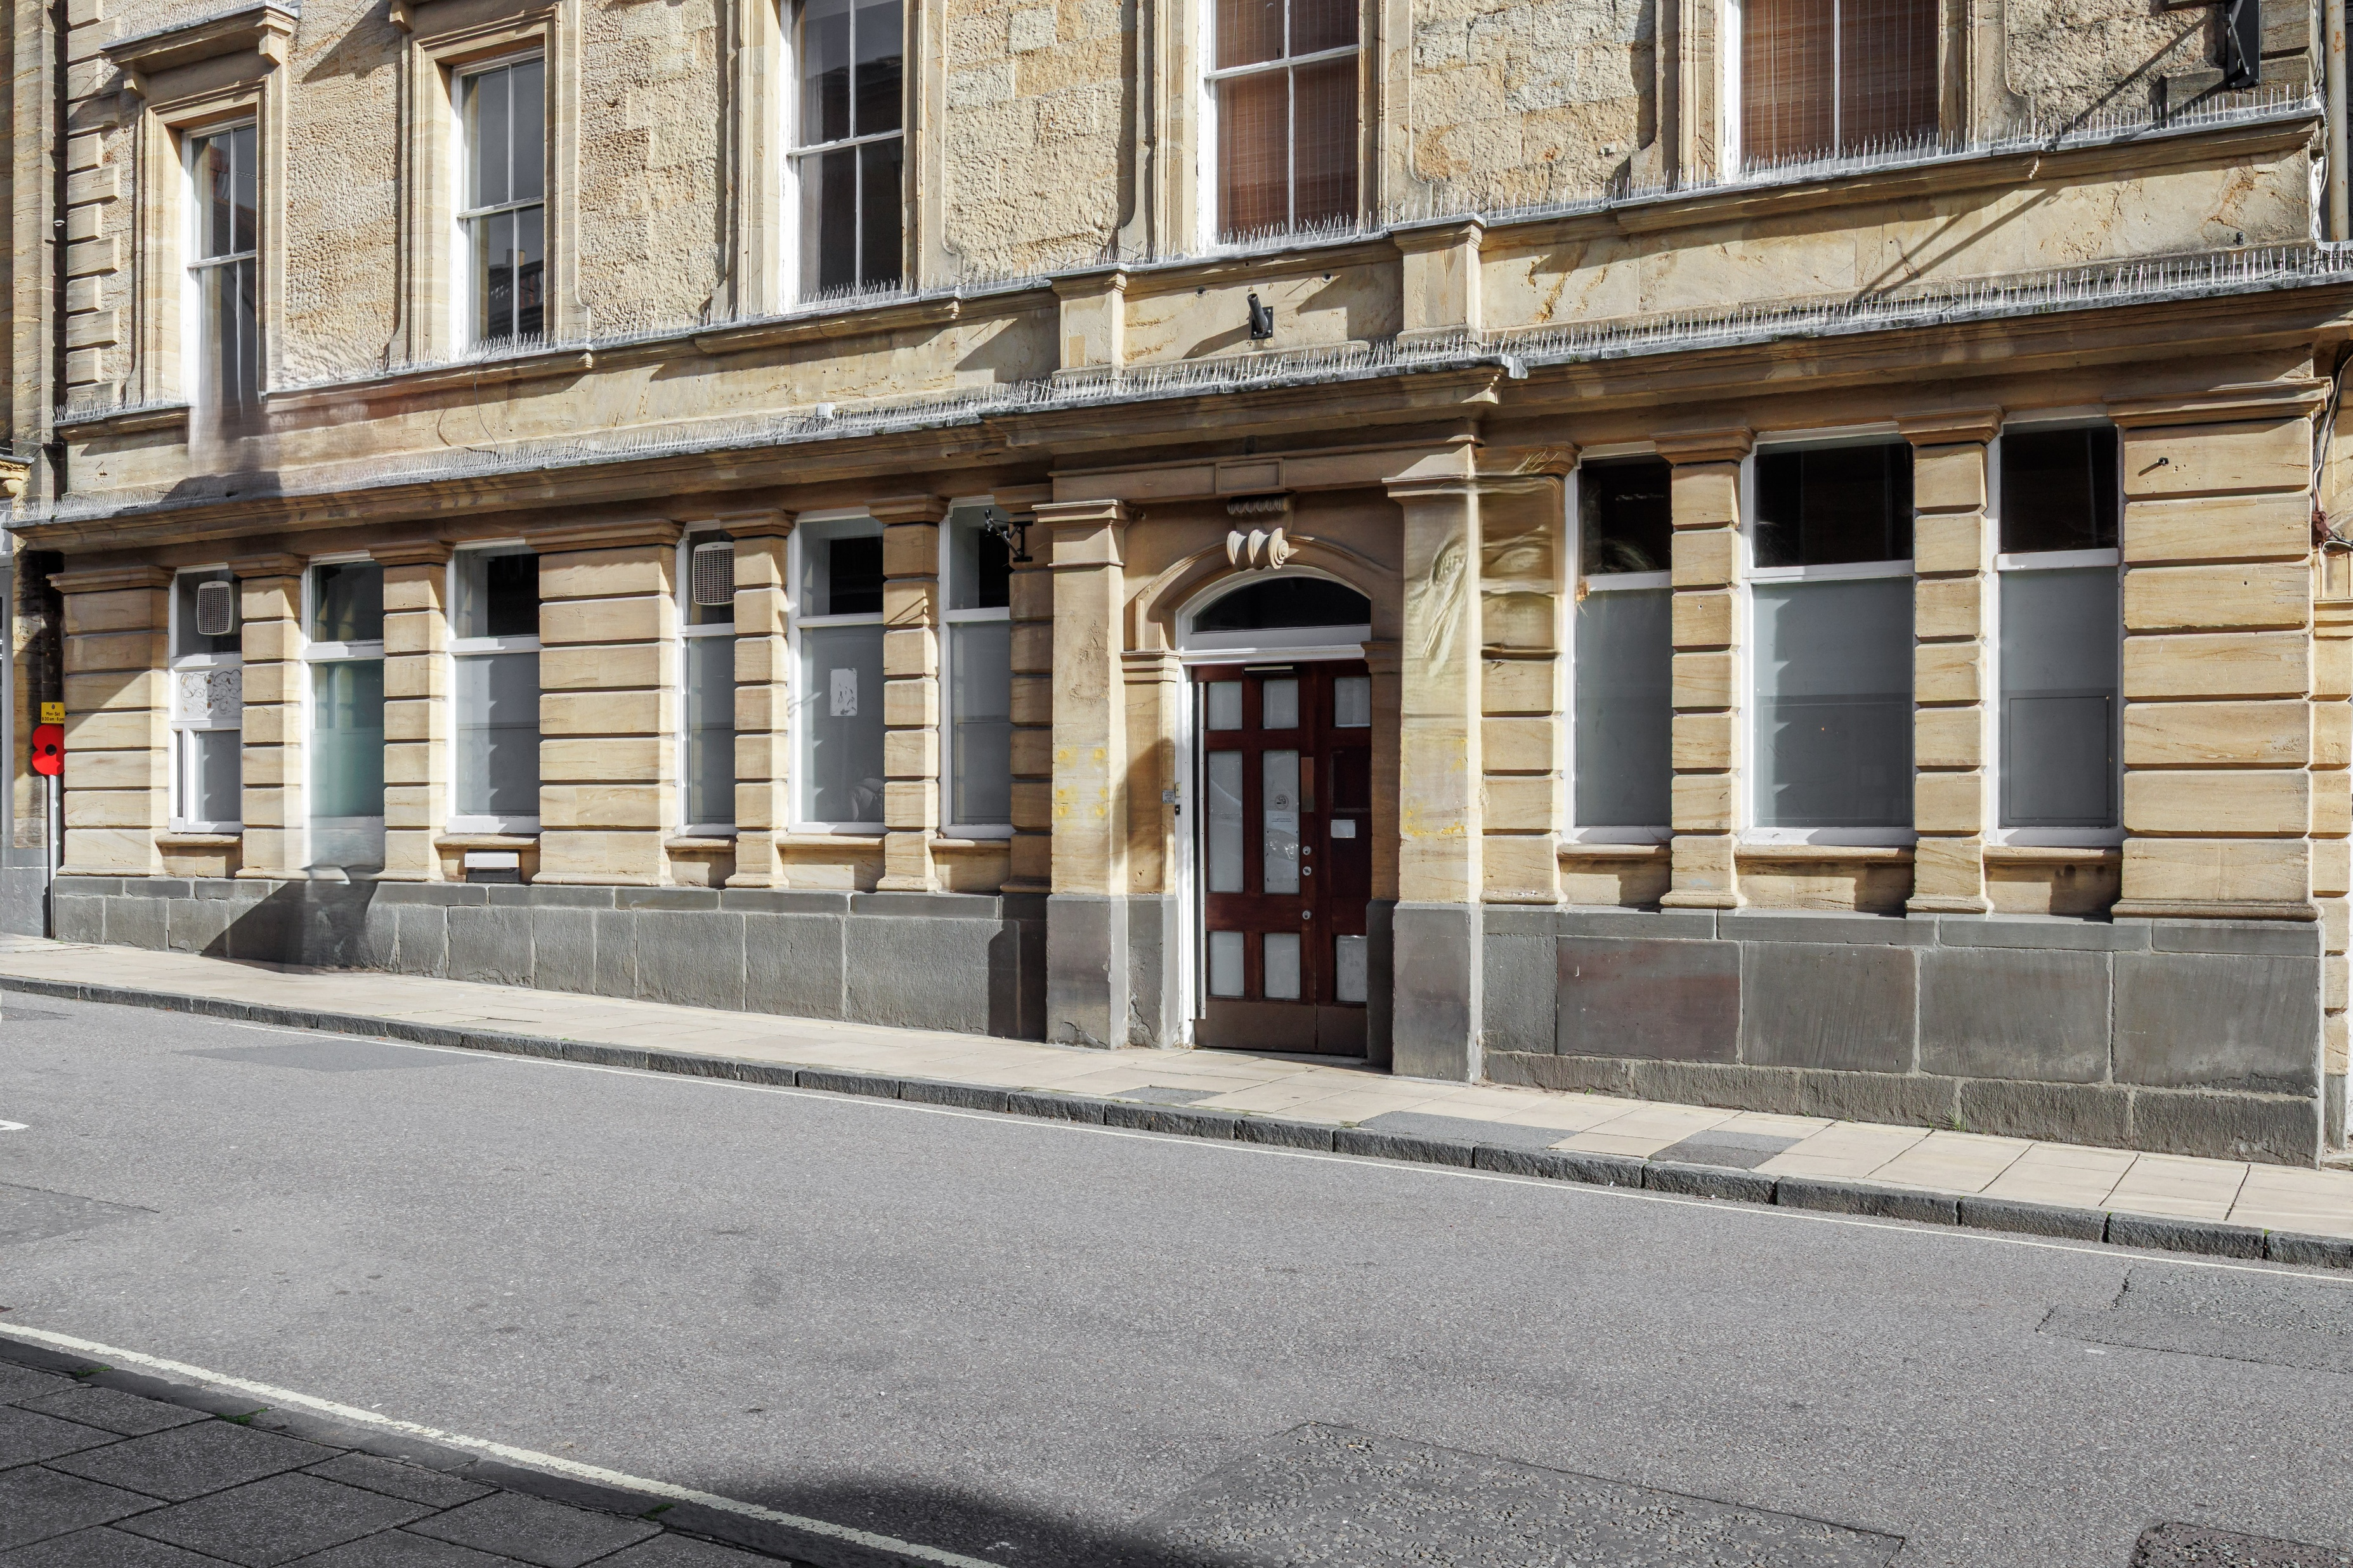

GROUND FLOOR RETAIL UNIT TO LET
75 CHEAP STREET, SHERBORNE, DORSET, DT9 3BD

Slide 2
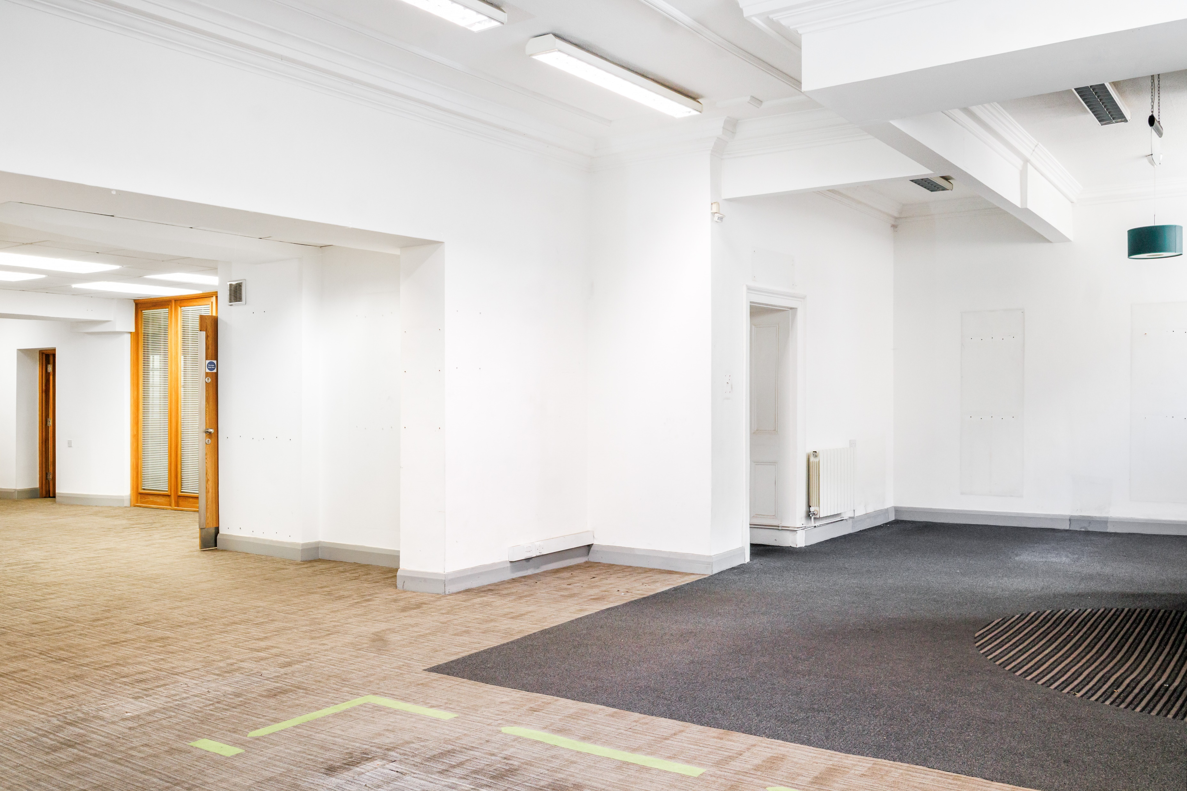
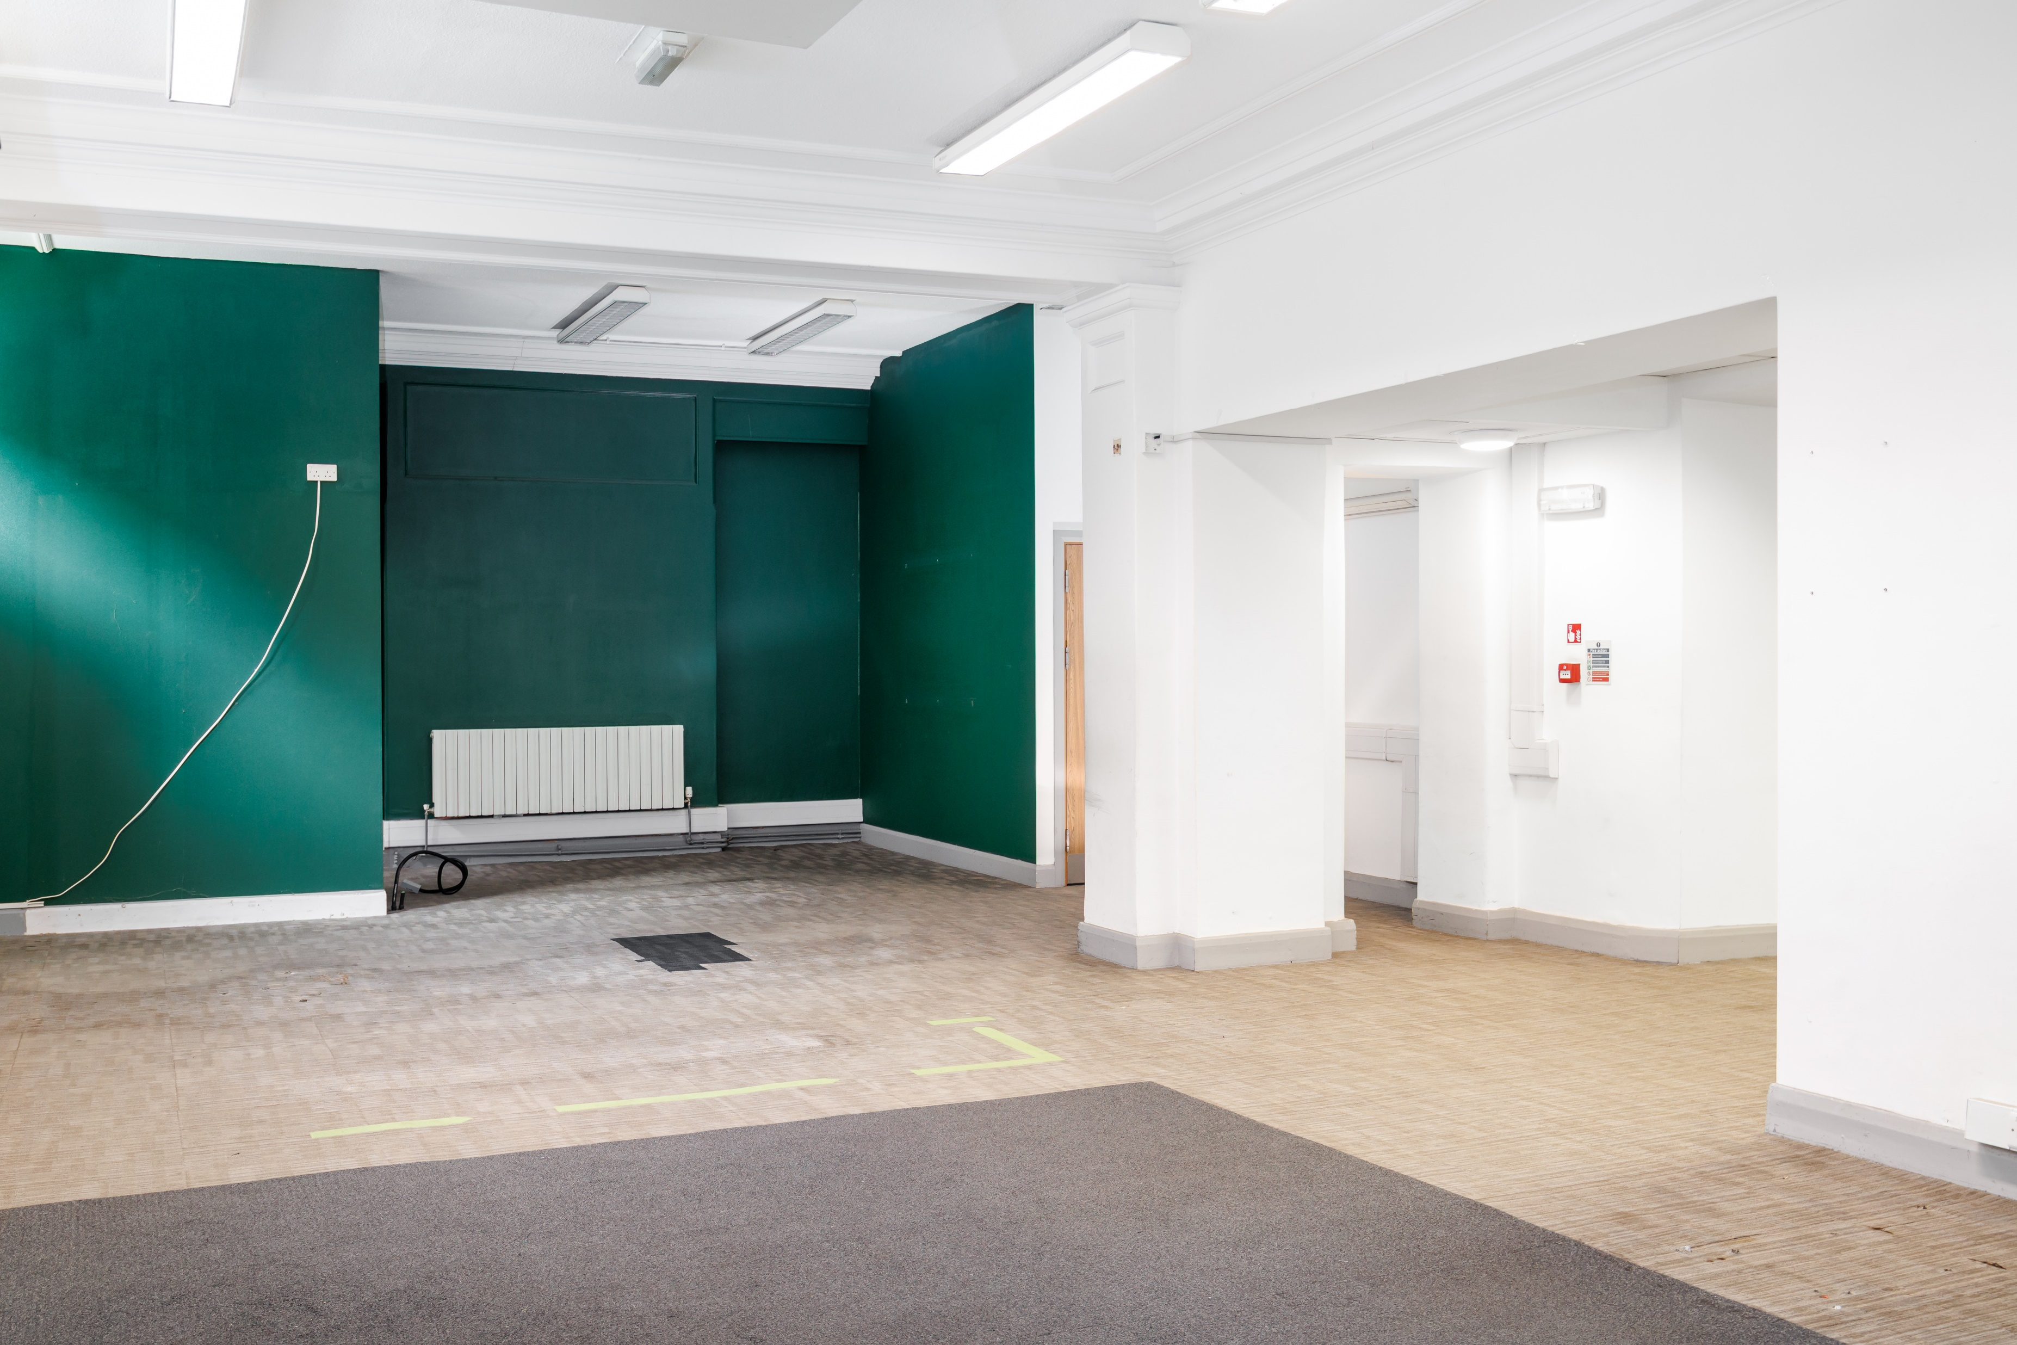
75 CHEAP STREET, SHERBORNE, DORSET, DT9 3BA
SUMMARY
Prime trading location in the heart of Cheap Street with Abbey Views
Close to Nero, Fat Face and Grape Tree
Landmark Listed building with extensive double frontage
Rear garden/courtyard
Cheap Street is mainly pedestrianised other than loading
New lease offered on flexible terms
THE PROPERTY
The property is an attractive Grade II Listed building, comprising the ground floor of a former banking hall with rear ancillary accommodation.
There is a rear yard and garden if required.
THE LOCATION
Sherborne is a historic, attractive and affluent Dorset market town, popular with tourists and famous for its medieval buildings, Castles, The Abbey and public schools.
The property is situated on the east side of Cheap Street, the town’s principal retailing thoroughfare with occupiers including Fat Face, WH Smith, Crew Clothing, Boots and Waitrose.
Floor Areas | Approx. NIA (m2) | Approx. NIA (sq ft)
Retail | 172.71 | 1,859
Ancillary | 23.60 | 254
Office | 14.40 | 155
TOTAL | 210.71 | 2,268

Slide 3
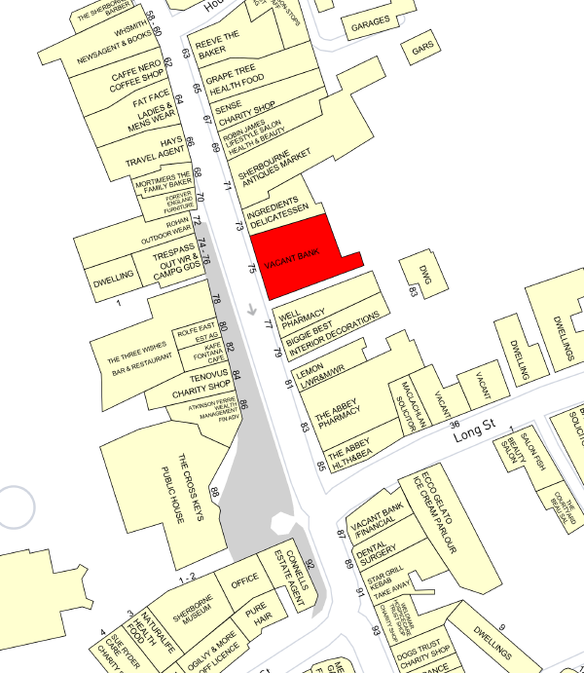
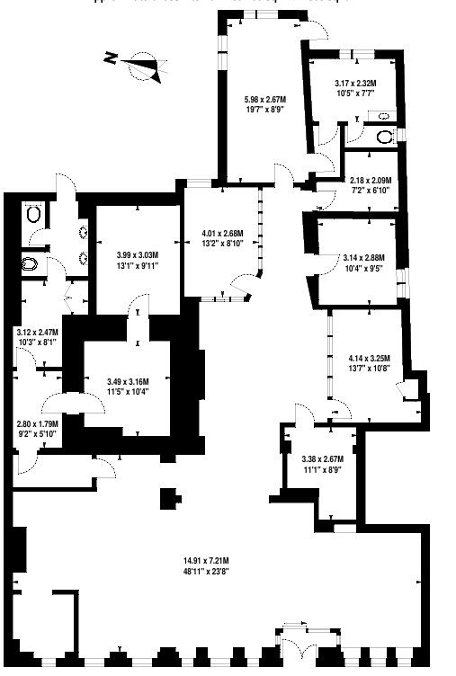
75 CHEAP STREET, SHERBORNE, DORSET,
DT9 3BD

Slide 4
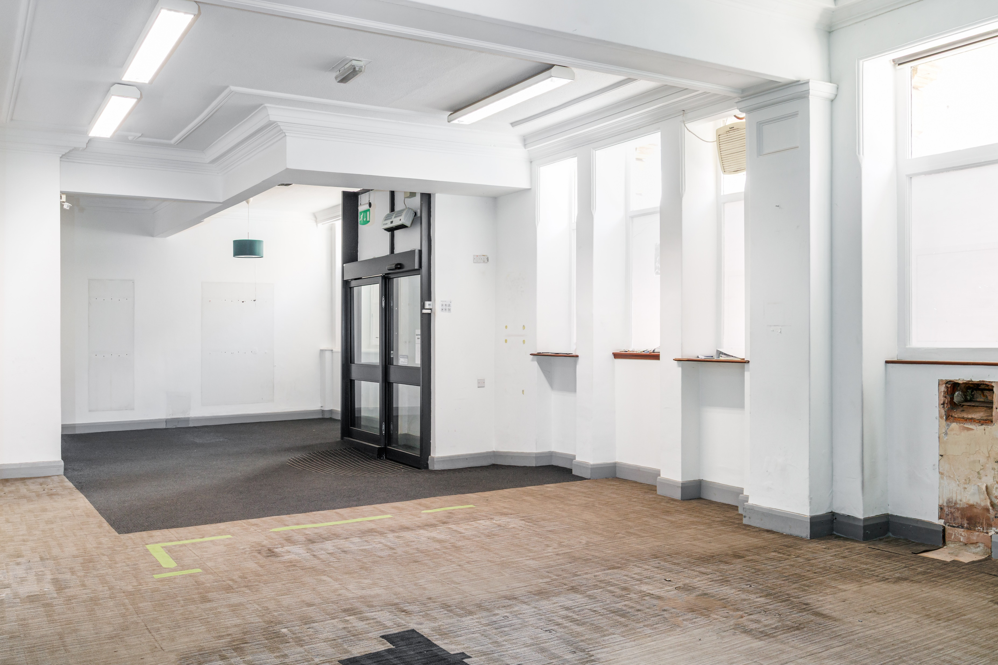
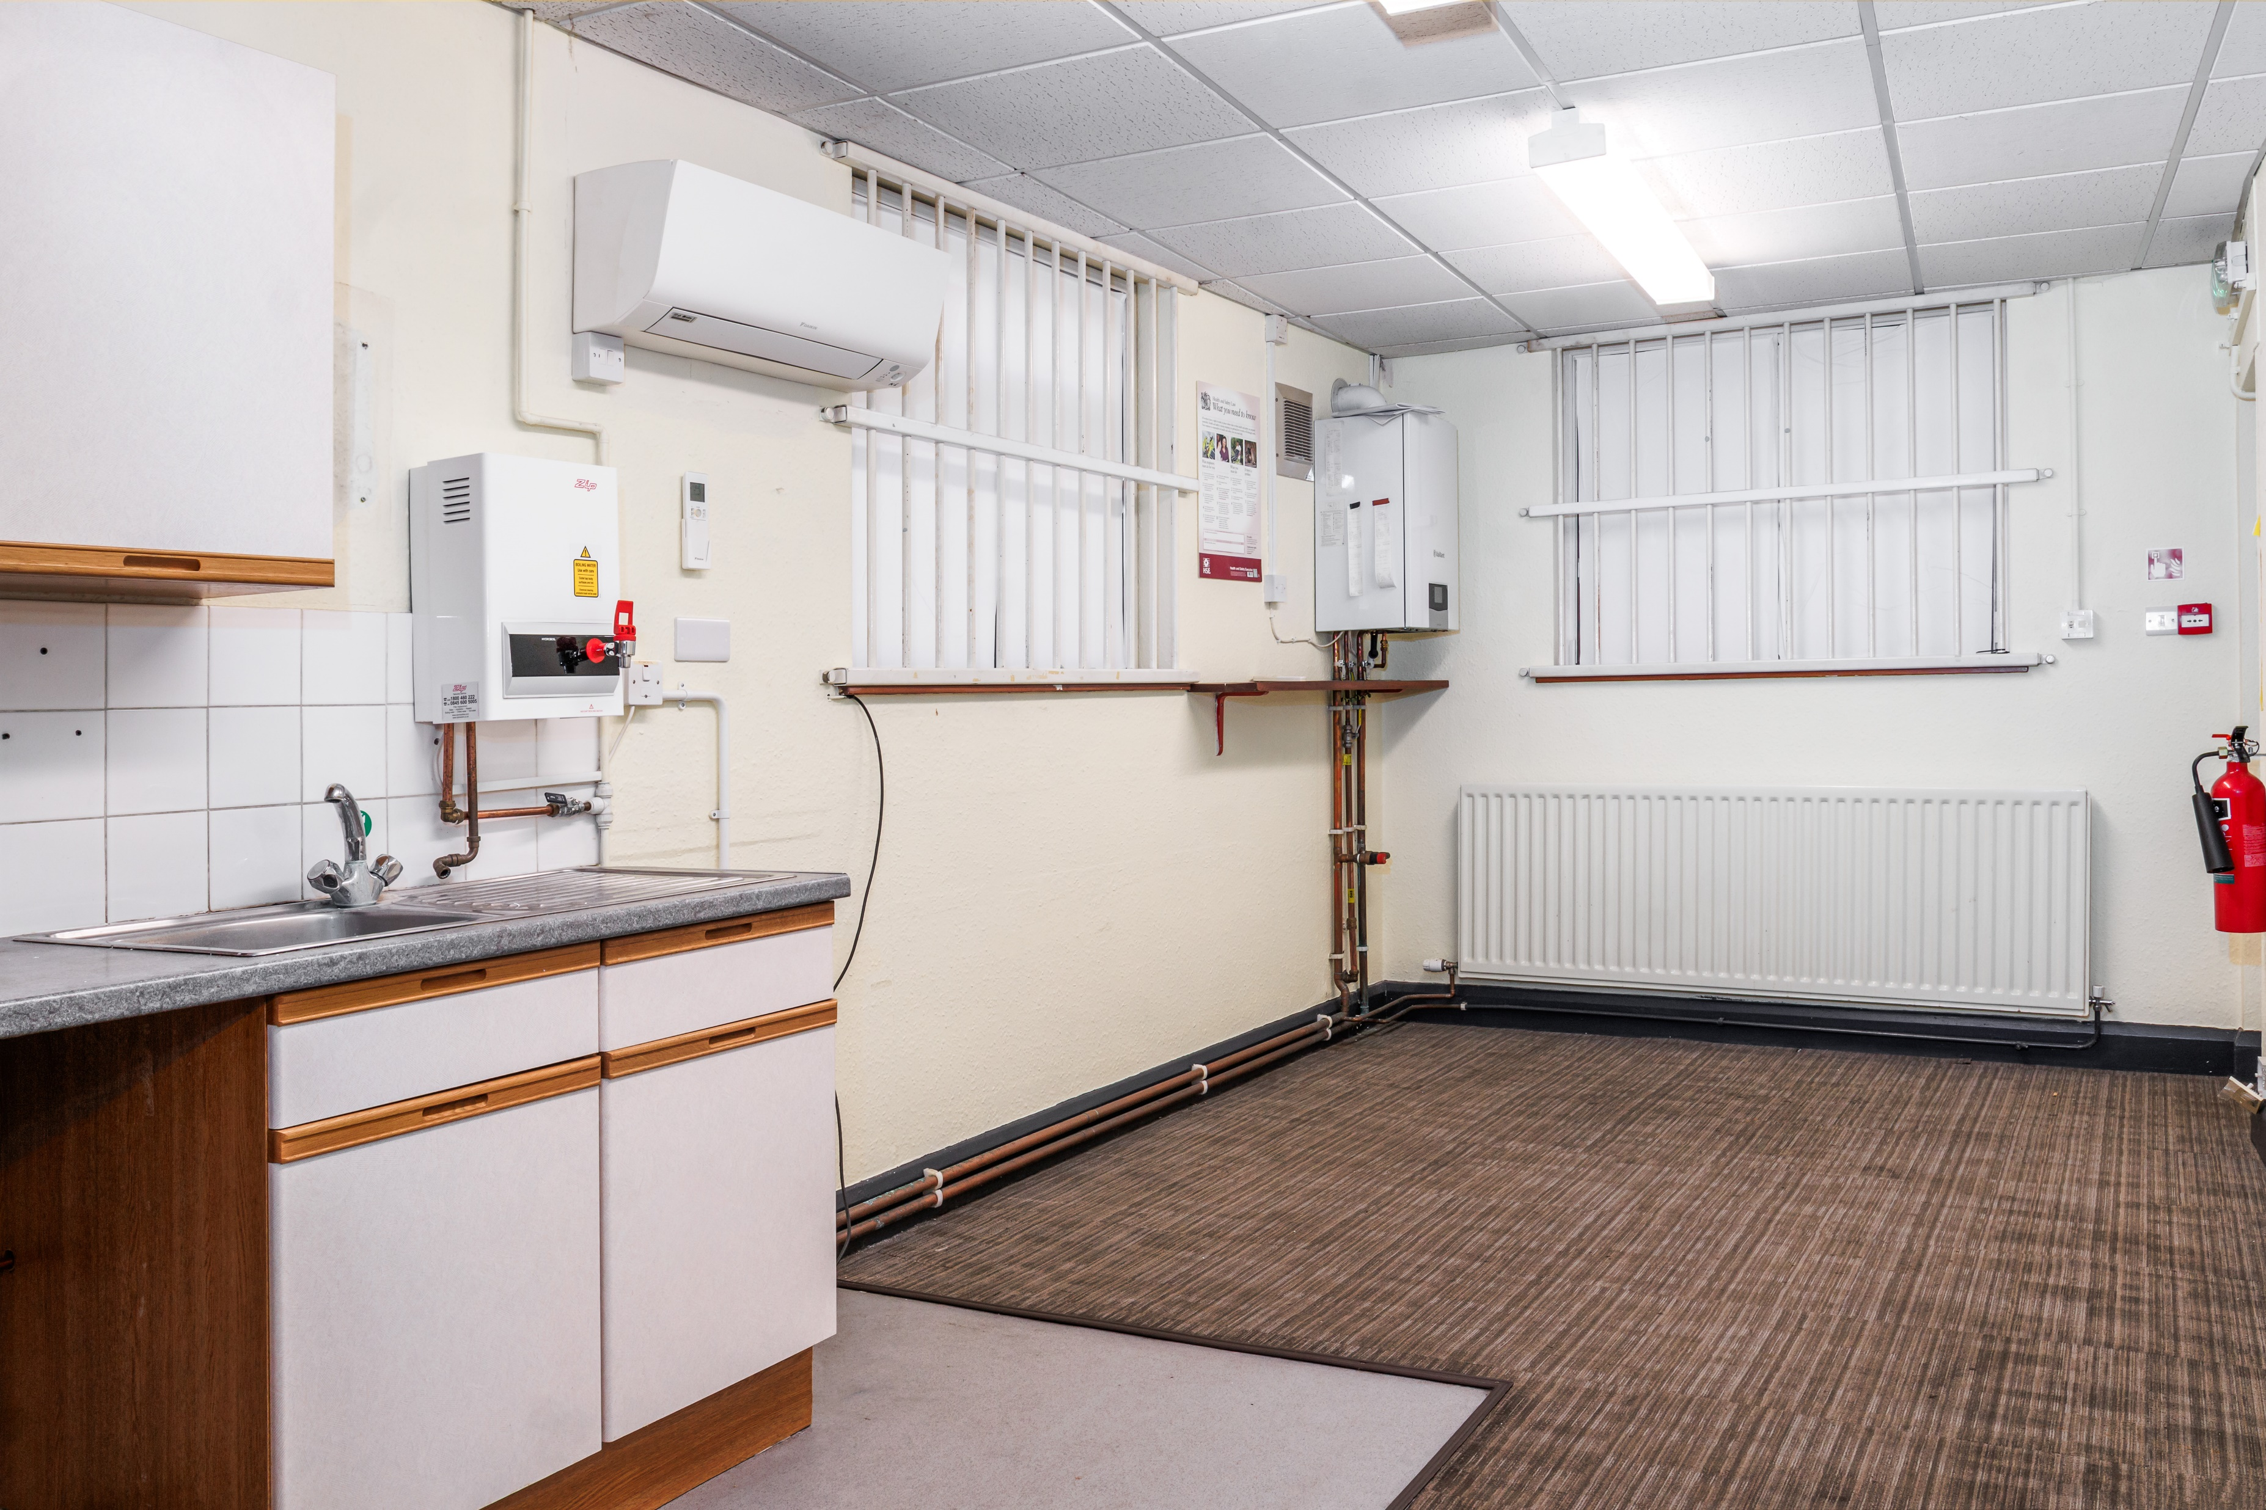
75 CHEAP STREET, SHERBORNE, DORSET, DT9 3BD
RENT
On application
LEASE
A new lease is offered on terms to be agreed.
VOA
RV £53,500
LISTING
The building is Listed Grade 11 (1110774)
PLANNING
Class E (Commercial, business, Service)
VAT
All terms are quoted exclusive of VAT
SERVICE CHARGE
There is a service charge in place
CONTACT
For further information please contact Chesters Harcourt :
David Foot MRICS
david.foot@chestersharcourt.com
07825 525055 or 01935 415454
OR
Chris Wright
chris.wright@avisonyoung.com
Chesters Harcourt Ltd, for themselves and for the vendor of this property, or as the case may be, lessor whose agents they are, give notice that:- i) These particulars are intended for guidance only. They are prepared and issued in good faith and are intended to give a fair description but do not constitute part of any offer or contract. Any information given should not be relied on as a statement or representation of fact or that the property or its services are in good condition. ii) Chesters Commercial Ltd have not made any investigations into the existence or otherwise of any issues concerning pollution and potential land, air and water contamination. The purchaser is responsible for making his or her own enquiries in this regard. iii) Neither Chesters Commercial Ltd nor any of their employees has any authority to make or give any representation or warranty whatsoever in relation to the property. iv) The images show only certain parts and aspects of the property at the time they were taken/created. Any areas, measurements or distances given are approximate only. Any plans are for identification purposes only. v) Any reference to alterations to, or use of, any part of the property is not a statement that any necessary planning, building regulations or other consent has been obtained. An intending purchaser must verify these matters. An occupier should not rely upon the Use stated in these particulars and should check their proposed use with the relevant Planning Authority to ensure it is permitted.

