Slide 1

12
CARTHUSIAN STREET
FARRINGDON EC1
2,813 – 5,851 SQ FT(261-543 SQ M)
48 DESKS + 10 AGILE WORK STATIONS
FURNISHED OFFICES IN PRIME FARRINGDON LOCATION
AVAILABLE ON MANAGED LEASE

Slide 2
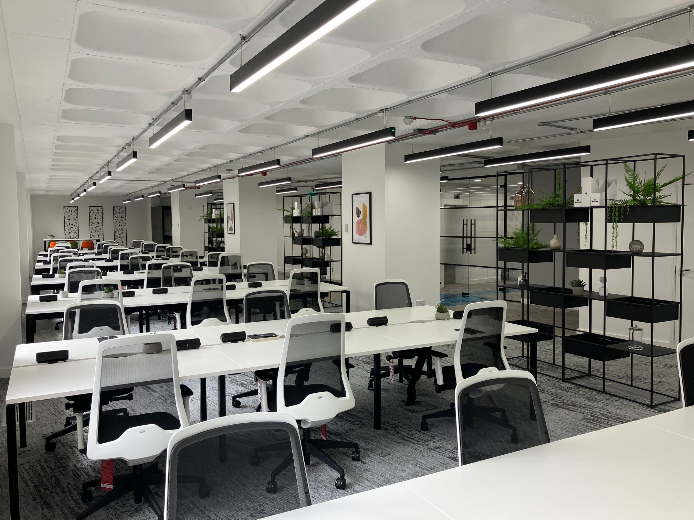

Slide 3
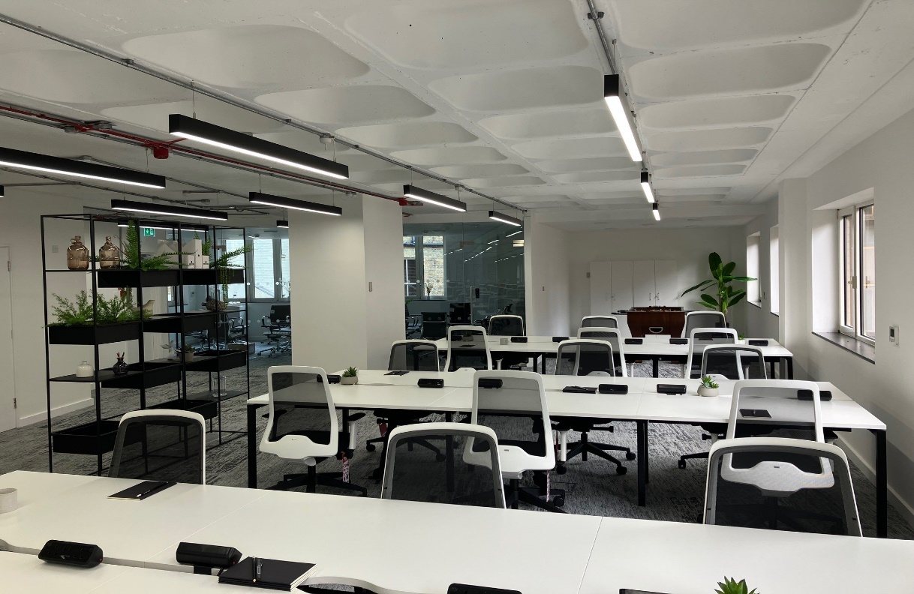
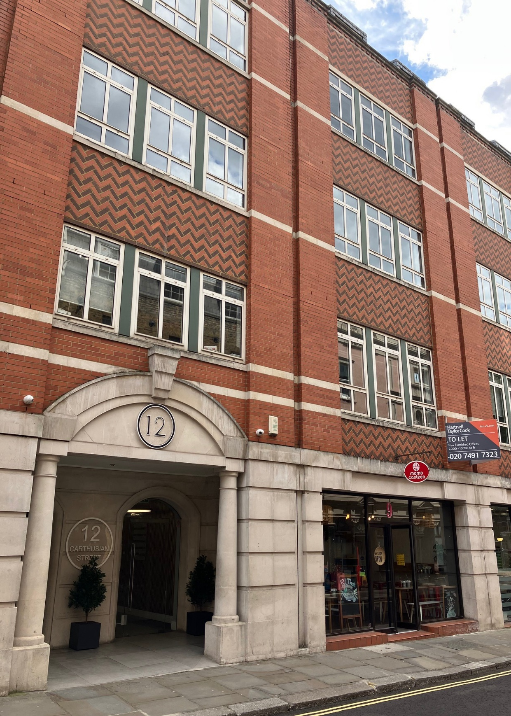
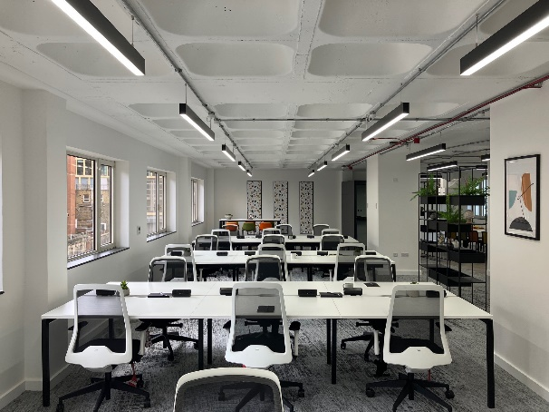
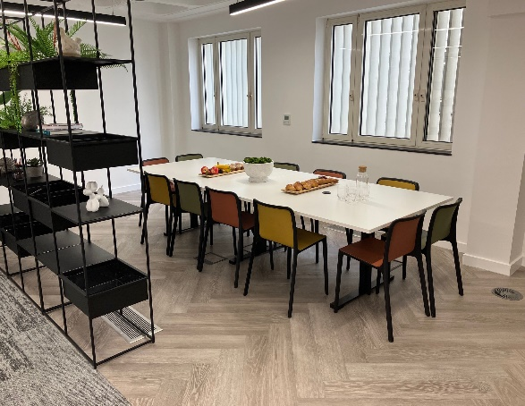
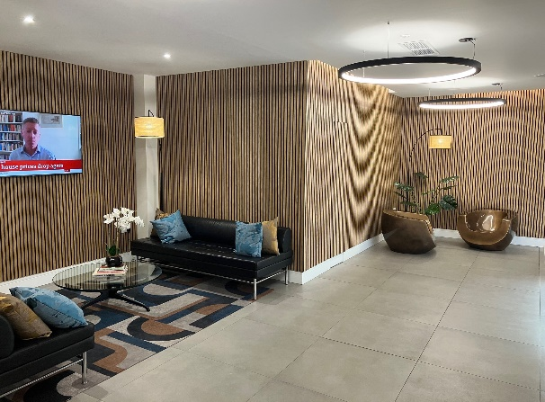
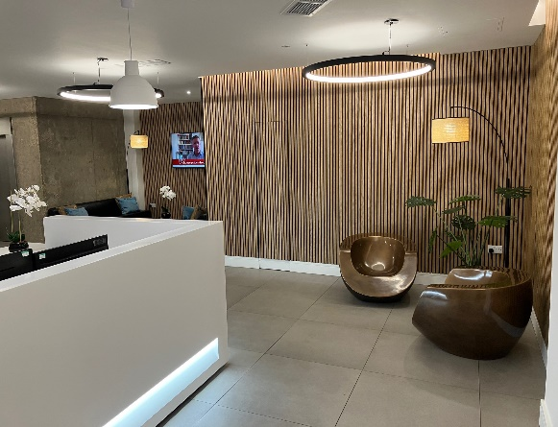

Slide 4
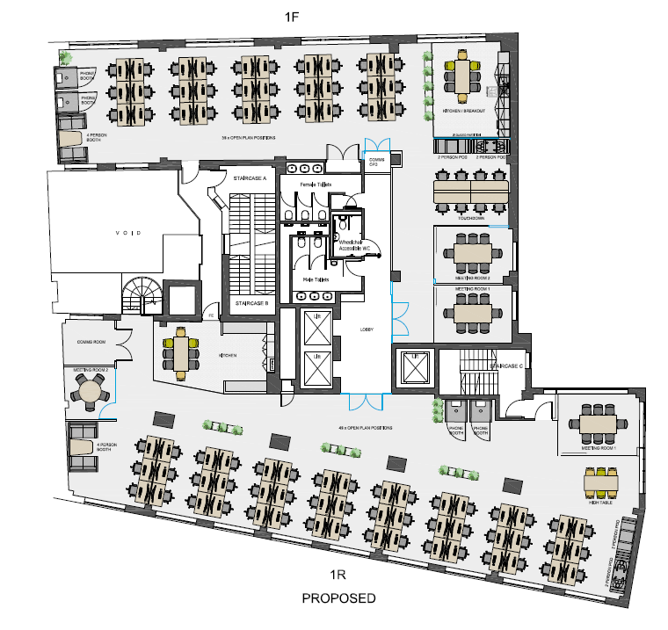
12 CARTHUSIAN STREET, LONDON, EC1M 6EZ
12 Carthusian Street offers good quality, open plan office accommodation set just across from Charterhouse Square. Located less than 100m from Farringdon Station (Elizabeth Line entrance) and Barbican Underground Station.
Farringdon offers unrivalled local amenities with numerous award-winning restaurants, trendy bars and retailers, and is home to some of London’s most recognized gourmet food markets.
FLOOR PLAN
SCHEDULE OF AREAS
Floor | Area sq ft | Area sq m | Desks
First (South) Ground Total | 3,038 2,813 8,889 | 282 261 825 | 48 + 10 Agile 35 + 10 Agile
MANAGED SOLUTION
SPECIFICATION
What is included:
All inclusive price of:
£33,000 per month + VAT
£28,000 per month + VAT
Internet of 100 Mbps capable upgrade to 500 Mbps
Cleaning 5 hours per week
Dilapidations / Reinstatement
2 data ports per desk
Handsets on desks
All utilities & local taxes
Fully furnished & fitted
48 Fixed Desks plus 10 agile work-stations
Meeting rooms / phone booths
Informal meeting / breakout areas
Refurbished building reception
Refurbished WC’s
Air conditioning
Raised floors
New LED lighting
Cycle storage
Shower & locker facilities

Slide 5
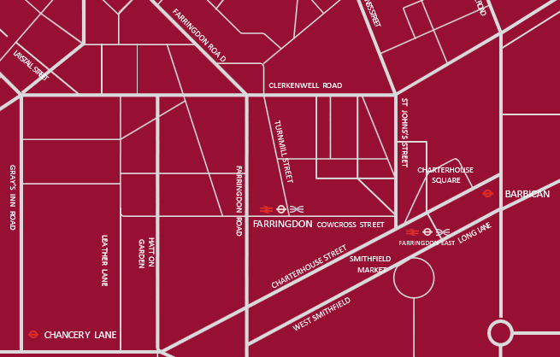

FOR MORE INFORMATION
STRICTLY THROUGH THE LETTING AGENT:
JAMES PROCTOR
j.proctor@kinneygreen.com
+44 (0)7779 789 957
CHARLES FOGG
c.fogg@kinneygreen.com
+44 (0)7841 782 124
Misrepresentation Act: 1. Kinney Green LLP on its own behalf and on behalf of the vendor/lessor of this property whose agent Kinney Green LLP is, gives notice that: (a) these particulars do not constitute in whole or in part an offer or contract for sale or lease; (b) none of the statements contained in these particulars as to the property are to be relied on as statements or representations of fact; and (c) the vendor/lessor does not make or give, and neither Kinney Green LLP nor any of its members or any person in its employment has any authority to make or give, any representation or warranty whatsoever in relation to the property. The only representations, warranties, undertakings and contractual obligations to be given or undertaken by the vendor/lessor are those contained and expressly referred to in the written contract for sale or agreement for lease between the vendor/lessor and a purchaser or tenant. 2. Prospective purchasers or tenants are strongly advised to: (a) satisfy themselves as to the correctness of each statement contained in these particulars; (b) inspect the property and the neighbouring area; (c) ensure that any items expressed to be included are available and in working order; (d) arrange a full structural (and where appropriate environmental) survey of the property; and (e) carry out all necessary searches and enquiries. April 2026.

