Slide 1

5-10 BURY STREET
LONDON EC3
1,570-7,467 SQ FT (146-694) SQ M) OFFICES TO LET

Slide 2
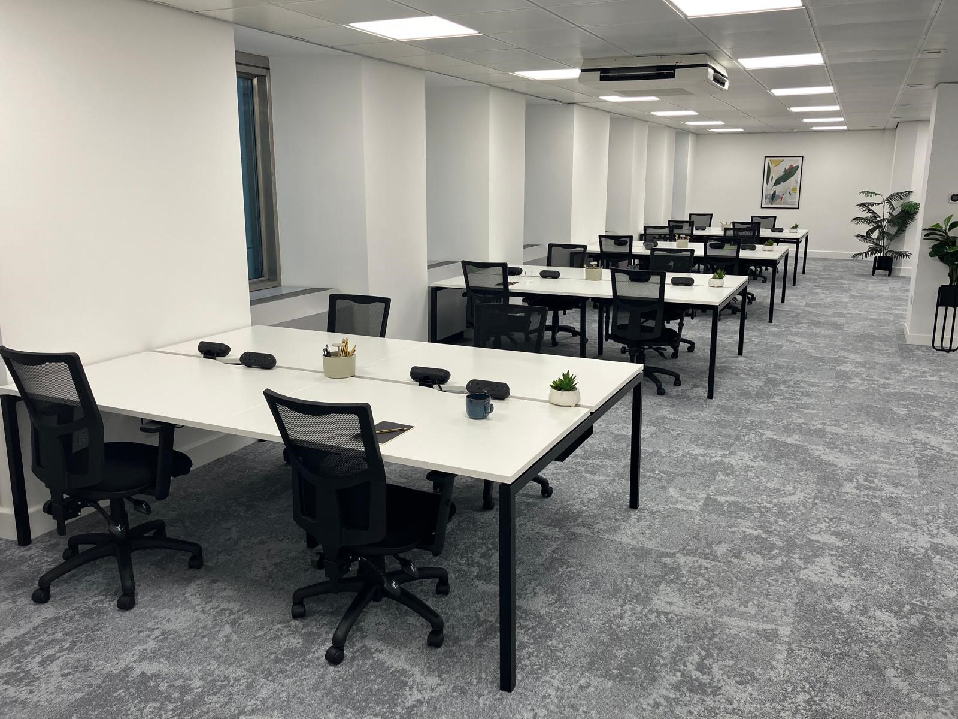
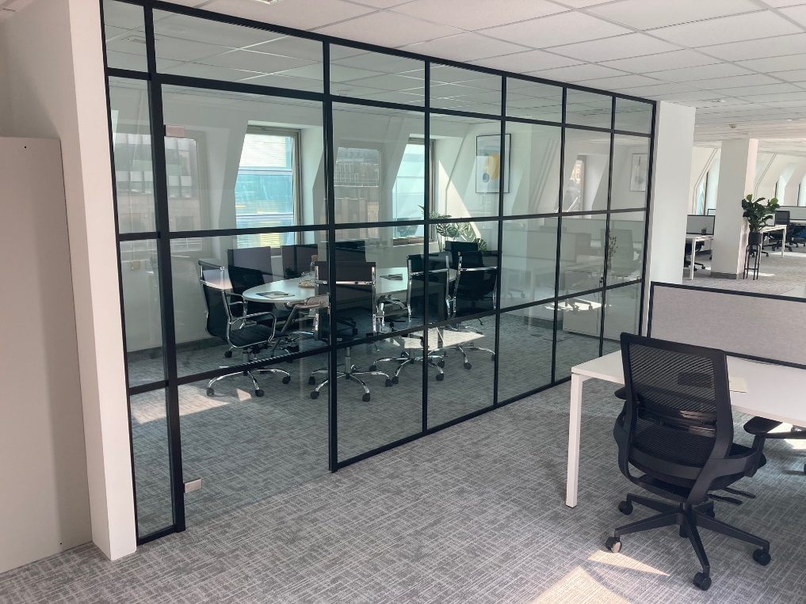
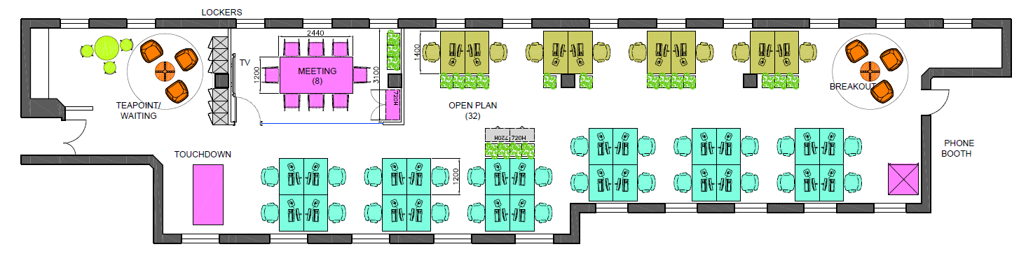
5-10 BURY STREET, LONDON, EC4
The Property offers good quality, open plan office accommodation with good transport links close by.
Schedule of Areas
Floor | Area sq ft | Area sq m | Desks
Sixth | 1,925 | 179 | 32
Specification
Fully Furnished & Fitted
32 x ????mm desks
1 x 8 person meeting room
1 x Phone Booth
Kitchenette
Cycle Storage
Shower & Locker Facilities
Floor Plan

Slide 3

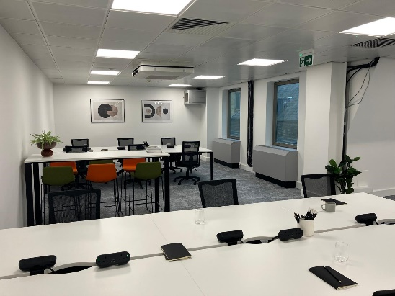
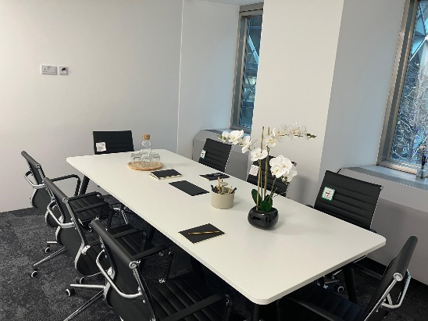
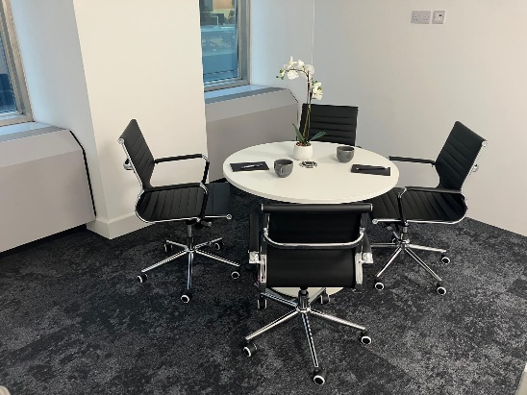
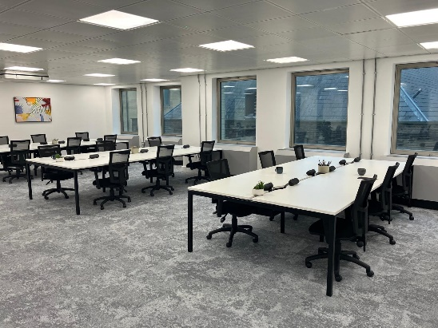
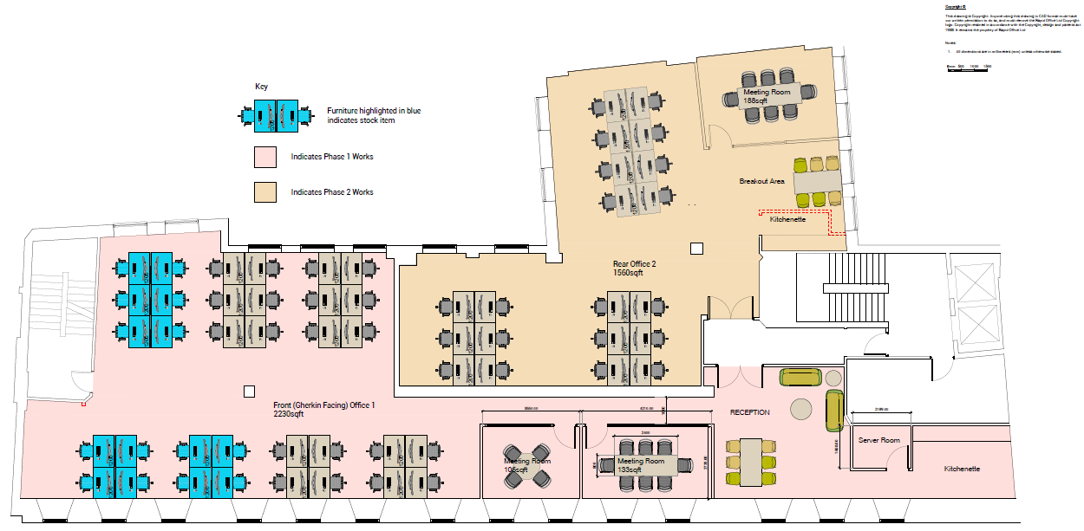
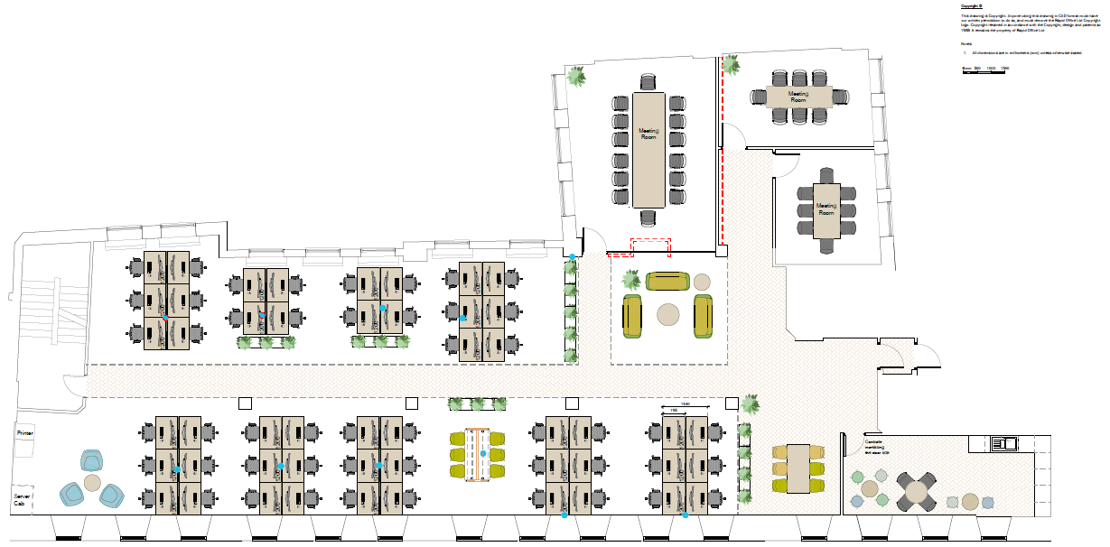
5-10 BURY STREET, LONDON, EC3
The Property offers good quality, open plan office accommodation with good transport links close by.
The building is located on Bury Street in the heart of the insurance district, adjacent to 30 St Mary Axe and close to Bishopsgate, Liverpool Street, Bank and Fenchurch Street stations.
SPECIFICATION
OUTGOINGS
1 x Phone Booth
Kitchenette
LED Lighting
2 x Passenger lifts
Cycle Storage
Shower & Locker Facilities
Manned front desks receptionist
Rent - £45.00 per sq ft pax
Rates – 4th TBC; 2nd £19.11 per sq ft
Service Charge - £16.94 per sq ft
NO VAT
EPC – C
SCHEDULE OF AREAS
Floor | Area sq ft | Area sq m | Desks
Fourth Second (north) Second (east) TOTAL | 3,667 2,230 1,570 7,467 | 341 207 146 694 | 50 34 20

Slide 4

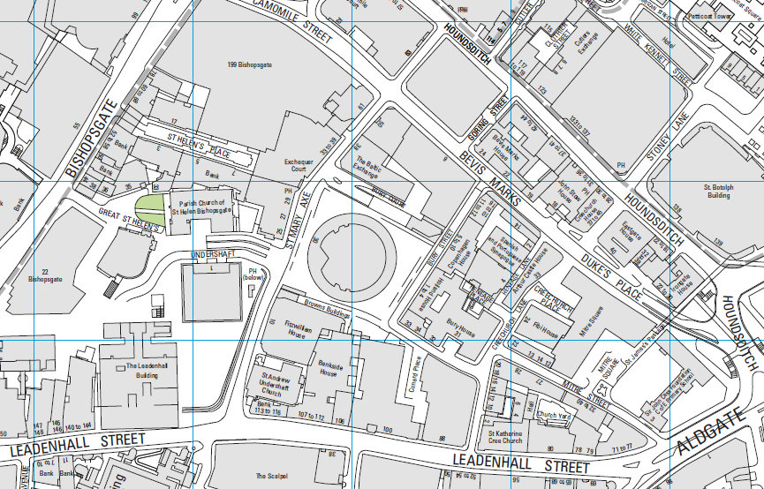
CONTACT US
JAMES PROCTOR
j.proctor@kinneygreen.com
+44 (0)7779 789 957
CHARLES FOGG
c.fogg@kinneygreen.com
+44 (0)7841 782 124
Misrepresentation Act: 1. Kinney Green LLP on its own behalf and on behalf of the vendor/lessor of this property whose agent Kinney Green LLP is, gives notice that: (a) these particulars do not constitute in whole or in part an offer or contract for sale or lease; (b) none of the statements contained in these particulars as to the property are to be relied on as statements or representations of fact; and (c) the vendor/lessor does not make or give, and neither Kinney Green LLP nor any of its members or any person in its employment has any authority to make or give, any representation or warranty whatsoever in relation to the property. The only representations, warranties, undertakings and contractual obligations to be given or undertaken by the vendor/lessor are those contained and expressly referred to in the written contract for sale or agreement for lease between the vendor/lessor and a purchaser or tenant. 2. Prospective purchasers or tenants are strongly advised to: (a) satisfy themselves as to the correctness of each statement contained in these particulars; (b) inspect the property and the neighbouring area; (c) ensure that any items expressed to be included are available and in working order; (d) arrange a full structural (and where appropriate environmental) survey of the property; and (e) carry out all necessary searches and enquiries. April 2026.

