Slide 1


Recent Advances in Allergic Bronchopulmonary Aspergillosis Complicating Cystic Fibrosis
ISHAM 2018, S2.6 ABPA
Amsterdam
July 2, 2018
Richard B. Moss MD
Center for Excellence in Pulmonary Biology
Department of Pediatrics, Stanford University

Slide 2
Similarities Between CF and ABPA
Allergic sensitization to A. fumigatus
  Positive skin test
  Serum IgE Af antibodies
Episodic obstructive airways disease
Pulmonary infiltrates
Bronchiectasis
Mold allergy (50-70% CF)
Early, pervasive adaptive immune responses to A. fumigatus
  Serum IgG, IgE, IgA antibodies
  Serum precipitins
Elevated total IgE (25-33% CF)

Slide 3
Distinct Sputum Mycobiomes in Healthy People, CF and Asthma
Healthy
CF
Asthma
Nguyen LD et al, Front Micro 2015; 6:1

Slide 4
Aspergillus Phenotypes in CF
Colonization
  Initial/transient/persistent
Infection
  Bronchitis
  Aspergilloma
  Chronic pulmonary aspergillosis
  Invasive pulmonary aspergillosis
Atopic sensitization
Severe asthma with fungal sensitization
ABPA
Overlap syndromes

Slide 5
ABPA Worsens Pediatric CF Structural Lung Disease
N=64, median 12.7 yr (6.4-18.1)
Kongstad T et al, Eur Clin Resp J 2017:4:1318027

Slide 6
Clinical Impact of Aspergillus Phenotypes in CF Adults
Phenotypes defined by serology (tIgE, Af-sIgE, Af-sIgG) and sputum (culture, Af-PCR, GM) biomarkers
ABPA and Af-sensitized patients showed greater FEV₁ decline over 2 years
n=130, no azole therapy
ABPA also had a greater FVC decline than Af-negative patients (162 vs 276 ml, p = 0.05)
.
 | Af-negative (38%) | ABPA (18%) | Af-sensitized (15%) | Af bronchitis (30%)
Mean FEV₁ decline (ml) | 125 | 243 | 222 | 192
p-value |  | 0.02 | 0.03 | 0.09
Baxter C et al. JACI 2013;132:560

Slide 7
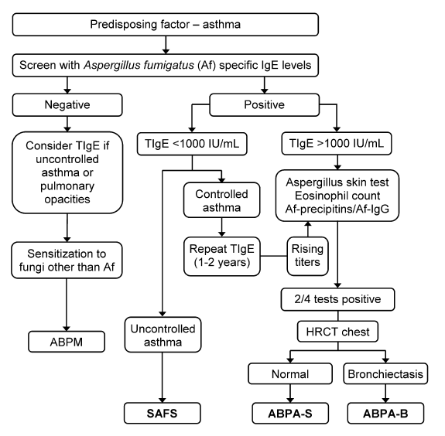
ABPA 2013 Diagnostic Algorithm
Ongoing issues
Cutoff for Af-IgE?
1000 IU total IgE cutoff?
Utility of Af skin test?
Eosinophil cutoff?
Af precipitin outdated?
Af-IgG cutoff?
How many positives?
Is ABPA-S = to ABPA-B?
How does CF affect these?
Agarwal R et al, Clin Exp Allergy 2013;43:850

Slide 8
CFF Consensus Conference: Screening for ABPA in CF
CFF Consensus Conference: Diagnosis of ABPA in CF ( Minimal Criteria)
1. Acute or subacute clinical deterioration (cough, wheeze, exercise intolerance, exercise induced asthma, change in pulmonary function, increased sputum) not attributable to another etiology
2. Total serum IgE >500 IU/mL
3. Immediate skin test reactivity, or in vitro demonstration of IgE antibody, to A. fumigatus
4. One or both of the following:
a. Serum precipitins, or IgG antibody, to A. fumigatus
b. New or recent abnormalities on the chest radiograph (infiltrates, mucus plugging) or chest CT (bronchiectasis) that have not cleared with antibiotics and standard physiotherapy
Annual total serum IgE after age 6
If total IgE >500 IU/mL: Aspergillus skin test or A. fumigatus serum antibody test
If total IgE <500 IU/mL: repeat if increased suspicion for ABPA (such as pulmonary exacerbation) and do skin test or serum antibody test
Stevens D et al, Clin Infect Dis 2003;37:S225

Slide 9
Survey of ABPA Diagnostic Criteria in UK CF Centers
Data obtained from 45/58 Centers (78%)
Cunningham S et al , Arch Dis Child 2001;84:89

Slide 10
An Audit of Diagnosis and Treatment of ABPA in Nottingham UK Adult CF Center
Background:
Despite accepted diagnostic criteria¹ the diagnosis of ABPA in CF is often challenging due to its insidious presentation.
Our Audit prompted by a case of acute CMV colitis due to inappropriate steroids.
There are no CF RCT in the treatment of ABPA but the UK CF Trust has provided a recommended treatment regimen².
A previous study has suggested a threshold of IgG >90mgA/L to suggest ABPA³.
Methods:
A retrospective case note review to identify CF patients given a diagnosis of ABPA.
Diagnostic tests compared to the minimum diagnostic criteria and treatment regimes recorded.
40 control patients with CF but not ABPA were compared.
¹Stevens DA et al. 2003 Clin Infect Dis 37(3): S225-264. ²Antibiotic treatment for CF 2009. UK CF Trust report.
³Barton RC et al. 2008 Diagn Microbiol Infect Dis 62(3): 287-291.
K Prescott & A Clayton, JCF 2012;11 Suppl 1:S101

Slide 11
An Audit of Diagnosis and Treatment of ABPA in Nottingham UK Adult CF Center
Results
10 (7.6%) of 132 CF patients had been given a diagnosis of ABPA.
Only 3 met all 4 minimum diagnostic criteria. None met criteria for a classic case.
Total IgE and AF specific IgE grade were higher in the ABPA group.
IgG Precipitin titres were higher in control group (78 vs 58mgA/L).
Treatment choice, dose and duration were variable according to prescriber preference.
Conclusions
The diagnosis of ABPA in our unit seldom met minimum diagnostic criteria and the treatment regimens were variable.
A new ABPA protocol has been introduced to address these inconsistencies.
Our Audit is unable to assess the assertion that an Aspergillus IgG >90mgA/L is suggestive of ABPA.
K Prescott & A Clayton, JCF 2012;11 Suppl 1:S101

Slide 12
Variable Center-Based Diagnostic Criteria:
Leeds UK Regional CF Unit Example
•ABPA: IgE ≥400 IU/mL, Af-sIgE >3.7 U/L, Af-sIgG>90 mg/L,
≥10% drop in FEV₁, wheezing
•Aspergillus bronchitis: ≥4 cultures in 12 mos, IgE≤400, Af-sIgE<3.7, ≥10% drop in FEV₁, wheezing, cough
ABPA 2.5%
AB 4.0%
Antifungal use 17.3%
Lauren L et al, J Cyst Fibros 2013;12:S88
Notes:
ABPA 12/474 = 2.5%
Af bronchitis 19/474 = 4%

Slide 13
The Search for ABPA Diagnosis Using Recombinant A. fumigatus Allergen Immunoassays Continues

Slide 14
The Search for ABPA Diagnosis Using Recombinant A. fumigatus Allergen Immunoassays Continues
39 CF-AfS
10 ABPA (3CF)
7/10 ABPA &
35/39 CF-AfS
differentiated
Vitte J et al, Front Immunol 2017;8:1019

Slide 15

Innate Basophil Activation in T_{H}2 Disease
allergen
FcεR
CD123
CD63
CD203c
Innate and Adaptive Basophil
Activation Biomarkers
Gieseck RL et al, Nat Rev Immunol 2017 Aug 30 ePub
Yamanishi Y et al, Immunol Rev 2017;278:237

Slide 16

ABPA Biomarker Diagnostic Evaluation Method
•TARC/CCL17
(ELISA)
Plasma
•Histamine
(Mass Spectometry)
Baseline
One drop of whole blood
Cells
•Surface staining for
basophil gating and
CD203c quantification
(FACS)
Supernatant
•Histamine
(Mass Spectometry)
In vitro stimulation
(10 and 30 minutes)
with Af extract or
rAsp f1
Cells
Surface staining for
basophil gating and
CD203c/CD63 quantification
(FACS)
Notes:
16

Slide 17
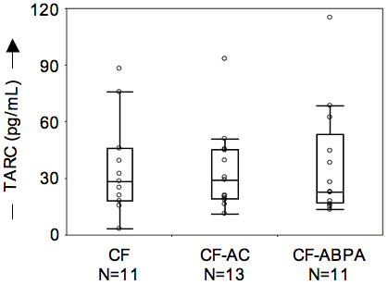
Plasma TARC/CCL17 Levels in CF-ABPA, CF with A. fumigatus colonization, and A. fumigatus-negative CF
TARC affected by
processing (serum vs
EDTA vs heparin)
Gernez Y et al, J Cyst Fibros 2012;11:502
TARC/CCL17 did not correlate with standard diagnostic ABPA tests
Wiliams C et al, , J Cyst Fibros 2011;10:S37
Notes:
17
Wiliams et al – Glasgow. n=?, 2-14 yrs (avg 9)
Chotirmall mycobiome paper submitted to AJRCCM also did not find TARC useful.

Slide 18
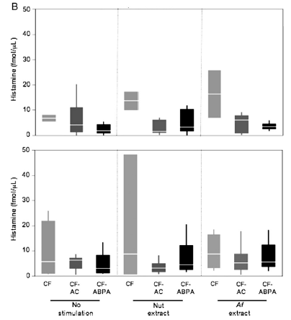
Histamine Release was not Diagnostic for CF ABPA
Baseline
Post-activation
Gernez Y et al, J Cyst Fibros 2012;11:502

Slide 19
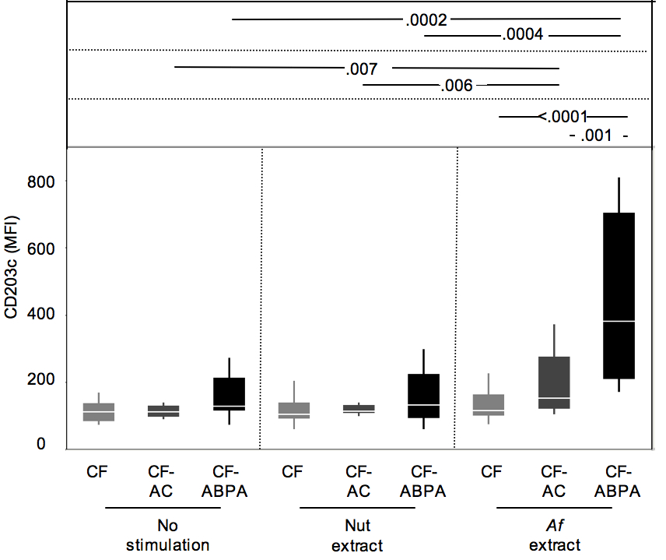
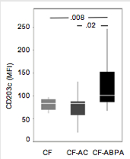
Blood Basophils are Activated and Hyper-responsive to Aspergillus in CF ABPA
At baseline
Cross-sectional study
n=37
Gernez Y et al, J Cyst Fibros 2012;11:502
Notes:
19
(centered around the sample mean, with endpoints spanning the 95% confidence interval) for CF-ABPA, CF-AC CF-NEG and HC groups (N=8, 11, 12, and 11, respectively) measured for blood basophil CD203c expression in median fluorescence intensity units (MFI), upon Af antigen (mixed extract) stimulation. Note the clear distinction between CF-ABPA and CF-AC groups (area under the ROC curve is .93, P=.0002), which is promising in view of developing a clinical diagnostic assay, contrasting with the gray areas in current differential diagnostic criteria

Slide 20
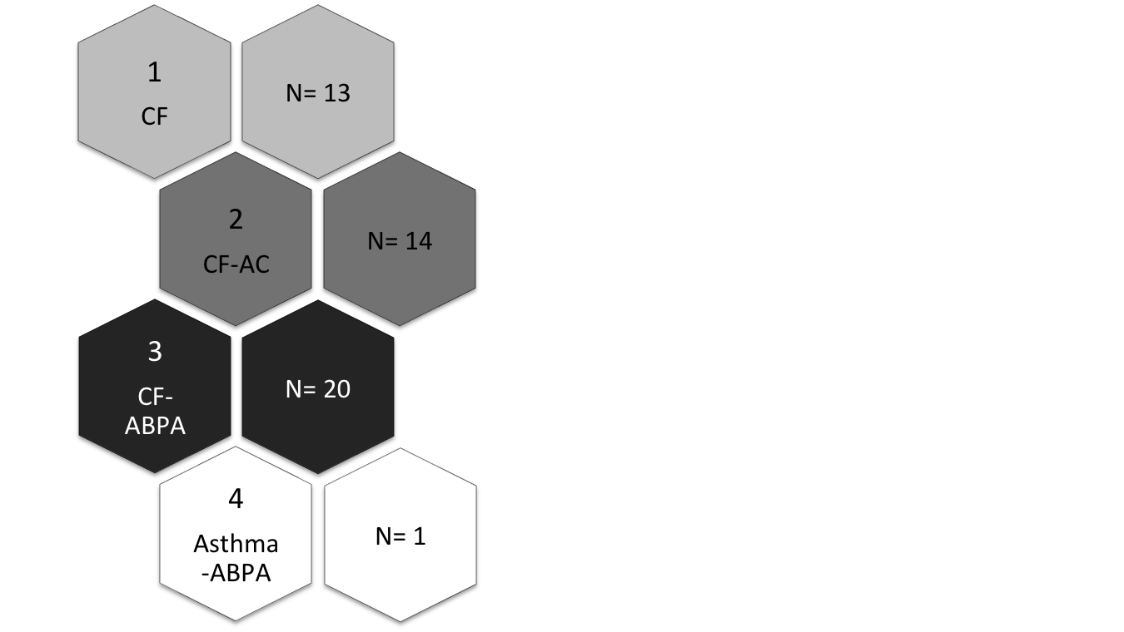
International Longitudinal 2-Year Cohort Study
4 Groups of Patients: Stanford Cohort
Cystic Fibrosis
(No Af colonization or ABPA)
CF and Af colonization (no ABPA)
CF and ABPA
Stevens et al, Clin Inf Dis, 2003
Asthma and ABPA
Greenberger, JACI 2002
Children and adult with CF provide blood and sputum samples for the study:
  - 6 month intervals, for 4 clinic visits
  - as well as ‘sick visit’ samples during pulmonary exacerbations
Gernez Y et al, Eur Respir J 2016;47:1892
Mirkovic B et al, JACI 2016;137:436
Notes:
For our study we have concentrated on four groups. CF, CF-AC, CF-ABPA, Asthma-ABPA.
Children and adult with CF provide blood and sputum samples for the study:
6 month intervals,
as well as ‘sick visit’ samples during pulmonary exacerbations
Patients will have four schedule visits (+/- sick visits), presented here 3 visits
20

Slide 21
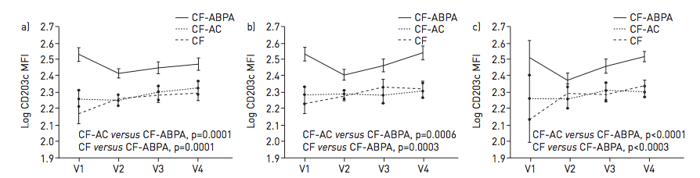
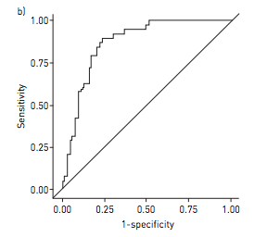
Af-Specific Basophil Activation Robustly Discriminates CF-ABPA from CF-AC and CF over time
Following 10-minute
of ex vivo activation with
Af extract
Following 30-minute
of ex vivo activation with
Af extract
Following 30-minute
of ex vivo activation with
rAsp f1
ROC
AUC
0.86
Gernez Y et al, Eur Respir J 2016;47:1892
Notes:
NEED P VALUES

Slide 22
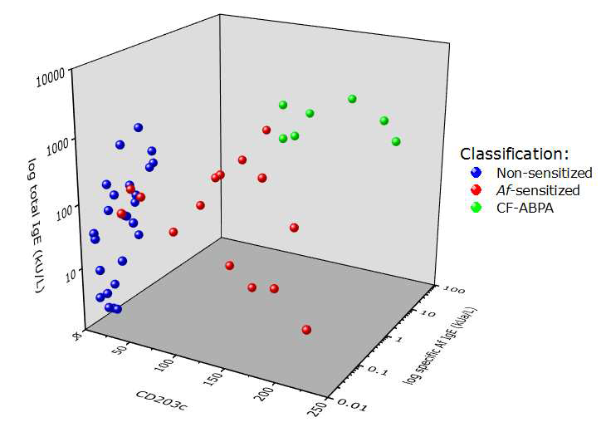
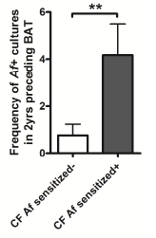
Basophil Activation Test and Af-sIgE Differentiate Aspergillus Infection, Sensitization and ABPA in CF
Dublin cohort: Validation of BAT and focus on distinguishing Af-sensitized from ABPA
Mirkovic B et al, JACI 2016;137:436

Slide 23
Basophil Activation Test Predicts Development of ABPA in
A. fumigatus-sensitized CF Patients
17 ABPA
24 Af-sensitized
15 non-sensitized
10 BAT+ →median 9 months to ABPA dx
29 BAT- → only 1 ABPA dx up to 7 yr later
Katelari A et al, J Cyst Fibros 2016;15:587

Slide 24
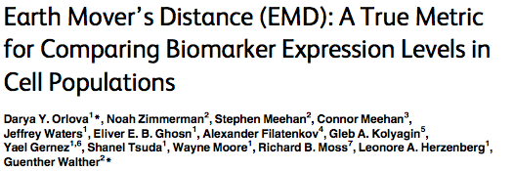

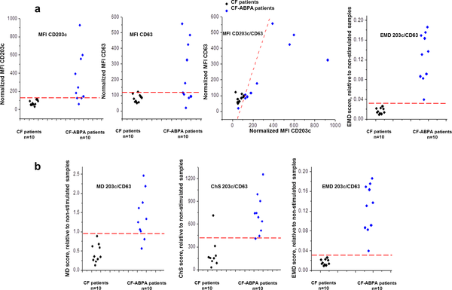
2016 Mar 23;11(3):e0151859
Fig 4. EMD scores based on expression of two independent flow cytometry markers more accurately distinguish allergic (CF-ABPA) from non-allergic (CF) patients.
Notes:
This panel compares EMD scores for the combined expression of CD203c and CD63 with “classical” median fluorescence intensity (MFI) values computed separately for the expression of each marker and with MFI values computed for the combined expression of CD203c and CD63. (b) Performance comparison between EMD and two other representative “metrics”, one based on test statistics, Chi-Square (ChS) [2] and the other is a distance measure, Mahalanobis Distance (MD). All six measures were calculated relative to each sample’s unstimulated control. Data are shown for 20/45 CF patients (10 with CF-ABPA and 10 with only CF) drawn from a previously published CF-ABPA study [19, 23] and selected as described in Materials and Methods. For each CF patient sample (n = 10) and CF-ABPA (n = 10), we calculated the EMD on the CD63 and CD203c channels between the unstimulated controls and samples stimulated with theA.fumigatus allergen/extract. U

Slide 25
MRI as a CF APBA Diagnostic Tool
CT
T1
T2
ABPA
No
ABPA
N=18 CF ABPA,
90 CF no ABPA
Mucus Signal Intensity
Dournes G et al, Radiology 2017;285:261
Notes:
Mucoid impactions – increased calcium salt, iron, manganese
T1 hyperintensity
T2 hypointensity

Slide 26
Therapeutic Approaches for CF ABPA
First line: Oral glucocorticosteroids (prednisone, prednisolone)
  Toxicity issues often limiting
  Alternative: Pulse intravenous glucocorticosteroids (methylprednisolone)
    Potential for reduced steroid toxicity
Second line: Triazoles
  Validated by placebo-controlled trials
  Frequent toxicities (vori>itra>posa). Absorption, metabolism, drug interactions mandate drug level monitoring; resistance increasing
  Alternative: Inhaled amphotericin B
    Multiple formulations, doses, delivery systems
Omalizumab
  Validated by placebo-controlled trial, open-label trials
  Expensive
  Requires q 2-4 week office/clinic visit, observation
Notes:
2011 Danish study – Af in 51% CF, 22% chronic, 4.5% azole resistance. Mortensen KL et al, JCMicro 2011 Jun;49(6):2243-51

Slide 27
Aspects of CF Affecting ABPA Therapeutic Choices
•Pervasive, age-related glucose intolerance and diabetes
•Frequent osteopenia/osteoporosis
•Pervasive biochemical hepatic dysfunction (clinical disease
relatively rare)
•Frequent GI symptoms and problems (hyperacidity, malabsorption,
obstruction, reflux)
•Use of CYP3A4-affected CFTR modulators
(e.g., ivacaftor-substrate, lumacaftor-inducer)
•Complex pulmonary microbial infection and early onset of
recalcitrant neutrophilic inflammation
•Episodic airway hyper-reactivity and asthma-like symptoms

Slide 28
Treatment Variability of ABPA in CF
32 adult, 25 pediatric UK CF
consultants (61% survey return
rate)
Boyle M et al, Med Mycol 2018 Mar Epub

Slide 29
Azole-Resistant Aspergillus in CF
Seufurt R et al, J Antimicrob Chemother 2018 Mar 23 ePub

Slide 30
Omalizumab for CF ABPA: The Novartis Trial Fiasco
Only study data available via ClinTrial website (NCT00787917).
Randomized DBPCT design included omazilumab dosing of 600 mg or placebo (4.8 mL, given in 4 injections) injected SQ daily. Maximal FDA approved dose for asthma 375 mg every 2 weeks.
Dosing for CF ABPA based on flawed hypothesis (falsified by Volkamp et al) on required level needed for biologic effect.
10 EU sites. Trial halted early. More AEs on active drug and failure to recruit required sample size.

Slide 31
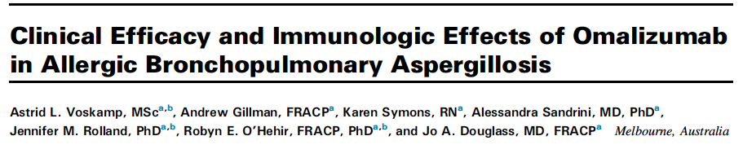
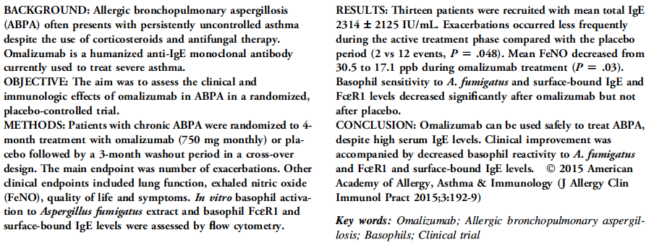

Slide 32
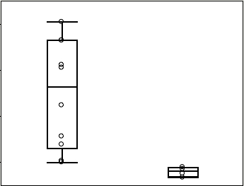
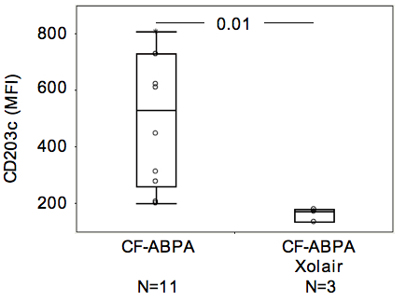
Omalizumab Ablates Basophil
CD203c Upregulation in CF-ABPA
Peanut allergy
CF-ABPA
.004
4
Gernez, Int Arch Allergy Immunol 2011;154:318
Notes:
32
Preliminary from CF-ABPA patients undergoing (N=3) or not (N=8) Omalizumab treatment show similar difference in basophil CD203c levels upon Af antigen stimulation.

Slide 33
Response to Omalizumab in CF ABPA
N=102 cases (40 CF), 30 published papers
Li J-X et al, Respir Med 2017;122:33
N=18 CF
8 French
CF Centers
Perisson C et al, Respir Med 2017;133:12

Slide 34
J Allergy Clin Immunol Pract 2017;5:1591-1598.e6
n=387, retrospective 2000-2006
r= -.20
p<0.0001
Systemic steroid treatment (median, 20 days; itraconazole also used in 85% of cases) of most severe episodes
(i.e., ≥100% increase in tIgE within 3 months, >95th age-specific percentile) in at-risk patients improved FEV1
outcome
p=0.0049
p=0.033
Notes:
Two further take aways: (1) Only minority of patients/responders met CFF criteria for ABPA dx,
(2) IgE before/after increase levels often below “minimal” consensus cutoff of 500 U/mL.

Slide 35
Future Developments
Consortia for study of fungal disease in CF have been established in UK and EU
Inhaled antifungals: novel drug-delivery device bundles
  azoles, amphotericin, other
T_{H}2 pathway targets for precision biologics
  IL-5, IL4Rα, IL-13, IL-33/ST2, IL-25/IL-17E, TSLP, PGD2/CRTH2
Standardized diagnostics: tIgE, Af-sIgE/G, BAT, MR
Biomarker monitoring: ΔtIgE, Af burden

