Slide 1



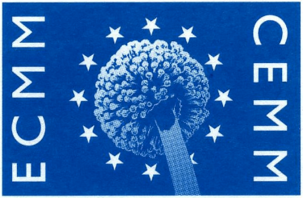
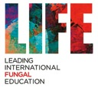

Global burden of fungal disease
Malcolm Richardson
NHS Mycology Reference Centre
ECMM Excellence Centre
Manchester University Foundation Trust
Manchester, UK

Slide 2
“We wrestle not against flesh and blood, but against the dominations, the powers, the lords of darkness, the mischievousness of spirits in the upper regions” – The Second Epistle to Timothy (Saint Paul)

Slide 3
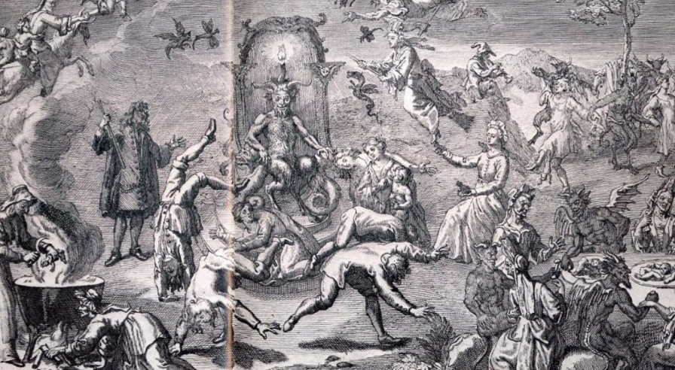
The Demonic Dark Spirits (Fungi) of the Air

Slide 4
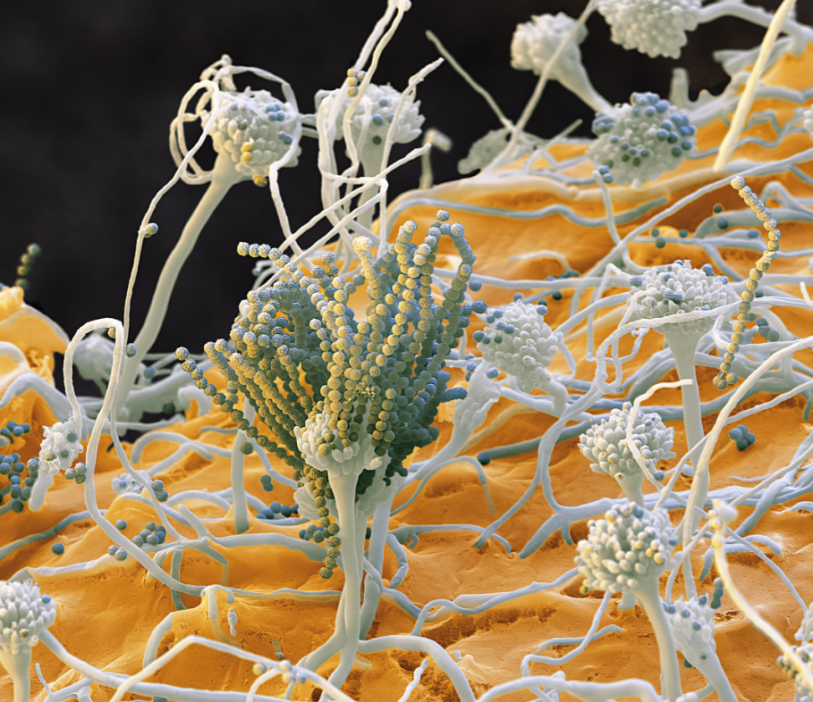
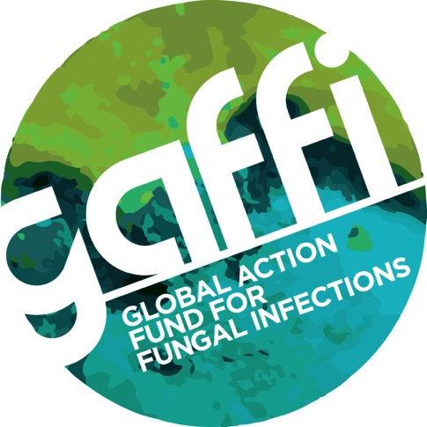
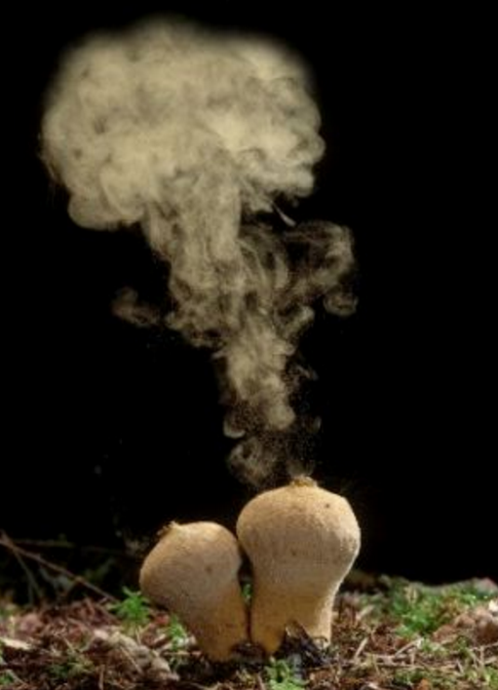
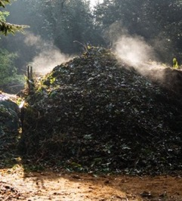
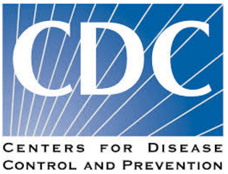
Fungi here, fungi there, fungi everywhere
One Health Initiative (WHO/CDC)

Slide 5
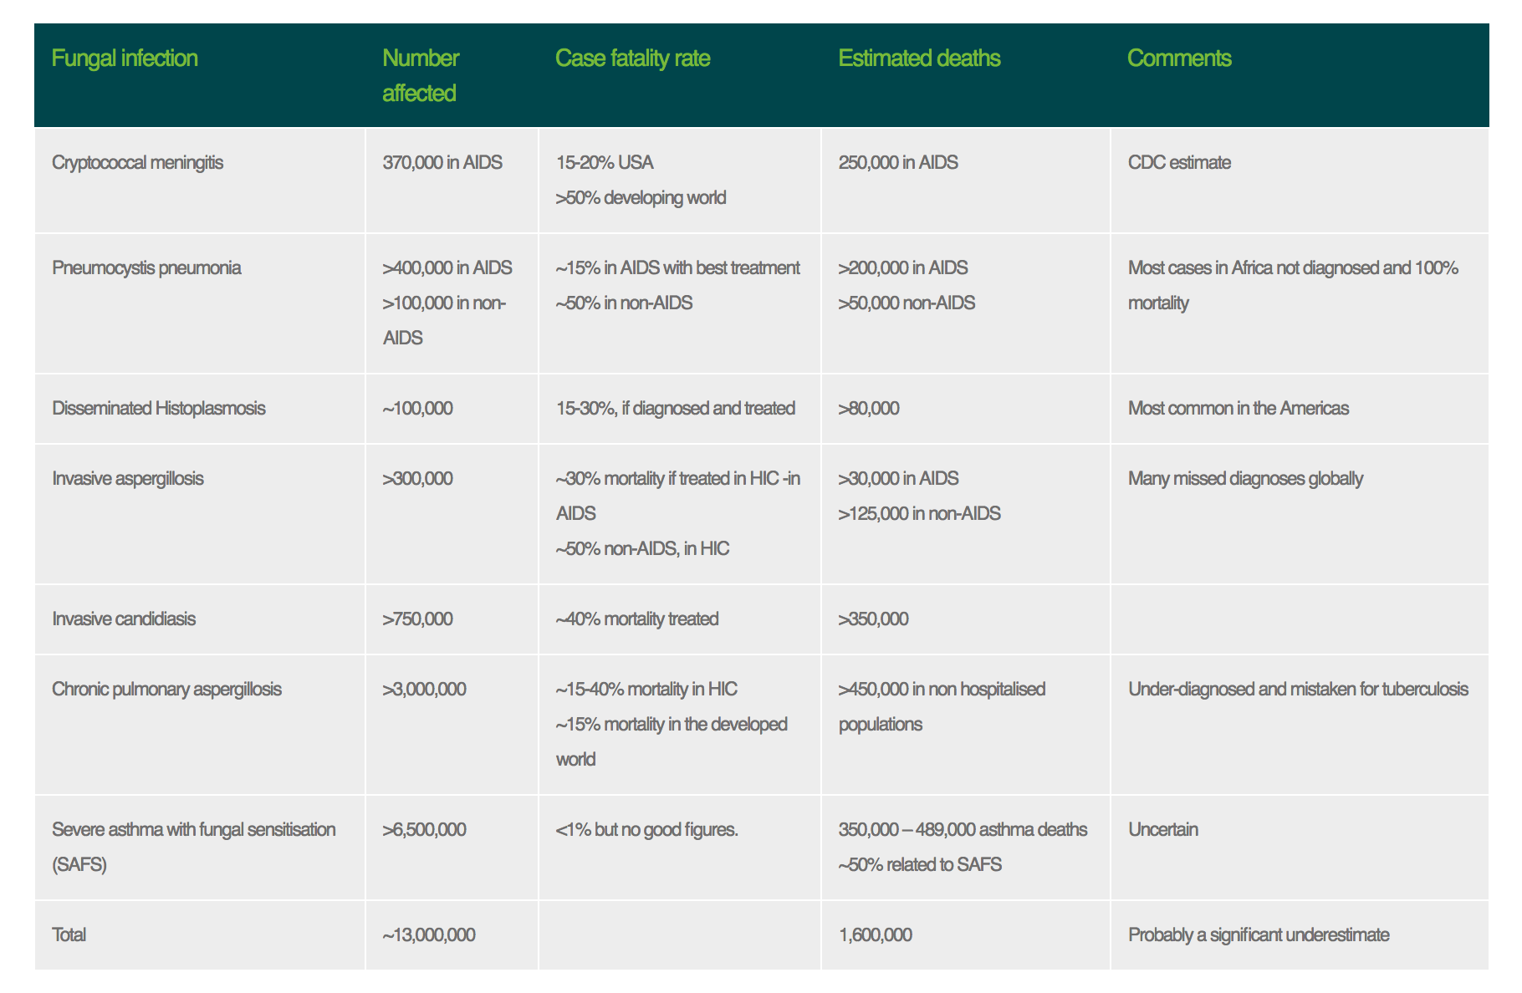
Some numbers

Slide 6
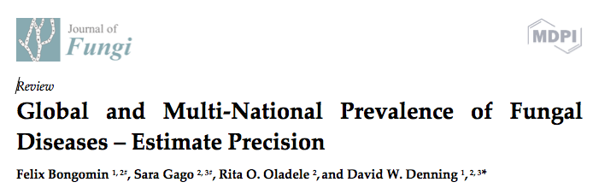
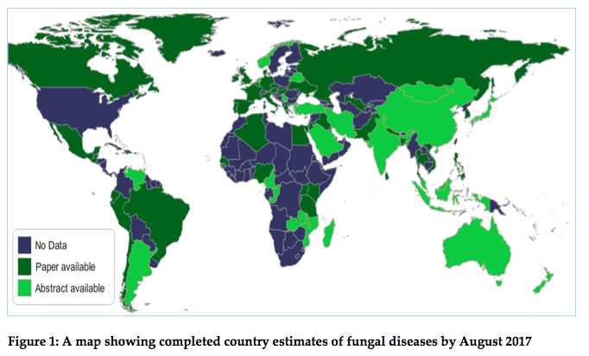
Under review

Slide 7
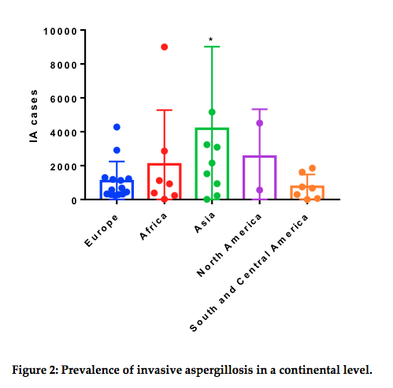

Slide 8
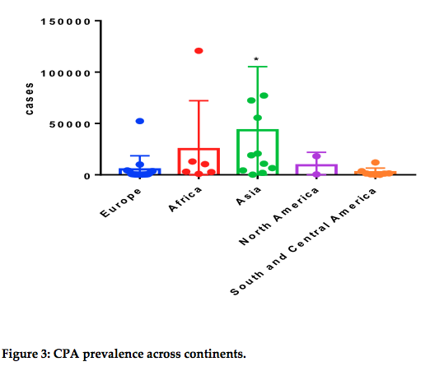

Slide 9
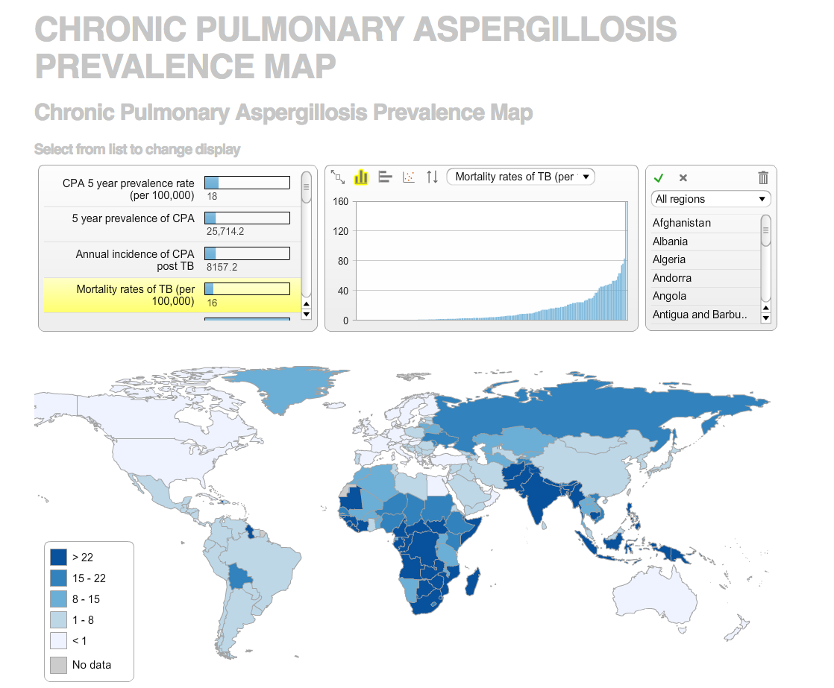

Slide 10
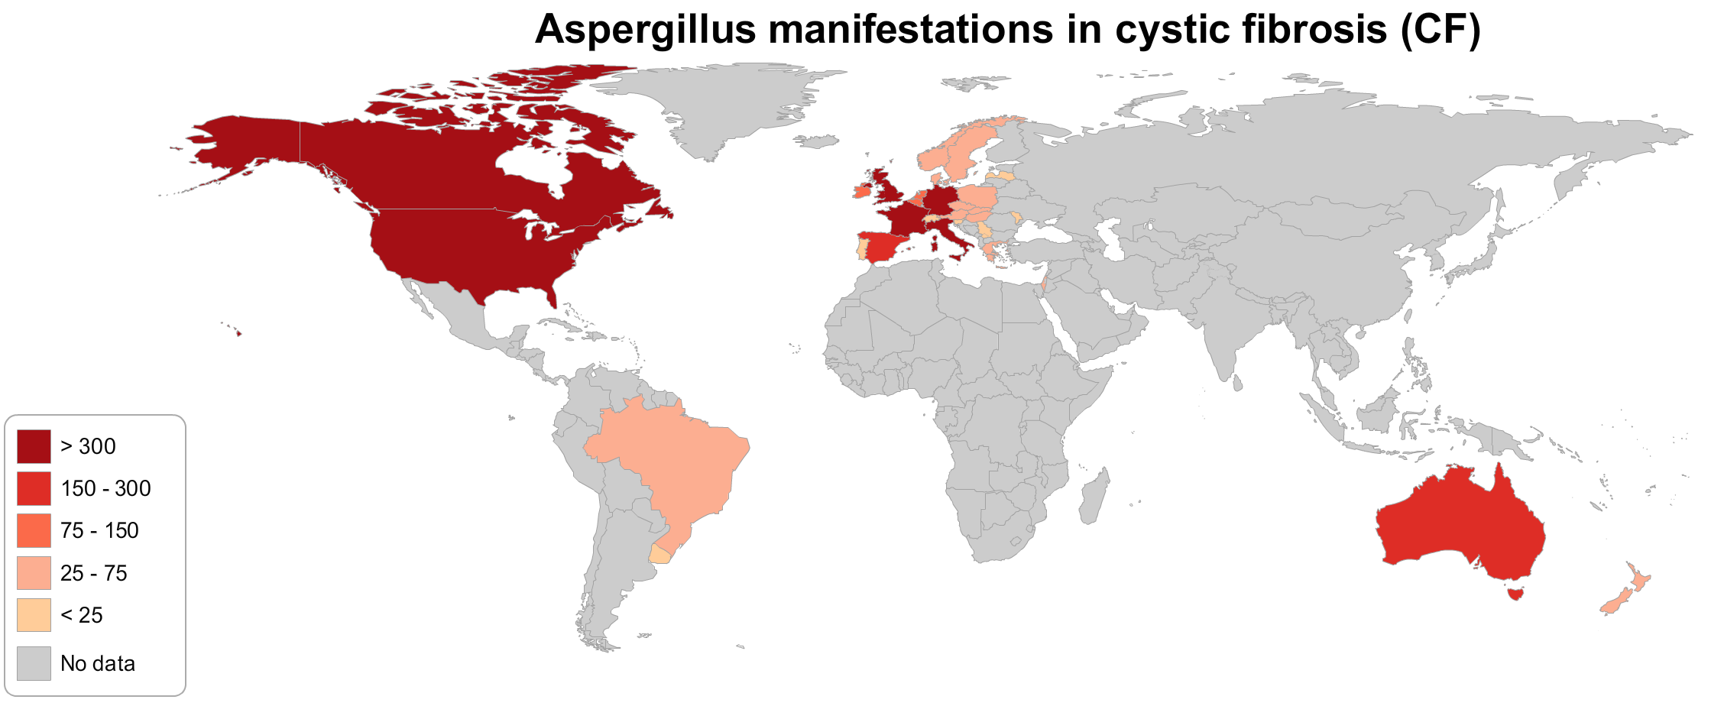

Slide 11
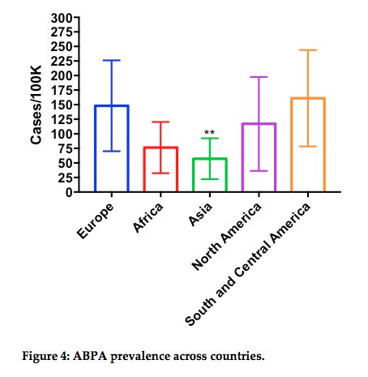

Slide 12
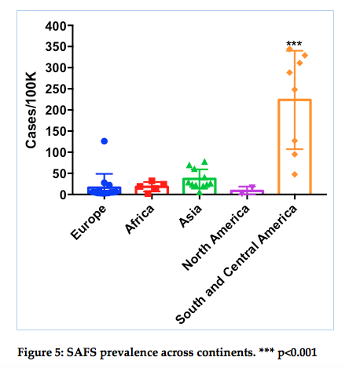

Slide 13
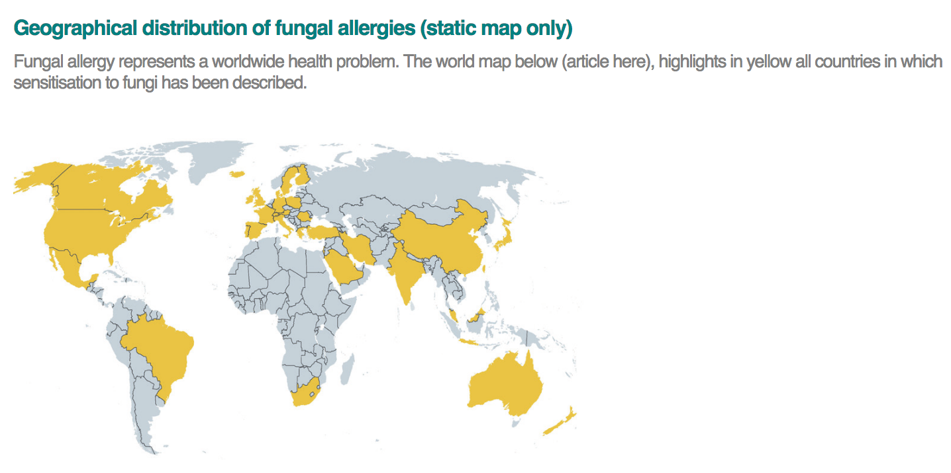

Slide 14
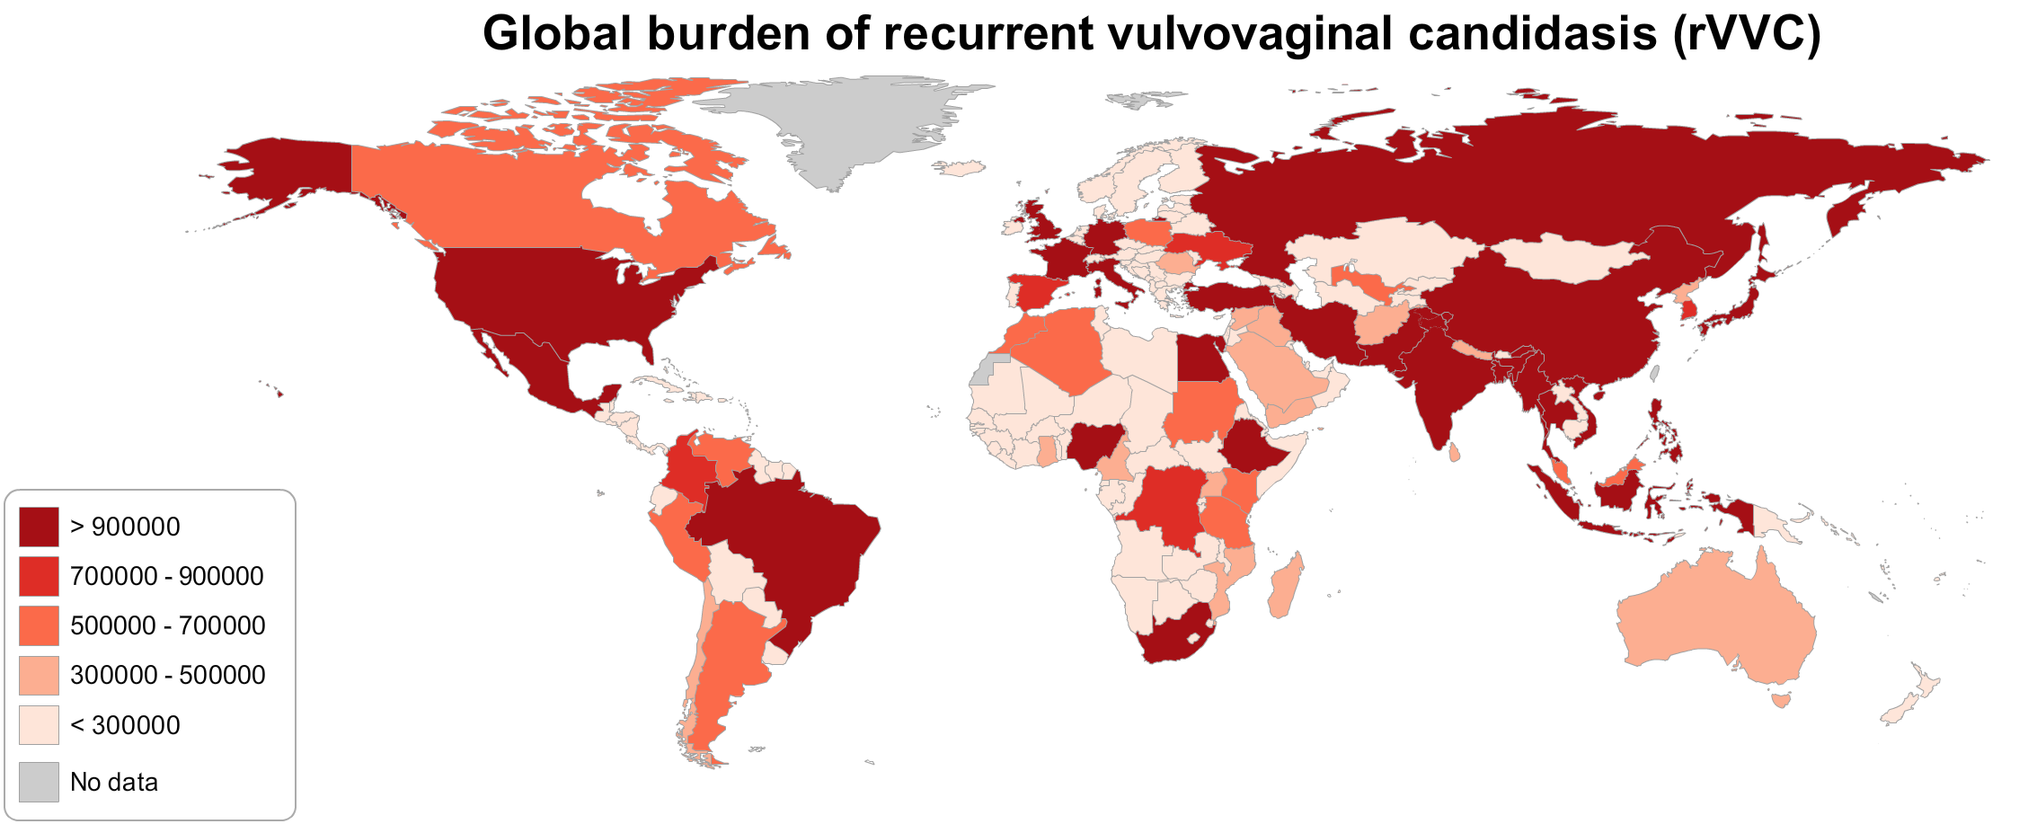

Slide 15


“Candida here, Candida there, Candida everywhere”
(including Candida auris)
Plays Pleasant, 1884

Slide 16
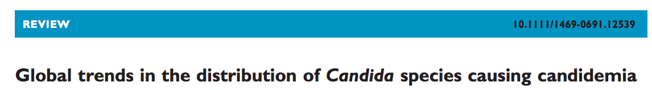
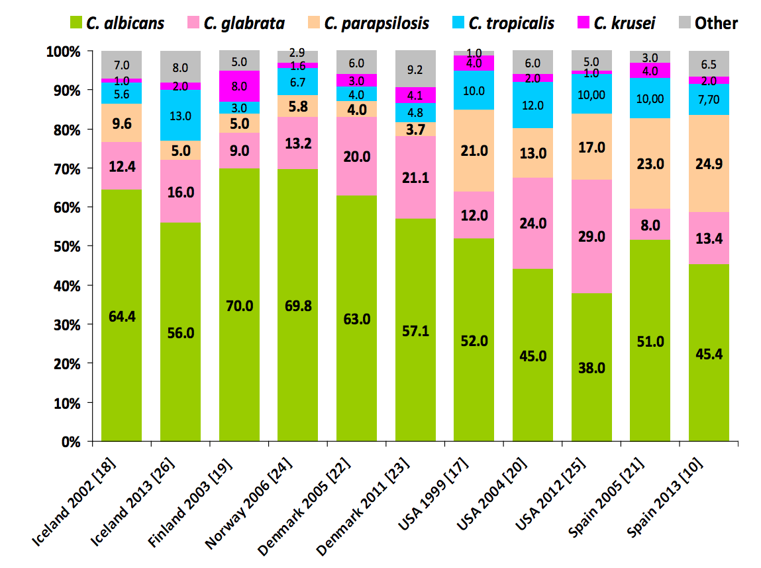
Guinea, Clin Microbiol Infect 2014; 20 (Suppl. 6): 5-10.

Slide 17
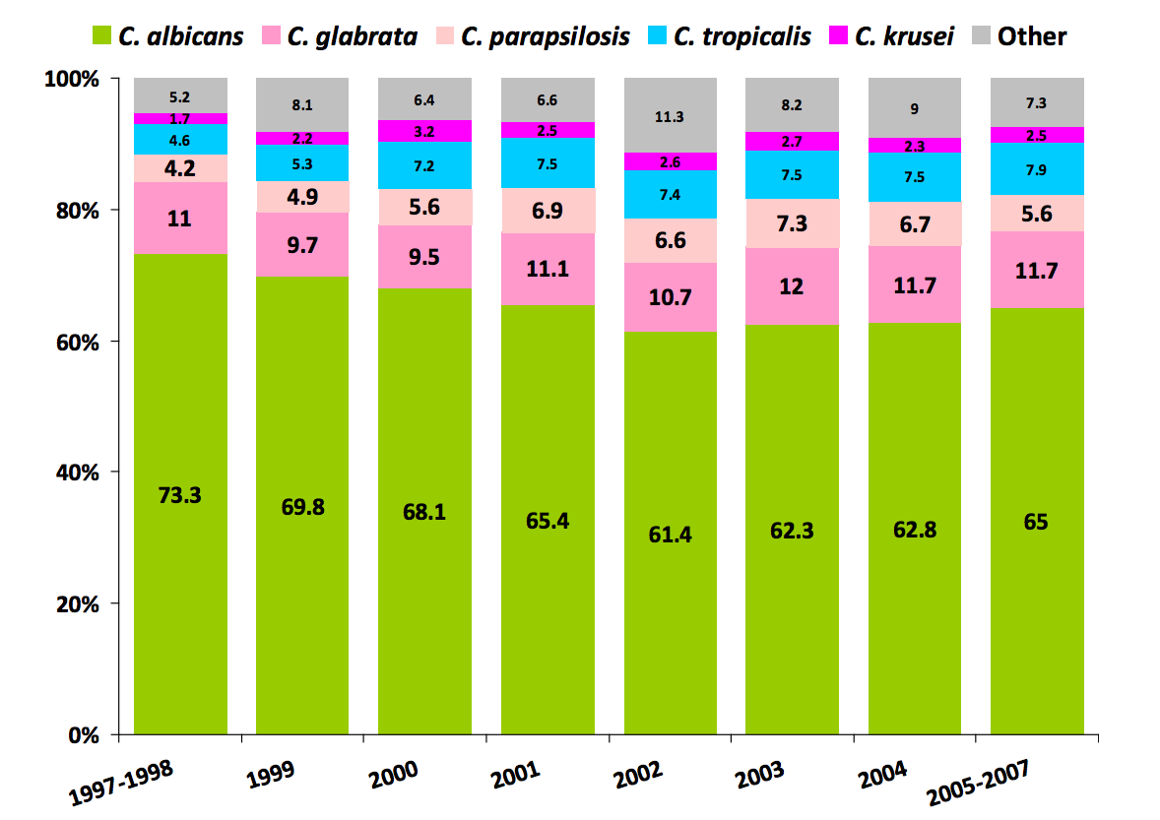

Slide 18
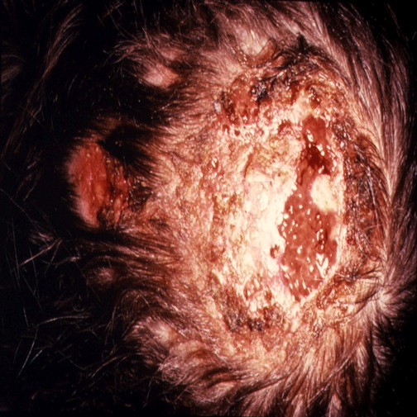
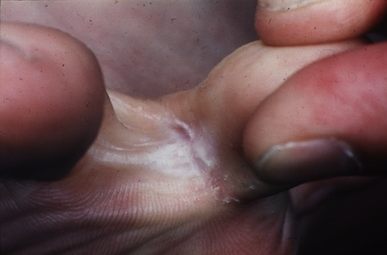
Fungal skin disease

Slide 19
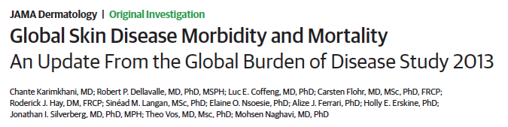
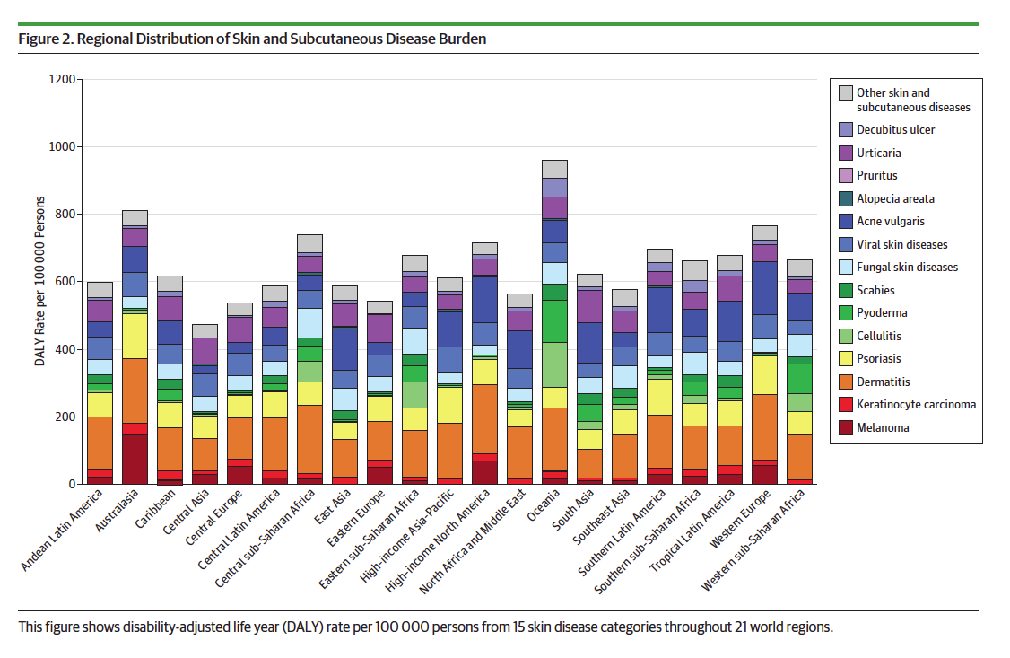

Slide 20
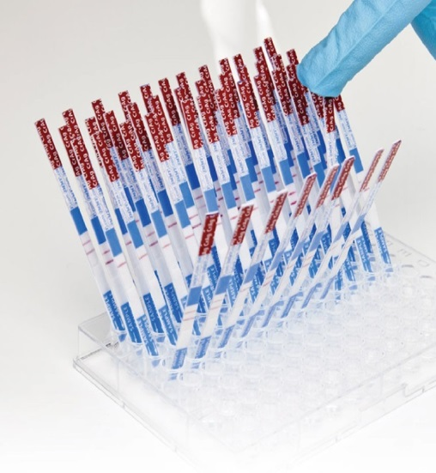
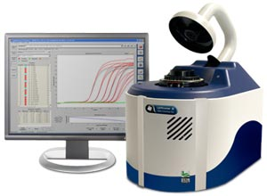
Surveillance for cryptococcosis

Slide 21
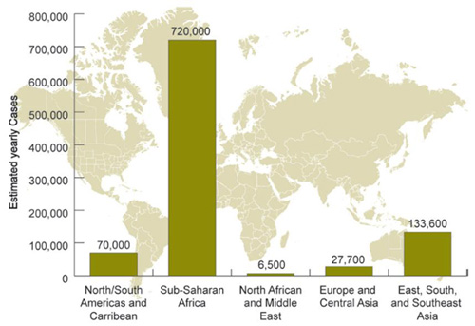
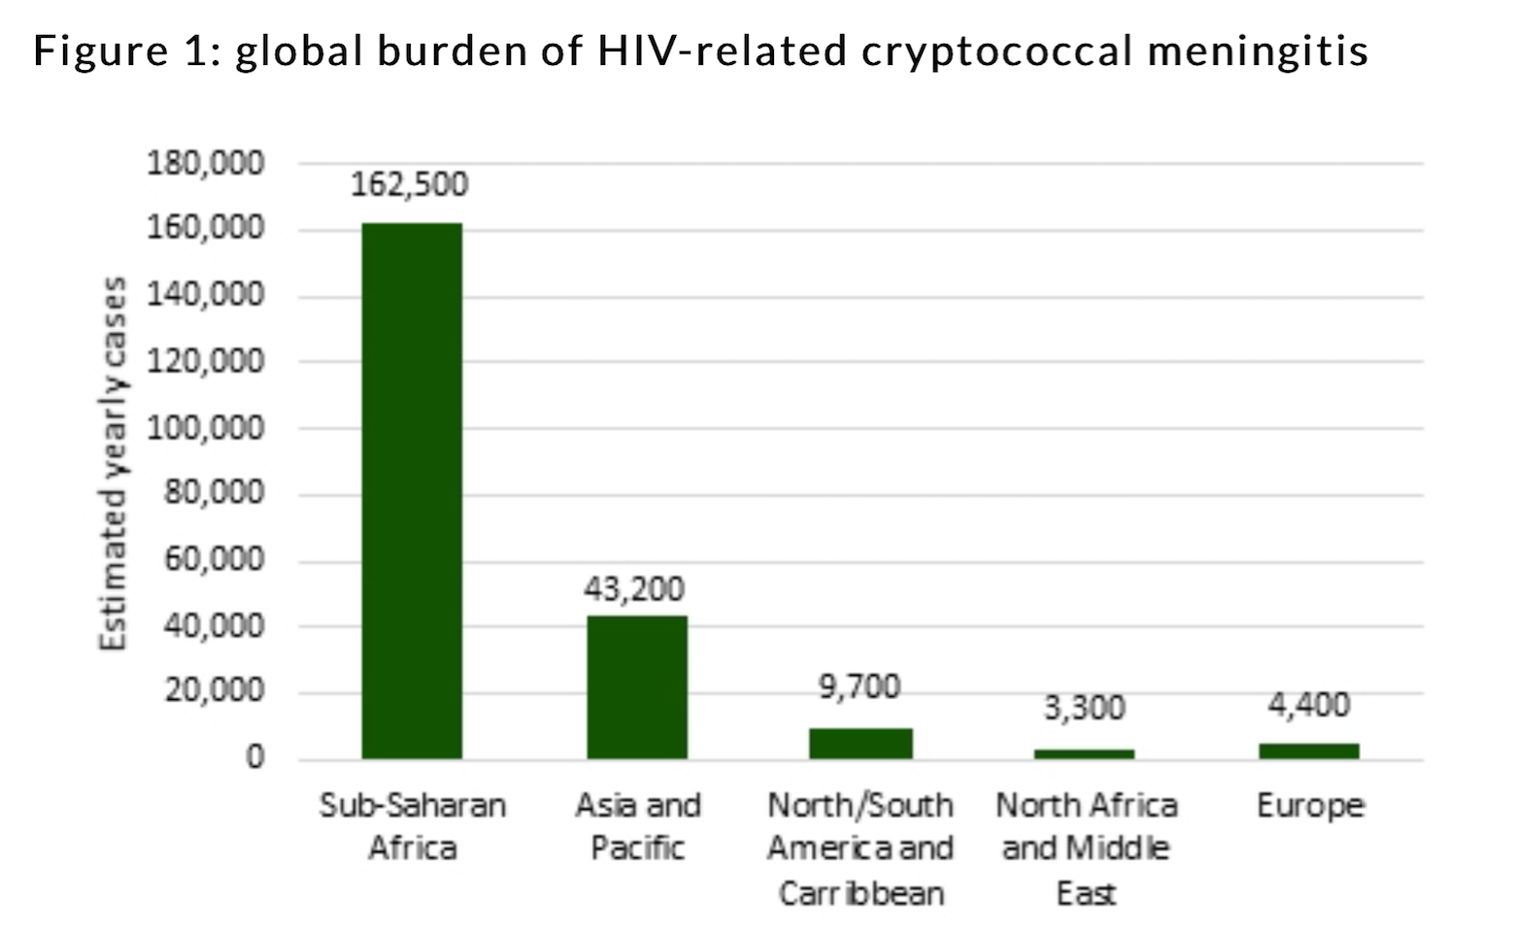
Global burden of cryptococcal disease
Parks et al 2009
Parks et al:
Based on few provider-based cohort studies
Probably an over estimate of the actual burden
Rajasingham et al:
Decreased global burden
Mortality remains unchanged
  65% (2009) vs. 80% (2017)
Sub-Saharan Africa still has majority of cases and deaths
Rajasingham et al. Lancet Infect Dis. 2017; 3099(17), pp. 1–9
Park et al. Aids. 2009; 23(4), pp. 525–30.

Slide 22
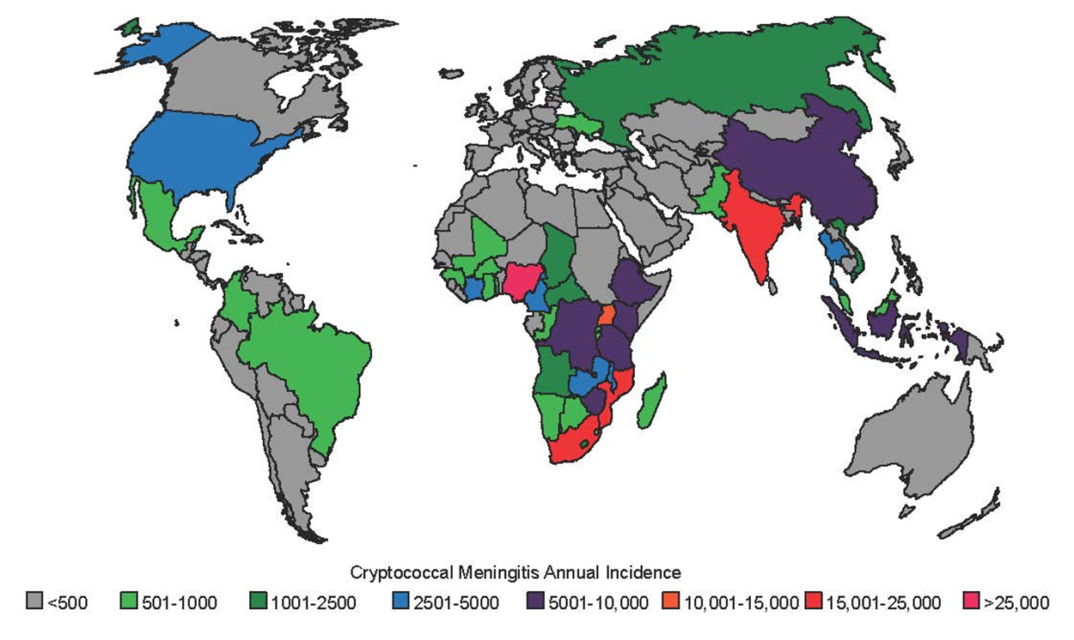
Cryptococcus is responsible for 15% of AIDS-related mortality globally
CRAG prevalence of 6·0% among HIV/AIDS patients with CD4<100 cells/µL
Rajasingham et al. Lancet Infect Dis. 2017; 3099(17), pp. 1–9
Notes:
95% CI 10% to 19%).

Slide 23
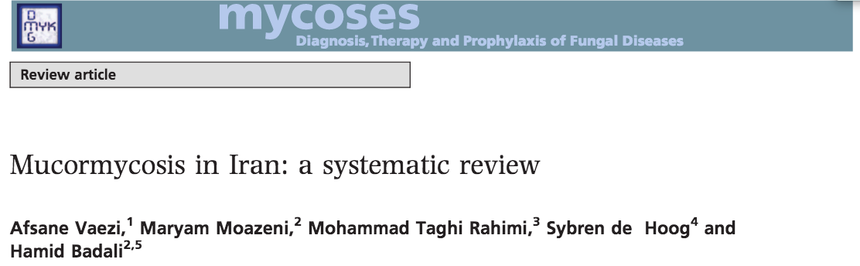
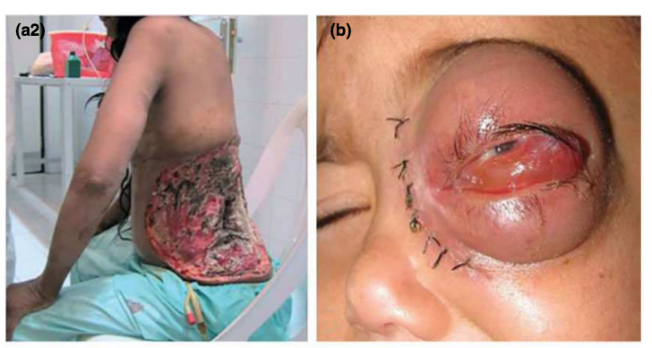

Slide 24
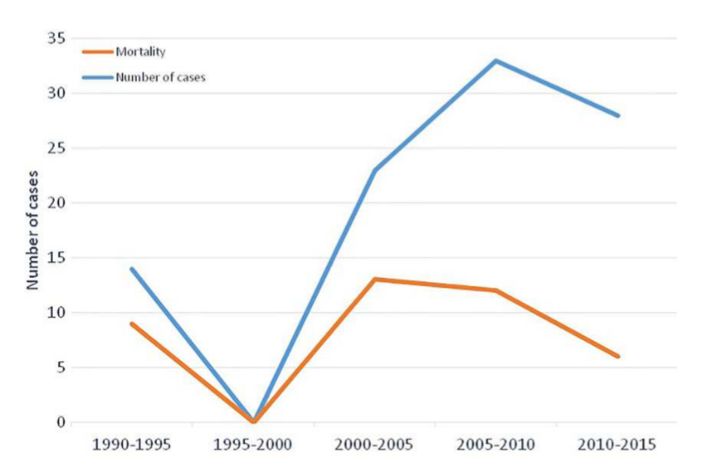

Slide 25
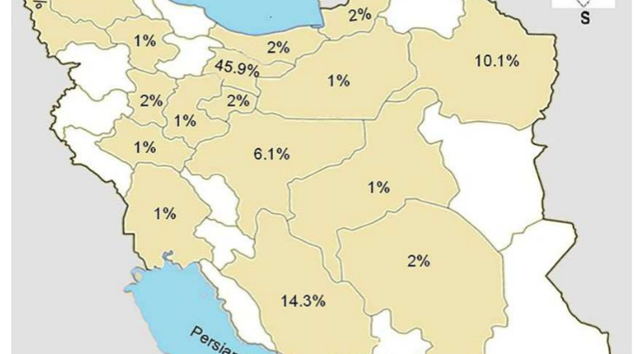

Slide 26
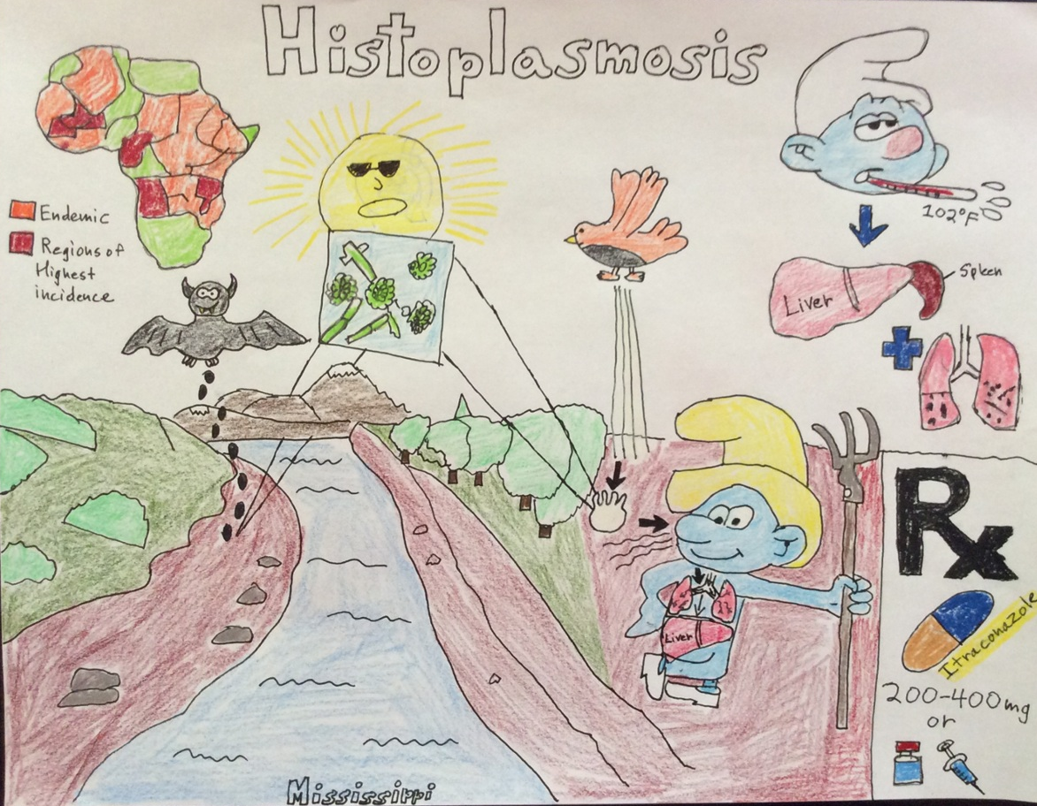

Slide 27
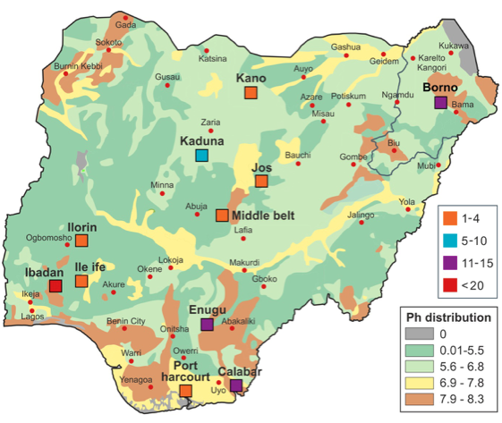
Cutaneous reactivity to histoplasmin in Nigeria: in relation to soil type
Oladele et al (unpublished)

Slide 28
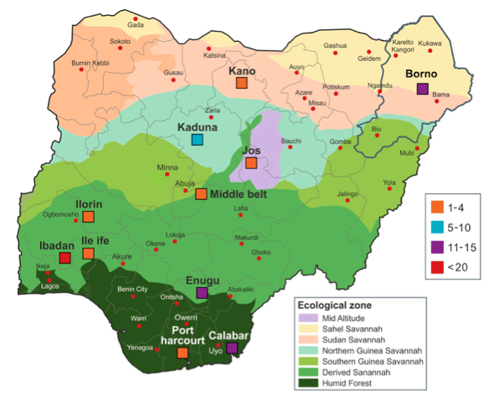
Cutaneous reactivity to histoplasmin; relation to vegetation type
Oladele et al (unpublished)

Slide 29
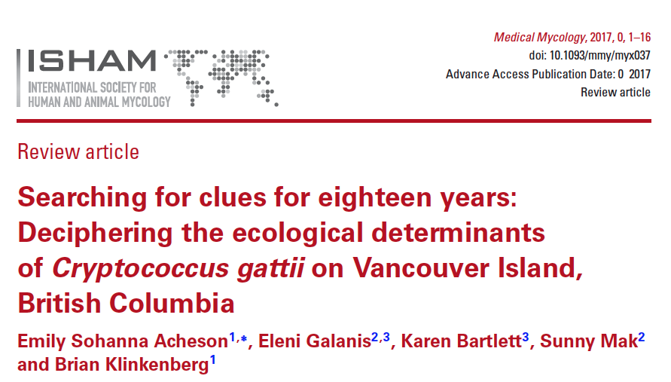
Reviewed publications from January 1970 - June 2016
Identified 56 relevant studies.
Identified environmental isolations of C. gattii from 18 countries, spanning 72 separate regions across six continents.
Fifty-three tree species were Associated with C. gattii , spanning 10 climate classifications and 36 terrestrial ecoregions.
No studies directly tested the potential effects of climatic changes (including climatic oscillations and global climate change) on C. gattii
Only one study directly assessed land use change.

Slide 30
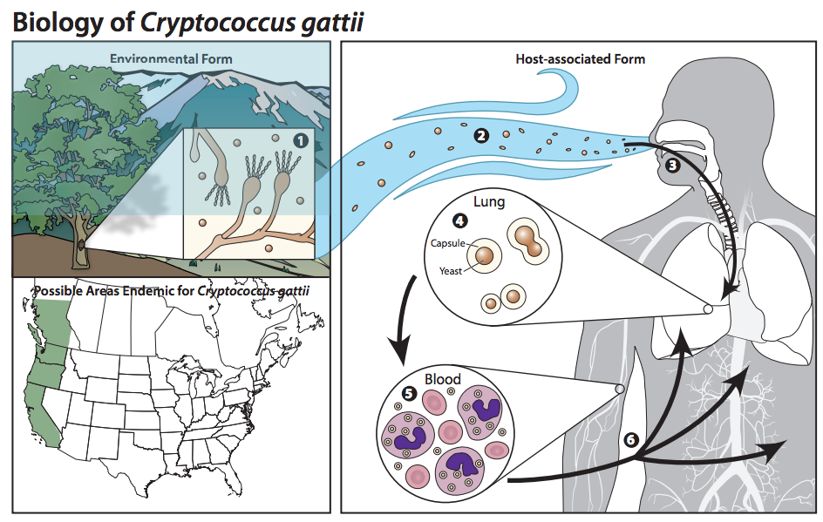

Slide 31
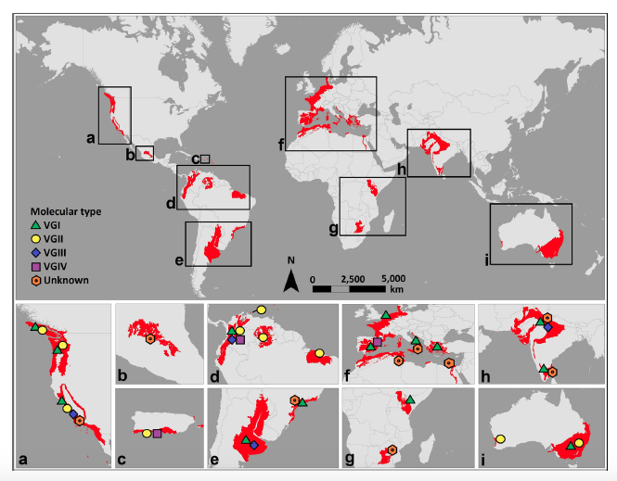

Slide 32
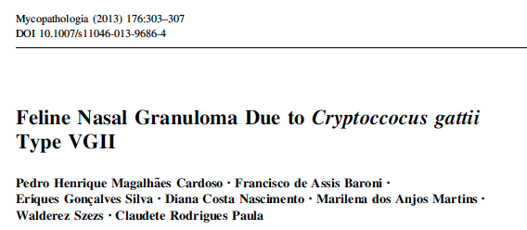
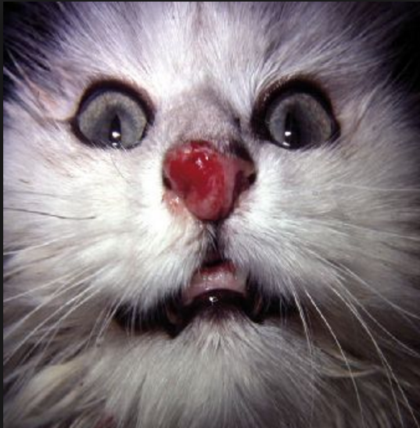
Mycology Reference Centre Manchester: VGI (AFLP4 Clade)

Slide 33
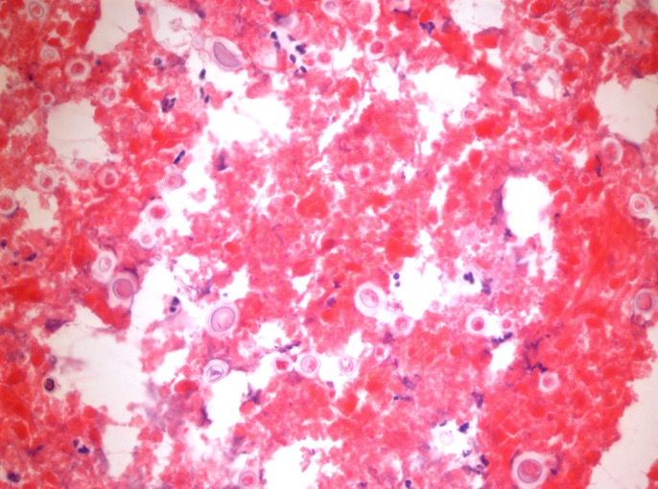
Patient PH
Frozen section: encapsulated, budding yeasts

Slide 34
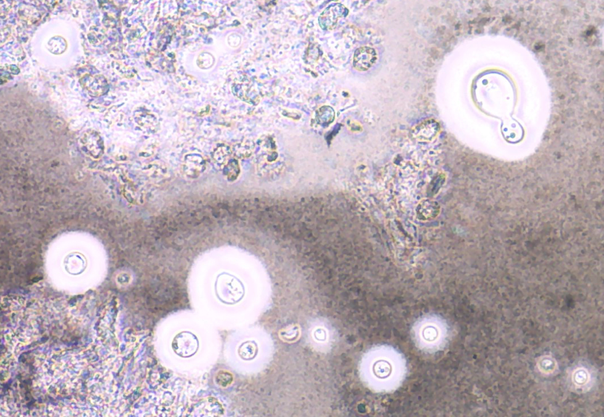
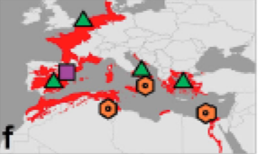
Patient PH: lung biopsy culture: encapsulated, budding yeasts:
Cryptococcus gattii VGI (AFLP4 Clade)
= VGI
First isolation in UK

Slide 35
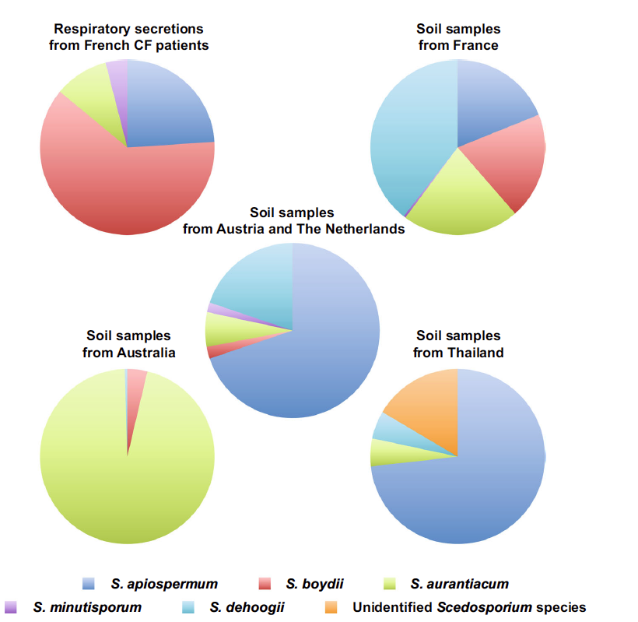
Ecology of Scedosporium species

Slide 36
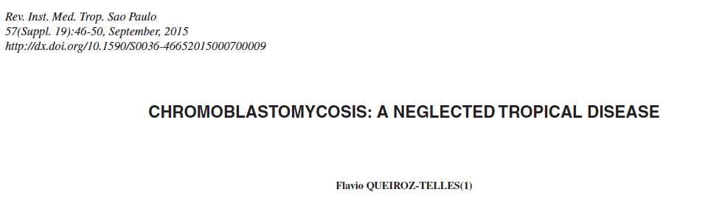
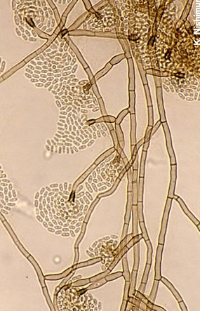
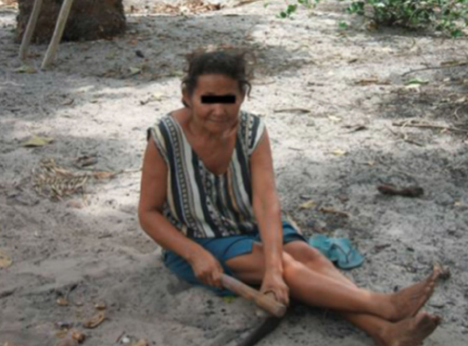



Slide 37


Slide 38
Future directions
To improve model predictions of current and future distributions of pathogenic fungi , more focus is needed on the potential effects of climatic and land use changes to help decrease the public health risk.
To explore the environmental factors behind emerging infectious diseases.

Slide 39

isk
Need for improved rapid diagnostic methods
Absence of routine surveillance for most IFIs
Adherence to infection control practices
New populations at risk due to:
  travel or relocation
  occupation
  immunosuppression
Fungal pathogens appearing in geographical areas in which they have nor been previously recognised
Contaminate compounded medications
Lancet Infectious Diseases 2017

