Slide 1


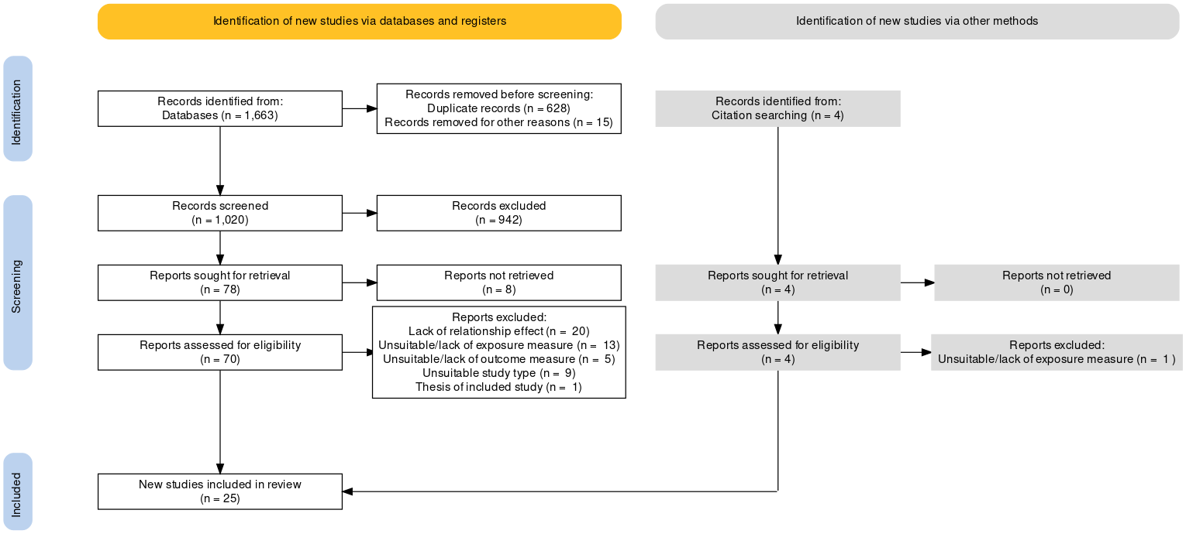
Sensory processing and eating behaviours in autism: A systematic review
Emy Nimbley, Lisa Golds, Helen Sharpe, Fiona Duffy & Karri Gillespie-Smith
Background
Results
Discussion
Sensory processing differences are highly prevalent in autism, reflecting a heterogenous global and multi-modal presentation across all ages (Crane et al, 2009; Marco et al, 2011), with the most commonly reported patterns relating to hyper- or hypo-sensitivities (Ben-Sasson et al, 2009).
Differences in sensory processing have been identified as a possible underlying mechanism for atypical eating behaviours (Cermak et al, 2010) and disordered eating (Brede et al, 2020) in autism.
To date, no review has systematically asked the following research question:
Is there a relationship between sensory processing and eating behaviours in autism across the lifespan?
Synthesis of results:
The current review also seeks to account for a wide range of clearly defined and conceptualised eating behaviours following calls to address significant heterogeneity in definitions of eating behaviours and criticism of previous measures in their neglect of important autism-specific behaviours associated with the mealtime environment (Bandini et al, 2017; Page et al, 2021; DeMand et al, 2015)
Thus, review findings were synthesised according to three distinct eating outcomes; Mealtime Beahviours, Food Repertoire and Food Neophobia.
Key results:
Mealtime Behaviors (including general mealtime behaviours, food selectivity, food refusal, ritualistic eating behaviours, over- and under-eating)
  Sig relationship reported across all eating outcomes, with taste/smell sensitivities notably implicated bar over- and under-eating
  Hypersensitivites implicated in general mealtime behaviours and food refusal
  Under-eating implicated complex interplay between oral sensitivities and negative emotions
Food Repertoire
  Sig relationship reported with limited food repertoire, with taste/smell sensitivities notably implicated
  Preliminary evidence for role of hypersensitivities
Food Neophobia
  Sig relationship reported with food neophobia, with taste/smell sensitivities implicated but spare evidence base (n=2)
No study looked at the relationship between sensory processing and disordered eating outcomes in a clinically diagnosed autism sample.
Sensory processing was associated across all included eating behaviours
Eating behaviours in autism reflect a multi-sensory experience, with taste/smell sensitivities notably implicated. Hypersensitivities were also tentatively implicated but future research is warranted.
No study looked at the relationship with disordered eating outcomes, despite emerging evidence for notable overlap between autism and restrictive eating disorders particularly (Westwood & Tchanturia, 2017).
  Sensory processing identified as possible shared mechanism (Brede et al, 2020) but thus far only explored in ED samples with elevated autistic traits (e.g., Kinnaird et al, 2020a)
  Sensory needs successfully identified in clinical pathway for autistic individuals with anorexia nervosa (Kinnaird et al, 2020b)
Methods
Limitations of included studies
Conducted in line with PRISMA (Page et al, 2020).
Database search in March 2021: psychINFO (OVID interface), PubMed, Scopus and Web of Science; ProQuest Dissertation & Theses.
Studies were included if they:
(a) published or unpublished with full-text in English;
(b) quantitative studies reporting a measure of effect between sensory processing and eating behaviours;
(c) diagnosis of autism under DSM-V/ICD-10 with no exclusion on age, gender or comorbidity;
(d) behavioural or neurophysiological measures of sensory processing, either self-, parent- or clinician-report; and
(e) behavioural or observational measures of eating behaviours, either self-, parent- or clinician-report
Data extraction tool developed from Cochrane Developmental, Psychosocial and Learning Problems data collection form.
Quality assessment tool developed from the NIH Quality Assessment Tool for Observational, Cross-Sectional and Cohort Studies.
Methodological limitations
  Lack of control and/or comparison group
  Over-reliance on cross-sectional designs and parent-report measures
  Unrepresentative samples (e.g., Western countries, mothers)
Conceptual limitations
  Conflation of taste/smell sensitivities into single domain
  Lack of attention paid to specific sensory patterns and no study looked at multi-sensory integration
  No study looked at adult participants, reflective of a lack of developmental approach
  See below table for a summary of suggested directions for future research.
Conceptual considerations | Research design | Measurement and Assessment | Interventions
Research focusing on… Food neophobia, including treatment of food neophobia as distinct outcome Disordered eating outcomes in clinically diagnosed autism samples Taste and smell as distinct domains Different sensory patterns/multi-sensory integration | Research including: Control/comparison groups Longitudinal design, measuring relationship across development Adult participants More diverse and representative samples | Research adopting: Direct, observational assessments of eating behaviours Physiological or neurological assessments of sensory processing. | Research focusing on: Developing sensory-based eating and feeding interventions for non-clinical eating outcomes Developing sensory-based eating and feeding interventions for clinical eating outcomes.
Ben-Sassoon, A., Hen, L., Fluss, R., Cermak, S., Engel-Yeger, B., & Gal, E. (2009). A meta-analysis of sensory modulation symptoms in individuals with autism spectrum disorders. Journal of Autism and Developmental Disorders, 39(1), 1-11.
Brede, J., Babb, C., Jones, C., Elliott, M., Zanker, C., … & Mandy, W. (2020). “For me, the anorexia is just a symptom, and the cause is autism”: Investigating restrictive eating disorders in autistic women. Journal of Autism and Developmental Disorders, 50, 4280-4296.
Cermak, S., Curtin, C., & Bandini, L. (2010). Food selectivity and sensory sensitivity in children with autism spectrum disorders. Journal of the American Dietetic Association, 110(2), 238-246.
Crane, L., Goddard, L., & Pring, L. (2009). Sensory processing in adults with autism spectrum disorders. Autism, 13(3), 215-228.
Kinnaird, E., Stewart, C., & Tchanturia, K. (2020a). The relationship of autistic traits to taste and olfactory processing in anorexia nervosa. Molecular Autism, 11(1), 25. https://doi.org/10.1186/s13229-020-00331-8
Kinnaird, E., Dandil, D., Li, Z., Smith, K., Pimblett, C., … & Tchanturia, K. (2020b). Pragmatic sensory screening in anorexia nervosa and associations with autistic traits. Journal of Clinical Medicine, 9(4), 1182. https://doi.org/10.3390/jcm9041182
Marco, E., Hinkley, L., Hill, S., & Nagarajan. (2011). Sensory processing in autism: a review of neurophysiologic findings. Pediatric Research, 69(5), 48-54.
Westwood, H., & Tchanturia, K. (2017). Autism spectrum disorder in anorexia nervosa: An updated literature review. Current Psychiatric Reports, 19(7), 41.
Page, M., McKenzie, J., Bossuyt, P., Boutron, I., Hoffman, T., .... & Moher, D. (2020). The PRISMA 2020 statement: updated guideline for reporting systematic reviews. BMJ, doi: https://doi.org/10.1136/bmj.n71

