Slide 1
Fungal Infections in Pakistan; Local Challenges
Dr. Afia Zafar
MBBS, DCP, FRCPath
Department of Pathology and Laboratory Medicine,
The Aga Khan University

Slide 2
Plan
Introduction
Burden of disease
Challenges: Diagnostics and capacity of laboratory / availability of tests /drugs/cost
Initiatives and possible solution

Slide 3
Disclosure
I have has no personal or professional financial relationship or interest with any proprietary entity producing healthcare goods/or services

Slide 4
Introduction
Fungal infections are neglected disease world wide
Recently identified as ‘hidden killers’ as mortality due to top 10 invasive fungal infections have been estimated to be equivalent to TB and exceed malaria Brown GD, Denning DW, Gow NAR et al 2012
Notes:
A tremendous burden of infectious diseases and noncommunicable
diseases (NCDs) exists in Pakistan [1, 2]. In the absence of a national healthcare system, very limited surveillance is done with regards to various infectious and noninfectious diseases. Fungal infections are no exceptions and the true burdenof even a singlefungal infection is unknown.
Fungal infections have been recently identified as ‘hidden killers’ as mortality due to top ten invasive fungal infections (IFIs) have been estimated to be equivalent to tuberculosis (TB) and now significantly exceed malaria [3].

Slide 5
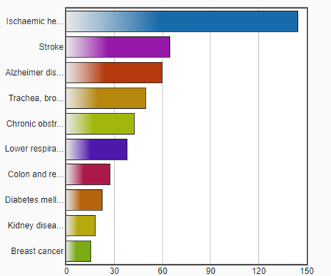
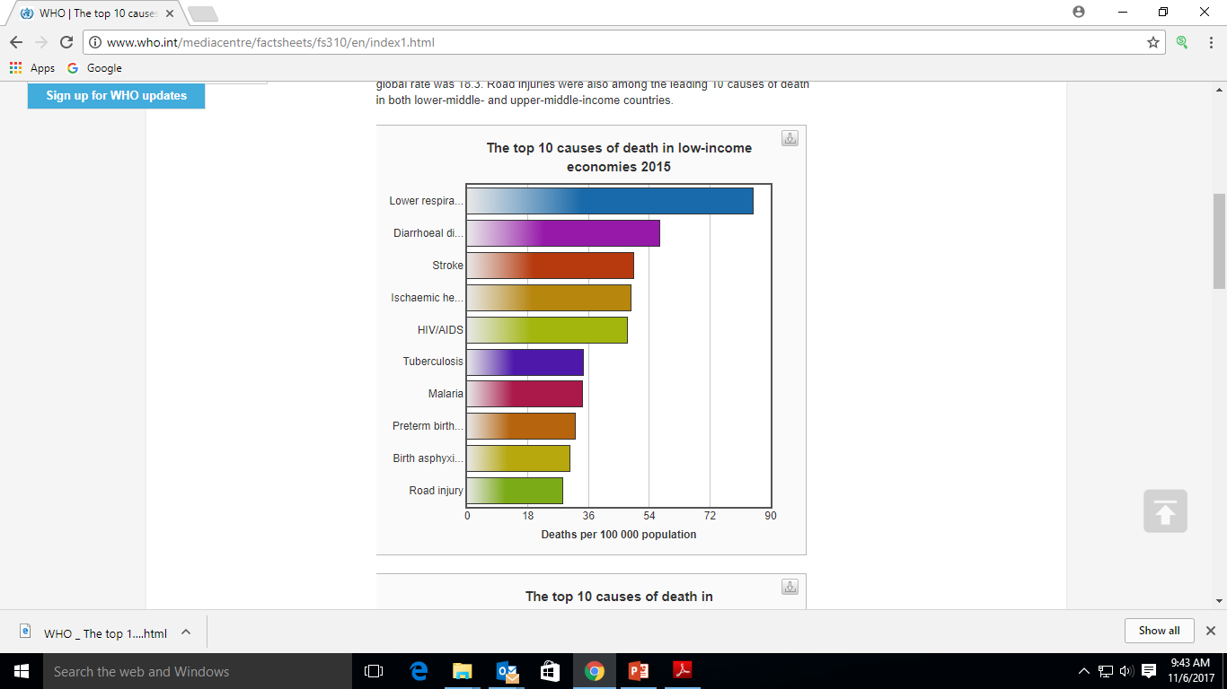
Top 10 Causes of Death
High - income economies
Low - income economies
deaths per 100 000 population
WHO 2015
Notes:
Fungal infections are not included, Hidden killer

Slide 6
Fungal infections are growing problem
New groups of high-risk individuals are appearing
Incidence of fungal infections are increasing
New pathogens and drug-resistant pathogens are emerging

Slide 7
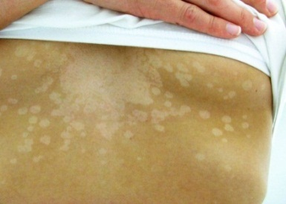
Fungal Infections
Superficial mycoses
  Ring worm, Yeast infection
Subcutaneous mycoses
  Mycetoma, Chromomycosis, Sporotrichosis
Systemic mycoses due to primary pathogens
  Cocci. immitis, Blast. dermatidis, Histo. capsulatum
Systemic mycoses due to opportunistic pathogens
  Candida, Aspergillus, Mucor
Toxin mediated
  Cancers

Slide 8
The Spectrum of Fungal Diseases
Community
associated
Healthcare-associated
Cryptococcosis
Dermatophytes
Mycetoma
Aspergillosis
Mucormycosis
Thrush
Invasive Candidiasis
Courtesy of Mary Brandt

Slide 9
High-risk populations for fungal infections
IFIs are also on rise due to increasing size of high risk patient
  HIV/AIDS infection
  Post transplant and ICU patients
  Malignancy, burns, indwelling devices, & low-birth weight infants, use of steroid, advanced liver disease
Tuberculosis Diabetes Chronic respiratory diseases | Asthma Cancer COPD
Notes:
Over the last two decades, invasive fungal infections have assumed a much greater importance, largely because of the increasing size of the population at risk. This population includes persons with human immunodeficiency virus （HIV） infection, recipients of solid organ or haematopoietic stem cell transplants （HSCT, patients with hematologic malignancies, burns, or indwelling medical devices, and low-birthweight infants. For all of its benefits, medical progress has led to an expanding population of susceptible hosts with impaired immunological defenses against infection. These individuals are at heightened risk for many invasive fungal infections, including aspergillosis, candidiasis, cryptococcosis, and zygomycosis.
Over the last two decades, invasive fungal infections have assumed a much greater importance, largely because of the increasing size of the population at risk. This population includes persons with human immunodeficiency virus （HIV） infection, recipients of solid organ or haematopoietic stem cell transplants （HSCT, patients with hematologic malignancies, burns, or indwelling medical devices, and low-birthweight infants. For all of its benefits, medical progress has led to an expanding population of susceptible hosts with impaired immunological defenses against infection. These individuals are at heightened risk for many invasive fungal infections, including aspergillosis, candidiasis, cryptococcosis, and zygomycosis.
Over the last two decades, invasive fungal infections have assumed a much greater importance, largely because of the increasing size of the population at risk. This population includes persons with human immunodeficiency virus （HIV） infection, recipients of solid organ or haematopoietic stem cell transplants （HSCT, patients with hematologic malignancies, burns, or indwelling medical devices, and low-birthweight infants. For all of its benefits, medical progress has led to an expanding population of susceptible hosts with impaired immunological defenses against infection. These individuals are at heightened risk for many invasive fungal infections, including aspergillosis, candidiasis, cryptococcosis, and zygomycosis

Slide 10
Disease Burden in Pakistan
Recent estimates show a high burden of serious fungal infections of 1.78%
Jabeen K, Farooqi F, Mirza S, Zafar A, Denning D. 2017. Serious fungal infections in Pakistan. Eur J Clin Micro Infec Dis
Determination of spectrum and prevalent fungi is crucial to assess burden and to guide patient management
Currently, only few labs are reporting fungal pathogens

Slide 11
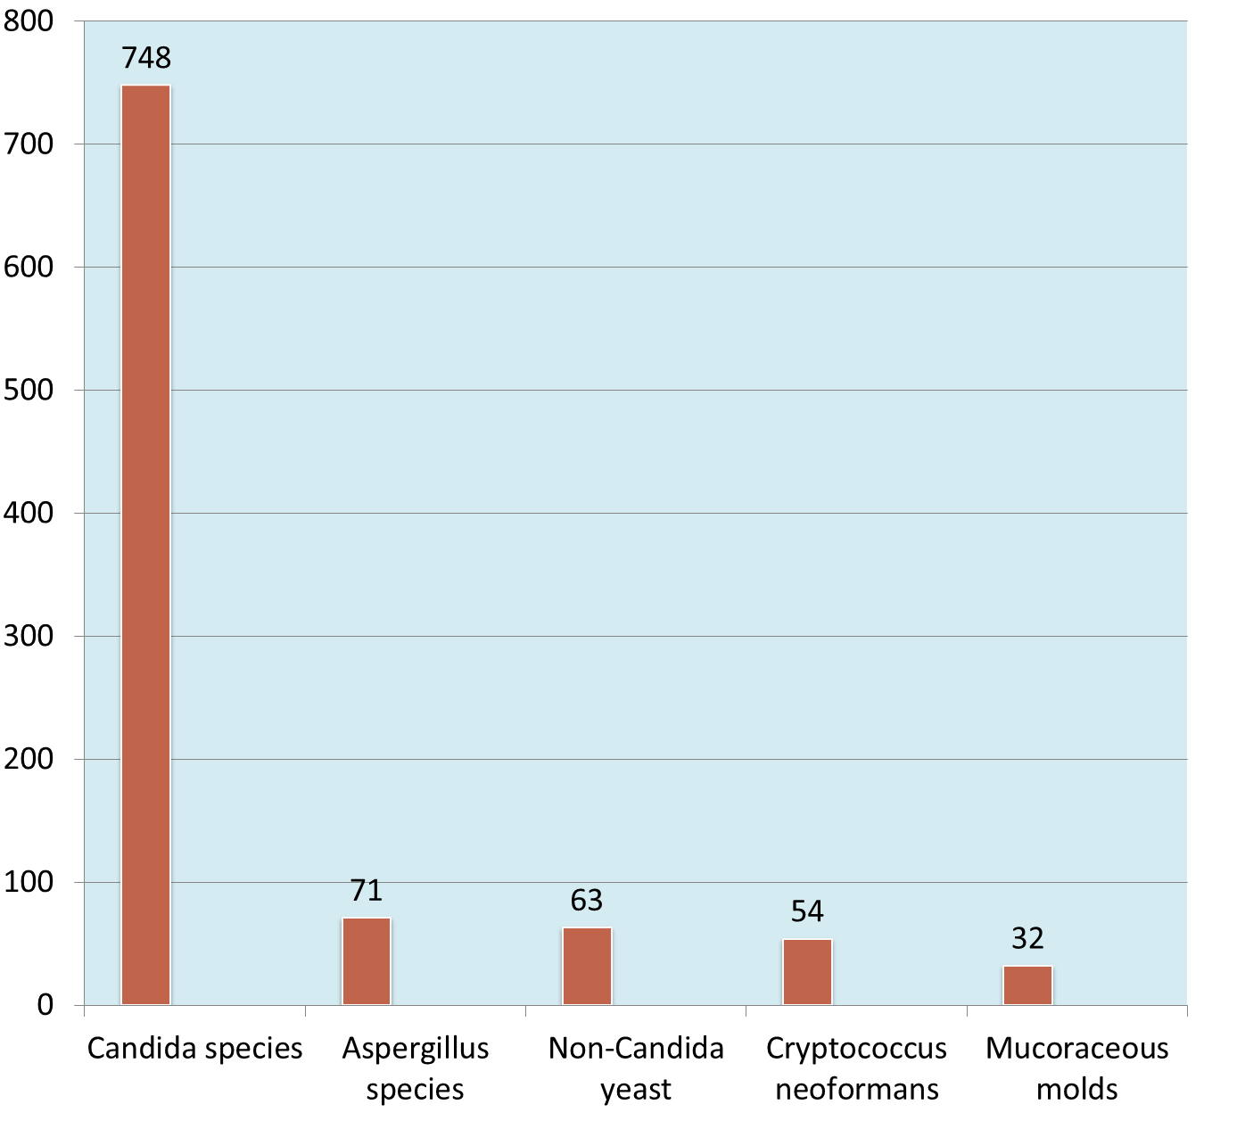
Invasive Fungi
AKU Laboratory Based Surveillance data (2009-2014)
(n=1008)

Slide 12
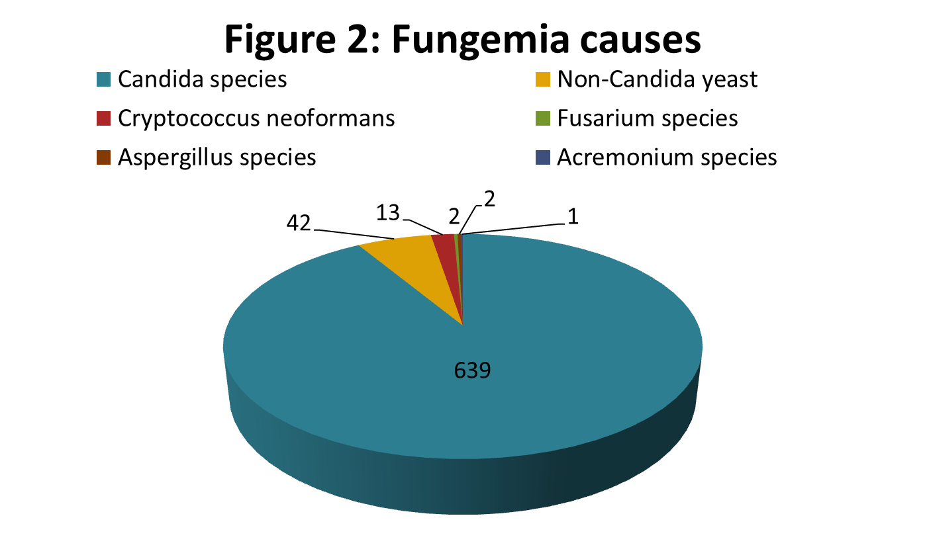
Fungi causing invasive infections
AKU Laboratory Based Surveillance data (2009-2014)
The most frequent infection was fungemia (699 cases) mainly due to Candida species

Slide 13
Spectrum of Invasive Fungal Infections
Fungemia | n= 699 | Candida species
Fungal meningitis | n= 48 | Cryptococcus neoformans (n=34), Candida species shunt related meningitis (n=11)
Fungal brain abscess | n=17 | Aspergillus species (n=7), Rhinocladiella species (n=6)
Pulmonary mycosis | n=38 | Aspergillus species (n=16), Fusarium species (n=4), Mucoraceous molds (n=4)
Intra-abdominal infection | n=43 | Mostly Candida species, Pancreatic abscess Rhizopus species (n=1)
Invasive rhinosinusitis | n=29 | Aspergillus species (n=18), mucoraceous molds (n=8)
Invasive soft tissue infection | n=42 | mucoraceous molds (n=14), Aspergillus species (n=13), melanized fungi (n=4)

Slide 14
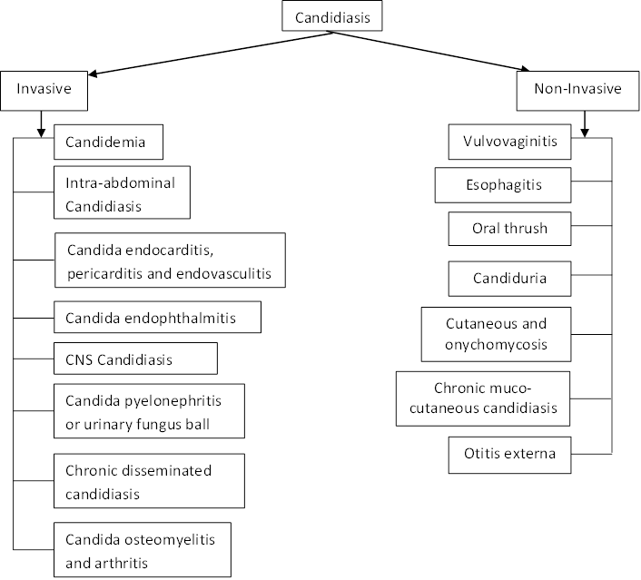
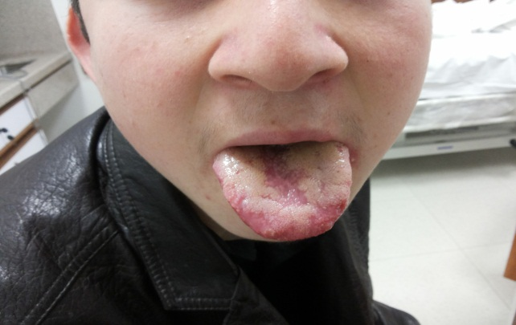
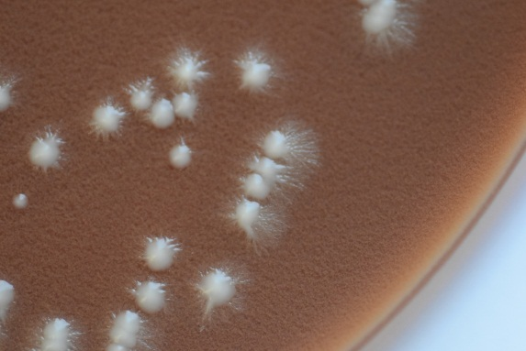
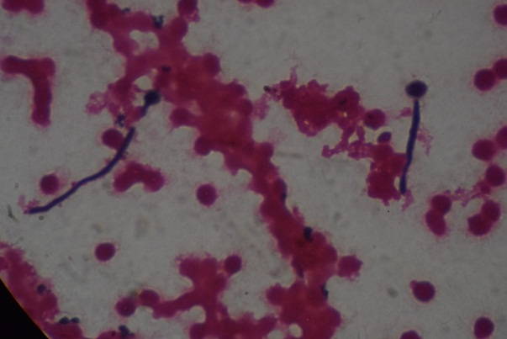
Candidiasis

Slide 15
Candidaemia
Candidaemia is common
Estimated candidaemia (21/100,000/year)
Jabeen K, Farooqi F, Mirza S, Zafar A, Denning D. 2017. Serious fungal infections in Pakistan. Eur J Clin Micro Infec Dis
High burden of Candidemia with fatality rate 23-52% Kumar S et al 2014, J farooqi et al 2013
If a 40% mortality rate is used, then an estimated 15,498 patient die with candidaemia annually in Pakistan
Only 38% of cases of candidaemia shows in blood cultures

Slide 16
Candida
A High Priority in the ICU Bloodstream Infection Pathogens
Pathogen | % BSI (n=10,515) | Crude Mortality, %
Coagulase-negative Staph Staphylococcus aureus Candida species Enterococcus species Pseudomonas aeruginosa | 35.9 (1)ª 16.8 (2)ª 10.1 (3) 9.8 (4) 4.7 (5) | 25.7 34.4 47.1 43.0 47.9
ªP<.05 for patients in ICU vs non-ICU settings.
SCOPE data. Wisplinghoff et al. Clin Infect Dis. 2004;39:309-317.
Notes:
16
Part of normal flora of mucosa
Mostly opportunistic organisms
The SCOPE study looked at the incidence of various BSIs, specifically in ICUs
Candidemia was the third most common BSI in the ICU setting
CoNS were most common, followed by Staphylococcus aureus, Candida species, enterococci, and Pseudomonas aeruginosa
This is particularly important because Candida has a higher incidence in ICU compared with non-ICU settings
Candidemia has 1 of the highest crude mortality rates (47%) in this study and 1 of the highest associated mortality rates in the ICU setting
Gram-positive infections are now the most common cause of BSIs in patients with central lines, followed by fungal infections
Candida is the second most common infection in patients with central catheter lines in the ICU
As recently as several years ago, catheter-related infections were caused predominantly by gram-negative bacteria, followed by infections with other organisms, thus underscoring the changing epidemiology in ICU patients
BSI = bloodstream infection, CoNS = coagulase negative Staphylococci, SCOPE = Surveillance and Control of Pathogens of Epidemiological Importance.
Wisplinghoff et al. Clin Infect Dis. 2004;39:309-317.

Slide 17
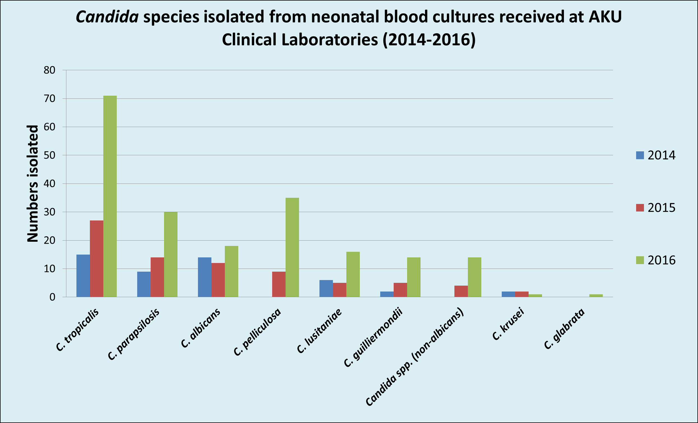
304 blood cultures from 289 neonates yielded 326 Candida isolates, 22 cultures having 2 or more Candida spp

Slide 18
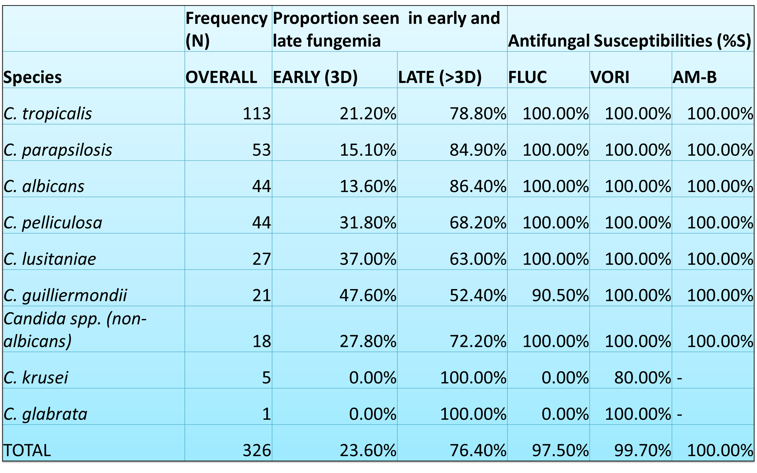
Frequency of Acquisition of Candida Infection & Antifungal Susceptibilities 2014-16 (n 326)

Slide 19
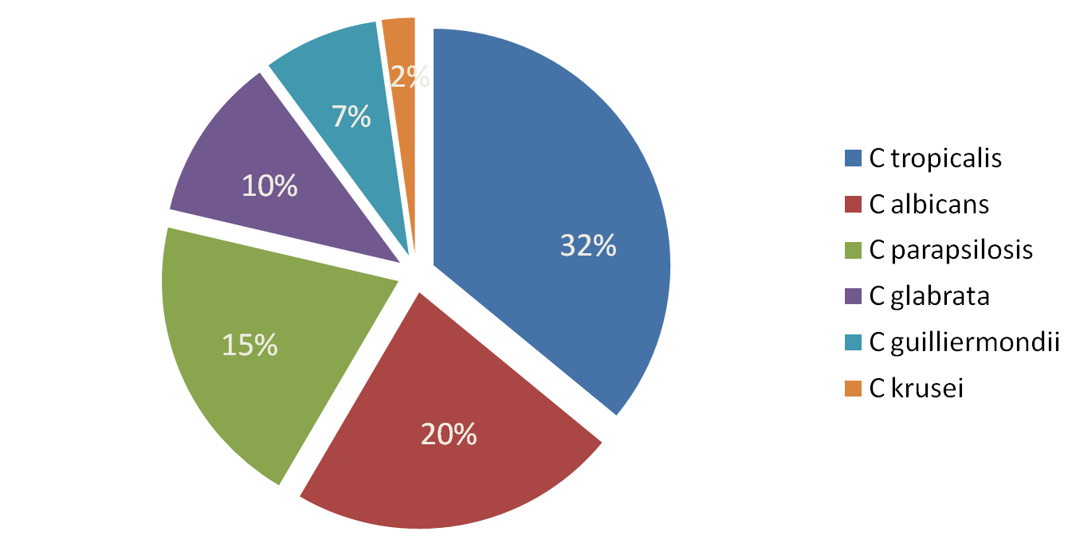
Candidiasis in Pakistan: 2006-09
Farooqi JQ, Jabeen K, Saeed N, Iqbal N, Malik B, Lockhart S, Zafar A, Brandt ME, Hasan R. Invasive Candidiasis in Pakistan: Clinical characteristics, species distribution and antifungal susceptibility. J Med Microbiol. 2012

Slide 20
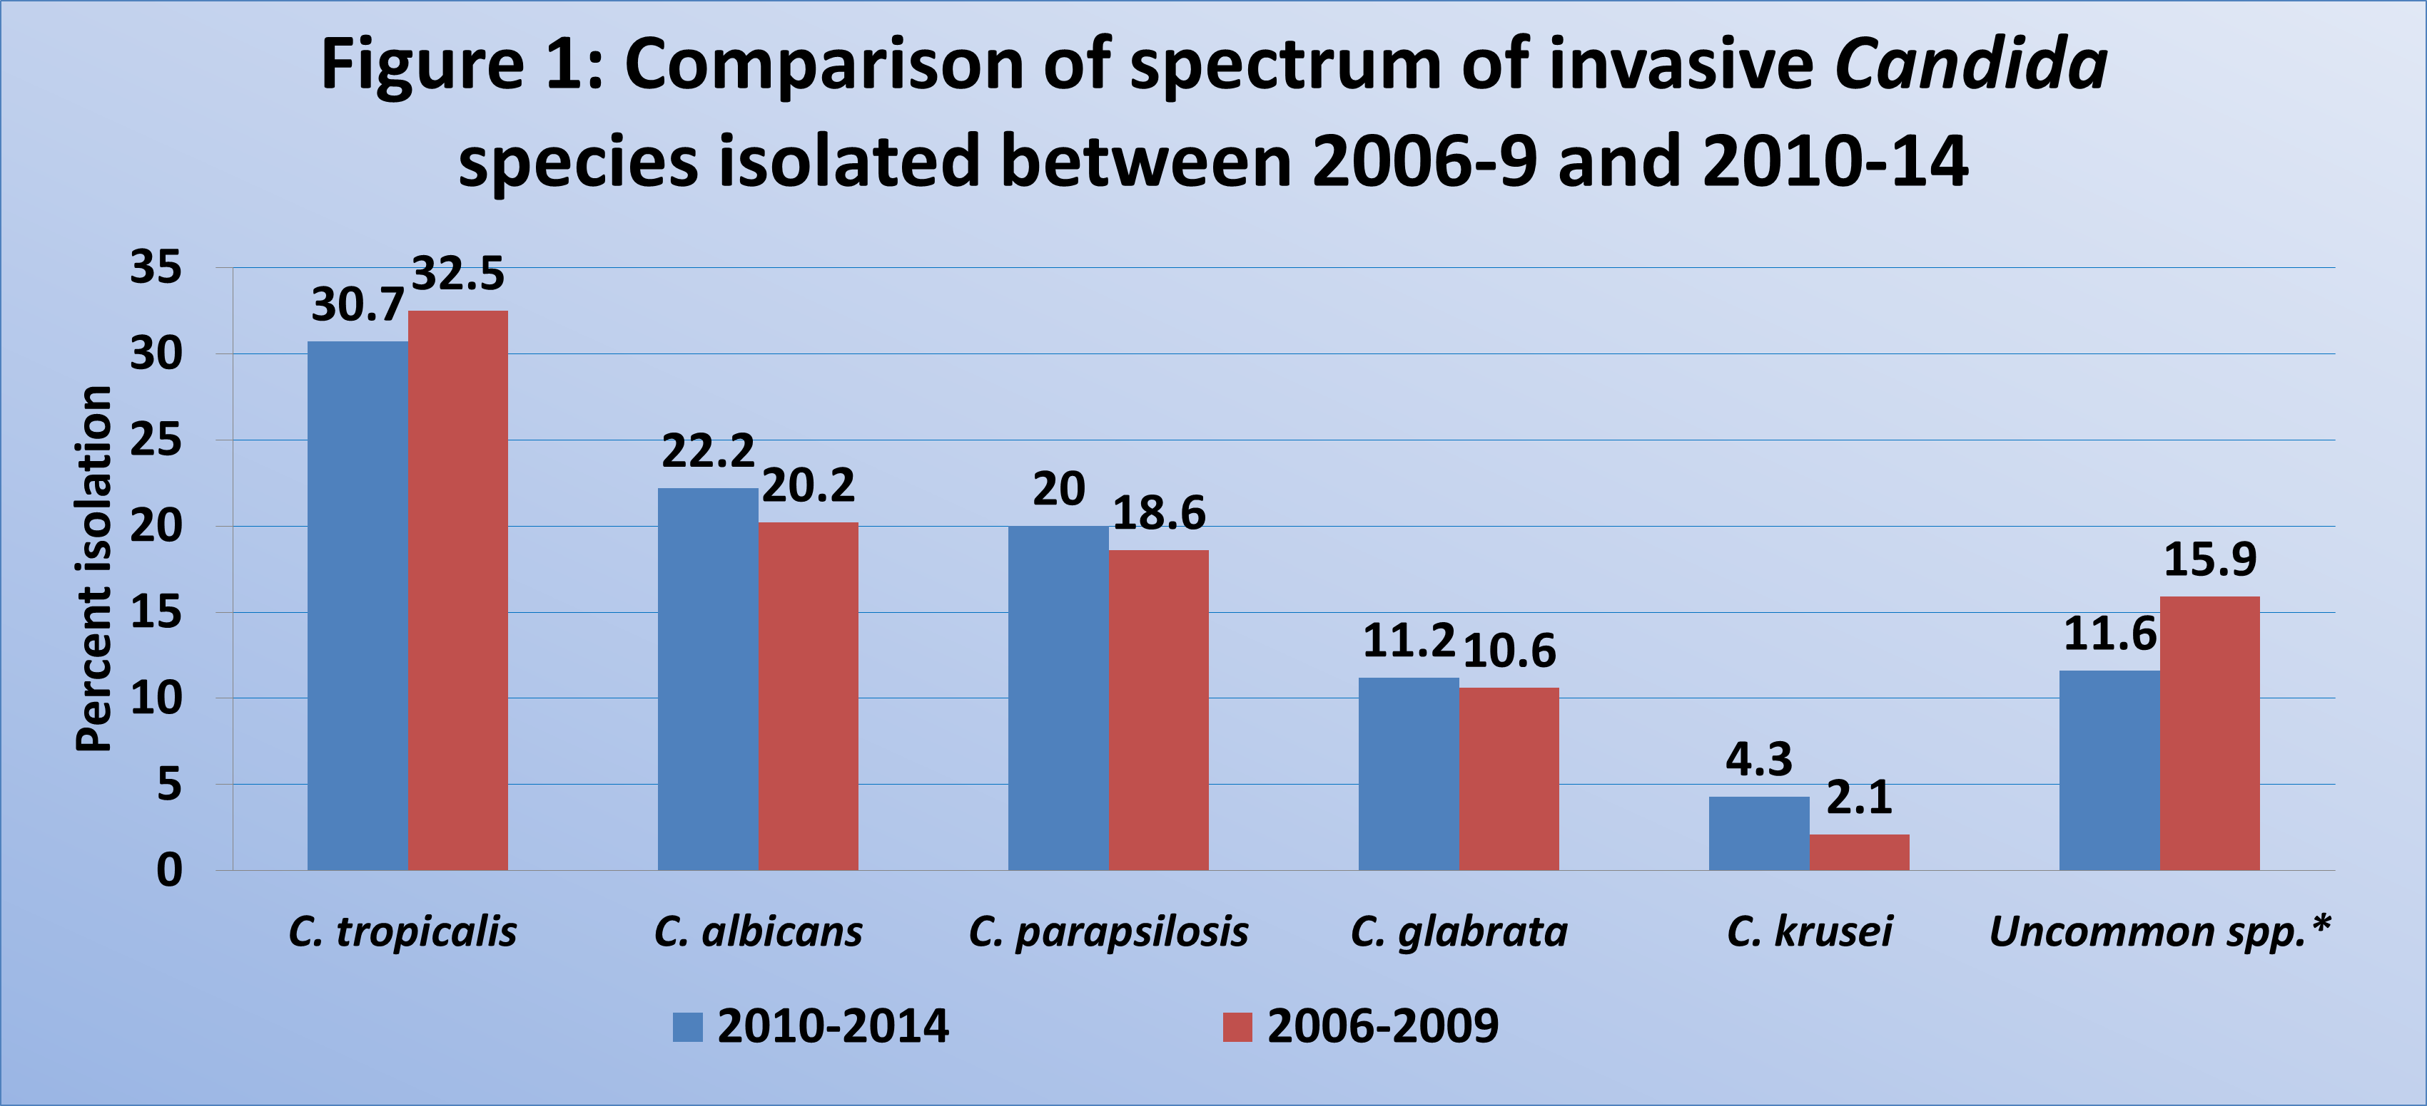
Comparison of Spectrum of Invasive Candida species Isolated between 2006-9 & 2010-14

Slide 21
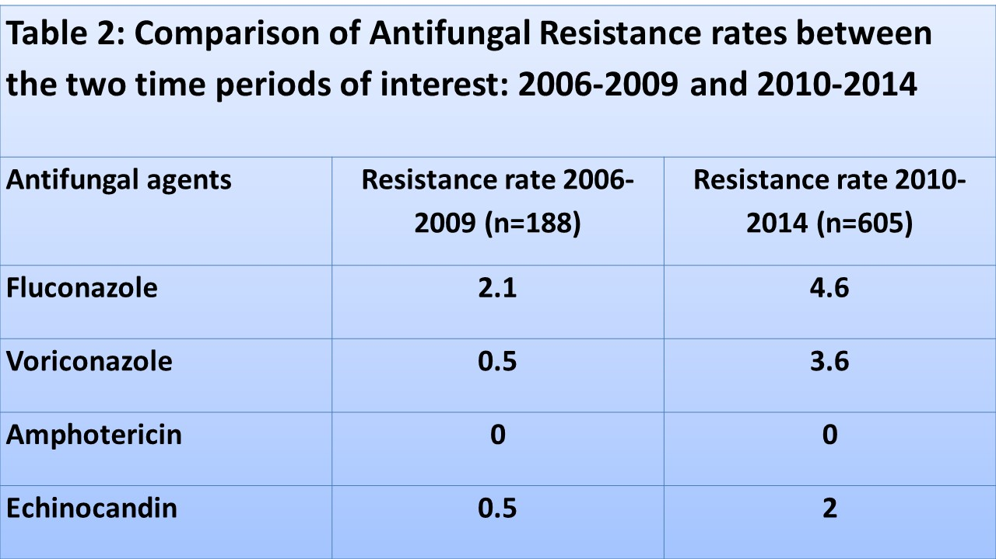
Comparison of Antifungal Resistance Rates between the two time Period of Interest

Slide 22
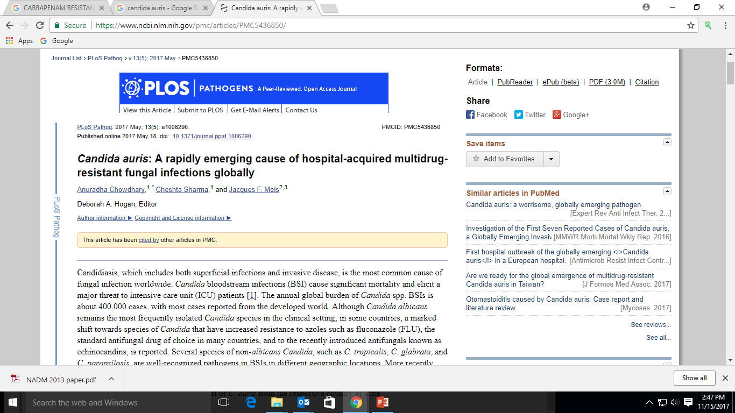

Slide 23
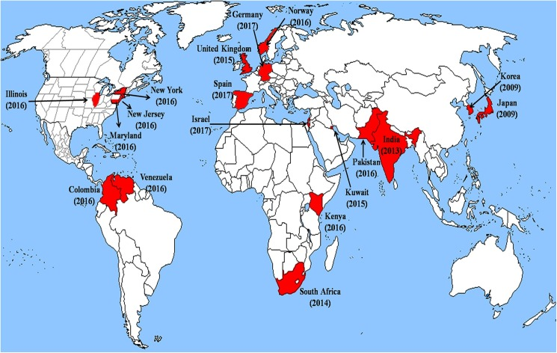
Candida auris: A rapidly emerging cause of hospital-acquired MDR fungal infections globally
PLoS Pathog. 2017 May; 13(5)

Slide 24
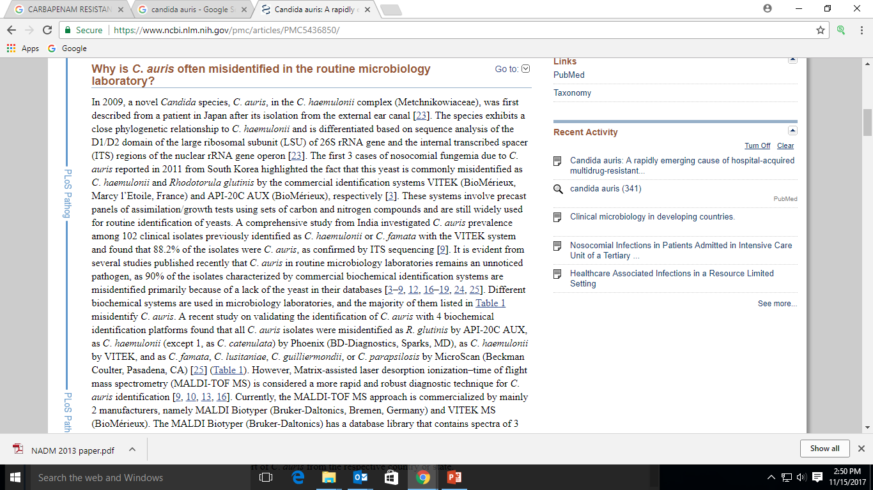
Limitations in Identification

Slide 25
Challenge
Routine micro/mycology lab can miss this pathogen
MDR yeast; important for labs to identify & perform susceptibility tests to
  provide optimum patient care
  take infection control measures

Slide 26
Outbreak investigation report of Candida auris at a tertiary care hospital in Karachi, Pakistan 2016-2017

Slide 27
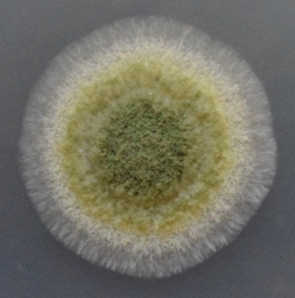
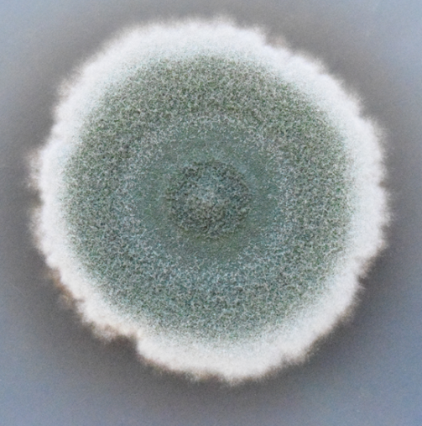
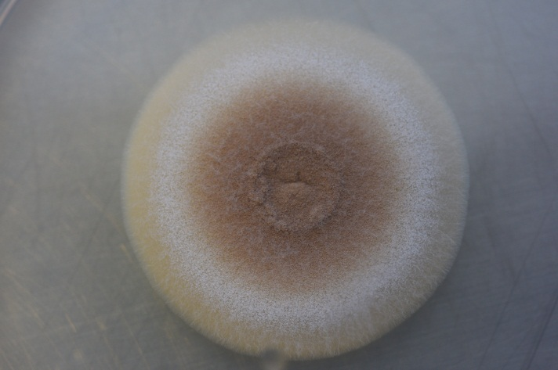
Major Etiologic Agents of Human Aspergillosis
Aspergillus terreus
Aspergillus fumigatus
Aspergillus flavus

Slide 28
Human Aspergillosis
Hypersensitivity | Colonization | Superficial | Invasive
Allergic Broncho Pulmonary Aspergillosis (ABPA) Asthma Allergic rhinosinusitis | Aspergilloma | Keratitis Otomycosis Sinusitis Cutaneous | Pulmonary Aspergillosis (acute & chronic) Tracheobronchitis Extra pulmonary CNS Endophthalmitis Endocarditis Osteomyelitis Arthritis

Slide 29
Allergic Bronchopulmonary Aspergillosis (ABPA)
Aspergillus spp. are commonest indoor & outdoor environmental fungus from Pakistan Rao TA et al 2012
Higher indoor conc. of fungi is associated with acute exacerbation asthma Ali Zubairi et al 2014
Recent repot, high burden of ABPA in Pakistan (>100/100,000)
3.3% prevalence in India Agarwal R, Denning DW, Chakrabarti A (2014) Estimation of the burden of chronic and allergic aspergillosis in India. PLoS One
ABPA misdiagnosis as TB
ABPA is associated with cystic fibrosis, which is also under diagnosed in the Pakistani population
Notes:
ABPA, often misdiagnosed as TB [58]. In one series, around 76% of ABPA cases occurred in asthmatic patients, followed by 17% of cases in patients with cystic fibrosis or non-cystic fibrosis bronchiectasis [59].
as appropriate diagnostic tools are not available; therefore,accurate prevalence in the country is not known [60]. However, cystic fibrosis prevalence of 1 in 9000 population has been reported in South Asian Canadian immigrants, as well as World Health Organization (WHO) estimates suggesting a prevalence of 1 in 10,000–40,000 in the Asian population [25, 61]. Considering a prevalence of 1 in 10,000 population and as 9% of these will develop ABPA as suggested by a recent meta-analysis, we have estimated 1661 cases per year in Pakistan [26].

Slide 30
Chronic Pulmonary Aspergillosis (CPA)
Prevalence is high in TB burden countries
Occurs in immunocompetent individuals with cavitary or non-cavitary disease
High risk group: damaged lung (TB, sarcoidosis, ABPA, COPD)
Challenge
  Difficult to diagnose as Aspergillus-specific IgG and IgE are not available in many centers
  Non-availability of tests makes it problematic to exclude CPA in smear -ve patients with suspected TB

Slide 31
Invasive Aspergillosis (IA)
Mainly in immunocompromised population
Reports from patients with no apparent immune defect*( rhinocerebral cases in Sind)
As per estimate
  >10,000 COPD patients develop IA annually in Pakistan
  **Bhurgri reported that in Karachi 2% cancers are myeloid leukaemia & 10% develop IPA*** so about 300 cases of IA each year in Karachi
  177 cases of IPA/ year in lung cancer patients
Diabetes and TB have strong association with IA
Probably an under estimate, as other patients with haematological malignancies are also at risk of IPA
*Chakrabarti A et al 2011
**Bhurgri Y et al 2000
***Caira et al 2008
Notes:
Around 10,172 COPD patients develop IA annually in Pakistan (using the 3.9% rate in hospital ised patients from China, based on culture and imaging) [17]. Assuming that 2% of all cancers as reported in Karachi, Pakistan are myeloid leukaemia [19] and in these patients 10% will develop invasive pulmonary aspergillosis (IPA)[20],we estimated around296 cases in this population. This is probably an under estimate, as other patients with haematological malignancies are also at risk of IPA; therefore, an equal number of cases was estimated for all other haematological conditions. In addition, we also estimated 177 cases of IPA per year in lung cancer patients. Emerging populations at risk of IPA are patients with pre-existing lung disease like COPD, critically ill patients in the ICU, especially those given cortico steroids, diabetes and advanced liver disease [64]. IA has been reported from Pakistan in patients with bone marrow, renal and liver transplant, and haematological malignancy [65–67]. A study conducted recently at our centre on 69 patients revealed diabetes and chronic renal failure as the most prominent risk factors for pulmonary aspergillosis. Prior or active TB was found in 50% of these patients. The overall mortality was 20%, with around 70% mortality in patients admitted to the ICU. Diabetes mellitus was identified as an independent risk factor for mortality [68].

Slide 32
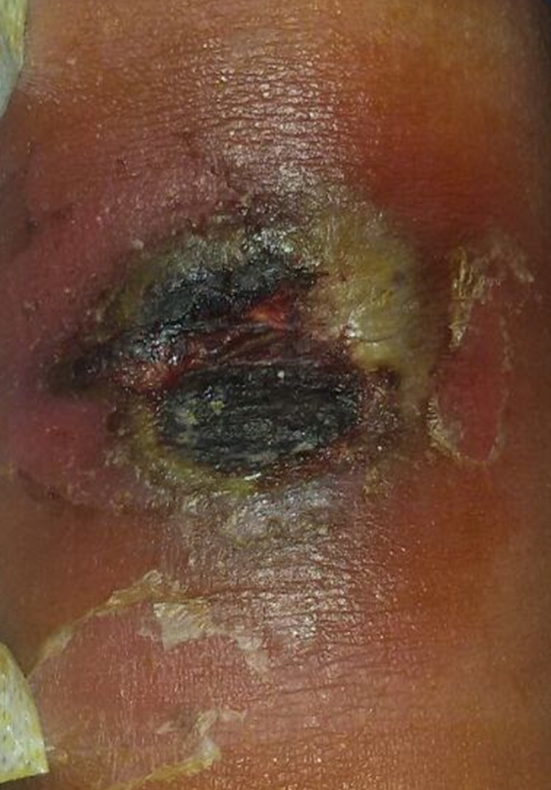
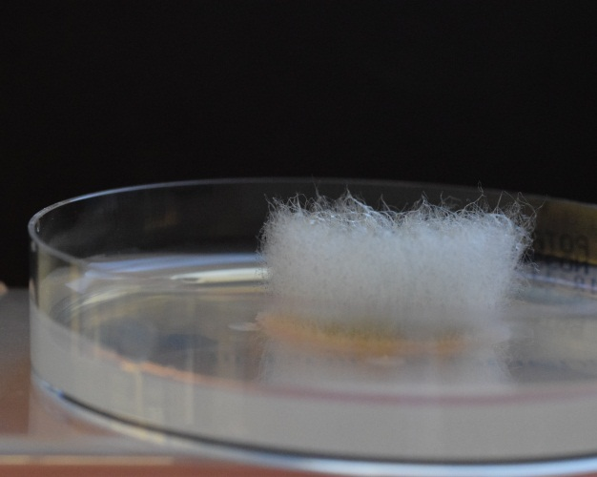
Mucormycosis
Difficult to treat infections, high occurrence in diabetics and patients with chronic renal disease
Infections have been reported in patients with no apparent risk factors
Recent data indicate increasing trends in mucormycosis cases with very high mortality
As per estimate around 25,000 cases/year with prevalence of 0.14/1000 population (38% mortality)

Slide 33
Invasive Molds (2009-2014)
Genus | Number | Percent
Aspergillus species | 61 | 51.2
Mucoraceous molds | 23 | 19.3
Fusarium species | 15 | 12.6
Other molds | 20 | 16.8
Total | 119 | 100

Slide 34
Spectrum of Invasive Molds
Hylohyphomycetes (n) % |  |  | Mucoraceous (n) %
Aspergillus spp. n=61 | A. flavus | (41) 67.2 | Mucoraceous molds n=23 | Absidia spp | 35
 | A. fumigatus | (8) 13.1 |  | Rhizopus spp | (7)30.4
 | A. terreus | (6) 9.8 |  | Mucor spp | (4) 17.4
 | A. niger | (3) 4.9 |  | Rhizomucor spp | (3) 13
 | A. glaucus | (1) 1.6 |  | Apophysomycetes | (1) 4.3
 | A .nidulans | (1) 1.6 | Dematiaceous n=10 | Rhinocladiella spp | (3)
 | A. ochraceus | (1) 1.6 |  | Curvularia spp | (2)
 | Fusarium spp | 65
Non-Aspergillus n=23 |  |  |  | Alterneria spp | (2)
 |  |  |  | Fonsecace spp | (1)
 | Acremonium spp | (5) 22
 |  |  |  | Phialophora spp | (1)
 | Penicillium spp | (1) 4.3
 |  |  |  | Cladosporium spp | (1)
 | Scedosporium spp | (1) 4.3 | Other molds | Chaetomium spp | (1)
 | Paceiliomycetes | (1) 4.3

Slide 35
Wound (tissue, pus)
Zygomycetes 11
  Absidia spp 4
  Apophysiomycetes 1
  Mucor 2
  Rhizomucor 1
  Rhizopus 3
Aspergillus Spp 24
  A . terreus 1
  A . flavus 15
  A . fumigatus 5
  A . glaucus 1
  A. niger 1
  A. nidulans 1
Other Molds 9
  Acremonium spp 1
  Fusarium spp 4
  Phialophora spp 1
  Curvularia spp 2
  Fonsecaea spp 1

Slide 36
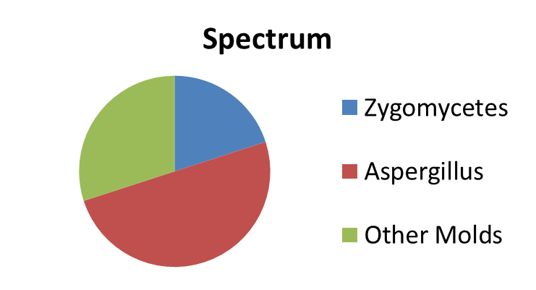
Pulmonary
Zygomycetes 4
  Absidia spp 1
  Mucor spp 1
  Rhizopus 2
Aspergillus spp 10
  A. flavus 6
  A. terreus 1
  A. niger 1
  A. fumigatus 1
  A. ochraceus 1
Other Molds 6
  Acremonium spp 1
  Fusarium spp 1
  Alterneria spp 1
  Cladosporium 1
  Penicillium spp 1
  Secdosporium 1

Slide 37
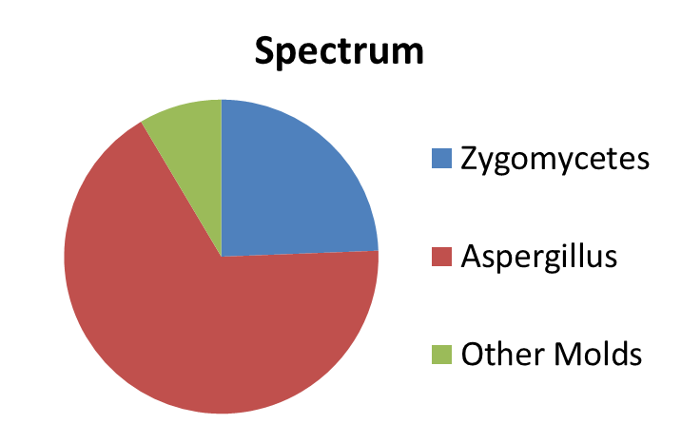
Nasal Tissue
Zygomycetes 4
  Rhizopus 2
  Mucor spp 1
  Rhizomucor 1
Aspergillus spp 11
  A. flavus 9
  A. fumigatus 1
  A. terreus 1
Other Mold 2
  Acremonium spp 1
  Fusarium spp 1

Slide 38
Brain
Absidia spp 1
A. fumigatus 1
A. terreus 1
Cheatomium spp 1
Rhinocladiella spp 2
Different spectrum from West
Underutilized Mycology service

Slide 39
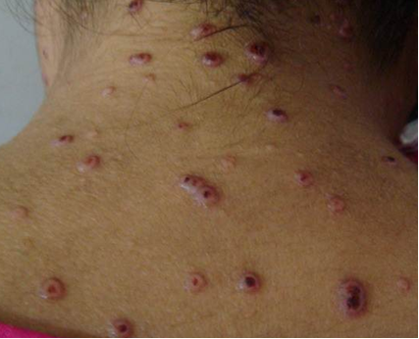
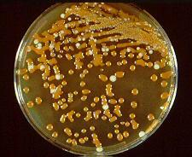
Cryptococcus neoformans
Geographic distribution: Worldwide
Candidates: post transplant, AIDS, post chemo, on steroid
Cryptococcal meningitis in HIV/AIDS patients in Pakistan
  It is estimated that around 800 cases/year occur locally K Jabeen et al 2017
  Previously 2.5 and 9% cases reported Baqi S et al 1999, Luxmi S et all 2012

Slide 40
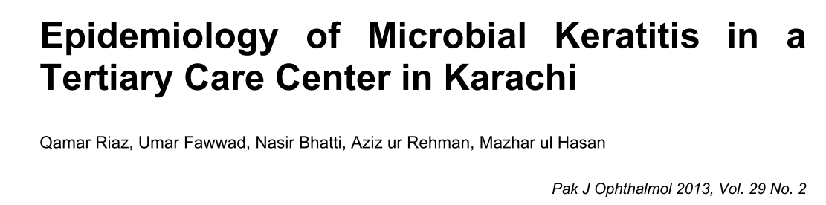
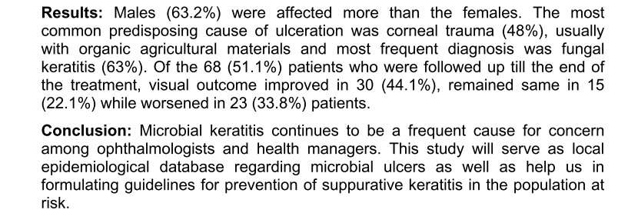

Slide 41
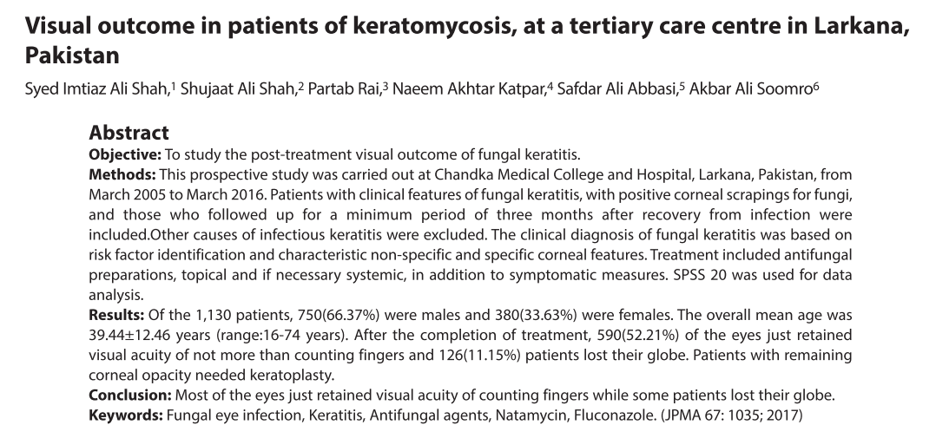

Slide 42
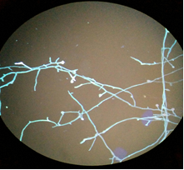
Fungal Keratitis
Fungal keratitis ranging from 8 - 51% among infectious keratitis
Estimated rates are very high (44/100,000)and are comparable to Nepal, where fungal keratitis rate of 73/100,000 Khwakhali US, Denning DW, 2015 Burden of serious fungal infections in Nepal. Mycoses
This rate is alarming and suggest major need for improved diagnostics, enhanced management strategies and education.

Slide 43
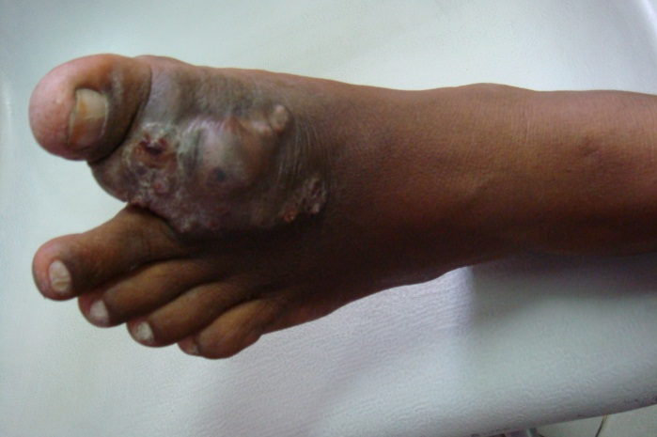
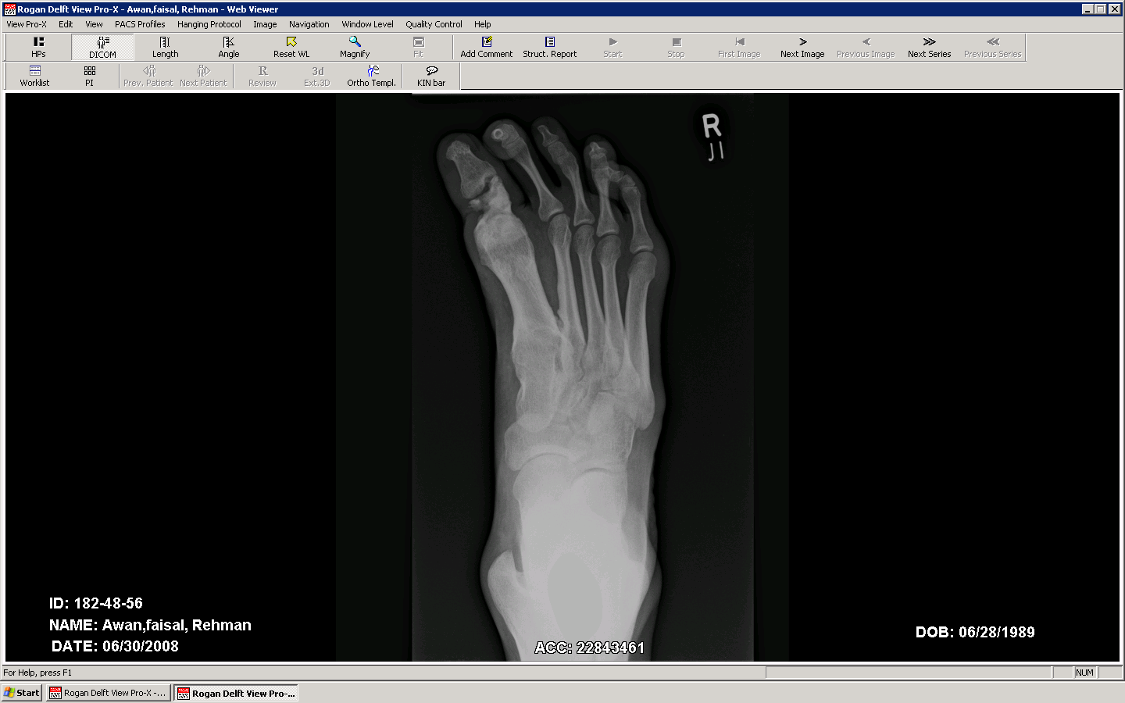
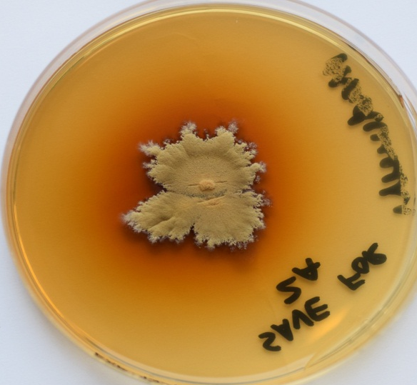
Mycetoma
Prevalent in tropical countries
Caused by bacteria and fungi
Around 40% of cases are due to fungi
Madurella mycetomatis as the most common agent van de Sande WWJ (2013) Global burden of human mycetoma: a systematicreviewandmeta-analysis. PLoSNeglTropDis
Laboratory diagnosis is crucial as treatment is different

Slide 44
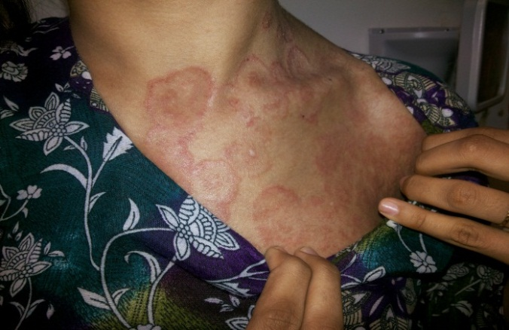
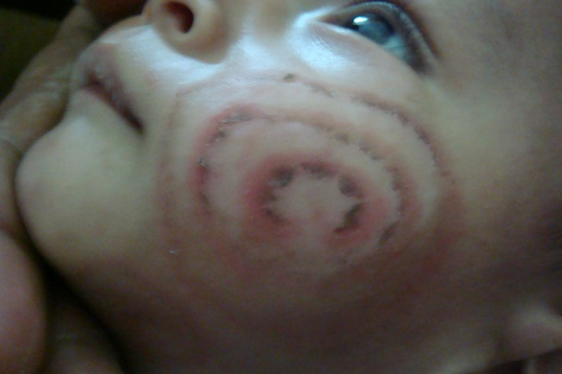
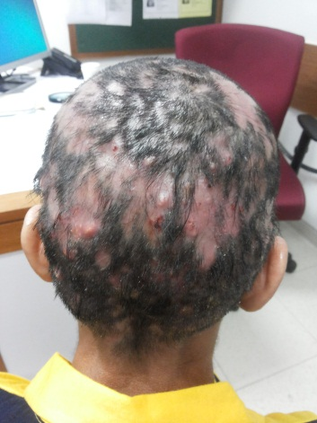
Dermatophytosis
Very common infection in community
Currently, treatment failure is an issue, Drug resistance?
Performance of antifungal susceptibility testing is challenging and is not established locally

Slide 45

Challenges in the Management of Fungal Infections
Conventional modalities are slow

Slide 46
Challenges in the Management of Fungal Infections
Inadequate diagnostic capabilities
Lack of antimicrobial stewardship
Poor infection control practices
Emergence of antifungal resistance
Non-availability of essential antifungal agents

Slide 47
Challenges in the Management of Fungal Infections
Non existing surveillance infrastructure at national level
Knowledge of prevalent fungi is crucial to assess burden & patient management
Limited local epidemiological data

Slide 48
State of Clinical Microbiology/Mycology Laboratory
Many tertiary care hospitals have no lab facility
Some have very basic facilities
Hospital labs don’t have trained staff
Some have state of the art micro lab
Very few have decent diagnostic facility but no susceptibility testing

Slide 49
Why Primitive Laboratory?
Microbiology service not recognized as a priority by the government and health departments
Negligible investment
Apparent cost associated with maintenance of a good quality lab
Notes:
Antimicrobial susceptibility testing without quality assurance
Clinical microbiology has not been recognized as a priority by government and health departments
The problem often has been compounded prohibitive costs associated with maintaining a laboratory

Slide 50
Antifungal Susceptibility
Yeast susceptibility has been established
Sensitivity of Molds
  Standardization is an issue
  Only highly experienced labs

Slide 51

Human Resource!!
Technical staff (1-2 year training program)
  Not well paid
  Change their profession
  Migration/brain drain
No career path
Consultants
(4 years training after MD & internship)

Slide 52
Multimodal Strategy
Sensitization and awareness
Education & training
Gov. & Public partnership
Future directions Automation and POCT
Human resource development

Slide 53
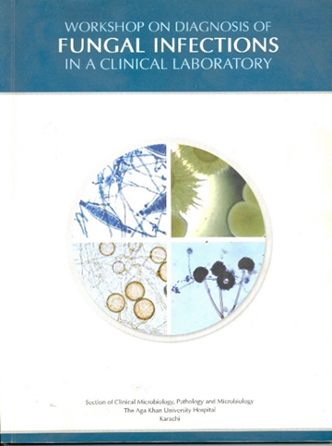
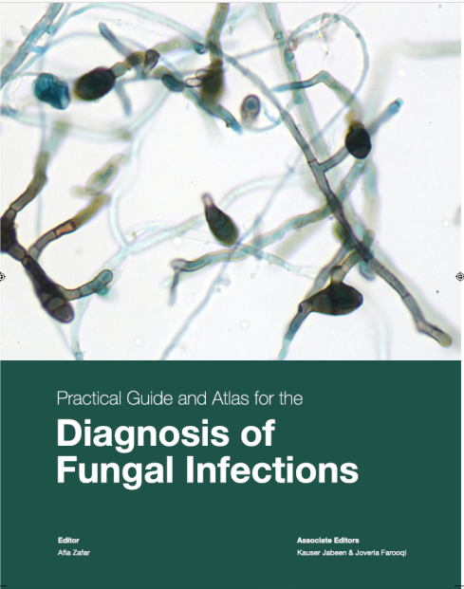
How to Improve?
Education and Capacity Building
Strengthening of laboratory services
  Establish Public health (surveillance)
  Government & Public Partnership
  International support & collaboration
Notes:
We must overcome the hurdles as advantages outweigh the problems

Slide 54
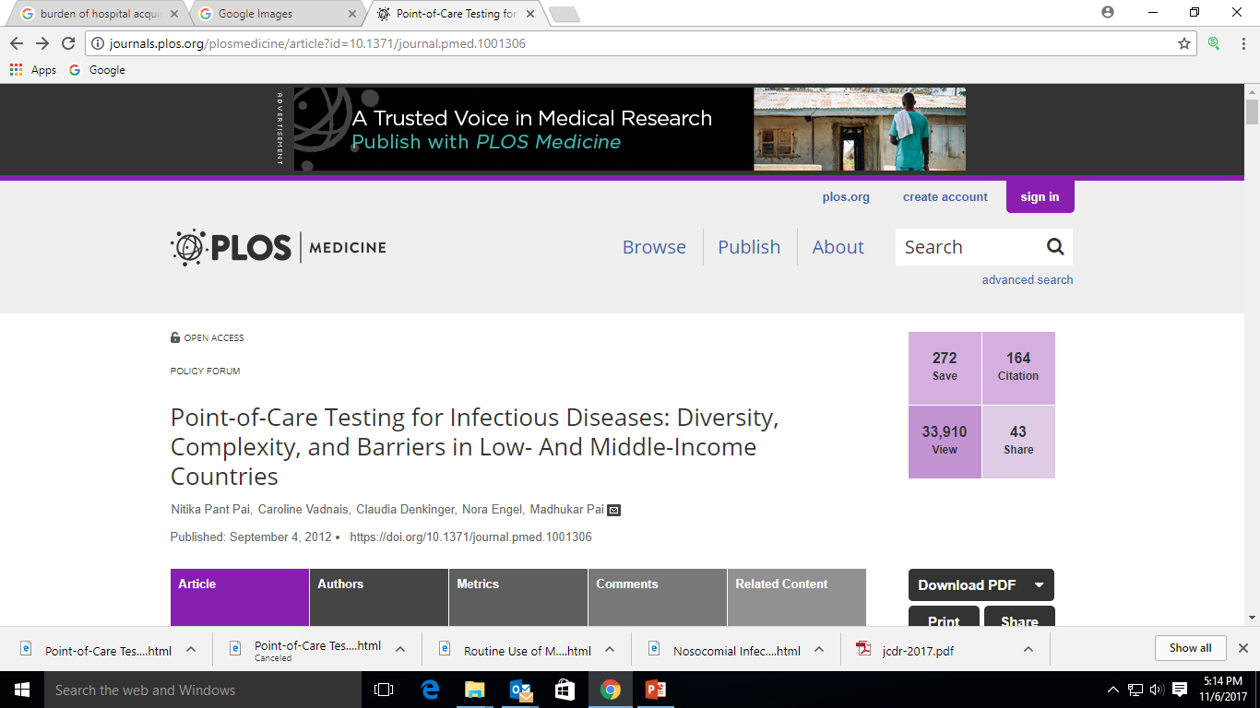
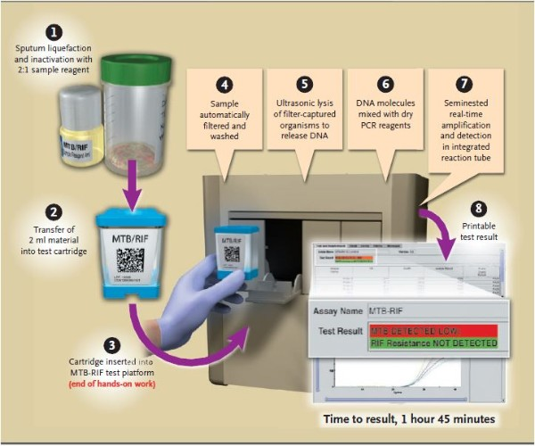
Possible Growth and Future Directions
Good quality laboratory services with simple, robust, cost effective diagnostic tests
  Early Detection & susceptibility testing
Molecular testing/POCT
Notes:
Corruption at government level and at private level

Slide 55
Conclusion
Fungal infections are common, but grossly underdiagnosed
Need to improve diagnostics to allow quicker initiation of antifungal therapy
Continued surveillance is essential to identify changing trends to help in institution of preventive measures

Slide 56
Thank you

