Slide 1
Achieving AMR goals through better fungal diagnostic in Pakistan
Kauser Jabeen
Associate Professor and Consultant Microbiologist
Pathology and Laboratory Medicine
Aga Khan University, Karachi, Pakistan

Slide 2
Conflict of interest: None

Slide 3
AMR situation in Pakistan
AMR, largely arises from excess use of antibiotic and antifungal drugs
Limiting inappropriate antibiotic drug usage play a central role
Significance of accurate fungal infection diagnosis in AMR containment has been completely absent from policy discussions
Accurate diagnosis or exclusion of fungal infection will have a substantial effect on antimicrobial drug usage and on our ability to limit AMR to bacteria

Slide 5
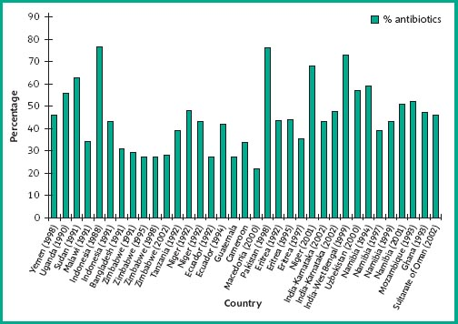
World Medicine Situation 2004

Slide 6
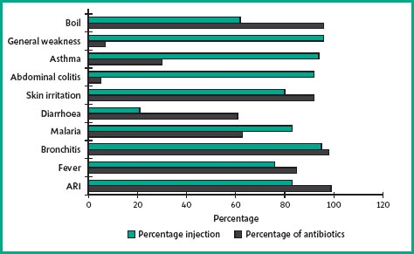

Slide 7
Pakistan; Fungal burden

Slide 8
Candidemia
45 year old male, severe asthma with steroid dependence
Frequent history of exacerbations, multiple courses of antibiotics and systemic steroids
Presented with high grade fever, joint pain
TLC: 22,000, CRP: 14
Started on piperacillin tazobactam
Fever was not resolved in 5 days

Slide 9
Candidemia
Blood cultures on admissionx3 negative
Meropenem and vancomycin were started
Fever did not subside
Patient continued to deteriorate
Blood culture sent on day 10 turned out to be positive for Candida rugosa
He was started on Amphotericin and 48 hours later fever was resolved

Slide 10
Accurate diagnosis; candidemia
Candidemia high rates in Pakistan
Neonatal candidemia; early onset is also common (28%)
Underestimate; based on blood cultures (Sen:40%)
Hospitalized patients are often inappropriately placed on broad-spectrum antibiotic drugs
  81% in China
  95% in India

Slide 11
Blood cultures and Invasive Candidiasis
Candidemia
Deep seated
Candidiasis
Candidemia with deep seated Candidiasis
50% of cases
0% of cases

Slide 12
Finding the missing 50%
Candidemia
Deep seated
Candidiasis
Candidemia with deep seated Candidiasis
Mannan-Antimannan
Beta-D-Glucan
Candida PCR

Slide 13
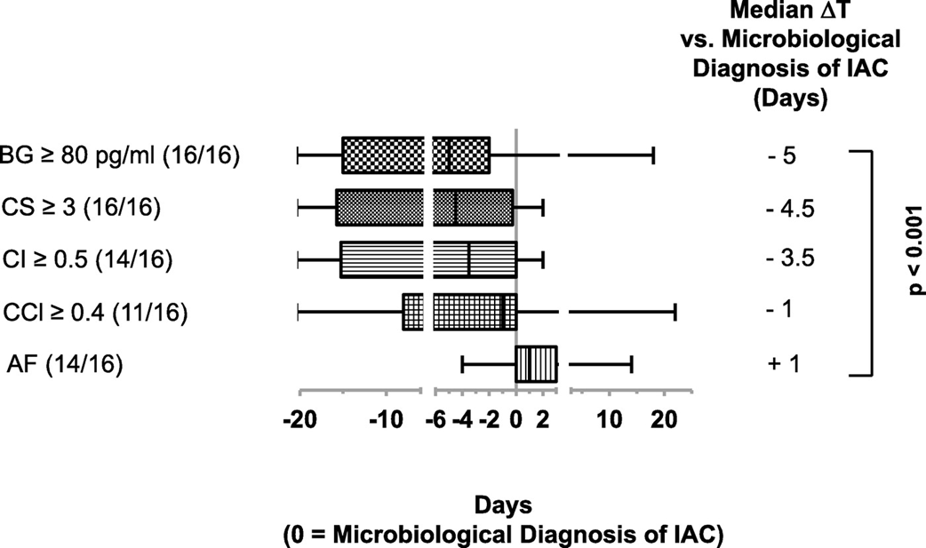
BDG antigenemia precedes diagnosis of blood culture-negative IA candidiasis
Sn and Sp; 65 and 78 percent, respectively
High NPV
Am J Respir Crit Care Med. 2013

Slide 14
What is required?
Widespread implementation of rapid nonculture diagnostics for Candida spp. will greatly improve prescribing practices for hospitalized patients using multiple medications
Once Candida-associated sepsis is confirmed, antibacterial agents can usually be stopped or deescalated and, if Candida sepsis is ruled out, empiric antifungal therapy can be stopped

Slide 15
Chronic Pulmonary Aspergillosis
Young female with post TB bronchiectasis (5 years back)
In past one year there was history of multiple hospitalizations with multiple broad spectrum antibiotics
Serial imaging shows increased destruction of lung parenchyma
Sputum culture grew Aspergillus spp.; GM+ve
Treated with itraconazole

Slide 16
CPA misdiagnosis
Post-TB sequelae are common, are poorly studied, and may be mistaken for active, recurrent TB
An apparent under-recognized diagnosis for patients with smear-negative TB is chronic pulmonary aspergillosis (CPA), which can mimic the signs and symptoms of TB

Slide 17
What is required?
Aspergillus IgG antibody detection is the key diagnostic test for CPA; the test has 96%–97% sensitivity and 92%–98% specificity
It needs to be sought actively by Aspergillus antibody testing in symptomatic patients who have completed ATT

Slide 18
Fungal Exacerbation of Asthma
Common practice to treat asthma exacerbations with antibiotic and corticosteroids
Most patients respond, even if the exacerbation is virus-induced
Patients may take several antibiotic drug courses a year, and in some cases, long-term antibiotic

Slide 19
Fungal Exacerbation of Asthma
It is now well established that colonization (or infection) of the airways with Aspergillus spp. is strongly associated with exacerbations
Fungal asthma, recent entity and includes asthma exacerbated by fungal sensitization, airways fungal colonization in asthma, and/or ABPA complicating asthma
Timely diagnosis of fungal asthma could substantially reduce inappropriate use of antibiotic
Long-term antifungal therapy is efficacious in 60%–80% of asthma patients with fungal exacerbations, most notably ABPA and SAFS
Successful antifungal therapy results in a reduction in the use of antibiotic drugs and corticosteroids and may reduce hospitalizations

Slide 20
What is required?
Diagnosis of fungal asthma relies on total and fungal-specific IgE testing
It is critical that fungal culture and nonculture diagnostics (i.e., A. fumigatus IgE, IgG, and antigen testing and PCR) for asthma exacerbations be evaluated and implemented and that fungal asthma be properly diagnosed and treated

Slide 21
Burns wounds infections
Burns hospital in Peshawar
Tissue from burn wound from several patients has growth of filamentous molds as well as Candida species
Many of these patients had history of receiving broad spectrum antibiotics
Condition improved after appropriate antifungal

Slide 22
Burns wounds infections
Pakistan has a very high incidence of burns (400-476/100,000)
Of these BWI is the most common complication (around 50-60)
Infection could be due to bacteria (70%) followed by fungi (30%)
In settings with advanced diagnostics, fungal infection has even surpassed bacterial

Slide 23
What is required?
Cultures: Direct confirmation of positive fungal cultures from burn wounds is the standard diagnostic approach
Candida and Aspergillus antigen test: Low sensitivity
Histology: Reliable method to confirm fungal colonization and infection

Slide 24
Conclusion
Lack of availability of nonculture fungal diagnostics results in overprescribing, longterm antibacterial agents prescription, and excess empirical use of antifungal agents
In many countries, the government and private healthcare providers should be actively promoting diagnosis of fungal infections; such efforts will probably also have a positive benefit on inappropriate antibacterial drug usage and support stewardship programs

Slide 25
Acknowledgement
Denning et al. Delivering on Antimicrobial Resistance Agenda Not Possible without Improving Fungal Diagnostic Capabilities. Emer Infect Dis; Feb 2017

