Slide 1
Sandeep Jaitly
Editor of Gold Basis Service
﻿#soundmoneyconf

Slide 2
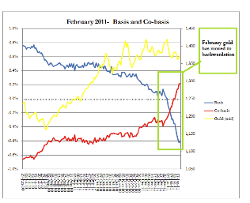

Slide 3
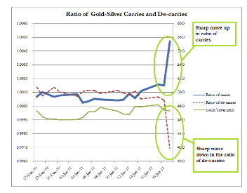

Slide 4
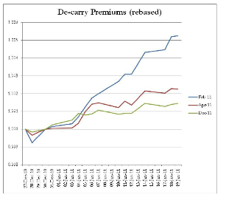

Slide 5
Sandeep Jaitly
Editor of Gold Basis Service
﻿#soundmoneyconf

