Slide 1
Sandeep Jaitly
Editor of Gold Basis Service
﻿#soundmoneyconf

Slide 2
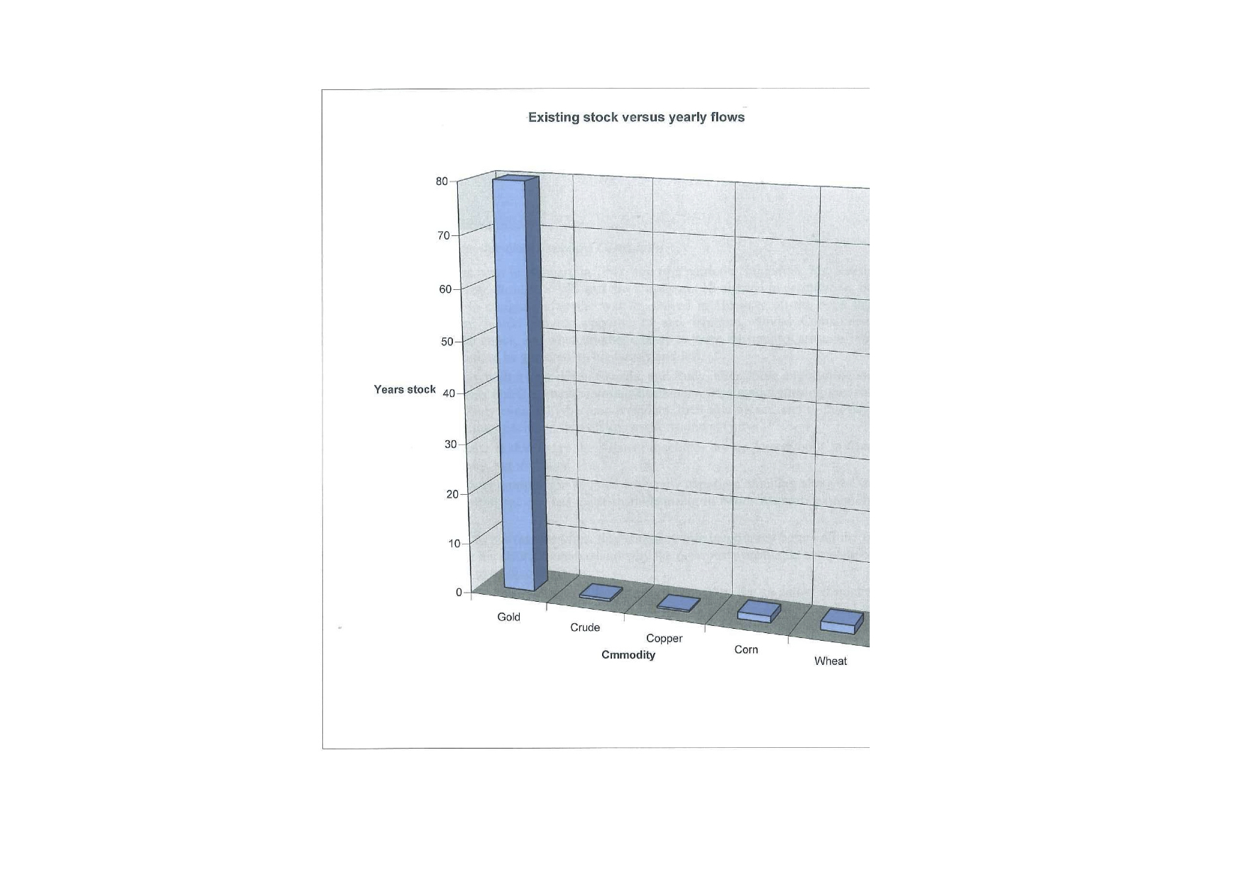

Slide 3
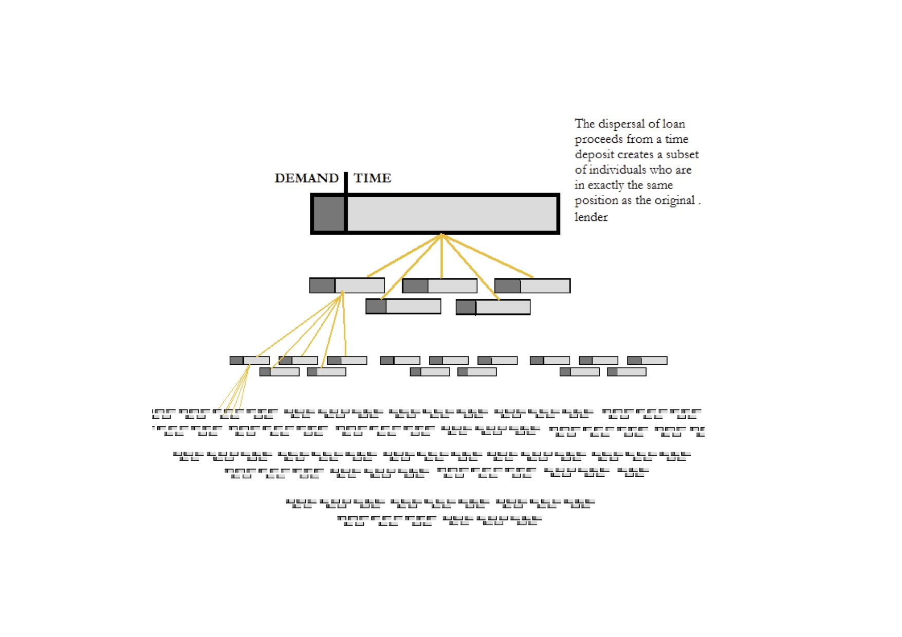

Slide 4
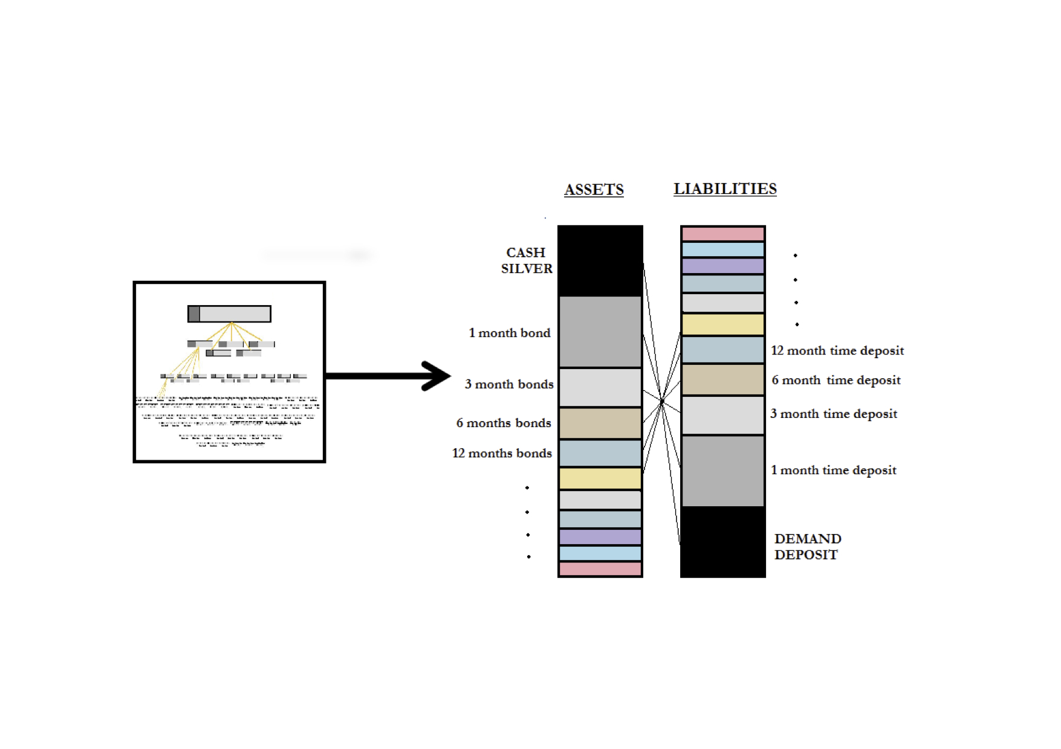

Slide 5
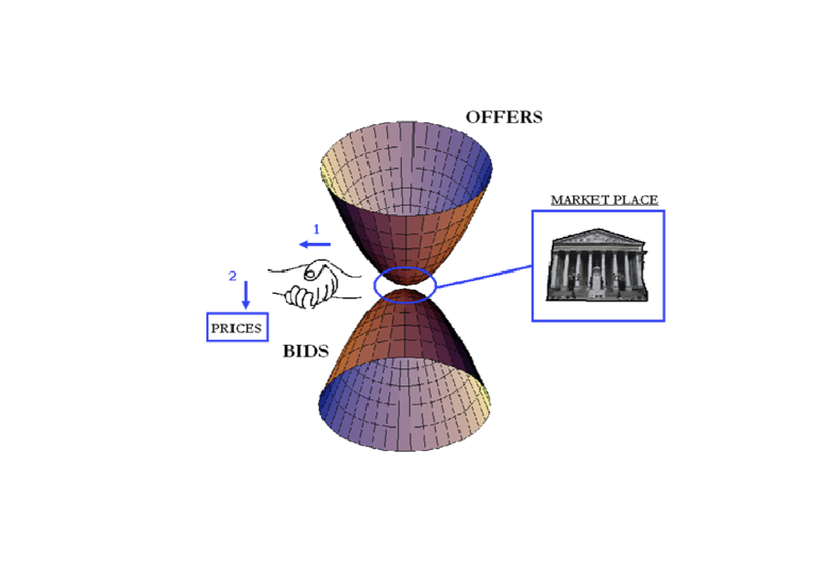

Slide 6
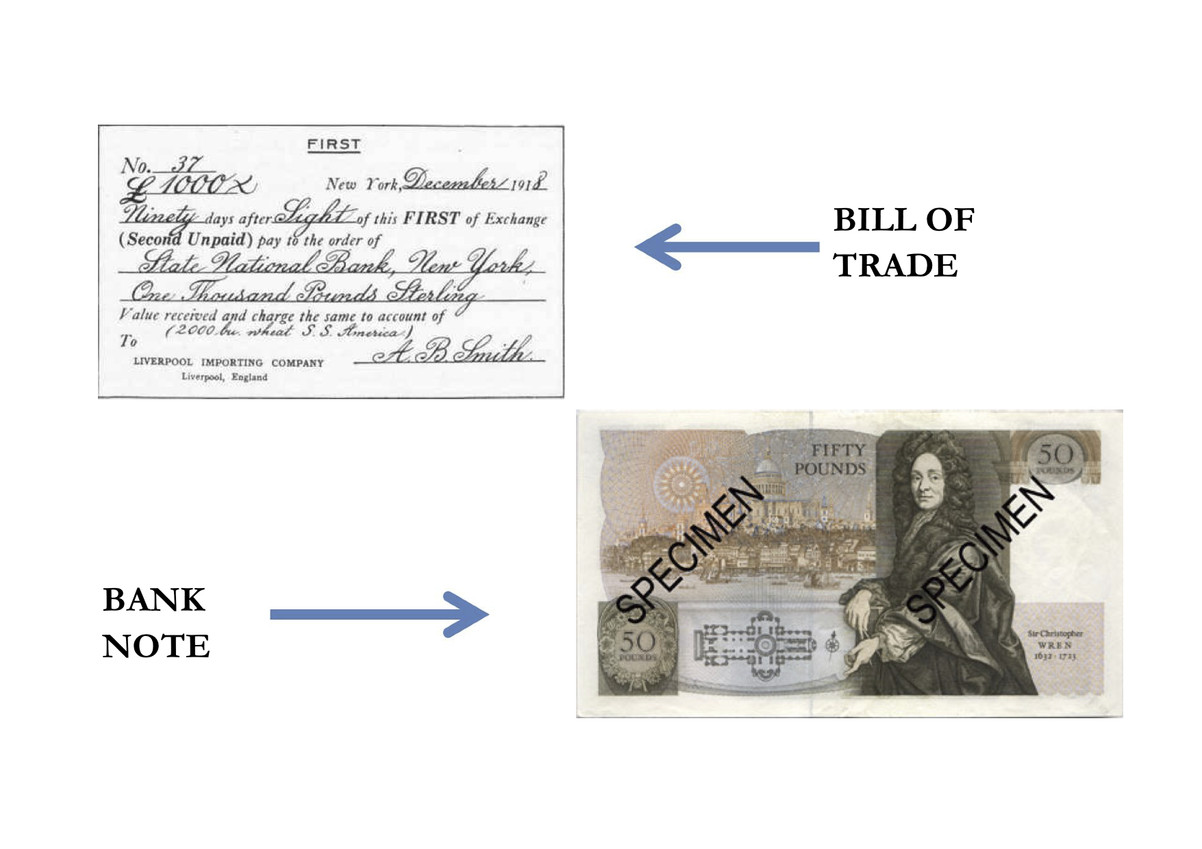

Slide 7
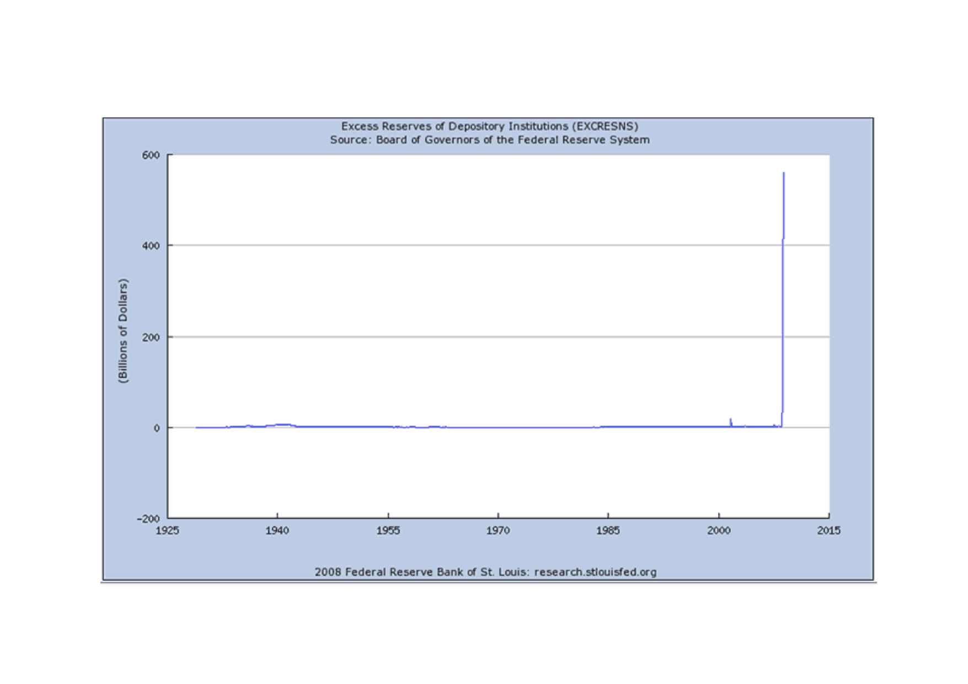

Slide 8


Slide 9
Sandeep Jaitly
Editor of Gold Basis Service
﻿#soundmoneyconf

