Slide 1
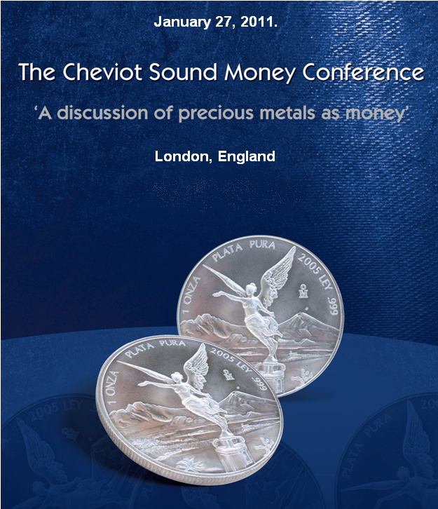
Essay by
Hugo Salinas Price

Slide 2
Elements for monetizing
the silver ounce in British Pounds
2

Slide 3
First condition
The coin shall not bear an engraved monetary value.
The Treasury will attribute a quote, a monetary value in pounds to the ounce.
The quote will serve the same function as an engraved value.
3

Slide 4
The method for monetization
Prices registered on December 1st, 2010:
Spot silver: $28.74 dollars/oz.
Dollar/British Pound: 0.639
4

Slide 5
The method for monetization…
Spot price of silver in British Pounds= £18.36
Plus
Cost of minting: 50 pence (estimated) = £18.86
Plus
10% seigniorage : £1.88 (suggested) = £20.74
Rounded up
To the next higher multiple of 50 pence
(suggested) = £ 21.00
Monetary value of the UK silver ounce: £ 21.00
5

Slide 6
Second condition
The last monetary quote given to the ounce by the issuer must not be reducible.
Just as is the condition of present British pound coins and bank notes.
If the quote is allowed to fluctuate in value downward, according to the price of silver, then the ounce will not be currency: it will continue existing as a commodity.
6

Slide 7
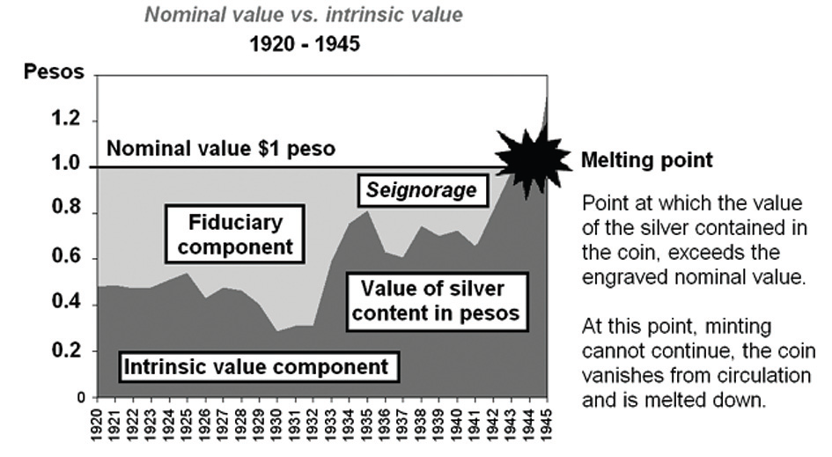
What happens when the price of silver falls?
The case of the Mexican Peso .720 Fine (12 grams of pure silver)
Nothing happens!
7

Slide 8
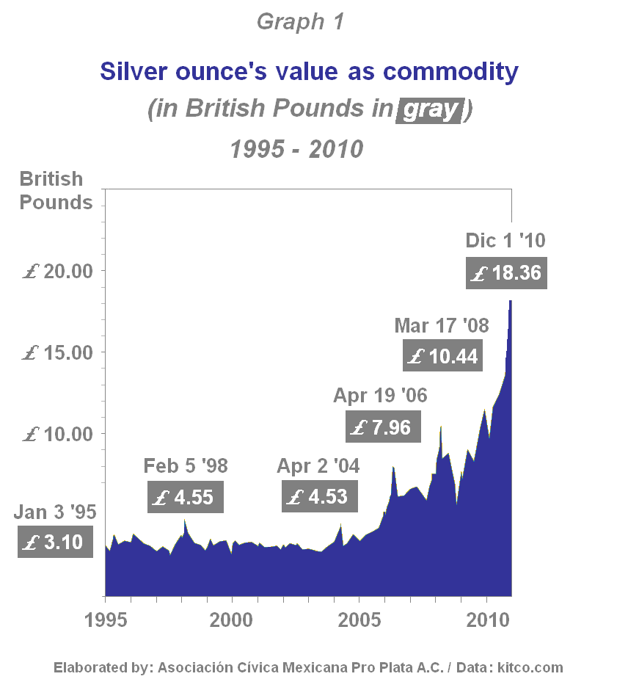
8

Slide 9
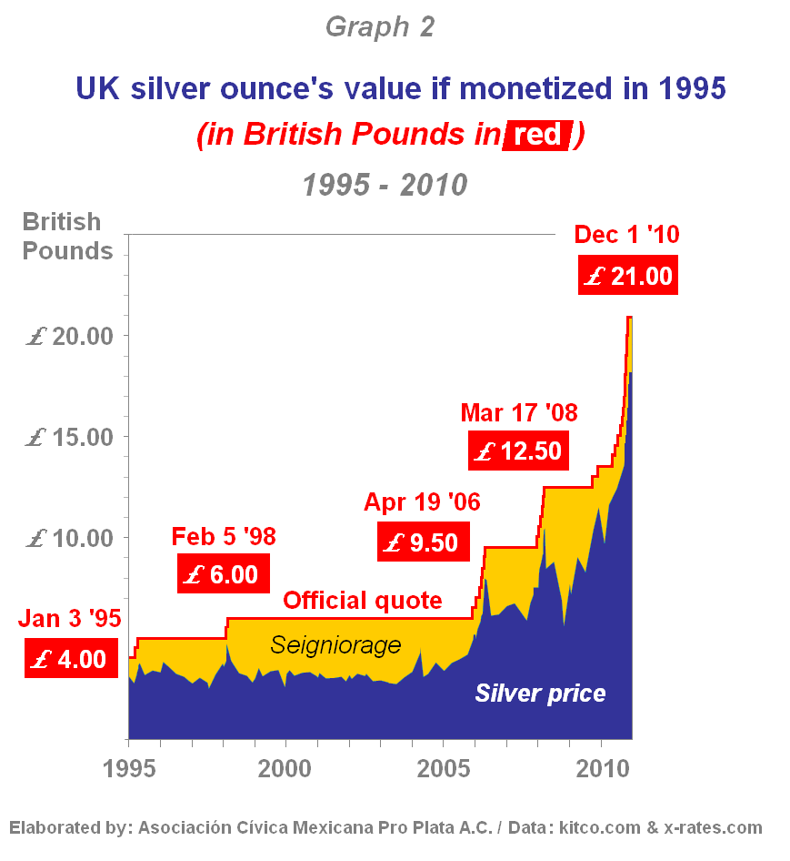
9

Slide 10
Minting silver
without a mining industry
10

Slide 11
‘Conditioned Mint’
Three conditions
1. The amount to be minted is determined, from time to time, by the Treasury.
2. The silver is purchased by the Treasury and minted for the account of the Treasury, and not for the account of the providers of the silver.
3. The silver purchase is paid to the sellers in monetized silver coins with a monetary value in British pounds equal to the purchase price.
11

Slide 12
Example of a minting operation
of 100 tonnes of silver under ‘Conditioned Mint’
(Silver prices on December 1st, 2010)
100 tonnes of silver = 3,215,074 Troy ounces x £18.36/oz =
£59,028,759 purchase price.
Quote of the monetized silver ounce: £21.00
How many monetized ounces would be required to
pay those who sold 100 tonnes of silver to the Treasury?
59,028,759 / 21.00= 2,810,893
12

Slide 13
Example of minting operation…
Ounces delivered
(100%) 3,215,074 £18.36 spot price /oz. £59,028,759
Seigniorage
(12.6%) 404,181
Ounces returned
(87.4%) 2,810,893 x £21.00 official quote /oz. £59,028,759
Although the seller only receives 87.4% of the silver, he obtains the full price of the silver, in British Pounds,in form of monetized ounces.
13

Slide 14
Reasons for the sellers to accept
selling their silver under these terms
They will get full payment in British pounds, but in the form of real money.
The sellers can deposit these monetized coins in British banks at their monetary value.
The coins, monetized in British pounds, are immune to devaluation; they can only rise in value.
14

Slide 15
Demand for a silver coin monetized in pounds would be worldwide.
Eventual use as an international reserve.
Enhanced prestige of London as financial centre.
15

Slide 16
A gradual and non-disruptive way to reintroduce real money into circulation in Britain and the world.
Perhaps open the way for later reinstatement of gold as international numeraire.
16

Slide 17
The world is waiting for the sunrise
17

Slide 18
Modern banking systems have completely usurped this fundamental function of the State: issuing money.
They have arrogated unto themselves the function of being the central promoters of growth and prosperity.
Thus have the money-lenders promoted themselves into a ruling plutocracy, which is now bankrupt.
18

Slide 19
By minting real money, the prevailing paradigm of fiat money, issued exclusively by the Central Bank and its related system will have been broken!
The State, through the Treasury, will be creating true money.
19

Slide 20
Silver money will remain permanently in circulation and will never be at risk of disappearing due to a collapse of the banking system.
20

Slide 21
Tension building .
Welfare State or personal savings.
But how to save effectively?
21

Slide 22
Silver money: mute but unexpressed desire because no one is providing such money.
22

Slide 23
Silver money closes a circuit.
A vast potential is unleashed.
Enormous demand for silver money.
23

Slide 24
Should we dread what the people desire, or should we understand that desire and its justification, and open the way for it to express itself?
24

Slide 25
A political party offering silver money.
A powerful political platform.
25

Slide 26
The world is waiting for the sunrise!
26

Slide 27


