Slide 1

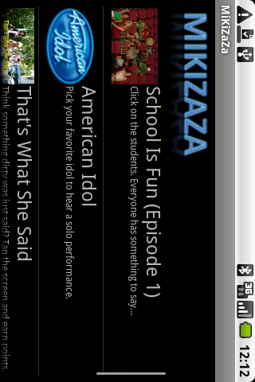
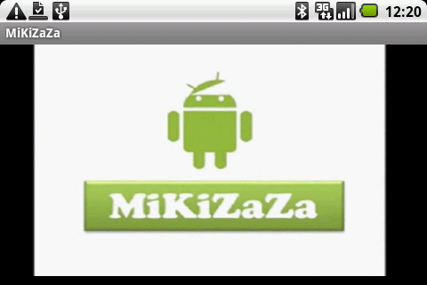
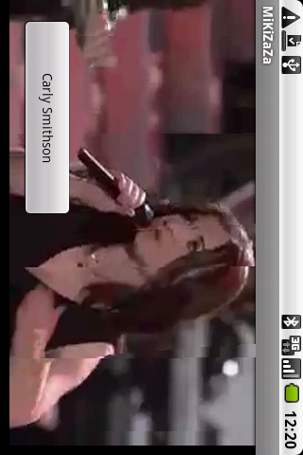
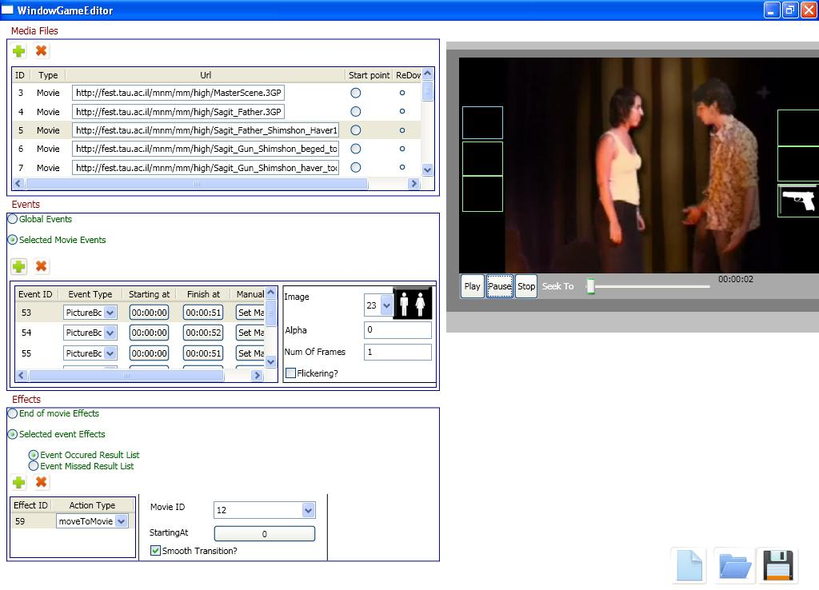
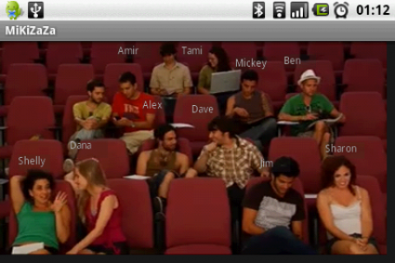
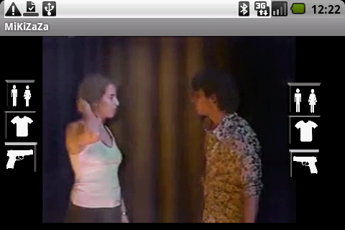

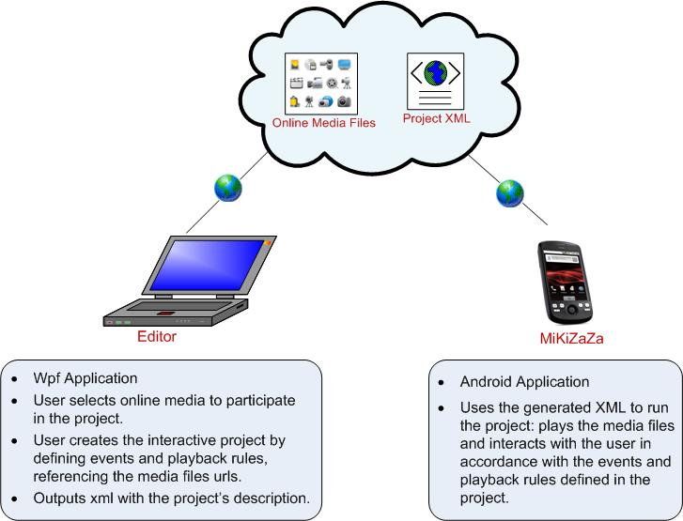

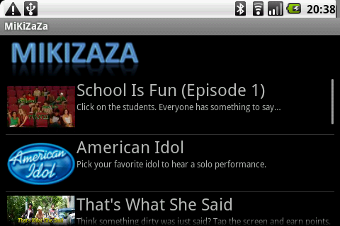
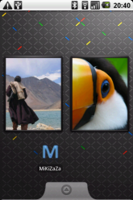
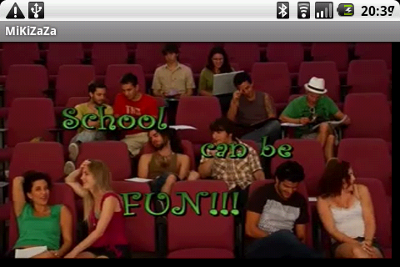
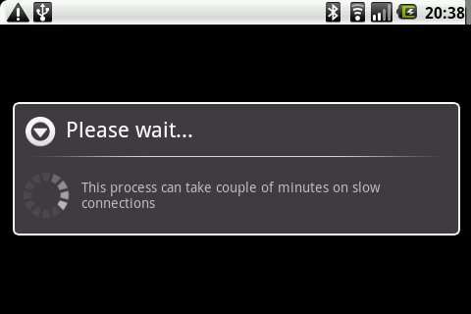
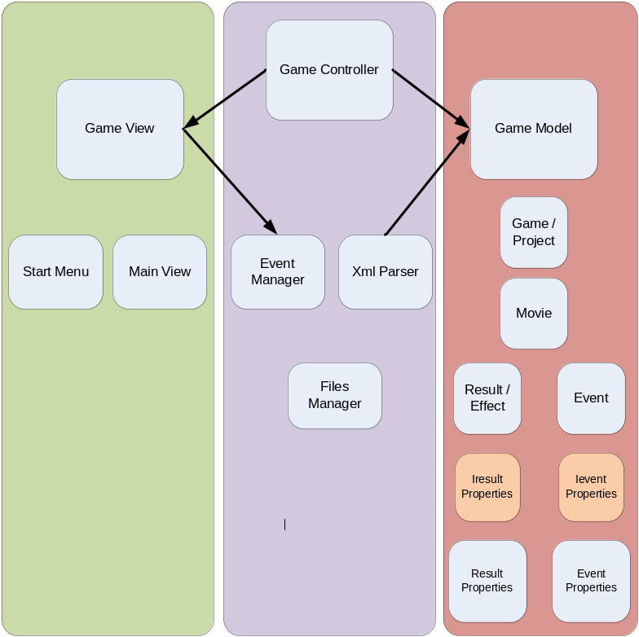
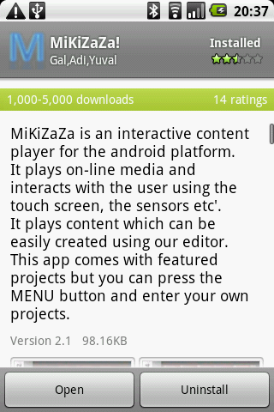
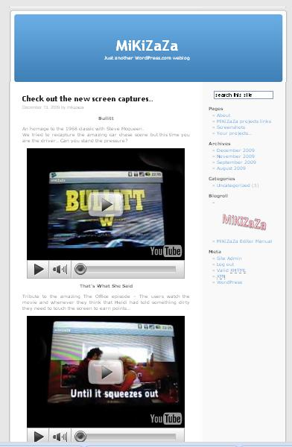
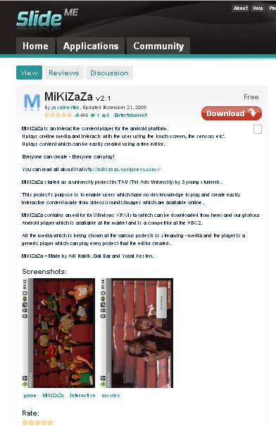
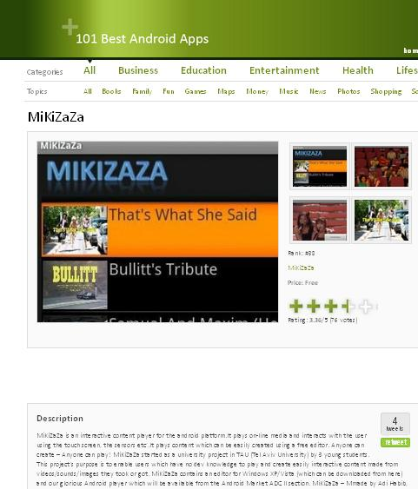
MiKiZaZa
Computer Science Workshop
Under the supervision of Prof. Muli Safra
Presented by: Gal Bar, Adi Haviv, Yuval Kesten
MiKiZaZa is an interactive content player for the android platform.
It plays on-line media and interacts with the user using the touch screen, accelerometer, compass, GPS and more.
It plays content which can be easily created using our PC editor.
Technologies
Android SDK
Amazon S3
XML-SAX
WPF
Java
.NET
MiKiZaZa was developed due to TAU cinema students’ need - mobile aware interactive content player for hand-held devices.
Instead of implementing a specific project we decided to develop a generic platform.
We developed an editor which allows easy creation, modification and display of MiKiZaZa projects.
Dynamic Content
In each run the android app downloads an XML catalogue from an Amazon S3 server.
The catalogue holds references to all the MiKiZaZa projects available at the time.
When the user picks a movie, all the required media and the interactive screenplay are being downloaded .
This design enables adding tons of new content without ever needing to update the app.
Design
Promoting the app

