Slide 1
The National Literacy and Numeracy Framework Supporting you to differentiate the teaching of skills in order for all learners to fulfil their potential

Slide 2
Progress Tracker
Curriculum and Assessment
C2
In incorporating the LNF requirements into the school curriculum, provision has been made for pupils with ALN as well as MAT pupils
Notes:
Every Headteacher/Leadership team in Wales worked with their NSP lead partner to complete a progress tracker. The tracker is broken down into questions that fall under the headings of: School leadership, management and strategic planning, Curriculum and Assessment, Teaching and Learning, the whole tracker gives an indication as to where each school in Wales sits with regard to its implementation of the LNF and the support/actions needed to successfully embed the LNF framework.

Slide 3
Aims of the Workshop
To discuss and consider definitions of “Differentiation”
To consider the National Literacy and Numeracy Framework as
a planning tool that enables differentiation
To illustrate an approach to planning rich learning activities,
incorporating the LNF, differentiated to meet the needs of
Individual learners.
To offer opportunities to ask questions and share ideas.
Notes:
The workshop does not set out to provide a bank of learning activities for teachers. The aim is to guide the participants through a process of using the annual expectations in the LNF to help them to provide sufficient differentiation when planning lessons for all learners, and then to give them time to try it out for themselves at the end of the workshop. Nationally, around 20% of schools identified this element of the
NSP Progress Tracker (C2) as an area for support?

Slide 4
Differentiation is necessary because …
Think about the range of abilities in your “middle ability”
class/groups.
Sort the cards into OFTEN, SOMETIMES, NEVER
Think about the range of abilities in your “middle ability”
class/groups.
Now think about your ALN learners; would you change your cards around?
Why?
ACTIVITY 1
Notes:
Activity 1: This ice-breaking activity is intended to get participants talking and working together at the beginning of the workshop. Say that the aim of the activity isn’t to find “right” answers, but to raise questions and encourage discussion. Ask participants to work in pairs to begin with, to sort the cards (see final slide for a template) under the headings OFTEN, SOMETIMES and NEVER. (5 min). Now join twos into fours and ask each group to combine their classifications to come up with one agreed version. Encourage participants to identify areas where they agreed and only then to discuss the areas where they thought differently, and why, before re-arranging cards if necessary (5 - 10 min). At the end of the activity, ask if there are any areas of disagreement and discuss these, along with any questions raised. NB It’s likely that all, or almost all, of the cards will fall into the “Sometimes” category, because all learners skills acquisition are varied . Any cards that are placed in the “OFTEN” or “NEVER” categories are likely to flag-up issues about learners/planning and teaching strategies that may need to be addressed in this or subsequent sessions.

Slide 5
Enjoy reading | Are discussed in staff meetings | Need specialist teachers | Can become disaffected learners | Can learn for themselves
Have good parental support | Work best on their own | Are good all-rounders | Enjoy being ‘pushed’ | Are good communica-tors
Show their potential right from the start | Have good number skills | Reach their full potential on their own | ‘Get’ real-life problem-solving | Need an accelerated curriculum
Often
Sometimes
Rarely
Notes:
This is the template for the card-sort activity on SLIDE 3. You will need to print the slide and cut out the cards into sets – one set per pair. This ice-breaking activity is intended to get participants talking and working together at the beginning of the workshop. Say that the aim of the activity isn’t to find “right” answers, but to raise questions and encourage discussion. Ask participants to work in pairs to begin with, to sort the cards (see final slide for a template) under the headings OFTEN, SOMETIMES and NEVER. (5 min). Now join twos into fours and ask each group to combine their classifications to come up with one agreed version. Encourage participants to identify areas where they agreed and only then to discuss the areas where they thought differently, and why, before re-arranging cards if necessary (5 - 10 min). At the end of the activity, ask if there are any areas of disagreement and discuss these, along with any questions raised. NB It’s likely that all, or almost all, of the cards will fall into the “Sometimes” category, because learners skills acquisition is varied, not a linear process. Any cards that are placed in the “OFTEN” or “NEVER” categories are likely to flag-up issues about learners/planning/teaching strategies that may need to be addressed in this or subsequent sessions.

Slide 6
The Literacy/Numeracy Framework
The requirement to plan for developing literacy and numeracy skills
in different subjects is not new.
All that’s really new is an explicit set of annual expectations for
what learners can do..
Turn to your partner and discuss - one way that having annual
expectations might affect our planning for all our pupils.
Notes:
Make the point, here, that we should not think about planning the LNF as a new venture – many schools have been planning skills across the curriculum, e.g. using the non statutory skills framework to develop communication and number skills, for a long time. (relate personal experiences) All that’s new is having an explicit set of expectations for capability year-on-year.

Slide 7
Progression & Consolidation
In the context of the LNF, progression is defined as: increasing
The breadth and depth of learning at each stage of
development as well as providing greater challenge for
learners. (Welsh Government, 2013)
Consolidation involves practising a skill in a variety of
contexts – showing increasing capability of applying the skill
to more unfamiliar situations and requiring less support.
Notes:
It is important to remember that each skill is expected to be acquired over a year and during this time learners must be given the opportunity to practise consolidate and extend the skill through a variety of contexts (subjects) creating breadth and depth of learning through interesting and stimulating activities.
Discussion: What opportunities for consolidation would you provide? The LNF describes the fundamental skills of literacy and numeracy which should be developed across the curriculum and sets out broad expectations for progression in these skills with its yearly expectations.
‘Progress’ will not necessarily be ‘linear’ and individual learners will progress with different skills at different rates. The LNF offers opportunities for learners to...

Slide 8
Next Steps leading to.......
‘Next steps’ - a series of small improvements a
learner can make to ‘close the gap’ towards gaining
competence within an LNF Year group skill.
‘Next steps’ are most effective in supporting
Progression when they provide clear and are
generated in collaboration with learners.
Notes:
In planning effective learning opportunities, it is vital that next steps are
considered not in terms of what learners can/can’t do reliably and
consistently but in terms of what they need to do next in order to make
progress. Thus ‘next steps’ describe improvements learners need to
put into action in order to make progress.
Sign post AfL and ARR document, use of Pupil Friendly Framework.

Slide 9
Differentiation
Next steps to improvement will often be within or between
LNF statements rather than a direct jump from one
statement to another.
Increasing the complexity or changing the context
(from familiar to less familiar) and/or the level of
Independence required is how ‘differentiation’ using the
LNF should work.
Notes:
Teach the skill (probably but not necessarily, in English/Maths lesson) then apply that skill in another subject/learning environment. Model the skill with the class/group/ individual learner – construct a writing frame/rubric or method to support learning where necessary. Self/Peer assess the work. Teacher provide feedback as to how the learner can move forward. Practice the skill across many subject areas, Remove the structure chosen to support learning. Consolidate the learning, feedback next step......
Look at examples of Pupil Friendly LNF
Use ‘rotating papers’ for this activity.
Qu1 -How could learners in your school use the pupil friendly framework to track their progress?
Qu2 –How could your school incorporate the use of Next Steps into their use of AfL
Qu3 - How could teachers use Next Steps to inform their planning?

Slide 10
Differentiation and the LNF......
The LNF is designed so that the expectations for the year
group below and above can be used as an indicator of
skill level in comparison to the learner’s school year.
The LNF expects us to have high expectations of our
learners and so, for example, Y6 statements are more like
Level 5 than Level 4.
Learners should be given success criteria for their own
Skills competence, not simply the year group expectations
Notes:
Good practice shows indication of 3 year groups of skills within all planning – Year of Class/group year below and year above. However, if a child is at SA+ on the register or has a statement and is working well below their chronological age provision should be made to differentiate the skills to that level.

Slide 11
How do we assess which year group of skills fits the learner......
Summative assessment
The standardised scores of the National Reading and
Numeracy Tests.
Other standardised tests used within the school
Formative assessment – assessment for learning
While the LNF is designed as a curriculum planning tool,
it is also supports formative assessment.

Slide 12
Planning for Progression
Setting the Pitch
Part of the ‘Reading: comprehension’
Skills Progression Pathway
Card Sort Activity
ACTIVITY
Notes:
Hand out cards and sort, feed back. Now take one of the year group expectations from the LNF and consider how you would design learning opportunities for a learner to ‘progress’ in this numeracy skill. What opportunities for ‘consolidation’ would you provide? List subjects and activities where the skill could be consolidated. Activity 3.

Slide 13
Head of Gaer Primary, Newport
http://www.youtube.com/watch?v=9G8chZEFHfU&feature=player_embedded
Notes:
The deputy headteacher (featured here, now head of Gaer Primary, Newport), told me that he had Y5 children in a MAT group accessing level 6 NC skills. Whilst we do not all have children in Y5 working at this level the principles of good differentiation are the same regardless of whether your highest ability are working at Y8 skills or Y4 skills.

Slide 14
The LNF as a planning tool for ALL pupils
Four steps
Decide which skill, or skills, will be applied or extended
Set the pitch
Identify the subject focus
Choose the engaging scenario in which the learning will happen
Context
Notes:
There are four steps in planning the LNF for ALL pupils. The subject focus and the scenario for learning, together, are the engaging context in which the literacy or numeracy skills will be applied or extended.

Slide 15

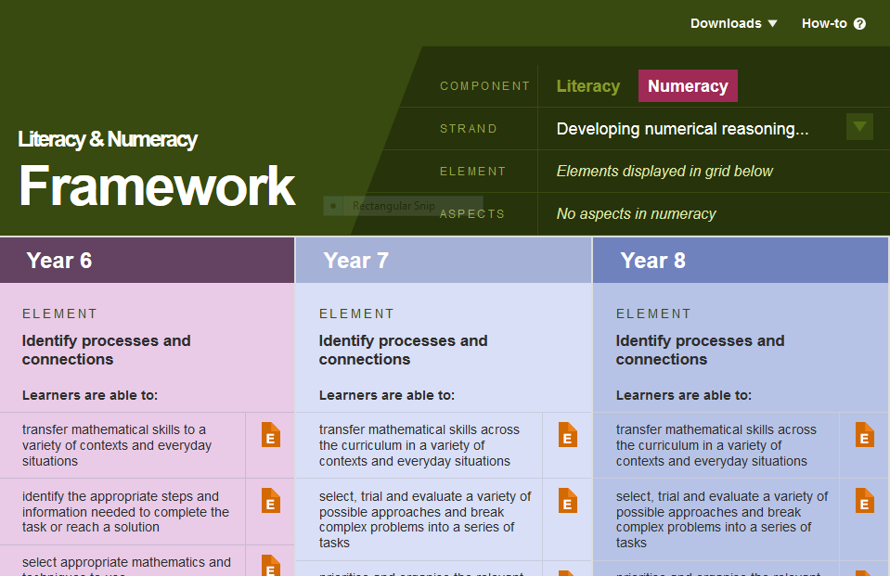
The LNF as a planning tool for all pupils – decide which skills.
LNF Skills
Subject Skills
Notes:
Remind participants that literacy and numeracy skills are taught explicitly in maths and Welsh or English (or, sometimes, by whole-school agreement, in another subject). Their curriculum audits will then have identified (or be identifying) where those skills can then be applied and extended in different subjects. The first stage in planning is identifying specific skills as a focus.

Slide 16
The LNF as a planning tool
Skills progression
show understanding of main ideas and significant details in texts, e.g. mind mapping showing hierarchy of ideas, flowchart identifying a process
select the main points from texts and identify how information and evidence are used to support them
A
B
Reading: comprehension
show understanding of main ideas and significant details in different texts on the same topic
accurately identify the main points and supporting information in texts
C
D

Slide 17
The LNF as a planning tool for All pupils
Looking at skills
Accurately identify the main points and supporting information in texts
show understanding of main ideas and significant details in texts, e.g. mind mapping showing hierarchy of ideas, flowchart identifying a process
Y4
Y5
select the main points from texts and identify how information and evidence are used to support them
show understanding of main ideas and significant details in different texts on the same topic
Y7
Y6
Notes:
This slide shows the progression pathway for this skill. Knowing your pupils and having considered their age equivalent , you will know how to pitch the skill. Lets imagine we have taught the principles in our English lesson now we want to practise, consolidate and extend learning in this transferable skill.

Slide 18
The LNF as a planning too for all pupils
The differences in people’s daily lives in two contrasting periods of the twentieth century
Context: History KS2.
…Chronological Awareness
Historical Knowledge and understanding
Interpretations of history
Notes:
As a subject focus, we have chosen history, but could have chosen others. Point out the range (differences in peoples lives in two contrasting periods of twentieth century) (KS2 Programme of Study) and the skills (Level 4 description), and how there appears to be fruitful ground for linking with the comprehension skill we are focusing on (see next slide). Topic World War 11,

Slide 19
The LNF as a planning tool for ALL pupils
differences in people’s daily lives in two contrasting periods of the twentieth century (World War 2)
Context: History.
Pupils should be given opportunities to:
identify the ways in which the past is represented and
interpreted
2. distinguish between ‘fact’ and ‘opinion’, giving some
evidence/knowledge-based reasons for this.
Reading – Aspect – response and analysis…
Reading
Response and Analysis
Y6 skill:
Collate and make connections between information and ideas from different sources
L.O. Children’s lives were different during Word War 2
Notes:
We’ve chosen a Y6 literacy skill as our pitch – the pitch would depend on your own pupils. Ask participants what contributory skills we would need to be sure the pupils have mastered before we present them with this level of challenge (the aim is that the participants refer back to the Y3 [make links between what they know and what they read]; [Y4, know that the same information can be shown in different ways]; [Y5 can collect and organise information from different sources] skills to help them to decide this). What’s the challenge now? – to use those skills to select ideas and information from a range of texts to support their view.

Slide 20
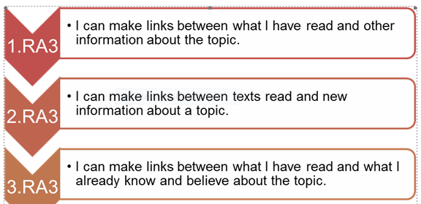

Slide 21
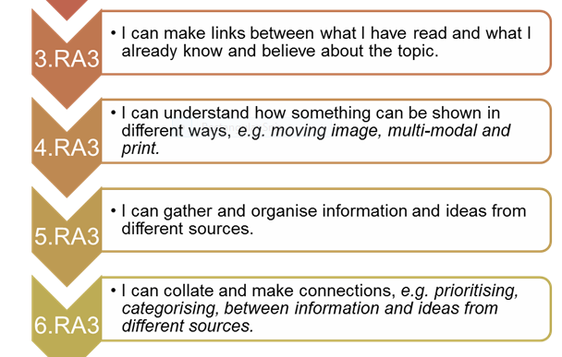

Slide 22
Pupil friendly progression pathways
I can show I understand the main ideas and important details in a text, e.g. mind mapping showing hierarchy of ideas, flowchart identifying a process.
5.RC3
I can show understanding of main ideas and significant details in different texts on the same topic.
6.RC3
I can select the main points from texts and identify how information and evidence are used to support them.
7.RC3
I can locate, select and use additional information from different sources.
8.RC3
Are you familiar with these?

Slide 23
Success criteria?
Task?
Notes:
Ask participants to work in groups of 2 or 4 to devise a learning task and success criteria (at least 10 minutes, with time for questions afterwards).
(e.g. let’s use the squared board to find out the size of the fish. Can you work out how many squares the fish covers? What about the squares that are not covered completely? Numeracy success criteria could be: show the Caterpillars Group the biggest fish and the smallest fish. Tell them how you know) KUW success criteria could be: tell an adult some reasons why the fish are different sizes. However this does need to be set with the children in their own language.

Slide 24
Foundation Phase
Cognitive aspects of learning support the development of numeracy when
addressed in situations that allow the learners to transfer skills and
knowledge that relates directly to their school, home, work and community life.
(Welsh Government, 2012).
Continuous and enhanced provision allow for opportunities to reinforce the
experiences that each learner has experienced in Focus Activities.
Through role play they can practically use and apply the
taught skills. Learners will only transfer knowledge and understanding if
planning for these opportunities occurs at the identified differentiated level.
FP Activity.......
Notes:
Continuous and enhanced provision within the Foundation Phase (for example: role play, construction, sand, water, malleable, outdoor, ICT, workshop, block play) allow for these opportunities to take place in a non-threatening environment and reinforce the experiences that each learner has experienced in Focus Activities. Learners should be given the opportunity to transfer the skills they are developing in focused provision. Through role play they can practically use and apply the taught skills and understand the purpose for the learning process. Learners will only transfer knowledge and understanding if planning for these opportunities occurs at the identified differentiated level ie if in the focus group you taught R level children read and write numbers to at least 10, Y1 to 20, Y2 read and write numbers to 100, your activity in Enhanced is Bingo in the “leisure centre” area, there needs to be a variety of cards set at each of these levels that suite each group and the child who is the caller.

Slide 25
The LNF as a planning tool
Reading: response and analysis
I can make links between what I have read and what I already know and believe about this topic
Y3
Y4
I can understand how something can be shown in different ways e.g. moving image, multi-modal and print
Possible success criteria
I can gather and organise information and ideas from different sources
I can collate and make connections, e.g. prioritising, categorising between information and ideas from different sources
Y5
Y6

Slide 26
The LNF as a planning tool
Reading: response and analysis
Possible success criteria

Slide 27
Plenary
What is the most valuable message about differentiating learning in the
LNF that you can share back at school?
What is likely to be the next step in differentiating learning in the LNF that
your school needs to make?
Is there an unanswered question about differentiating learning in the LNF
that you want ask during this plenary?
I
Notes:
Finish the workshop by inviting final questions/observations about the subject covered.
Ask participants to spend a few minutes thinking about their own “next step” which is to plan a RLT.
Thank participants for attending and for their involvement.

