Slide 1



Portfolio
Sanjula Banerjee

Slide 2
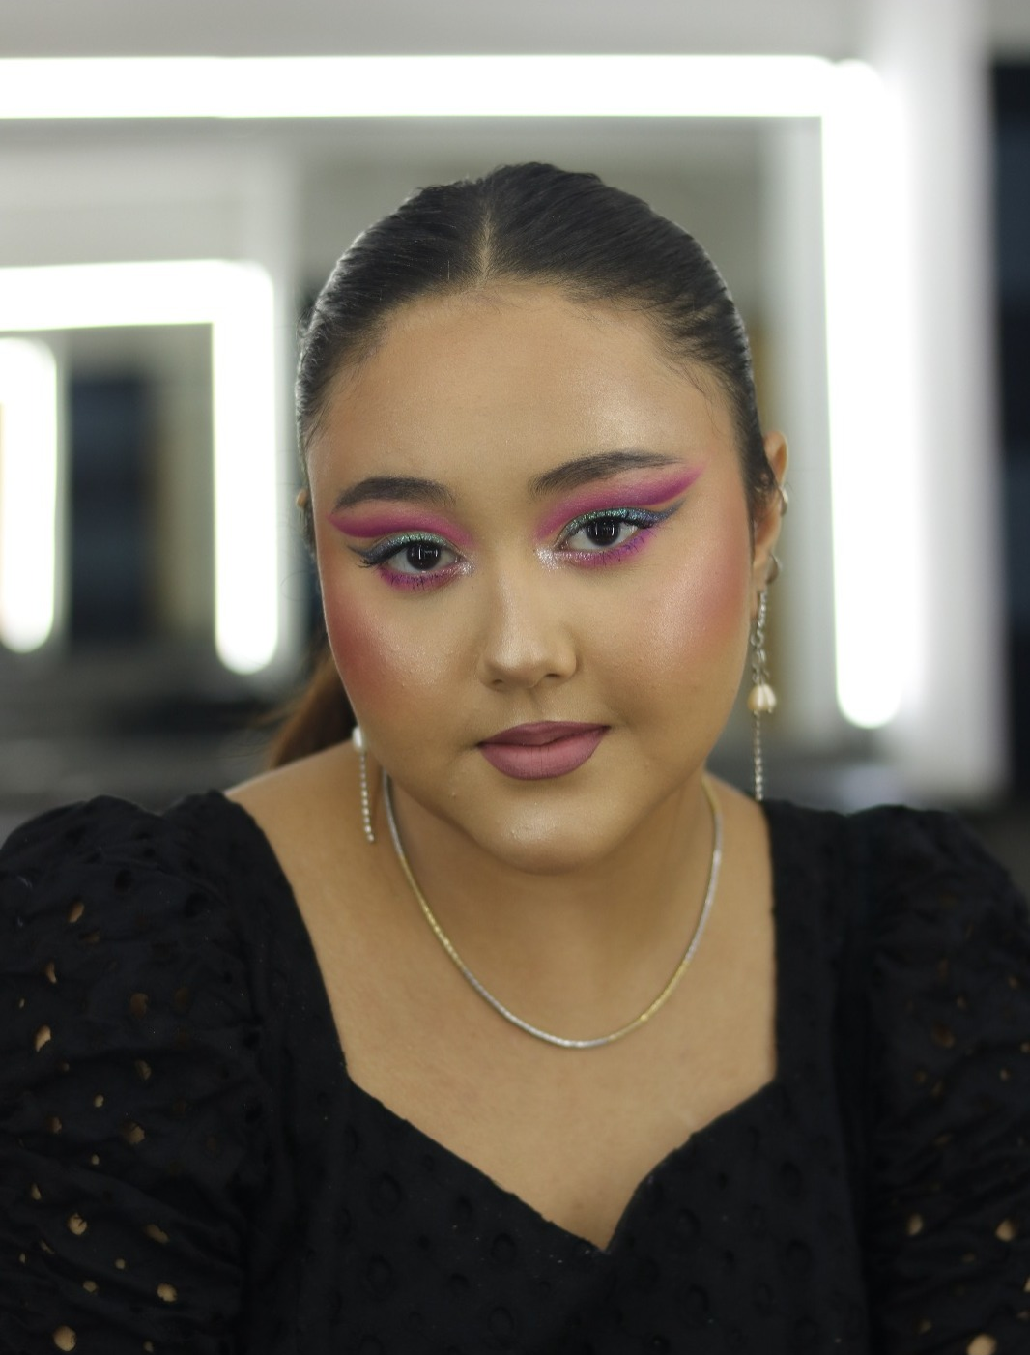
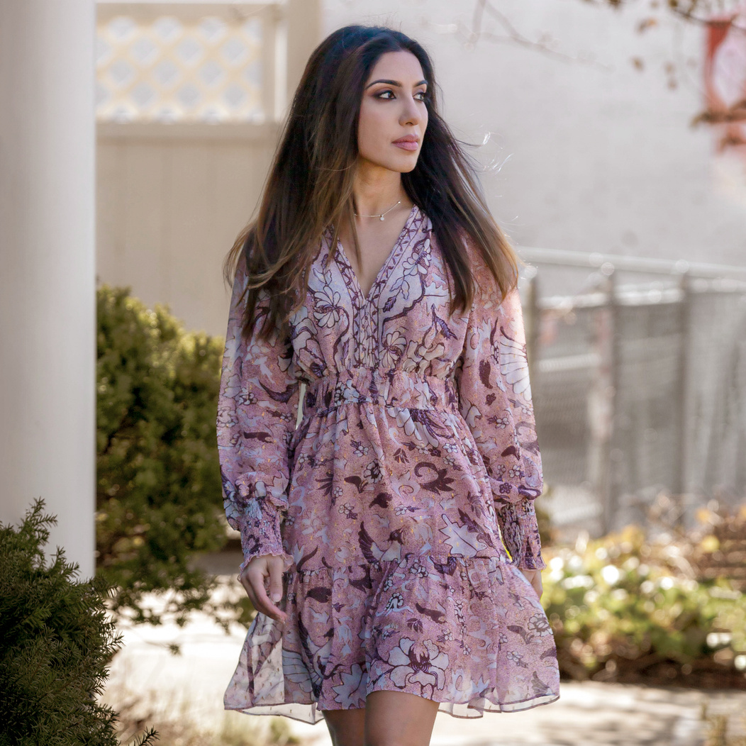
Sanjula
Age: 24
City: Hyderabad
State: Telangana
About Me
I am a passionate makeup artist with a keen interest in creative work and experience across all fields of makeup such as TV, Film, Bridal, Party etc. in the past 6 years.
Education
B.A Political Science
Certification in Makeup Artistry
Skills
Bridal makeup
Party makeup
Editorial makeup
Makeup for film
Expert product knowledge

Slide 3
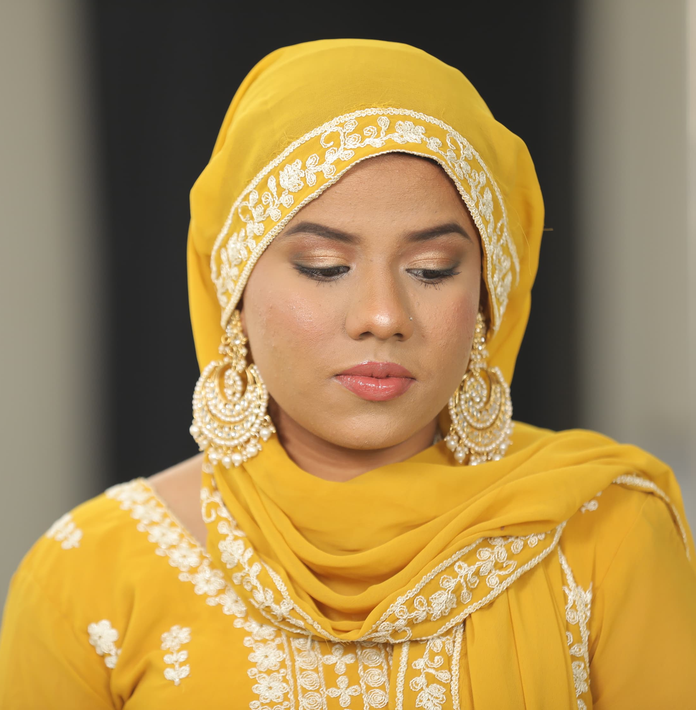
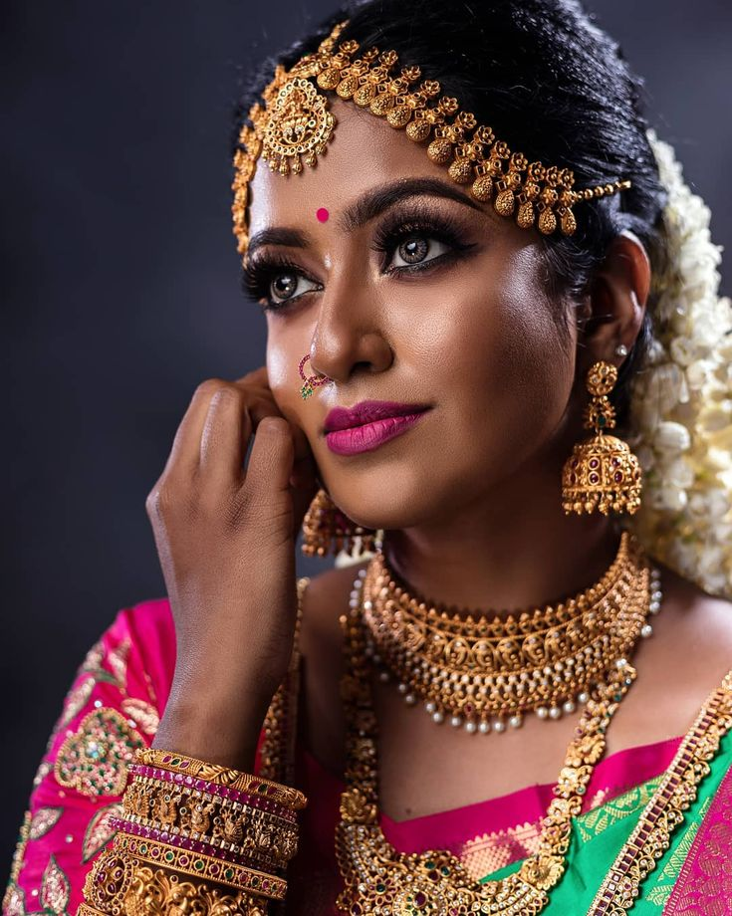
Bridal work
Iqra's Haldi Look
Pallavi's Muhurtham

Slide 4
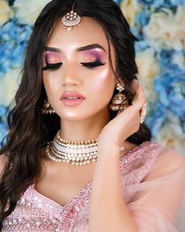
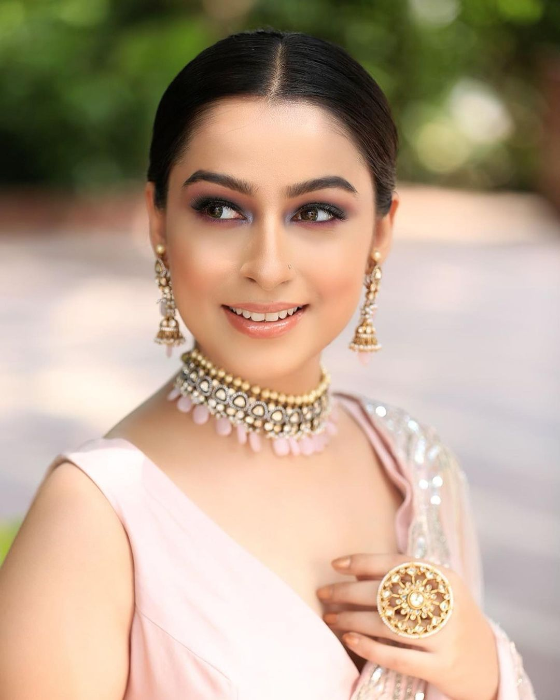
Bridal work
Ananya's Roka
Mansi's Reception

Slide 5
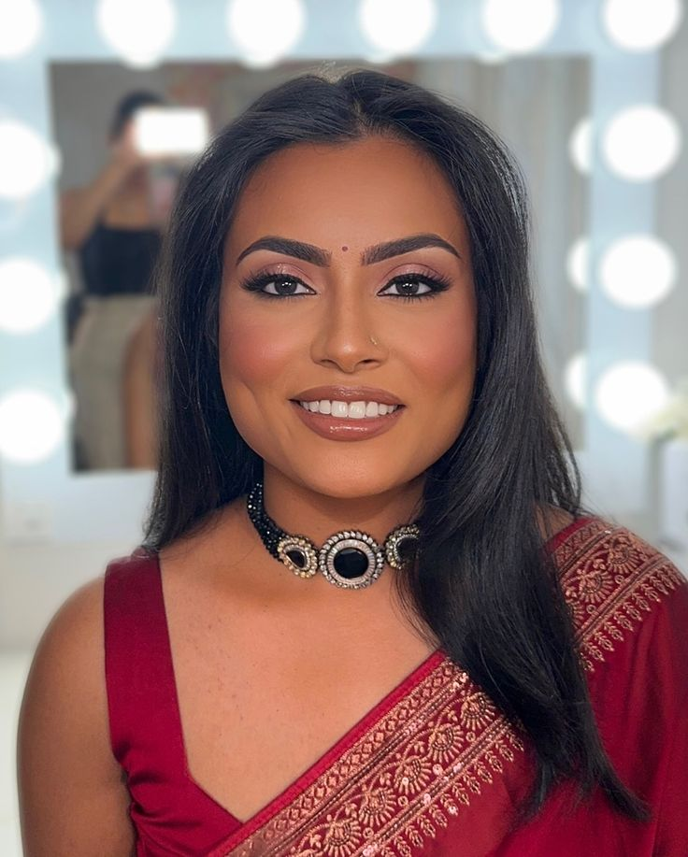
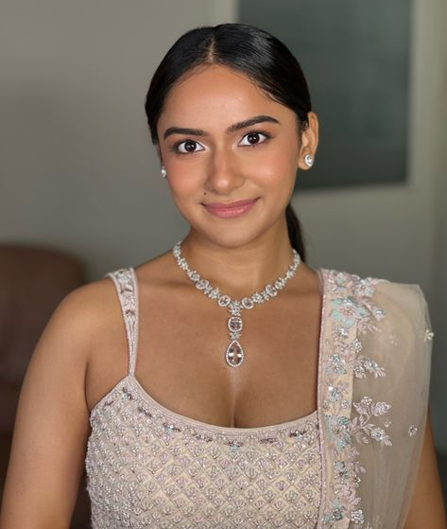
Party Makeup
Sanjana
Prachi

Slide 6
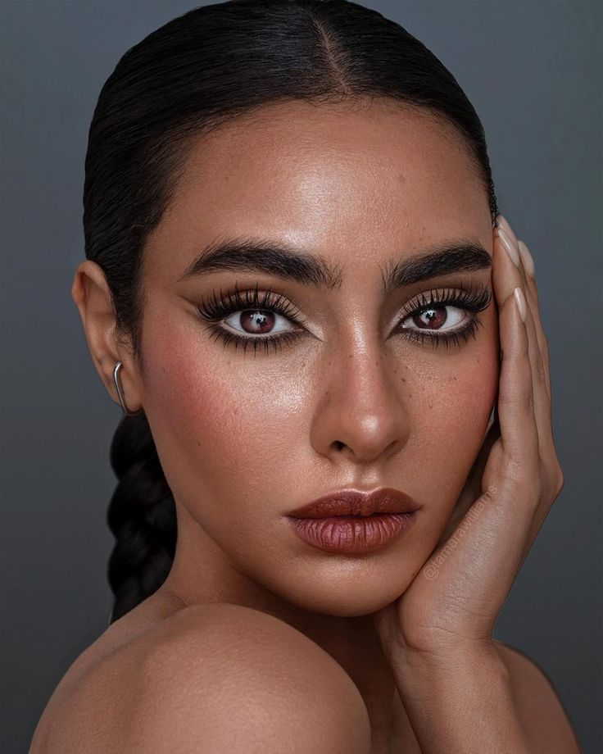
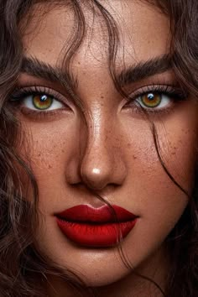
Photoshoots - Editorial

Slide 7
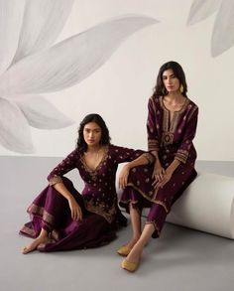
Photoshoots - Designers

Slide 8
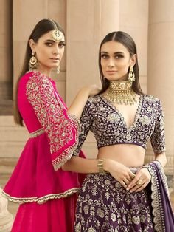
Photoshoots - Designers

