Slide 1



Portfolio
Meghana Patnam

Slide 2
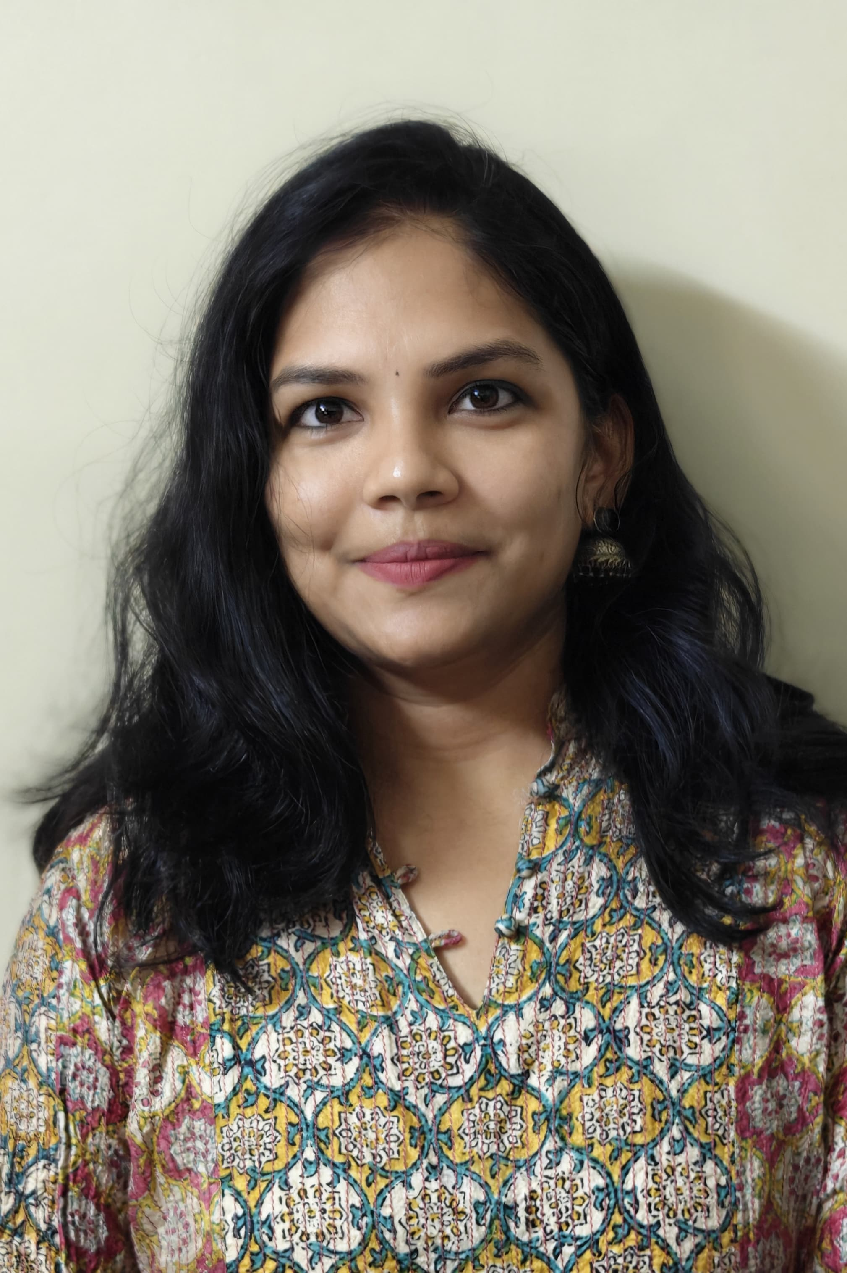
Food Faculty Portfolio
Meghana
Age: xyz​
City: Hyderabad
State: Telangana
Education ​
Bsc Computers
Pastry Diploma
Skills​
Cakes & Cupcakes
Breads
Healthy Tea cakes
Gluten free desserts
Custom cakes
Fondant cakes

Slide 3
About Me
My name is Meghana Patnam and I am a passionate baker.
I persuaded a professional certified course in baking and confectionery. I have gained good knowledge in theoretical science behind baking and cooking.
I have also conducted many workshops for kids and adults through online and offline.

Slide 4
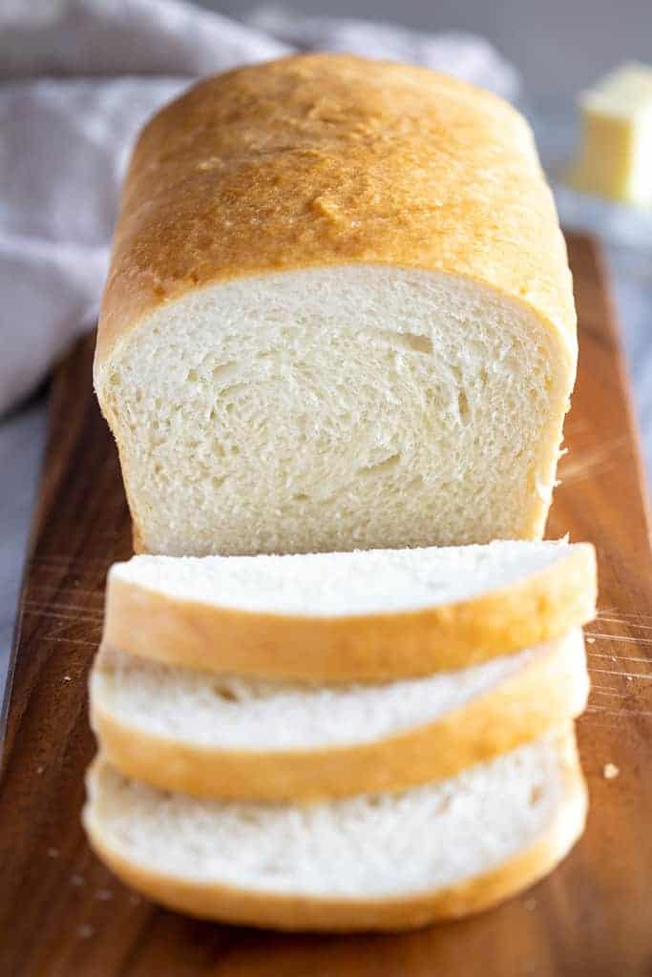
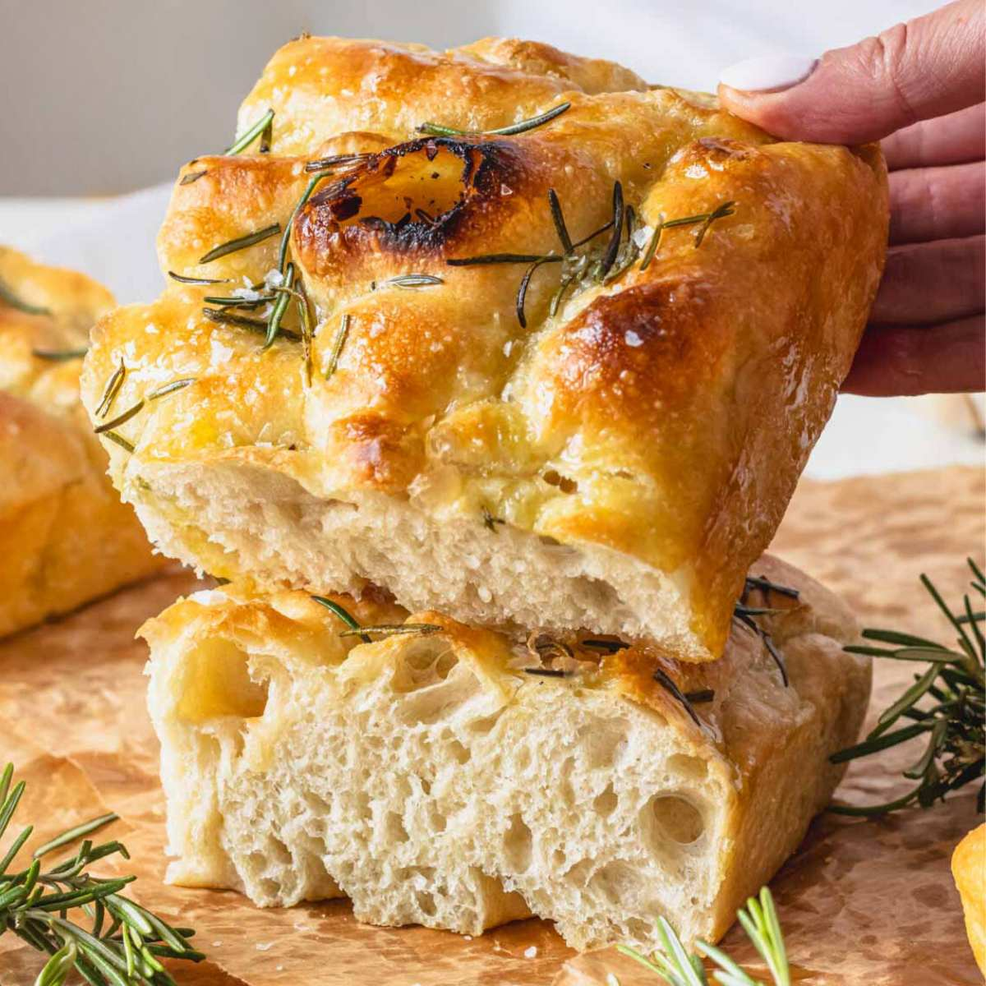
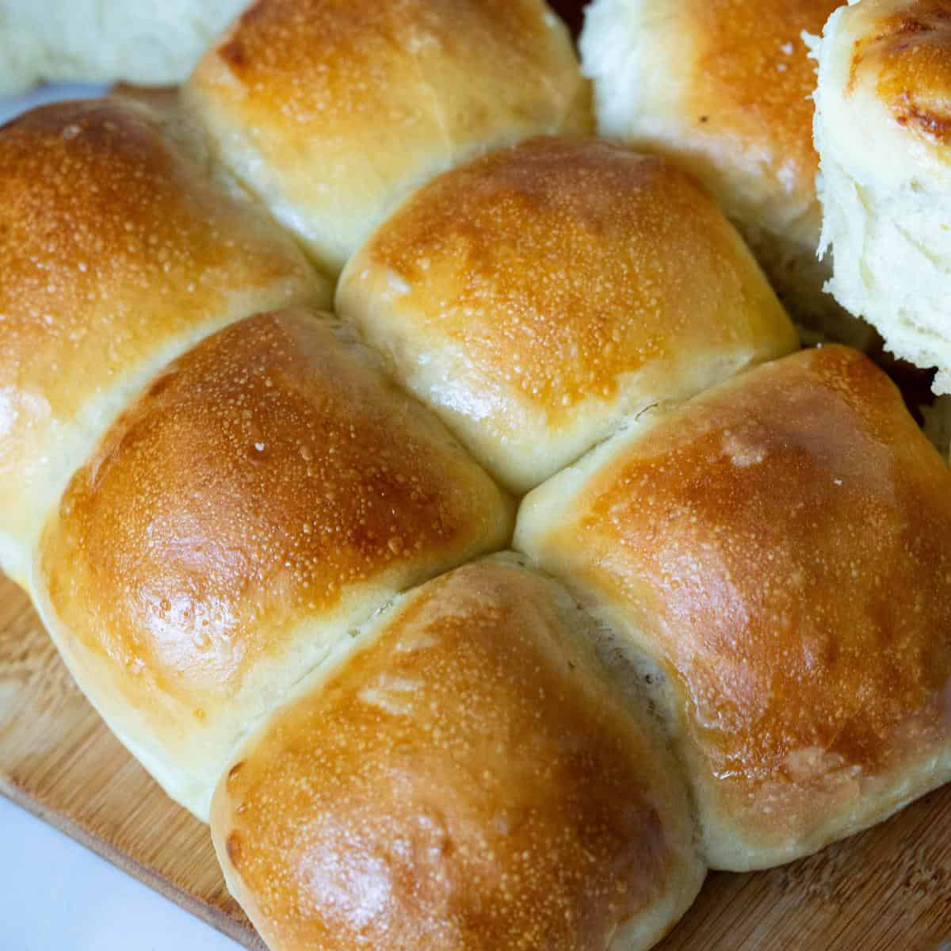
Skills & Expertise
Types of Breads
Basic Bread
Foccacia
Pav Buns

Slide 5
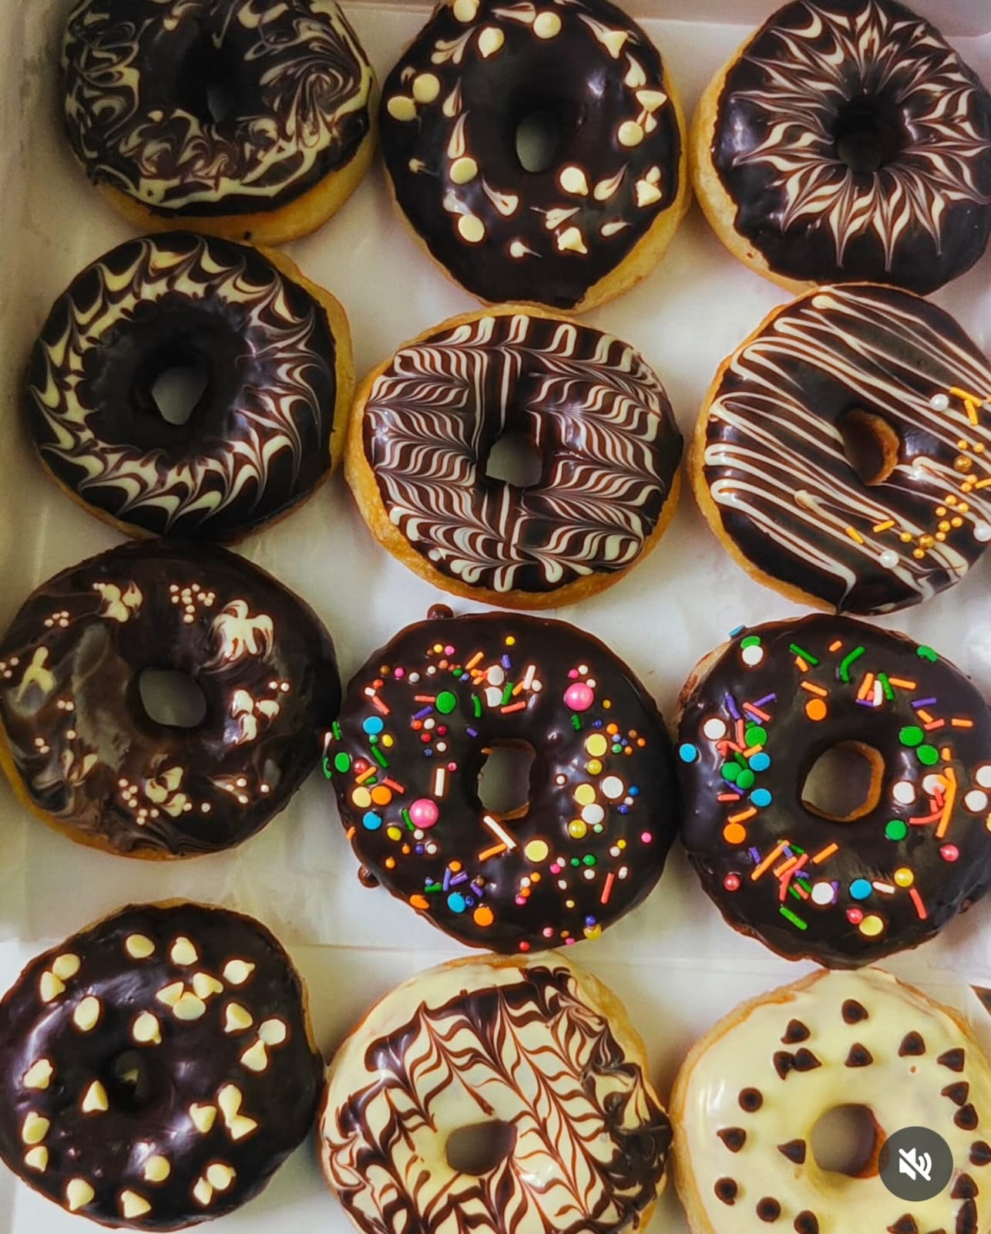
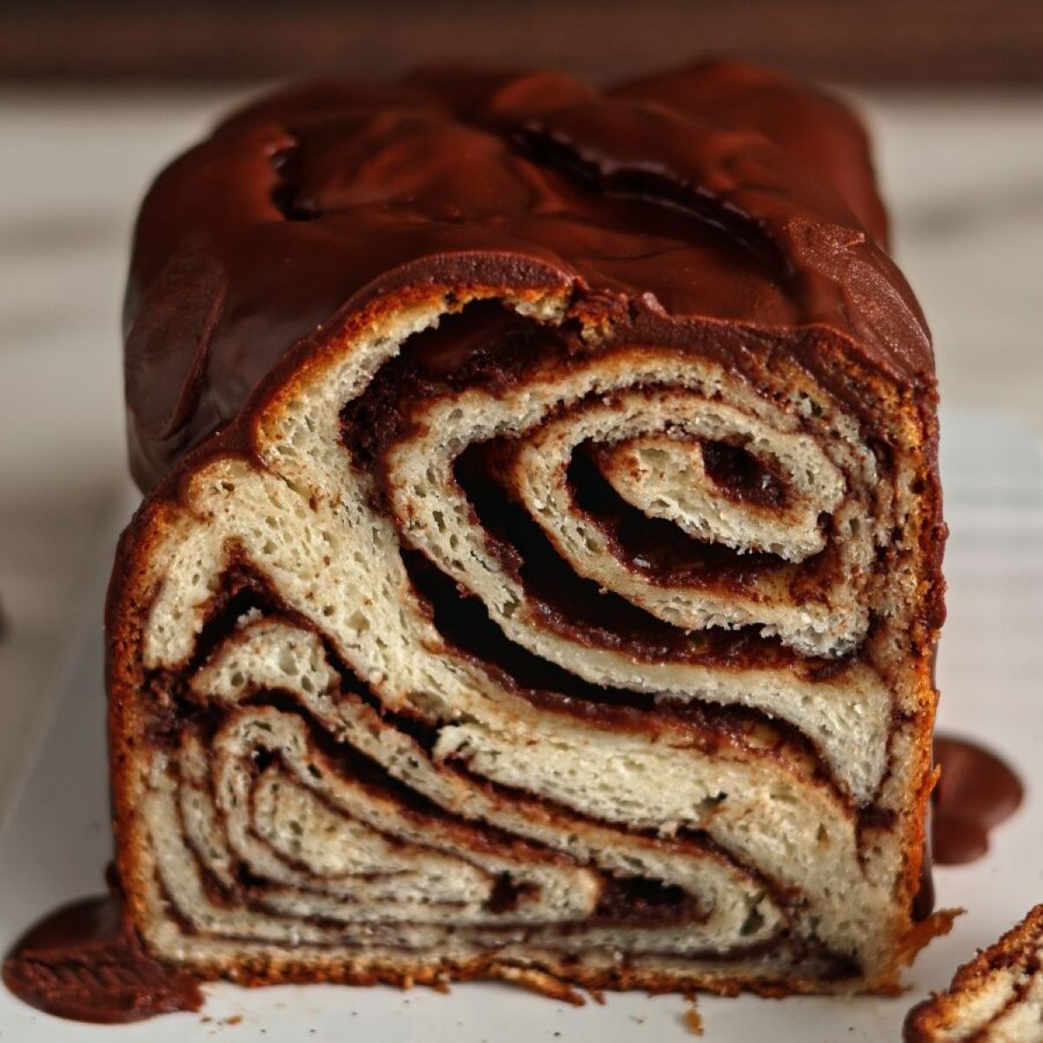
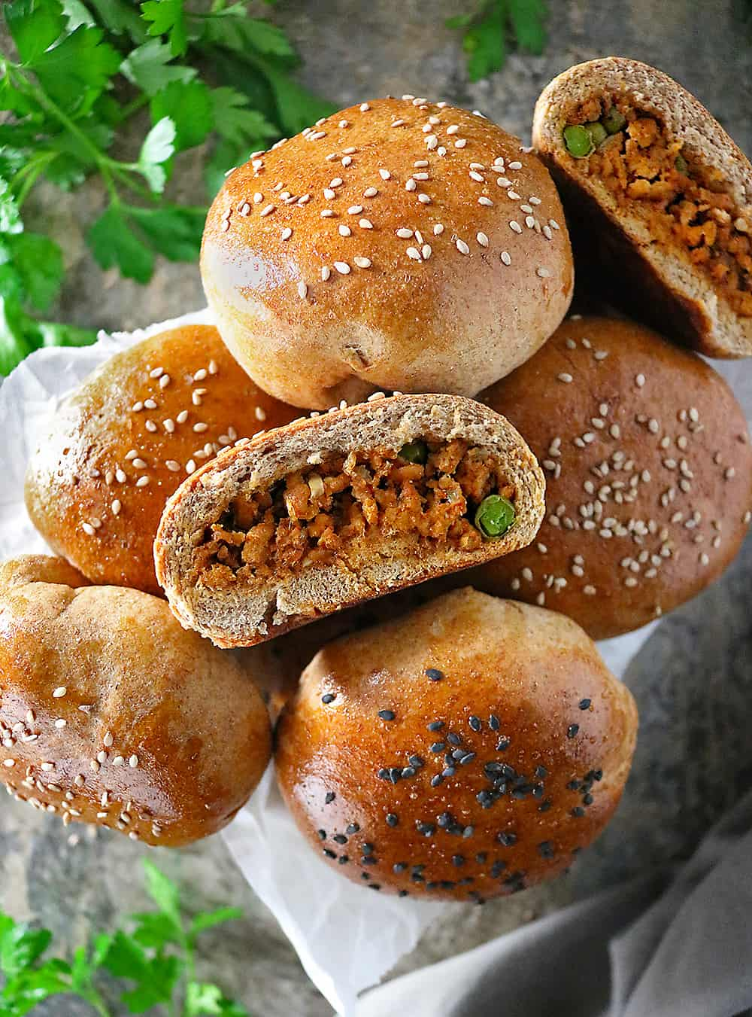
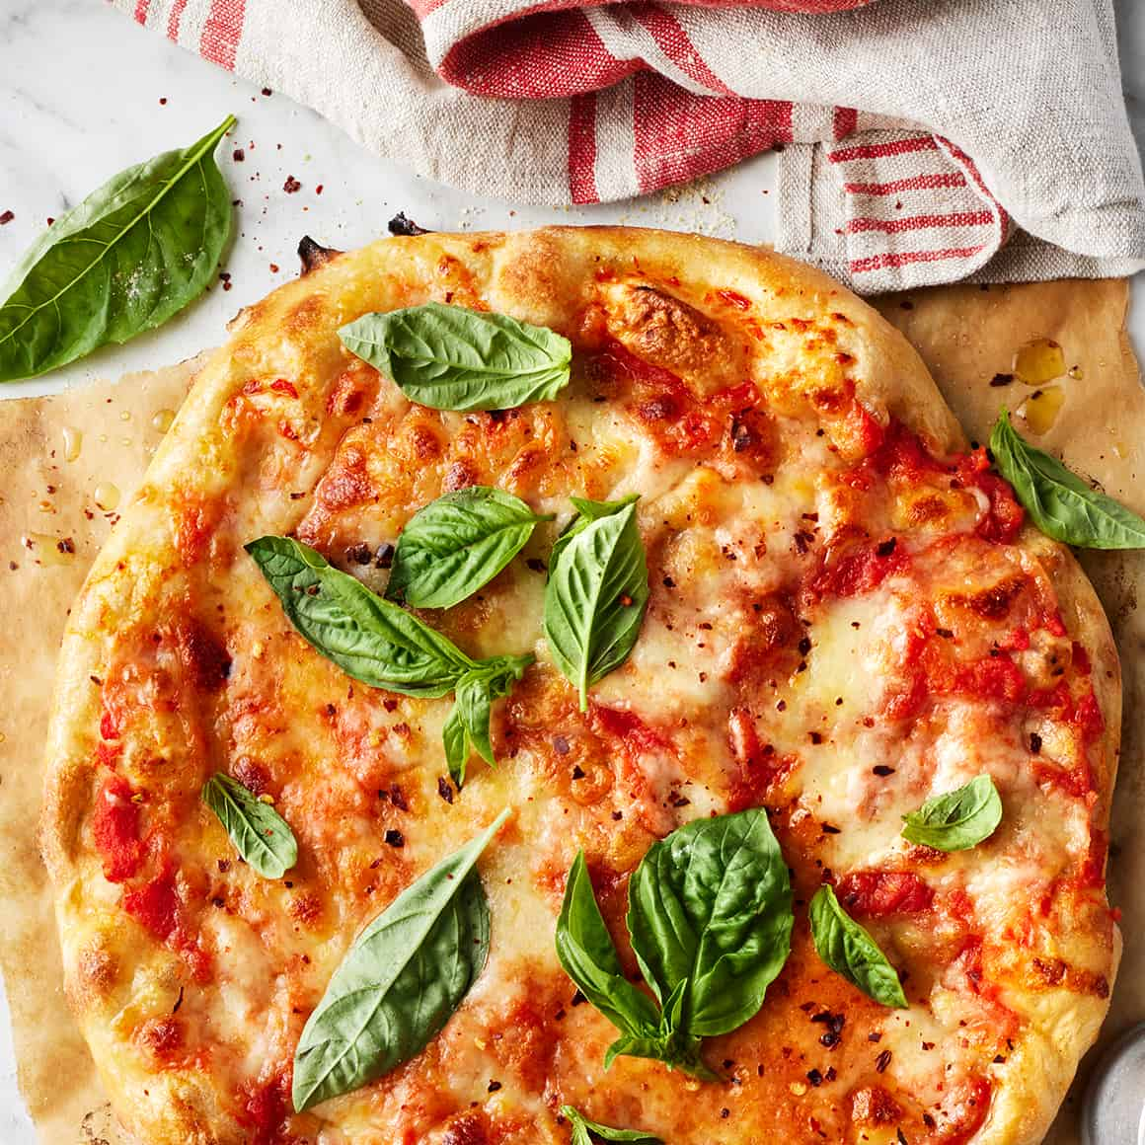
Types of Breads

Slide 6
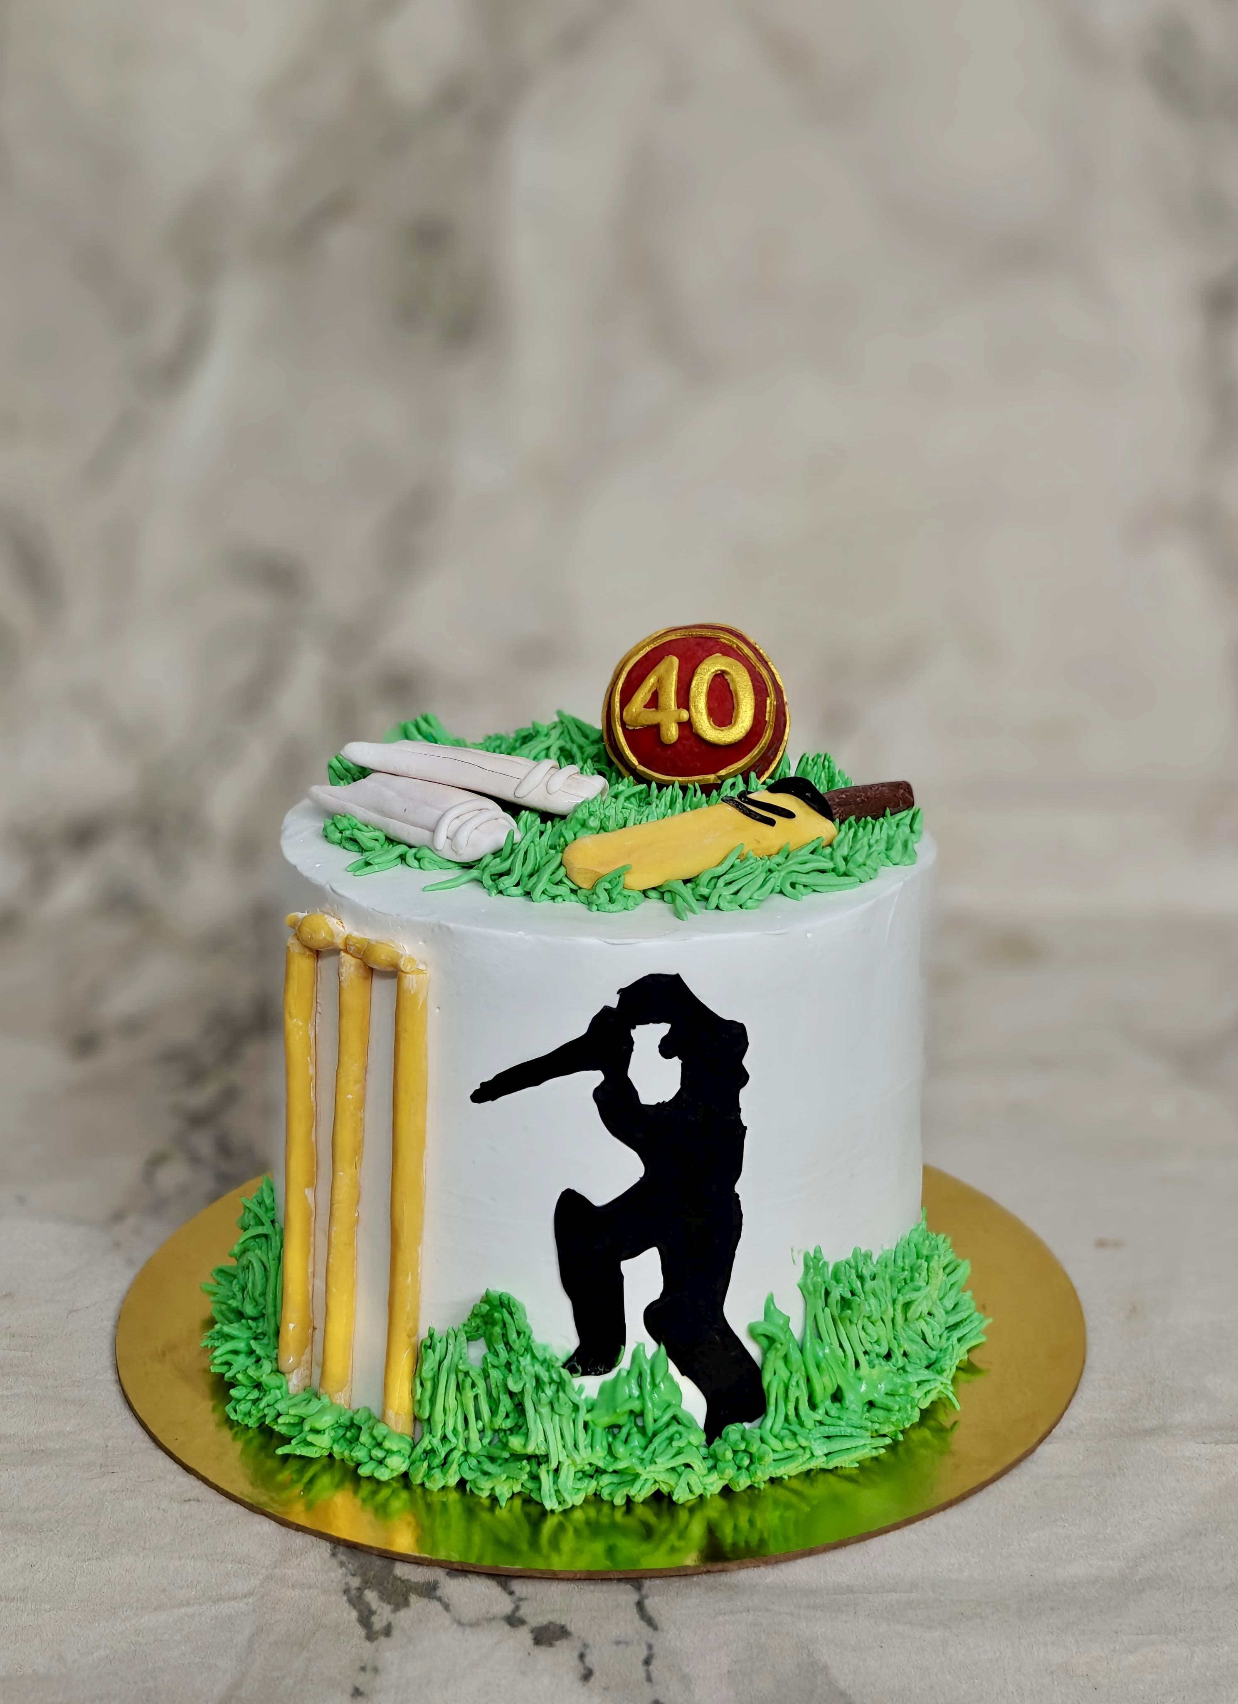
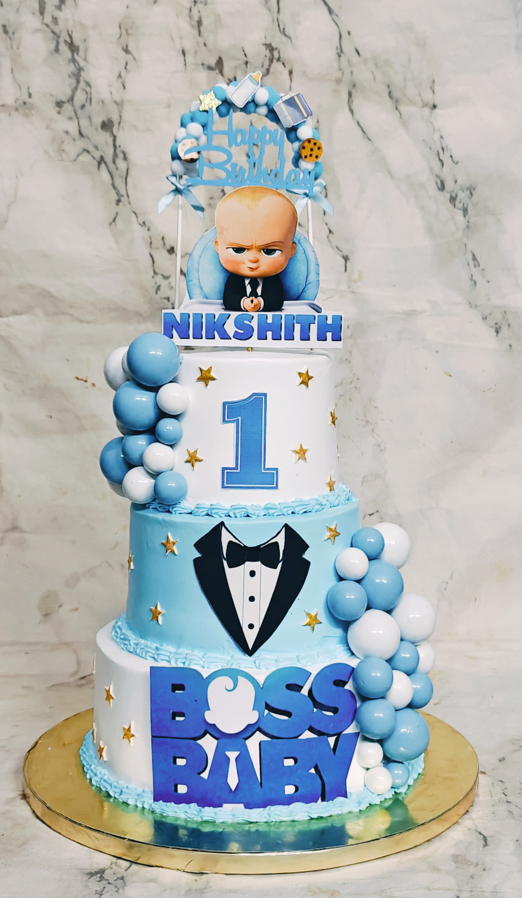
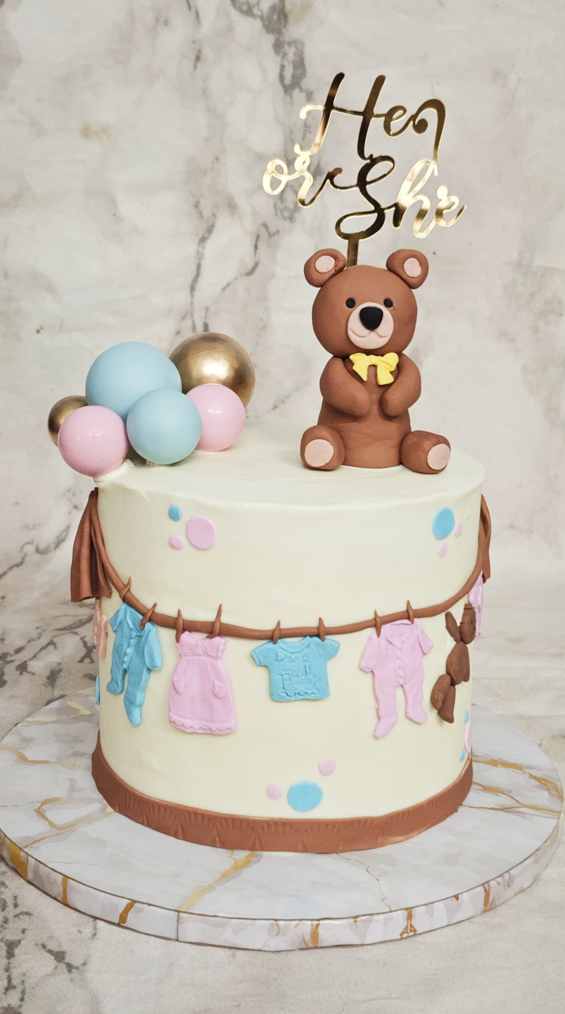
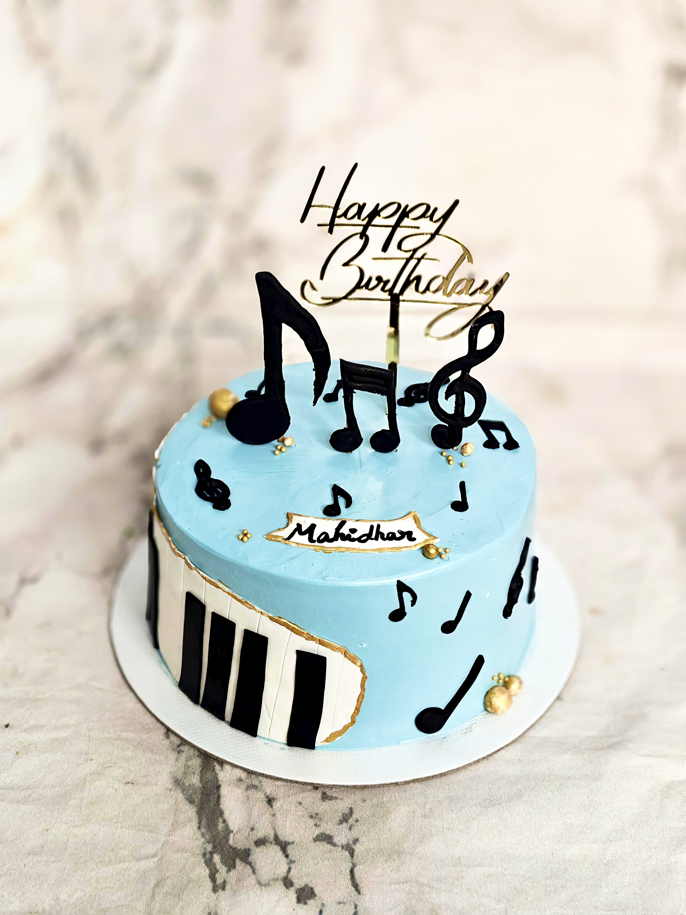
Theme cakes

Slide 7
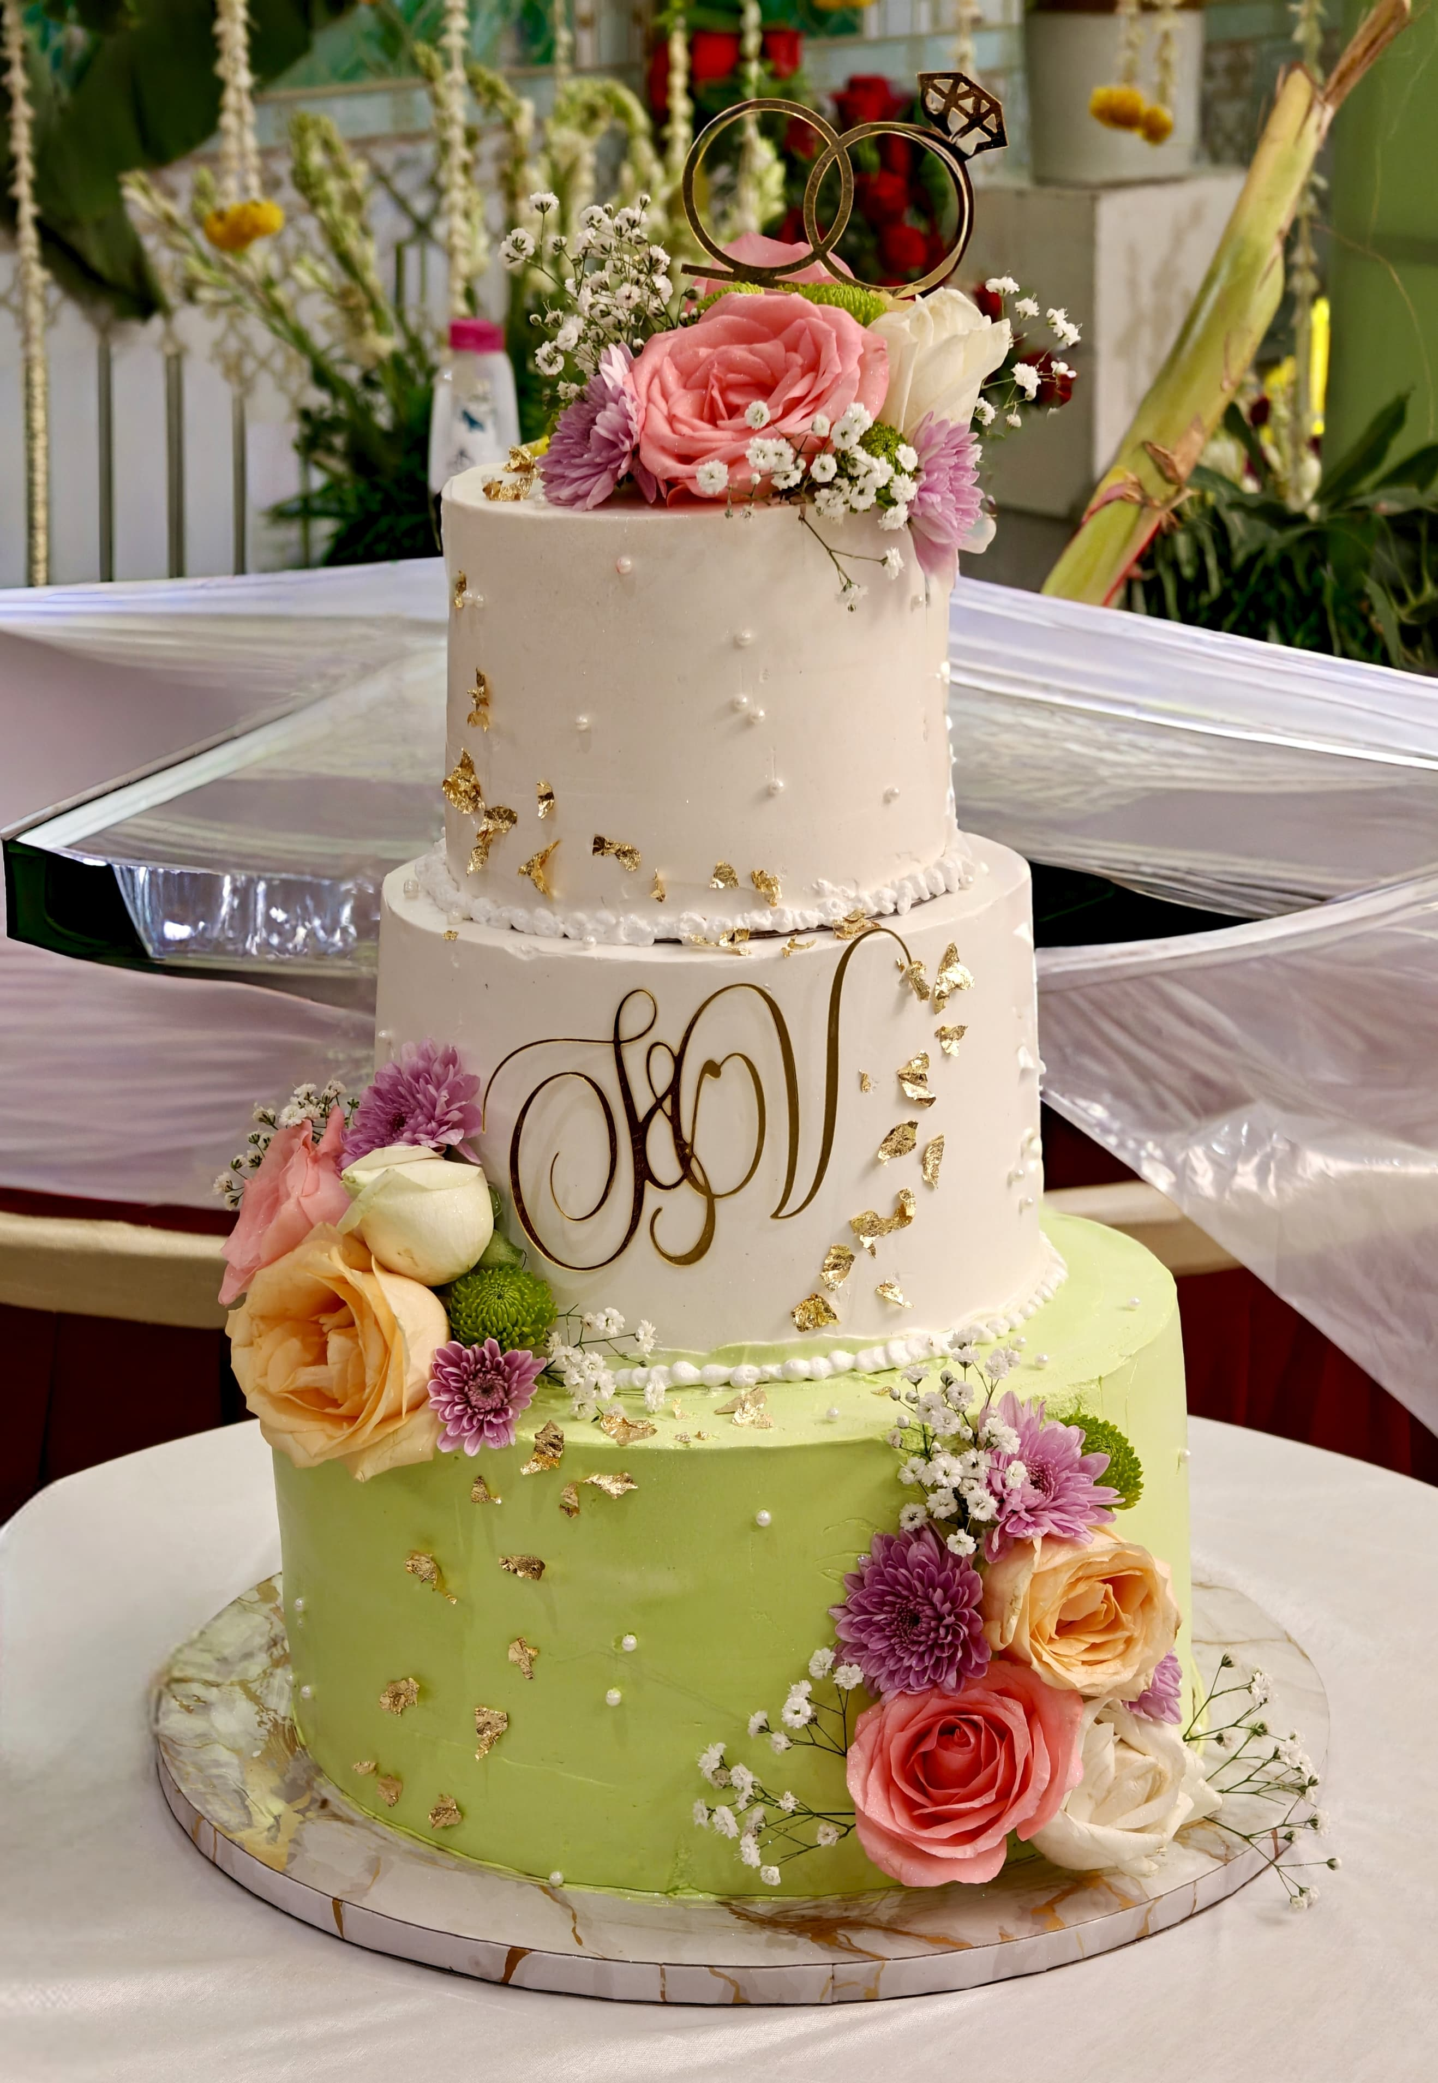
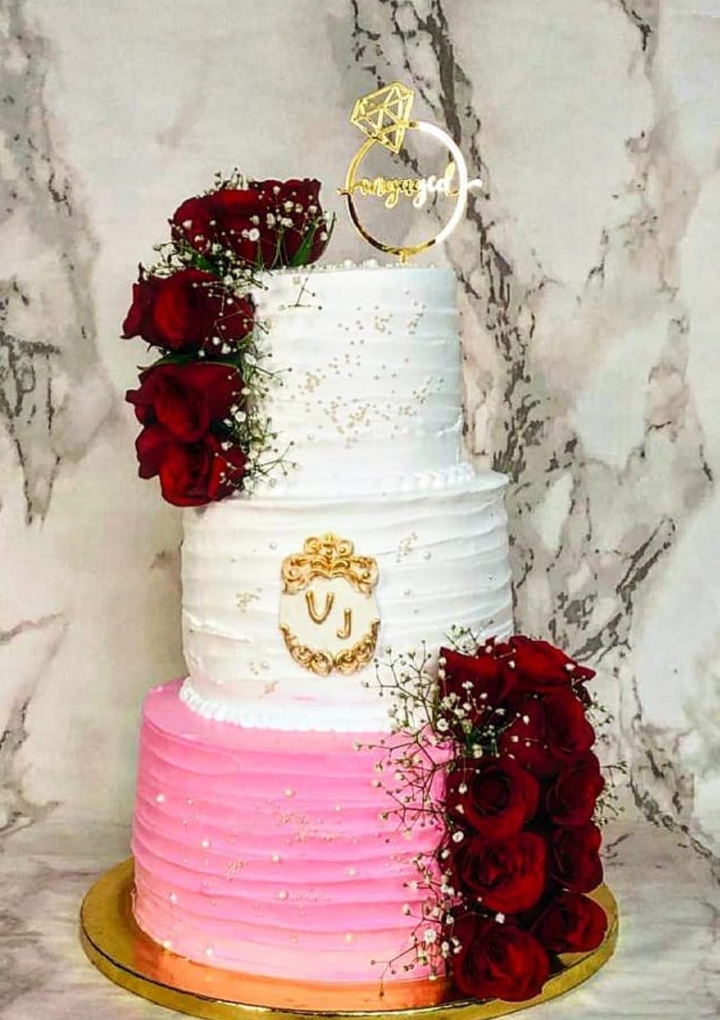
Wedding cakes
Three tier Wedding cakes decorated with fresh flowers.

Slide 8
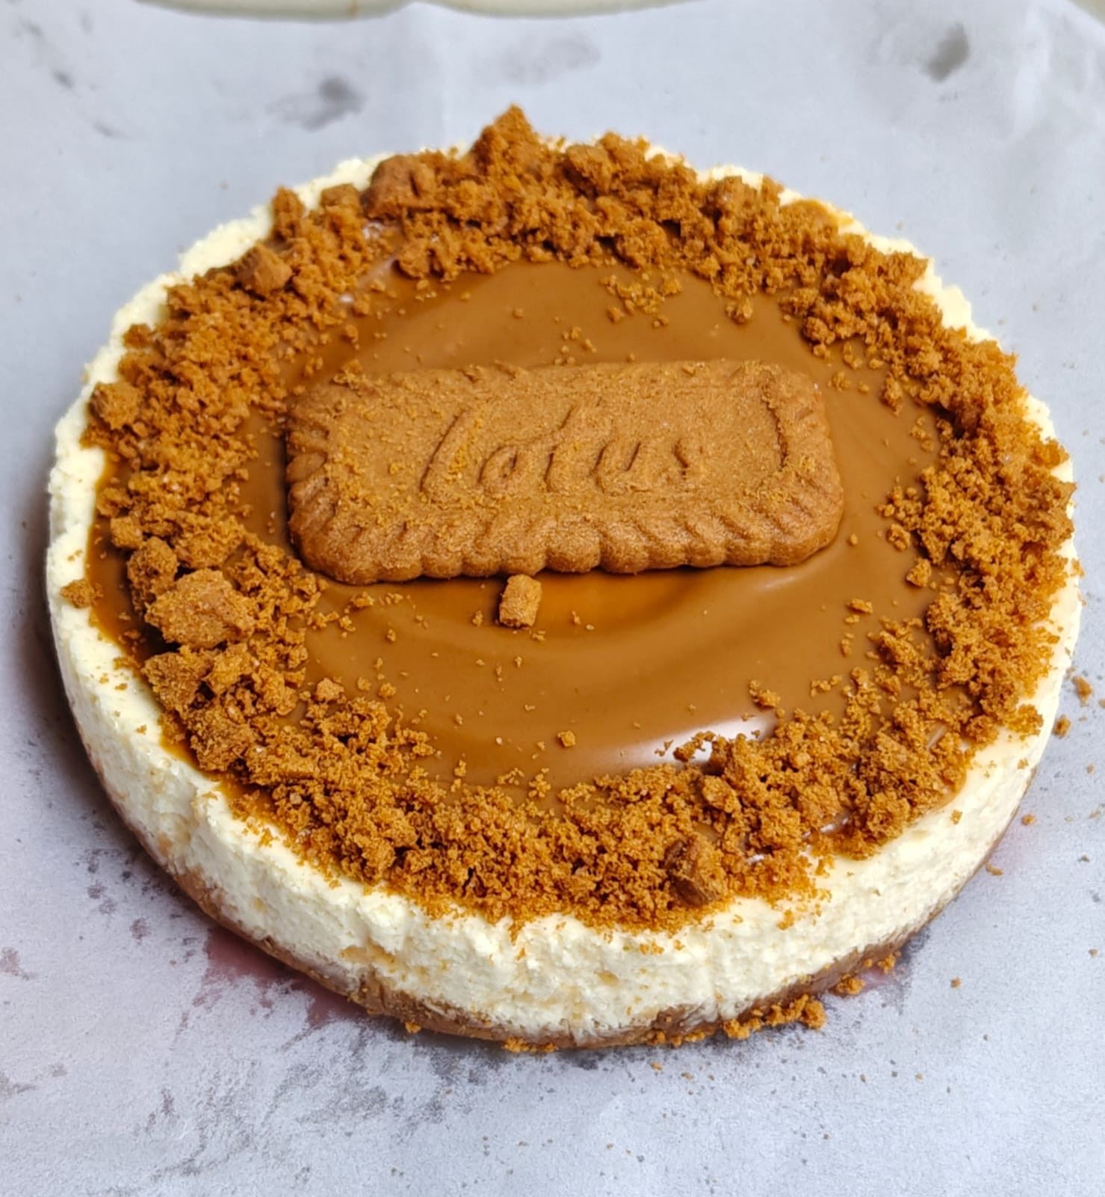
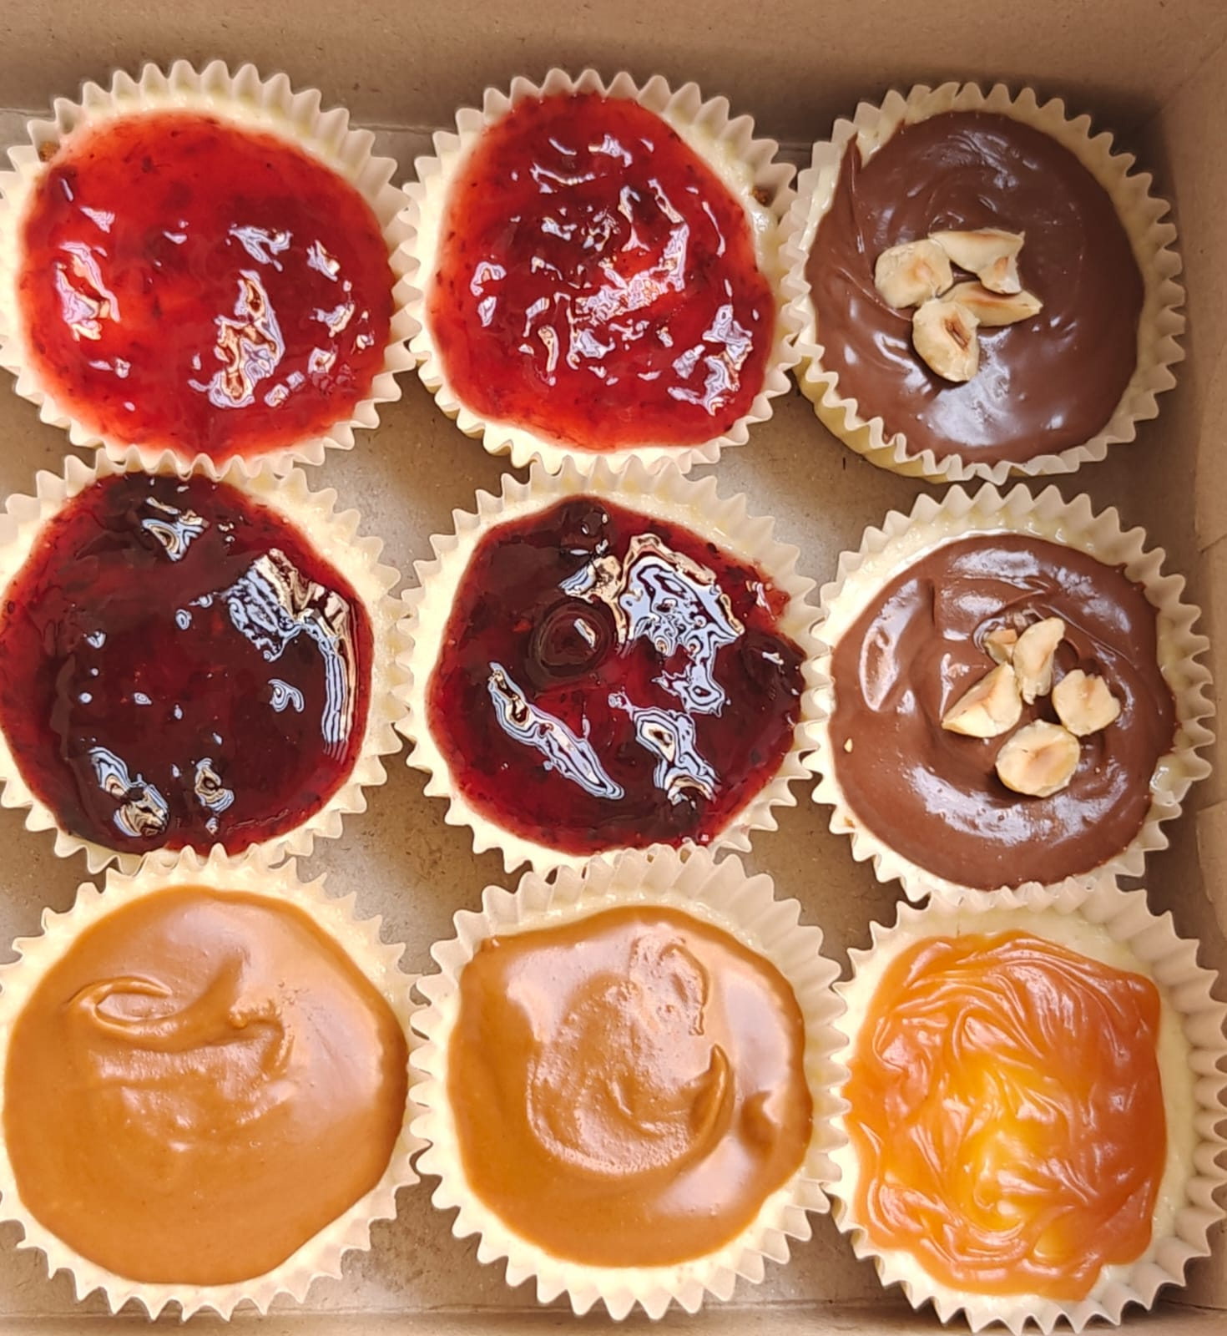
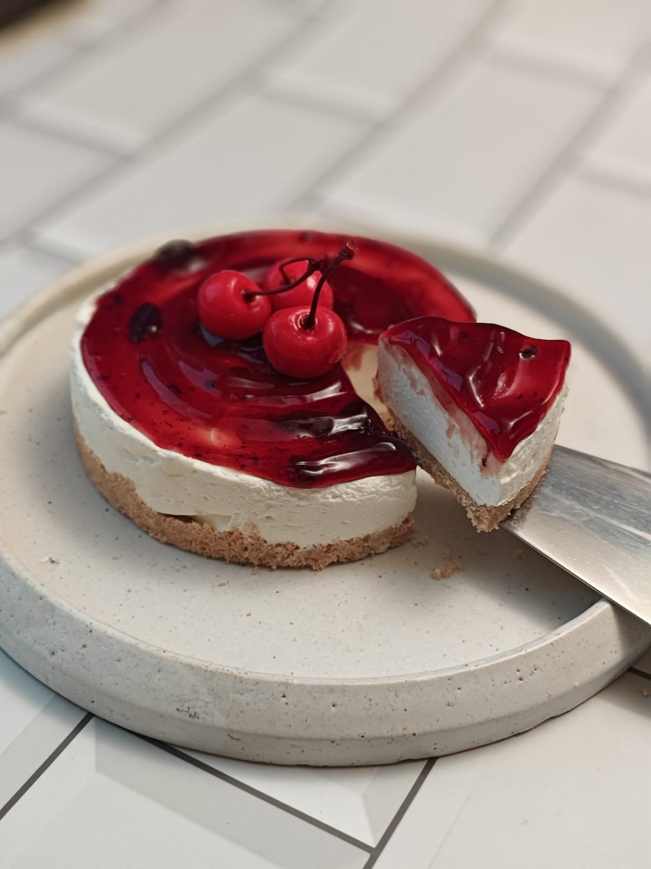
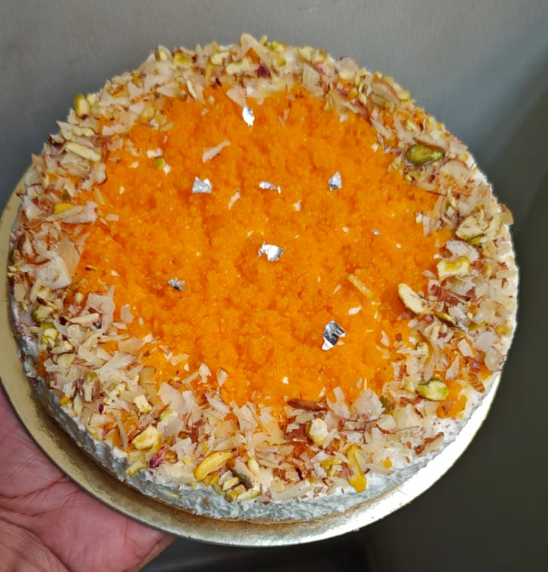
Cheese cakes
Lotus Biscoff
Assorted Cheesecakes
Cherry cheesecake
Motichoor cheesecake

Slide 9
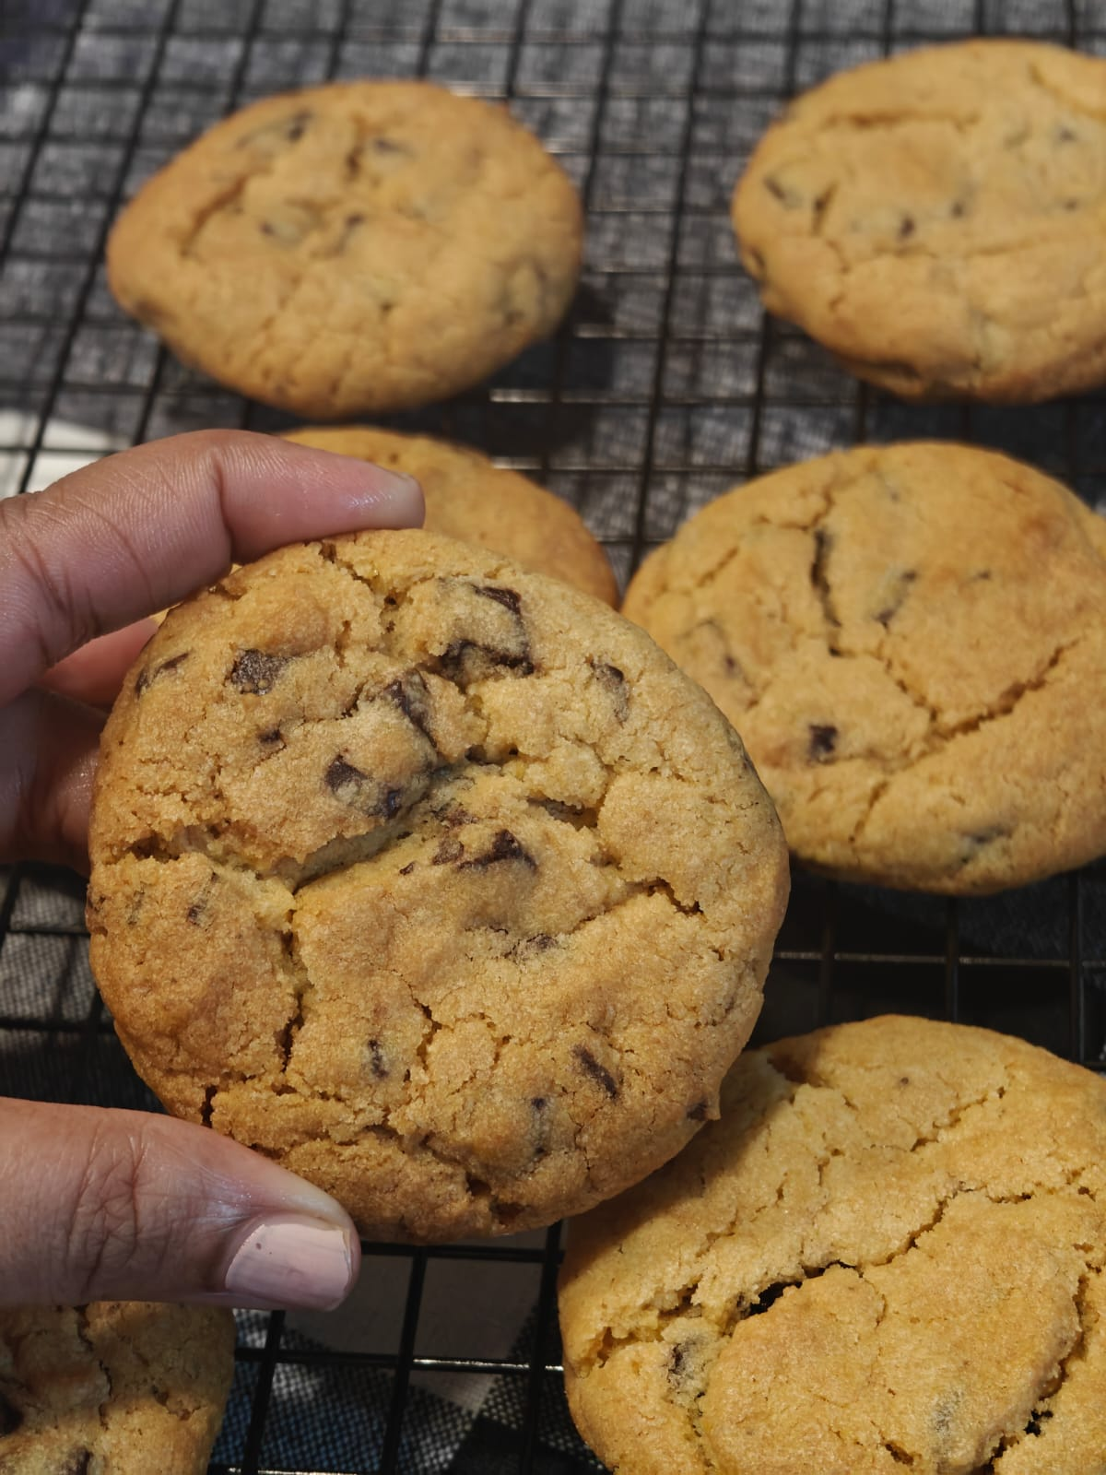
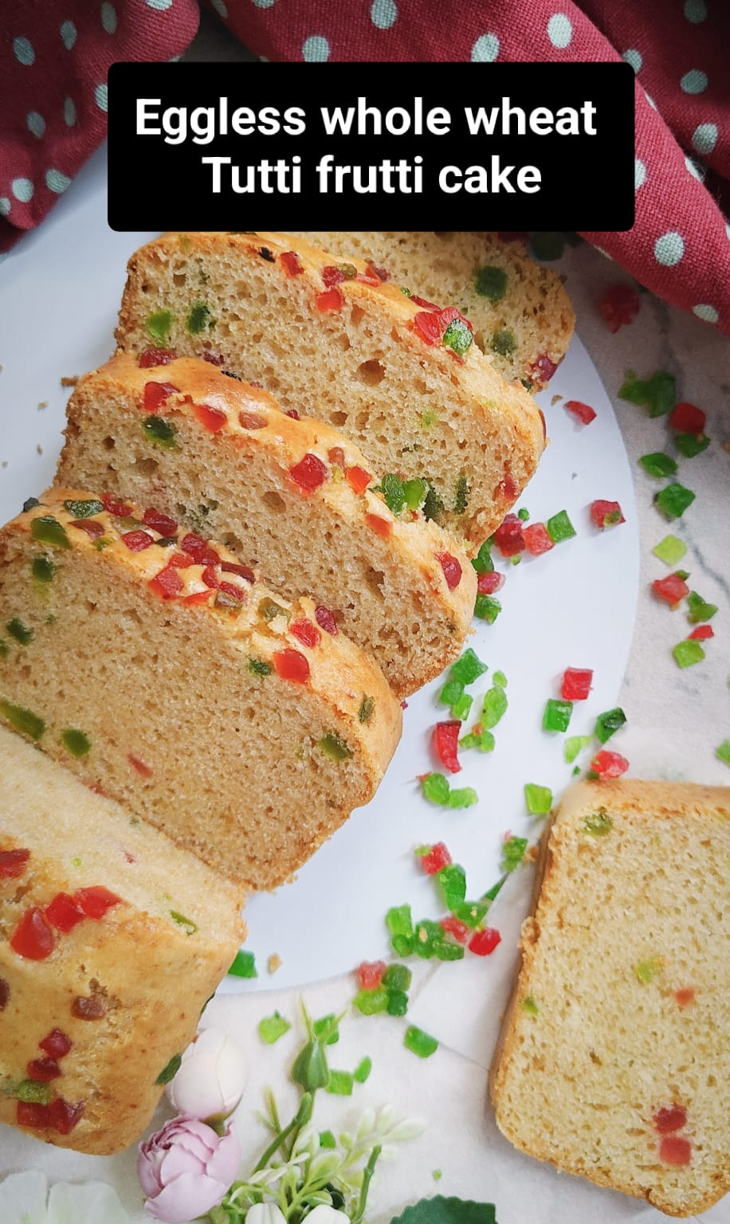
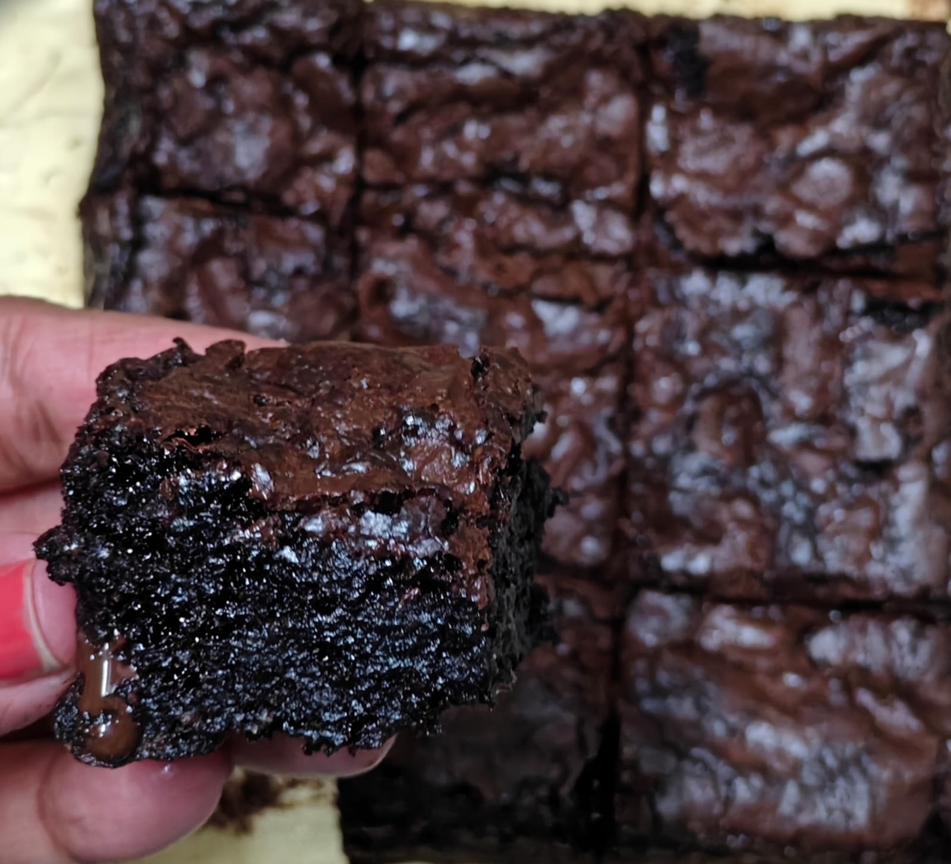
Healthy Bakes
I also Make healthy desserts without maida and processed sugar like Ragi brownies, whole wheat jaggery teacakes, healthy cookies etc.

Slide 10
Acknowledgement
I believe that every pastry tells a story and I look forward to share my passion and knowledge of baking and food with you!

