Slide 1

University of Dhaka
Mobile Phone Technology in Academic Library Services: A Public University Students’ Perceptions and Paradigm
Md. Anwarul Islam
Assistant Professor
Department of Information Science and Library Management
University of Dhaka, Dhaka-1000, Bangladesh
E-mail: anwar81du@gmail.com

Slide 2

Mobile Phone Technology in Academic Library Services: A Public University Students’ Perceptions and Paradigm
Content ……….
Prologue
Objectives of the study
Mobile phone in Bangladesh
Mobile phone based information services in Bangladesh
Wireless application in education and library and information services

Slide 3
Mobile Phone Technology in Academic Library Services: A Public University Students’ Perceptions and Paradigm
Continue ……….
Methodology
Findings and discussion
Conclusion and future works ……

Slide 4
Mobile Phone Technology in Academic Library Services: A Public University Students’ Perceptions and Paradigm
Technology in today’s modern society is constantly evolving at a rapid pace. Tech savvy, consumers are demanding access to information and instantaneous communication on portable devices such as smart phones and personal digital assistants (PDAs) (Pollara & Broussard, 2011).
This devices has made access to information very convenient and timely to the users from the comfort of their own home, office and from where ever they are!

Slide 5
Mobile Phone Technology in Academic Library Services: A Public University Students’ Perceptions and Paradigm
The world is fast becoming a global village and a necessary tool for this process is communication where telecommunication is a key player.
Over the past decade, the expansion of mobile cellular networks and popularization of mobile phones have been driving growth in information and communications technology (ICT) in Asia and the Pacific, and the world.

Slide 6
Mobile Phone Technology in Academic Library Services: A Public University Students’ Perceptions and Paradigm
China and India, these two countries simply added
284 millions in 2009 and
660 millions in 2011 (ITU, 2011).

Slide 7
Mobile Phone Technology in Academic Library Services: A Public University Students’ Perceptions and Paradigm
Objectives of the study
To identify the existing status of mobile phone, mobile phone based information services in Bangladesh;
This study seeks to explore the utilization of mobile phone services in the educational environment;
Explore the nature of mobile phone use among university students, and investigate the perception of university students on mobile phone uses in library and information services.

Slide 8
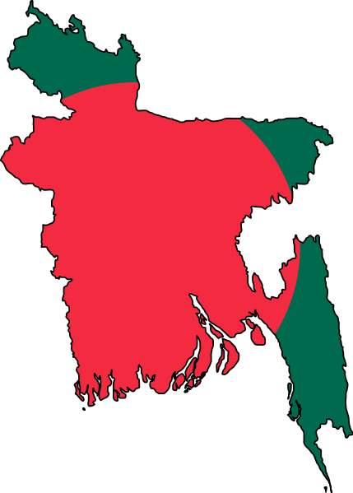
Mobile Phone Technology in Academic Library Services: A Public University Students’ Perceptions and Paradigm
Bangladesh : A Brief Description
Name: Peoples Republic of Bangladesh.
Capital: Dhaka
Location: Sothern Asia, sharing border by bay of Bengal, India and Myanmar.
Area: 143,998 sq km
Population : 15,2518015 (16-07-2012)
Literacy: 51.8%
Language: Most of the people speak in Bengali (However, English is widely spoken and used)
Religions: 89.5 % Muslim of the total population , others are Hindu, Buddhists, Christians and others.
Independence: 16 December 1971 (from West Pakistan)
Economy: Agrarian but readymade garments, textile, fisheries, jute products, pharmaceuticals, tea and leather goods are also major industries.
Natural resources: natural gas, arable land, timber, coal

Slide 9
Mobile Phone Technology in Academic Library Services: A Public University Students’ Perceptions and Paradigm
Mobile phone in Bangladesh
Bangladesh is one of the few countries in the world that can guarantee each one of its residents can get a cellphone signal - no matter where they are in the country with a population of over 150 million (BBS, 2012).
Citycell is the first cellular company in Bangladesh started operation in 1996.

Slide 10
Mobile Phone Technology in Academic Library Services: A Public University Students’ Perceptions and Paradigm
Continued…..
GrameenPhone (Widely known as GP) is the second operator that start their operations in 1997. It is a joint venture enterprise between Telenor and Grameen Telecom Corporation, a non-profit sister concern of the internationally acclaimed microfinance organization and community development bank name as ‘Grameen Bank.’

Slide 11

Mobile Phone Technology in Academic Library Services: A Public University Students’ Perceptions and Paradigm
In 2006, first Bangladeshi Professor Muhammad Younus and Grameen received the Nobel Peace Prize for the economic and social development . PalliPhone (Rural phone, a service of grameenphone for the rural people) was the first mobile tools that reached to the rural women in Bangladesh.

Slide 12
Mobile Phone Technology in Academic Library Services: A Public University Students’ Perceptions and Paradigm
Continued …..
The total number of Mobile Phone subscribers now has reached 94.714 million at the end of July 2012 (BTRC, 2012).
At present, there are six mobile phone operators are providing mobile phone services in Bangladesh. There name , subscribers are presented in the table. (Table: 1)

Slide 13
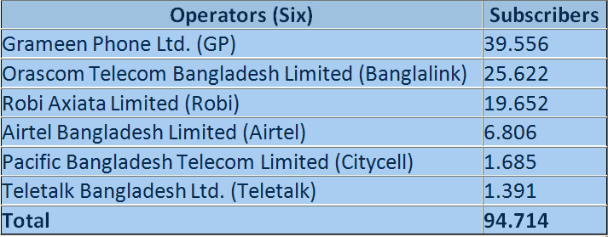
Mobile Phone Technology in Academic Library Services: A Public University Students’ Perceptions and Paradigm
Table 1: Mobile phone operators & users in Bd.

Slide 14
Mobile Phone Technology in Academic Library Services: A Public University Students’ Perceptions and Paradigm
Continued …..
In Bangladesh, 3G is still considered underway. Several major telecommunication operators GrameenPhone, Banglalink, Robi, Airtel, Citycell and government owned Teletalk have been granted the license to operate the new 3G standard. Teletalk has launched its 3G based services in the mid of July 2012 and with no other operator able to launch until late-September (Teletalk, 2012).

Slide 15
Mobile Phone Technology in Academic Library Services: A Public University Students’ Perceptions and Paradigm
Mobile phone based information services
In Bangladesh, mobile phones have become an important element of pilot and live programs across multiple urban development sectors. Primarily its an aid for;
Data collection, voice call
Information dissemination
Time savings
Decision making, data accuracy and so on.

Slide 16
Mobile Phone Technology in Academic Library Services: A Public University Students’ Perceptions and Paradigm
Continued …..
Through PushPull or assigned number dialing, six operators are providing the following services to their users (Charge applicable);
News services as latest news from BBC, CNN and domestic private TV channels news.
Weather information , weather update to its users who request for weather update services.
Namaz alerts, providing prayer times information for the Muslim community.

Slide 17
Mobile Phone Technology in Academic Library Services: A Public University Students’ Perceptions and Paradigm
Continued ….
Health line service: Health line is a unique service that provides medical consultation and services to patients 24 hours a day 7 days a week over the mobile phone. At present Banglalink and GrameenPhone are providing health line service.
Primary health care;
emergency;
Doctor, medical facilities in clients areas;
Report consultation

Slide 18
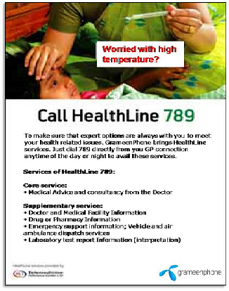
Mobile Phone Technology in Academic Library Services: A Public University Students’ Perceptions and Paradigm
BDT 5/Minute
Received GSMA Award for ‘Best use of Mobile for Social and Economic Development’
Works as a lifeline for people in remote areas.
Making health care more accessible.

Slide 19
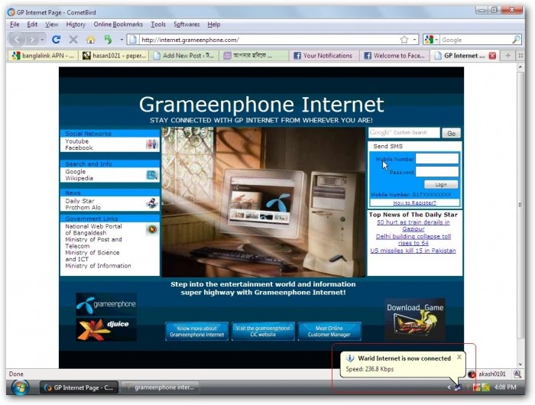
Mobile Phone Technology in Academic Library Services: A Public University Students’ Perceptions and Paradigm
Through CIC, GrameenPhone providing internet services for the rural communities.
Providing mobile internet
Different internet packages with suitable rate.

Slide 20
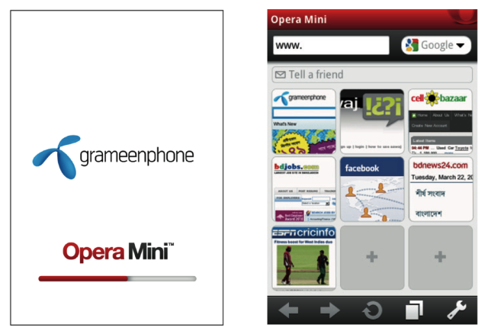
Mobile Phone Technology in Academic Library Services: A Public University Students’ Perceptions and Paradigm
Making internet services easier for the community people.
Providing SN services
Sports, entertainment and others.
Business & Commerce
Online shopping.

Slide 21
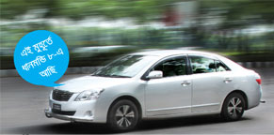
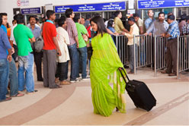
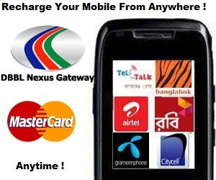
Mobile Phone Technology in Academic Library Services: A Public University Students’ Perceptions and Paradigm
GPS based Vehicle tracking!
E-ticketing (Only train)
E-banking

Slide 22
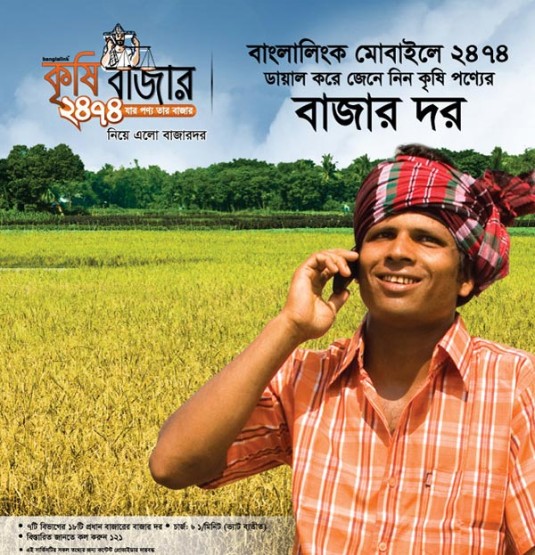
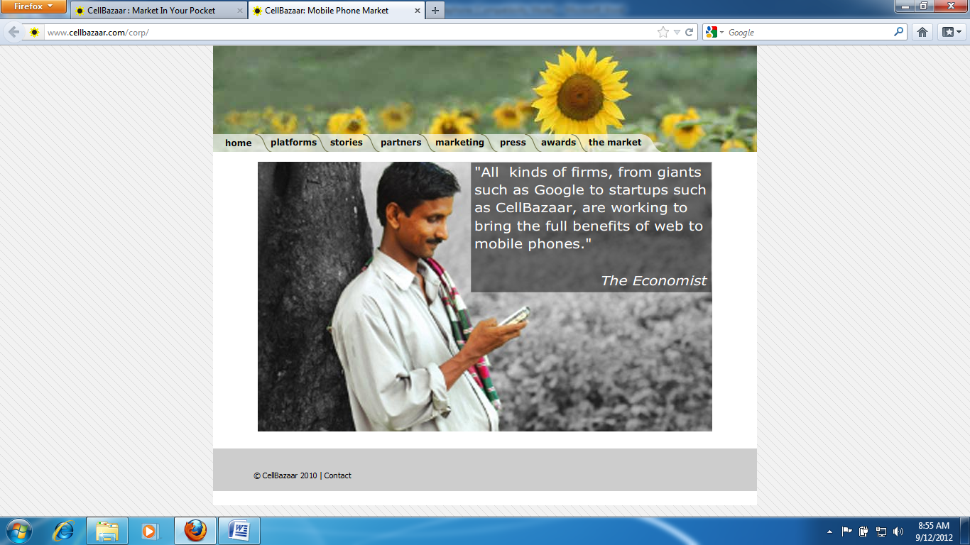
Mobile Phone Technology in Academic Library Services: A Public University Students’ Perceptions and Paradigm
Banglalink Jigyasha 7676, which provides agricultural information, vegetables, fruit farming, poultry and others.
CellBazaar (Market in your pocket)
Received GSMA global mobile award
Market place to buy and cell goods
5 million users are now
CellBazar processes 1000 posts per day (www.cellBazaar.com)

Slide 23

M4Health
Mobile Phone Technology in Academic Library Services: A Public University Students’ Perceptions and Paradigm
Grameenphone (GP) has joined an innovative new coalition to improve mother-infant health through a voice- and text messaging service. The service aims to reach 500,000 pregnant women and new mothers within three years
The M4H initiative is currently in its design and test phase to build a platform to provide both audio and text messages with vital information on antenatal, neonatal, and infant health. The messages will be linked to the women’s delivery dates, giving them critical information at the right stage in their pregnancy and early motherhood.

Slide 24
Mobile Phone Technology in Academic Library Services: A Public University Students’ Perceptions and Paradigm
Education and mobile services in Bangladesh
Bangladeshi educational environment, wireless application can take into various forms. The most basic services can be seen made in the form of information delivery such as; examination results, admission status, course registrations, etc., to their respective customers (i.e. students, faculty members and staffs, vendors, etc.).

Slide 25
Mobile Phone Technology in Academic Library Services: A Public University Students’ Perceptions and Paradigm
Continued…..
Common services are information queries and deliveries via sms. Some WAP applications have been observed especially in the European countries. The University of Northumbria UK, for instance, has been providing campus wide information and various other administrative services to the respondents through WAP services (http:// Northumbria.ac.uk).

Slide 26
Mobile Phone Technology in Academic Library Services: A Public University Students’ Perceptions and Paradigm
Continued
Mayer (2002) has introduced several steps through which institutions may follow in providing SMS services;
Lectures, meeting schedule, exam dates, academic information;
Crucial homework reminders;
Urgent messaging;
Announcement and
Changes in schedule.

Slide 27
Mobile Phone Technology in Academic Library Services: A Public University Students’ Perceptions and Paradigm
Continued ……
Many higher academic institutions in Bangladesh have been providing various wireless phone based services (Table: 2).
Yerulshalmy and Ben-Zaken(2004) shows the potential for educational applications is huge. Students use updated educational applications on their phones, share their learning process and outcomes, without being in the same physical place and they may get personal tailored exams and quizzes on their cellular phones.

Slide 28
Mobile Phone Technology in Academic Library Services: A Public University Students’ Perceptions and Paradigm
T
Table 2: Universities and mobile services (Bangladesh)
¹ Dhaka Univeristy, ² Jagannath Univeristy, ³ Jahangirnagar university,
⁴ Bangladesh Univeristy of Engineering and Technology and ⁵ Rajshahi Univeristy.
Services | DU¹ | JU² | JU² | BAU³ | BUET⁴ | RU⁵
Exam result | ● | ● | ● | ● | ● | ●
Admission process | ● | ● | ● | ● | ● | ●
Student intake information |  | ● | ●
Registration | ● | ● | ●
Class schedule
Date and venue of exam | ● | ● | ● | ● | ● | ●
Help desk
Complaints
Campaign | ● | ● | ● | ● | ● | ●
News

Slide 29
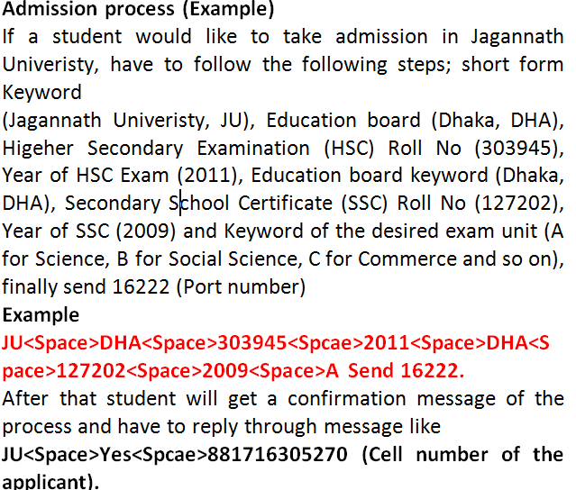
Mobile Phone Technology in Academic Library Services: A Public University Students’ Perceptions and Paradigm

Slide 30
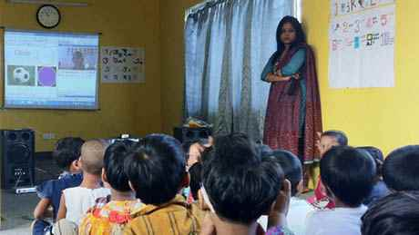
Continued…..
Mobile Phone Technology in Academic Library Services: A Public University Students’ Perceptions and Paradigm
GrameenPhone partners with JAAGO Foundation to bring the classroom to remote areas of Bangladesh via the Internet
Pilot project launched in Tongi, outside Dhaka last December.
Online school creates a classroom for children who are deprived of quality education in remote Bangladesh

Slide 31
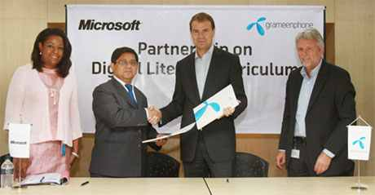
Continued…..
Mobile Phone Technology in Academic Library Services: A Public University Students’ Perceptions and Paradigm
In November 2009, GrameenPhone partnered with Microsoft to increase digital literacy among the rural people in Bangladesh (IVR based services)
Microsoft’s Digital Literacy Curriculum is a well-established e-learning module which teaches people basic computer skills, helping them to develop new social and economic opportunities for themselves, their families and their communities.

Slide 32
Continued…..
Mobile Phone Technology in Academic Library Services: A Public University Students’ Perceptions and Paradigm
All the content of the curriculum is in Bengali and aimed particularly at rural students, unemployed youth and women.
The curriculum is disseminated through more than 500 authorized Community Information Centers (CICs) as well as through other vehicles of GrameenPhone initiatives – school cyclone shelters, Information Boats and other educational institutions – across Bangladesh.

Slide 33
Mobile Phone Technology in Academic Library Services: A Public University Students’ Perceptions and Paradigm
Mobile application on LIS services
Wireless technology has the potential to offer many new possibilities for accessing information from online catalogues, online databases, the internet and virtual libraries (Karim, Darus & Hussin, 2006)
Today, the convergence of mobile phones and the internet through the WAP standard presents libraries with a real opportunity to deploy wireless phone technology to manage their operations for the following services……

Slide 34
Mobile Phone Technology in Academic Library Services: A Public University Students’ Perceptions and Paradigm
Continued ………
checking records of books borrowed;
getting alerts on overdue books;
getting alerts on outstanding fines;
receiving reminders to return library items that will be due soon;
renewing library items;
reference enquiry services;
receiving text alerts to new resources on the library web site;

Slide 35
Mobile Phone Technology in Academic Library Services: A Public University Students’ Perceptions and Paradigm
Continued ………
getting alert on library event information;
getting information from the library opac/database; and
contacting librarian for help.
Currently, libraries are looking for ways to communicate with their users in such an effective manner. Although, the applications are limited to notification, very few libraries in Bangladesh are making the effort to use the wireless application services for such purposes.

Slide 36
Mobile Phone Technology in Academic Library Services: A Public University Students’ Perceptions and Paradigm
Continued ………
Fig: An outline of system X architecture

Slide 37
Mobile Phone Technology in Academic Library Services: A Public University Students’ Perceptions and Paradigm
Continued ………
Wireless application in library services can be established through an infrastructure that integrates the library systems and databases, through an application system that allows for information to be processed and delivered to a smaller device such as a mobile phone unit. Before offering this service, the library should list their subject and assign code against each subject and provide the code to the users.

Slide 38
Some examples are ;
For example to subscribe to the CAS user need to write ‘On CAS’ and send the message to 1000 number from his/her mobile.
On CAS
1000
After the user send message to 1000, a confirmation message will be sent to user mobile.
Congratulations. You have been subscribed to CAS. To unsubscribe write Off CAS and send to 1000. Taka 15 will be deducted from your mobile balance for this service for one month.

Slide 39
Mobile Phone Technology in Academic Library Services: A Public University Students’ Perceptions and Paradigm
Book renew services
If a user is on the move or is unable to go to the library when his/her issued book return time is ticking, Book renew service is a solution to this problem. To renew a book user need to write the ISBN no. and library member id and send to BOOK (2000). After the message is received by the server a confirmation message will be sent to the sender.

Slide 40
Confirmation message is to be sent to the user mentioning date of expire of the book.
1-85739-260-4, ID 306
2000
Your book entitled “Introduction to cataloguing and classification” by Margaret Mann is renewed for 21st days. It will expire on October 15, 2012.

Slide 41
Mobile Phone Technology in Academic Library Services: A Public University Students’ Perceptions and Paradigm
Methodology
Population and sample
The study was conducted on the students of Dhaka University, the oldest and largest public university in Bangladesh. The data from the study was gathered from the undergraduate and graduate students from two faculties, namely, the Faculty of Arts and Faculty of Social Science. Faculty of Arts has 16 and Social Science has 11 departments.

Slide 42
Mobile Phone Technology in Academic Library Services: A Public University Students’ Perceptions and Paradigm
Continued …..
For this study, students of the two departments have been selected namely from the department of Information Science and Library Management (ISLM), Faculty of Arts and department of Mass Communication and Journalism (MCJ), Faculty of Social Science. The total numbers of ISLM and MCJ students (237) of these two departments were considered as the research population.

Slide 43
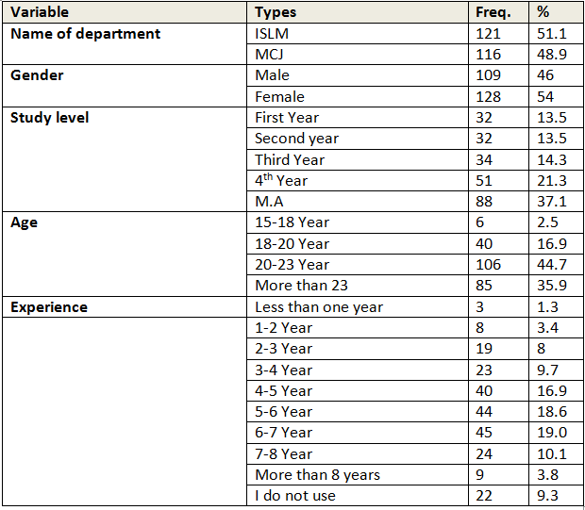
Table 3: Demographic information
Mobile Phone Technology in Academic Library Services: A Public University Students’ Perceptions and Paradigm

Slide 44
Mobile Phone Technology in Academic Library Services: A Public University Students’ Perceptions and Paradigm
Measurement and data collection
The study used a survey questionnaire for the purpose of data collection. For this survey, in early June 2012, the students of ISLM and MCJ were contacted in their scheduled classes and given an explanation of the study.
To maximize the response rate, students were advised that their responses would be completely anonymous and the data would only be used for the purposes of this study.

Slide 45
Mobile Phone Technology in Academic Library Services: A Public University Students’ Perceptions and Paradigm
Measurement and data collection
A printed version of questionnaire was distributed in their class period separately. The data collection for this study began in July 2012 and continued through last week of August, 2012.Out of these 290 questionnaires, 237 were returned, giving a response rate of 81.72%. Few responses that were either incomplete or contained skipped answers were dropped from the analysis.

Slide 46
Mobile Phone Technology in Academic Library Services: A Public University Students’ Perceptions and Paradigm
Continued …..
Since this study is dominantly descriptive in nature, the measurement of the mobile phone experience variables was made based on the mutually exclusive list of possible answers. The categories were elicited from a preliminary study conducted to identify the types of mobile phone services provided by the telecommunication providers.

Slide 47
Mobile Phone Technology in Academic Library Services: A Public University Students’ Perceptions and Paradigm
Continued …..
The questionnaire was pre-tested among good number of the students.
The data collected were analyzed dominantly using descriptive statistical analysis. The findings were presented in tables, percentages and frequency distributions.
The Statistical Package for Social Sciences (SPSS) was used for this purpose. A few inferential statistics were also performed to find out the relationships between variables.

Slide 48
Mobile Phone Technology in Academic Library Services: A Public University Students’ Perceptions and Paradigm
Findings and discussion
The respondents of this study were almost evenly distributed among the two academic programmes; ISLM (51 percent) and MCJ (48 percent). On the other hand, the distribution of the respondents was uneven in terms of year of study, gender and nationality. The majority of them were in their Masters Classes (37 percent), female (54 percent) and experience of using mobile phone 6-7 years 19%. (Table: 1)

Slide 49
Mobile Phone Technology in Academic Library Services: A Public University Students’ Perceptions and Paradigm
Fig. 1: Experience of using mobile phone N=237

Slide 50
Mobile Phone Technology in Academic Library Services: A Public University Students’ Perceptions and Paradigm
Fig. 2: Operator they use N=215

Slide 51
Mobile Phone Technology in Academic Library Services: A Public University Students’ Perceptions and Paradigm
It is apparent from the data that most of the students (87.8%) use prepaid plan and most of them (37.1%) spend more than 300 BDT/ per month. ( 1 Tk. =85 US$)
The result may have proven otherwise if the respondents were the academic faculty members. This is perhaps due the fact that the respondents did not earn a fix income.

Slide 52
Mobile Phone Technology in Academic Library Services: A Public University Students’ Perceptions and Paradigm
Table 4: Awareness of wireless phone services N=237
The respondents were also distributed according to their awareness and use of wireless application services available via their mobile phones (Table 4).
Application services | Frequency | Percentage
SMS | 198 | 83.5
GPRS | 78 | 32.9
MMS | 70 | 29.5
WAP | 67 | 28.3

Slide 53
Mobile Phone Technology in Academic Library Services: A Public University Students’ Perceptions and Paradigm
In case of multiple wireless services, it is apparent from the calculation in Table 5.
Table 5: Multiple services
Service types | Frequency | %
0 | 22 | 9.3
1 | 87 | 36.7
2 | 72 | 30.4
3 | 42 | 17.7
4 | 14 | 5.9
Total | 237 | 100

Slide 54
Mobile Phone Technology in Academic Library Services: A Public University Students’ Perceptions and Paradigm
Table 6: Information services made available via sms, mms, wap, gprs
Information services | Frequency | %
News | 143 | 60.3
Sports | 87 | 36.7
Banking | 44 | 18.6
Ticketing | 36 | 15.2
Entertainments | 92 | 38.8
Games | 65 | 27.4
E-mail | 95 | 40.1
Others | 63 | 26.6

Slide 55
Mobile Phone Technology in Academic Library Services: A Public University Students’ Perceptions and Paradigm
Table 7: Frequency of library visits
Variables | Frequency | Percentage
Everyday | 37 | 15.6
Few days a week | 60 | 25.3
Once a week | 28 | 11.8
If needed | 109 | 46.0
Once a month | 3 | 1.3
Total | 237 | 100.0

Slide 56

Mobile Phone Technology in Academic Library Services: A Public University Students’ Perceptions and Paradigm
Table 8: Purposes of library visit (%)
Purpose of library visit | Never | Seldom | sometimes | Often | Always | Mean | SD
Search for assignment | 3.8 | 8 | 44.3 | 25.3 | 18.6 | 3.47 | 1.01
Borrow or return books | 24.1 | 18.1 | 35 | 15.6 | 7.2 | 2.64 | 1.21
Read for test or exam | 1.7 | 13.5 | 27 | 32.5 | 25.3 | 3.66 | 1.05
Discuss with group study | 10.5 | 27.4 | 29.1 | 23.6 | 9.3 | 2.94 | 1.14
Use the internet facility | 24.5 | 22.8 | 29.5 | 15.6 | 7.2 | 2.58 | 1.22
Know current global news | 20.3 | 22.8 | 26.6 | 20.7 | 9.7 | 2.77 | 1.26
Audio visual materials | 44.3 | 19.8 | 19 | 14.3 | 2.1 | 2.1 | 1.18
Ask questions to librarin | 21.1 | 23.2 | 31.6 | 18.1 | 5.9 | 2.65 | 1.17
Others | 11.8 | 30 | 29.1 | 22.4 | 6.8 | 2.82 | 1.11

Slide 57
Mobile Phone Technology in Academic Library Services: A Public University Students’ Perceptions and Paradigm
Figure 3 : Use of mobile phone in academic library services

Slide 58
Mobile Phone Technology in Academic Library Services: A Public University Students’ Perceptions and Paradigm
Table 9: Borrowing books (%)
Methods of borrowing | Never | Seldom | sometimes | Often | Always | Mean | SD
Using OPAC | 40.9 | 13.1 | 20.7 | 17.3 | 8 | 2.38 | 1.36
Library website | 27.4 | 15.6 | 26.2 | 15.6 | 15.2 | 2.76 | 1.4
Through circulation counter | 11.8 | 15.6 | 24.9 | 28.7 | 18.6 | 3.27 | 1.27
Information desk | 14.8 | 22.8 | 26.2 | 25.7 | 10.5 | 2.95 | 1.23
Others | 19 | 14.3 | 36.7 | 20.3 | 9.3 | 2.86 | 1.21

Slide 59
Mobile Phone Technology in Academic Library Services: A Public University Students’ Perceptions and Paradigm
Table 10: Perceived mobile phone application
Perceived mobile phone application | 1 | 2 | 3 | 4 | 5 | Mean | SD
Renewing of library items | 2 | 3 | 13 | 49 | 34 | 4.1 | 0.85
Getting information from the library | 0 | 1.3 | 11 | 43 | 45 | 4.3 | 0.74
OPAC/Database | - | 2.5 | 16 | 45 | 37 | 4.16 | 0.78
Checking records of book borrowed | - | 0.4 | 12 | 56 | 32 | 4.19 | 0.65
Alerts of overdue books | - | 0.4 | 13 | 49 | 38 | 4.24 | 0.69
Information on outstanding fines | - | 0.4 | 14 | 54 | 32 | 4.19 | 0.69
Reminders to return library items | - | 0.4 | 14 | 39 | 46 | 4.32 | 0.72
Reference enquiry services | - | - | 10 | 42 | 48 | 4.38 | 0.66
Current Awareness Service (CAS) | - | - | 7.6 | 39 | 54 | 4.46 | 0.63
Help text message (Text librarian) | - | - | 19 | 42 | 38 | 4.19 | 0.74
Read e-book | - | 0.4 | 18 | 45 | 37 | 4.19 | 0.73
Opening hours, working days | - | 0.8 | 13 | 41 | 46 | 4.32 | 0.72
List of new resources by subject | 2 | 0.8 | 5.5 | 44 | 47 | 4.34 | 0.8

Slide 60
Mobile Phone Technology in Academic Library Services: A Public University Students’ Perceptions and Paradigm
The Kruskal-Wallis tests were carried out to determine the differences by age and study level. The results showed that although the differences were no significant for the perception of the potential application of mobile phone application in academic library services. But the result was significant in the items ‘renewing of library materials’ and ‘getting information from the library’ (Significant p <.05)

Slide 61
Mobile Phone Technology in Academic Library Services: A Public University Students’ Perceptions and Paradigm
In this section, general comments were also gathered using an open ended question. Respondents were asked to state in their own words their opinion pertaining to the wireless application in library services proposed. Examples of such responses are as follows;
It is important because sometimes I do not have much time to go to the Library because I will be busy with the assignments and projects in the computer lab.

Slide 62
Mobile Phone Technology in Academic Library Services: A Public University Students’ Perceptions and Paradigm
Continued…..
It is useful for those who stay off campus !
Users may access library services after working hours.
It is one of the effective ways for the Library services. It makes the Library convenient for us in various ways.
It is a good idea because wireless application is a new trend that gives more flexibility.

Slide 63
Mobile Phone Technology in Academic Library Services: A Public University Students’ Perceptions and Paradigm
Although various library services have been made available over the Internet in Bangladesh, their access to the Internet is may not be as widespread as their access to the various mobile phone services. This may explain why majority of the students were using the justification of convenience of access to indicate their positive view on mobile phone services proposed.

Slide 64
Mobile Phone Technology in Academic Library Services: A Public University Students’ Perceptions and Paradigm
Conclusion and future work……
The application of mobile phone technologies is considered as new in the libraries of Bangladesh.
In higher academic institutions, it has been providing their users specially via sms services.
Provision of library services in mobile is new in Bangladesh.
Even if there are such services, they are only limited to passive services such as opening hours, circulation and other information services.

Slide 65
Mobile Phone Technology in Academic Library Services: A Public University Students’ Perceptions and Paradigm
Conclusion and future work……
More active library applications such as interactive information search in the OPAC system are yet to be introduced.
This happens due to many constraints of network applications and devices, complexity of operations
Though it is showed that mobile phone services has not been yet implemented in the university libraries of Bangladesh,

Slide 66
Mobile Phone Technology in Academic Library Services: A Public University Students’ Perceptions and Paradigm
Conclusion and future work……
But responses indicated that the respondents were willing to utilize the library services through their mobile phone devices. The widespread use of mobile phones among students might have also lead to the positive opinion and perception on its application in the library related services.

Slide 67
Mobile Phone Technology in Academic Library Services: A Public University Students’ Perceptions and Paradigm
Conclusion and future work……
This application was also seen as beneficial by the users perhaps due the fact that they were visiting the library less frequently, and only when needed. On the other hand, this decreased in visits should not be seen as a threat by the librarian, but instead as an opportunity for them to be more visible to the users. Such services, if offered, will allow the libraries to reach a wider range of user groups, giving them more opportunities for better promotion.

Slide 68
Mobile Phone Technology in Academic Library Services: A Public University Students’ Perceptions and Paradigm
Conclusion and future work……
The results of this study have provided the necessary information on what the users really want. Thus, this study has perhaps given a signal for libraries to begin participating in this kind of services. Libraries in Bangladesh should not wait too long to work with the respective authorities in making the mobile phone services a reality.

Slide 69
Mobile Phone Technology in Academic Library Services: A Public University Students’ Perceptions and Paradigm
Conclusion and future work……
Telecommunication providers to need to produce a good study that investigate the appropriateness of library functions to be delivered in the smaller interface environment like other mobile phone services already they offered. The result of such study should be used in the actual implementation of the services.

Slide 70
Mobile Phone Technology in Academic Library Services: A Public University Students’ Perceptions and Paradigm
Conclusion and future work……
Currently, services such as borrowing and renewal status should be made a priority in the context of the Bangladeshi academic library services. Such services should also be utilized by other types of libraries such as the public libraries, the corporate
information service centers and the national library networks for better access.

Slide 71
Mobile Phone Technology in Academic Library Services: A Public University Students’ Perceptions and Paradigm
Conclusion and future work……
This study is not without limitations. Although it is assumed that variability in the sample is low in relation to the variables under study, the possibility of greater differences may be observed with bigger sample size, and with other categories of library users such as the academic staffs. The replication of a similar study may be needed to verify the validity of the result.

Slide 72
Mobile Phone Technology in Academic Library Services: A Public University Students’ Perceptions and Paradigm
Thank you!!
Contact
anwar81du@gmail
www.anwaruldu.info

