Slide 1














Welcome to our E-Safety Tuesday
How many of these icons can you name?

Slide 2


“The internet is the new neighbourhood, the new playground. We equip our kids to play safely in the street; we now have to teach them how to be safe online. We can no longer say ‘I don’t understand the Internet’ and relinquish responsibility”
Scott Freeman 2013

Slide 3
Young people can be very tech savvy
Young people do not necessarily have experience to judge risk
The digital world can seem as important as the real world.

Slide 4
The internet is amazing. Children can play, learn, create and connect - opening up a whole world of exciting possibilities. But with the digital world changing all the time, how can you make sure your child’s staying safe?

Slide 5


Video streaming
Messenger / text
Shopping
Social Media
Video calling
Work / homework
Cloud storage
Catch up TV / Music
Gaming

Slide 6




WhatsApp – messaging app for photos, video and voice
Screenshots can be taken and reposted
Age restricted to 16+ by WhatsApp but frequently used under-age
Can lead to cyber-bullying and access to inappropriate posts
Snapchat - self-destructing video and picture app
Screenshots can be taken before picture goes away
Images can still be recovered
Links with cyber-bullying
Instagram - video and photo app
Public posts are default
Use of hashtag can make images easy to find
Posts can be ‘liked’ – children often compete to get the most likes
Allows group messages/posts
Many video sharing sites allow instant sharing to here as well
Video Sharing sites - You Tube, Live.ly, Musical.ly, Twitch, Periscope .
All need an account and to be 18 (or 13 with parental consent) to post but can fake date of birth to create email. Regular cause for concern in school.
Uploaded videos are easily shared with other social media – often without the original poster knowing.
Can be difficult to remove videos especially since they may already have been shared to other sites

Slide 7
Gaming: what is it?
Games which require the Internet in order to play them, via a laptop, tablet, games console (e.g. PlayStation, Wii, Xbox) or a mobile phone.
Gaming has developed in leaps and bounds over the last few years. Now, many games consoles can access the internet, enabling users to keep up-to-date with the latest games, downloads and tips and tricks.

Slide 8
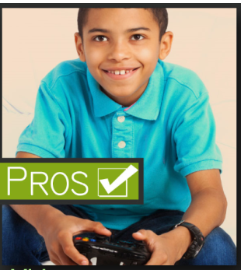

Gaming Pros and Cons
Problem solving
Multi tasking
Improves short term memory
More alert
Develops decision making skills
Can effect physical health
Sleep disturbances
Obesity
Sitting for hours in front of screen
Obsessive
Agitation
Evidence shows increased anger in children who are playing violent games.
Aggressive behaviour

Slide 9
Top tips
When you buy a game console make sure you ask the vender about its online capabilities. Know what the equipment is capable of.
Check if age appropriate.
Discuss the risks with your child. Don't wait for something to happen before you talk to your child about the potential risks of gaming online. Ensure they have privacy settings activated and help them to understand why this needs to be done.
Gaming sites often have ways of reporting abusive chat and blocking unwelcome contact from other users. Familiarise yourself with how the gaming sites work and make sure that your child knows how to report anything that makes them feel uncomfortable. Ensure they know that they should report it to you also.

Slide 10
Think about the location of the game console. Keep it in a common area if possible. A family room is best for monitoring and supervision.
Play the games yourself to test them for appropriateness. Games often come with an age rating and while this should be used as a guide, you should also test the game yourself or play with your child to make sure you are happy for them to use it.
Ask your child what they are playing. Take an interest in your child's gaming life - just as you would if they were in a football team in the real world. Watch them playing and always keep lines of communication open.
Limit the amount of time children play on the game. Suggested time is less than 2 hours per day.

Slide 11

What are parental controls?
Parental controls help you to block or filter upsetting or inappropriate content, and control purchases within apps. You can install parental control software on your child's and family's phones or tablets, games consoles, laptops and your home internet.
Parental controls can help you to:
  plan what time of day your child can go online and how long for
  create content filters to block apps that may have inappropriate content
  manage the content different family members can see.

Slide 12
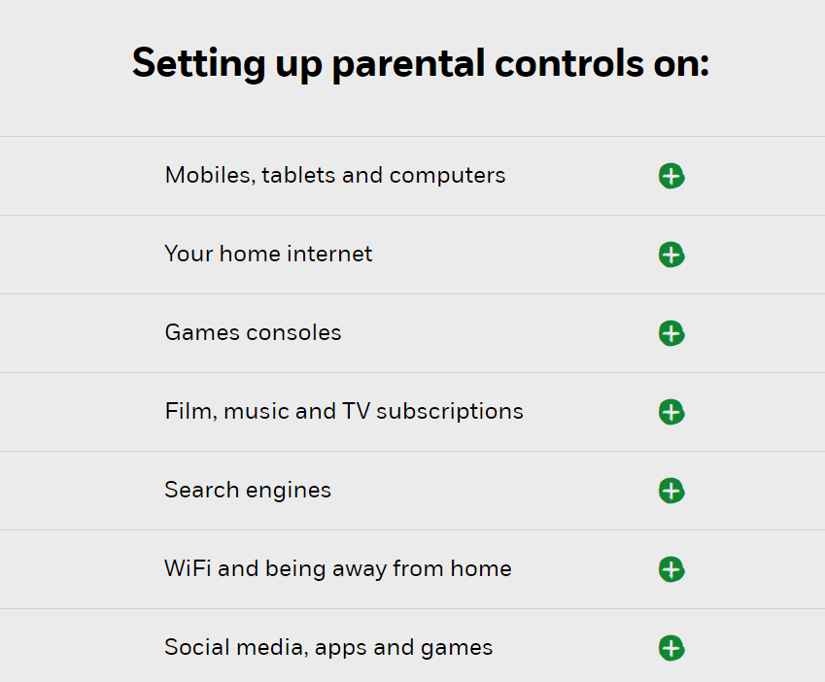

Slide 13
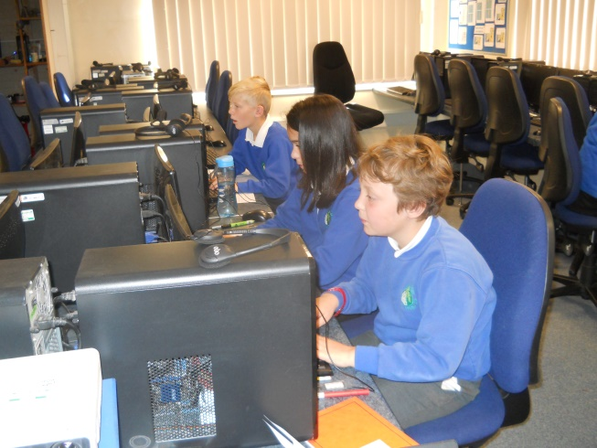
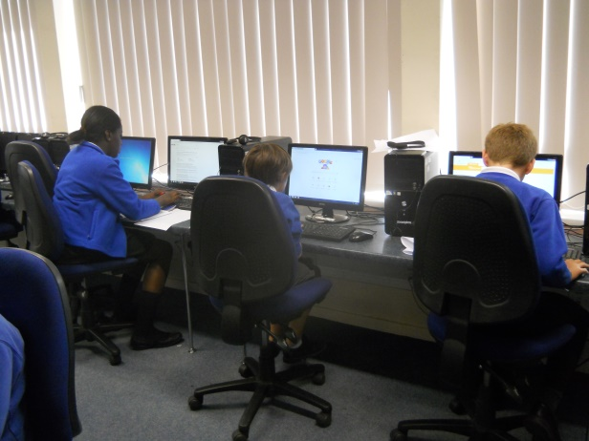
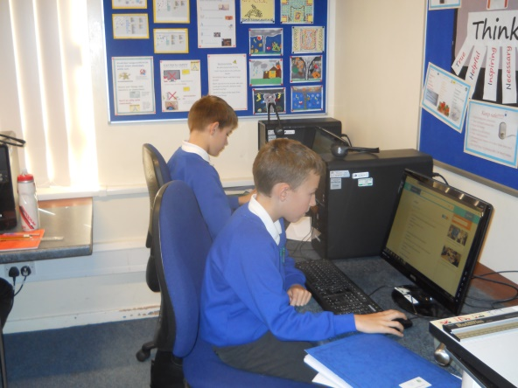
In School…
Every year group learns about the safe use of technology in their computing lessons.
Being safe online discussed during PSHE lessons.
Every year, we are involved in Safer Internet Day.
We are responsive and will discuss issues as they arise.

Slide 14
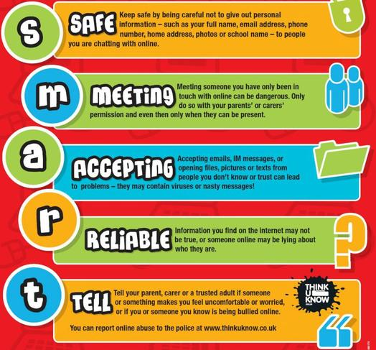


Slide 15


Slide 16

KS1
Esafety
Pupils are able to… …know that passwords are there to keep information safe …know that they should keep their personal information private. …explain what personal information is. …understand that they should tell an adult when they see something unexpected or worrying online …use online resources when told to by an adult. … only use websites/ apps/films/games with support from an adult …talk about why it’s important to be kind and polite online …understand that we have esafety rules to keep us safe online and talk about some of these rules List of Apps/Resources that could be used: 'Digiduck's big decision' SWGFL Digital literacy programme of study for year1/2 'Thinkuknow' resources
Learning about personal information and what to share/not share
Using a personal login and password to access the computers
To tell an adult if they see something worrying online Learning how to recognise trustworthy sites Age appropriate sites/apps/games etc
Talk about being kind and polite online Understand we have e-safety rules to keep us safe Only go online with permission from an adult

Slide 17


What can I do right now?
Sign up to the UK Safer Internet Centre newsletter at:
saferinternet.org.uk
Open dialogue with your child
Family agreement
Consider filtering and blocking software
Think before you/they post
Understand the laws
Privacy settings and reporting
Save the evidence and report the incident
Know where to get help
Watch SID TV clips
Notes:
Slide 12
• There are real advantages in maintaining an open dialogue with your child about their
internet use, encourage them to talk to you about their time online; for example who they’re
talking to, what services they are using, and any issues that they may be experiencing.
• Create a family agreement to establish your children’s boundaries, and your expectations,
when on the internet. Give your child strategies to deal with any online content that they are
not comfortable with – such as turning off the screen, telling an adult they trust and using
online reporting facilities. A template agreement and guide can be downloaded from
www.childnet.com/have-a-conversation
• Consider using filtering software to block unwanted content. In addition to filtering,
remember that discussion with your child, and involvement in their internet use, are both
effective ways to educate them about the internet.
• Encourage your children to ‘think before you post.’ Online actions can impact not only
yourself but the lives of others. Content posted privately online can be publicly shared by
others, and may remain online forever.
• Understand the law. Some online behaviour may break the law, for example when
comments online threaten or incite hatred.
• Familiarise yourself with the privacy settings and reporting features available on popular
sites and services.
• If your child is being bullied online, save all available evidence and know where to report the
incident, for example to the school, service provider, or the police if the law has
been broken.
• Make sure you know how to get help from service providers, your child’s school or other
organisations if you have concerns about a child.
• Watch the Safer Internet Day TV (SID TV) clips for more tips and advice at
www.saferinternetday.org.uk

Slide 18





Want more information?
We are happy to answer questions!
education@childnet.com
www.saferinternet.org.uk
www.childnet.com
Follow us
saferinternetuk
@UK_SIC

Slide 19

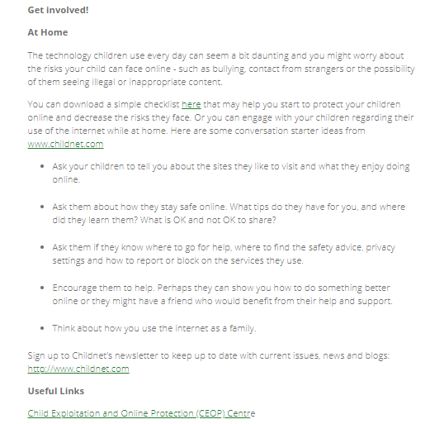
Website
www.nspcc.org.uk
Notes:
Keep an eye out for news stories you can share about adults who have suffered the consequences of posting without thinking, especially when these involve historic posts – lots of stories recently of people losing their jobs when old tweets and posts have been rediscovered. Be prepared to talk about sensitive issues like online grooming, sexting and fake profiles. Encourage your child to talk to you about anything they are uncomfortable about. Reassure them that you can and will help if they make a mistake using social media. Be supportive if they are worried about a friend’s online behaviour. If you know the parents, you could share information with them.

Slide 20



Slide 21
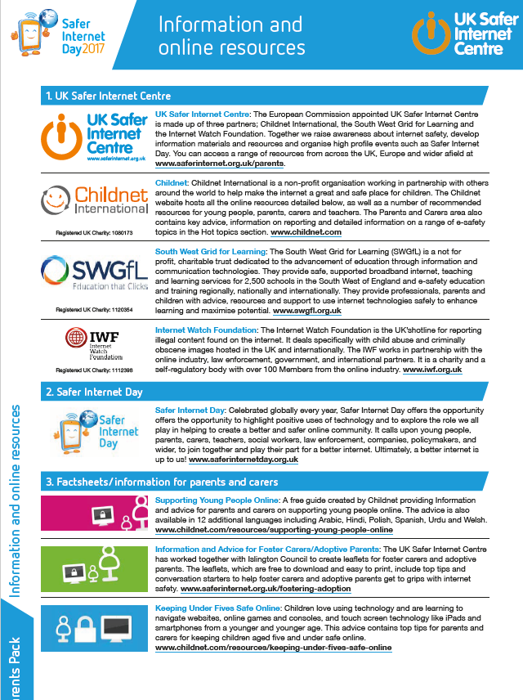

Slide 22
