Slide 1


Powered by:
Virtual Conference Check-In
Via Text Message:
Today’s Session Child ID: 7232
Pair your mobile number to your account: Text your email address to (866) 875-4686.
You will receive a text notification indicating your phone number has been updated.
Send the course ID above via text to (866) 875-4686.
Please note, that texting attendance can only be recorded 60 minutes prior to the course start time, during the course, and up to 120 minutes after the course end time.
If you encounter any issues, please email ccpd@mednet.ucla.edu.

Slide 2

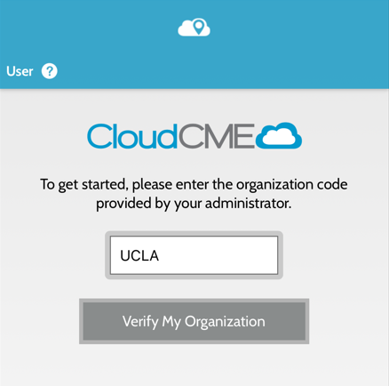
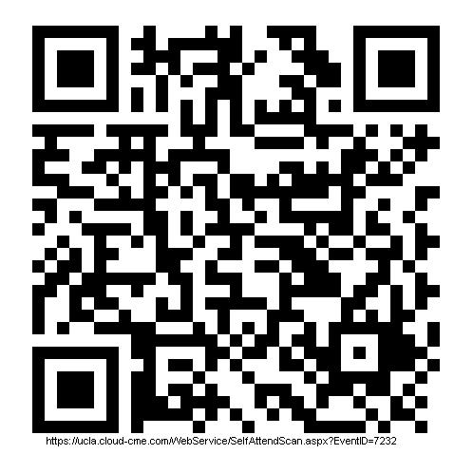
Powered by:
Virtual Conference Check-In
Via QR Code using CloudCME Mobile App:
Download the app from your mobile
Input the organization code: UCLA
Sign in using your username and password
Click “Scan Attendance”
Scan the QR code
THIS IS SAMPLE
REPLACE QR CODE
Please note, that attendance can only be recorded 60 minutes prior to the course start time, during the course, and up to 120 minutes after the course end time.
If you encounter any issues, please email ccpd@mednet.ucla.edu.

