Slide 1
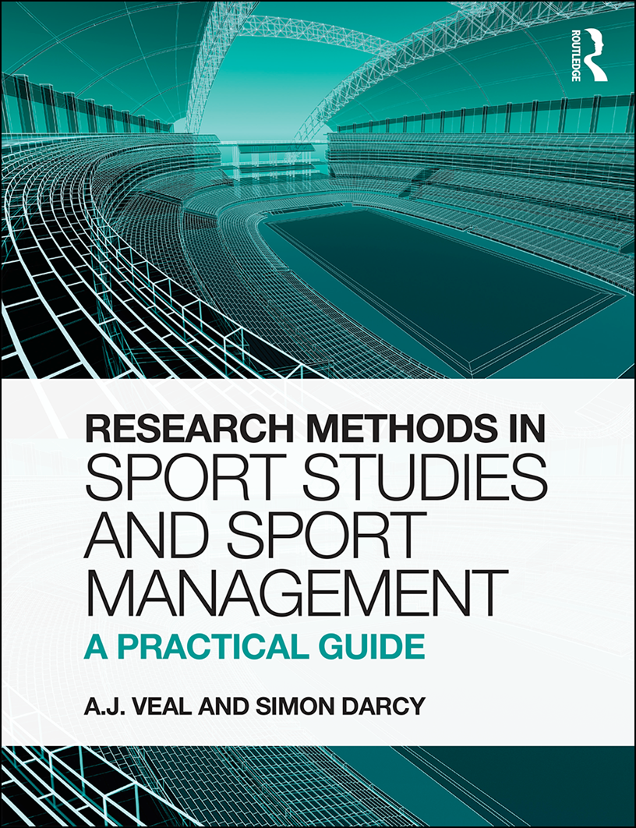
PART II
DATA COLLECTION

Slide 2
Structure
PART II DATA COLLECTION
PART III ANALYSIS
PART I PREPARATION
7. Secondary data
14. Secondary
1. Introduction
8. Observation
2. Approaches
9. Qualitative
15. Qualitative
3. Starting out
10. Questionnaires
16. Survey data
4. Research ethics
11. Experimental
17. Statistical
5. Range of methods
12. Case studies
6. Reviewing lit.
PART IV COMMUICATE RESULTS
13. Sampling
18. Research report

Slide 3
Chapter 7:
Secondary
data sources

Slide 4
Preliminary issue: measuring sport activity
A. J. Veal & S. Darcy (2014) Research Methods for Sport Studies and Sport Management: A practical guide. London: Routledge

Slide 5
Typology of individual engagement with sport (Fig. 7.1)
Action/ consumption | Type of engagement
Production/ active | 1. Professional
 | 2. Active leisure
 | 3. Volunteer
Consumption/ receptive | 1. Spectator/ fan/supporter
 | 2. Consumer/ fan
A. J. Veal & S. Darcy (2014) Research Methods for Sport Studies and Sport Management: A practical guide. London: Routledge

Slide 6
Typology of individual engagement with sport (contd)
Action/ consumption | Type of engagement | Mode of engagement
Production/ active | 1. Professional | Full-time Part-time
 | 2. Active leisure | Amateur Hobbyist
 | 3. Volunteer | Volunteer
Consumption/ receptive | 1. Spectator/ fan/supporter | Committed live Occasional live
 | 2. Consumer/ fan | Mediated
A. J. Veal & S. Darcy (2014) Research Methods for Sport Studies and Sport Management: A practical guide. London: Routledge

Slide 7
Typology of individual engagement with sport (contd)
Action/ consumption | Type of engagement | Mode of engagement | Examples
Production/ active | 1. Professional | Full-time Part-time | F/T professional athlete, official, manager P/T professional athlete
 | 2. Active leisure | Amateur Hobbyist | Amateur athlete (org./comp/club-based) Casual participant
 | 3. Volunteer | Volunteer | Volunteer/unpaid coach, official, marshal
Consumption/ receptive | 1. Spectator/ fan/supporter | Committed live Occasional live | Reg. live spectator/supporter club member Occasional live spectator
 | 2. Consumer/ fan | Mediated | Watching on TV/DVD, listen to radio, on-line, reading sport print-media
A. J. Veal & S. Darcy (2014) Research Methods for Sport Studies and Sport Management: A practical guide. London: Routledge

Slide 8
Measuring Sport (Fig. 7.2)
Measure | Definition | Relationships
Participation rate | The proportion of a defined population which engages in an activity in a given period of time
B. Number of participants | Number of people in a defined community who engage in an activity in a given period of time. | A x pop'n. or C ÷ frequency of visit
C. Volume of activity (visits) | The number of visits made to a defined geo-graphical area, or games played in an activity by members of a defined community in a specified time period | B x visits/games per time period
D. Time | The amount of leisure time available to the individual in a defined community, over a specified period - or time spent on specific activity | C x time per visit
E. Expenditure | Amount of money spent per individual or by a defined community on leisure or particular leisure goods or services over a specified time period. | C x spend per visit
E. Intensity | Energy expenditure during exercise or max. rate at which body can transport/use oxygen (VO2max)
F. Employment | Engagement in sporting activity involving payment

Slide 9
Measurement: Sport examples (Fig. 7.2 contd)
Measure | Example
A. Participation rate | 6 per cent of the adult population of community X go swimming at least once a week.
B. Number of participants | 20,000 people in community X swim at least once a week.
C. Volume of activity (visits) | There are 1.2 million visits to swimming pools in community X (one million by local residents) in a year.
D. Time | Adults spend an average of 15 minutes per day engaging in exercise .
E. Expenditure | Consumer expenditure on leisure in Britain is over £50 billion a year
F. Intensity | Elite male runners have VO₂ max of more than 80 millilitres per kilogram of bodyweight per minute
G. Employment | It is estimated that 4.5 million people are employed in sport in Europe.
A. J. Veal & S. Darcy (2014) Research Methods for Sport Studies and Sport Management: A practical guide. London: Routledge

Slide 10
Counting heads: sport (Fig. 7.3)
Administrative – facility based
  Individual ticket sales
  Bookings data
  Season ticket/annual pass sales
  Membership records/surveys
  Parking ticket sales data
Questionnaire-based surveys (see Ch. 10)
  Resident survey
  Tourist survey
  On-site visitor interview surveys
A. J. Veal & S. Darcy (2014) Research Methods for Sport Studies and Sport Management: A practical guide. London: Routledge

Slide 11
Counting heads: sport (Fig. 7.3) contd
On-site visitor counts (see Ch.8)
  Automatic
  Automatic vehicle counters
  Automatic pedestrian counters
  Video-time-lapse cameras/aerial photography
  Visual/manual
  Entrance or exit flows
  Spot counts of numbers present at various times
A. J. Veal & S. Darcy (2014) Research Methods for Sport Studies and Sport Management: A practical guide. London: Routledge

Slide 12
Primary vs Secondary data
Primary data:
  new data specifically collected in the current project
  researcher is primary user
Secondary data
  data already exists, collected for some other purpose
  researcher is secondary user
A. J. Veal & S. Darcy (2014) Research Methods for Sport Studies and Sport Management: A practical guide. London: Routledge

Slide 13
Advantages/disadvantages of using secondary data (Fig. 7.4)
Advantages
Timing – data may be instantly available.
Cost – cost of collecting new data avoided.
Experience – the 'trial and error' experience of those who collected the original data can be exploited.
Scale – possibly larger samples than would otherwise be possible.
Serendipity – inductive process of data analysis may yield serendipitous findings, which may not have arisen otherwise.
A. J. Veal & S. Darcy (2014) Research Methods for Sport Studies and Sport Management: A practical guide. London: Routledge

Slide 14
Disadvantages
Design – secondary data has been designed for another purpose: may not be ideal.
Analysis limitations – opportunities for analysis/manipulation of the data for the current project may be limited.
A. J. Veal & S. Darcy (2014) Research Methods for Sport Studies and Sport Management: A practical guide. London: Routledge

Slide 15
Types of secondary data (Fig. 7.5)
Administrative/management data
National sport participation surveys
Economic surveys
Elite sport performance data
The census of population
Documentary sources
Opportunism
A. J. Veal & S. Darcy (2014) Research Methods for Sport Studies and Sport Management: A practical guide. London: Routledge

Slide 16
Administrative/management data
Management data (Fig. 7.6)
Visitor numbers (in various categories)
Visitor expenditure/income (in various categories)
Bookings and facility utilisation
Customer enquiries
Membership numbers and details
Customer complaints
Results of visitor/customer surveys
Expenditure of the organisation (under various headings)
Staff turnover/absenteeism, etc.
A. J. Veal & S. Darcy (2014) Research Methods for Sport Studies and Sport Management: A practical guide. London: Routledge

Slide 17
National sport participation surveys: International publications (Fig. 7.8)
Trends in Sports: a Multinational Perspective. Kamphorst & Roberts (1989)
Worldwide Experiences and Trends in Sport for All. DaCosta & Miragaya (2002)
Free Time and Leisure Participation: International Perspectives. Cushman, Veal & Zuzanek (2006)
Participation in Sport: International Policy Perspectives. Nicholson, Howe & Houlihan (2011)
The Citizens of the European Union and Sport: Special Eurobarometer Reports. European Commission (nd)
A. J. Veal & S. Darcy (2014) Research Methods for Sport Studies and Sport Management: A practical guide. London: Routledge

Slide 18
National sport participation surveys: UK
Active People survey
Conducted by: Sport England
Sample size: 190,000
Dates: Annual since 2007
Age-range: persons aged 16 and over
Participation data items
Sport and recreational physical activity
Walking – at least 30 mins (freq. in last 4 weeks, pace)
Cycling – as for walking
Other sport/recreation/physical activity – as for walking
Sports club membership
Competitive sports participation
Instruction/coaching in sport
Overall satisfaction with sports provision
Likelihood to do more sport: name one activity
Change in participation in last year: reason
A. J. Veal & S. Darcy (2014) Research Methods for Sport Studies and Sport Management: A practical guide. London: Routledge

Slide 19
National sport participation surveys: Active People Survey contd
Socio-demographic data items
Gender
Age
Ethnic group
Age completed full-time education
Highest qualification
Accommodation type
No. of children in household
Car/van availability
Disability
Current work status
Socio-economic status (10 questions)
Main income-earner occupation
Postcode
A. J. Veal & S. Darcy (2014) Research Methods for Sport Studies and Sport Management: A practical guide. London: Routledge

Slide 20
National sport participation surveys: Australia
Exercise Recreation and Sport Survey (ERASS)
Conducted by: Standing Committee on Recreation and Sport (SCORS)
Dates: Annual since 2001-2010
Sample size: 13,000
Age-range: persons aged 16 and over
Participation data items
Individual sport/physical activities participated in at least once in previous year.
For the above: no. of times; whether organised by club etc. or informal
Activities participated in during previous 2 weeks: frequency, time spent.
Socio-demographic data items
Gender, Age, Marital status, Parental status, no. children
Highest education qualification, Employment status, Hours worked
Aboriginal , Language spoken at home Postcode
A. J. Veal & S. Darcy (2014) Research Methods for Sport Studies and Sport Management: A practical guide. London: Routledge

Slide 21
National sport participation surveys: Australia contd
Since 2010:
Australian Bureau of Statistics
Participation in Sport and Physical Recreation (Cat. No. 4177.0)
2009-10
2011-12 (Spreadsheet tables only)
A. J. Veal & S. Darcy (2014) Research Methods for Sport Studies and Sport Management: A practical guide. London: Routledge

Slide 22
National surveys: issues
Validity and reliability
  dependent on self-report
Sample size
  typically large
Main question: reference period (see next slide)
Age range
  most exclude children
Social characteristics
  opportunities for detailed study/forecasting
A. J. Veal & S. Darcy (2014) Research Methods for Sport Studies and Sport Management: A practical guide. London: Routledge

Slide 23
National surveys: effect of reference period differences
Table 7.1 | England 2002
Sports* | Participated at least once in last year | = most common measure
 | % of persons aged 16 and over
Walking | 45.9
Swimming | 34.8
Cycling | 19.1
Football | 9.1
Athletics** | 1.0
Golf | 12.1
Badminton | 6.4
Tennis | 7.0
Squash | 3.8
Cricket | 2.4
Equestrian | 3.5
Bowls | .3.8
A. J. Veal & S. Darcy (2014) Research Methods for Sport Studies and Sport Management: A practical guide. London: Routledge

Slide 24
National surveys: effect of reference period differences
Table 7.1 | England 2002
Sports* | Participated at least once in last year | Participated at least once in last 4 weeks
 | % of persons aged 16 and over
Walking | 45.9 | 34.9
Swimming | 34.8 | 13.8
Cycling | 19.1 | 9.0
Football | 9.1 | 4.9
Athletics** | 1.0 | 0.3
Golf | 12.1 | 4.8
Badminton | 6.4 | 1.8
Tennis | 7.0 | 1.9
Squash | 3.8 | 1.3
Cricket | 2.4 | 0.6
Equestrian | 3.5 | 1.9
Bowls | .3.8 | 1.3
A. J. Veal & S. Darcy (2014) Research Methods for Sport Studies and Sport Management: A practical guide. London: Routledge

Slide 25
National surveys: effect of reference period differences
Table 7.1 | England 2008-09
Sports* | Participated at least once in last month | P
 | % of persons aged 16 and over
Walking | na
Swimming | 13.2
Cycling | 9.3
Football | 7.4
Athletics** | 6.4
Golf | 3.5
Badminton | 2.4
Tennis | 2.4
Squash | 1.2
Cricket | 1.0
Equestrian | 1.0
Bowls | 1.0
A. J. Veal & S. Darcy (2014) Research Methods for Sport Studies and Sport Management: A practical guide. London: Routledge

Slide 26
National surveys: effect of reference period differences
Table 7.1 | England 2008-09
Sports* | Participated at least once in last month | Participated for at least 30 mins in last week
 | % of persons aged 16 and over
Walking | na | na
Swimming | 13.2 | 7.6
Cycling | 9.3 | 4.5
Football | 7.4 | 5.1
Athletics** | 6.4 | 4.2
Golf | 3.5 | 2.1
Badminton | 2.4 | 1.3
Tennis | 2.4 | 1.3
Squash | 1.2 | 0.7
Cricket | 1.0 | 0.5
Equestrian | 1.0 | 0.8
Bowls | 1.0 | 0.6
A. J. Veal & S. Darcy (2014) Research Methods for Sport Studies and Sport Management: A practical guide. London: Routledge

Slide 27
Time-use surveys
Survey respondents keep a diary of activities for 1-2 days
 | Britain, 2005 | Australia, 2006
 | Hrs per week: average for all persons aged 15+
Sleep | 57.3 | 59.6
TV/video/radio/music | 18.3 | 16.3
Sport/physical recreation | 1.2 | 2.2
Other leisure | 23.4 | 18.2
Paid work | 19.8 | 24.1
Personal care | 14.7 | 17.1
Domestic work/childcare | 22.3 | 22.7
Travel and other | 12.3 | 10.0
Total | 168.0 | 168.0
A. J. Veal & S. Darcy (2014) Research Methods for Sport Studies and Sport Management: A practical guide. London: Routledge

Slide 28
Elite sport performance
Measures of national performance in multi-sport international sport events
Gold medals won
Total medals won (gold, silver, bronze)
Medal points (e.g.: gold=3, silver =2, bronze =1)
No. of athletes qualifying to take part
No. of athletes in finals
No. of athletes posting:
  season's best,
  personal best performance
  breaking records
Market share: country's % share of all medals or points awarded
Cost (government expenditure) per medal
Each of the above related to national population and/or income
See Shibli & Bingham (2005) + Ch. 14 Case Study 14.5
A. J. Veal & S. Darcy (2014) Research Methods for Sport Studies and Sport Management: A practical guide. London: Routledge

Slide 29
Economic data
Household expenditure survey data
A. J. Veal & S. Darcy (2014) Research Methods for Sport Studies and Sport Management: A practical guide. London: Routledge

Slide 30
Population census
Count of every person present in a country on a specified night
Typically conducted every 10 years (UK) or 5 years (Australia)
A. J. Veal & S. Darcy (2014) Research Methods for Sport Studies and Sport Management: A practical guide. London: Routledge

Slide 31
Census: Data available at various levels (Fig. 7.11)
Britain
  National
  Regions
  Counties
  Local government areas
  Parliamentary constituencies
  Enumeration districts (EDs)
Australia
  National
  State
  Postal codes
  Local government areas
  State and federal Parliament electorates
  Collection districts (CDs)
A. J. Veal & S. Darcy (2014) Research Methods for Sport Studies and Sport Management: A practical guide. London: Routledge

Slide 32
Census data: resident population (Fig. 7.12)
Number of males/females
Number/proportion in 5-yr age-groups (single yrs for < 20s)
Numbers of people:
  with different religions
  by country of birth
  speaking different languages
  by country of birth of parents
Numbers of families/households:
  of different sizes
  with different numbers of dependent children
  which are single parent families
  with various numbers of vehicles
Numbers of people:
  who left school at various ages
  with different educational/technical qualifications
  different occupational groups
  by working hours
A. J. Veal & S. Darcy (2014) Research Methods for Sport Studies and Sport Management: A practical guide. London: Routledge

Slide 33
Uses of the census (see Ch. 14)
planning sport facilities
conducting feasibility studies
area management/marketing
facility performance evaluation
market segmentation
A. J. Veal & S. Darcy (2014) Research Methods for Sport Studies and Sport Management: A practical guide. London: Routledge

Slide 34
Documentary sources (Fig. 7.12)
Minutes of committee/council/board meetings
Correspondence of an organisation or an individual
Archives (may include both of the above + other papers)
Popular literature, such as novels, magazines
Newspapers, particularly coverage of specific topics and/or particular aspects, such as editorials, advertising or correspondence columns
Brochures and advertising material
Diaries
A. J. Veal & S. Darcy (2014) Research Methods for Sport Studies and Sport Management: A practical guide. London: Routledge

