Slide 1

From Birth to Three: An Early Years Educator’s Handbook
Written by: Julia Manning-Morton
Web support materials for
Chapter 3.1 Key Aspect of Practice: Care
Part 1

Slide 2

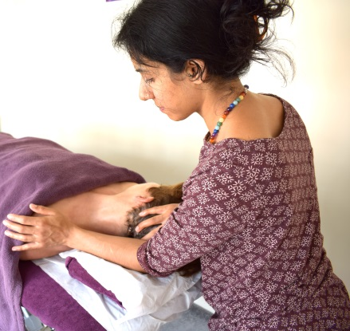


Reflection Point 1: Touch
Reflect on a time when you were being physically handled by a professional such as a doctor / nurse, massage therapist, osteopath or hairdresser
What were your feelings before, during and after your treatment?
What made this experience positive or negative for you?
Notes:
Let us now reflect on your own experience of being physically handled by others
Think of a time when you were with a professional such as a doctor / nurse, massage therapist, osteopath or hairdresser.
What was it like being physically handled by this person?
What was positive or negative about this experience?
What was a negative experience of physical care like? What did they do that was negative?
How did it make you feel?
What was a positive experience of physical care like? What did they do that was positive?
How did it make you feel?
I just want to give a Health warning on doing this; If thinking about these things makes you too uncomfortable then think about a scenario from another person’s perspective, perhaps the professional’s or think about your care events at work.
Make some notes and, you can share any important insights in the Q&A session after.
But in the meantime, you may have noted…

Slide 3
Personal Care Experiences
Negative Felt
Positive Felt
Rough
Rejecting
Ignoring
Casual
Dismissive
Inattentive
Unsafe
Vulnerable
‘Wrong’
Let down
Angry
Worthless
Attentive
Gentle
Reassuring
Respectful
Taking time
Inclusive
Contentment
Security
Confidence
Trust
‘Good’
Worthwhile
Notes:
You may have noted that a negative experience of physical care is one that is; rough, rejecting, ignoring, casual, dismissive and inattentive, which might make you feel unsafe, vulnerable, in the wrong, let down, angry and ultimately worthless as a person.
In contrast a positive experience is attentive, gentle, reassuring, respectful, calm, taking time and inclusive, which leads to feelings of contentment, security, confidence and trust and overall feeling worthwhile as a person.
In addition, you may have noted how this treatment made you want to respond and behave either negatively by being aggressive or argumentative or positively by being cooperative.
The point of this exercise of course, is that babies and young children will feel and behave in these ways also, in response to the way they are handled by practitioners during care events.
Abrupt / Hurried handling = feeling hurried and unimportant = very tense or go floppy
Avoidance, non-cooperation, rejection
Calm, respectful handling = feeling trusting and secure = active participation, cooperation and fun.
As adults caring for babies and young children we are in a powerful position and we can choose to use that power positively or negatively. Think about how your positive behaviours can set up a benign cycle of positive care and positive feelings in a child, which will then give you positive feedback and thereby positive feelings about your professional skills.
This is the art of caregiving
And practitioners?
You might want to reflect on how you feel as a professional if you respond negatively to a child. An interesting issue is that practitioners with a negative approach often feel negative about themselves as professionals, whereas practitioners with a positive approach tend to feel competent and confident as professionals (Manning-Morton 2006).

Slide 4
Implications for practice
How do you build trust through positive physical interactions?

