Slide 1

From Birth to Three: An Early Years Educator’s Handbook
Written by: Julia Manning-Morton
Web support materials for
Chapter 5: Being and becoming who I am: Connecting with feelings
Part 2: Well-being

Slide 2
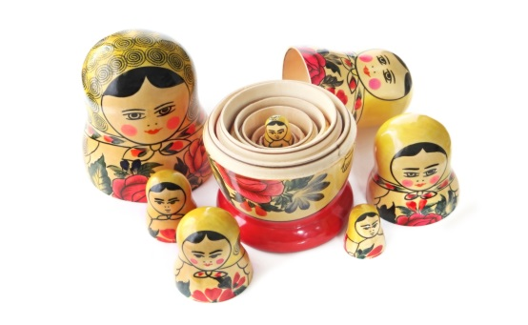
Well-being and resilience
Children who are in a state of well-being are like ‘fish in water’ (Laevers 1997, p.15)
Well-being as an internal state
Well-being and external socio-cultural factors
Internal well-being can be enhanced or impaired by external social factors
How we interpret and engage with external factors will be influenced by our inner capacity for well-being (Manning-Morton 2014).

Slide 3
Indicators of well-being
Well-being is dynamic and can change and fluctuate according to circumstances
The way in which children show well-being will depend on:
  their individual temperament
  their age
  their particular developmental profile

