Slide 1

Economics of Technology and Innovation
Pandemic economics
Chapter 11

Slide 2
Topics
Innovation in a Time of Crisis
The Process of Technological Advance
Theories of Economic Growth
Networks of Innovation
Pandemics, Innovation, and Transformative Change
Lasting Effects

Slide 3
Learning Objectives
After reading this chapter, you will be able to:
LO1 Explain the motivation for innovation during a time of crisis.
LO2 Discuss the process of technological advance, including the stages of invention, innovation, diffusion, and adoption/rejection.
LO3 Contrast theories of economic growth that model technological advance as an exogenous variable and technological advance as an endogenous variable.
LO4 Explain why networks enhance the process of innovation.
LO5 Discuss innovation in a period of transformative change, including technological advances for vaccines and medical care.
LO6 Address why a pandemic may lead to lasting effects with respect to innovation.

Slide 4
1. Innovation in a Time of Crisis
A pandemic ravages public health and the economy, impacting industries, businesses, and households.
But if history repeats itself, innovation emerges from crisis, when necessity fosters creation.

Slide 5
Process of Innovation
The process of innovation—the application of a new idea or new application of an existing idea—stems from the desire to create new methods, markets, and products.
When an exogenous shock strikes, such as a pandemic, the demand for new methods, markets, and products determines the quantity of investment.
With the coronavirus pandemic, innovations occurred in both the development of a vaccine and clinical practices in medical care, including advances in diagnoses and telemedicine.
Innovations also occurred in the marketplace.

Slide 6
Innovation During a Pandemic
Most innovation occurs in labs, plants, and firms.
The firms pay the bills and researchers are compensated with salaries.
In modern economies, most innovation occurs in the private sector, but during a pandemic innovation also comes from universities and government labs.

Slide 7
2. The Process of Technological Advance
Joseph Schumpeter (1934), the prominent Austrian economist, describes economic development as a historical process of structural change.
In Schumpeter’s framework, structural change includes three stages:
  Invention
  Innovation
  Diffusion
According to Schumpeter (1942), innovation causes periods of creative destruction:
  A “process of industrial mutation…incessantly revolutionizes the economic structure from within, incessantly destroying the old one, incessantly creating a new one.”

Slide 8
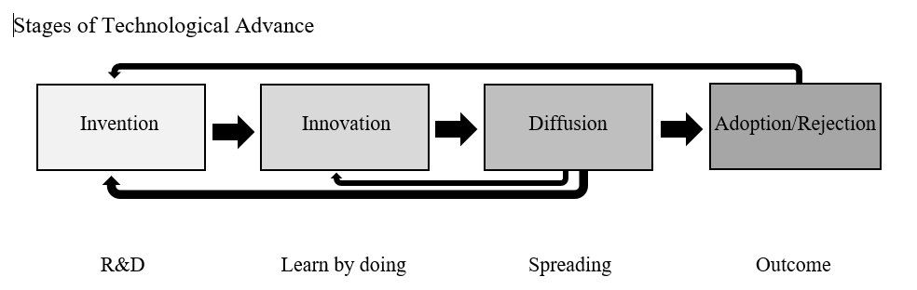

Slide 9
Each Stage Has a Specific Purpose
Invention: the first occurrence of an idea for a new product or process.
Innovation: the first attempt to carry it out into practice.
Diffusion: the process in which an innovation is (spread) through certain channels over time among the members of a social system.
After diffusion, a new product or method may be adopted or rejected, depending on market outcomes, network effects, and best practices.

Slide 10
Attributes of Innovation
compatibility
complexity
The degree to which an innovation is consistent with the needs of potential adopters
How difficult a product or method is to use

Slide 11
observability
Relative advantage
The extent to which potential adopters observe the benefits of the new method or product
The degree to which it is perceived as better than the alternative

Slide 12
trialability
The degree to which potential adopters may experiment with it

Slide 13
Frames of Analysis for Technological Advance
Framings:
  interpretations of experience
  orderings of present circumstance
  imaginations of future potentialities that create the foundations for policy analysis and action
  shape expectations concerning potentials and opportunities

Slide 14
Practitioners of New Ideas
Practitioners of new ideas connect time periods in the past, present, and future.
The framings that result from these connections evolve over time, changing when they cannot adequately interpret existing circumstances.

Slide 15
Framings
First framing: innovation for growth
Second framing: systems of innovation
Addresses the impact of science and technological advance on economic prosperity
Grew in response to a level of incompleteness of the first framing, which was subsequently updated to reflect the growing realization of the impact of science on industry

Slide 16
Third framing: transformative change
Considers how to use scientific knowledge and technological advance to meet contemporary challenges

Slide 17
The Framing Perspective
The framing perspective implies that technological advance leads to a certain directionality toward a positive outcome.
But rejection remains a possibility, especially with the development of a vaccine.
In addition, the innovations that emerge during a pandemic, such as remote work and online education, lead to the “creative destruction” or dismantling of previous practices, using Schumpeter’s (1942) term.

Slide 18
3. Theories of Economic Growth
The process of innovation is not a new phenomenon.
Inherent to human development, innovation characterizes economic activity, labor methods, and technological advance.

Slide 19
Technology as an Exogenous Factor
The neoclassical growth model originates in the work of Robert Solow (1956), who posits a long-term relationship between economic growth and capital formation.
Technology serves an explanatory variable that leads to the aspect of economic growth not explained by capital and labor.

Slide 20
Technology as an Endogenous Factor
The idea of technology serving as an endogenous factor stems from Schumpeter (1947), who stresses the important roles of innovation and entrepreneurship in the process of economic growth.
In this view, improvements in technology serve as the driving force behind rising living standards.

Slide 21
4. Networks of Innovation
A network is a system of interconnected elements, including nodes or agents and the connections between them.
Innovation networks exist when collaborative efforts between agents contribute toward the development and creation of new markets, methods, and products.

Slide 22
Model of Innovation Networks
Innovation networks may exhibit high power-law functions, especially in the case of the development of a vaccine:
  A small number of agents have many connections and direct a large percentage of the flow of knowledge
Hub firms, O = {o₁, o₂, …, o_{n}}:
  Orchestrate the process of innovation and initiate the creation of value
Network members, N = {n₁, n₂, …, n_{n}}:
  Adopt the methods and products established by the orchestrators

Slide 23
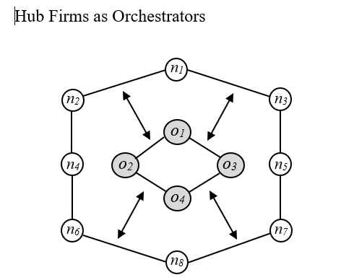

Slide 24
Orchestrators
Through market share and previous success, orchestrators gain their position, in which they use to gather resources and capabilities.
They create value by expanding the size of the market and extract value by increasing their degree of prominence in the network.
From the perspective of hub firms, several intentional actions characterize the creation of value, including knowledge mobility, innovation appropriability, and network stability.

Slide 25
Knowledge mobility
Innovation appropriability
The first task for orchestrators in the creation of value is knowledge mobility:
The ease with which knowledge is shared, acquired, and deployed within the network
The second task for orchestrators in the creation of value is innovation appropriability:
The ability of an innovator to capture the profits from an innovation

Slide 26
Network stability
The third task for orchestrators in the creation of value, network stability, means:
Fostering stable links among network members.

Slide 27
5. Pandemics, Innovation, and Transformative Change
During a period of transformative change, both strategic and serendipitous alterations to society’s methods of operation produce new interactions and outcomes.
This transition leads to new ways to supply output.

Slide 28
Examples
New interactions and outcomes create changes in how consumers purchase goods and services.
For an economy, it leads to different degrees of product availability, affordability, quality, and reliability.
Evolving attitudes toward the marketplace create new methods of organizational structure:
  Working from home using telecommunications technology
  New preferences for consumption, such as delivery on demand

Slide 29
Innovation During a Crisis
During a crisis, different firms innovate.
One category, competitive firms that exhibit the characteristics of dynamic agents, cannot maintain market share without innovation.
They participate in the process of creative accumulation and innovate as matter of routine.
Another category, firms that serve as new innovators, are not members of the industry before the crisis.
They take advantage of their opportunity to increase market share, launch new products, and participate in the process of creative destruction.

Slide 30
Technological Advances During the Coronavirus Pandemic
vaccination
Advances in medical care
Vaccines have the potential to both stop the spread of an infectious disease and eradicate it.
The coronavirus pandemic disrupted systems of clinical care, leading to innovations in virtual care, diagnosis, and therapy.

Slide 31
Stages of Development of a Vaccine
Research
Pre-clinical trials
Clinical trials
Building factories
Manufacturing
Distribution
Approval

Slide 32
6. Lasting Effects
Large-scale crises such as pandemics prompt acts of innovation.
The medical system innovates new ways to provide care.
Companies adapt to changing market circumstances through the process of technological advance, an example consisting of virtual work models.
Households learn to use new methods of communication, consumption, and delivery.
School systems learn to educate students through distance learning.

Slide 33
Moving Forward
Moving forward, the issue becomes the extent to which the process of technological advance that occurs during a crisis leads to lasting effects.
Individuals, companies, and systems of organization could analyze the lessons of technological advance and apply them to periods of relative calm.
But not all examples of technological advance that occur during crises offer a blueprint for sustainable methods of innovation.

Slide 34
Tools for the Innovative Process
Lindsey Lyman (2020), a clinical professor of entrepreneurship at the Chicago Booth School of Business, argues that four tools used to assess economic conditions during a pandemic should become a part of the innovative process.
Taken together, the tools provide a framework for creating solutions for upcoming problems:
First, firms should challenge orthodoxies or pre-existing assumptions
Second, constraints on methods, capacity, or delivery may accelerate and not inhibit the process of innovation
Third, collaboration leads to competitive advantage
Fourth, the process of technological advance often moves at a methodical pace

