Slide 1
Chapter 1
Introduction to Energy Economics
Part B
Peter Schwarz, Professor of Economics and Associate, Energy Production and Infrastructure Center (EPIC), University of North Carolina Charlotte

Slide 2
Chapter 1 Outline
Why Energy Economics?
Energy Indispensable to Modern Life
Key Energy Issues
Economic Approach
A Roadmap for the Reader

Slide 3
Key Energy Issues (1)
  Are We Running Out?
  Effects on the Planet
    Climate Change
    Production

Slide 4
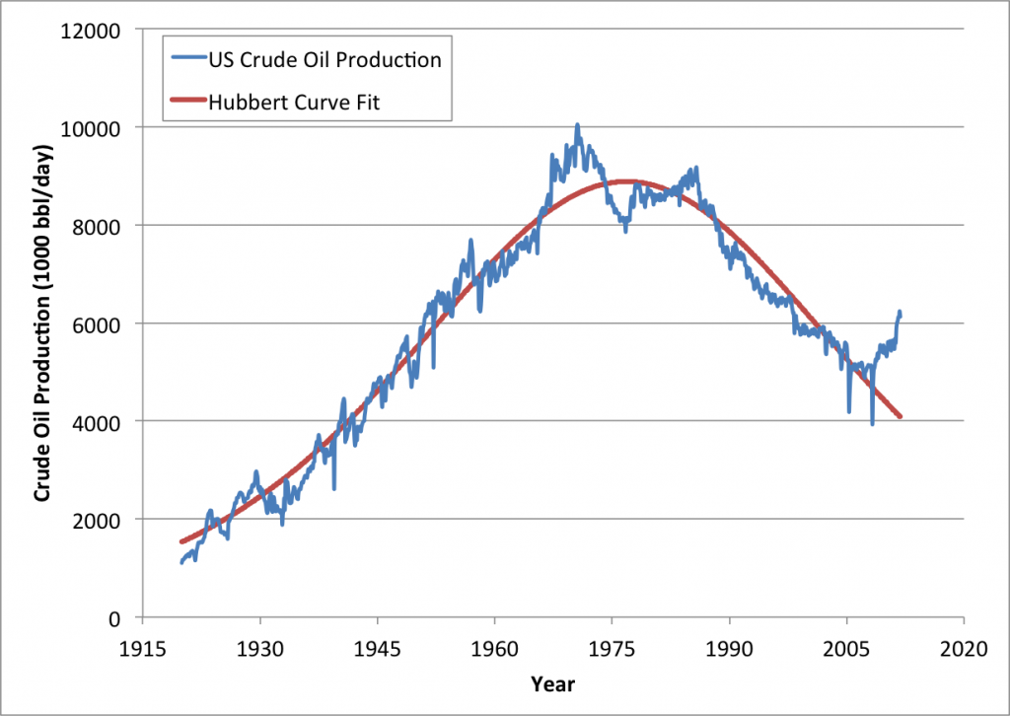
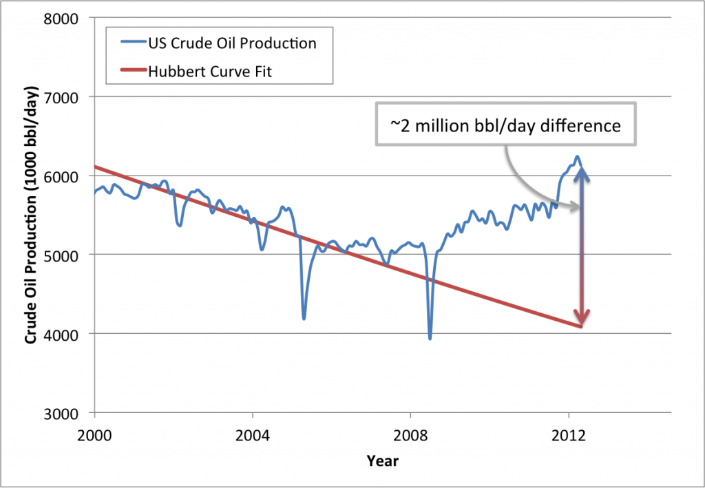
Key Energy Issues (2)
  Are we running out?
    Hubbert Curve
US Oil Production 1920-2012. Data Source: US Energy Information Administration (eia.gov)
US Oil Production 2000-2012. Data Source: US Energy Information Administration (eia.gov)

Slide 5
Key Energy Issues (3)
  Are we running out?
    Hubbert model fails to consider:
      Price
        Higher price
          Additional reserves economical
          Motivates new technologies
          Search for alternative fuels
Absolute Scarcity (Physical Reserves) vs. Relative Scarcity (Opportunity Cost)

Slide 6
Key Energy Issues (5)
      Limits to Growth (Meadows, et al. 1972)
        Resource Collapse (à la Paul Ehrlich)
        Environmental Collapse
        Population Explosion
          Neo-Malthusians
      Economist Response (à la Julian Simon)
        Price
          New Reserves, Technology, Alternatives
        Growth in income: Demand better environment
        Advanced economy: Demand fewer children

Slide 7

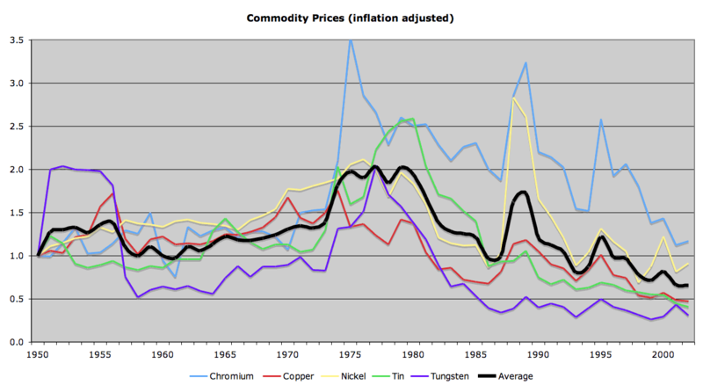
Key Energy Issues (6)
  Are we running out?
    The Bet
      Julian Simon vs. Paul Ehrlich
https://en.wikipedia.org/wiki/File:Simon-Ehrlich.png
http://www.wsj.com/articles/SB10001424127887324165204579026631593290784
https://en.wikipedia.org/wiki/File:Simon-Ehrlich.png

Slide 8
Key Energy Issues (7)
  Are we running out?
    Hotelling (1931) Model:
      Dynamic model
        Incorporates time
          Balance today’s price vs. future price
            Price rises over time
              At rate of interest

Slide 9
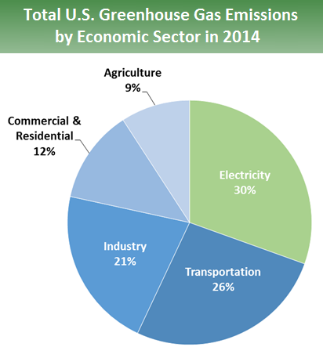
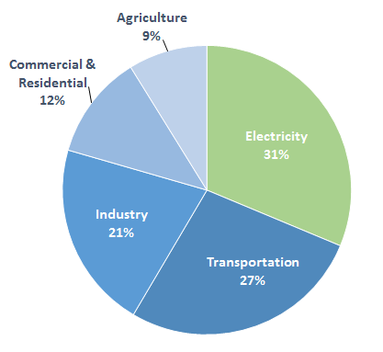
Key Energy Issues (8)
Total U.S. Greenhouse Gas Emissions by Economic Sector in 2013
  B. Effects on Planet
    Climate Change
      CO₂
        _{Methane}
http://www.epa.gov/climatechange/ghgemissions/sources/electricity.html

Slide 10
Key Energy Issues (9)
  B. Effects on Planet
    2. Production
      Coal
        Mountain top removal
        Coal ash spills
      Oil
        Spills
          Double-hulled ships
      Natural Gas
        Fracking
      Nuclear
        Waste
      Hydro
        Dams
Variable (intermittent)
Land required
Viewshed
Wind
Solar

Slide 11
IV. Economic Approach (1)
  Efficiency and Inefficiency
  Market Failure and Government Failure

Slide 12
IV. Economic Approach (1)
  Efficiency and Inefficiency
    Efficiency
      Get the most from scarce resources
        Net Benefit = Benefit-Cost
          Stop when MB = MC.

Slide 13
IV. Economic Approach (2)
      Pareto
        Pareto Improvement
          Possible to make someone better off without making someone else worse off.
        Efficiency
          Impossible to make someone better off without making someone else worse off.
      Hicks-Kaldor
      Potential Pareto Efficiency
          Winners could compensate the losers
            But compensation does not take place

Slide 14
IV. Economic Approach (3)
  Government Regulation
    Command-and-control
      Technology-based
      Standard-based
        Inefficient
    Incentive- (market-) based
      Taxes
      Trading

Slide 15
IV. Economic Approach (4)
  Efficiency and Inefficiency
  Market Failure and Government Failure

Slide 16
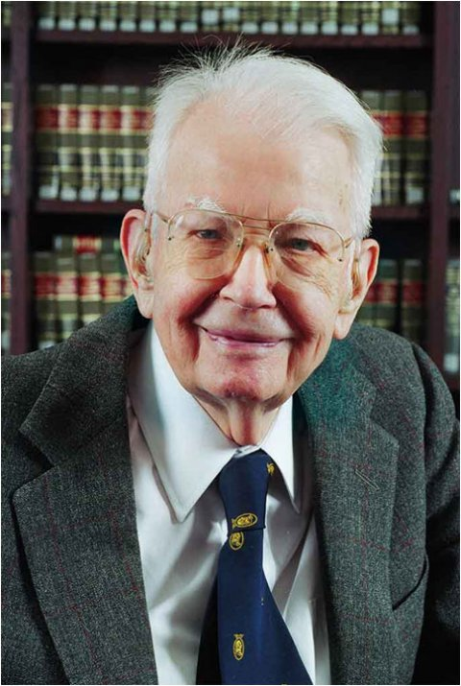
IV. Economic Approach (5)
Choose the least bad solution.
  Efficiency and Inefficiency
  Market Failure and Government Failure
    Market Failure
        Market fails to produce an efficient outcome
          Ex. Externalities
    Government Failure
          Government fails to remedy market inefficiency
            Ex. Ethanol
Ronald Coase, 1910-2013
https://www.coase.org/aboutronaldcoase.htm

Slide 17


A Roadmap for the Reader
http://news.sap.com/sap-roadmap-for-human-resources/
III. Alternatives
A. Renewable Fuels
B. Next-Generation Alternatives
C. Energy Efficiency
IV. Electricity
A. Traditional Regulation
B. Deregulation and Restructuring
Policy
  Environment
  Sustainability
  National Security
  Comprehensive Energy Policy
  Fundamentals
    Introduction
    Energy, Markets, and Society
    Static Efficiency
    Dynamic Efficiency
  Conventional Energy Sources
    Oil
    Natural Gas
    Coal
    Nuclear

