Slide 1
The future of English as a global language
For use with Chapter 10 of:
Galloway, N. and Rose, H. (2015). Introducing Global Englishes. Routledge.
© Dr. Heath Rose and Dr. Nicola Galloway

Slide 2
Review of Lecture 9
Traditionally ELT has posited NE as the main goal of English learning. Nevertheless, the importance attached to NESs is declining.
Studies show that students see NESTs and NNESTs as having different skills, the former being preferred for their perceived ‘fluency’ in the language.
Recent years have seen many proposals for the way ELT is approached.
GELT is clearly very different from traditional ELT, with the NES and the NNES placed on equal footing and the aim to emancipate the NNES from the norms of a minority group of English users.
However, a number of barriers exist, including an attachment to ‘standard’ English, the prevalence of standardized language tests, and the continued recruitment of NESTs.

Slide 3
Overview
The future of English in a globalized culture
The future of English in ‘international’ education
The future of English: spread, recession, or reconceptualization?
The future of English: convergence, divergence, or adaptation?

Slide 4
Introductory activities
Look at the Figure 10.1 in the introduction to Chapter 10 (also shown on the next slide), then answer the following questions.
Do you think any languages are inaccurately placed?
Graddol (1997, p. 13) notes that ‘English and French are at the apex, with the position of French declining and English becoming more clearly the lingua franca’. Do you agree with the other ‘big languages’ that he predicts to replace French by 2050?
What do you believe is the future of English? Will it remain at the apex of this hierarchy, or will it eventually fall out of favour? What forces might cause it to decline in use in the future?

Slide 5
Graddol’s (1997) prediction of the
World Language Hierarchy
Figure 10.1: The World Language Hierarchy (source: Graddol, 1997, pp. 13 & 59)

Slide 6
The future of English in a globalized culture
Part 1

Slide 7
Technology and global Englishes
The printing press helped disseminate written language, but new technologies can also spread spoken language.
Speakers can engage in a wide range of communities of practice without having to leave their homes.
We are likely to see further innovation and usage of ELF as technology brings speakers together in new domains.

Slide 8
Localization, globalization, and ‘glocalization’
Many channels are producing increasingly localized content in local languages.
‘When there are 500 channels to choose from – some showing the same film, but at different starting times, others showing the same film, but in different languages – national viewers will no longer have a shared experience’ (Graddol, 1997, p. 47).

Slide 9
The future of English in ‘international’ education
Part 2

Slide 10
A changing world
Increased importance placed on English language education and education through English:
  ‘Globally we are seeing trends towards greater use of English at primary level in many school systems, as well as a trend towards the use of English medium instruction in secondary science and technology classes. From Chile to Korea, we have seen major proposals for the greater use of English across the educational system’ (Pennycook, 2010, p. 677).

Slide 11
Internationalization of higher education
Many ENL higher education institutions see internationalization as a business transaction, and are in fierce competition:
  Australia: 3rd biggest export ‘industry’.
  UK: international students make up one third of tuition, and add £10 billion to the economy.
Unfortunately there is a tendency to view international students as ‘“empty vessels” to be filled with Euro-American knowledge’ (Singh 2005, p. 10), or just as a financial source:
  ‘Australian education exporters’ and regulators’ decision to embrace a “no frills” highly commercial approach to international students and their welfare has almost certainly contributed to the major slump in the number of international students studying in Australia in recent years’ (Forbes-Mewett and Nyland, 2012,
  p. 191).

Slide 12
Jenkins on international education
Jenkins (2011) is very critical of NE nation-centric views of international education:
  ‘while many universities claim to be deeply international they are in essence deeply national at the linguistic level. And given that language is such a key component of academic life, their claim to internationalism rings somewhat hollow’ (p. 927).
  Do you think Jenkins (2011) is right in her assertion that
  ‘it is a contradiction for any university anywhere that considers itself international to insist on national English language norms’ (p. 934)?

Slide 13
English-medium instruction
‘English medium instruction has become commonplace in many institutes of higher education where English is not the native language’ (Wilkinson, 2013, p. 3):
  Economic, social, political, and educational drivers.
Half of the world’s international students are learning through English (Ball and Lindsay, 2013).
Internationalization and English-medium instruction are intertwined (Kirkpatrick, 2011).

Slide 14
European context
It has been observed that Chinese students see a difference between British universities and French, German, and Danish universities in that the UK views internationalization as a source of income, but European universities see internationalization as a means of ‘attracting and keeping the best brains from around the world to help develop their own economies’
(Shen, 2008, p. 223).
In 2007, there were 2,400 programmes that taught in English at 400 mainland European universities and colleges.
  This is a 340% increase in just 5 years (in 2002 there were only 700 such programmes (Brenn-White and Faethe, 2013).

Slide 15
European higher education
Table 10.1: Number and percentage of recent increases in English-medium taught Masters programmes in major European countries (Source: Brenn-White and Faethe, 2013, p. 6)
 | Number of programmes in June 2013 | Percentage increase 2011–2013 | Ranking in total number of courses
Denmark | 327 | 74% | 6
Sweden | 708 | 73% | 3
Italy | 304 | 60% | 7
Finland | 261 | 52% | 9
France | 494 | 43% | 4
Switzerland | 281 | 19% | 8
Belgium | 253 | 18% | 10
Netherlands | 946 | 16% | 1
Spain | 373 | 14% | 5
Germany | 733 | 13% | 2
Europe (total) | 6,407 | 38%
According to the same source, the leading disciplines in taught Masters programmes in English are Business and Economics (28%), and Engineering and Technology (21%).

Slide 16
Asian context
Domestic universities are integrating English language into domestic programmes:
  ‘internationalization at home’ experience.
Many of the leading universities in Japan, China, Korea, and other ASEAN nations have seen increases in English-taught undergraduate and postgraduate courses in recent years.
Knock-on effect, e.g.:
  In Taiwan, ‘rising investment in top universities in other countries (particularly Taiwan’s neighbours) has alarmed the government as a potential threat to the country’s competitiveness in the long run’ (Song and Tai, 2007).
  Thus Taiwan is also aggressively pursuing an internationalization policy, which is indicative of a growing trend throughout Asia in the future.

Slide 17
Latin American context
In Latin America, Berry and Taylor (2013) argue that less attention has been given to internationalization of higher education when compared with other parts of the globe, but this is beginning to change:
  The international imperatives observed elsewhere, often based upon fierce marketization of higher education and driven by rankings and comparative measures, are less apparent, nor do institutions seem as aware of the financial opportunities arising from internationalization.
  The perceived benefits of an international campus and the desire of academic staff to work with international students, not for financial motives but to enhance the educational and pedagogic experience, are also less established.
Although there is some indication that the focus on internationalization of universities in this region is changing, the movement is not as large as in the US, Europe, Asia, or Australasia.
This finding is also apparent in Jenkins’ (2013) study where she found that Latin American universities do not make the same link with internationalization and English.

Slide 18
Internationalization and academic ELF
Academics are becoming under increasing pressure to publish in English (Ingvarsdóttir & Arnbjörnsdóttir, 2013), but ‘despite pressure from the university to increase international publication, where ENL writing standards seem to be the only accepted norm, no official writing support is offered’ (p. 123).
This fact indicates that NNES academics are at a disadvantage in publishing and this, therefore, hurts their institution’s internationalization.
Conventions in academic writing are highly standardized and safeguarded by publishers of scholarly work, and this seems one domain that is resistant to change.

Slide 19
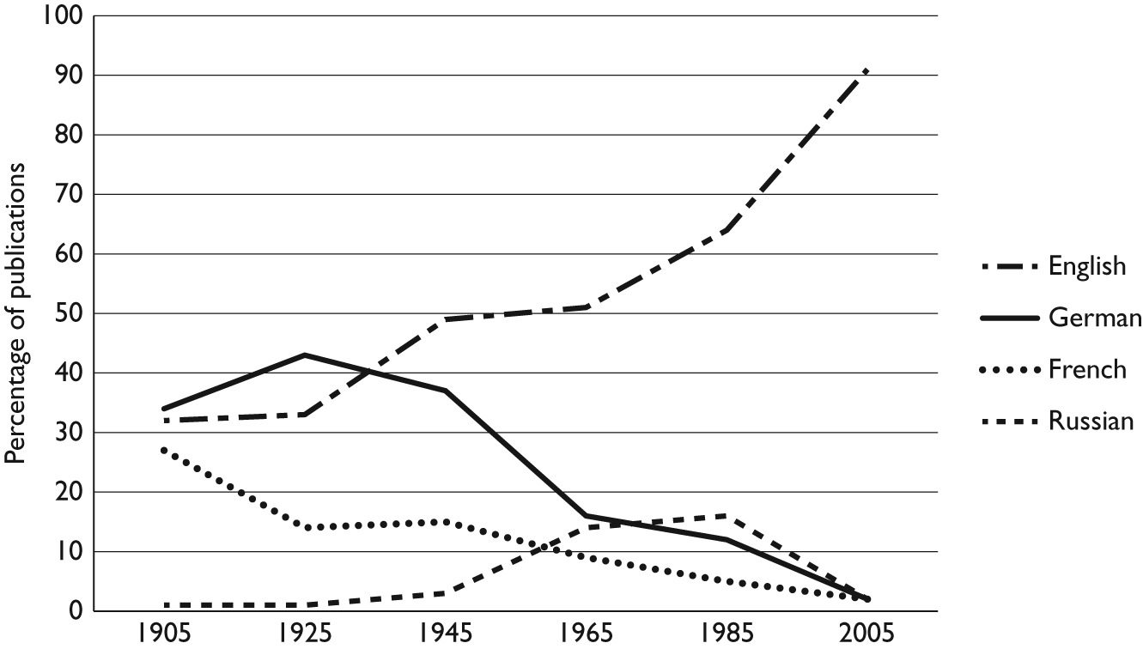
The language of academia (1)
Figure 10.2: Language shares in total academic publications over the past 100 years (adapted from Montgomery, 2013, p. 90)

Slide 20
The language of academia (2)
Trend of publishing in English is not necessarily led by Western nations.
The total number of scientific papers in English written by Chinese researchers increased by 174% from 2002 to 2008 alone (Montgomery, 2008, p. 84), and it has been noted that:
  ‘Given recent trends, the Chinese could even match the US levels in peer-reviewed English-language ‘output’ by about 2025, perhaps sooner ... However interpreted in political terms, its fortifying impact on scientific English would be beyond question. Aside from America, China may well be the most powerful force behind the spread of English in science’ (Montgomery, 2008, p.84, emphasis added).

Slide 21
Indications of a shift in academic language
Seidlhofer (2004) argues that there seems to be no principled justification for the norms of written academic English throughout the world to be those of Britain and North America.
She points out that the practice of subjecting non-native academic English to correction in order that their writing conforms to native conventions allows journals produced in native English countries ‘to exert a gatekeeping function based not on academic expertise but purely on linguistic criteria whose relevance for international intelligibility has not actually been demonstrated’ (Seidlhofer, 2004, p. 222).

Slide 22
Jenkins on academic English
Jenkins (2013) reports that she always ends her lectures on ELF in pre-sessional EAP courses at her university by telling the international students:
  ‘Your lecturers will expect you to use native-like English norms. But you can educate them about ELF and the fact that it is a contradiction for any university anywhere that considers itself international to insist on national English language norms’ (Jenkins, 2013, p. 934).
  Do you think this is possible?

Slide 23
The future of English in academia
Academia is one field where English holds a near monopoly.
For the future of academic writing, ‘cultivating tolerance in the academic community for these types of ELF textual characteristics may be less of a hurdle than calling for acceptance of salient surface errors’ (Ingvarsdóttir & Arnbjörnsdóttir, 2013).
Just as WE research helps legitimize notions of variation in acceptable forms of language, ELF research is here pertinent to show that surface ‘errors’ are, in fact, characteristic of a language that is being used to share academic knowledge within this global community of practice.

Slide 24
The future of English: spread, recession, or reconceptualization?
Part 3

Slide 25
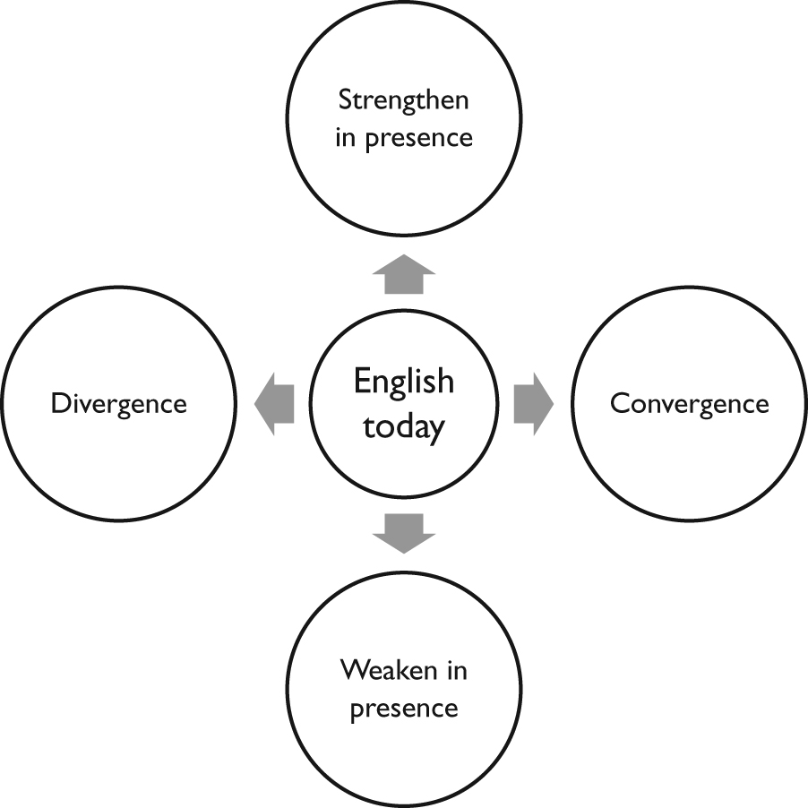
Figure 10.3: A ‘black and white’ view of the future directions for English

Slide 26
Unlikely scenarios for English’s future
Many global Englishes will emerge
A world ‘standard’ English will emerge
Englishes will fragment into separate dialects or languages
English will decline as the world’s lingua franca

Slide 27
Four unlikely ‘black and white’ scenarios
If we consider just two dimensions, which underpin much of the debate, we can see four possible outcomes of the future of English:
The English language will strengthen and converge, and a global standard of English will emerge as the world lingua franca.
The English language will strengthen and diverge, resulting in distinctly different Englishes used across the globe.
The English language will weaken and converge, resulting in a standard form (much like how a standard form of written Latin persisted after its spoken form receded from use, or how classical written Arabic existed after the recession of the Islamic Empire).
The English language will weaken and diverge, resulting in the emergence of distinctly different dialects/languages (much like how historical languages emerged from imperialistic roots, e.g. French, Spanish, and Italian from Latin).

Slide 28
Dimension one
Spread?
Recede?

Slide 29
Figure 10.4: De Swaan’s Global Language System (Source: De Swaan, 2001, pp. 5–6)
Hypercentral language:
ENGLISH
Supercentral languages:
ARABIC, [MANDARIN] CHINESE, ENGLISH, FRENCH, GERMAN, HINDI, JAPANESE, MALAY, PORTUGUESE, RUSSIAN, SPANISH, SWAHILI
Central Languages:
Widely spoken languages, such as URDU, AFRIKAANS, DUTCH, KOREAN, POLISH, VIETNAMESE
Peripheral languages:
THE REST

Slide 30
Graddol’s prediction
Graddol (1997) warns:
  The global popularity of English is in no immediate danger, but it would be foolhardy to imagine that its pre-eminent position as a world language will not be challenged in some world regions and domains of use, as the economic, demographic, and political shape of the world is transformed.
Such shifts in world power have caused predictions of changes to the current world languages hierarchy, with many scholars downgrading the future importance of languages like German, Japanese, and French, in lieu of increasingly important languages like Chinese, Hindi, and Arabic.
Based on statistics of world economic trends, such as those which show Asia will hold 60% of the world’s wealth in 2050, as opposed to 21% in 1990, Graddol (1997, p. 29) predicts a possible shift in the use of world languages over the next four decades.

Slide 31
The demise of English?
The predicted demise of English is often discussed with a ‘Latin analogy’ (McArthur, 1987).
Latin was a pervasive language across much of Europe during and after Roman times, and its fall from widespread usage sparks many to predict a similar future fate for the English language.
Thus ‘the history of Latin makes an attractive backcloth against which the present state of English can be assessed and its fate – or, more neutrally, its future –predicted’ (Wilton, 2012, p. 342).

Slide 32
Why the Latin analogy is fundamentally flawed
Wilton (2012, pp. 243–4) argues that three problems can be identified with the comparison of English to Latin:
Modern linguists draw comparisons with Latin without a thorough understanding of the historical development of Latin. Likewise, Latin experts draw comparisons with English despite a lack of knowledge of ELF and WE research.
The historical study of Latin’s development over a long period of time cannot be compared with the comparatively short rise of English. While superficial comparisons can be used – such as both languages’ use in education, science, and its spread as a second language – this is where comparisons end. One glaring difference is the denial of access to Latin to large parts of society, compared with access to English today.
The largely written record of Latin only gives glimpses into its oral uses as a lingua franca, as opposed to spoken English which has been recorded and codified in much more detail. Thus, any comparison of English and Latin as a spoken lingua franca is only speculative, and thus comparisons that English will fragment into separate vernacular languages as Latin did are tenuous.

Slide 33
Dimension one – a third possibility
Spread?
Recede?
Other direction?

Slide 34
A third direction
Galloway and Rose (2015).
History has shown that languages attached to power, wealth and prestige have spread at the expense of those viewed less favourably:
  Therefore, as the power attached to Mandarin Chinese or Hindi/Urdu grows, so, too, will the use of these languages in the global arena.
However, it is unlikely that they will ‘replace’ English in the near future:
  The very idea of ‘replacing’ seems at odds with ELF research on how language is used in language contact situations, where multilingualism is the norm.

Slide 35
Evidence for a third direction
Pennycook (2010) argues that the growth of other languages is not necessarily at the expense of English, because the trade-off between the languages is not a zero-sum game:
  There does not have to be a ‘winner’ and a ‘loser’ in ELF communication, where multilingualism, code-mixing, and code-meshing are the norm.
Block (2012) argues that many applied linguists mistakenly take on a ‘presentist’ view of the social implications of globalization. In fact, globalization is not occurring, it has already occurred:
  The era of globalization has been well underway for the better part of 60 years, built on a foundation of centuries of colonialism before it.
  English was in the right place at the right time – that time has passed.

Slide 36
A GE perspective
De Swaan (2010, p. 73) notes:
  ‘Even if the hegemonic position of the US was to decline, English would continue to be the hub language of the world language system for quite some time, if only because so many millions of people have invested so much effort in learning it and, for that very reason, expect so many millions of other speakers to continue to use it.’
While this is true, a GE-oriented view would argue that we need to reconceptualize what we understand by ‘language’ and ‘lingua franca’. The question of whether English will weaken or strengthen in the future is flawed because it imagines language to be a static and monolithic entity with clearly defined parameters, so that growth and recession can be accurately measured (Galloway and Rose, 2015).
  How do you measure the growth of a fluid, borderless concept?
This notion is supported by Canagarajah’s (2013) positioning of translingual practice, where he shows text and talk involve the meshing of diverse codes and languages, even if not superficially evident.

Slide 37
Dimension two
Diverge?
Converge?

Slide 38
The future of English: convergence, divergence, or adaptation?
Part 4

Slide 39
Arguments for convergence
Many linguists point to future scenario where a ‘world standard English’ will emerge (McIntyre, 2009; Crystal, 1997, 2006).
McIntyre (2009, p. 33) writes:
  ‘World Standard English might avoid the use of idioms (expressions that are common only to some varieties of English) and colloquialisms, and it might utilise particular pronunciations. The important point here is that it is not likely to be an Anglo-centric standard. The notion that English belongs to Britain and America is simply no longer true (if, indeed, it ever was) and we can fully expect to see other communities world-wide exerting an influence on the development of any new standard.’
These predictions are at odds with ELF research, which challenge notions of standards and varieties.

Slide 40
Arguments for divergence
Prestige and economic power shape the languages people speak, the lexical choices they make, and the accents they imitate:
  Such prestige is likely to differ according to social and political alliances, and the mix of Englishes found in each region of the world.
Different social and political alliances will cause different Englishes to emerge:
  e.g. a distinctly Asian English vs. a distinctly European English.
Crystal (2003), also discusses the possibility of a ‘family of Englishes’ in which a central variety, called Standard World Spoken English, might be used to unite them all.

Slide 41
Divergence and fragmentation
Standard World Spoken English
Standard Asian English
Standard American English
Standard East African English
Standard British English
Standard West African English
Standard South American English

Slide 42
Diverge or converge (or other?)
If such diversification occurred, the question arises as to what extent these Englishes will continue to diversify in parallel, and sometimes in opposition, to one another.
  Obviously a globalized and interlinked world renders the divergence of English into a number of dialects an unlikely outcome.
  Notions of identity are a central part of communication, thus linguistic identity is constructed in the diversity that exists in language. The emergence of a ‘standard’ is just as unlikely.

Slide 43
The wrong perspective
Diverge
Converge

Slide 44
The complexity of language
Language is complex, and notions of convergence and divergence are problematic.
Larsen-Freeman and Cameron (2008) prefer to view language as a complex adaptive system. They argue that, while linguists ‘treat language as a stable, even static system’
(p. 79), applied linguists need a very different theory of language: ‘complex systems are at one and the same time both stable and variable’ (p. 79).
The central notion here is not what type of English will emerge, but that the language will adapt according to the changes occurring in the complex systems within which it is situated (Galloway and Rose, 2015).

Slide 45
Pennycook’s view
Pennycook (2007, 2010) has questioned whether English as a language, or Englishes as many languages, exists at all, as the very idea of language constrains us to draw boundaries around forms and variation:
  ‘To argue for a monolithic version of English is clearly both an empirical and political absurdity, but we need to choose carefully between the available models of pluricentric Englishes, avoiding the pitfalls of states-centric pluralities that reproduce the very linguistics they need to escape, in order to deal with globalized linguascapes.
  ‘This can help us avoid the national circles and boxes that have constrained World Englishes and, indeed, linguists more generally.
  In pedagogical terms, this means treating English less as a discreet object – even with its variations – that can be taught only in its own presence, and rather deal with English as multilingual, as a language always in transition, as a language is always under negotiation’ (Pennycook, 2010, p. 685).

Slide 46
Summary of Lecture 10
Complexity theory seems to work hand-in-hand with a GE perspective, where drawing lines around complex systems like language is entirely problematic (Larsen-Freeman and Cameron, 2008):
  This view is supported in Canagarajah’s (2013) positioning of the translingual orientation, in that treating language as ‘a tightly knit system’ and ‘a self-standing product’ (p. 7) that is detached from its environment distorts the real practices, underlying how meaning is created in communication.
Galloway and Rose (2015) encourage people to view language as a moving, breathing, and unpredictable organism – much in line with Larsen-Freeman and Cameron’s (2008) call for an ‘ecological metaphor applied to language use in context’ (p. 79).
  English, like any organic system, is capable of changing and adapting to its surroundings; it is made up of many distinct parts that give it its whole interconnected form, but is entirely dependent on the systems which surround it. It is capable of morphing to such a degree that it is entirely possible that, in the future, it will adapt and change into a completely different looking organism in its ever-changing environment.

Slide 47
Key terms
Academic English Internationalization Internationalization at home Localization Glocalization Fragmentation of audiences Languacultures Global youth culture Transcultural flows Third place Third culture Crossings Shuttling between communities | World Standard English Big languages Regional lingua francas National languages ‘Latin analogy’ Hypercentral language Supercentral language Central languages Peripheral World Standard Spoken English Complexity theory Complex adaptive system Textspeak World Language Hierarchy Global Language System

Slide 48
Further reading
Globalization and Global Englishes:
Pennycook, A. (2007). Global Englishes and Transcultural Flows. Abingdon and
New York: Routledge.
On English in International Education:
Jenkins, J. (2013). English as a Lingua Franca in the International University:
The Politics of Academic English Language Policy. Abingdon: Routledge.
Jenkins, J. (2011). ‘Accommodating (to) ELF in the international university.’
The Journal of Pragmatics, 43(4), pp. 926–36.
On the future of English:
Pennycook, A. (2010). ‘The future of Englishes: one, many, or none?’ In A. Kirkpatrick (ed.), The Routledge Handbook of World Englishes. Abingdon and
New York: Routledge.
Crystal, D. (2006). ‘Into the 21st century.’ In L. Mugglestone (ed.), The Oxford History of English. Oxford: Oxford University Press.

